Slide 1
Predicting Research Funding Success from Grant Proposal Abstracts
GROUP 3
Unu Batsuuri / unu.batsuuri@mail.utoronto.ca / 1007766703 / batsuuri
Joyce Lin / joycetheok.lin@mail.utoronto.ca / 1007957285 / linjin42
Daniella Chung / daniella.chung@mail.utoronto.ca / 1007687120 / chungd25

Slide 2
Motivation
Notes:
JOYCE

Slide 3
On the Social Significance of Research
Research is the lifeblood of progress. It creates innovations that save lives and tackles the most pressing issues we face today. It can drive global economies, create new industries, and influence policy that improves welfare for all.
The Challenge:
Traditional grant proposal evaluation is
time-consuming
subjective
unable to fully account for the societal and economic impact of proposed research
As a result, high-potential projects may go underfunded, delaying progress.
The cost of inaction is incalculable.

Slide 4
Our Approach & Contribution
We aim to leverage machine learning and textual analysis to identify the key features that predict the likelihood of a grant proposal abstract receiving higher funding.
Machine learning has the potential to: (Ueda et al., 2021)
significantly reduce time spent reviewing grants
reduce human bias in the evaluation process
Thus, our research can make the grant review process more objective, efficient, and transparent.

Slide 5
Research Question
Notes:
JOYCE

Slide 6
Can the textual features of grant proposal abstracts predict funding outcomes in Canadian social health research?
Does the identity of the researcher impact funding amount?
What about their alma mater, or the ranking of the institution they are conducting their research with?
Do the topics of the abstract affect amount of funds received?
Can we compare the topic of the abstracts to hot topics in public opinion or scientific communities to assess if having a highly relevant topic increases funds received?

Slide 7
Data Source &
Methods
Notes:
UNU

Slide 8
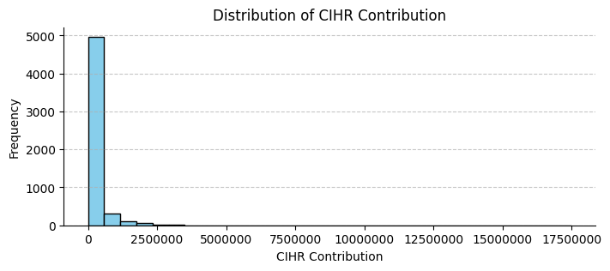
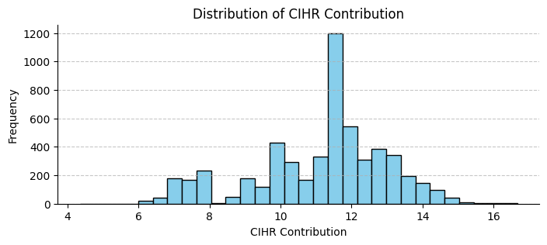
Data Source
Our dataset is exported on November 17th from the Government of Canada’s Canadian Institutes of Health Research funding Decision Database.
Focus Theme: Social/Cultural/Environmental/Population health
Geographic Scope: USA, Canada
Total projects: 7011 projects
Key Variables:
Institution Paid – Institution responsible for the project (categorical)
Abstracts – Abstracts of the proposed projects (text)
CIHR Contribution – The funding amount provided by the Canadian Institutes of Health Research (numerical)
Descriptive Statistics:
No missing data
Around 1% of the total are duplicates
Source: https://webapps.cihr-irsc.gc.ca/decisions/p/main.html?lang=en#fq={!tag=theme2}theme2%3A%22Social%20%2F%20Cultural%20%2F%20Environmental%20%2F%20Population%20Health%22&fq={!tag=country}country%3ACanada%20%20%20OR%20%20%20country%3A%22United%20States%20of%20America%22&sort=namesort%20asc&start=0&rows=20

Slide 9
Methodology
Data Processing
01
Clean text to ensure meaningful topic extraction
Topic Modeling (LDA)
Extract latent themes for abstracts
02
Feature Engineering
03
Incorporate novelty score, project term years and text features to enrich the dataset
Train-Test Split
Ensure fair evaluation on unseen data
04
05
Model Training
Model Evaluations
Test multiple algorithms to assess predictive power
Select the best performing model for our project
06

Slide 10
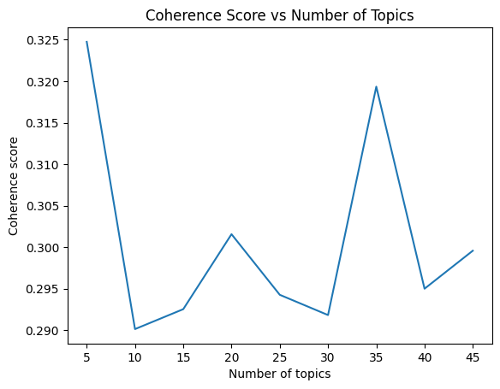
Data Processing and Topic Modeling
1. Text
Preprocessing:
Scraped data using selenium
Tokenized and cleaned abstracts
Extracted bigrams using gensim
2. Topic Modeling:
Used Latent Dirichlet Allocation (LDA) to identify latent themes across abstracts
Optimal number of topics (5) determined using coherence scores
Generated topic distributions for each abstract

Slide 11
Feature Engineering and Train-Test Split
3. Novelty Scores:
Measured how novel each abstract is compared to other abstracts using cosine similarity.
Scores range from 0 - 1, reflecting textual uniqueness.
4. Train-Test Split and Scaling:
Split data into 80% training and 20% testing.
Scaled numerical features using StandardScaler.
Notes:
Log transformation reduces the influence of extreme outliers in funding amounts, making the dataset more suitable for regression-based models.
Encoding universities as dummy variables allows the model to consider institutional affiliations without introducing bias or incorrect numeric ordering.

Slide 12
Model Training and Evaluation
6.1. Algorithms Used:
Linear Models: Linear Regression, Lasso, Ridge, Elastic Net
Tree-Based Models: Decision Tree, Random Forest, Gradient Boosting
KNN
6.2. Hyperparameter Tuning:
Used GridSearchCV with 5-fold cross-validation to tune model hyperparameters
Extracted the best performing models
7. Model Evaluation Metrics:
Mean Squared Error (MSE): measures average squared prediction error
R² Score: measure variance explained by the model
Notes:
Linear Models:to capture linear relationships and reduce multicollinearity
Tree models: to capture nonlinear relationships. Classification and regression.
Hyperparameter tuning: e.g. alpha for Ridge/Lasso, max_depth for trees
R^2 higher => better
Explains how much variance in the data was captured by the model
MSE lower => better
Shows the magnitude of the error between the model and actual results

Slide 13
Literature Review

Slide 14
On Predicting Research Grants’ Productivity Via Machine Learning - Tohalino and Amancio
ABOUT:
Tohalino and Amancio employ machine learning to predict grant productivity for grants in medicine, dentistry, and veterinary medicine. The article finds that the topic and year of publication to be the most significant predictors.
PROJECT
LITERATURE
Features: Grant Abstract (textual analysis)
Outcome: Amount of Funding Received
Features: Bibliometric Statistics
Outcome: Publication output
Method: Machine Learning to analyze grants
Notes:
DANI
33 sec

Slide 15
From Algorithms to Grants: Leveraging Machine Learning for Research and Innovation Fund Allocation
- Lupyani and Phiri
ABOUT:
The paper explores the application of machine learning to improve the grant allocation process. By analyzing historical grant data and employing text classification models, the study aims to automate the evaluation of proposals, and increase the transparency of funding decisions.
PROJECT
LITERATURE
Goal: Determine the efficient allocation of funds based on grant applications using text analysis
Method: Implements text classification algorithms to categorize and rank grant proposals.
Method: Implements regression models to predict grant funding amounts.
Notes:
UNU

Slide 16
A Data-Driven Approach in Predicting Scholarship Grants of a Local Government Unit in the Philippines Using Machine Learning - Fajardo et al.
ABOUT:
Fajardo et al. develops a machine learning model to match scholarship applicants in the Philippines with the best scholarship.
The article finds the logistic regression to be the best-performing model.
PROJECT
LITERATURE
Method: considers additional features of the grant itself, e.g. length of project
Goal: predict fund allocation patterns based on an application
Method: focuses on the students’ characteristics and background
Notes:
JOYCE

Slide 17
Results
Notes:
DANI

Slide 18
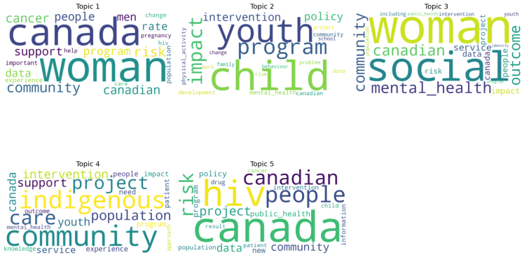
Topic Modelling
The optimal number of topics was 5, with a coherence score of 0.325.
Topic 1 - Women’s Health in Canada
Topic 2 - Youth-Centered Policy
Topic 3 - Mental Health and Social Outcomes
Topic 4 - Indigenous Community Health
Topic 5 - HIV Risk and Canadian Population Health

Slide 19
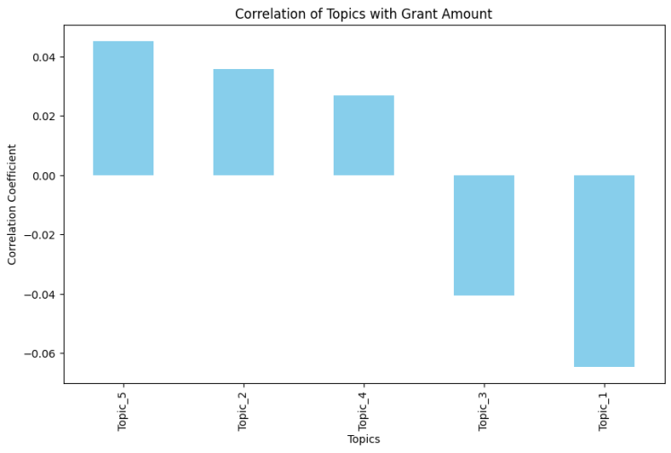
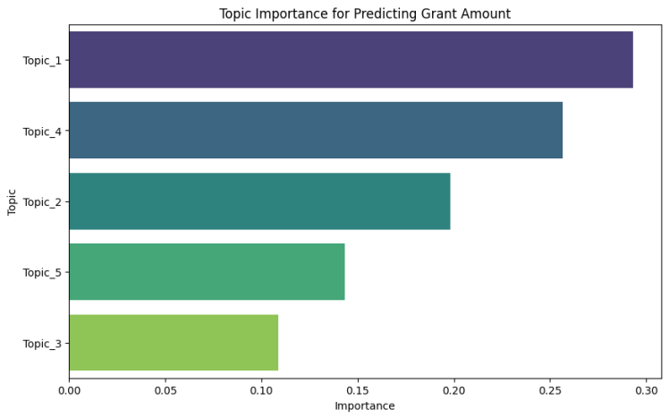
Correlation: Topics and Grant Amounts
Topic 1 (Women’s Health in Canada) is the most important feature for predicting grant amounts - with a negative correlation. Topic 1 most strongly predicts lower grant amounts.
Topic 4 (Indigenous Community Health) is the next most important feature, and is moderately positively correlated with grant amount, being predictive of and associated with higher grant amounts.
Topic 3 (Mental Health and Social Outcomes) is the least predictive of grant amount and is negatively correlated with grant amounts.
Notes:
Next, we explored the correlation between topics and grant amounts. The left graph is correlation coefficient by topic, and the right graph is topic by prediction importance.
Topic 1 is our strongest predictor, and it is associated with lower grant amounts. Topic 4 is the next greatest predictor, and is associated with higher grant amounts. Interestingly, while topic 3 is the least predictive, it has the same correlation as topic 4, but is negatively associated with grant amounts. Women's health and mental health are negatively correlated.

Slide 20
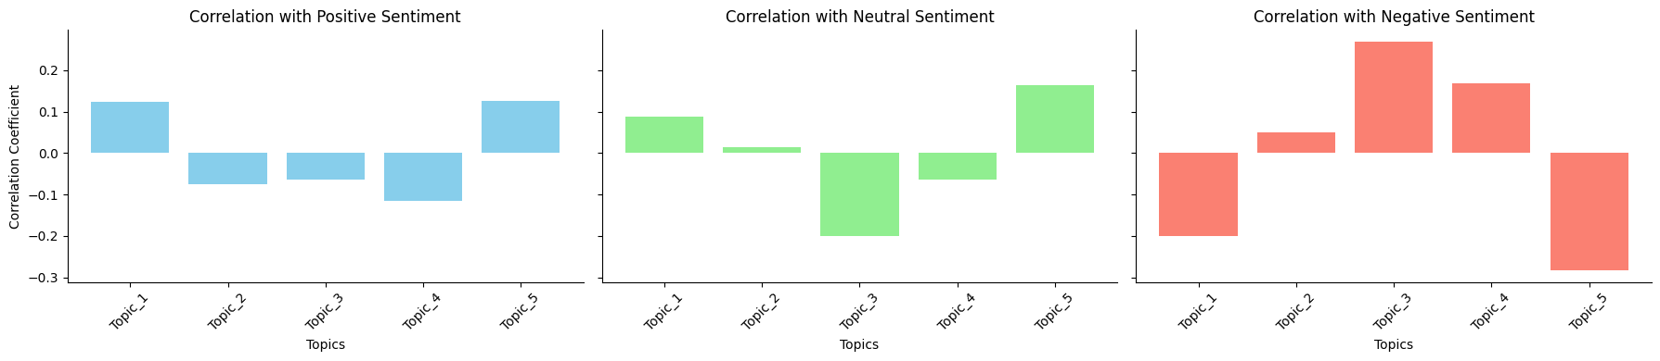
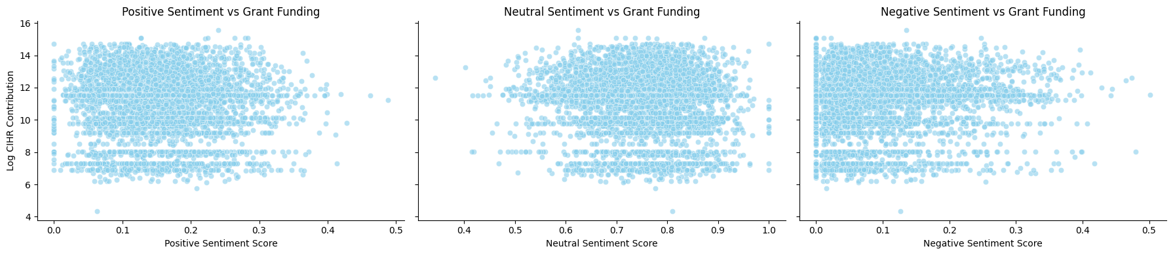
Sentiment Analysis
VADER lexicon
Less variation in positive/neutral, more in negative
Notes:
JOYCE

Slide 21
Model Evaluation: Grant Amount Regression
MODEL | R² | MSE
Linear Regression | -1.0703 e+22 | 9.6195 e+22
Ridge Regression | 0.4460 | 1.8736
Lasso Regression | 0.4517 | 1.8543
Elastic Net | 0.4517 | 1.8543
Decision Tree | 0.5241 | 1.6095
Random Forest | 0.5590 | 1.4916
Gradient Boosting | 0.5714 | 1.4496
KNN | 0.3312 | 2.2618
Hyper Parameters:
Trees: 100
Learning Rate: 0.1
Max Depth: 5
Features:
Topic distribution (from LDA)
Term years (length of project)
Year (year which grant was submitted)
Institution (dummy)
Abstract length
Novelty score (uniqueness of abstracts)
Notes:
*** didnt include sentiment analysis as it decreased model performance
We assessed multiple models, as seen in the graph. The superior model was Gradient Boosting, with an R² of 57%, meaning that 57% of the variability in grant allocation was explained by the features in our model.

Slide 22
Conclusion
Notes:
Dani

Slide 23
Limitations
Area of Focus: We focused on Social / Cultural / Environmental / Population Health theme from the CIHR database, leaving other themes in Health Research such as Biomedical or Clinical research unexplored
Monetary Constraints: More optimal resources were locked behind a paywall, e.g. the LIWC lexicon, suitable for academic content.
Limited Variables: According to the he 57% R² score, there is still 43% of variation in grant allocation unexplained. Characteristics and background of the grant review committee were not taken into account, and neither were qualifications or demographics of the applicants.

Slide 24
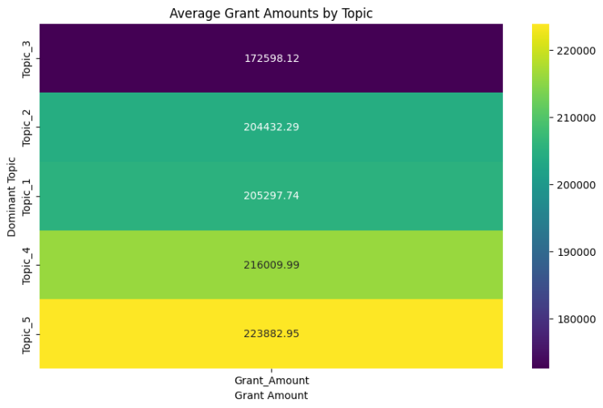
Identifying Bias
Topic 1 (Women’s Health in Canada) was the most important predictor of grant allocation and had the largest correlation, which was negative
Topic 3 (Mental Health and Social Outcomes) received the least funding. It was not very predictive but did have a notable negative correlation.
This suggest that grant review committees may have viewed these topics as not as worthy of funding, revealing potential bias against marginalized groups in healthcare such as women and those struggling with mental health.

Slide 25
Further Research
Topic Relevance: Relation of grant abstract to current hot-topics in public opinion or scientific fields would be an interesting and relevant predictor of grant allocation.
Applicant Qualifications: Does the applicant’s research history (renown, achievements, past publications) impact grant allocation?
Productivity of Grant: While we focused on the monetary grant received by applicants, it would be prudent to investigate the results of the funded research - this can help determine if grants are being efficiently allocated.
Notes:
Excitement for certain topics should lead to greater interest in the funding of said research, and as such, we expect it to be positively correlated with grant allocation.
Applicant qualifications: winners of awards, notable speakers at conferences, number of citations, number of published papers, gender, nationality…
Other disciplines: e.g mental health

Slide 26
References
A. Fajardo, R. C., Yara, F. B., Ardeña, R. F., Hernandez, M. K., & T. Arroyo, J. C. (2024). A data-driven approach in predicting scholarship grants of a Local Government Unit in the Philippines using Machine Learning. International Journal of Engineering Trends and Technology, 72(6), 74–81. https://doi.org/10.14445/22315381/ijett-v72i6p108
Government of Canada, C. I. of H. R. (2018, January 24). Funding decisions database. CIHR. https://webapps.cihr-irsc.gc.ca/decisions/p/main.html?lang=en#fq={!tag=theme2}theme2%3A%22Social%20%2F%20Cultural%20%2F%20Environmental%20%2F%20Population%20Health%22&fq={!tag=country}country%3ACanada%20%20%20OR%20%20%20country%3A%22United%20States%20of%20America%22&sort=namesort%20asc&start=0&rows=20
Lupyani, R., & Phiri, J. (2024). From algorithms to grants: Leveraging Machine Learning for Research and Innovation Fund Allocation. Lecture Notes in Networks and Systems, 469–480. https://doi.org/10.1007/978-3-031-54820-8_38
Tohalino, J. A. V., & Amancio, D. R. (2022). On predicting research grants productivity via machine learning. Journal of Informetrics, 16(2), 101260. https://doi.org/10.1016/j.joi.2022.101260
Ueda, D., Kakinuma, T., Fujita, S., Kamagata, K., Fushimi, Y., Ito, R., Matsui, Y., Nozaki, T., Nakaura, T., Fujima, N., Tatsugami, F., Yanagawa, M., Hirata, K., Yamada, A., Tsuboyama, T., Kawamura, M., Fujioka, T., & Naganawa, S. (2023). Fairness of Artificial Intelligence in Healthcare: Review and recommendations. Japanese Journal of Radiology, 42(1), 3–15. https://doi.org/10.1007/s11604-023-01474-3
Icons by Flaticon

Slide 27
Thank You! Questions?

Slide 28
Model-evaluation: Funding Category Classification
MODEL | CV ACCURACY
Logistic Regression | 0.499
Decision Tree | 0.545
Random Forest | 0.567
Gradient Boosting | 0.568
Naive Bayes | 0.278
KNN (k = ) | 0.493
LDA (Lin. DIsc. Ana.) | 0.289
Hyper Parameters:
Trees: 200
Learning Rate: 0.01
Max Depth: 5

Slide 29
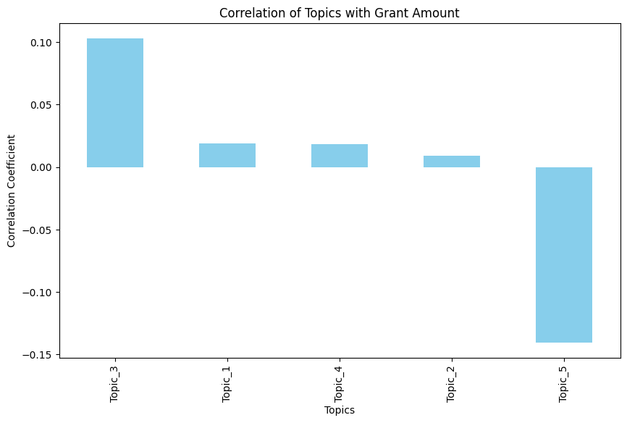
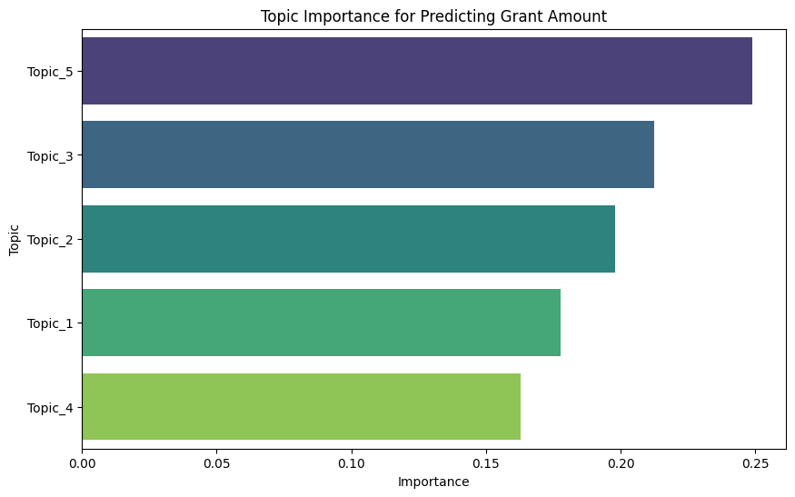
Correlation between Topics and Grant amounts
Topic_5 (Child & Mental Health Interventions in Public Health) is the most important feature for predicting grant amounts, even though its correlation is negative. This suggests that Topic_5 might have a strong but inverse relationship with grant amounts indicating that it strongly predicts lower grant amounts.
Topic_3(Youth-Centered Policy and Social Impact) follows as the next most important feature. Its positive correlation (from the second graph) suggests that it contributes positively to predicting higher grant amounts indicating that it is both predictive and associated with higher grant amounts.
Topics 1, 2, and 4 have relatively lower importance but still contribute to predictions.

Slide 30
Correlation: Topics and Grant Amounts
Topic_5 (Child & Mental Health Interventions in Public Health) is the most important feature for predicting grant amounts - with a negative correlation. Topic 5 most strongly predicts lower grant amounts.
Topic_3 (Youth-Centered Policy and Social Impact) is the next most important feature, being predictive of and associated with higher grant amounts.
Topics 1, 2, and 4 have relatively lower importance but still contribute to predictions.

Slide 31
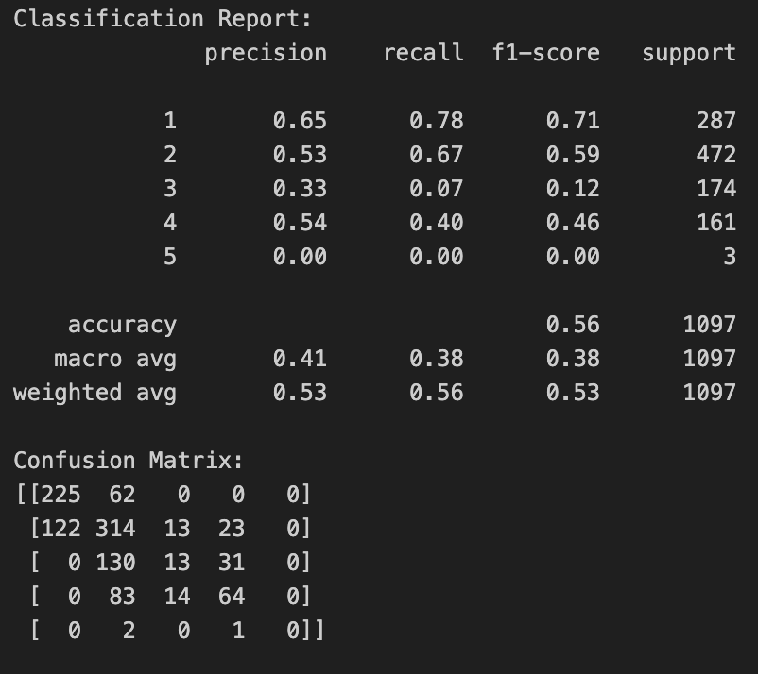
How well does Gradient Boosting classify abstracts into topics?
56% classification accuracy
Topic 1 (Womens Health + RIsk Factors ) is classified correctly 71% of the time
75% of observations in Topic 3 (Youth-Centered) are misclassified as Topic 2 (Indigenous)
There are only 3 observations in Topic 5 (Child and Mental Health)
Notes:
Interesting thing to note:
Class 1 (Womens Health) is classified correctly about I 71% of the time, followed by Topic 2 (Indigenous) at 59%. Topic 5 (Child and Mental Health) is very poorly classified - in fact, of the 3 instances in topic 5 none were correctly classified. Topic 3 (Youth-Centered) is commonly misclassified as indigenous, to the point that most of the abstracts in this topic, 74.7% (130/174) are misclassified as topic 2, indigenous, while only 7.5% (13/174) are correctly classified.

Slide 32
Which topics receive the most funding?
Topics by CIHR contr

Slide 33
Predicted Answer + Contribution
We predict that certain textual features, such as word complexity, the overall sentiment of the abstract, and relation to high profile topics can predict the amount of funds received from grant proposals.
Demystifying the Grant Review Process
  Researchers will be aware of what textual features predict greater funding, and as such, will pay greater attention to these areas while crafting their proposals, leading to increased funding.
  Further, this will enable new researchers to write more compelling abstracts earlier into their careers, leveling the playing field.
Improving Grant Review Efficiency
  Our model can serve as a tool for funding agencies or review committees, aiding in the pre-screening of applications, the ranking process, and the determination of fund distribution amongst recipients.
Identifying Bias in Funding Allocation
  Our model could reveal a systematic preference for certain topics or linguistic features in the grant review process, revealing bias in the system that can be corrected to afford researchers equal opportunity in receiving funding.
Impact in other fields
  Our project will inform the greater scientific community of proposal writing strategies to maximize funds for research projects. These insights will be valuable to those in other sectors like environmental sciences or economics, and could prompt grant-writing seminars for prospective researchers and those already established.
Notes:
Alt: focus on what is likely to prevent something from getting funding.

Slide 34
MOTIVATION
01
LITERATURE REVIEW
02
TABLE OF CONTENTS
METHODS
03
RESULTS
04
05
CONCLUSION & FURTHER DISCUSSION

Slide 35
Methodology
STEPS
Data Processing
  Tokenizing, lowercasing, lemmatization
  Resampling, adjusting weights
  BoW and TF-IDF
Train and Evaluate Models with Cross-Validation using a 80 - 20 split
  Random oversampling and undersampling
Compare Models using AUC-ROC and Accuracy Scores
Analysis
MODELS
Decision Tree + Random KNN
Forest + Gradient Boosting
Naive Bayes LDA
Logistic Regression
VISUALIZATIONS
Word Cloud Similarity Matrix

Slide 36
Instruction box fkjal;jfdj;sg
Start with TFIDF (optional. Alternatively can just show topic modeling)
Then say it bad, and do topic modeling
Topics and word cloud
Also try not separating into 20perc bins
For decision tree, have importance matrix
Sentiment analysis?!?!?! (e.g. if a grant seems super hopeful)

Slide 37
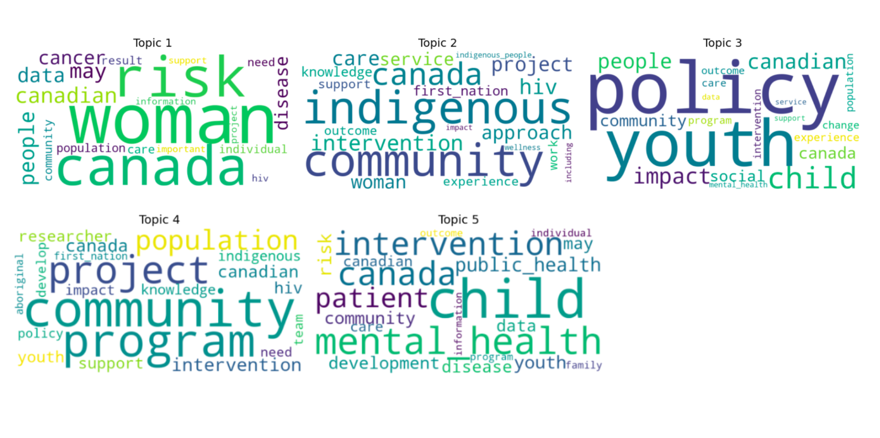
Topic Modelling
By optimizing the number of topics using coherence score we got an optimal number of 5 topics with a coherence score of 0.325.
Topic 1 - Women’s Health and Risk Factors in Canada
Topic 2 - Indigenous Community Health & Interventions
Topic 3 - Youth-Centered Policy and Social Impact
Topic 4 - Community Program Development & Population Health
Topic 5 - Child & Mental Health Interventions in Public Health

