Slide 1
Distributed Computing using Hadoop and Spark
Joy Chakraborty
Aug 11, 2016
Philly Code Camp
Email: joychak1@[yahoo/gmail].com

Slide 2
Who am I ???
Or why does it important ???
I learn and apply ….
- Design and write software for living
- for last 16 years …

Slide 3

Agenda
1
What is Big-Data?
2
Why do we care?
3
Big-Data Architecture, Design and Technologies
4
Big-Data in Practise

Slide 4
Computing System
Compute
Storage
Networking

Slide 5
Distributed Computing System

Slide 6

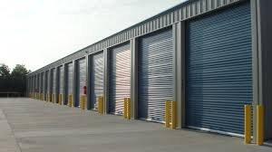
Big-Data
Processing Resource
Storage Resource

Slide 7
Big-Data– Why?
Problems need to be solved
Store massive amounts of data in a cost-effective way
Process the data efficiently and fast
Constraints
Limited storage capability per machine
Limited processing capability per machine

Slide 8
Big-Data and Hadoop – How it looks
Echo-System Software(s)
Hadoop Infrastructure
Hardware Infrastructure, OS, Virtualization

Slide 9
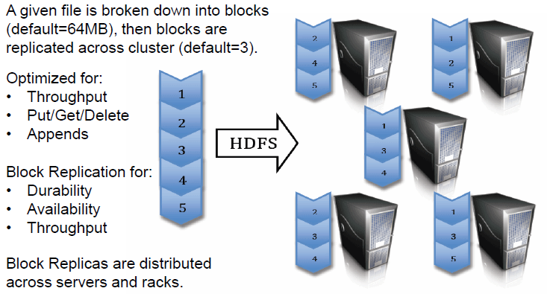
HDFS: Hadoop Distributed File System

Slide 10
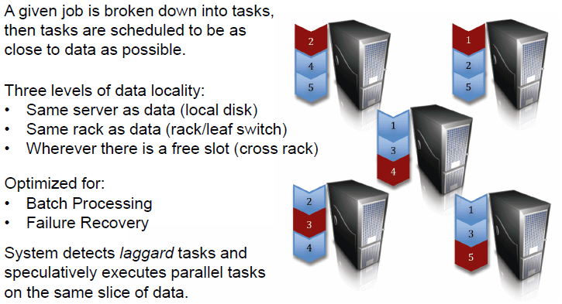
MapReduce: Resource Manager/Scheduler

Slide 11
MapReduce: Example – Word Count
“the quick brown fox jumps over the lazy dog”
Map
(the, 1) (quick, 1) (brown, 1) (fox, 1) (jumps, 1) (over, 1) (the, 1) (lazy, 1) (dog, 1)
Sort/Shuffle
(brown, 1) (dog, 1) (fox, 1) (jumps, 1) (lazy, 1) (over, 1) (quick, 1) (the, 1) (the, 1)
Reduce
(brown, 1) (dog, 1) (fox, 1) (jumps, 1) (lazy, 1) (over, 1) (quick, 1) (the, 2)

Slide 12
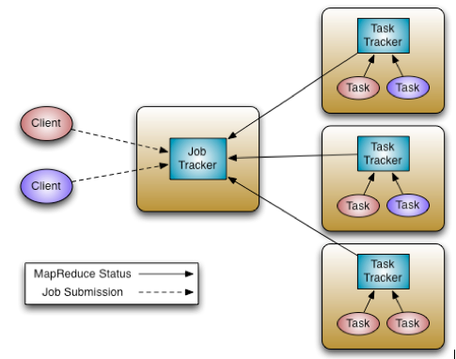
Hadoop – 1.0

Slide 13
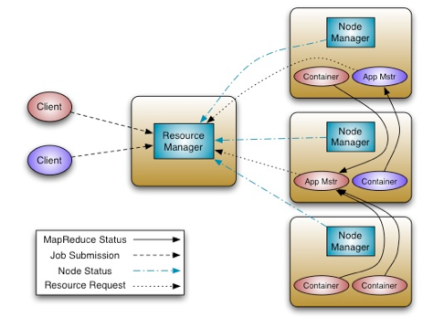
Hadoop 2.0 (YARN)
Client submits an “App” to the RM
RM instantiates APP Master on a node.
App Master asks RM for more containers.
Container reports status to AM.
Client queries AM for status of the job.
Nodes reports status to RM.

Slide 14
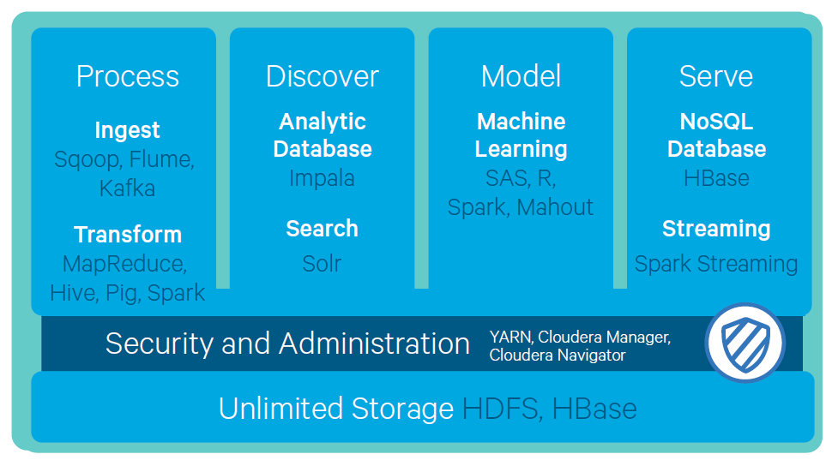
Coludera Hadoop Architecture (CDH v5.0)

Slide 15
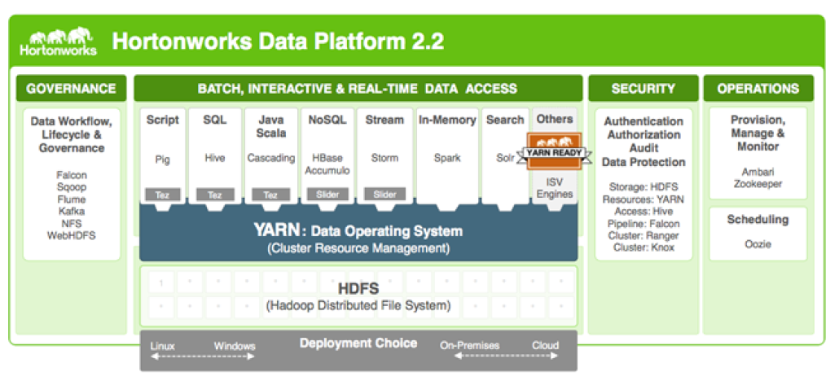
Hortonworks Hadoop Stack (HDP v2.3)

Slide 16
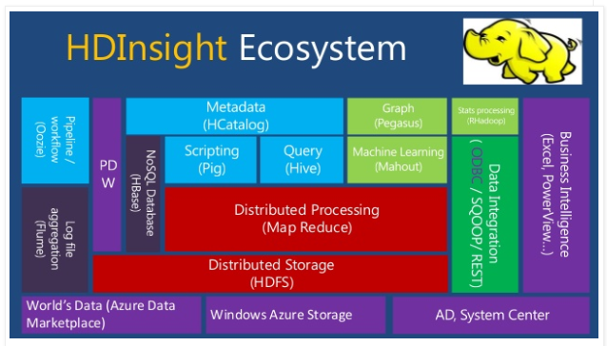
Microsoft
Big-Data
in Cloud

Slide 17

Hadoop In Action

Slide 18
Problem with Hadoop Map-Reduce
Lots of Disk I/O
Not taking advantage memory
In efficient networking between data nodes
Unnatural Programming Paradigm
Mostly good for batch processing not much real-time
Notes:
General Purpose

Slide 19

Introducing Apache Spark

Slide 20
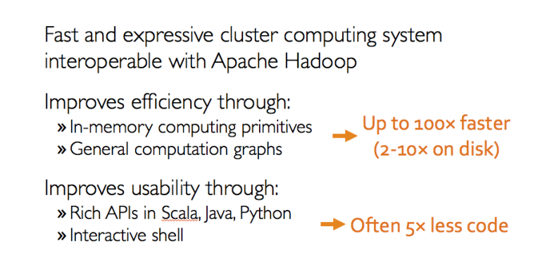
What is Apache Spark
Notes:
General Purpose

Slide 21
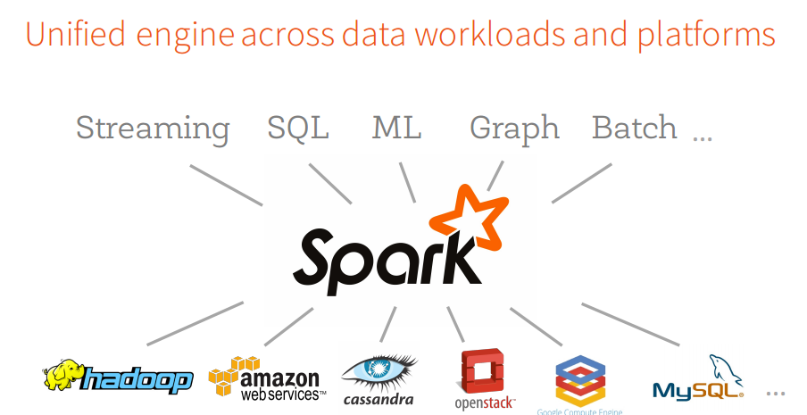
Apache Spark
Notes:
General Purpose

Slide 22
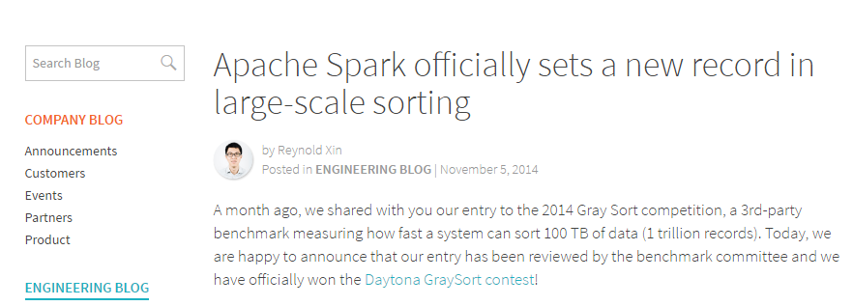
Apache Spark
Notes:
General Purpose

Slide 23
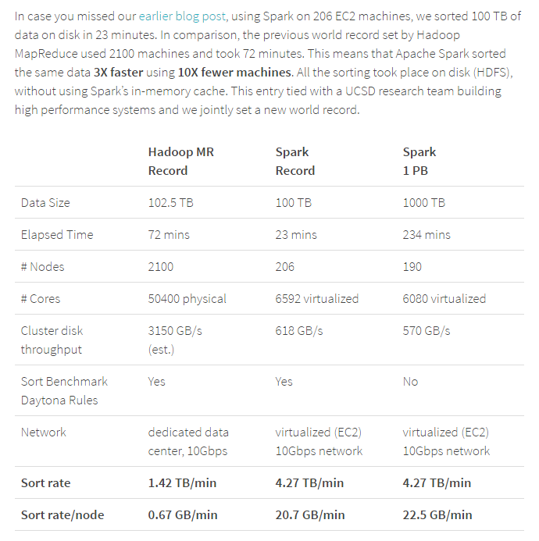
Apache Spark
Notes:
General Purpose

Slide 24
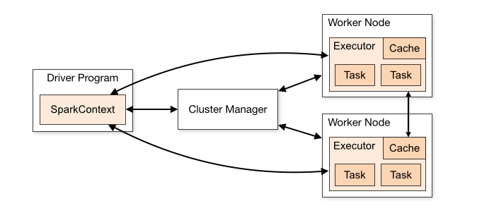
Apache Spark - Architecture
Spark Context
Notes:
General Purpose

Slide 25
Apache Spark
Notes:
General Purpose

Slide 26
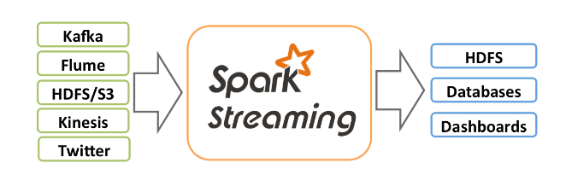
Spark Streaming
Notes:
General Purpose

Slide 27
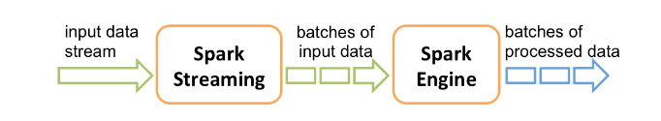
Spark Streaming
Notes:
General Purpose

Slide 28
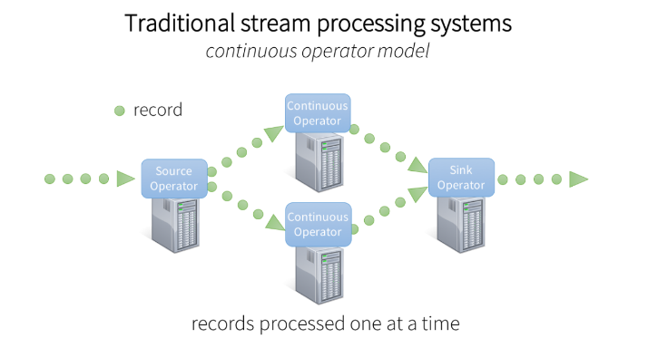
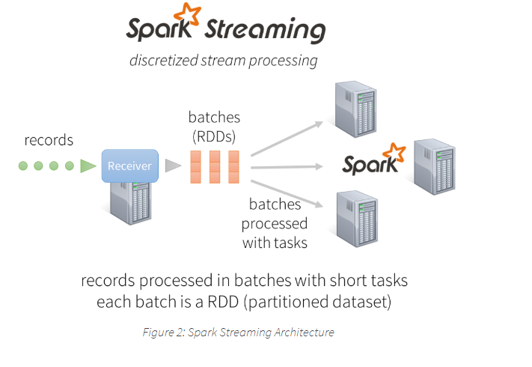
Spark Streaming vs. Other Streaming
Notes:
General Purpose

Slide 29
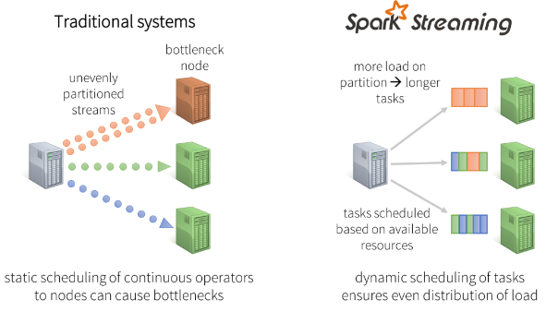
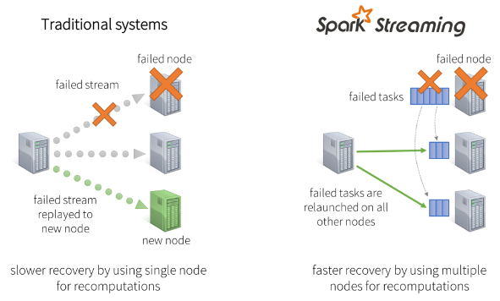
Spark Streaming vs. Other Streaming
Notes:
General Purpose

Slide 30
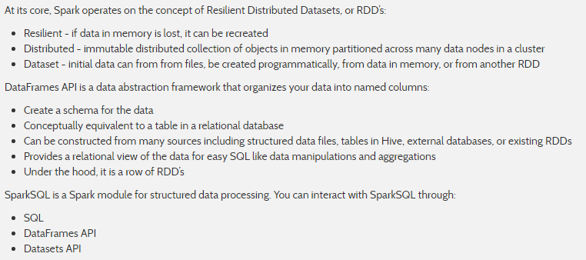
Spark RDDs – DataFrames - SparkSQL
Notes:
General Purpose

Slide 31
Spark In Action

Slide 32

No SQL Data Store

Slide 33
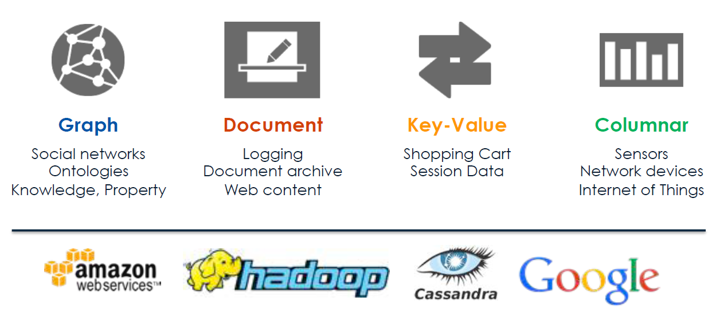
What are the choices you have today ???
Notes:
General Purpose

Slide 34
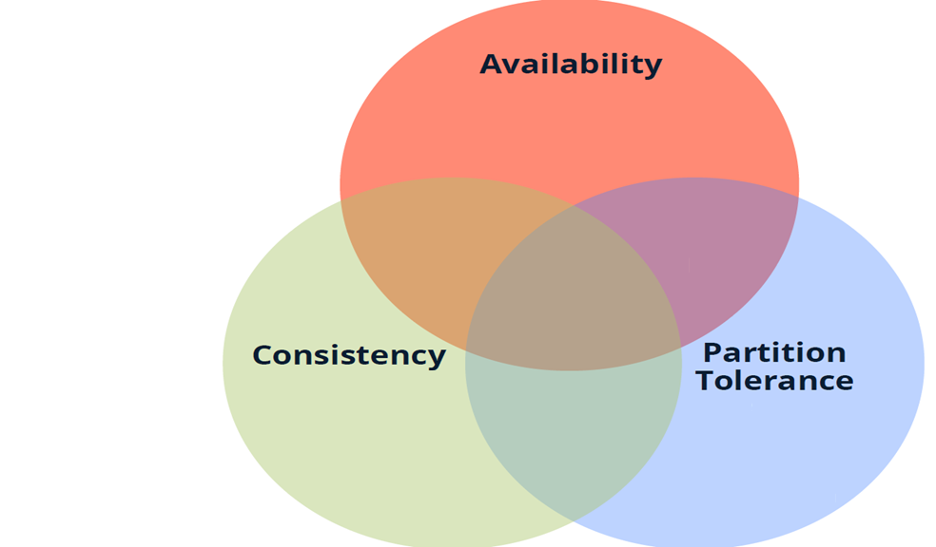
What you want vs What you can???

Slide 35
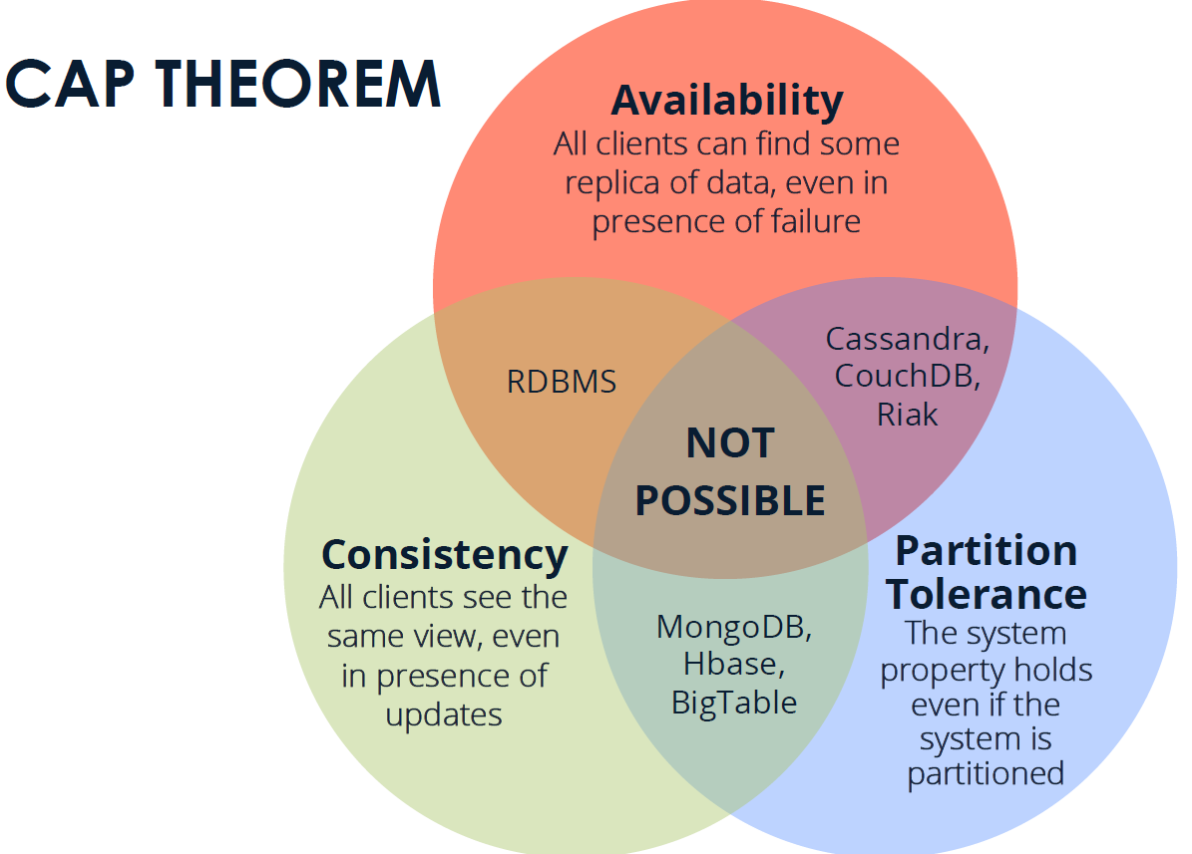
What you want vs What you can???

Slide 36
Some Other Important Technologies

Slide 37
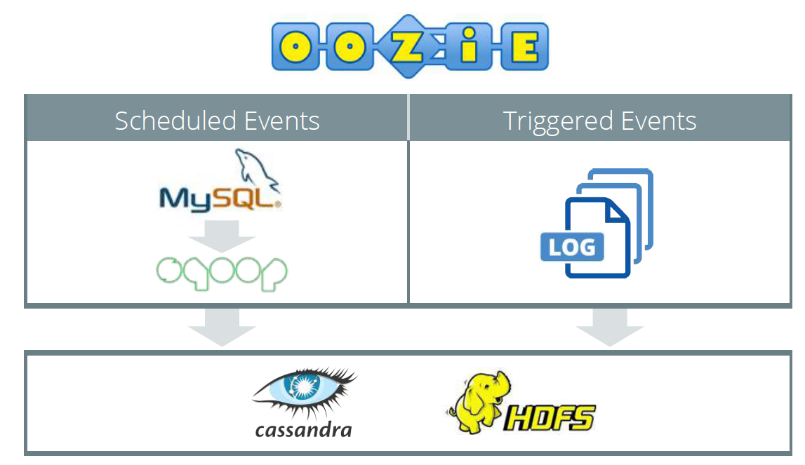
Offline Processing - 1

Slide 38
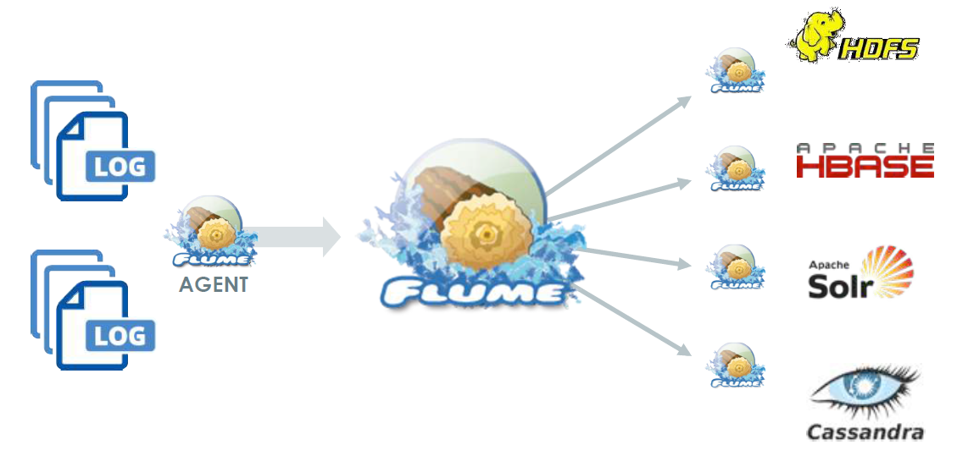
Offline Processing - 2

Slide 39
Q & A

Slide 40
Thank You
Email: joychak1@[yahoo/gmail].com

