Slide 1
Secured (Kerberos-based)
Spark Notebook for Data Science
Spark Summit East 201
Joy Chakraborty Distributed System Architect
February 8, 2018
Notes:
Welcome to the last session of Day-1.

Slide 2
Speaker Bio
I am a Distributed System Architect with 17+ years of application software development experience and 10+ years of experience in designing, architecting and developing Distributed systems. I have a special interest in distributed and parallel computing, and currently work on Cloud and Big Data technologies. I also actively participate in various Software architectural organizations.
I have been working in Bloomberg’s Data Platform team as a Data Engineer since 2014. My responsibility is to store and process petabytes of data reliably, predictably and securely.
Notes:
For last 17 years, I design and write Software for living. I current work in Bloomberg Data Platform team as a Distributed System Architect

Slide 3

Agenda
1
Why Secured Data Science Notebook?
2
Design and technologies consideration
3
Integration and Implementation
4
Question/Answers
Notes:
We will first set the context about why we need a notebook for data science activities

Slide 4
Why Data Science Notebook?
Notes:
2 min.

Slide 5
Why Data Science Notebook?
Create Distributed Data platform to :
Ingest various data sources across the organization
Store data at most granular level in consistent format
Provide tooling across organization to perform Data-exploration, Analysis & Machine learning activities
Notes:
Couple of years back in Bloomberg there was an initiative in the data platform team and it was to create an infrastructure that can –
1. Ingest and Store the data at its lowest level
2. Provide tooling across the organization to access the data for various purpose such as data exploration, Analysis and doing Machine Learning to provide better service and develop better products.
But the most important thing for the organization was not to only do these activities but to do it consistently, reliably and securely across the entire organization

Slide 6



Data exploration, Analysis and Machine Learning
Other Sources
Data
Data
Data
Databases
Data
Files
Cluster
Notes:
To put these requirements at an abstract in a pictorial view, it looks something like this where –
Data coming from various sources get ingested in a distributed cluster and then process and access the stored data for various purposes and needs

Slide 7
Data exploration, Analysis and Machine Learning
Data
Other Sources
Data
Data
Databases
Data
Files
Cluster
Notes:
But tin his presentation I will talk about how to provide a consistent and secured tolling to access and process the data in a cluster using Spark. Because Spark in Bloomberg is one of the major distributed processing Framework running in a Yarn cluster.

Slide 8
What are organization requirements for tooling?
Notes:
While working on this topics and doing product evaluation on available products in market, it was evident that the tool needs to be –
Very easy to use
Customizable and extensible
Can be used by data-scientist who having strong programming background as well as who has sql skills
So, we decided to use Jupyter Notebook as our client side tooling for data access and processing in yarn cluster running Spark

Slide 9
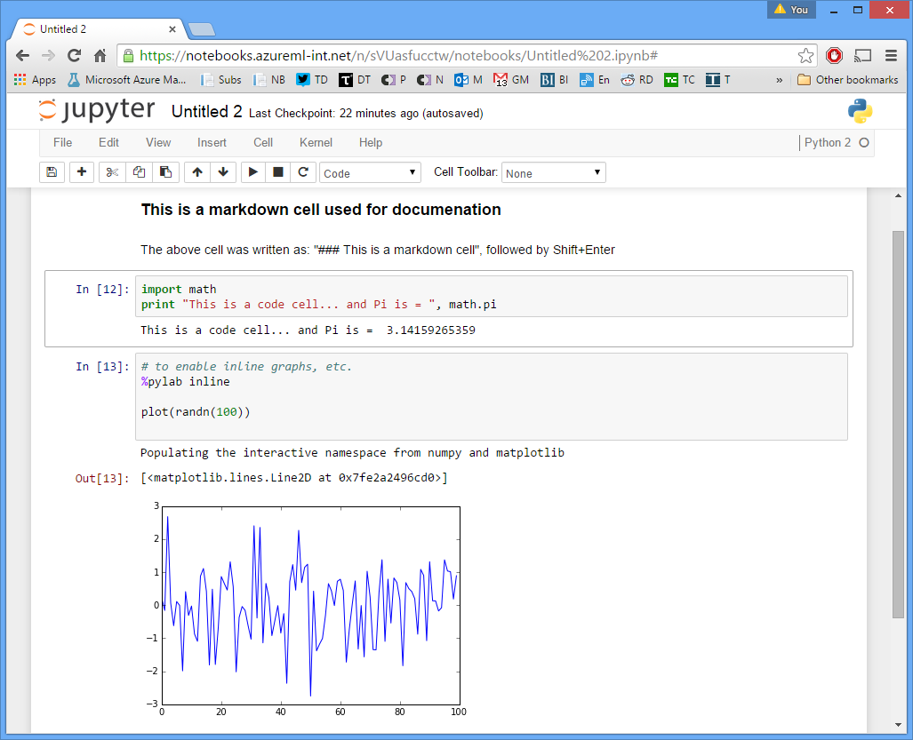
Jupyter Notebook for Spark
Spark Notebook for
Web-based
Scala/Python libraries
Templates
Security and login integration
Data discovery
Enhanced SQL support
Notes:
Now lets have a look at what is Jupyter notebook for Spark Or Spark Notebook. I will use these two terms interchangeably during this presentation.

Slide 10
Spark Notebooks – Tech Stack
Notes:
Jupyter Notebook in its plain vanilla form doesn’t do much with Spark.
Also, since Jupyter is a web app, it has to submit a Spark job over Web and HTTP which is different than traditional shell job like spark-submit.
So, in-order to make it work, we have to introduce few more components

Slide 11
Spark Notebooks – Tech Stack
JupyterHub (Notebook web-application for multi-users environment)
SparkMagic (Spark kernel for Jupyter Notebook supporting Python & Scala)
Livy (HTTP REST web-service for to submit Spark jobs, managing sessions, etc.)
HDFS/Yarn (HDFS and Yarn running Spark jobs)
Notes:
10 min.

Slide 12
JupyterHub – Current State
Notes:
So, lets what we get when we run JupyterHub, SparkMagic and Livy in its current state available today.

Slide 13
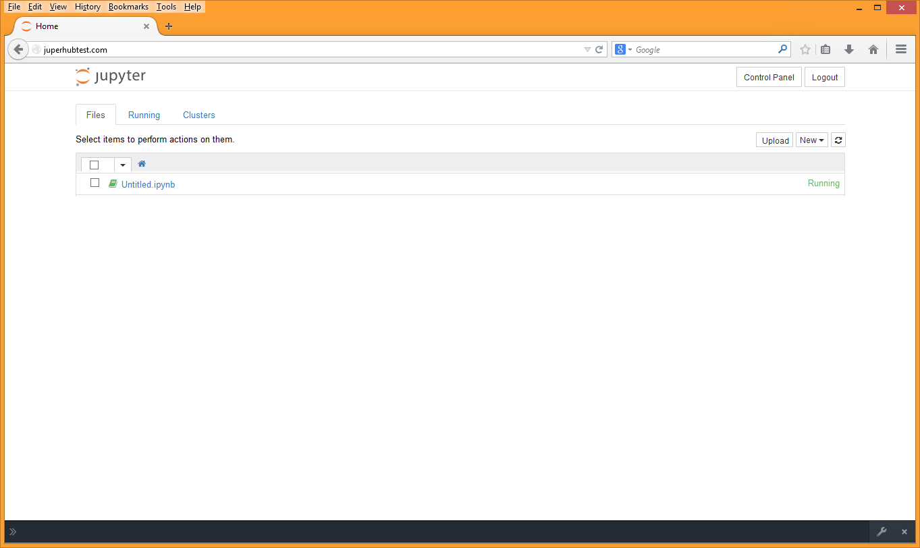
JupyterHub – Current State
Notes:
10 min.

Slide 14
JupyterHub – Current State
1. JupyterHub login using OAuth
JupyterHub
Web Service
Yarn Cluster
SparkMagic
Livy
3. Creates/maintains Spark session and
submits the Spark job to the yarn cluster
Spark Job
2. Sends HTTP Request
Spark-Scala
Spark-Python
5. HTTP Response
4. Spark job output
xxxxxxxx
yyyyyyyy
xxxxxxxx
yyyyyyyy
xxxxxxxx
yyyyyyyy
xxxxxxxx
yyyyyyyy
xxxxxxxx
yyyyyyyy
xxxxxxxx
yyyyyyyy
xxxxxxxx
yyyyyyyy
xxxxxxxx
yyyyyyyy
Running multiple Notebooks
Notes:
OAuth is an open standard for authorization, commonly used as a way for Internet users to authorize websites or applications to access their information on other websites but without giving them the passwords.

Slide 15
Requirement – Kerberos Integration
Kerberos is a Network Authentication Protocol that works on the basis of 'tickets' to allow nodes communicating over a network to prove their identity to one another in a secure manner. Kerberos uses account databases such as domain’s Active Directory.
Notes:
Initial user authentication is integrated with the Winlogon single sign-on architecture. The Kerberos Key Distribution Center (KDC) is integrated with other Windows Server security services running on the domain controller. The KDC uses the domain's Active Directory service database as its account database.

Slide 16
Current State (with Kerberos)
Notes:
10 min.

Slide 17
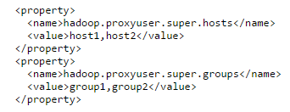
Current State (with Kerberos)
HDFS supports Kerberos
Livy Supports Kerberos (configurable in Livy)
Can impersonate a user using HDFS “proxyuser” setting and submit Spark job on behalf of a user
A superuser with username ‘super’ wants to submit job and access hdfs on behalf of a user1. The superuser has kerberos credentials but user user1 doesn’t have any. The tasks are required to run as user user1. It is required that user1 can connect to the namenode or job tracker on a connection authenticated with super’s kerberos credentials.
JupyterHub and SparkMagic: No support for Kerberos
<property>
<name>hadoop.proxyuser. livyusr.hosts</name>
<value>*</value>
</property>
<property>
<name>hadoop.proxyuser.livyusr.groups</name>
<value>LIVY_GRP</value>
</property>
Notes:
10 min.

Slide 18
How Kerberos works in HDFS and Yarn cluster running Spark Jobs?
Notes:
10 min.

Slide 19
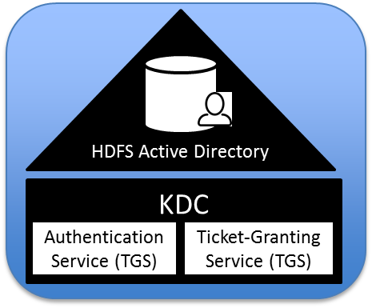
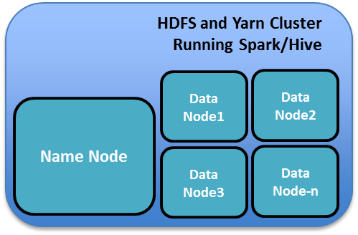
HDFS/Spark with Kerberos
Client
Notes:
During the startup all the services in the hadoop cluster talks to KDC

Slide 20
HDFS/Spark with Kerberos
0. Service
Principles/Keys
Client
Notes:
10 min.

Slide 21
HDFS/Spark with Kerberos
2. KDC sends TGT
0. Service
Principles/Keys
1. Client requests Ticket
Client
Notes:
10 min.

Slide 22
HDFS/Spark with Kerberos
2. KDC sends TGT
0. Service
Principles/Keys
3. Client Sends TGT and ask for HDFS/Hive Service Ticket
4. KDC sends Service Ticket
1. Client Request Ticket
Client
Notes:
10 min.

Slide 23
HDFS/Spark with Kerberos
2. KDC sends TGT
0. Service
Principles/Keys
3. Client sends TGT and asks for HDFS/Hive Service Ticket
4. KDC sends Service Ticket
1. Client requests Ticket
Client
5. Sends Service Ticket and requests for Authentication
Notes:
10 min.

Slide 24
HDFS/Spark with Kerberos
2. KDC sends TGT
0. Service
Principles/Keys
Retrieves
User roles/permissions
3. Client sends TGT and asks for HDFS/Hive Service Ticket
4. KDC sends Service Ticket
1. Client requests Ticket
Client
5. Sends Service Ticket and requests for Authentication
6. User Authenticated using Service Principle/key
Notes:
10 min.

Slide 25
HDFS/Spark with Kerberos
2. KDC sends TGT
0. Service
Principles/Keys
Retrieves
User roles/permissions
3. Client sends TGT and asks for HDFS/Hive Service Ticket
4. KDC sends Service Ticket
1. Client requests Ticket
Client
5. Sends Service Ticket and requests for Authentication
6. User Authenticated using Service Principle/key
Client/Server session established
Notes:
This is how kerberos works with HDFS and Yarn

Slide 26
Let’s have JupyterHub as Client and bring SparkMagic and Livy
Notes:
10 min.

Slide 27
Jupyter + Spark with Kerberos
2. KDC sends TGT
0. Service
Principles/Keys
Retrieves
User roles/permissions
3. Client sends TGT and asks for HDFS/Hive Service Ticket
4. KDC sends Service Ticket
1. Client requests Ticket
Client
Browser
5. Sends Service Ticket and requests for Authentication
6. User Authenticated using Service Principle/key
Client/Server session established
Notes:
10 min.

Slide 28
Jupyter + Spark with Kerberos
The nature of communication between Browser client and HDFS will be different
2. KDC sends TGT
0. Service
Principles/Keys
3. Client sends TGT and asks for HDFS/Hive Service Ticket
4. KDC sends Service Ticket
1. Client requests Ticket
Client
Browser
Notes:
10 min.

Slide 29
Jupyter + Spark with Kerberos
Also the TGT process between Browser client and KDC will change.
2. KDC sends TGT
0. Service
Principles/Keys
1. Client requests Ticket
Client
Browser
Notes:
10 min.

Slide 30
Jupyter + Spark with Kerberos
KDCAuthenticator: JupyterHub Authentication extensibility point
KDCSpawner: JupyterHub per user session extensibility point
2. KDC sends TGT
0. Service
Principles/Keys
1. Client requests Ticket
Client
Web Service
KDC
Authenticator
KDC
Spawner
Livy
Browser
SparkMagic
JupyterHub
Notes:
10 min.

Slide 31
Jupyter + Spark with Kerberos
2. KDC sends TGT
0. Service
Principles/Keys
1. Client requests Ticket
Client
???
Web Service
???
KDC
Authenticator
KDC
Spawner
Livy
Browser
???
SparkMagic
JupyterHub
Notes:
10 min.

Slide 32
Jupyter + Spark with Kerberos
2. KDC sends TGT
0. Service
Principles/Keys
0. LIVY HTTP Service
Principles/Keys
0. JHUB HTTP
Service Principles/Keys
1. Client requests Ticket
Client
???
Web Service
???
KDC
Authenticator
KDC
Spawner
Livy
Browser
???
SparkMagic
JupyterHub
Notes:
10 min.

Slide 33
Jupyter + Spark with Kerberos
1. Client requests Ticket (kinit)
2. KDC sends TGT
0. Service
Principles/Keys
2
0. LIVY HTTP Service
Principles/Keys
1
0. JHUB HTTP
Service Principles/Keys
Client
???
Web Service
???
KDC
Authenticator
KDC
Spawner
Livy
Browser
???
SparkMagic
JupyterHub
Notes:
10 min.

Slide 34
Jupyter + Spark with Kerberos
1. Client requests Ticket (kinit)
2. KDC Sends TGT
3. Jhub sends URL request (GET)
Spnego
4. 401/www-Authenticate: Negotiate
0. Service
Principles/Keys
2
0. LIVY HTTP Service
Principles/Keys
Retrieves
User roles/permissions
1
0. JHUB HTTP
Service Principles/Keys
Client
3
Web Service
???
KDC
Authenticator
KDC
Spawner
Livy
Browser
4
???
SparkMagic
JupyterHub
Notes:
SPNEGO is a standard specification defined in The Simple and Protected GSS-API Negotiation Mechanism (IETF RFC 2478). When WebSphere Application Server global and application security are enabled, and SPNEGO web authentication is enabled, SPNEGO is initialized when processing a first inbound HTTP request

Slide 35
Jupyter + Spark with Kerberos
1. Client requests Ticket (kinit)
2. KDC sends TGT
3. Jhub sends URL request (GET)
4. 401/www-Authenticate: Negotiate
0. Service
Principles/Keys
5. Client sends TGT and asks for JHUB Service Ticket
6. KDC sends Service Ticket
2
0. LIVY HTTP Service
Principles/Keys
1
5
0. JHUB HTTP
Service Principles/Keys
6
Client
3
Web Service
???
KDC
Authenticator
KDC
Spawner
Livy
Browser
4
???
SparkMagic
JupyterHub
Notes:
10 min.

Slide 36
Jupyter + Spark with Kerberos
1. Client requests Ticket (kinit)
2. KDC sends TGT
3. Jhub sends URL request (GET)
4. 401/www-Authenticate: Negotiate
0. Service
Principles/Keys
5. Client sends TGT and asks for JHUB Service Ticket
6. KDC sends Service Ticket
2
0. LIVY HTTP Service
Principles/Keys
7. Sends HTTP GET with Get- Authorization: Negotiate <jhub service-ticket>
1
5
0. JHUB HTTP
Service Principles/Keys
6
Client
3
Web Service
???
KDC
Authenticator
KDC
Spawner
Livy
Browser
4
???
7
SparkMagic
JupyterHub
Notes:
10 min.

Slide 37
Jupyter + Spark with Kerberos
1. Client requests Ticket (kinit)
2. KDC sends TGT
3. Jhub sends URL request (GET)
4. 401/www-Authenticate: Negotiate
0. Service
Principles/Keys
5. Client sends TGT and asks for JHUB Service Ticket
6. KDC sends Service Ticket
2
0. LIVY HTTP Service
Principles/Keys
7. Sends HTTP GET with Get- Authorization: Negotiate <jhub service-ticket>
1
5
0. JHUB HTTP
Service Principles/Keys
6
Client
3
Web Service
???
KDC
Authenticator
KDC
Spawner
Livy
Browser
4
???
7
Supports SPNEGO
Authenticates user using HTTP service principle/key
Retrieves user-id
SparkMagic
JupyterHub
Notes:
10 min.

Slide 38
Jupyter + Spark with Kerberos
1. Client requests Ticket (kinit)
2. KDC sends TGT
3. Jhub sends URL request (GET)
4. 401/www-Authenticate: Negotiate
0. Service
Principles/Keys
5. Client sends TGT and asks for JHUB Service Ticket
6. KDC sends Service Ticket
2
0. LIVY HTTP Service
Principles/Keys
7. Sends HTTP GET with Get- Authorization: Negotiate <jhub service-ticket>
1
5
0. JHUB HTTP
Service Principles/Keys
6
Client
3
Web Service
???
KDC
Authenticator
KDC
Spawner
Livy
Browser
4
???
7
SparkMagic
JupyterHub
Connection/session established
Notes:
10 min.

Slide 39
Jupyter + Spark with Kerberos
1. Client requests Ticket (kinit)
2. KDC sends TGT
3. Jhub sends URL request (GET)
4. 401/www-Authenticate: Negotiate
0. Service
Principles/Keys
5. Client sends TGT and asks for JHUB Service Ticket
6. KDC sends Service Ticket
2
0. LIVY HTTP Service
Principles/Keys
7. Send HTTP GET with Get- Authorization: Negotiate <jhub service-ticket>
1
8. Spawns user session
5
0. JHUB HTTP
Service Principles/Keys
6
Client
3
8
Web Service
???
KDC
Authenticator
KDC
Spawner
Livy
Browser
4
???
7
SparkMagic
JupyterHub
Connection/session established
Notes:
10 min.

Slide 40
Jupyter + Spark with Kerberos
1. Client requests Ticket (kinit)
2. KDC sends TGT
3. Jhub sends URL request (GET)
4. 401/www-Authenticate: Negotiate
0. Service
Principles/Keys
5. Client sends TGT and asks for JHUB Service Ticket
6. KDC sends Service Ticket
2
0. LIVY HTTP Service
Principles/Keys
7. Sends HTTP GET with Get- Authorization: Negotiate <jhub service-ticket>
1
8. Spawns user session
5
0. JHUB HTTP
Service Principles/Keys
Opens Notebook session
Encrypts user-id and puts it into env['PROXY_USER']
6
Client
3
8
Web Service
???
KDC
Authenticator
KDC
Spawner
Livy
Browser
4
???
7
SparkMagic
JupyterHub
Connection/session established
Notes:
10 min.

Slide 41
Jupyter + Spark with Kerberos
1. Client requests Ticket (kinit)
2. KDC sends TGT
3. Jhub sends URL request (GET)
4. 401/www-Authenticate: Negotiate
0. Service
Principles/Keys
5. Client sends TGT and asks for JHUB Service Ticket
6. KDC sends Service Ticket
2
0. LIVY HTTP Service
Principles/Keys
7. Sends HTTP GET with Get- Authorization: Negotiate <jhub service-ticket>
1
8. Spawns user session
0. JHUB HTTP
Service Principles/Keys
9. Uses SM keytab to asks for LIVY service ticket (kinit)
5
9
10. KDC sends Livy Service Ticket
6
10
Client
3
8
Web Service
???
KDC
Authenticator
KDC
Spawner
Livy
Browser
4
???
7
SparkMagic
JupyterHub
Connection/session established
Notes:
10 min.

Slide 42
Jupyter + Spark with Kerberos
1. Client requests Ticket (kinit)
2. KDC sends TGT
3. Jhub sends URL request (GET)
4. 401/www-Authenticate: Negotiate
0. Service
Principles/Keys
5. Client sends TGT and asks for JHUB Service Ticket
6. KDC sends Service Ticket
2
0. LIVY HTTP Service
Principles/Keys
7. Sends HTTP GET with Get- Authorization: Negotiate <jhub service-ticket>
1
8. Spawns user session
0. JHUB HTTP
Service Principles/Keys
9. Uses SM keytab to asks for LIVY service ticket (kinit)
5
9
10. KDC sends Livy Service Ticket
6
11. Forwards the request to SparkMagic kernel
10
Client
3
8
Web Service
???
KDC
Authenticator
KDC
Spawner
Livy
Browser
4
???
7
11
SparkMagic
JupyterHub
Connection/session established
Notes:
10 min.

Slide 43
Jupyter + Spark with Kerberos
1. Client requests Ticket (kinit)
2. KDC sends TGT
3. Jhub sends URL request (GET)
4. 401/www-Authenticate: Negotiate
0. Service
Principles/Keys
5. Client sends TGT and asks for JHUB Service Ticket
6. KDC sends Service Ticket
2
0. LIVY HTTP Service
Principles/Keys
7. Sends HTTP GET with Get- Authorization: Negotiate <jhub service-ticket>
1
8. Spawns user session
0. JHUB HTTP
Service Principles/Keys
9. Uses SM keytab to asks for LIVY service ticket (kinit)
5
9
10. KDC sends Livy Service Ticket
6
11. Forwards the request to SparkMagic kernel
10
Client
3
8
Web Service
???
KDC
Authenticator
KDC
Spawner
Livy
Browser
4
???
7
11
SparkMagic
JupyterHub
SparkMagic reads the encrypted env['PROXY_USER'] and adds it to the Http request body as “proxyUser”.
Connection/session established
Notes:
10 min.

Slide 44
Jupyter + Spark with Kerberos
1. Client requests Ticket (kinit)
2. KDC sends TGT
3. Jhub sends URL request (GET)
4. 401/www-Authenticate: Negotiate
0. Service
Principles/Keys
5. Client sends TGT and asks for JHUB Service Ticket
6. KDC sends Service Ticket
2
0. LIVY HTTP Service
Principles/Keys
7. Sends HTTP GET with Get- Authorization: Negotiate <jhub service-ticket>
1
8. Spawns user session
0. JHUB HTTP
Service Principles/Keys
9. Uses SM keytab to asks for LIVY service ticket (kinit)
5
9
10. KDC sends Livy Service Ticket
6
11. Forwards the request to SparkMagic kernel
10
12. Submits the Spark request over HTTP to Livy with Get- Authorization: Negotiate <Livy service-ticket>
Client
3
8
Web Service
???
KDC
Authenticator
KDC
Spawner
Livy
Browser
4
7
11
SparkMagic
12
JupyterHub
Connection/session established
Notes:
10 min.

Slide 45
Jupyter + Spark with Kerberos
1. Client requests Ticket (kinit)
2. KDC sends TGT
3. Jhub sends URL request (GET)
4. 401/www-Authenticate: Negotiate
0. Service
Principles/Keys
5. Client sends TGT and asks for JHUB Service Ticket
6. KDC sends Service Ticket
2
0. LIVY HTTP Service
Principles/Keys
7. Sends HTTP GET with Get- Authorization: Negotiate <jhub service-ticket>
1
8. Spawns user session
0. JHUB HTTP
Service Principles/Keys
9. Uses SM keytab to asks for LIVY service ticket (kinit)
5
9
10. KDC sends Livy Service Ticket
6
13
11. Forwards the request to SparkMagic kernel
10
14
12. Submits the Spark request over HTTP to Livy with Get- Authorization: Negotiate <Livy service-ticket>
Client
3
8
Web Service
???
KDC
Authenticator
KDC
Spawner
Livy
13. Uses Livy keytab to asks for HDFS service ticket
Browser
4
14. KDC sends HDFS Service Ticket
7
11
SparkMagic
12
JupyterHub
Connection/session established
Notes:
10 min.

Slide 46
Jupyter + Spark with Kerberos
1. Client requests Ticket (kinit)
2. KDC sends TGT
3. Jhub sends URL request (GET)
4. 401/www-Authenticate: Negotiate
0. Service
Principles/Keys
5. Client sends TGT and asks for JHUB Service Ticket
6. KDC sends Service Ticket
2
0. LIVY HTTP Service
Principles/Keys
7. Sends HTTP GET with Get- Authorization: Negotiate <jhub service-ticket>
1
8. Spawns user session
0. JHUB HTTP
Service Principles/Keys
9. Uses SM keytab to asks for LIVY service ticket (kinit)
5
9
10. KDC sends Livy Service Ticket
6
13
11. Forwards the request to SparkMagic kernel
10
14
12. Submits the Spark request over HTTP to Livy with Get- Authorization: Negotiate <Livy service-ticket>
Client
3
8
Web Service
???
KDC
Authenticator
KDC
Spawner
Livy
13. Uses Livy keytab to asks for HDFS service ticket
Browser
4
14. KDC sends HDFS Service Ticket
7
11
SparkMagic
12
JupyterHub
Livy decrypts the “proxyUser” and sets the “proxy-user” value for remote Spark-Submit
Connection/session established
Notes:
10 min.

Slide 47
Jupyter + Spark with Kerberos
1. Client requests Ticket (kinit)
2. KDC sends TGT
3. Jhub sends URL request (GET)
4. 401/www-Authenticate: Negotiate
0. Service
Principles/Keys
5. Client sends TGT and asks for JHUB Service Ticket
6. KDC sends Service Ticket
2
0. LIVY HTTP Service
Principles/Keys
7. Sends HTTP GET with Get- Authorization: Negotiate <jhub service-ticket>
1
8. Spawns user session
0. JHUB HTTP
Service Principles/Keys
9. Uses SM keytab to asks for LIVY service ticket (kinit)
5
9
10. KDC sends Livy Service Ticket
6
13
11. Forwards the request to SparkMagic kernel
10
14
12. Submits the Spark request over HTTP to Livy with Get- Authorization: Negotiate <Livy service-ticket>
Client
3
8
Web Service
KDC
Authenticator
KDC
Spawner
Livy
13. Uses Livy keytab to asks for HDFS service ticket
Browser
4
15
14. KDC sends HDFS Service Ticket
7
11
15. Livy submits remote Spark job using HTTP Spnego with Get- Authorization: Negotiate <HDFS service-ticket>
SparkMagic
12
JupyterHub
Connection/session established
Notes:
10 min.

Slide 48
Jupyter + Spark with Kerberos
1. Client requests Ticket (kinit)
2. KDC sends TGT
3. Jhub sends URL request (GET)
4. 401/www-Authenticate: Negotiate
0. Service
Principles/Keys
5. Client sends TGT and ask for JHUB Service Ticket
6. KDC sends Service Ticket
2
0. LIVY HTTP Service
Principles/Keys
Retrieves
User roles/permissions
7. Sends HTTP GET with Get- Authorization: Negotiate <jhub service-ticket>
1
8. Spawns user session
0. JHUB HTTP
Service Principles/Keys
9. Uses SM keytab to asks for LIVY service ticket (kinit)
5
9
10. KDC sends Livy Service Ticket
6
13
11. Forwards the request to SparkMagic kernel
10
14
12. Submits the Spark request over HTTP to Livy with Get- Authorization: Negotiate <Livy service-ticket>
Client
3
8
Web Service
KDC
Authenticator
KDC
Spawner
Livy
13. Uses Livy keytab to asks for HDFS service ticket
Browser
4
15
14. KDC sends HDFS Service Ticket
7
11
15. Livy submits remote Spark job using HTTP Spnego with Get- Authorization: Negotiate <HDFS service-ticket>
SparkMagic
12
JupyterHub
16
16. User Authenticated using Service Principle/key
Connection/session established
Notes:
SPNEGO is a standard specification defined in The Simple and Protected GSS-API Negotiation Mechanism (IETF RFC 2478). When WebSphere Application Server global and application security are enabled, and SPNEGO web authentication is enabled, SPNEGO is initialized when processing a first inbound HTTP request

Slide 49
Jupyter + Spark with Kerberos
1. Client requests Ticket (kinit)
2. KDC sends TGT
3. Jhub sends URL request (GET)
4. 401/www-Authenticate: Negotiate
0. Service
Principles/Keys
5. Client sends TGT and ask for JHUB Service Ticket
6. KDC sends Service Ticket
2
0. LIVY HTTP Service
Principles/Keys
Retrieves
User roles/permissions
7. Sends HTTP GET with Get- Authorization: Negotiate <jhub service-ticket>
1
8. Spawns user session
0. JHUB HTTP
Service Principles/Keys
9. Uses SM keytab to asks for LIVY service ticket (kinit)
5
9
10. KDC sends Livy Service Ticket
6
13
11. Forwards the request to SparkMagic kernel
10
14
12. Submits the Spark request over HTTP to Livy with Get- Authorization: Negotiate <Livy service-ticket>
Client
3
8
Web Service
KDC
Authenticator
KDC
Spawner
Livy
13. Uses Livy keytab to asks for HDFS service ticket
Browser
4
15
14. KDC sends HDFS Service Ticket
7
11
15. Livy submits remote Spark job using HTTP Spnego with Get- Authorization: Negotiate <HDFS service-ticket>
SparkMagic
12
JupyterHub
16
16. User Authenticated using Service Principle/key
Connection/session established
Connection/session established
Notes:
SPNEGO is a standard specification defined in The Simple and Protected GSS-API Negotiation Mechanism (IETF RFC 2478). When WebSphere Application Server global and application security are enabled, and SPNEGO web authentication is enabled, SPNEGO is initialized when processing a first inbound HTTP request

Slide 50
Jhub-Kerberos Development Summary
JupyterHub
KDC Authenticator (configurable using JupyerHub configuration)
Supports Kerberos-Spnego authentication using HTTP Service Principle and keys
KDC Spawner (configurable using JupyerHub configuration)
Encrypts the current user-name and stores it in the “PROXY_USER” environment variable (before spawning a new user child process) which SparkMagic reads/uses later.
Kinit to get the Livy Service ticket for Spnego Authentication with Livy server.
SparkMagic
Adds current user-name (reading from “PROXY_USER” environment variable) as “proxyUser” in the Livy HTTP Request body. This behavior can enabled or disabled (default) by SparkMagic configuration
Livy changes (configurable using Livy configuration)
Supports to decrypt the “proxyUser” from the request body & adds to the remote Spark job request for HDFS impersonation
Notes:
10 min.

Slide 51
Jhub-Kerberos Development Setup
Learnings
KDC Domain controller running the AS and TGS
Multiple nodes running JupyterHub, Livy and Yarn (Spark) at different DNS farm and networking between these farms
Creating/modifying key-tabs and principles on demand basis in a corporate environment for dev
Corporate IT dependency
How Docker helps
Easy to bootstrap the JupyterHub, Livy, Yarn and KDC using Docker script
Seamless networking (easy to configure) between Docker instances
Creating Service principles and key-tabs on demand (without involving corporate IT)
Custom DNS farm setup for POC and development activities
Notes:
10 min.

Slide 52
Q&A

