Slide 1
Running secured Spark job in Kubernetes compute cluster and integrating with Kerberized HDFS
Joy Chakraborty
June 21, 2018
Email: joychak1@[yahoo/gmail].com]]
Notes:
Welcome to the first session of the last day of the summit … We will be talking about how to setup and run Spark Job in Kubernetes but accessing data in HDFS specifically in a corporate setup which means in a secured environment.

Slide 2
What we will be talking about -
Running Spark job on Elastic Compute (Kubernetes) accessing data stored in distributed storage (HDFS)
Notes:
The content that I will present, this patterns can be applied to any elastic compute cluster and any distributed storage … Not specifically to Kubernetes or HDFS …

Slide 3
Who am I ???
I learn and apply ….
- Design and write software for living
- for last 18+ years …
Notes:
My name is Joy Chakraborty … I design and write software for living … Most of my recent projects involves designing and building distributed compute and storage systems for data analysis and data science activities including machine learning

Slide 4
Disclaimer
We will be just scratching the Surface !!!
Notes:
Just want to make sure, the technologies that I will be covering, I will just scratch the surface …

Slide 5

Agenda
1
Kubernetes as Elastic Compute
2
HDFS as secured distributed storage
3
Configuring Spark to run in Kubernetes & accessing HDFS
4
Demo - Build & setup the Kubernetes/Spark in local environment
Notes:
Setting up these technologies in local environment such as laptop is essential for doing development and testing without involving network dependencies ….

Slide 6
Why Kubernetes?
Notes:
Lets start with why Kubernetes … There are few reasons … And it doesn’t have to be Kubernetes and it could be something similar … The reason we are talking about Kubernetes because it is one of the popular one now

Slide 7
Compute Requirements
Notes:
What actually we need is a compute environment that

Slide 8
Compute Requirements
Support Elasticity
Flexibility and variability in work load
Process massive amount of data in parallel
Support Reliability & Multitenancy
Ease in Accessibility without compromising Security
Notes:
Supports elasticity, Can perform various kind of work loads such as CPU and GPU compute to process massive amount of data in secured, reliable and predictable way …
For lots of use cases, GPU is becoming essential, so we can’t ignore it anymore …
But at the same time, the end user using these systems should have easy and consistent access patterns …
In a corporate env, we always end up with multiple systems, but we as engineer’s job is to provide a consistent access pattern and abstract away the system level variances as much as possible

Slide 9
Distributed Containerized
Notes:
The next is, it has to be distributed and containerized …
Containerized solution provides isolation and reusability …

Slide 10
Distributed Containerized System
Container Management
Scheduling
Resource Management
Notes:
Some of the characteristics of such distributed and containerized solution should be to provide –
Management capabilities for
Containers
Resources
Scheduling

Slide 11
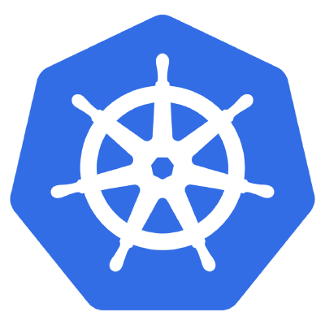
Distributed Containerized System
Container Management
Scheduling
Resource Management
Kubernetes
Notes:
Kubernetes does provide these capabilities that we just talked about in last few slides and Spark now supports running in Kubernetes
So, it is the good time to catch up and see how we can run Spark in Kubernetes to build an elastic compute cluster
One point to be noted, Our goal should be to run Spark the same way it runs in yarn or Mesos, without changing the access pattern … again to be consistent … And the good news is we can do it … We will see how in this presentation …

Slide 12
what?
Notes:
Lets, talk little bit about Kubernetes, just to make sure that we are all in same page and have a common understanding for the rest of the presentation …
Regarding Spark, it is in the industry for long time and most of you probably know … And, I will cover throughout the presentation whenever required …

Slide 13
Kubernetes
An open-source system for automating deployment, scaling, and management of containerized applications.
Portable
Extensible: modular, plug-able, compos-able
Self-healing: auto-placement, auto-restart, auto-replication, auto-scaling
Latest Release: 1.8.14
Community driven completely
Written in GoLang
Notes:
Kubernetes is an open-source container and resource management System
It is modular in design, and very much extensible ..
The latest release is 1.8.14
It is written in GoLang

Slide 14
Kubernetes High Level Architecture
Notes:
High level architecture and design of a Kubernetes cluster is

Slide 15
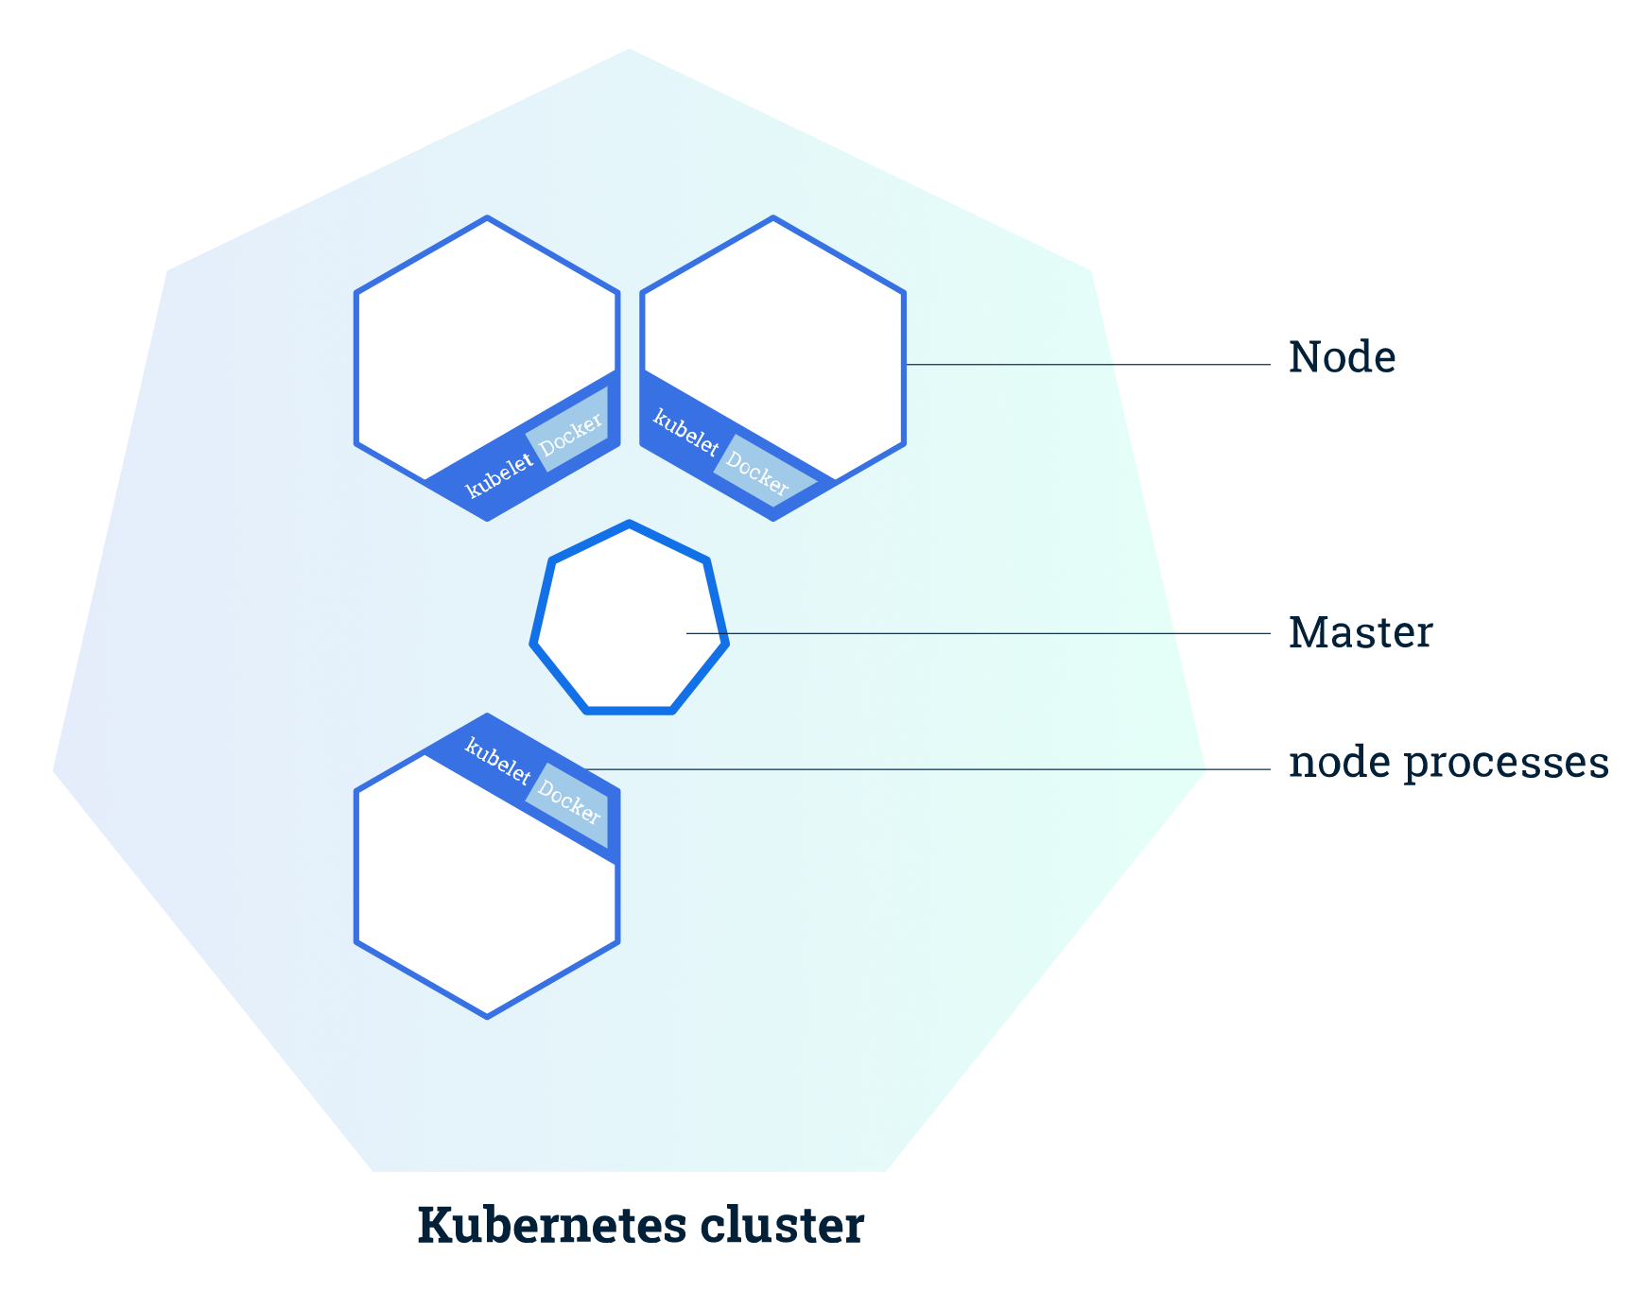
Kubernetes High Level Architecture
The Kubernetes Master is a collection of three processes that run on a single node in your cluster, which is designated as the master node.
kube-apiserver
kube-controller-manager
kube-scheduler
Each individual non-master node in your cluster runs two processes –
kubelet, which communicates with the Kubernetes Master
kube-proxy, a network proxy which reflects Kubernetes networking services on each node.
Kube-apiserver
Kube-Controller-manager
Notes:
It has a master node, which is responsible for running the central services such as api-server (through which the end user accesses the cluster), scheduler service and other services
The slave nodes runs a process called Kubelets which is responsible for maintaing the state of the cluster fabric and communicate to the respective services of the master.
It is kind of master-slave architecture

Slide 16
Kubernetes - basic components
Notes:
Some of the basic or core components that Kubernetes provides out of the box and also you will be dealing with any kubernetes cluster are -

Slide 17
Kubernetes Object/Resource (out of the box)
Namespace
Pod (a basic unit of work)
Service
Volume
Notes:
Namespace gives a workspace or work area for a user to create other resources and run services … Namespace can be used to assign permissions or policies.
Pod is a basic unit of compute resource where you will run your compute workload … You can think of this as a container representing a running process that you get for the given specification that you asked for … The container is build primarily using Docker images but you can also you other container runtime solutions
Service gives you the abstraction to deploy and run any kind of service (primarily stateless) with endpoints
Volume is abstraction layer for the storage resources, you can mount different kind of storages such as HDFS …

Slide 18
Kubernetes Object/Resource (out of the box)
Namespace
Pod (a basic unit of work)
Service
Volume
ReplicaSet
Deployment
Job
Notes:
Some more component those are very useful –
These are just for references … We will not be talking about these but you encourage you to look …

Slide 19
Kubernetes Object/Resource (out of the box)
Namespace
Pod (a basic unit of work)
Service
Volume
ReplicaSet
Deployment
Job
RBAC
Notes:
One of the other important one –
Kubernetes does support RBAC, through which you can setup the permissions, access rights and policies …

Slide 20
Kubernetes Object/Resource (out of the box)
Namespace
Pod (a basic unit of work)
Service
Volume
ReplicaSet
Deployment
Job
RBAC
*** Custom Resource
Notes:
Finialy, one of the most powerful capabilities is, you can create your custom resource and deploy … It will be treated as first class citizen, which means the end user will create, update, delete and serach the custom resource the same way it accesses other resources such as Pod

Slide 21
Kubernetes Pod
Pod is the basic building block of Kubernetes–
the smallest and simplest unit in the Kubernetes object model that you create or deploy
represents a running process on your cluster.
encapsulates an application container (or, in some cases, multiple containers), storage resources, a unique network IP, and options that govern how the container(s) should run
Docker is the most common container runtime used in a Pod, but Pods support other container runtimes as well
Notes:
Little bit more on Pod,

Slide 22
How to Interact with Kubernetes
Notes:
Next, how to interact with Kubernetes -

Slide 23
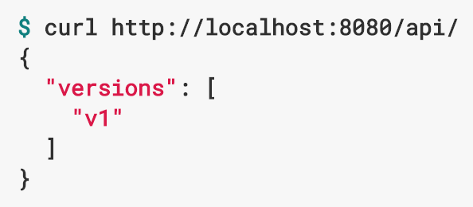

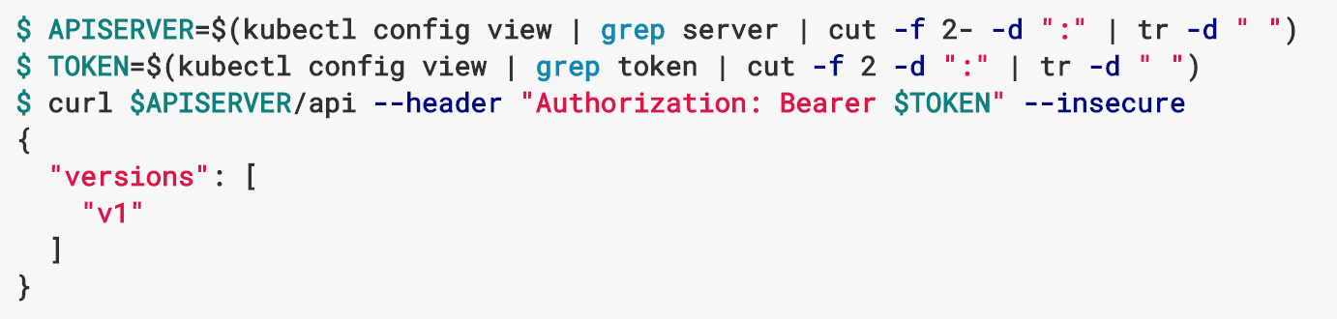
How to Interact with Kubernetes
REST API
Curl or browser
Command Line Interface
Kubectl
Kube Config
Created during cluster creation
Programmatic
GoLang, Python, Scala
Notes:
Primariliy, There are 2 ways you can access the Kubernetes resources –
REST API
Command line … Also called kubectl … this is the CLI
In order to access the Kubernetes cluster, you need the configuration (also called kube config) … You normally get it from the admin or for you local deployment, it will be automatically created during cluster setup …

Slide 24
How Secured (kerberized) HDFS works?
Notes:
Now before we talk on designing a Kubernetes cluster running Spark jobs and accessing data from secured HDFS, lets see how secured or kerberized HDFS works. Many of you probably know but these is just a quick recap for completeness …

Slide 25
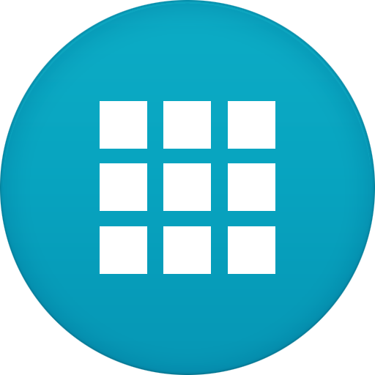
Secured/Kerberized HDFS
Active Directory
KDC
AS
TGS
Client Machine
Client Application
HDFS
Name node
Data Node
Data Node
Data Node
Data Node
Notes:
In a kerberized HDFS setup, you have 3 basic components … The KDC backed by Active directory, the HDFS and the Client

Slide 26
Secured/Kerberized (keytab) HDFS
Active Directory
KDC
1. Service
Principles/Keys
AS
TGS
3. KDC sends TGT
Retrieves
User roles/permissions
2. Client-app requests Ticket
4. Client sends TGT (from keytab) and asks for HDFS Service Ticket
5. KDC sends Service Ticket
Client Machine
6. Sends Service Ticket and requests for Authentication
Client Application
HDFS
Name node
Data Node
Data Node
5. User Authenticated using Service Principle/key
Data Node
Data Node
Notes:
This slides summarizes the the Kerberos authentication workflow.
It starts with, HDFS getting authenticated with KDC using its Service principal/keys. What essentially it means, the HDFS is now trusted for this KDC and KDC allows the HDFS to authenticate a client using ticket issued by this same KDC.
Then Client requests the KDC for the Kerberos ticket using principal/pwd or Keytab
KDC sends the TGT (also called Ticket granting Ticket)
Now, when Client wants to talk to HDFS, it uses the TGT to get the service token from Ticket granting service of KDC and then it uses this token to get authenticated by HDFS Namenode.
Once the HDFS authenticates the, connection established between Client and HDFS.
This is how Kerberized HDFS works.

Slide 27
Secured/Kerberized (delegation token) HDFS
Active Directory
KDC
1. Service
Principles/Keys
AS
TGS
3. KDC sends TGT
Retrieves
User roles/permissions
2. Client-app requests Ticket
4. Client sends TGT (from keytab) and asks for HDFS Service Ticket
5. KDC sends Service Ticket
Client Machine
6. Sends Service Ticket and requests for Delegation Token
Client Application
HDFS
Name node
Data Node
Data Node
7. User Authenticated using Service Principle/key
Data Node
Data Node
8. Name node sends delegation token
Notes:
But wait, there is a little variation to it … This is not the only option,
The other option is called using delegation token.
In this case, the last two steps are different.

Slide 28
Spark + Kubernetes + HDFS
Notes:
Now finally, Lets see how to design a kubernetes cluster running Spark job accessing data from kerberized HDFS by combining all these technologies …
One point, I would highlight is, traditionally we run spark job using spark-submit which is well known … And in Kubernetes, we will submit the spark job using same spark-submit command … No difference because in Spark 2.3, it does support kubernetes using spark-submit and this is good because it is consistent with Yarn and Mesos …

Slide 29
Spark Running in Kubernetes
Kubernetes Cluster
Kube Master
Notes:
We start with the kubernetes cluster having master node running …

Slide 30

Spark Running in Kubernetes
Kubernetes Cluster
Kube Master
Spark-Submit
(--master k8s://…)
Notes:
Now, the user wants to do spark-submit … The only difference here is to set the master as kubernetes master

Slide 31
Spark Running in Kubernetes
Kubernetes Cluster
Kube Master
Spark Master
Spark Job
Driver Pod
Spark-Submit
Worker
Pod
Worker
Pod
Worker
Pod
Worker
Pod
Notes:
Kubernetes master creates the driver and worker pods

Slide 32
Spark Running in Kubernetes
Kubernetes Cluster
Kube Master
Spark Master
Spark Job
Driver Pod
Spark-Submit
Worker
Pod
Worker
Pod
Worker
Pod
Worker
Pod
Docker Hub
Spark Docker Images
Notes:
Now in order to create the pod, kubernetes needs a docker image … So, in the spark-submit, you have to specify the docker image name and kubernetes will use it … And this is same for creating any pod not specific to Spark

Slide 33
Spark Running in Kubernetes
Kubernetes Cluster
Kube Master
Spark Master
Spark Job
HDFS
Driver Pod
Name node
Data Node
Data Node
Spark-Submit
Worker
Pod
Data Node
Data Node
Worker
Pod
Worker
Pod
Worker
Pod
Docker Hub
Spark Docker Images
Notes:
The process or the code in spark wants to access data from HDFS … Since the HDFS is kerberized … The driver and worker need the Kerberos keytab or password.

Slide 34
Spark Running in Kubernetes
Kubernetes Cluster
Kube Master
Kube Secret
Spark Master
Keytab
Spark Job
HDFS
Driver Pod
Name node
Data Node
Data Node
Spark-Submit
Worker
Pod
Data Node
Data Node
Worker
Pod
Worker
Pod
Worker
Pod
Docker Hub
Spark Docker Images
Notes:
Kubernetes provides a resource called secrets similar to docker swarm. You can stored your secret to your namespace which you can only allow to read and they will be mounted to the driver/worker pod as regular keytab file, which the spark JVM will use to talk to HDFS.

Slide 35
Spark Running in Kubernetes
Kubernetes Cluster
Kube Master
Kube Secret
Spark Master
Keytab
Spark Job
HDFS
Driver Pod
Name node
Data Node
Data Node
Spark-Submit
Worker
Pod
Data Node
Data Node
Worker
Pod
Worker
Pod
Worker
Pod
Docker Hub
Spark Docker Images
Notes:
So, this is how the over interaction looks like.

Slide 36
Lets build the Kubernetes/Spark/HDFS environment !!!
Notes:
So, how to use setup this environment

Slide 37
What to use
To install Kubernetes
vagrant-kubeadm (https://github.com/c9s/vagrant-kubeadm)
Run local Docker Hub (https://docs.docker.com/registry/deploying )
Run Docker registry container and map localhost to some ip (10.0.2.2)
Build Spark Docker image from Spark download Dockerfile under Kubernetes directory (spark-2.3.0-bin-hadoop2.7/ kubernetes)
Publish the image to Docker hub
Run Spark-submit
Notes:
Before we look into different components to setup, lets revisit our objectives, we want to build an environment which I can run in Laptop, then port it to multi-node dev cluster and finally to the prod cluster which could be cloud.

Slide 38
Demo !!!

Slide 39
Thank You
Email: joychak1@[yahoo/gmail].com]

