Slide 1
Running secured Spark job in Kubernetes compute cluster and integrating with Kerberized HDFS
Joy Chakraborty
June 21, 2018
Email: joychak1@[yahoo/gmail].com]]

Slide 2
Essentially what we will be doing -
To run Spark job on Elastic Compute platform (Kubernetes) accessing data stored in HDFS

Slide 3
Who am I ???
I learn and apply ….
- Design and write software for living
- for last 18 years …

Slide 4
Disclaimer
We will be just scratching the Surface !!!

Slide 5

Agenda
1
Kubernetes as Elastic Compute
2
HDFS as secured distributed storage
3
Configuring Spark to run in Kubernetes & accessing HDFS
4
Demo - Build & setup the Kubernetes/Spark/HDFS environment

Slide 6
Why Kubernetes?

Slide 7
Compute Requirements

Slide 8
Compute Requirements
Support Elasticity
Flexibility and variability in work load
Process massive amount of data in parallel
Support Reliability & Multitenancy
Ease in Accessibility without compromising Security

Slide 9
Distributed Containerized

Slide 10
Distributed Containerized System
Container Management
Scheduling
Resource Management

Slide 11
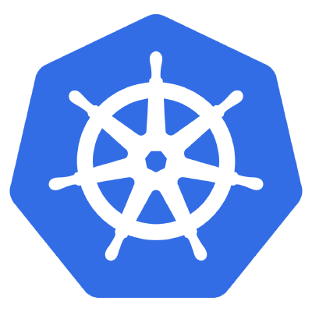
Distributed Containerized System
Container Management
Scheduling
Resource Management
Kubernetes
Notes:
Artificial intelligence is intelligence exhibited by machines. In computer science, the field of AI defines itself as the study of "intelligent agents": any device that perceives its environment and takes actions that maximize its chance of success at some goal

Slide 12
what?

Slide 13
Kubernetes
An open-source system for automating deployment, scaling, and management of containerized applications.
Portable
Extensible: modular, plug-able, compos-able
Self-healing: auto-placement, auto-restart, auto-replication, auto-scaling
Latest Release: 1.8.13
Community driven completely
Written in GoLang

Slide 14
Kubernetes High Level Architecture

Slide 15
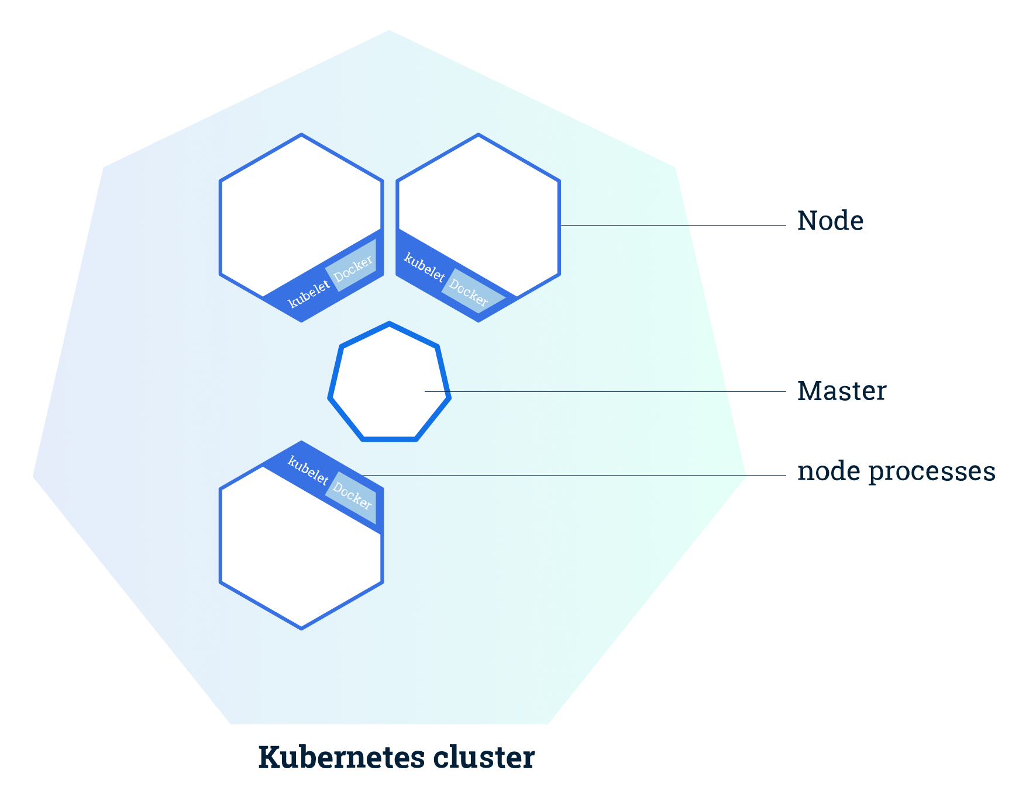
Kubernetes High Level Architecture
The Kubernetes Master is a collection of three processes that run on a single node in your cluster, which is designated as the master node.
kube-apiserver
kube-controller-manager
kube-scheduler
Each individual non-master node in your cluster runs two processes –
kubelet, which communicates with the Kubernetes Master
kube-proxy, a network proxy which reflects Kubernetes networking services on each node.
Kube-apiserver
Kube-Controller-manager

Slide 16
Kubernetes - basic components

Slide 17
Kubernetes Object/Resource (out of the box)
Namespace
Pod (a basic unit of work)
Service
Volume

Slide 18
Kubernetes Object/Resource (out of the box)
Namespace
Pod (a basic unit of work)
Service
Volume
ReplicaSet
Deployment
Job

Slide 19
Kubernetes Object/Resource (out of the box)
Namespace
Pod (a basic unit of work)
Service
Volume
ReplicaSet
Deployment
Job
RBAC

Slide 20
Kubernetes Object/Resource (out of the box)
Namespace
Pod (a basic unit of work)
Service
Volume
ReplicaSet
Deployment
Job
RBAC
*** Custom Resource

Slide 21
Kubernetes Pod
Pod is the basic building block of Kubernetes–
the smallest and simplest unit in the Kubernetes object model that you create or deploy
represents a running process on your cluster.
encapsulates an application container (or, in some cases, multiple containers), storage resources, a unique network IP, and options that govern how the container(s) should run
Docker is the most common container runtime used in a Pod, but Pods support other container runtimes as well

Slide 22
How to Interact with Kubernetes

Slide 23
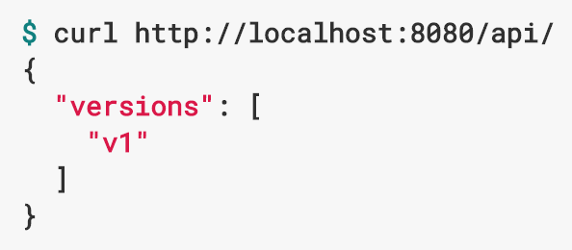

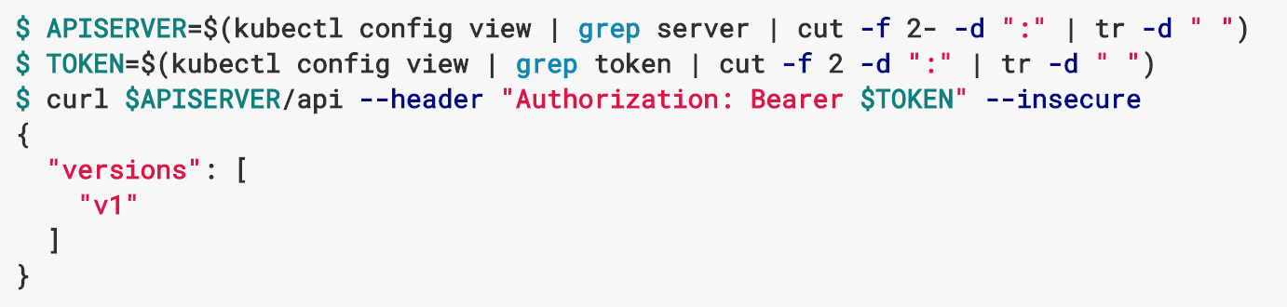
How to Interact with Kubernetes
REST API
Curl or browser
Command Line Interface
Kubectl
Kube Config
Created during cluster creation
Programmatic
GoLang, Python, Scala

Slide 24
How Secured (kerberized) HDFS works?

Slide 25
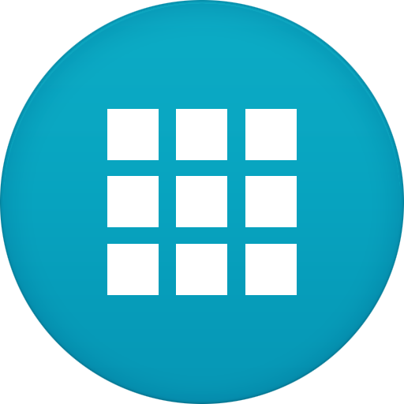
Secured/Kerberized HDFS
Active Directory
KDC
AS
TGS
Client Machine
Client Application
HDFS
Name node
Data Node
Data Node
Data Node
Data Node

Slide 26
Secured/Kerberized (keytab) HDFS
Active Directory
KDC
1. Service
Principles/Keys
AS
TGS
3. KDC sends TGT
Retrieves
User roles/permissions
2. Client-app requests Ticket
4. Client sends TGT (from keytab) and asks for HDFS Service Ticket
5. KDC sends Service Ticket
Client Machine
6. Sends Service Ticket and requests for Authentication
Client Application
HDFS
Name node
Data Node
Data Node
5. User Authenticated using Service Principle/key
Data Node
Data Node

Slide 27
Secured/Kerberized (delegation token) HDFS
Active Directory
KDC
1. Service
Principles/Keys
AS
TGS
3. KDC sends TGT
Retrieves
User roles/permissions
2. Client-app requests Ticket
4. Client sends TGT (from keytab) and asks for HDFS Service Ticket
5. KDC sends Service Ticket
Client Machine
6. Sends Service Ticket and requests for Delegation Token
Client Application
HDFS
Name node
Data Node
Data Node
7. User Authenticated using Service Principle/key
Data Node
Data Node
8. Name node sends delegation token

Slide 28
Spark + Kubernetes + HDFS

Slide 29
Spark Running in Kubernetes
Kubernetes Cluster
Kube Master

Slide 30

Spark Running in Kubernetes
Kubernetes Cluster
Kube Master
Spark-Submit
(--master k8s://…)

Slide 31
Spark Running in Kubernetes
Kubernetes Cluster
Kube Master
Spark Master
Spark Job
Driver Pod
Spark-Submit
Worker
Pod
Worker
Pod
Worker
Pod
Worker
Pod

Slide 32
Spark Running in Kubernetes
Kubernetes Cluster
Kube Master
Spark Master
Spark Job
Driver Pod
Spark-Submit
Worker
Pod
Worker
Pod
Worker
Pod
Worker
Pod
Docker Hub
Spark Docker Images

Slide 33
Spark Running in Kubernetes
Kubernetes Cluster
Kube Master
Spark Master
Spark Job
HDFS
Driver Pod
Name node
Data Node
Data Node
Spark-Submit
Worker
Pod
Data Node
Data Node
Worker
Pod
Worker
Pod
Worker
Pod
Docker Hub
Spark Docker Images

Slide 34
Spark Running in Kubernetes
Kubernetes Cluster
Kube Master
Kube Secret
Spark Master
Keytab
Spark Job
HDFS
Driver Pod
Name node
Data Node
Data Node
Spark-Submit
Worker
Pod
Data Node
Data Node
Worker
Pod
Worker
Pod
Worker
Pod
Docker Hub
Spark Docker Images

Slide 35
Spark Running in Kubernetes
Kubernetes Cluster
Kube Master
Kube Secret
Spark Master
Keytab
Spark Job
HDFS
Driver Pod
Name node
Data Node
Data Node
Spark-Submit
Worker
Pod
Data Node
Data Node
Worker
Pod
Worker
Pod
Worker
Pod
Docker Hub
Spark Docker Images

Slide 36
Lets build the Kubernetes/Spark/HDFS environment !!!

Slide 37
What to use
To install Kubernetes
vagrant-kubeadm (https://github.com/c9s/vagrant-kubeadm)
Run local Docker Hub (https://docs.docker.com/registry/deploying )
Run Docker registry container and map localhost to some ip (10.0.2.2)
Build Spark Docker image from Spark download Dockerfile under Kubernetes directory (spark-2.3.0-bin-hadoop2.7/ kubernetes)
Publish the image to Docker hub
Run Spark-submit

Slide 38
Demo !!!

Slide 39
Thank You
Email: joychak1@[yahoo/gmail].com]

