Slide 1
Architecture and Design Practices
Joy Chakraborty
19th & 20th March, 2014

Slide 2
Architecture - 1
“The fundamental organization of a system, embodied in its components, their relationships to each other and the environment, and the principles governing its design and evolution.”
- ISO/IEC 42010:2007, Systems and Software Engineering – Recommended Practice for Architectural Description of Software-Intensive Systems, Edition 1 (technically identical to ANSI/IEEE Std 1471-2000).
Enterprise
Architecture
System
Architecture
Software
Architecture

Slide 3
Architecture - 1
“Architecture provides a vehicle for communication among stakeholders”
“Every system has an architecture. Every system is composed of elements,
and there are relationships among them.”
“Just having an architecture is different from having an architecture that
is known to everyone.”
Enterprise
Architecture
System
Architecture
Software
Architecture
Communication/Interaction is KING

Slide 4
Agenda
Enterprise Architecture
Software System Architecture
Technical
Process
Technical Design
Project and Process Design
Case Study

Slide 5
Enterprise Architecture
What, Why & How?

Slide 6
Introduction
Definitions
Architecture (as per IEEE 1471-2000 / ISO/IEC 42010:2007)
…is the fundamental organization of a system embodied in its components, their relationships to each other, and to the environment, and the principles guiding its design and evolution

Slide 7
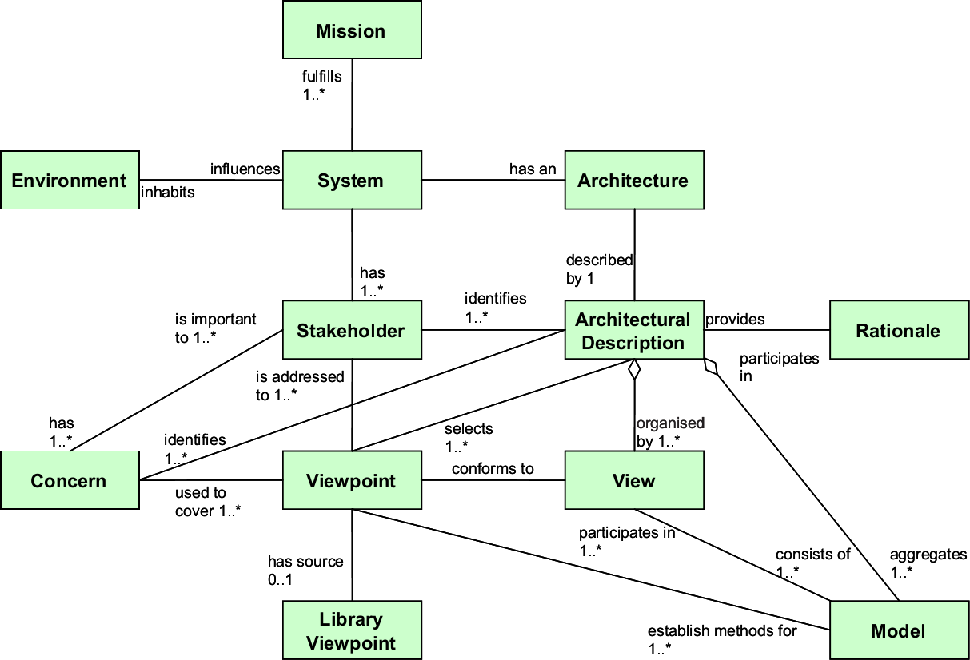
A standard definition of architecture
IEEE 1471-2000 / ISO/IEC 42010:2007
Notes:
The standard gives a set of definitions for key terms such as acquirer, architect, architecture description, architectural models, architecture, life cycle model, system, system stakeholder, concerns, mission, context, architectural view, architectural viewpoint. As essential ideas we note a clear separation between an architecture and its architecture descriptions (defined as means to record architectures), and the central role of the relationship between architectural viewpoint and architectural view.
The standard gives six architecture description practices:
− Architectural documentation referring to identification, version, and overview information.
− Identification of the system stakeholders and of their concerns, established to be relevant to the architecture.
− Selection of architectural viewpoints, containing the specification of each viewpoint that has been selected to organise the representation of the architecture and the reasons for which it was selected.
− Architectural views corresponding to the selected viewpoints.
− Consistency among architectural views.
− Architectural rationale for the selection of the current architecture from a number of considered alternatives.

Slide 8
Introduction
Definitions
Enterprise (as per )
Enterprise architecture (as per)
…is any collection of organizations that has a common set of goals and/or a single bottom line
…is a coherent whole of principles, methods, and models that are used in the design and realization of an enterprise’s organizational structure, business processes, information systems, and infrastructure

Slide 9
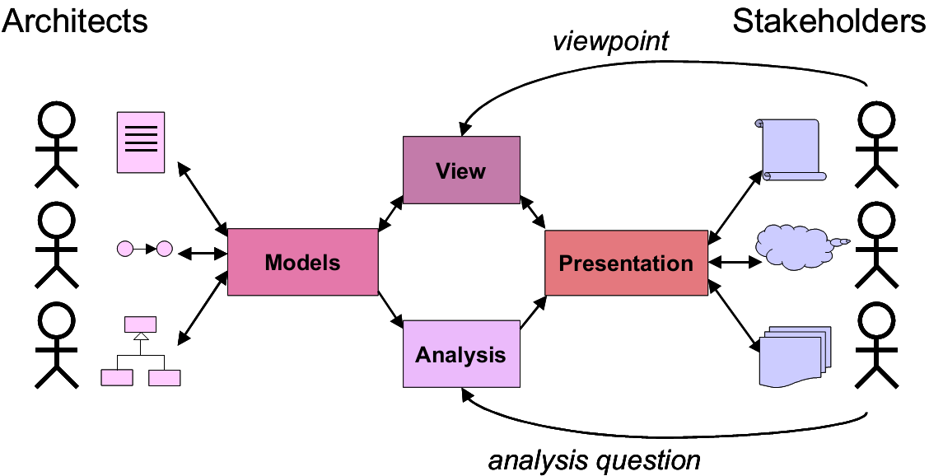
Enterprise architecture
…is about effective communication between all the stakeholders of the systems and systems of systems utilized in realizing the business of the enterprise

Slide 10
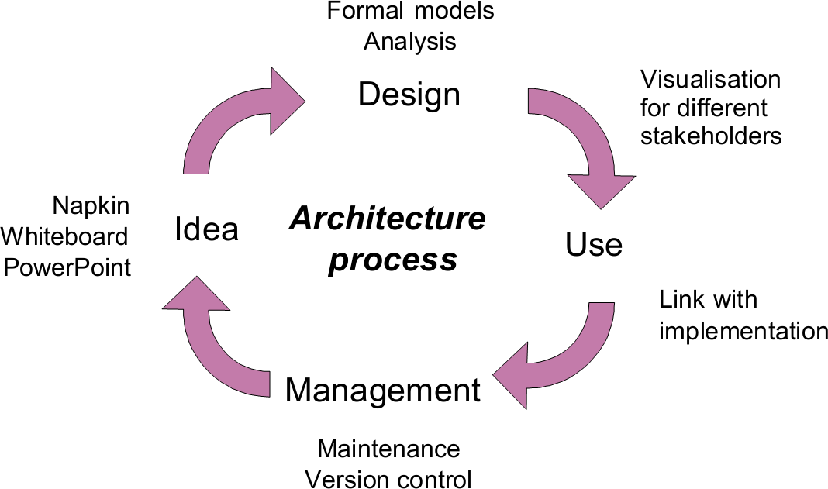
Enterprise architecture
…is about effective communication between all the stakeholders of the systems and systems of systems utilized in realizing the business of the enterprise

Slide 11
The enterprise perspective
Challenges
Efficiency in business function
Agility in responding to market trends and customer demands
Efficiency in the use of information technology
Improvement in return on investment
Reduction in investment risk
Speed in leveraging technological innovation
Simplicity in operational procedures
Adaptation to change

Slide 12
How enterprise architecture helps
Provides a holistic view of the enterprise
Global scope bridging from objectives to instruments
Facilitates translation of corporate strategy into operations
Provides end-to-end cut-through insight
Enables defining the proper balance between conflicting requirements (e.g., performance versus flexibility)
Transparency of decisions and outcomes
Allows for local optimization within individual domains
Architectures within individual domains may be optimal
Such local optimization does not necessarily result in a desired global outcome

Slide 13
What does enterprise architecture facilitate
“Who are concerned?”
Accommodating stakeholders
Identifying and refining the requirements that the stakeholders have
Representing stakeholder concerns
Developing views of the architecture
Show how the concerns and requirements will be addressed by the architecture
Supporting informed decisions
Clarifying the trade-offs that are going to be made in reconciling the potentially conflicting concerns of different stakeholders
“What are their concerns?”
“Which decisions are good?”

Slide 14
What does enterprise architecture mean for AGT?
Enterprise architecture
…brings a consistent, transparent and enterprise-wide discipline in the managing the life cycle of system architectures
…provides concrete support in terms of processes, documentation and guidelines in the practice of system architecture

Slide 15
Governance instruments
Governance Domain | Governance Instrument
Strategic management | Balanced Score Card (BSSC)
Strategy execution | European Foundation for Quality Management (EFQM)
Quality management | ISO 9001
Information technology | Control Objectives for Information and Related Technology (COBIT)
Information technology delivery and support | Information Technology Infrastructure Library (ITIL)
Information technology implementation | Capability Maturity Model (CMM)

Slide 16
Methods and frameworks
Architecture framework
Architecture method
…is a structured collection of architecture description techniques and their accompanying documentation that identifies and relates different architectural viewpoints and the associated modeling techniques
…is a structured collection of techniques and process steps for creating and maintaining an enterprise architecture

Slide 17
Architecture methods
Rational Unified Process (RUP)
Defines an iterative process, as opposed to the classical waterfall process, that realizes software by adding functionality to the architecture at each increment
UN/CEFACT Modeling Methodology (UMM)
Defines an incremental business process and information model construction methodology that is independent of technology
TOGAF Architecture Development Method (ADM)
Defines a detailed and well-described phased approach for developing an information technology architecture
Provides a framework and development method for developing enterprise architectures

Slide 18
Architecture methods
Federal Enterprise Architecture Framework (FEAF)
Defines a common approach for the integration of strategic, business and technology management as part of organization design and performance improvement in the domain of the US federal government
TOGAF is the most widely used one and most flexible

Slide 19
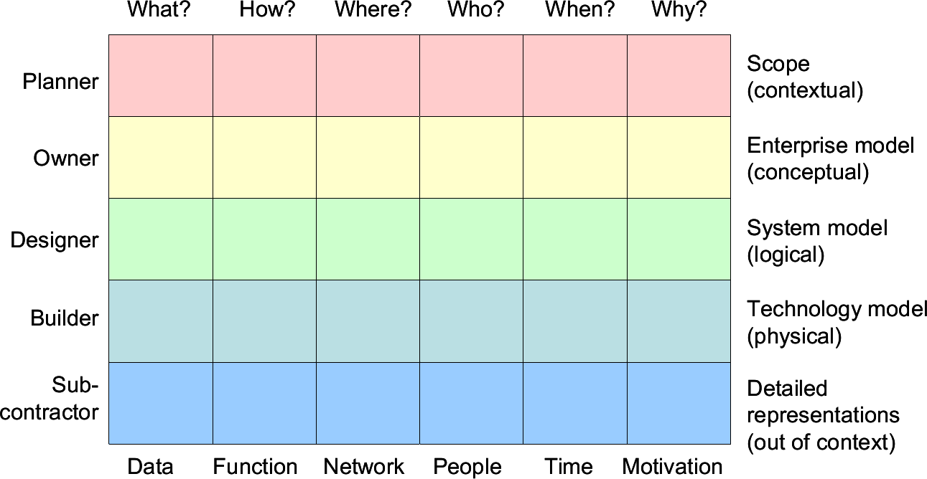
Architecture frameworks
Zachman
Is a logical structure for classifying and organizing the descriptive representations of an enterprise that are significant to the management of the enterprise as well as to the development of the enterprise’s systems

Slide 20
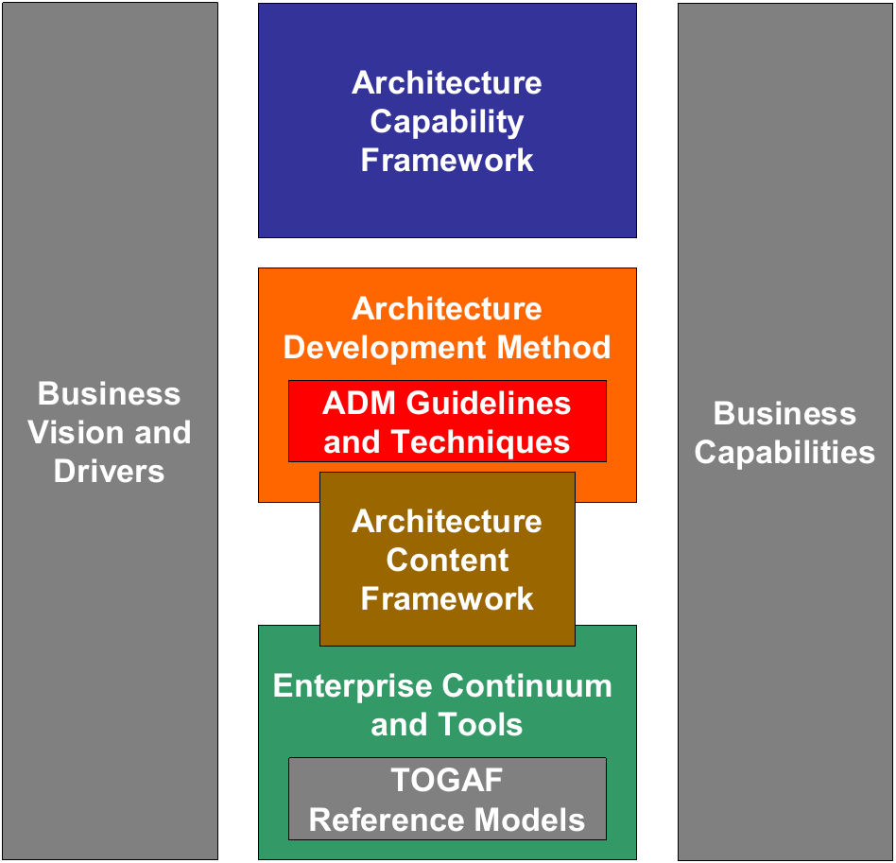
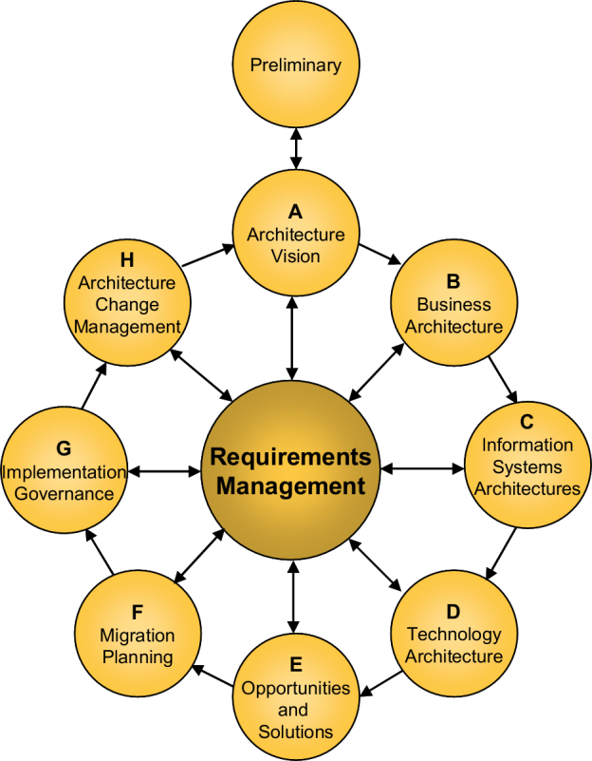
AGT Enterprise Architecture framework
The Open Group Architecture Framework (TOGAF)
Is an enterprise architecture framework and an accompanying architecture development method
Notes:
An Architecture Capability Framework, which addresses the organization, processes, skills, roles and responsibilities required to establish and operate an architecture function within an enterprise.
– The Architecture Development Method (ADM), which provides a ‘way of working’ for architects. The ADM is considered to be the core of TOGAF, and consists of a stepwise cyclic approach for the development of the overall enterprise architecture.
– The Architecture Content Framework, which considers an overall enterprise architecture as composed of four closely interrelated architectures: Business Architecture, Data Architecture, Application Architecture, and Technology (IT) Architecture.
– The Enterprise Continuum, which comprises various reference models,
such as the Technical Reference Model, The Open Group's Standards
Information Base (SIB), and The Building Blocks Information Base
(BBIB). The idea behind the Enterprise Continuum is to illustrate how
architectures are developed across a continuum ranging from foundational architectures, through common systems architectures and indus-try-specific architectures, to an enterprise’s own individual architecture.

Slide 21
Architecture domains
Business architecture
Defines the business strategy, governance, organization, and key business processes
Data architecture
Describes the structure of an organization's logical and physical data assets and data management resources
Application architecture
Provides a blueprint for the individual applications to be deployed, their interactions, and their relationships to the core business processes of the organization

Slide 22
Architecture domains
Technology architecture
Describes the logical software and hardware capabilities that are required to support the deployment of business, data, and application services.
Includes IT infrastructure elements
Middleware
Networks
Communications
Processing
Standards
…

Slide 23
Architecture development techniques
Architecture principles
Principles for the use and deployment of IT resources across the enterprise
Stakeholder management
A discipline that successful architecture practitioners can use to win support for their projects
Architecture patterns
Provides guidance on using architectural patterns
Business scenarios
A method for deriving business requirements for architecture and the implied technical requirements
Gap analysis

Slide 24
Architecture development techniques continues …
Migration planning techniques
Interoperability requirements
Business transformation readiness assessment
A technique for identifying business transformation issues
Risk management
A technique for managing risk during an architecture and/or business transformation project
Capability-based planning

Slide 25
Architecture governance
Architecture governance
The practice and orientation by which enterprise architectures and other architectures are managed and controlled at an enterprise-wide level
Operational context for architecture governance
Architecture governance takes place within a hierarchy of governance structures which can include all of the following domains
Corporate governance
Technology governance
IT governance
Architecture governance

Slide 26
Benefits of architecture governance
Quality
Ensures that architecture work is conducted properly
Efficiency
Provides guidance on architecture work practice
Effectiveness
Facilitates effective and equitable usage of resources to ensure sustainability of an organization's strategic objectives

Slide 27
Elements of architecture governance
Systems
A system of controls over the creation and monitoring of all architectural components and activities
A system to ensure compliance with internal and external standards and regulatory obligations
Processes
Establishing processes that support effective management of the above systems within agreed parameters
Practices
Introducing practices that ensure accountability to a clearly identified stakeholder community, both inside and outside the organization

Slide 28
Properties of architecture governance
Discipline
All involved parties will have a commitment to adhere to procedures, processes, and authority structures established by the organization
Transparency
All actions implemented and their decision support will be available for inspection by authorized organization and provider parties
Independence
All processes, decision-making, and mechanisms used will be established so as to minimize or avoid potential conflicts of interest

Slide 29
Properties of architecture governance
Accountability
Identifiable groups within the organization are authorized and accountable for their actions
Responsibility
Each contracted party is required to act responsibly to the organization and its stakeholders
Fairness
All decisions taken, processes used, and their implementation will not be allowed to create unfair advantage to any one particular party

Slide 30
Instruments of architecture governance
Architecture board
Oversees the implementation of the governance strategy
Is representative of all the key stakeholders in the architecture
Will typically comprise a group of executives responsible for the review and maintenance of the overall architecture
Architecture governance framework
Provides assistance assist in identifying effective processes and organizational structures
Enables that business responsibilities associated with architecture governance can be elucidated, communicated, and managed effectively

Slide 31
The architecture board
Areas of responsibility
Providing the basis for all decision-making with regard to the architectures
Consistency between architectures
Establishing targets for reuse of components
Flexibility of enterprise architecture
To meet changing business needs
To leverage new technologies
Enforcement of architecture compliance
Improving the maturity level of architecture discipline within the organization
Ensuring that the discipline of architecture-based development is adopted
Supporting a visible escalation capability for out-of-bounds decisions

Slide 32
Governance aspects of the architecture board
Areas of responsibility
The production of usable governance material and activities
Providing a mechanism for the formal acceptance and approval of architecture through consensus and authorized publication
Providing a fundamental control mechanism for ensuring the effective implementation of the architecture
Establishing and maintaining the link between the implementation of the architecture, the architectural strategy and objectives embodied in the enterprise architecture, and the strategic objectives of the business
Identifying divergence from the architecture and planning activities for realignment through dispensations or policy updates

Slide 33
Practical aspects of architecture governance
Policy management and take-on
Ensures the orderly integration with existing governance content such that all relevant parties, documents, contracts, and supporting information are managed and audited
Compliance
Compliance assessments against
Service Level Agreements (SLAs)
Operational Level Agreements (OLAs)
Standards
Regulatory requirements

Slide 34
Practical aspects of architecture governance
Dispensation
A compliance assessment can be rejected where the subject area (design, operational, service level, or technology) are not compliant, leading to the following options for the subject area:
Be adjusted or realigned in order to meet the compliance requirements
Request a dispensation
Dispensations are not granted indefinitely
They are used as a mechanism to ensure that service levels and operational levels are met while providing a level of flexibility in their implementation and timing

Slide 35
Concepts of architecture governance
Monitoring and reporting
Monitoring against Service Level Agreements (SLAs) and Operational Level Agreements (OLAs)
Feedback for adjustment and reporting
Business control
Includes processes invoked to ensure compliance with the organization's business policies
Environment management
Identifies all the services required to ensure that the repository-based environment underpinning the governance framework is effective and efficient

Slide 36
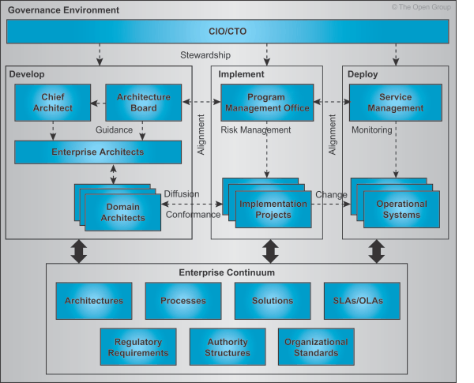
Organizational aspects of architecture governance

Slide 37
Quality impacts of architecture governance
Consistency
Links IT processes, resources, and information to organizational strategies and objectives
Efficiency
Integrates and institutionalizes IT best practices
Interoperability
Aligns with industry frameworks such as COBIT (planning and organizing, acquiring and implementing, delivering and supporting, and monitoring IT performance)
Effectiveness
Enables the organization to take full advantage of its information, infrastructure, and hardware and software assets

Slide 38
Quality impacts of architecture governance continue …
Integrity
Protects the underlying digital assets of the organization
Standardization
Supports regulatory and best practice requirements such as auditability, security, responsibility, and accountability
Stability
Promotes visible risk management

Slide 39
Success factors of architecture governance
Best practices
For the submission, adoption, re-use, reporting, and retirement of architecture policies, procedures, roles, skills, organizational structures, and support services
Organization structures
Organizational responsibilities and structures to support the architecture governance processes and reporting requirements
Supporting instruments
Integration of tools and processes to facilitate the take-up of the processes, both procedurally and culturally

Slide 40
Success factors of architecture governance continue …
Transparency
Criteria for the control of the architecture governance processes, dispensations, compliance assessments, SLAs, and OLAs
Cohesiveness
Internal and external requirements for the effectiveness, efficiency, confidentiality, integrity, availability, compliance, and reliability of all architecture governance-related information, services, and processes

Slide 41
Software System Architecture
What, Why & How?

Slide 42
What is Software System Architecture – What?
“The software system architecture of a program or computing system is the structure or structures of the system, which comprise the software elements, the externally visible properties of those elements, and the relationships among them.”
- Bass, L.; Clements, P. & Kazman, R. Software Architecture in Practice, Second Edition. Boston, MA: Addison-Wesley, 2003).
Architecture provides a vehicle for communication among stakeholders
Every system has an architecture. Every system is composed of elements, and there are relationships among them.
Just having an architecture is different from having an architecture that is known to everyone
Notes:
Software engineering vs other engineering
Computer engineering but not science
Difference between a mechanical engineer vs physicist

Slide 43
Architecture – Why?
Is this a good design?

Slide 44
Architecture – Why?
Is this a good design?

Slide 45
Architecture – Why?
Is this a good design?
Maintainability
Reusability
Availability
Security
Testability
Modifiability
Usability
…….
Better Design

Slide 46
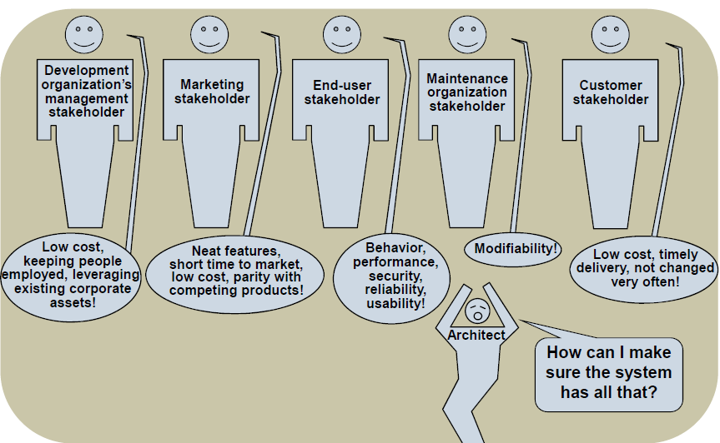
Factor Influencing Architecture
Architectures are influenced by –
system stakeholders
customers
users
developers
project managers
marketers
maintainers
the development organization
Cost , time to market, targeted markets, available expertise, plans for long-term infrastructure
organizational structure, support for existing products, projected lifetime of the system
rollout schedule, investment in existing assets, existing architectures, use of legacy systems
the technical environment
the architect’s background and experience
Notes:
Update at the end

Slide 47
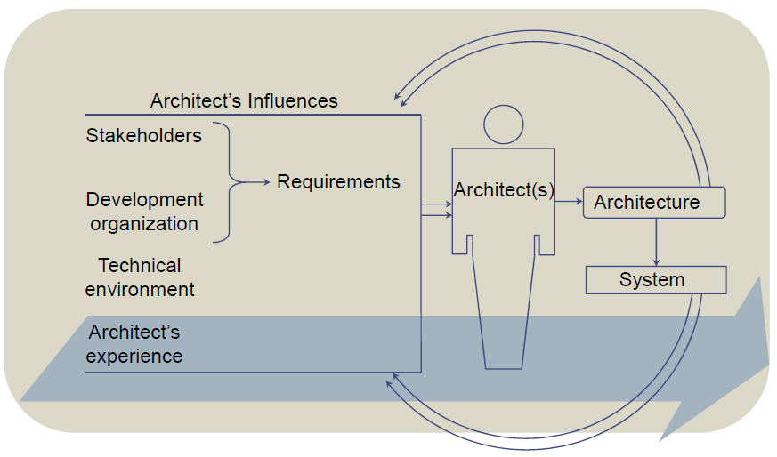
Architecture Business Cycle
Influence on Architecture and it’s Influence back

Slide 48
AGT Architecture
Technical
Process
System & Software Design
Work assignment, Estimation, Project Tracking

Slide 49

Technical Design

Slide 50
Terminology
An architectural pattern is a description of element and relationship types and a set of constraints on how they
are used.
Patterns define families of architectures such as client-server, pipe-and-filter, and so forth.
Patterns exhibit known quality attribute properties.
The selection of an architectural pattern is often the architect’s first major design choice.
The term architectural style has also been widely used to describe architectural patterns.
A reference model is a division of functionality into elements and the data flow between them.
Reference models include databases and compilers, among other things.
Data flow and connectivity between these pieces are well established.
A reference architecture is a reference model that is mapped onto the software elements that implement the
functionality defined in the model.
Mapping does not have to be one to one.
Software elements might implement one function, parts of a single function, or many functions.
Templates, standards, and tools speed up development and help
implementers adhere to the constraints prescribed by the reference architecture.
Reference Model
Reference Architecture
Software System Architecture
Architectural Pattern

Slide 51
AGT Software System Architecture Life-Cycle
Functional Requirement
Preparing Use Cases
Finding Quality Attributes
Business Drivers
Creating Quality
Attribute Scenarios
Design Patterns
Architectural
Analysis & Design
Design Tactics
Architectural Prototyping
Creating Architecture Document
Information Flow
Inputs
Architectural Evaluation
Enterprise/System/Software Architecture
*** AGT Software System Architecture Life-Cycle is customized based on Zachman, TOGAF and Other architectural Frameworks

Slide 52
AGT Software System Architecture Life-Cycle
Functional Requirement
Preparing Use Cases
Finding Quality Attributes
Business Drivers
Creating Quality
Attribute Scenarios
Design Patterns
Architectural
Analysis & Design
Design Tactics
Architectural Design
Architectural Prototyping
Creating Architecture Document
Information Flow
Inputs
Architectural Evaluation
Enterprise/System/Software Architecture

Slide 53
Motivation
“For Beginners there are many options but for Master there are few”
“All happy families look similar but the unhappy families are unique”

Slide 54
Motivation - 1
Simple and effective analysis and design technique
Mechanizes design decisions
Focuses on the required run-time behavior
Reducing the design time
The architecture comprising 40-60 diagrams
Design validation
Vertical slice implementation and demonstration
Stress testing
Removing design and technology as Risk
Time crunch essential for prioritizing, focusing and avoiding design gold-plating
Eliminating analysis-paralysis
Notes:
Parkinson Law: The work will always expand to fit to the given timeframe.

Slide 55
Motivation - 2
Sharing and capturing across the team
Thought process
Tradeoffs and insights
Use cases analysis
Operational assumptions
Design decisions
Design and Architecture survival
Communicate between architects
“Better Wrong than Vague”

Slide 56
Motivation - 3
No method is silver bullet
Does not take away
Creativity
Responsibility to get the use cases right
Liability for getting it wrong
It provides
Good staring point
Mechanical approach to design
“Can’t take away the act of design”

Slide 57
Motivation - Fundamental Problem
“Flow-chart” or “Functional” Decomposition
Basing services on order of logical steps in use cases
Functional and time decomposition
Leads duplicating behaviors across services in increased numbers
Explosion of services
Intricate relationships
Couples multiple services to data contract
Promotes implementing use cases in highest level terms thus difficult to reuse same behavior in another use case
Couples services to order and current use case
Functional decomposition makes service too big or small
Consider performing anti-design activity
Think about building a house functionally
“The goal is to minimize the impact of the change”

Slide 58
AGT Architectural Design Method – 1A
How -
Decompose based on volatility
Identify areas of potential change
Can be functional but not domain functional
Encapsulate in services
Milestones based on integration not features
Implement behavior as interaction between volatile services or sub systems
Volatility is often not-self evident
Takes longer than functional
Notes:
Ask questions
Will we use the same system for 2 customers …. No
Will we use the same system for the same customer over time … no
Encapsulate the area of volatility in a service
Functionality comes as an aggregate when you put together 2 pieces through integration
No-body will tell you what will change in future

Slide 59
AGT Architectural Design Method – 1B
The method provides template for common areas to encapsulate
A good starting point
Encapsulate classic volatile areas
Layers encapsulate top-down
Services inside layers encapsulate sideways

Slide 60
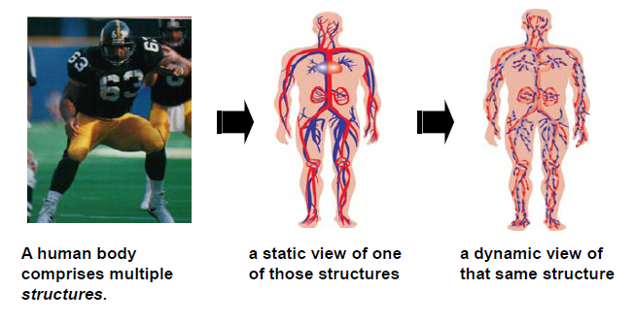
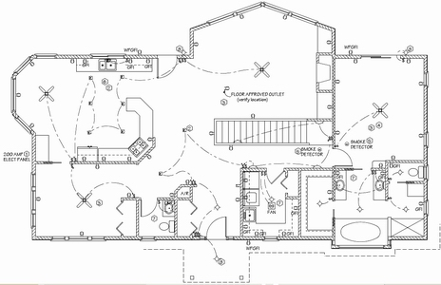
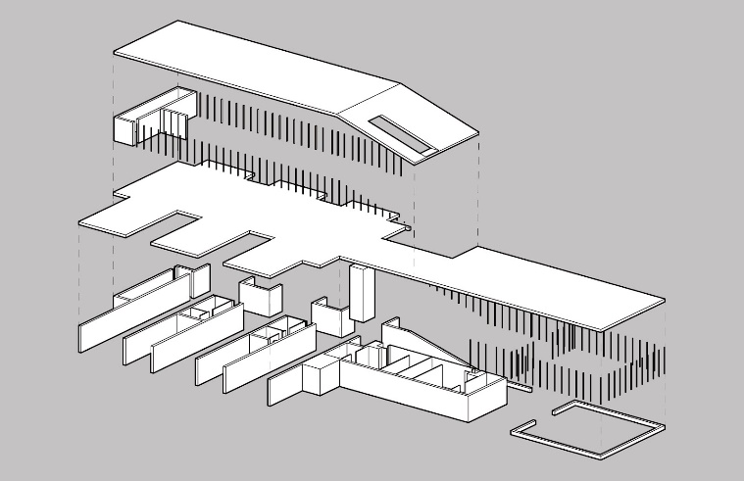
Architectural Structure
a Structural View of Building
a Electrical system view of Building
Any architecture has many structures. So it is with Software Systems…

Slide 61
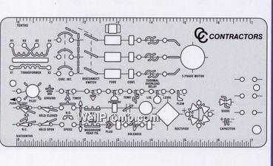
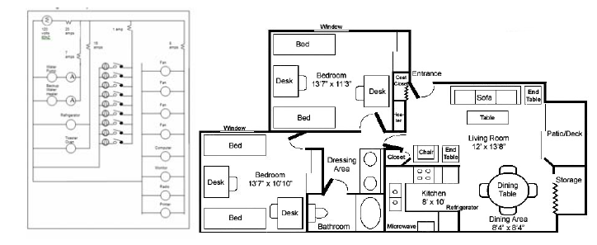
View and View Point
View
A view is a representation of a system from the perspective of a related set of concerns. A view is what you see (or what a stakeholder sees).
Viewpoint
A viewpoint defines the perspective from which a view is taken. It defines how to construct and use a view (templates).

Slide 62
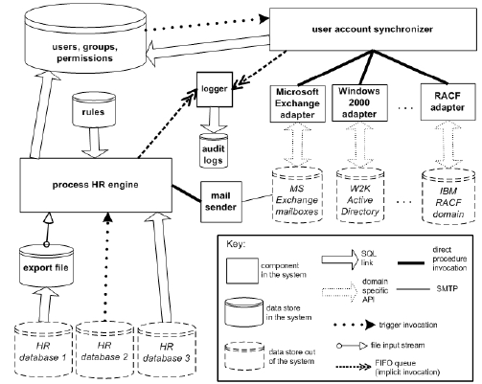
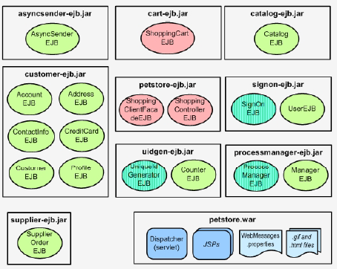
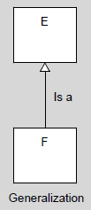

Architectural Views
Module View: consisting of elements that are units of implementation called modules and the relationships among them.
E.g. Uses View, Layered View, etc.
Component-and-Connector View: consisting of runtime components (units of computation) and the connectors (communication paths) between them.
E.g. 3-Tiers, Sequence Diagram, etc.
Allocation Views: consisting of software elements and their
relationships to elements in external environments in which the software is created and executed.
E.g. Deployment view, Implementation View, etc.

Slide 63
AGT Architectural Design Method – 2A
Method Notations -
Conventional common-place methodologies and tools -
UML
VSTS
VS-Architect
Focuses heavily on object relations and class hierarchy
UML is too verbose
Notes:
Half of the box in brain is visual cortex. We are good in doing things graphically.
The brain converts the graphics into text like OCR …
UML -> Multiple ways to representing the same thing or multiple ways to interpreting the same thing

Slide 64
AGT Architectural Design Method – 2B
UML has no way or very hard way for graphically capturing
Service boundaries
Endpoint & callbacks
Assembly allocation
Hosts and processes
Transaction boundaries
Identities
Authentication and authorization boundaries
Logical threads of execution and synchronization
Various context map
Notes:
UML notation for transaction?
How identities flows?
How about deadlock situation?

Slide 65
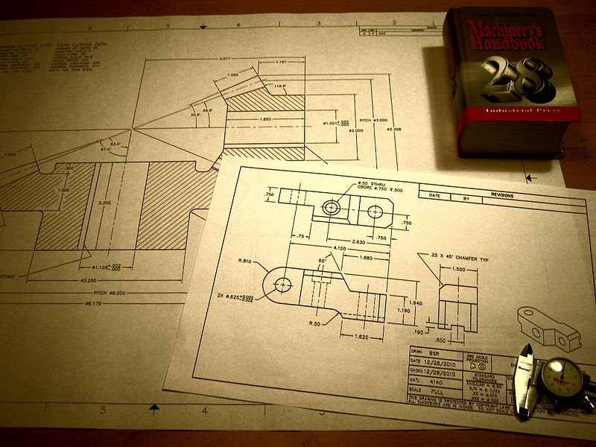
AGT Architectural Design Method - 2
Method Notations -
The Method relies on simple diagrams
Aspect or boundary is marked out
Simplest symbols such as a box or a bar or Lines
No explosion of notations
Semantic of box or bar differs by context
Notes:
No other engineering field has explosion of notation
Blueprint of a house – blue line means -> power-line, water-line, heating/cooling duct, may be wall but the it may be a power diagram and then some simple other element like valve …
Not a single diagram captures all design decisions … for a house such diagram would be a solid black box … Sewer diagram, water diagram, ….

Slide 66
Layered Approach
Systems are typically designed in layers
Even simple systems
Layers layer encapsulation
Cross layer call to service promote and enable
Consistency
Scalability
Fault Isolation
Security
Separation of presentation from logic
Availability
Throughput
Responsiveness
Synchronization
WCF Service Infrastructure
Notes:
Consistency ->Propagates the transaction across service calls
Security –> Object pass by reference
Ava -> Using Queuing
Scalability -> Creating instance of each services

Slide 67
Typical Layers - 2
Client A
Client B
Client A
Client
Client C
Client D
Utilities
Security
Manager A
Manager B
Manager C
Manager D
Admin
Client
Engine A
Engine B
Engine C
Engine D
Logging
Business Logic
. . .
Resource
Access
Pub/Sub
Resource Access A
Resource Access B
Resource Access C
Reports
Support
Resource
Resource 1
Resource 2
Notes:
Client
AKA Presentation
Can be a user or another system
Can be variety of client application technologies
Business
Managers encapsulate sequence in use cases and workflows
Each manager is collection of related use cases
Engines encapsulates business rules
Manager may use zero or more engines
Engines may be shared between managers
Resource access (no CRUD … Insert, Update …. Use Credit, Debit ….) -> Not a database
Encapsulate resource access
May call resource stored in other services
Can be shared across engines and managers
Resources
Physical resources
Utilities
Common infrastructure to all services

Slide 68
Typical Layers - 3
A cohesive interaction between the manager, engines and resource access may constitute logical service to the world
Implementing a set of use cases
Target of the vertical slice
How you extend the system
Notes:
How to implement the functionality

Slide 69
Typical Layer - 4
Client A
Client B
Client A
Client
Client C
Client D
Utilities
Security
Manager A
Manager B
Manager C
Manager D
Admin
Client
Engine A
Engine B
Engine C
Engine D
Logging
Business Logic
Use Cases
. . .
Resource
Access
Pub/Sub
Resource Access A
Resource Access B
Resource Access C
Reports
Support
Resource
Resource 1
Resource 2
Notes:
A cohesive interaction between the manager, engines and resource access may constitute logical service to the world
Implementing a set of use cases
Target of the vertical slice
How you extend the system
In between layers should pass only
Primitives
Arrays of primitives
Data contracts
Arrays of data contracts
Logic behind data contracts should not cross layers
'Entities' could break encapsulation
Behavior should be encapsulated not spread and shared

Slide 70
Typical Layer – 4: Grouped by Use-case scenario
Client
Client A
Client B
Client C
Client D
Host
Security
Service A Manager
Service B Manager
Service C Manager
Service D Manager
Admin
Client
Service A Engine
Service B Engine
Service C Engine
Service D Engine
Business Logic
Logging
. . .
Resource Access
Pub/Sub
Service A Res Access
Service B Res Access
Service C Res Access
Service D Res Access
Reports
Resources
Resource 1
Resource 2
Support
Notes:
A cohesive interaction between the manager, engines and resource access may constitute logical service to the world
Implementing a set of use cases
Target of the vertical slice
How you extend the system
In between layers should pass only
Primitives
Arrays of primitives
Data contracts
Arrays of data contracts
Logic behind data contracts should not cross layers
'Entities' could break encapsulation
Behavior should be encapsulated not spread and shared
Strive to have the minimal set of interacting services that satisfy use cases
Present and future use cases
Known and unknown use cases
Iterative factoring process
May affect use case as well
When all conceivable use cases are satisfied architecture is validated
Start with top distinct 4-6 use cases
No need for all use cases
Change to use case means change to work flow
Manger implementation
Not underlying services
Bulk of effort in system goes into
Engines
Resource access
Resource
Clients and UI
Utilities and infrastructure
Reuse effort across use cases
And their inherit volatility

Slide 71
Typical Layers - 5
A cohesive interaction between the manager, engines and resource access may constitute logical service to the world
Implementing a set of use cases
Target of the vertical slice
How you extend the system
In between layers should pass only
Primitives
Arrays of primitives
Data contracts
Arrays of data contracts
Logic behind data contracts should not cross layers
'Entities' could break encapsulation
Behavior should be encapsulated not spread and shared
Notes:
How to implement the functionality
To identify the core set of services

Slide 72
Typical Layers - 6
Strive to have the minimal set of interacting services that satisfy use cases
Present and future use cases
Known and unknown use cases
Iterative factoring process
May affect use case as well
When all conceivable use cases are satisfied architecture is validated
Start with top distinct 4-6 use cases
No need for all use cases
Notes:
Your best architecture not the best in the world …
Spending 2 months to reduce 2 weeks of development effort
Every design has a point of diminishing return.

Slide 73
Typical Layers - 7
Change to use case means change to work flow
Manger implementation
Not underlying services
Bulk of effort in system goes into
Engines
Resource access
Resource
Clients and UI
Utilities and infrastructure
Reuse effort across use cases
And their inherit volatility
Notes:
The change is now contained inside manager or engine
The bulk of the effort is in the other places not the manager

Slide 74
Open and Closed Architecture - 1
Open architecture
Can call anybody else
Up, down, sideways
Most flexible
Least encapsulated
Little point in layers
Potential for coupling
Closed architecture
Can call only into layer immediately underneath
Cannot call sideways to others
Coupled use cases
Least flexible
Most encapsulated
Promotes loose-coupling

Slide 75
Open and Closed Architecture - 2
Semi closed/semi open
Can call any layer underneath but not up or sideways
Trades encapsulation for flexibility and performance
Use only in infrastructure or rarely maintained code
Always strive for closed architecture
Notes:
What will not change -> TCP stack change, WS standard

Slide 76
Open and Closed Architecture - 3
Should reduce complexity and overhead in closed systems
Can always call utilities anywhere
Can queue up calls sideways
Need to 'open up' a system typically indicates need for
Pub/sub system
Queuing
Does not actually violate design
Managers can call engines and resource access
Not all steps in use case are volatile
Engines and resource access are "thin" layer compared with resource or presentation
Notes:
Stop abusing utility -> Litmus test -> when it should be a utility …
When this happened .. I need to call the client … How about the other client or manager … is it a callback or an event …
Manager and Engine are in the same plane and at the same layer

Slide 77
Open and Closed Architecture - 4
Sharing engines and resource access across managers is permitted
Engines are at orthogonal axis to managers at different plane
Strategy pattern
Clients should not call multiple managers in single use case
Managers are coupled
Functional decomposition
Other points
Never queue calls to engines
Do not queue calls to resource access
Engines do not publish events
Resource access do not publish events
Engines do not subscribe to events
Engines never call each other
Resource access never call each other
Notes:
Queue calls to engine -> Calculate tax and do nothing ….

Slide 78
Calls Notations
Should use interaction diagrams
Too time consuming and subverts 'crunch'
Focus on architecture not detailed design
Superimpose use cases on services
Black arrow for synchronous calls
Gray dashed arrow for queued call

Slide 79
2. Endpoint and Callback Views
Client A
Service A Manager
Service B Manager
Direct Call
Service A Engine
Queued Call
Pub/Sub
Service A Res Access
Resource 1
Notes:
Should do it for a small minimalistic set of services

Slide 80
The Method
Once you finish the decomposition and identify the core set of services, the rest of the process is mechanized

Slide 81
AGT Architectural Design Method - 3
Minimalistic set of Views for every System -
Services
Endpoints and callbacks
Assembly allocation
Hosts and processes
Transaction boundaries
Identities
Authentication and authorization boundaries
Logical threads of execution and synchronization
Various context maps

Slide 82
3. Assembly Allocation View
Capture allocation of clients, services and utilities into assemblies
In general
Client applications reside in application assemblies
Everything else in class libraries
When not hosting in the WAS/AppFabric add host application assemblies
Developers should not share assemblies
May or may not lead to 1:1 services to assemblies
Provide early to build master
Developers hit the ground running

Slide 83
3. Assembly Allocation View
Client A Application Assembly (EXE)
Client B Application Assembly (EXE)
Client C Application Assembly (EXE)
Client D ASP.NET Assembly (DLL)
Admin Client Application Assembly (EXE)
Service A Manager Library Assembly (DLL)
Service B Manager Library Assembly (DLL)
Service C Manager Library Assembly (DLL)
Service D Manager Library Assembly (DLL)
Custom Security Library Assembly (DLL)
Service A Engine Library Assembly (DLL)
Service B Engine Library Assembly (DLL)
Service C Engine Library Assembly (DLL)
Service D Engine Library Assembly (DLL)
Logbook Viewer Application Assembly (EXE)
Service A Res Access Library Assembly (DLL)
Service B Res Access Library Assembly (DLL)
Service C Res Access Library Assembly (DLL)
Service D Res Access Library Assembly (DLL)
Logbook Library Assembly (DLL)
Host Application Assembly (EXE)
Pub/Sub Library Assembly (DLL)
Reports Application Assembly (EXE)
Notes:
Capture allocation of clients, services and utilities into assemblies
In general
Client applications reside in application assemblies
Everything else in class libraries
When not hosting in the WAS/AppFabric add host application assemblies
Developers should not share assemblies
May or may not lead to 1:1 services to assemblies
Provide early to build master
Developers hit the ground running

Slide 84
4a. Service Allocation View
Mark services in a box
In general, these are always services
Managers
Engines
Resource access
Logbook
Optional services
Clients
Every other class

Slide 85
4a. Service Allocation View
Client C
Service A Manager
Service B Manager
Service C Manager
Service D
Manager
Service A Engine
Service B Engine
Service C
Engine
Service D
Engine
Logbook
Pub/Sub
Service A Res Access
Service B Res Access
Service C Res Access
Service D Res Access
Notes:
Mark services in a box
In general, these are always services
Managers
Engines
Resource access
Logbook
Optional services
Clients
Every other class

Slide 86
4b. Run-Time Processes Allocation View
Allocation of services to run-time processes
Who hosts whom
Base on need for
Fault isolation
Security isolation
Identities
Authentication
Authorization
Time-line isolation
Administration and Operations isolation

Slide 87
4b. Run-Time Processes Allocation View
Typically
Layer boundary is process boundary
Managers do not share process
Engines and resource access are in-proc to managers
No meaning on their own
May be loaded into multiple manager processes
Group all assemblies that share process and enclose in a box
Show WAS/AppFabric processes as well

Slide 88
4b. Run-Time Processes Allocation View
Client A Application Assembly (EXE)
Client B Application Assembly (EXE)
Client C Application Assembly (EXE)
WS Portal ASP.NET Assembly (DLL)
Logbook Viewer Application Assembly (EXE)
Host Application Assembly (EXE)
Host Application Assembly (EXE)
Host Application Assembly (EXE)
Service D Manager Library Assembly (DLL)
Logbook Library Assembly (DLL)
Service A Manager Library Assembly (DLL)
Service B Manager Library Assembly (DLL)
Service C Manager Library Assembly (DLL)
Service D Engine Library Assembly (DLL)
Service A Engine Library Assembly (DLL)
Service B Engine Library Assembly (DLL)
Service B Engine Library Assembly (DLL)
Service A Res Access Library Assembly (DLL)
Service A Res Access Library Assembly (DLL)
Service B Res Access Library Assembly (DLL)
Service C Res Access Library Assembly (DLL)
Logbook Library Assembly (DLL)
Logbook Library Assembly (DLL)
Logbook Library Assembly (DLL)
Logbook Library Assembly (DLL)
Notes:
Allocation of services to run-time processes
Who hosts whom
Base on need for
Fault isolation
Security isolation
Identities
Authentication
Authorization
Time-line isolation
Administration and Operations isolation
Typically
Layer boundary is process boundary
Managers do not share process
Engines and resource access are in-proc to managers
No meaning on their own
May be loaded into multiple manager processes
Group all assemblies that share process and enclose in a box
Show WAS/AppFabric processes as well

Slide 89
5. Transaction View
Guidelines
Start transactions as up-stream as possible
Engulf as much as possible
Keep transactions short
Under 1 second
Group all services and resources in same transaction with a box
Typically
Managers are Client/Service mode
Engines, resources access are Client mode
Utilities are Service mode
Notes:
Either adapt the client mode or start a new one as service

Slide 90
5. Transaction View
Client A
Client B
Client C
Client D
Host
Security
Service A Manager
Service B Manager
Service C Manager
Service D Manager
Admin
Client
Service A Engine
Service B Engine
Service C Engine
Service D Engine
Logging
. . .
Pub/Sub
Service A Res Access
Service B Res Access
Service C Res Access
Service D Res Access
Reports
Resource 1
Resource 2
Support
Notes:
Guidelines
Start transactions as up-stream as possible
Engulf as much as possible
Keep transactions short
Under 1 second
Group all services and resources in same transaction with a box
Typically
Managers are Client/Service mode
Engines, resources access are Client mode
Utilities are Service mode

Slide 91
6. Identity Management
Process boundary enables identity boundary
Not mandates it
Assign identities based on credentials required to operate
Typically
Clients and manager do not share identity
The further from the client the less relevant its identity is
Managers from different processes may share identities
Strive to minimize overall number of identities
Use designated identities
Group all services that share identity and enclose in a box
Notes:
Strive to minimize the number of identities because it is pain to maintain multiple identities

Slide 92
6. Identity Management
Client A
Client B
Client C
Client D
Host
Security
Service A Manager
Service B Manager
Service C Manager
Service D Manager
Admin
Client
Service A Engine
Service B Engine
Service C Engine
Service D Engine
Logging
. . .
Pub/Sub
Service A Res Access
Service B Res Access
Service C Res Access
Service D Res Access
Reports
Resource 1
Resource 2
Support
Notes:
Process boundary enables identity boundary
Not mandates it
Assign identities based on credentials required to operate
Typically
Clients and manager do not share identity
The further from the client the less relevant its identity is
Managers from different processes may share identities
Strive to minimize overall number of identities
Use designated identities
Group all services that share identity and enclose in a box

Slide 93
7a. Call Authentication View
Prefer trusted sub-system pattern
Works well in a multi-tier design
Every layer
Authenticates its immediate caller
Implicitly trusts its caller to authenticate its callers
Authorizes its callers via role-based security
Identities are not fully propagated downwards
Can construct audit trail by
Composing local audits
Propagate full stack trace

Slide 94
7a. Call Authentication View
Typically
Every logical layer crossing is authenticated
Every cross-process call is authenticated
Do authenticate in-proc services
For message protection with Windows credentials
Mark authentication boundary with a solid bar
Notes:
Protect the in-Proc IPC Pipe to avoid classic attack to your service using USB stick ….
The method doesn’t say how to authenticate

Slide 95
7a. Call Authentication View
Client A
Client B
Client C
Client D
Host
Security
Service A Manager
Service B Manager
Service C Manager
Service D Manager
Admin
Client
Service A Engine
Service B Engine
Service C Engine
Service D Engine
Logging
. . .
Pub/Sub
Service A Res Access
Service B Res Access
Service C Res Access
Service D Res Access
Reports
Resource 1
Resource 2
Support
Notes:
Prefer trusted sub-system pattern
Works well in a multi-tier design
Every layer
Authenticates its immediate caller
Implicitly trusts its caller to authenticate its callers
Authorizes its callers via role-based security
Identities are not fully propagated downwards
Can construct audit trail by
Composing local audits
Propagate full stack trace
Typically
Every logical layer crossing is authenticated
Every cross-process call is authenticated
Do authenticate in-proc services
For message protection with Windows creds
Mark authentication boundary with a solid bar

Slide 96
7b. Call Authorization View
Authorization meaningless without authentication
Typically
Every logical layer crossing is authorized
Every cross process call is authorized
No point in authorizing calls to in-proc services
Shared identity
Authorization does not necessarily coincide with authentication
Mark authorization boundary with patterned bar
Notes:
Business normally talks about authorization but not authentication – what operators do …
AZ-Man, Active Dir, ….

Slide 97
7b. Call Authorization View
Client A
Client B
Client C
Client D
Host
Security
Service A Manager
Service B Manager
Service C Manager
Service D Manager
Admin
Client
Service A Engine
Service B Engine
Service C Engine
Service D Engine
Logging
. . .
Pub/Sub
Service A Res Access
Service B Res Access
Service C Res Access
Service D Res Access
Reports
Resource 1
Resource 2
Support
Notes:
Authorization meaningless without authentication
Typically
Every logical layer crossing is authorized
Every cross process call is authorized
No point in authorizing calls to in-proc services
Shared identity
Authorization does not necessarily coincide with authentication
Mark authorization boundary with patterned bar

Slide 98
8. Synchronization View
Identify logical thread of execution
Any reentrant cyclic path implies
Deadlock
Poor design and reentrancy
Need for queuing
Need for async event publishing

Slide 99
8. Synchronization View
Client A
Client B
Client C
Client D
Host
Security
Service A Manager
Service B Manager
Service C Manager
Service D Manager
Admin
Client
Service A Engine
Service B Engine
Service C Engine
Service D Engine
Logging
. . .
Pub/Sub
Service A Res Access
Service B Res Access
Service C Res Access
Service D Res Access
Reports
Resource 1
Resource 2
Support
Notes:
Identify logical thread of execution
Any reentrant cyclic path implies
Deadlock
Poor design and reentrancy
Need for queuing
Need for async event publishing

Slide 100
Designing with Patterns & Tactics
A pattern describes a particular recurring design problem that arises in specific design contexts, and presents a well-proven solution for the problem. The solution is specified by describing the roles of its constituent participants, their responsibilities and relationships, and the ways in which they collaborate.
The software architecture for a system is a collection of design decisions.
Some decisions are made to ensure we achieve the system’s functional requirements.
Other decisions are made to ensure we achieve the system’s quality attribute requirements.
These decisions are called tactics.
Tactics are influential in controlling quality attribute responses.
Stimulus
Tactics to Control Response
Response

Slide 101
Architectural Design and Analysis
This is an approach to defining a software architecture that bases the decomposition process on the quality
attributes the software must fulfill. It follows a recursive decomposition process where, at each stage in
the decomposition, tactics and patterns are chosen to satisfy a set of quality attribute scenarios.
Inputs include these architecturally significant requirements –
quality attribute requirements
design constraints
functional requirements
Outputs include –
first several levels of module decomposition
various other views of the system as appropriate
set of elements with assigned functionalities and the interactions among the elements
Steps –
 | 1. Confirm there is sufficient requirements information.
 | 2. Choose an element of the system to decompose.
 | 3. Identify candidate architectural drivers.
 | 4. Choose a design concept (patterns and tactics) that satisfies the architectural drivers.
 | 5. Instantiate architectural elements and allocate responsibilities
 | 6. Define interfaces for the instantiated elements
 | 7. Verify and refine requirements and make them constraints for instantiated elements.
 | 8. Repeat these steps for the next element.
Part-1
Part-2

Slide 102

AGT Software System Architecture Life-Cycle
Functional Requirement
Preparing Use Cases
Finding Quality Attributes
Business Drivers
Creating Quality
Attribute Scenarios
Design Patterns
Architectural
Analysis & Design
Design Tactics
Architectural Design
Architectural Prototyping
Creating Architecture Document
Information Flow
Inputs
Architectural Evaluation
Enterprise/System/Software Architecture

Slide 103
AGT Software System Architecture Life-Cycle
Functional Requirement
Preparing Use Cases
Finding Quality Attributes
Business Drivers
Quality Attribute
Creating Quality
Attribute Scenarios
Design Patterns
Architectural
Analysis & Design
Design Tactics
Architectural Prototyping
Creating Architecture Document
Information Flow
Inputs
Architectural Evaluation
Enterprise/System/Software Architecture

Slide 104
Quality Attribute - 1
The degree to which a software system meets its quality attribute requirements depends on its architecture.
Architectural decisions are made to promote various quality attributes.
A change in an architecture to promote one quality attribute often affects other quality attributes.
Architecture provides the foundation for achieving quality attributes but is useless if not adhered to in the implementation.
E.g.: Performance, Availability, Security, Modifiability, Reliability , Usability, Reusability, Configurability
Architecture is tradeoff between Quality Attributes

Slide 105
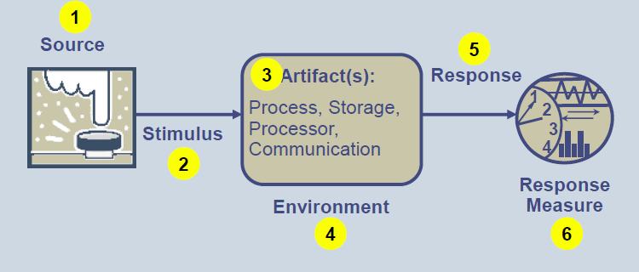
Quality Attribute - 2
A quality attribute scenario consists of six parts –
Source – an entity that generates a stimulus
2. Stimulus – a condition that affects the system
3. Artifact(s) – the part of the system that was stimulated by the stimulus
4. Environment – the condition under which the stimulus occurred
5. Response – the activity that results because of the stimulus
6. Response Measure – the measure by which the system’s response will be evaluated

Slide 106
Quality Attribute - 3
Steps -
Business/Mission Presentation
Architectural Plan Presentation
Identification of Architectural Drivers
Scenario Brainstorming
Scenario Consolidation
Scenario Prioritization
Scenario Refinement

Slide 107
Quality Attribute - Benefits
Potential Next Steps
Update Architectural Vision
Refine Requirements
Create Prototypes
Exercise Simulation
Create Architecture
Quality Attribute
Quality
Attribute
Scenario:
raw
prioritized
refined
can be
used to
Evaluate
Architecture
Potential Benefits
increased stakeholder communication
clarified quality attribute requirements
informed bases for architectural decisions

Slide 108
AGT Software System Architecture Life-Cycle
Functional Requirement
Preparing Use Cases
Finding Quality Attributes
Business Drivers
Quality Attribute
Creating Quality
Attribute Scenarios
Design Patterns
Architectural
Analysis & Design
Design Tactics
Architectural Prototyping
Creating Architecture Document
Information Flow
Inputs
Architectural Evaluation
Enterprise/System/Software Architecture

Slide 109
AGT Software System Architecture Life-Cycle
Functional Requirement
Preparing Use Cases
Finding Quality Attributes
Business Drivers
Creating Quality
Attribute Scenarios
Design Patterns
Architectural
Analysis & Design
Design Tactics
Architectural Prototyping
Creating Architecture Document
Documentation
Information Flow
Inputs
Architectural Evaluation
Enterprise/System/Software Architecture

Slide 110
AGT Architecture Documentation - 1
Why ?
Construction
Analysis
Education

Slide 111
AGT Architecture Documentation - 1
View Based Documentation
A view is a representation of a structure. We use views to manage complexity by separating concerns. Views give us our basic principle of architecture documentation. Documenting a software architecture is a matter of documenting the relevant views and then adding information that applies to more than one view.
Therefore, we have three kinds of views. Different kinds of views show different kinds of information –
Module views show how the system is structured as a set of code units
2. Component-and-connector views show how the system is structured as a set of elements with runtime behaviors and interactions.
3. Allocation views show how the system relates to non-software structures in its environment.
Every view contains information from at least one of these categories –
a view will show the elements that are in the structure and the relationships among them.
a view will also explain what the elements are, what their responsibilities are, and what their important properties are.
Properties are values used to describe the elements to help convey understanding and aid analysis. Properties are often quality-of-service values, such as an element’s performance or reliability characteristics.

Slide 112
AGT Architecture Documentation - 2
Other Information of the View-
View Based Documentation
Interfaces: Elements cannot interact each other at all except through their interfaces. Interfaces must be documented as part of
the architecture. Interfaces consist of syntax plus semantics – not just APIs!
Rationale: why the architect made the decisions he/she did can save critical time in the future, when the system is ready to
evolve and the original architect is long gone.
Variability in architectures, such as components that are plug-replaceable or optional.
Dynamic architectures – components and connectors that change at runtime
Context – the external environment and how it relates to our system.
Behavior –How do the elements behave when the system runs? Structure just shows connections; behavior shows how and when those connections “fire.”

Slide 113
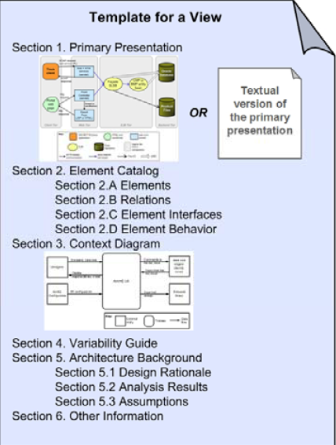
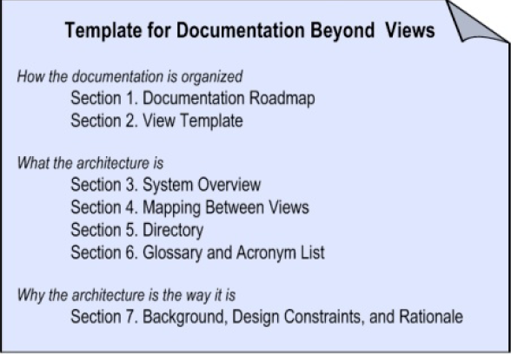
AGT Architecture Documentation - 3
Structural diagrams show all the potential interactions among
software elements.
Behavioral diagrams describe specific patterns of interaction –
the system’s response to stimuli.
Having template

Slide 114
AGT Software System Architecture Life-Cycle
Functional Requirement
Preparing Use Cases
Finding Quality Attributes
Business Drivers
Creating Quality
Attribute Scenarios
Design Patterns
Architectural
Analysis & Design
Design Tactics
Architectural Prototyping
Creating Architecture Document
Documentation
Information Flow
Inputs
Architectural Evaluation
Enterprise/System/Software Architecture

Slide 115
AGT Software System Architecture Life-Cycle
Functional Requirement
Preparing Use Cases
Finding Quality Attributes
Business Drivers
Creating Quality
Attribute Scenarios
Design Patterns
Architectural
Analysis & Design
Design Tactics
Architectural Prototyping
Creating Architecture Document
Information Flow
Inputs
Architectural Evaluation
Evaluation
Enterprise/System/Software Architecture

Slide 116
Evaluation - 1
Why -
An unsuitable architecture will precipitate disaster.
Architecture determines the structure of the project.
Repeatable, structured methods offer a low-cost risk mitigation capability that can be employed early
in the development life cycle.
Making sure an architecture is the right one simply makes good sense
“Since 1988, we’ve conducted more than 700 project reviews. Starting with AT&T, architecture reviews have grown across all
our companies. We estimate that projects of 100,000 non-commentary source lines of code have saved an average of
U.S. $1 million each by identifying and resolving problems early.”
Maranzano, J.F.; Rozsypal, S.A.; Zimmerman, G.H.; Warnken, G.W.; Wirth, P.E.; & Weiss, D.M.;
Architecture Reviews: Practice and Experience” Software, IEEE 22, 2 (2005): 34–43.

Slide 117
Evaluation - 2
When -
building a system
Architecture is the earliest artifact where tradeoffs are visible and where the most far-reaching
design decisions are made.
Evaluation should be done when deciding on an architecture.
The reality is that evaluation is often done during damage control, later in the project.
acquiring a system
Architecture evaluation is particularly useful if the system will have a long lifetime within an
organization.
Evaluation provides a mechanism for understanding how the system will evolve.
Evaluation provides early insight into system capabilities and quality attributes.
putting a system through major changes
Evaluation can provide insight into how well the architecture will support the

Slide 118
Evaluation - 3
Phase 1:
Preparation
Phase 2:
Initial Evaluation
Phase 3:
Complete Evaluation
Phase 4:
Follow-Up
Duration: varies
Meeting: In person
and/or Lync
Duration: 2 days each for phase 1 & 2
Meeting: In person typically
Duration: varies
Meeting: In person
and/or Lync
Phase-1: precedes the technical part of the evaluation –
The target team (own architecture) and a subset of the evaluation team discuss their understanding of the method and the
system whose architecture is to be evaluated.
An agreement to perform the evaluation is worked out.
A core evaluation team is fielded.
Phase-2: involves a small group of predominantly technically oriented stakeholders –
architecture-centric
focused on eliciting detailed architectural information and analyzing it
a top-down analysis
Phase-3: involves a larger group of stakeholders –
stakeholder-centric
focused on eliciting diverse stakeholders’ points of view and on verifying the results of Phase 1
bottom-up analysis
Phase-3: primarily involves producing a final report for the target team, as well as assessing the quality of the evaluation

Slide 119
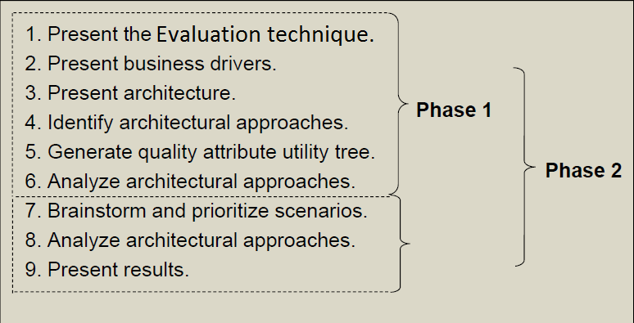
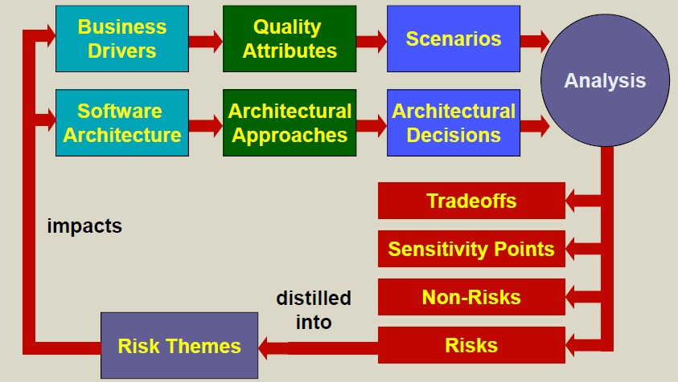
Evaluation - 4
Steps –
Conceptual Flow –

Slide 120
AGT Software System Architecture Life-Cycle
Functional Requirement
Preparing Use Cases
Finding Quality Attributes
Business Drivers
Creating Quality
Attribute Scenarios
Design Patterns
Architectural
Analysis & Design
Design Tactics
Architectural Prototyping
Creating Architecture Document
Information Flow
Inputs
Architectural Evaluation
Evaluation
Enterprise/System/Software Architecture

Slide 121
AGT Software System Architecture Life-Cycle
Functional Requirement
Preparing Use Cases
Finding Quality Attributes
Business Drivers
Creating Quality
Attribute Scenarios
Architectural Design
Quality Attribute
Documentation
Evaluation
Design Patterns
Architectural
Analysis & Design
Design Tactics
Architectural Prototyping
Creating Architecture Document
Information Flow
Inputs
Architectural Evaluation
Enterprise/System/Software Architecture

Slide 122
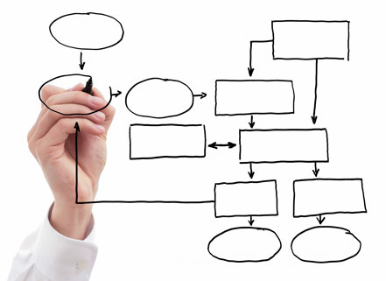
Project & Process Design

Slide 123
Objectives
Describe only the way key process areas are affected by componentizing you system
Today we call these things “services”
Yesterday in was “objects”
Each area has much more to it
Suitable for small teams < 7
Scalable?
Everything described is practiced in real life
Metrics and the charts are normalized projects data
Notes:
1+1 <> 2 in software … Effective vs Efficient

Slide 124
Architect’s Involvement
Along with Project Manager
Work Decomposition
Work Distribution
Effort Estimation
Dependency & Integration Planning
Release planning
Tracking and Projection
Others …

Slide 125
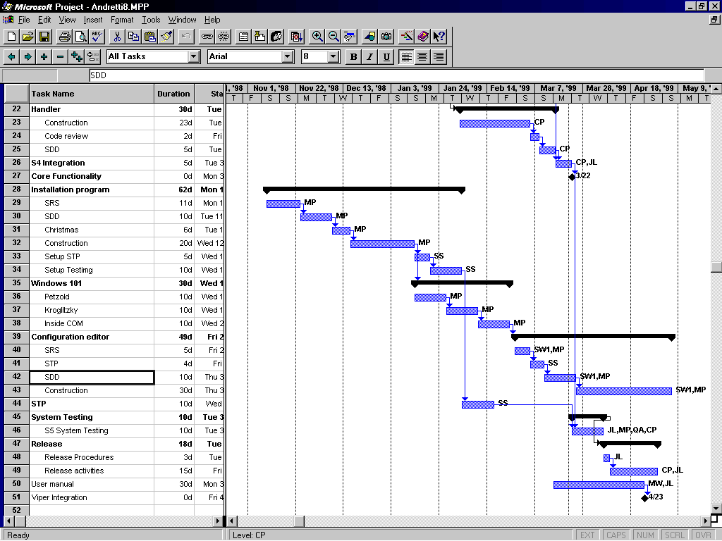
Project Planning
Staffing
Product life cycle
Service life cycle
Services integration plan

Slide 126
Process – What, Why & How?
Service 1
Service 1
Service 2
Service 3
Service 2
Service 3
OR
Service 4
Service 5
Service 4
Service 5

Slide 127
Job Of An Architect?
Balance number of services with development effort
Minimum Cost
Cost or Effort
Cost to
Integrate
Cost / Service
Number of services
Notes:
Complexity and integration is not linear
Every design effort has a point of diminishing return

Slide 128
Staffing
Not having a skilled architect is the #1 risk
Rather than the technology itself !
Requirements analysis and architecture are contemplative time consuming activities
More firepower does not expedite
Single architect usually suffices
In large projects, have a senior architect and a junior/apprentice
Assign a service to individual developer (1:1)
Assembly boundary is team boundary

Slide 129
Staffing
Interaction between team members is isomorphic to interaction between services

Slide 130
Staffing
A good design (minimized interactions, loose coupling, encapsulation) minimizes communication overhead

Slide 131
Work Distribution and Assignment
Get an Architect
Architect breaks product into services
5
4
Construction
CM and Sys. Testing
Staff
3
Management
2
Architecture
1
Marketing/Product management
Jan-
Feb-
Mar-
Apr-
May-
Jun-
Jul-
Aug-
Sep-
Oct-
Nov-
Calendar Months

Slide 132
Product Life Cycle – Staged Delivery
Preparation
Requirement & architecture
Interface compatible
emulator
Stage 1
Basic
capabilities
Stage 2
Setup, logging,
configuration editor
Stage 3
UI elements
Stage 4
Release

Slide 133
Product Life Cycle – Staged Delivery
Preparation
Requirement & architecture
Software
Infrastructure
Stage 0
Service Foundation
Stage 1
Service Platform
Stage 2 – Release 1.0 lease 1.0
Fusion Service
Stage 3 – Release 1.5
Fusion Platform
Stage 4 – Release 2.0
Analytics Platform
Stage 5 – Release 3.0Release 2.0
Modeling Service
Stage 6
Modeling Platform
Stage 7 – Release 4.0Release 2.5
Release

Slide 134
Service Integration Plan
Derived from services dependency graph
Start bottom-up
Avoids “big-bang” syndrome
Risk reduction oriented
Incompatibility discovered early
Daily builds and smoke tests to test evolving system
Regression if needed
Incrementally build a system
Provide a tested working system at each increment

Slide 135
Service Integration Plan – Dependency Map
HW
01/12
S1
01/28
DA
S2
Config
05/05
Command
02/01
S3
03/22
Queue
S4
Setup
Handler
Emulator
04/05
01/13
System
S5
Client App
Notes:
Continuous stream of good news out of this project

Slide 136
Service Integration Plan – Critical Path
11
16
17
18
Critical Path
Alternate Path
12
8
Milestone
Activities
13
2 Requirements
5
7
10
3 Infrastructure
4 Interface Data Access
5 Interface Manager
6 Security Data Access
7 Security
8 Admin Client
9 Utilities
10 TA FileNet
4
6
9
14
15
11 eFiling Client
12 eFiling Web Service
13 Form Manager
14 Form Data Access
15 Form Engine
16 eFiling Integration
3
2
17 System Testing
18 Release 1.0
Notes:
Critical path is the longest and the quickest way to finish the project. Project can’t accelerate beyond critical path.

Slide 137
Module/Service Life Cycle
For Each Service
SRS
SRS
Review
Some
Construction
STP
Detailed Design
(standard documentation)
Design Review
Test Client
Construction
Integration
Testing
Code
Review

Slide 138
Service Testing
EVERY service has its own testing environment
Visible signs of progress to management
Spice up “boring” testing
Test all method calls, call backs and errors (white box)
Fall back to isolate problems
Assumption - no need to test the test SW
System level test SW is provided to customer as well

Slide 139
Estimation and Tracking
Service-based effort estimation
Service-based earned value tracking

Slide 140
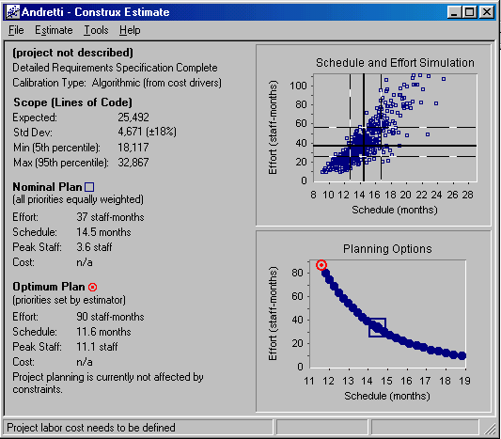
Service Based Effort Estimation
Use estimation tools
Team members participate in estimation
Itemize lifecycle of all services
Do not omit:
Learning curves
Test clients
Installation
Integration points
Peer reviews
Documentation

Slide 141
Service Based Effort Estimation
Both underestimation and overestimation are deadly
Padding allows for increased complexity
Gold plating
Inverted pyramid
Too aggressive schedule guarantee failures
Cutting corners and best practices
Nominal estimation maximizes probability for success

Slide 142
Earned Value Planning
Assign value of work item for the completion of service
Compare earned value (sum of all accomplished activities across services) against effort spent
Can predict completion date and costs

Slide 143
Earned Value: Planning - 1
Build a Gantt chart to derive actual dates
And convert work days to calendar days
Given each activity scheduled date and earned value plot planned progress
100%
Planned Completion Date
Date
Notes:
The pitch of the curve is the throughput of the team

Slide 144
Earned Value: Planning - 2
Can detect unrealistically optimistic/pessimistic plans
100%
100%
Optimistic
Pessimistic
Date
Date

Slide 145
Earned Value: Planning - 3
Pitch of plan curve is the planned team throughput
Fixed teams and resources should yield straight line
100%
Date

Slide 146
Earned Value: Planning - 4
Properly staffed and planned projects yield shallow S
Construction done
End of system testing
100%
Planning Done
Dev staffing
Date
Core team only

Slide 147
Earned Value: Planning - 5
Plan is both for progress and effort
Progress, Effort
Construction done
End of system testing
100%
Planning Done
Dev staffing
Date
Core team only

Slide 148
Earned Value: Planning - 6
When requirements, DD and test plan completed, the service is 45% done

Slide 149
Earned Value - Example
Finding accumulated earned value:

Slide 150
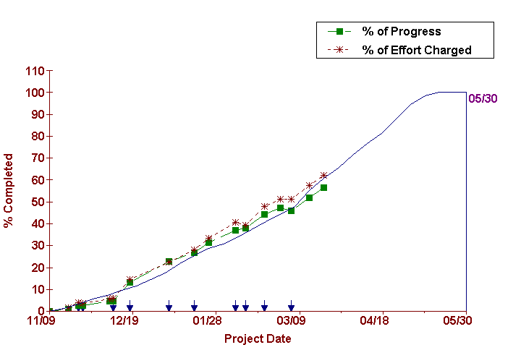
Earned Value - Example

Slide 151
Earned Value Projections
Can extrapolate actual progress line
Project actual completion date early on
Can extrapolate actual effort line
Project actual cost early on
Take corrective actions when still have effect

Slide 152
Tracking & Projection - 1
%
Plan
Progress
Effort
100%
Planned
Planned Completion Date
Date

Slide 153
Tracking & Projection - 2
%
Plan
Progress
Effort
100%
Planned
Planned Completion Date
Date

Slide 154
Tracking & Projection - 3
%
Plan
Progress
Effort
100%
Planned
Planned Completion Date
Projected Schedule Overrun
Projected Completion Date
Date

Slide 155
Tracking & Projection - 4
%
Plan
Progress
Effort
100%
Planned
Planned Completion Date
Projected Schedule Overrun
Projected Completion Date
Date

Slide 156
Tracking & Projection - 5
%
Projected Cost
Plan
Progress
Effort
Projected Cost Overrun
100%
Planned
Planned Completion Date
Projected Schedule Overrun
Projected Completion Date
Date

Slide 157
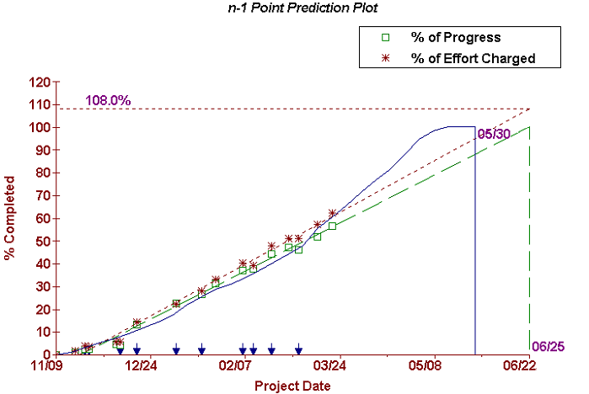
Tracking & Projection - Example

Slide 158
Earned Value - Symptoms
Plan
Progress
Effort
Life is good

Slide 159
Earned Value - Symptoms
Under Estimating
Plan
Progress
Effort

Slide 160
Earned Value - Symptoms
Resource Leaks
Plan
Progress
Effort

Slide 161
Earned Value - Symptoms
Plan
Progress
Effort
Over Estimating

Slide 162
Division of Labor
Architect plans
Designs the project
Project manager tracks
Both close the loop

Slide 163
Thank You

