Slide 1
HAII – Datawarehouse
Oz Levi
3/18/2014
Notes:
TODO:: Add Data Mining
Finish Big Data
Go over DWH last time

Slide 2
Agenda
Introduction and Reasoning
About a DWH projects
Common Practices and Concepts
Future of the DWH and its place in the Big Data World
Data Mining and Advanced Analytics

Slide 3
Who am I?
Data Architect and BI expert
8 Years of experience
Largest Datawarehouse I’ve built was 2PB
I am here to answer your questions!

Slide 4
Agenda
Introduction and Reasoning

Slide 5

1763 Stores
1.2 Billion records a day per store
2.115.600.000 Records daily!
Every customer is assigned with a Gusted ID and from then data is gathered for him
An Analyst used a data mining algorithm to determine if a woman is pregnant and what trimester she is in!

Slide 6
What is BI?
Understand
Smart Applications
Master Data
Operational
Social
Management
Alerts
Search
Collaboration
Performance
Reporting
Action
Dashboard
events
Integration
Analytics
Personal BI
Data
information
Weakness
Data Mining
decisions
Data Quality

Slide 7
Introduction to Data warehousing
Definition of BI:
The process of turning data into meaningful information that provide insight and drives to action
Data
Information
Insight
Action

Slide 8
What we Need to achieve? From Data to Insight
Value
Insight
Knowledge
Information
Data
Quantity
Notes:
A good Data warehouse in not necessarily a large one – as the Value of the data increases, usually it’s quantity decreases!!!

Slide 9
The questions we ask
Operational
Systems
How to
Make it
Happen?
What is
Going to
Happen?
Why did it
Happen?
Value
What happened?
When?
Raw
Data
Op Reports
& Queries
OLAP
& DWH
Data
Mining
Trending & Predications
Optimizations

Slide 10
What exactly is a Datawarehouse?
Notes:
There are many data sources – to make decisions we need to look from a Highview

Slide 11
What is data integration
“A data warehouse is a system that extracts, cleans conform and delivers source data in a dimensional data store and then supports and implements querying and analysis for the purpose of decision making”
Ralph Kimball 2004

Slide 12












Tiers of the classical Datawarehouse ecosystem
Data
Sources
Staging
Integration
DWH
Analysis
Presentation
Servers
Reports
In Memory
Flat files &
Excel
Data Marts
Forecasting
DWH
OLAP
Cloud \ Web
Services
Integration
Tools
Dashboards
Data Mining
Feeds
API

Slide 13

The Datawarehouse key traits
Subject Oriented
Datawarehouse is usually subject oriented (Finance, Customers etc.) but it is still possible to look at cross subject areas
Integrated & Multi Dimensional
Contains consolidated and integrated data from multiple data sources
Multidimensional Modeling creates relationships between different subject areas
Non-volatile & Historical
It is possible to save snapshots
No historical data updates are done
Time Variant
Usually Time dimension is the center and many subjects can be analyzed by it.
It’s possible to analyze by Day, Month, Quarter, Year or by Time based events

Slide 14
How is the Datawarehouse different from an OLTP
Subject Oriented
Large (hundreds of GB up to several TB and today even PB)
Historic data
De-normalized table structure (few tables, many columns per table)
Batch updates
Usually very complex queries
Operational System
Data Warehouse
Transaction Oriented
Small (MB up to several GB)
Current data
Normalized table structure (many tables, few columns per table)
Continuous updates for small amount of rows
Simple to complex queries
Requires Pre-Processing data with an ETL/ELT Mechanism
Allows a high view helps recognize patterns and properties
Building the DWH is just the beginning – other layers exist
Unified data repository to achieve ‘Single Version of the truth’

Slide 15
What Is a Data Warehouse Used for?
Knowledge discovery
Creating consolidated reports
Finding relationships and correlations
Data mining
Examples
Banks identifying credit risks
Insurance companies searching for fraud
Medical research

Slide 16
Why do we need a data warehouse at HAII?
Notes:
There are many data sources – to make decisions we need to look from a Highview

Slide 17
1) Many Data sources
telemetering
Egat
control
thaifloodwatch
samutsakorn
storm
bma
rid
egat1
navy
nhc_laravel
Notes:
There are many data sources – to make decisions we need to look from a Highview

Slide 18
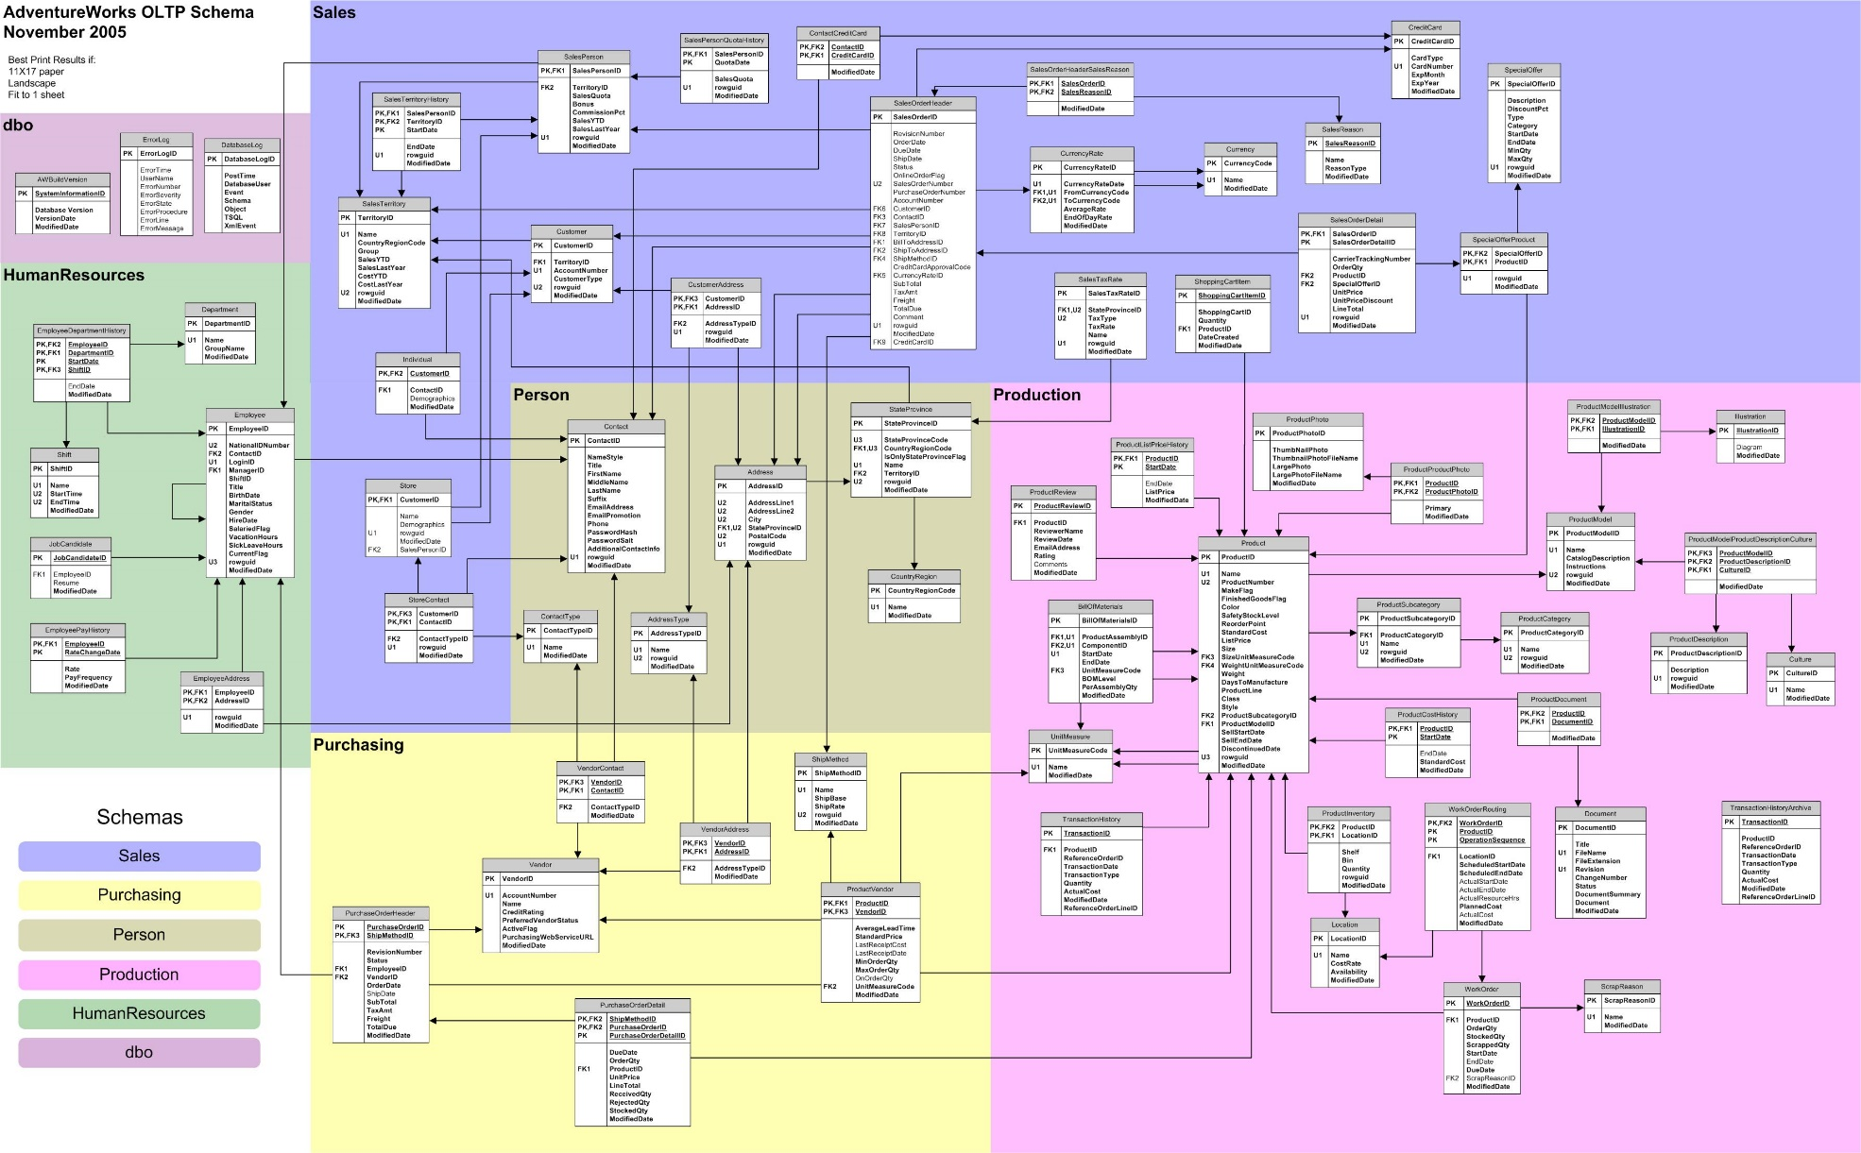
2) Complex relations make queries difficult

Slide 19


3) Separate research and decision support
Complex questions
Requires a consolidated views
Queries may be very heavy
May require enrichment with additional data
High importance for historical data
Operational
Research & DSS
Simple operations
Based on atomic level work
Must be fast and to the point
Operations are done only with operational data
Usually refers to current state
Users
Users
Analysts
Managers
& Decision
Makers
Operational
Systems
Information
workers
Notes:
Complex questions like – researching the behavior of a time period across years

Slide 20
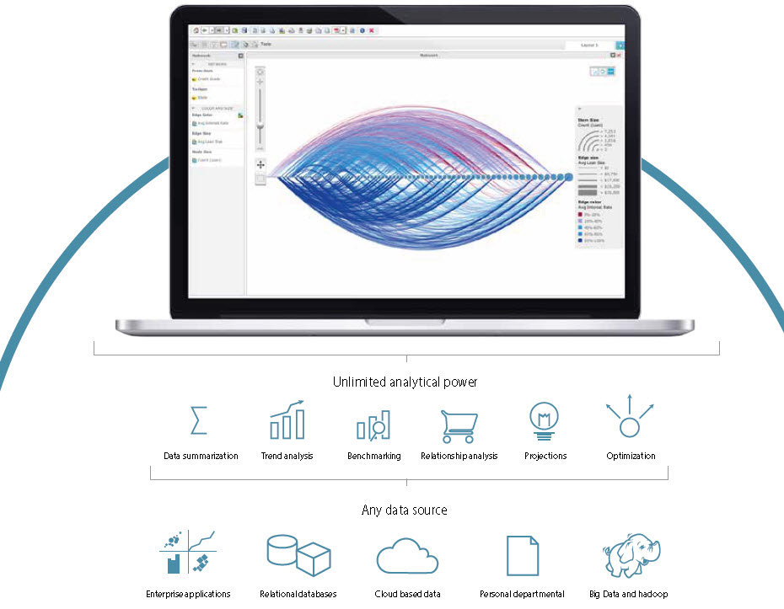
4) Advanced Analytics
Data Warehouse

Slide 21
What we will gain
DWH
Consolidation
Of Sources
Improve
Query Performance
Separate Research and Decision Support it is different!
Build the foundation for Advanced Analytics
Notes:
Consolidation of information resources
Improved query performance for reports
Separate research and decision support functions from the operational systems
Foundation for data mining, data visualization, advanced reporting and OLAP tools

Slide 22
Agenda
About Datawarehouse projects

Slide 23
Few Facts
40% Of Datawarehouse project fail
Average Enterprise Data Warehouse projects are developed in cycle of between 18 – 24 Months
ROI Is usually substantial

Slide 24
Reason No#1 - Strategy
Lack of strategic goals
We must ask -
DWH
How will we use this data?
What problem are we trying to solve?
Who will be viewing the reports or end product?
What decisions do they ultimately want to make using this data?

Slide 25
Reason No#2 - Poor Data Quality
Examples:
Outdated Data
Incorrect Geo locations
Duplicate data that effect summarization
Validation of data quality must be done before actual implementation

Slide 26
Reason No#3 – Trying to boil the ocean
Pulling every piece of available data from every possible source
Too much data and many access obstacles
Datawarehouse projects that try to do all at once will fail!
Take an Agile approach developing data marts (Agile BI).

Slide 27
Reason No#4 – The silent failure
The data warehouse project is completed and delivered successfully!
But no one uses it…
Validate the solution with the end users and consumers throughout the project

Slide 28
A Successful Datawarehouse project
Infrastructure Planning
Info. Management Deployment
Business Discovery
Solution
Definition
Solution (soft)
Development
Solution
Validation
Solution
Deployment
Business
Requirements
Prototyping
Data
Discovery
Solution
Modeling

Slide 29
A Successful Datawarehouse project
Infrastructure Planning
Info. Management Deployment
Business Discovery
Solution
Definition
Solution (soft)
Development
Solution
Validation
Solution
Deployment
Business
Requirements
Prototyping
Data
Discovery
Solution
Modeling
Notes:
The process of understanding and mapping the data in the Organization

Slide 30
A Successful Datawarehouse project
Infrastructure Planning
Info. Management Deployment
Business Discovery
Solution
Definition
Solution (soft)
Development
Solution
Validation
Solution
Deployment
Business
Requirements
Prototyping
Data
Discovery
Solution
Modeling

Slide 31
A Successful Datawarehouse project
Infrastructure Planning
Info. Management Deployment
Business Discovery
Solution
Definition
Solution (soft)
Development
Solution
Validation
Solution
Deployment
Business
Requirements
Prototyping
Data
Discovery
Solution
Modeling

Slide 32
A Successful Datawarehouse project
Infrastructure Planning
Info. Management Deployment
Business Discovery
Solution
Definition
Solution (soft)
Development
Solution
Validation
Solution
Deployment
Business
Requirements
Prototyping
Data
Discovery
Solution
Modeling

Slide 33
A Successful Datawarehouse project
Infrastructure Planning
Info. Management Deployment
Business Discovery
Solution
Definition
Solution (soft)
Development
Solution
Validation
Solution
Deployment
Business
Requirements
Prototyping
Data
Discovery
Solution
Modeling

Slide 34
Datawarehouse project Key personnel
Project Manager
System / Solution Architect
Business Analyst
Development Team Leader
UX Expert
QA Engineer
BI Developer
ETL Developer
Data Modeler
DBA
Notes:
Project Manager – Time lines
System / Solution Architect – Vision Structure, technology
Business Analyst – Business discovery, requirements gathering and analysis
Data Modeler – Physical data design, source to target mapping
Dev Team Leader – Development management + Hand ON
BI Developer – Development of reports, OLAP Cubes, In Memory and more.
ETL Developer – ETL
DBA - Schema development and maintenance, performance tuning.
UX Expert – Report design and data visualizations

Slide 35
Agile BI Project
Development phase of the project will be done by combining Water Fall in the HL Design and Architecture phase and Agile in the development and release cycles.
HL Scope, design & Architecture
Development
Testing
Release

Slide 36


Agile BI
Faster TTM
Time to market reduces considerably due to pin point feature development (what the customer wants) and iterative release cycles
Adaptable to changes
Changes in customer needs are reflected in the product and changes are more easily accepted
Development Speed
After the initial drop where most of the effort is made to release stable infrastructure, features are released in a high velocity
Time Intelligent
Working in short end to end work units provides higher adaptability allowing feature release in very early stages of the development

Slide 37
Agenda
Common Practices and Concepts

Slide 38
Design
Design
Top Down vs. Bottom Up
Shared data infrastructure
Data Structure
Information Systems (Ecosystem)
Relational Database
OLAP
In-Memory

Slide 39
Design – Top down vs. Bottom up
Top Down
Bottom UP
Users
Need
Map data in different sources
Construction of the Datawarehouse
Business discovery
Construction of the model
Provide
to
users

Slide 40
The steps for a Data warhouse
Data extraction
Data Staging
Data transformation
Data Loading
Dimensional Modeling
OLAP and InMemory Databases
Relational Partitioning

Slide 41
The steps for a Data warehouse
Data extraction
Data Staging
Data transformation
Data Loading

Slide 42



ETL
ETL = Extract, Transform, Load
Extract
The process of extracting data from one or more sources and creation of a mirror for that data source
Transform
Transforming the data into meaningful information, performing aggregations, calculation and implementation of business logic
Load
The insertion of information into the Datawarehouse and merging new and old data

Slide 43
ETL
ETL = Extract, Load, Transform
Extract
The process of extracting data from one or more sources and creation of a mirror for that data source
Load
The insertion of information into the Datawarehouse and merging new and old data
Transform
Transforming the data into meaningful information, performing aggregations, calculation and implementation of business logic

Slide 44
What is data integration
How can data be loaded to a DWH?
Scripts (shell, perl, python etc.)
SQL Procedures
Hardcoded Java, C# etc.
In-House built ETL tool
Off-the shelf ETL tool

Slide 45
The propose of ETL and Data Integration
Add value to data
Remove mistakes and correct data
Integrate data from multiple sources to be used together
Structure data for BI & Analytics tools
Enable subsequent analytical data processing
Data Mining
Forecast & Trending etc.

Slide 46
How to build it?
Data integration Lifecycle
Data Integration Tool
Access
Discover
Cleans
Integrate
Deliver
Develop & Manage
Audit, Monitor & Report

Slide 47
Extract
Access & Discover
Flat files DMBS, XML data, XLS (Excel)
Web Services, LDAP
Semi-structured data (emails, web logs. Wiki pages)
Unstructured data (blogs, documents, social networks)
Extensibility with custom connectors
Local data, remote data FTP, SFTP, SCP, http(s)

Slide 48
Cleanse
Cleansing is knowledge-Driven
Knowledge
management
Source data
KB
Map
Build
Discover/Explore
Data
Manage knowledge/
matching policy
Knowledge base
Duplicate
(Match)
Correct/Standardize
(Cleanse)
Processed Data
Export
Use
Data
Quality project

Slide 49
Integrate
Source B
Source A
Source C
Master Data
Integrate & Aggregate
The process of creating unified view of data that is coming from various sources (CRM, Transactions etc.)
Pre calculation data to achieve fast query time and minimal ad-hoc processing

Slide 50
Deliver
Deliver, Audit, Monitor & Report
Load the data into the destination Datawarehouse
Provide full trace of the transformed data
Monitor the process and Report the successful to erroneous process that took place

Slide 51
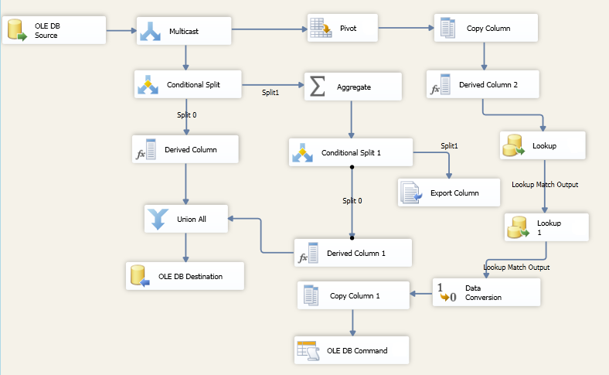
Dataflow Example

Slide 52
The steps for a Data warhouse
Dimensional Modeling

Slide 53
Design – Data structure
Key Objectives
Modeling technique that simplifies joins and tables
Organizes data into a format that is easy for business users to understand
Allows application developers to standardize ad-hoc queries

Slide 54
Designing a Start Schema
Dimension Tables
Easy to understand groupings of subject areas
Can be hierarchal used to drill down
DE normalized, decoded, and cleaned set of descriptive data elements
Fact Tables
Contains foreign keys referencing dimension Records
Contain either additive or semi-additive measures for analysis

Slide 55

Design - Shared Infrastructure
Allow indirect connection of dimension
Allow navigation through natural hierarchies
Measures and subjects that are not usually connected can be linked via shared dimensions
It is possible to create different hierarchies and navigate in them
Example: Country, Region, District, City)

Slide 56
Design - Shared Infrastructure
Shared
Dimension
Population
Time
Location
Demography
Rainfall
Barometrical
Weather
Time
Measure
Storm
Time
Weather
Population
Location
Dimension
Enterprise Datawarehouse

Slide 57
From Star to Snow-Flake

Slide 58
Designing a Start Schema
Designing a warehouse schema
Identify Facts and Fact Table Grain
Identify Dimension Keys and Attributes
Choosing Star vs. Snowflake schema
There are many types of dimension
Model your dimensions
Model the Time and Date dimension

Slide 59
Dimension types
Changing dimension
Slowly changing dimensions – Keep change history
Rapidly changing dimensions – No History, too many changes
Junk dimensions – Table of tables
Inferred dimensions – Records generated by Referential integrity processes
Conformed dimensions – Shared dimension
Degenerate dimensions – Stored inside of a FACT table
Role playing dimensions – Can be joined to multiple attributes
Shrunken dimensions – Subset of a different dimension
Outriggers – Many to Many relationships
Static dimensions – List of values

Slide 60
The steps for a Data warhouse
Relational Partitioning

Slide 61
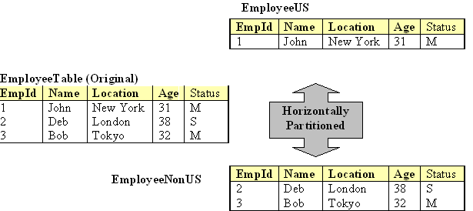
Relational Partitioning
Horizontal partitioning
Horizontal partitioning – Divides tables into multiple physical tables by row
i.e. Partition by Month

Slide 62
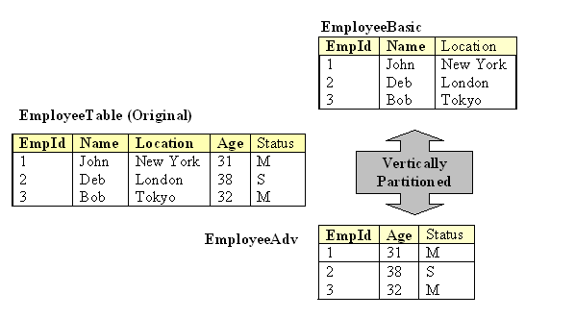
Relational Partitioning
Vertical Partitioning
Vertical partitioning – Dividing tables by their columns
i.e. Remove columns to increase scan speed AKA Normalization.

Slide 63
The steps for a Data warhouse
OLAP and InMemory Databases

Slide 64
Types of Information Systems
Relational & Analytical Database
OLAP (aka Cube)
In Memory
Usually the most used information system as the basis for the Datawarehouse implementation
Sub types are the columnar and Analytical databases
Online Analytical Processing Information system
Used for advanced reporting and analytics
Supports complex actions (slicing and dicing)
Used for High Velocity online aggregations and reporting
Provides order of magnitude performance gains for queries
Requires simple data models

Slide 65
Relational & Analytical Database
Row or Column based databases
Schema is designed specifically for data warehousing
No use of constraints or Foreign Keys
Row store is usually designed differently than Column oriented databases
Open source examples are SybaseIQ, Infobright Community Edition, Vertica Community Edition and more.

Slide 66
OLAP Databases
OLAP = Online Analytical Processing
Online
Fast Answers!
Analytical
Very complex business questions
OLAP Provides fast answers for complicated questions
Requires a well designed relational Datawarehouse as a data source

Slide 67

OLAP Fundamentals
Performance
Contains pre-Aggregated data for hierarchy levels
Allows scanning huge amount of data in seconds
Multi
Dimensional
Support operation such a Slicing and Dicing
Allows investigating different Measures and slicing them according to many dimensions
Navigation
In Hierarchies
Historical data analysis and looking on time based snapshot
The same report can be executed for different periods in time
Time Intelligence
Usually, the Time dimension is the most important dimension
Allows comparing between time based events, parallel periods and more

Slide 68
In Memory Databases
Loading entire datasets into memory for online aggregation
Provides ULTRA fast query response
The amount of data you can load in limited by the amount of RAM on the server
Not all In-Memory databases are suitable for use with BI

Slide 69
Deployment scenarios
ColumnStore
*Scalability=
- good support for concurrent queries
- not dependent on available memory
- good maintainability
50 TB
ROLAP
5 TB
Scalability*
MOLAP
500 GB
In Memory
2 GB
Local
Usability

Slide 70
Design - Reporting VS. Analytics
Combining data from many sources into a unified model
Separation to Facts and Dimensions
Pre-Calculated aggregations
Supports Analysis of large amounts of data
Simple design – to support easy query
Intended for employs but also to decision makers
Reporting
Analytics
Can be implemented directly on top of the OLTP
No facts and Dimension – Only tables
On the fly - long running queries
High Granularity of data – difficult to grasp
Normalized (complex) table structure
Provides operational data for mid-management and employees

Slide 71
Reporting VS. Analytics Types of Information Systems
Functionality
Type of IS
OLTP
DWH
OLAP /
In Memory
Reporting
Analysis
Main Requirement | Work | Reporting | Analysis
Ease and |  |  | 
Analytical Information |  |  | 
The ability to aggregate large amounts of data |  |  | 
Data Arranged by subjects |  |  | 
Historical Data analysis |  |  | 
The ability to work and save high grain level of data |  | 
Providing operational reports |  | 
Trending, Forecasting and advanced data modeling |  |  | 
Navigation in hierarchies, Time intelligence |  |  | 

Slide 72
Agenda
Future of the DWH and its place in the Big Data World

Slide 73



Some numbers
~8 Years of Video Uploaded to YouTube every Day
~140 Million Tweets on Twitter every Day
>250 Million Photos Uploaded to Facebook every Day
1.8 Million Photos Uploaded to Flickr every Day
Can a Datawarehouse
really handle that?

Slide 74
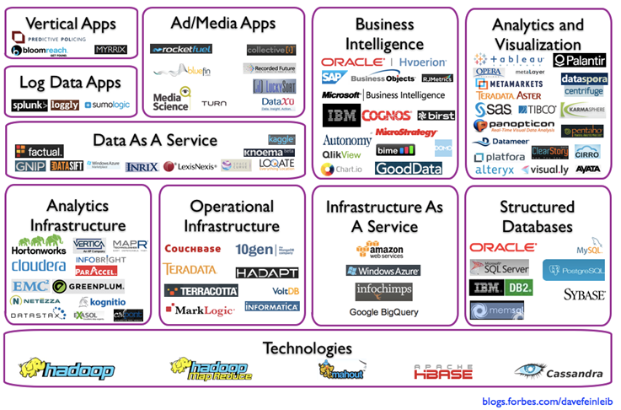
There are many new technologies
?

Slide 75
The Data world before Big Data
Structured Data
Relational Databases
Analytical Databases
Poly-Structured Data
Transform into structured
Expensive Access
Difficult to Analyze
Must Archive or Delete
Structured
Data
Tables, Records, CSV etc.
Poly-Structured
Data
Log Files
New insights with Big Data Technology
Social Data
Machine Data
Text, Image, Video

Slide 76
Technology types
Hadoop
Poly-Structured
Massively Parallel Processing
Structured
NoSQL
Semi-Structured
Key-Value

Slide 77
Hadoop very very quick intro ☺
What is Hadoop
Open Source
Fata Storage and Analysis platform for Huge Amounts of Data – TB to PB and more
Variety of Data (Structured, Poly-Structured)
Using commodity hardware?
DL380 - 12 Core, 64GB, 24 2TB Disks
Not a good basis for OLTP usage / OLAP

Slide 78
Hadoop very very quick intro ☺
Scalable
Scales linearly in storage capacity and compute capacity
Fault-tolerant
Marriage of the distributed file system and the fault-tolerant framework used for reading this data
Distributed processing
Following the divide-and-conquer strategy
Uses Master-Slave Shared Nothing architecture

Slide 79
Hadoop Structure
2 Main Ingredients
NameNode: Maintains mapping of file blocks to data
nodes slaves
DataNode: Stores and serves blocks of data
Block Size = 64 MB
Replication Factor = 3

Slide 80
Hadoop
HDFS
Distributed File System designed for huge datasets
Reliable and Good Performance
High throughput access: Disk latency
Self-Healing High-Bandwidth Clustered Storage
Split data across nodes in a cluster
Map Reduce
Scheduling Engine for Distributed Workload Processing
Pair Key-Value
Map function
Reduce function
Script langages: Java, python
Takes Advantage of HDFS’ data distribution

Slide 81
Hadoop
Hadoop is a very strong framework
BUT
In Most cases, it is not suitable by itself as a Datawarehouse

Slide 82
Evolution of Enterprise Data warehouse
Massively Parallel Processing
Some use special hardware
Relational & Columnar

Slide 83
Massive Parallel processing DWH
SQL
Standard SQL Interface
storage
Column orientation for fast results
Some times row orientation as well
HA
Built in High availability
MPP
Native DB aware clustering

Slide 84
Massive Parallel processing DWH
SQL Query
Leader Node
Node 1
Node 2
Node 3
Node N
Local Storage
Local Storage
Local Storage
Local Storage
Load Data

Slide 85
Massive Parallel processing DWH
MPP Key concepts
Horizontal scalability
Loading is done via Copy command and not INSERT
A 10GbE Network is usually required between nodes
Shared Nothing architecture uses Direct attached storage
Sometimes there is not leader node required (HP Vertica)
SQL Query
Leader Node
Node 1
Node 2
Node 3
Node N
Local Storage
Local Storage
Local Storage
Local Storage
Load Data

Slide 86
Massive Parallel processing DWH
MPP Key benefits
Provides extreme scalability on general purpose systems
Provide automatic parallelization
Just load and query like any database
All nodes can scan and process in parallel
Extremely scalable and I/O optimized
Linear scalability by adding nodes
Each nodes adds storage, query performance and loading performance

Slide 87
Real World Example MPP – 3 Node HP Vertica database
Time: First fetch (10 rows): 153.675 ms. All rows formatted: 153.733 ms c4db=> select count(*) from events; count -------------- 247915500000 (1 row)
Time: First fetch (1 row): 737.595 ms. All rows formatted: 737.620 ms c4db=> select count(distinct computer_id) from events; count ------- 5001 (1 row)
Time: First fetch (1 row): 1212.497 ms. All rows formatted: 1212.527 ms c4db=> c4db=> select count(distinct tm) from events; count ------- 65405 (1 row)
Time: First fetch (1 row): 9194.105 ms. All rows formatted: 9194.147 ms
Notes:
247,915,500,000

Slide 88
SELECT /* +label(c4q0022) */ computer_id,dt , count(distinct process_name) process_count From events WHERE dt = '2013-06-07' and tm between '14:41:30' and '21:01:45' Group by computer_id, dt ORDER BY process_count DESC limit 10;
Time: First fetch (10 rows): 16715.003 ms. All rows formatted: 16715.060 ms
this is what we have after the where to the group by and distinct. - 18.3B rows out of 248B
select count(*) from events WHERE dt = '2013-06-07' and tm between '14:41:30' and '21:01:45'; count ------------- 18288742669 (1 row)
Time: First fetch (1 row): 1703.826 ms. All rows formatted: 1703.861 ms

Slide 89
Massive Parallel processing DWH
MPP weak points
Not open source
Some have Community versions but are commercial
Usually very expensive licensing
Columnar types require special flat table design and not ‘Star Scheme’
Different vendors differ in capabilities

Slide 90
Datawarehouse and Hadoop – Electricity Company user story
Smart Meters
Power Generators
Meter Data Management System
Payments & Collection
Customer Service
HADOOP
Manual Meter reading
ETL
Datawarehouse
Events
CRM
Weather and Survey Data

Slide 91
Datawarehouse and Hadoop
Mahout
Pegasus
Lucene
…
Reporting & Adv. Analytics
Pig
Hive
Map Reduce
OLAP
In Mem
HDFS
Sqoop
(R)DWH
Flume
Integrating relational DW with Hadoop
Complex analysis results are kept as CSV
Sqoop allows extraction of then to the DWH
Users can analyze data using their BI tools

Slide 92
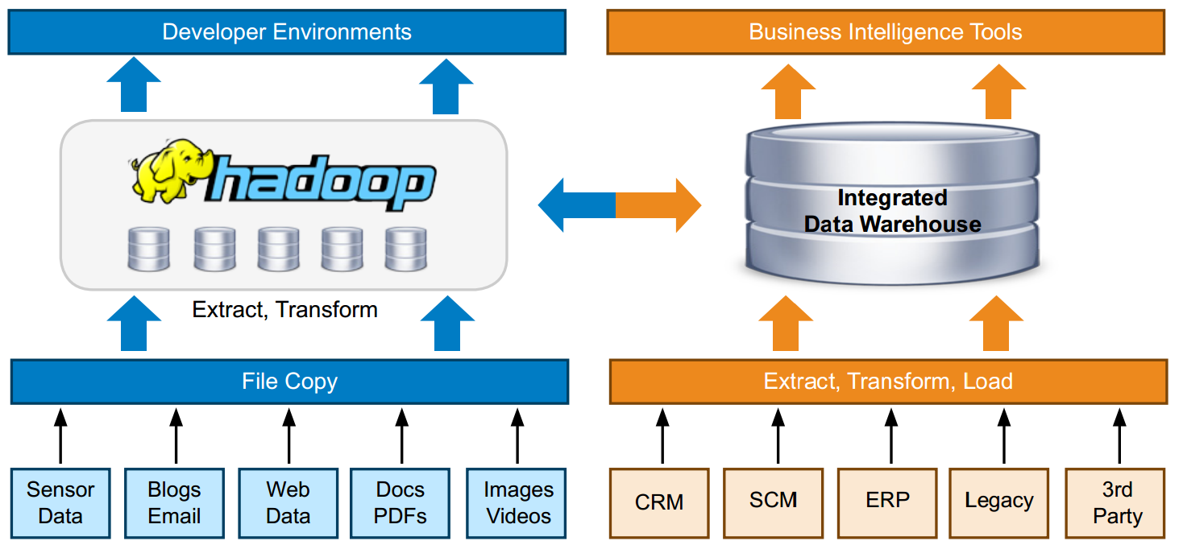
Datawarehouse and Hadoop

Slide 93
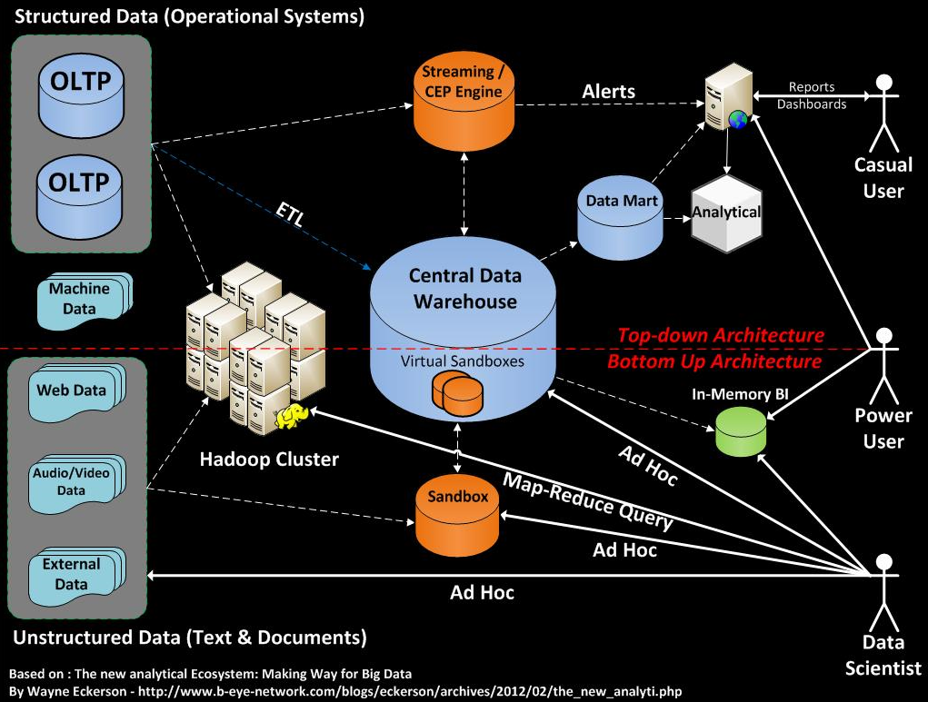

Slide 94
Agenda
Data Mining and Advanced Analytics

Slide 95
Tiers of the classical BI system
In the Datawarehouse ecosystem
Data
Sources
Staging
Integration
DWH
Analysis
Presentation
Servers
Reports
In Memory
Flat files &
Excel
Data Marts
Forecasting
DWH
OLAP
Cloud \ Web
Services
Dashboards
Data Mining
Feeds
API
Integration Tools

Slide 96
In the Datawarehouse ecosystem
Data
Sources
Staging
Integration
DWH
Analysis
Presentation
Servers
Reports
In Memory
Flat files &
Excel
Data Marts
Forecasting
DWH
OLAP
Cloud \ Web
Services
Dashboards
Data Mining
Feeds
API
Integration Tools

Slide 97
What is Data Mining
Data Mining
Deduce knowledge by examining data
Perform predictions on the knowledge extracted
Examining
Data
Gaining
Knowledge
scanning samples of known facts about
“cases” using their attributes - “variables”
Patterns, Cluster, Rules, Decision Trees, Neural Networks, Equations, Association Rules

Slide 98
Data mining platforms
Many platforms exit
Proprietary industry specific
AGT Readymind - hydrology models
Generic platforms
RapidMiner
RapidAnalytics
R
Big Data platforms
Weka
Apache Mahout
Many More

Slide 99
What can data mining do?
Detect patterns in data
Clustering
Decision Tree
Anomaly detection
Forecast behavior
Estimation
Prediction
Learn and Analyze behavior
Neural Network
Classification

Slide 100
Example for usage
Cross-selling - Amazon.com
Association Rules, Decision Trees
Fraud detection – banks
Clustering
Know your customers – CRM applications
Segmentation with Clustering, Decision Trees...
How is your Web site used
Sequence Clustering
Forecasting – nearly any business
Time Series

Slide 101
What can data mining do?
Directed data mining
(Supervised Learning)
Undirected data mining
(Unsupervised Learning)
We know what we are looking for
We don’t know what we are looking for
Classification
Prediction
Estimation
Affinity grouping
Clustering
Description
Top
Down
Bottom
Up

Slide 102
KDD Methodology
Business problems, Goals
Data selection, acquisition, integration
Data cleaning
noise, missing data, outliers, etc.
Exploratory data analysis
dimensionality reduction, transformations
Data mining
Selecting appropriate method that match set goals (classification, regression, clustering, etc.)
selecting algorithm
Testing and verification
Interpretation
Consolidation and use

Slide 103
Thank You

