Slide 1
December 13, 2017
Data Analytics and Data Science using Big Data Platform
Joy Chakraborty
Copyright 2016 Bloomberg L.P. All rights reserved.

Slide 2


What is this about?
Copyright 2016 Bloomberg L.P. All rights reserved.
Notes:
2 min.

Slide 3
Mission Statement
Create Distributed Data platform to :
Ingest various data sources across the organization
Store data at most granular level in consistent format
Provide tooling across organization to perform Data-exploration, Analysis & Machine learning activities
Copyright 2016 Bloomberg L.P. All rights reserved.
Notes:
2 min.

Slide 4
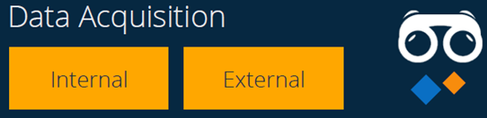
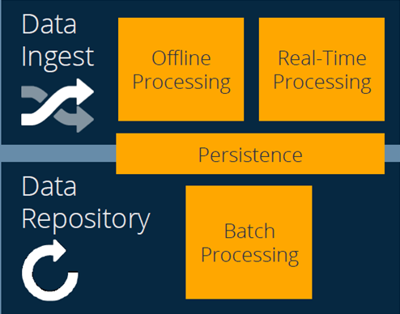
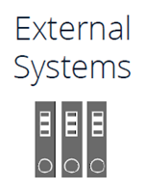
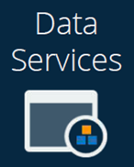
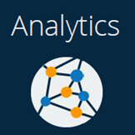
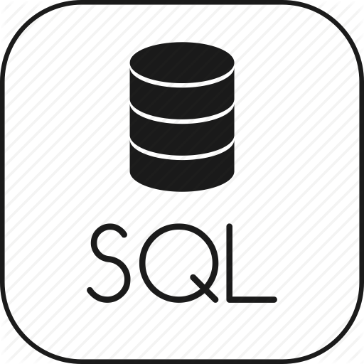



Data Platform Architecture – Target
Low Latency Access
Notebook
Copyright 2016 Bloomberg L.P. All rights reserved.
Notes:
2 min

Slide 5
Agenda
1
Data Ingestion
2
Data Processing
3
Data Access & Visualization

Slide 6
Data Ingestion
Low Latency Access
Notebook
Copyright 2016 Bloomberg L.P. All rights reserved.
Notes:
2 min

Slide 7
Data Ingestion Process – Overview
External Data
DMZ
Firewall
Machine1
Gateway Machines
Step-1
Internal Databases
Step-2
Machine1
Internal Files
Firewall
Hadoop Cluster
Copyright 2016 Bloomberg L.P. All rights reserved.
Notes:
3-4 min.

Slide 8
Data Ingestion Process – Step 1
External Data
Firewall
Machine1
Gateway Machines
Step-1
Internal Databases
Step-2
Machine1
Internal Files
Firewall
Hadoop Cluster
Copyright 2016 Bloomberg L.P. All rights reserved.
Notes:
3-4 min.

Slide 9
Data Ingestion Process – Step 1
Scalability
Horizontal scale out to add more data sets
Resilient
Recover & Reprocess after machine crash/turnaround
Holding zone for HDFS downtime
Multi Hadoop Cluster Support
Integration with Bloomberg Tools
APDX, ALMN

Slide 10
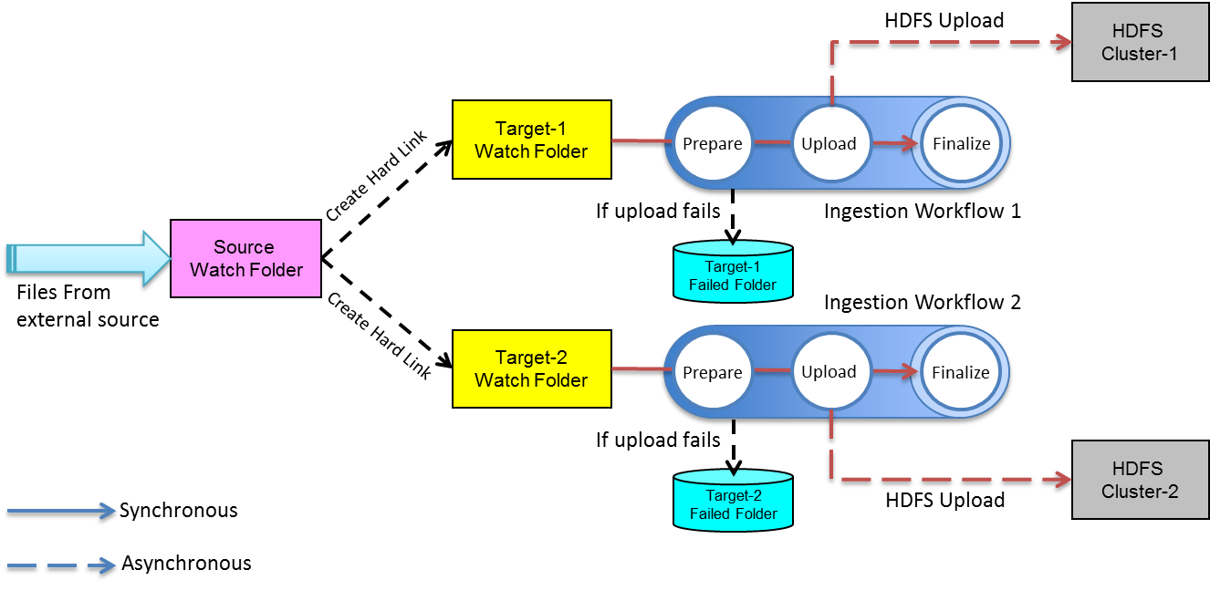
Data Ingestion Process – Step 1
Copyright 2016 Bloomberg L.P. All rights reserved.
Notes:
7 min.

Slide 11
Data Ingestion Process – Step 2
External Data
Firewall
Machine1
Gateway Machines
Step-1
Internal Databases
Step-2
Machine1
Internal Files
Firewall
Hadoop Cluster
Copyright 2016 Bloomberg L.P. All rights reserved.
Notes:
3-4 min.

Slide 12
Data Ingestion Process – Step 2
Data Source Uncertainty/Issues
Duplicate files
Late Arriving files
Corrupt data
Future reprocessing
Seamless rewind to a point in time
Data lineage
Metadata at record level

Slide 13
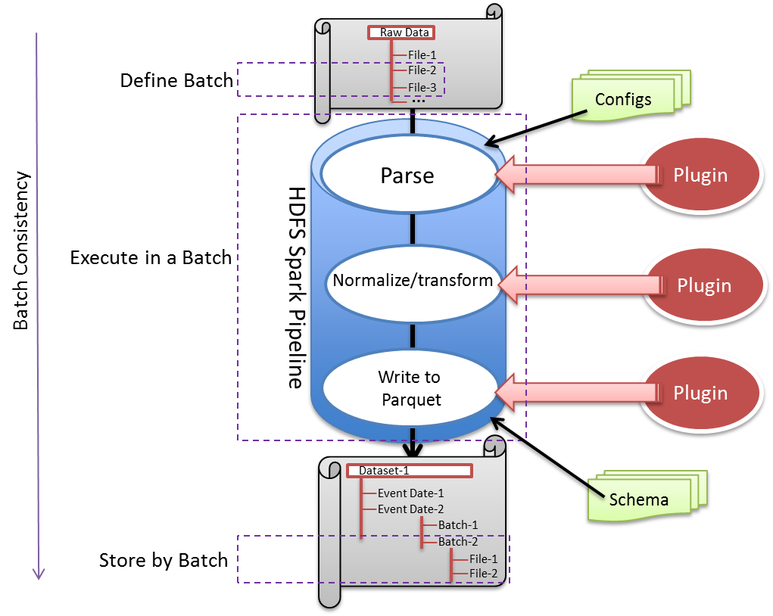
Data Ingestion Process – Step 2
Data at rest in PARQUET
Seamless Re-processing
Record level Audit trail (metadata)
De-dup check at file level
Alarming (ALMN-DRQS integration)
Reusable (Configuration/Plugin)
Workflow support
Data Access Security (PVF)
Copyright 2016 Bloomberg L.P. All rights reserved.
Notes:
10 min.

Slide 14
Data Ingestion– Tech Stack
Scala (Functional programming Paradigm)
Akka – Agent based message passing multithreading framework
Camel – File watcher
SBT – Scala Build tool
Apache Spark – In memory distributed processing framework
Artifactory – Library repositories
Oozie – Distributed workflow framework and scheduler
*** Adding a new Dataset is Configuration Driven
Copyright 2016 Bloomberg L.P. All rights reserved.
Notes:
1 min.

Slide 15
Data Ingestion - References
https://bbgithub.dev.bloomberg.com/bdip-datascience/ingestion
{TEAM NLP:DATA DMZ INGESTION FRAMEWORK<GO>}
Notes:
30 sec.

Slide 16

Data Ingestion
Low Latency Access
Notebook
Copyright 2016 Bloomberg L.P. All rights reserved.
Notes:
2 min

Slide 17
Data Access (Exploration & Analytics)
Low Latency Access
Notebook
Copyright 2016 Bloomberg L.P. All rights reserved.
Notes:
2 min

Slide 18
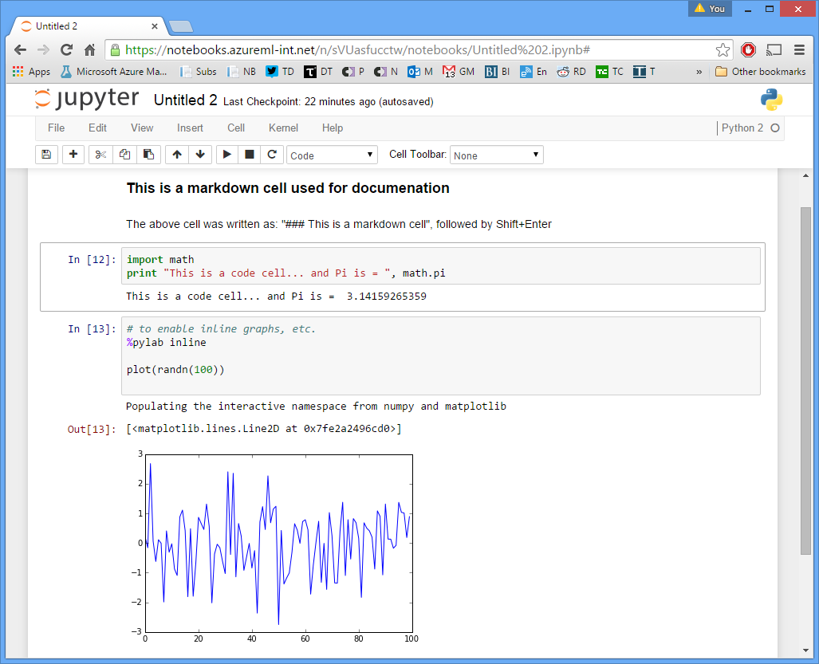
Secure Spark Notebooks
DMZ Notebook Infrastructure for Data Science
Web-based
Scala/Python libraries
Templates
Security and login integration
Data discovery
Enhanced SQL support
Integration with external DBs
Copyright 2016 Bloomberg L.P. All rights reserved.
Notes:
5-7 min.

Slide 19

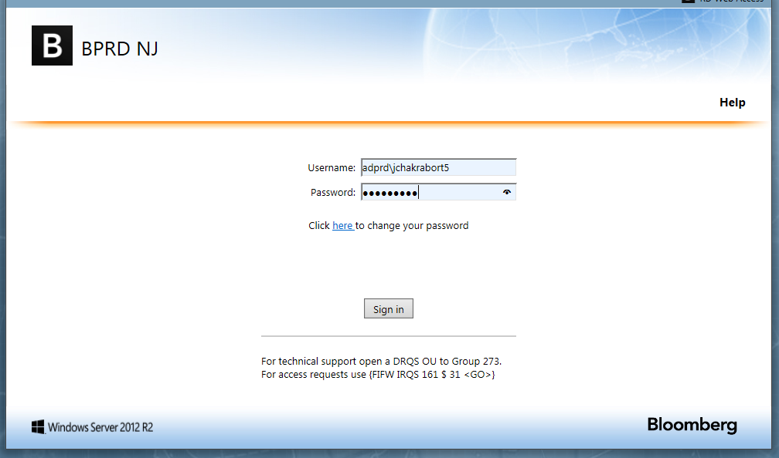
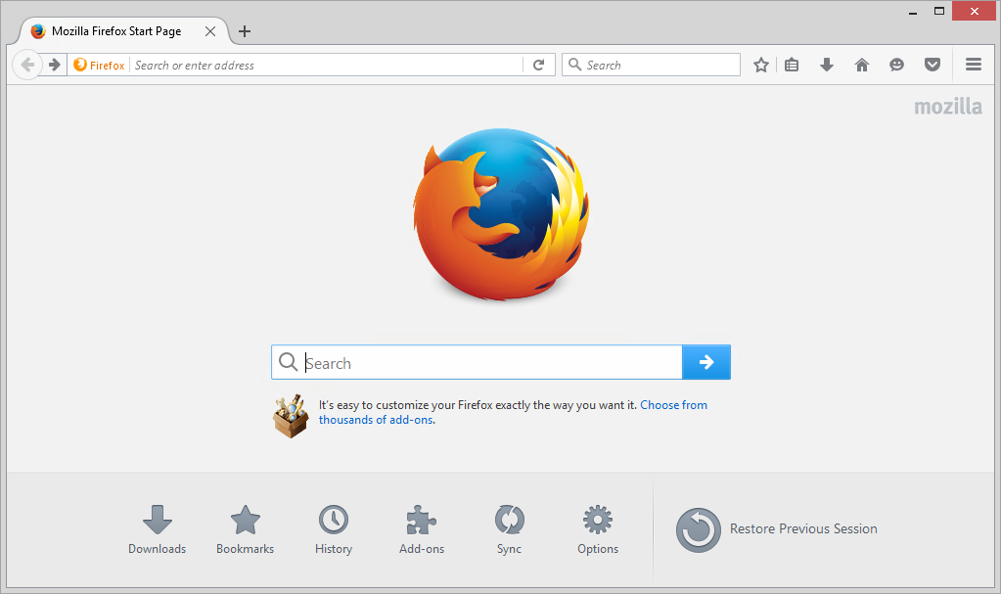
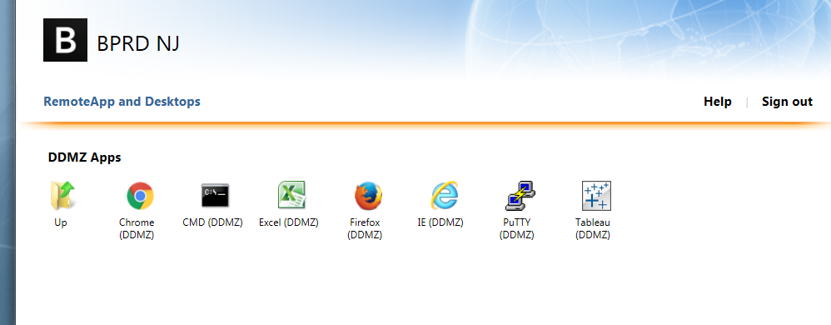
Kerberos Integration - Flow
1
Logged-in using Toolkit Account
3
4
5
Log-in using
Kerberos
Authentication
Communicate
using
SM principal
Communicate
using
Livy principal
ADPROD
Jupyter-Hub
LIvy
Spark
Spark Magic
Kinit
Service Principal
Kinit
Service Principal
Kinit
Service Principal
KDC Server
2
Copyright 2016 Bloomberg L.P. All rights reserved.
Notes:
10 min.

Slide 20
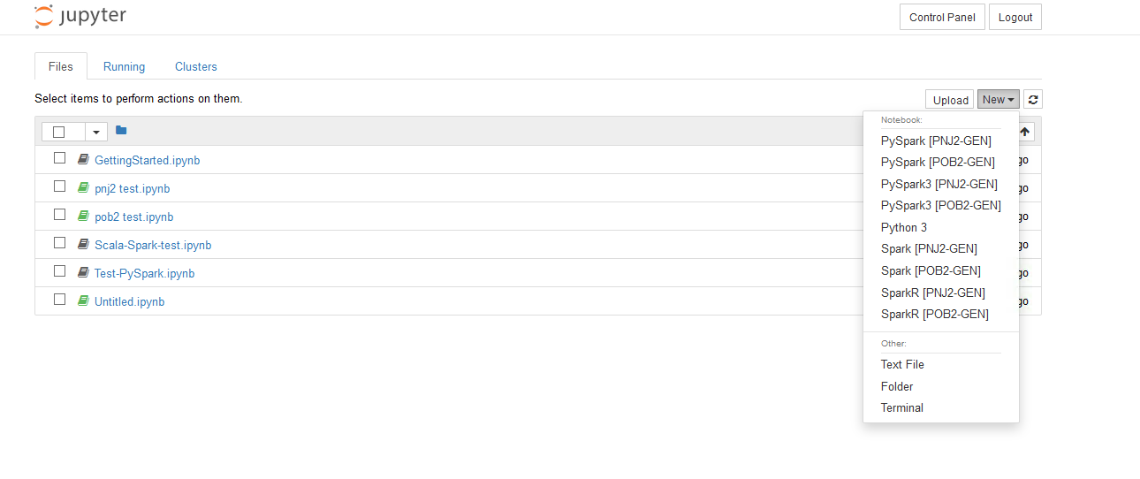
Notebook Choices
Copyright 2016 Bloomberg L.P. All rights reserved.
Notes:
10 min.

Slide 21
Kerberos Integration - Flow
1
Logged-in using Toolkit Account
3
4
5
Log-in using
Kerberos
Authentication
Communicate
using
SM principal
Communicate
using
Livy principal
ADPROD
Jupyter-Hub
LIvy
Spark
Spark Magic
Kinit
Service Principal
Kinit
Service Principal
Kinit
Service Principal
KDC Server
2
Copyright 2016 Bloomberg L.P. All rights reserved.
Notes:
10 min.

Slide 22
Kerberos Integration - Flow
Area of Our Work
1
Logged-in using Toolkit Account
3
4
5
Log-in using
Kerberos
Authentication
Communicate
using
SM principal
Communicate
using
Livy principal
ADPROD
Jupyter-Hub
LIvy
Spark
Spark Magic
Kinit
Service Principal
Kinit
Service Principal
Kinit
Service Principal
KDC Server
2
Copyright 2016 Bloomberg L.P. All rights reserved.
Notes:
10 min.

Slide 23
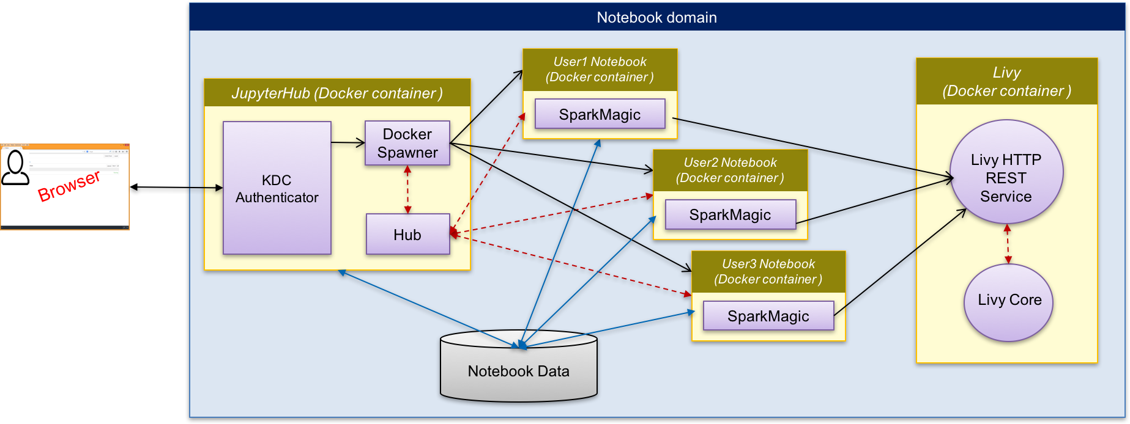
Notebook Deployment Design
Hadoop Cluster

Slide 24
Jupyter Notebook Integration - References
https://bbgithub.dev.bloomberg.com/bdip-datascience/docker-kerberos
{TEAM BBAT:SPARK NOTEBOOK SETUP<GO>} or {TEAM 710414041<GO>}
Notes:
30 sec.

Slide 25
Data Access (Exploration & Analytics)
Low Latency Access
Notebook
Copyright 2016 Bloomberg L.P. All rights reserved.
Notes:
2 min

Slide 26
Data Processing
Low Latency Access
Notebook
Copyright 2016 Bloomberg L.P. All rights reserved.
Notes:
2 min

Slide 27
Data Processing Platform
The Data Science Platform is a suite of tools and services that enables developers to rapidly scale their machine learning projects from development through training and deployment.
Using open source framework runtimes such as Spark or TensorFlow developers can train models on data accessible from anywhere in Bloomberg.
The Data Science Platform is built on top of Docker containers, Kubernetes and a fleet of specialized servers containing CPUs and ultra-fast GPUs.
Through app packaging conventions, users can seamlessly scale their machine learning jobs from workstation/laptop up to clusters of GPUs without changing their code.

Slide 28
Kubernetes Cluster
What it provides-
Scheduled and containerized compute environment built on Kubernetes
Access to GPUs Farm through Kubernetes APIs
What you can do-
Spark Jobs to process data
HDFS (BACH clusters) Access from Compute cluster
Machine learning Jobs using SparkML or Tensorflow
Adhoc analysis using Jupyter notebooks or on-demand Spark clusters
Deep learning using GPUs
How do you use it-
All of these capabilities can be handled through a convenient CLI, Katie CLI (UX to come in the future).

Slide 29
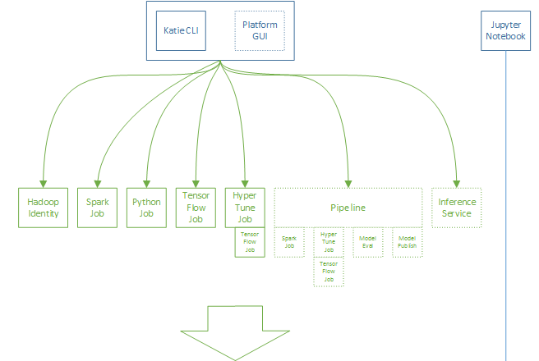
Platform Workflow

Slide 30
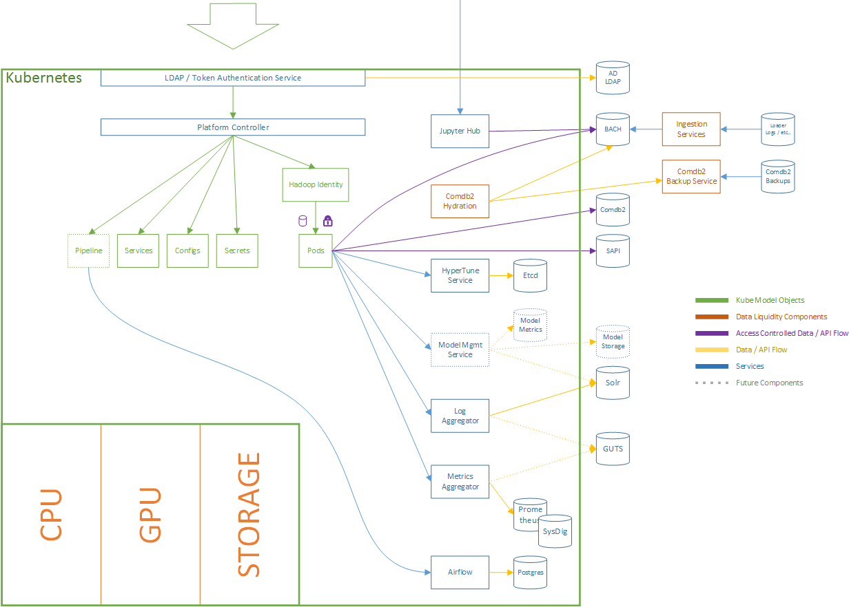
Platform Workflow continue …

Slide 31
Access to Kubernetes Cluster
{TEAM NLP:DATA SCIENCE INFRASTRUCTURE<GO>}
https://bbgithub.dev.bloomberg.com/pages/ds/ds-platform-ctrl/index.html

Slide 32
Kubernetes Deployment- Use Case
Jupyter Notebook for Spark

Slide 33
Notebook Docker Deployment
Hadoop Cluster

Slide 34
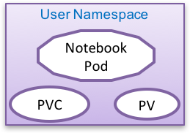
Kubernetes/Docker Deployment
Kubernetes Cluster
Encrypted user-id sent to Sparkmagic running inside notebook
Default
Namespace
Notebook Namespace
User Namespace
Jhub Pod
2
Notebook Pod
1
3
Secrets
PVC
PV
Hadoop Cluster
PV Claims
Livy Pod
4
PV Claims
Livy authenticates to Yarn using krb and sends the proxyUser
PV
Persistent Storage (NFS)
User gets authenticated using Kerberos & Jhub retrieves user-id and encrypts using shared key
Encrypted user-id sent to Livy as proxyUser, Livy decrypts using shared key. No krb authentication at Livy
User namespace and pv are created at runtime or during notebook access granting process.
The user pod and pvc are created and disposed (when not being used) dynamically

Slide 35

On-Demand Spark Cluster – Use case 2
Kubernetes Cluster
User Namespace
Platform Namespace
user.jpg
Driver Service
Driver
Pod
Master
Pod
Spark
Controller
Master Service
Data
In
HDFS
Python
Controller
Worker
Pod
Worker
Pod
Worker
Pod
Replicaset
Spark-Job
…
Docker Images
Spark
Artifactory Repository

Slide 36
Q & A
Copyright 2016 Bloomberg L.P. All rights reserved.

Slide 37
Thank You
Copyright 2016 Bloomberg L.P. All rights reserved.

