Slide 1
October 25, 2016
BDIP Data Science Platform
Pankaj Deshpande
Nauman Rupani
Joy Chakraborty
Copyright 2016 Bloomberg L.P. All rights reserved.

Slide 2


What is this about?
Copyright 2016 Bloomberg L.P. All rights reserved.
Notes:
2 min.

Slide 3
Mission Statement
Create Distributed Data platform to :
Ingest various data sources across the organization
Store data at most granular level in consistent format
Provide tooling across organization to perform Data-exploration, Analysis & Machine learning activities
Copyright 2016 Bloomberg L.P. All rights reserved.
Notes:
2 min.

Slide 4

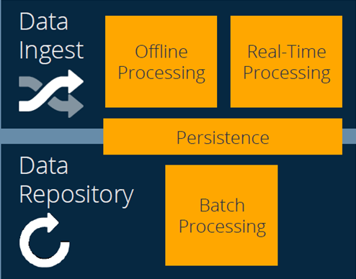
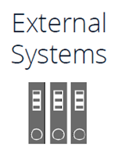






Data Platform Architecture – Target
Low Latency Access
Notebook
Copyright 2016 Bloomberg L.P. All rights reserved.
Notes:
2 min

Slide 5
Data Ingestion
Low Latency Access
Notebook
Copyright 2016 Bloomberg L.P. All rights reserved.
Notes:
2 min

Slide 6
Data Ingestion Process – Overview
External Data
DMZ
Firewall
Machine1
Gateway Machines
Step-1
Internal Databases
Step-2
Machine1
Internal Files
Firewall
Hadoop Cluster
Copyright 2016 Bloomberg L.P. All rights reserved.
Notes:
3-4 min.

Slide 7
Data Ingestion Process – Step 1
External Data
Firewall
Machine1
Gateway Machines
Step-1
Internal Databases
Step-2
Machine1
Internal Files
Firewall
Hadoop Cluster
Copyright 2016 Bloomberg L.P. All rights reserved.
Notes:
3-4 min.

Slide 8
Data Ingestion Process – Step 1
Reactive (Event based) Design
Iteration # 1 : Time based Trigger of upload
Scalability Issues
Iteration # 2 : Reactive
Akka Framework/Camel
Small memory footprint
Asynchronous by design
Multi-threading out of the box
Child actors spawned on-demand

Slide 9
Data Ingestion Process – Step 1
Scalability
Horizontal scale out (add nodes to BDNS farm)
[Future] Akka can also be deployed in cluster mode
Resilient
Recover & Reprocess after machine crash/turnaround
Multi Hadoop Cluster Support
Integration with Bloomberg Tools
APDX, ALMN

Slide 10
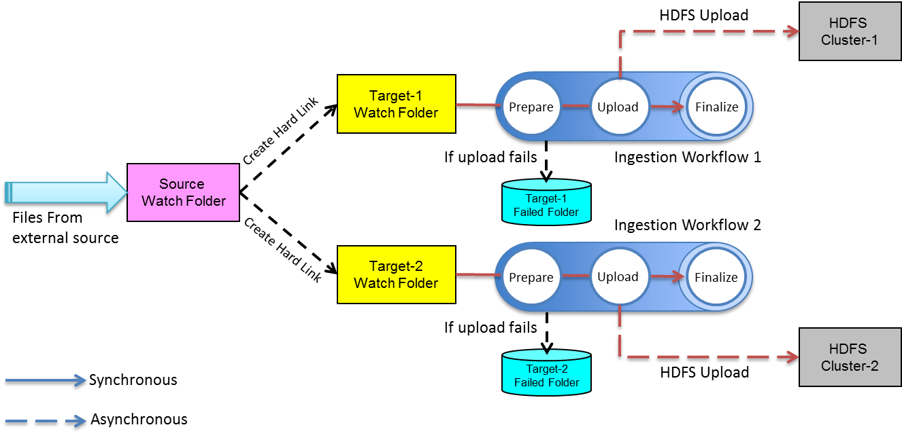
Data Ingestion Process – Step 1
Copyright 2016 Bloomberg L.P. All rights reserved.
Notes:
7 min.

Slide 11
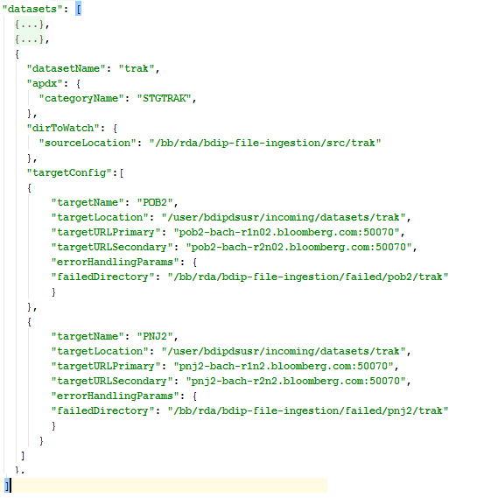

Data Ingestion Process – Step 1
Notes:
15-20 min.
How to upload file(s) to HDFS and Save in Parquet–
Pre-req
Folders for incoming files are defined on WL machines
Folders at HDFS are defined
AVRO Schema is defined
Parsing, filtering logics are defined
APDX

Slide 12
Data Ingestion Process – Step 2
External Data
Firewall
Machine1
Gateway Machines
Step-1
Internal Databases
Step-2
Machine1
Internal Files
Firewall
Hadoop Cluster
Copyright 2016 Bloomberg L.P. All rights reserved.
Notes:
3-4 min.

Slide 13
Data Ingestion Process – Step 2
Data Source Uncertainty/Issues
Duplicate files
Late Arriving files
Corrupt data
Future reprocessing
Seamless rewind to a point in time
Data lineage
Metadata at record level

Slide 14
Data Ingestion Process – Step 2
Extensibility
Data source-specific ETL plugins
Data Storage and Access
Well documented schema
ACL
Data at rest optimized for Query (File formats, partitions)
Data at rest optimized for Storage (Compression)
Standardized View across datasets

Slide 15
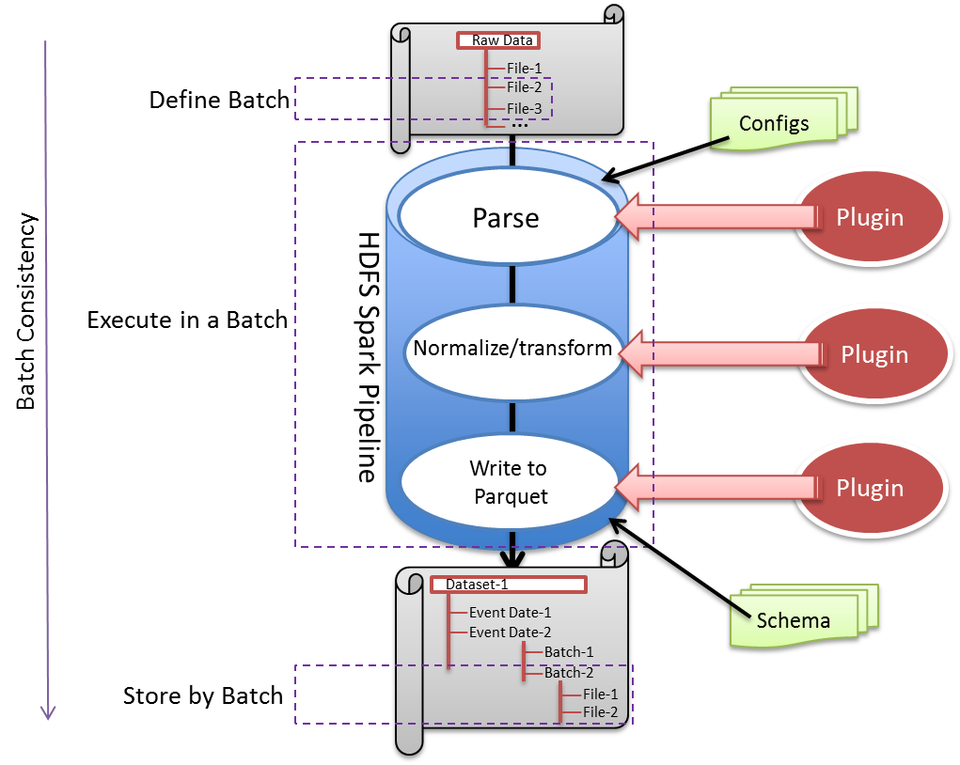
Data Ingestion Process – Step 2
Data at rest in PARQUET
Seamless Re-processing
Record level Audit trail (metadata)
De-dup check at file level
Alarming (ALMN-DRQS integration)
Reusable (Configuration/Plugin)
Workflow support
Data Access Security (PVF)
Copyright 2016 Bloomberg L.P. All rights reserved.
Notes:
10 min.

Slide 16

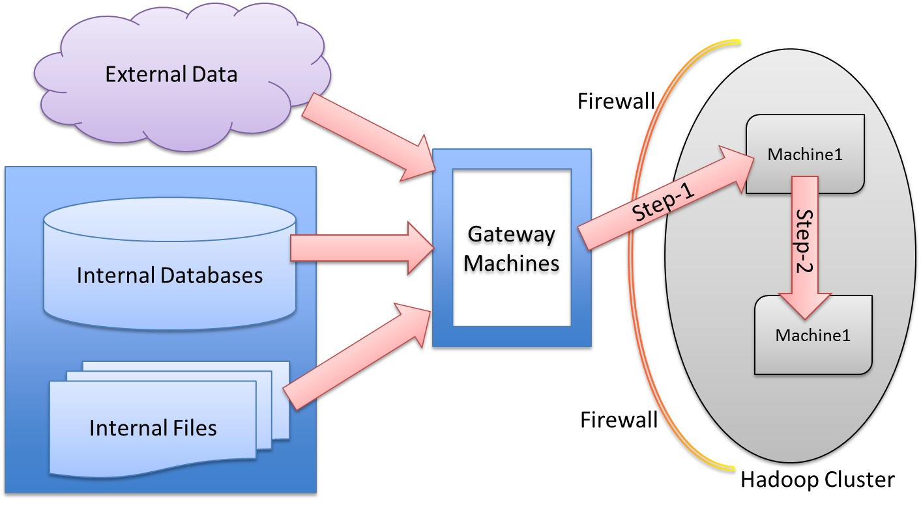
Data Ingestion Process
Notes:
15-20 min.
How to upload file(s) to HDFS and Save in Parquet–
Pre-req
Folders for incoming files are defined on WL machines
Folders at HDFS are defined
AVRO Schema is defined
Parsing, filtering logics are defined
APDX

Slide 17
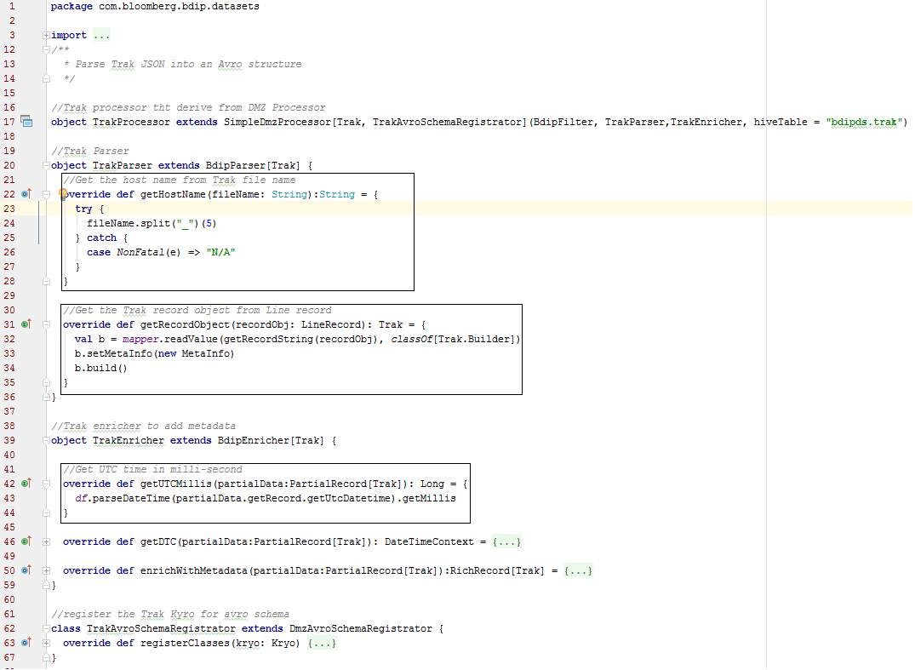
Data Ingestion Process – Step 2

Slide 18
Data Ingestion– Tech Stack
Scala (Functional programming Paradigm)
Akka – Agent based message passing multithreading framework
Camel – File watcher
SBT – Scala Build tool
Apache Spark – In memory distributed processing framework
Artifactory – Library repositories
Oozie – Distributed workflow framework and scheduler
Copyright 2016 Bloomberg L.P. All rights reserved.
Notes:
1 min.

Slide 19
Data Ingestion - Lessons Learned
Map/reduce to Spark - Performance gain for multi-step processing
Judiciously use HDFS - Too many small files => NameNode slowness - Too many files in directory => Heap space/OOM
Organize/Partition your data at rest - Better readability/navigation- Partition pruning, better access performance

Slide 20
Data Ingestion - Lessons Learned
AKKA configuration
With great power comes great responsibility
Metadata enrichment
Consistent view => assists in monitoring
Marry/combine different datasets to get holistic picture
Design for ease of reprocessing
Bugs are inevitable => reprocessing is inevitable
Reduces future reprocessing overhead

Slide 21
Data Ingestion - References
https://bbgithub.dev.bloomberg.com/bdip-datascience/ingestion
{TEAM BBAT:DATA INGESTION PLATFORM - OVERVIEW<GO>} or {TEAM 723880574<GO>}
Notes:
30 sec.

Slide 22
Data Ingestion – Future Capabilities
Support ingestion of Streaming data sources
BBDS Integration (schema management)
Metadata Management tool
Copyright 2016 Bloomberg L.P. All rights reserved.
Notes:
2 min.

Slide 23

Data Ingestion
Low Latency Access
Notebook
Copyright 2016 Bloomberg L.P. All rights reserved.
Notes:
2 min

Slide 24
Data Access (Exploration & Analytics)
Low Latency Access
Notebook
Copyright 2016 Bloomberg L.P. All rights reserved.
Notes:
2 min

Slide 25
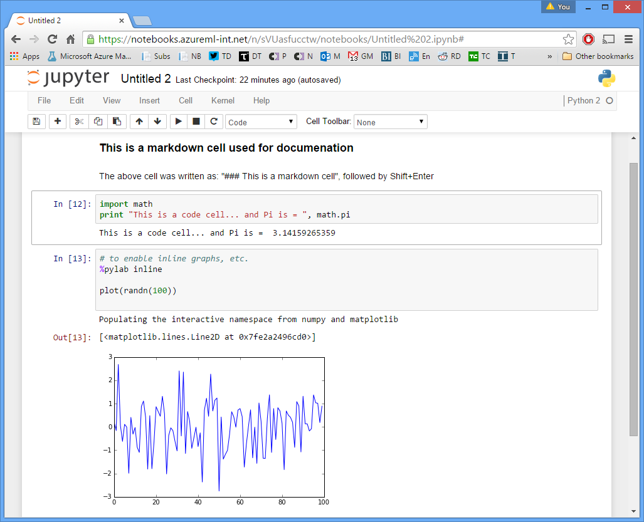
Secure Spark Notebooks
DMZ Notebook Infrastructure for Data Science
Web-based
Scala/Python libraries
Templates
Security and login integration
Data discovery
Enhanced SQL support
Integration with external DBs
Copyright 2016 Bloomberg L.P. All rights reserved.
Notes:
5-7 min.

Slide 26

Secure Spark Notebooks
Where is the Security?
Copyright 2016 Bloomberg L.P. All rights reserved.
Notes:
5-7 min.

Slide 27
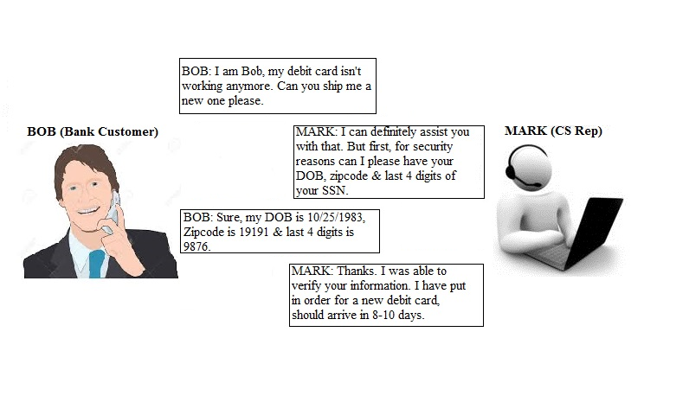
Kerberos Authentication

Slide 28
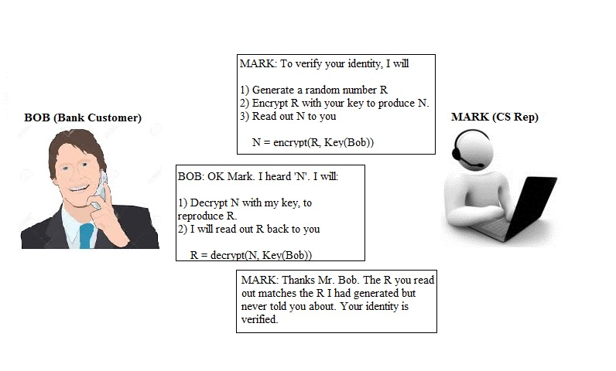
Kerberos Authentication

Slide 29
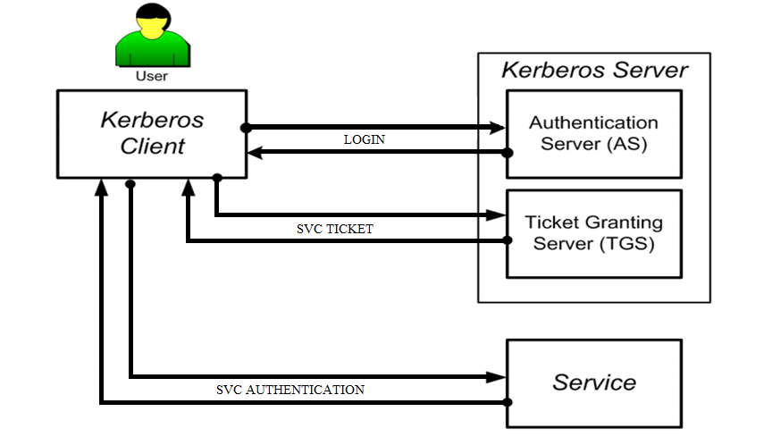
Kerberos Authentication

Slide 30
Secure Spark Notebooks – Tech Stack
Jupyterhub (Notebook web-application for multi-users environment)
SparkMagic (Spark kernel for Jupuyter Notebook supporting Python, Scala)
Livy (HTTP REST webservice for Spark to submit jobs, managing sessions, e.t.c.)
Kerberos (Network authentication protocol using secret-key cryptography)
HDP (HortonWorks Hadoop distribution)
*** Planning to contribute back to Open-Source
Copyright 2016 Bloomberg L.P. All rights reserved.
Notes:
10 min.

Slide 31
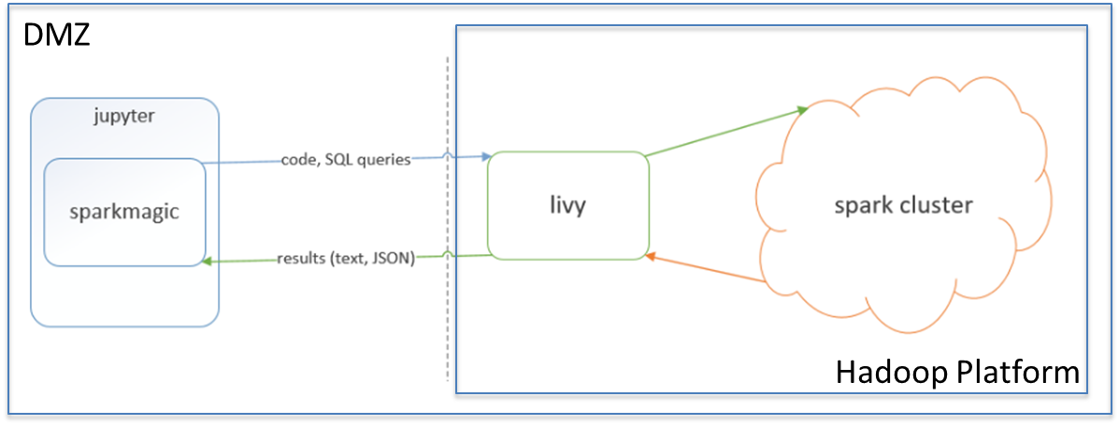
Secure Spark Notebooks – Design
Copyright 2016 Bloomberg L.P. All rights reserved.
Notes:
10 min.

Slide 32
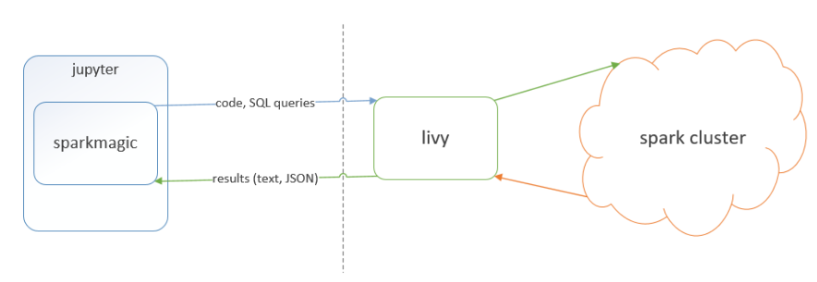
Secure Spark Notebooks – Kerberos
KDC Server
Hadoop Platform
DMZ
Copyright 2016 Bloomberg L.P. All rights reserved.
Notes:
10 min.

Slide 33
Kerberos 101
KDC Server
Kerberos Server (KDC Server)
Client
Hadoop Platform
DMZ
Copyright 2016 Bloomberg L.P. All rights reserved.
Notes:
10 min.

Slide 34
Kerberos 101
KDC Server
Kerberos Server (KDC Server)
1. Kinit using toolkit or Keytab
Client
Hadoop Platform
DMZ
Copyright 2016 Bloomberg L.P. All rights reserved.
Notes:
10 min.

Slide 35
Kerberos 101
KDC Server
Kerberos Server (KDC Server)
1. Kinit using toolkit or Keytab
2. Send a token
Client
Hadoop Platform
DMZ
Copyright 2016 Bloomberg L.P. All rights reserved.
Notes:
10 min.

Slide 36
Kerberos Integration
KDC Server
Hadoop Platform
DMZ
Copyright 2016 Bloomberg L.P. All rights reserved.
Notes:
10 min.

Slide 37
Kerberos Integration
ADPROD
Jupyter-Hub
LIvy
Spark
Spark Magic
KDC Server
Copyright 2016 Bloomberg L.P. All rights reserved.
Notes:
10 min.

Slide 38
Kerberos Integration – Hadoop Startup
ADPROD
Jupyter-Hub
LIvy
Spark
Spark Magic
Service Principal
KDC Server
Copyright 2016 Bloomberg L.P. All rights reserved.
Notes:
10 min.

Slide 39
Kerberos Integration – Livy Startup
ADPROD
Jupyter-Hub
LIvy
Spark
Spark Magic
Kinit
Service Principal
Service Principal
KDC Server
Copyright 2016 Bloomberg L.P. All rights reserved.
Notes:
10 min.

Slide 40
Kerberos Integration – Jupyter Startup
ADPROD
Jupyter-Hub
LIvy
Spark
Spark Magic
Kinit
Service Principal
Kinit
Service Principal
Service Principal
KDC Server
Copyright 2016 Bloomberg L.P. All rights reserved.
Notes:
10 min.

Slide 41

Kerberos Integration – User Login
1
Logged-in using Toolkit Account
ADPROD
Jupyter-Hub
LIvy
Spark
Spark Magic
Kinit
Service Principal
Kinit
Service Principal
Service Principal
KDC Server
Copyright 2016 Bloomberg L.P. All rights reserved.
Notes:
10 min.

Slide 42
Kerberos Integration – Authentication
1
Logged-in using Toolkit Account
ADPROD
Jupyter-Hub
LIvy
Spark
Spark Magic
Kinit
Service Principal
Kinit
Service Principal
Kinit
Service Principal
KDC Server
2
Copyright 2016 Bloomberg L.P. All rights reserved.
Notes:
10 min.

Slide 43
Kerberos Integration - Authentication
1
Logged-in using Toolkit Account
3
Log-in using
Kerberos
Authentication
ADPROD
Jupyter-Hub
LIvy
Spark
Spark Magic
Kinit
Service Principal
Kinit
Service Principal
Kinit
Service Principal
KDC Server
2
Copyright 2016 Bloomberg L.P. All rights reserved.
Notes:
10 min.

Slide 44
Kerberos Integration - Authentication
1
Logged-in using Toolkit Account
3
4
Log-in using
Kerberos
Authentication
Communicate
using
SM principal
ADPROD
Jupyter-Hub
LIvy
Spark
Spark Magic
Kinit
Service Principal
Kinit
Service Principal
Kinit
Service Principal
KDC Server
2
Copyright 2016 Bloomberg L.P. All rights reserved.
Notes:
10 min.

Slide 45
Kerberos Integration – at Startup
ADPROD
Jupyter-Hub
LIvy
Spark
Spark Magic
Kinit
Service Principal
Kinit
Service Principal
Service Principal
KDC Server
Copyright 2016 Bloomberg L.P. All rights reserved.
Notes:
10 min.

Slide 46
Kerberos Integration - Flow
1
Logged-in using Toolkit Account
3
4
5
Log-in using
Kerberos
Authentication
Communicate
using
SM principal
Communicate
using
Livy principal
ADPROD
(ADPRD)
Jupyter-Hub
LIvy
Spark
Spark Magic
Kinit
Service Principal
Kinit
Service Principal
Kinit
Service Principal
KDC Server
2
Copyright 2016 Bloomberg L.P. All rights reserved.
Notes:
10 min.

Slide 47
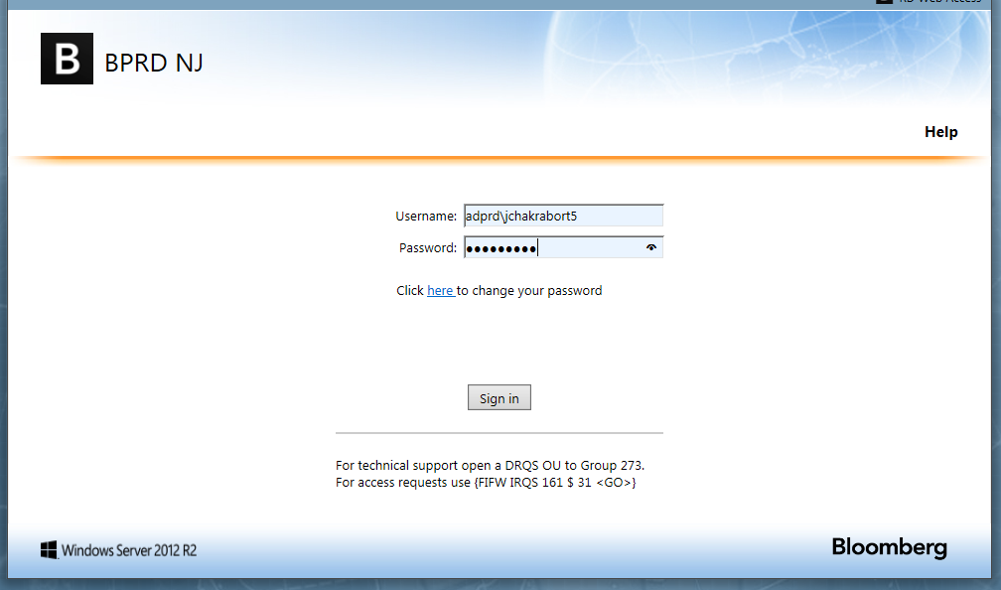
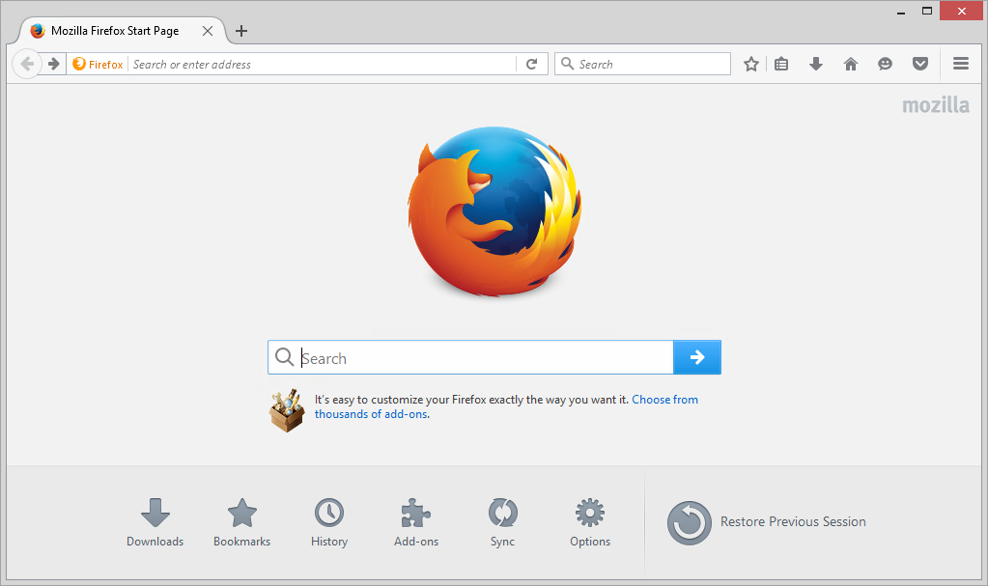
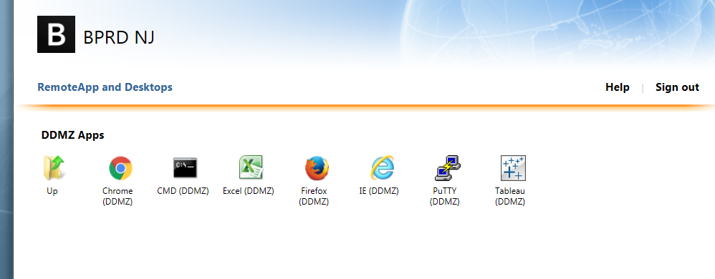
Kerberos Integration - Flow
1
Logged-in using Toolkit Account
3
4
5
Log-in using
Kerberos
Authentication
Communicate
using
SM principal
Communicate
using
Livy principal
ADPROD
Jupyter-Hub
LIvy
Spark
Spark Magic
Kinit
Service Principal
Kinit
Service Principal
Kinit
Service Principal
KDC Server
2
Copyright 2016 Bloomberg L.P. All rights reserved.
Notes:
10 min.

Slide 48
Kerberos Integration - Flow
1
Logged-in using Toolkit Account
3
4
5
Log-in using
Kerberos
Authentication
Communicate
using
SM principal
Communicate
using
Livy principal
ADPROD
Jupyter-Hub
LIvy
Spark
Spark Magic
Kinit
Service Principal
Kinit
Service Principal
Kinit
Service Principal
KDC Server
2
Copyright 2016 Bloomberg L.P. All rights reserved.
Notes:
10 min.

Slide 49
Kerberos Integration - Flow
Area of Our Work
1
Logged-in using Toolkit Account
3
4
5
Log-in using
Kerberos
Authentication
Communicate
using
SM principal
Communicate
using
Livy principal
ADPROD
Jupyter-Hub
LIvy
Spark
Spark Magic
Kinit
Service Principal
Kinit
Service Principal
Kinit
Service Principal
KDC Server
2
Copyright 2016 Bloomberg L.P. All rights reserved.
Notes:
10 min.

Slide 50
Jupyter Notebook Integration - Demo
Notes:
15-20 min.
How to upload file(s) to HDFS and Save in Parquet–
Pre-req
Folders for incoming files are defined on WL machines
Folders at HDFS are defined
AVRO Schema is defined
Parsing, filtering logics are defined
APDX

Slide 51
Jupyter Notebook Integration - References
https://bbgithub.dev.bloomberg.com/bdip-datascience/docker-kerberos
{TEAM BBAT:SPARK NOTEBOOK SETUP<GO>} or {TEAM 710414041<GO>}
Notes:
30 sec.

Slide 52
Q & A
Copyright 2016 Bloomberg L.P. All rights reserved.

Slide 53
Thank You
Copyright 2016 Bloomberg L.P. All rights reserved.

