Slide 1
Unleashing Kubernetes
Joy Chakraborty
December 13, 2017
Email: joychak1@[yahoo/gmail].com]]

Slide 2
Essentially what we will be doing -
To build an on-demand Distributed Compute platform using Kubernetes

Slide 3
Who am I ???
I learn and apply ….
- Design and write software for living
- for last 17 years …

Slide 4
Disclaimer
We will be just scratching the Surface !!!

Slide 5

Agenda
1
Why Kubernetes
2
What is Kubernetes
3
Ingredients to build a Distributed platform
4
Build and test a Distributed Compute platform

Slide 6
Why?

Slide 7
Distributed Platform ???

Slide 8
Distributed Platform ???
Support Elasticity
Store more and more data
Process massive amount of data in parallel
Support multitenancy

Slide 9
How it looks typically ???

Slide 10
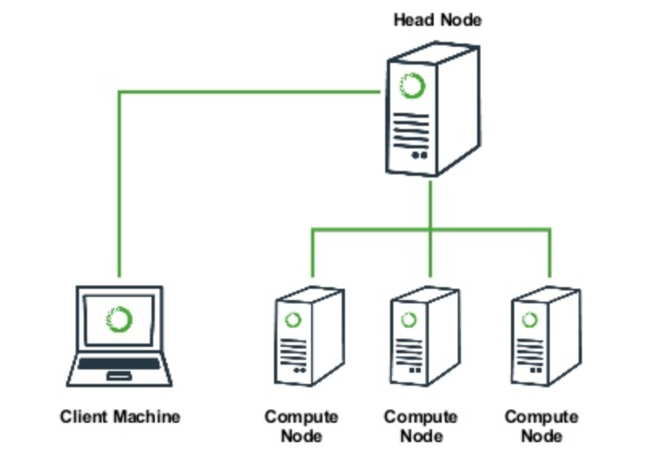
How it looks typically ???

Slide 11
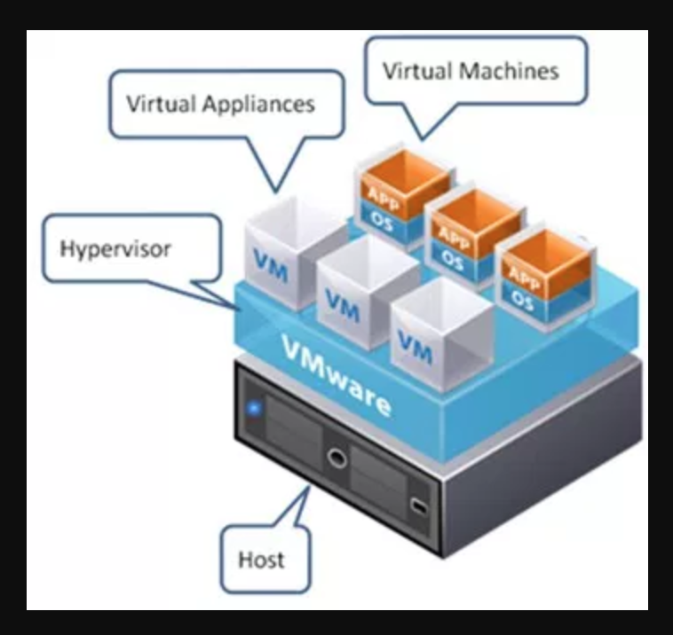
Options to build???
Virtualization (using VMs)
CPU
Memory
Network

Slide 12
Options to build???
Virtualization (using VMs)
CPU
Memory
Network
*** Clean isolation !!!

Slide 13
VM’s +/-

Slide 14
VM’s +/-
Virtual machines have
a full OS with its own memory management installed with the associated overhead of virtual device drivers
valuable resources are emulated for the guest OS and hypervisor
that makes it possible to run many instances of one or more operating systems in parallel on a single machine (or host)
every guest OS runs as an individual entity from the host system

Slide 15
Any other options?

Slide 16
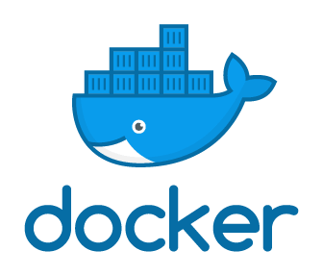
Containerized Solution (Docker)

Slide 17
Containerized Solution (Docker)
Containers are executed -
with the engine (Docker engine) rather than the hypervisor
smaller than Virtual Machines and enable faster start up with better performance
less isolation and greater compatibility possible due to sharing of the host’s kernel and application Libraries

Slide 18
Containerized Solution (Docker)
Containers are executed -
with the engine (e.g. Docker engine) rather than the hypervisor
smaller than Virtual Machines and enable faster start up with better performance
less isolation and greater compatibility possible due to sharing of the host’s kernel and application Libraries
A container image is a lightweight, stand-alone, executable package of a piece of software that includes everything needed to run it: code, runtime, system tools, system libraries, settings

Slide 19
VM/Hypervisor vs. Container
Application
Application
Application
Runtime System
Runtime System
Runtime System
Application
Application
Application
Operating System
Operating System
Operating System
Runtime System
Runtime System
Runtime System
Hypervisor
Container Manager
Operating System (Kernel + FS)
Operating System (Kernel + FS)

Slide 20
VM/Hypervisor vs. Container
Application
Application
Application
Runtime System
Runtime System
Runtime System
Application
Application
Application
Operating System
Operating System
Operating System
Runtime System
Runtime System
Runtime System
Hypervisor
Container Manager
Operating System (Kernel + FS)
Operating System (Kernel + FS)
Docker - to create, manage, and monitor Linux containers
Based on Linux libcontainer
Ansible is another container-management system favored by Red Hat

Slide 21
Containerized Distributed System - Infrastructure

Slide 22
Containerized Distributed System - Infrastructure
Container Management
Scheduling
Resource Management

Slide 23
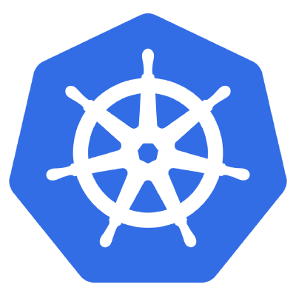
Containerized Distributed System - Infrastructure
Container Management
Scheduling
Resource Management
Kubernetes
Notes:
Artificial intelligence is intelligence exhibited by machines. In computer science, the field of AI defines itself as the study of "intelligent agents": any device that perceives its environment and takes actions that maximize its chance of success at some goal

Slide 24
what?

Slide 25
Kubernetes
An open-source system for automating deployment, scaling, and management of containerized applications.
Portable
Extensible: modular, plug-able, compos-able
Self-healing: auto-placement, auto-restart, auto-replication, auto-scaling
Latest Release: 1.8.5
Community driven completely
Written in GoLang

Slide 26
Kubernetes High Level Architecture

Slide 27
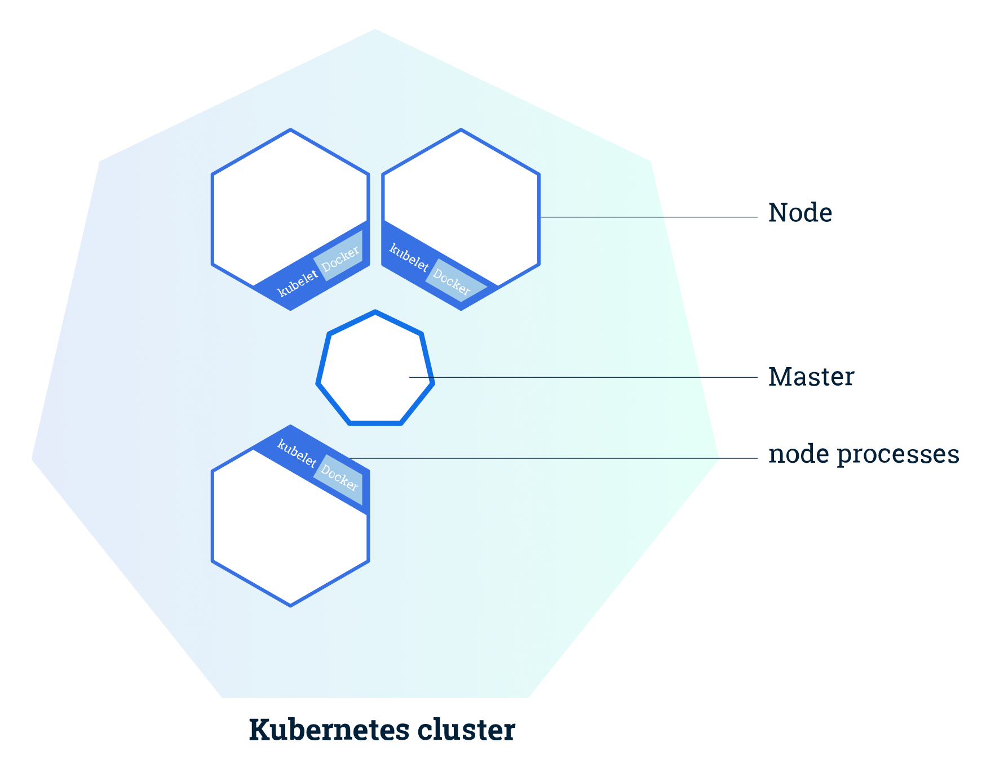
Kubernetes High Level Architecture
The Kubernetes Master is a collection of three processes that run on a single node in your cluster, which is designated as the master node.
kube-apiserver
kube-controller-manager
kube-scheduler
Each individual non-master node in your cluster runs two processes –
kubelet, which communicates with the Kubernetes Master
kube-proxy, a network proxy which reflects Kubernetes networking services on each node.
Kube-apiserver
Kube-Controller-manager

Slide 28
Kubernetes basic components -distributed platform

Slide 29
Kubernetes Object/Resource (out of the box)
Namespace
Pod (a basic unit of work)
Service
Volume

Slide 30
Kubernetes Object/Resource (out of the box)
Namespace
Pod (a basic unit of work)
Service
Volume
ReplicaSet
Deployment
Job

Slide 31
Kubernetes Object/Resource (out of the box)
Namespace
Pod (a basic unit of work)
Service
Volume
ReplicaSet
Deployment
Job
RBAC

Slide 32
Kubernetes Object/Resource (out of the box)
Namespace
Pod (a basic unit of work)
Service
Volume
ReplicaSet
Deployment
Job
RBAC
*** Custom Resource

Slide 33
Kubernetes Pod
Pod is the basic building block of Kubernetes–
the smallest and simplest unit in the Kubernetes object model that you create or deploy
represents a running process on your cluster.
encapsulates an application container (or, in some cases, multiple containers), storage resources, a unique network IP, and options that govern how the container(s) should run
Docker is the most common container runtime used in a Pod, but Pods support other container runtimes as well

Slide 34
How to Interact with Kubernetes

Slide 35
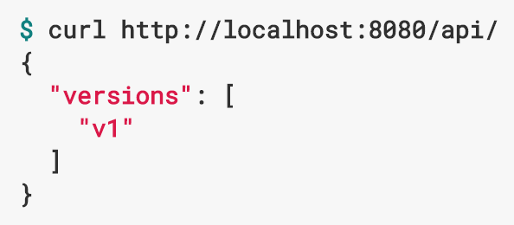

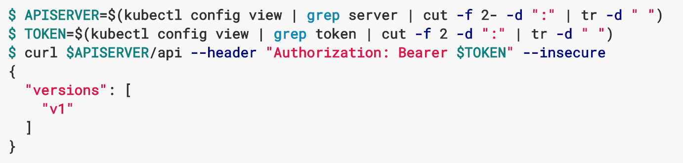
How to Interact with Kubernetes
REST API
Curl or browser
Command Line Interface
Kubectl
Kube Config
Created during cluster creation
Programmatic
GoLang, Python, Scala

Slide 36
How to Create a Pod

Slide 37
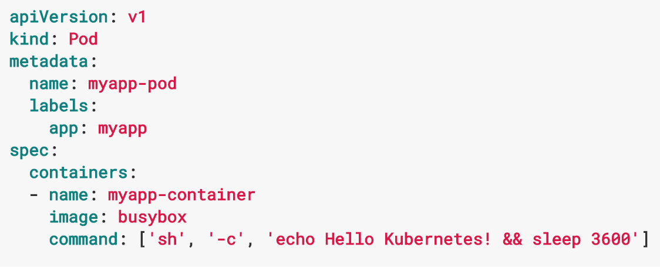
How to Create a Pod
Create a Pod template in YAML (data serialization standard)

Slide 38
How to Create a Pod
Create a Pod template in YAML (data serialization standard)
Run kubectl

Slide 39
Lets build a Distributed Compute Cluster !!!

Slide 40
Steps to follow -

Slide 41
Steps to follow -
Build a Kubernetes Cluster (https://github.com/kumulustech/vagrant-kubeadm)
Setup the config (kubectl cluster-info)
Setup the Kubectl CLI (https://kubernetes.io/docs/tasks/tools/install-kubectl/)
Develop and Deploy Controller
Create Custom Resource
Submit a Job

Slide 42
Steps to follow -
Build a Kubernetes Cluster (https://github.com/kumulustech/vagrant-kubeadm)
Setup the config (kubectl cluster-info)
Setup the Kubectl CLI (https://kubernetes.io/docs/tasks/tools/install-kubectl/)
Develop and Deploy Controller
Create Custom Resource
Submit a Job
Next Slide

Slide 43
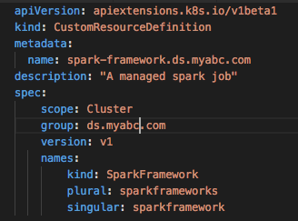
Custom Resource and Deploy

Slide 44
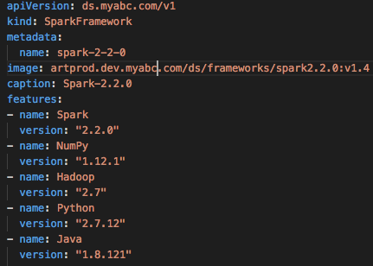
Custom Resource and Deploy

Slide 45
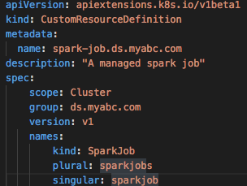
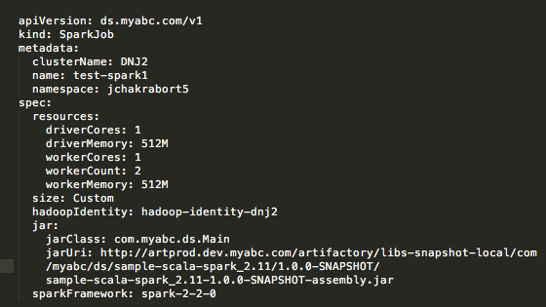
Custom Resource and Deploy

Slide 46
Custom Resource and Deploy

Slide 47
Custom Controller

Slide 48
Custom Controller
Kube-apiserver
Kube-Controller-manager

Slide 49
Custom Controller
Kube-apiserver
Kube-Controller-manager
Custom
Controller

Slide 50
Lets build a Spark Cluster !!!

Slide 51
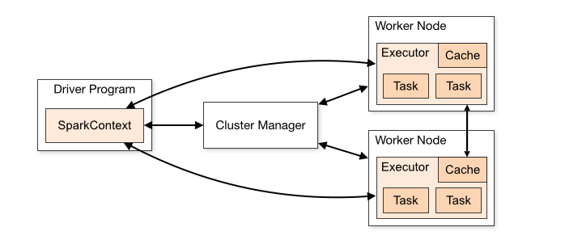
Apache Spark Cluster - Architecture
Notes:
General Purpose

Slide 52

Apache Spark – Kubernetes Deployment
Kubernetes Cluster
User Namespace
Platform Namespace
user.jpg
Driver Service
Driver
Pod
Master
Pod
Spark
Controller
Master Service
Python
Controller
Worker
Pod
Worker
Pod
Worker
Pod
Replicaset
Spark-Job
…
Docker Images
Spark
Artifactory Repository
Notes:
General Purpose

Slide 53
Lets Run a parallel program in a Spark Cluster !!!

Slide 54
Calculate PI (3.14……..)
Y

Slide 55
Calculate PI (3.14……..)
Y
X

Slide 56

Calculate PI (3.14……..)
Y
$$A=πr^{2}$$
X
1
1

Slide 57
Calculate PI (3.14……..)
Y
$$A=πr^{2}$$
X
1
1

Slide 58
Calculate PI (3.14……..)
Y
$$A=πr^{2}$$
y
X
x
1
1

Slide 59
Calculate PI (3.14……..)
Y
$$A=πr^{2}$$
1
y
X
x
1
1

Slide 60
Thank You
Email: joychak1@[yahoo/gmail].com]

