Slide 1
CS4101 Introduction to Embedded Systems Inter-Task Communication
Prof. Chung-Ta King
Department of Computer Science
National Tsing Hua University, Taiwan
(Materials from Prof. Insup Lee, Prof. Frank Drews, MQX User Guide, Using the FreeRTOS Real Time Kernel, Study of an Operating System: FreeRTOS)

Slide 2
Consider This FreeRTOS Example
int Light, xAxis, yAxis; void setup() { xTaskCreate(photoresistor,”Task1”,128,NULL,3,NULL); xTaskCreate(joystick,”Task2”,128,NULL,3,NULL); xTaskCreate(RGB_LED,”Task3”,128,NULL,3,NULL); vTaskStartScheduler(); } void photoresistor(void) { Light = ...; } void joystick(void) { xAxis = ...; yAxis = ...; } void RGB_LED(void) { ... = ...Light ... xAxis ... yAxis; }
Tasks communicate through shared variables
What’s wrong with this?
Notes:
1
1

Slide 3
Consider Another Example
int Shared = 0; void setup() { xTaskCreate(Task1,”Task1”,128,NULL,3,NULL); xTaskCreate(Task2,”Task2”,128,NULL,3,NULL); xTaskCreate(Task3,”Task3”,128,NULL,1,NULL); vTaskStartScheduler(); } void Task1(void) { ... Shared = Shared + 1; ... } void Task2(void) { ... Shared = Shared + 1; ... } Void Task3(void) { ... Ans = Shared; ... }
What will you get in Ans?
Notes:
2
2

Slide 4
Let’s Examine the Assembly Code
Task1 Task2
... ...
ld r1,M[Shared] ld r1,M[Shared]
add r2,r1,#1 add r2,r1,#1
st r2,M[Shared] st r2,M[Shared]
... ...

Slide 5
When Tasks Are Scheduled to CPU
Time Task1 Task2
...
ld r1,M[Shared]
ld r1,M[Shared]
add r2,r1,#1
st r2,M[Shared]
add r2,r1,#1
st r2,M[Shared]
Tick interrupt
CPU runs scheduler, which chooses Task2
CPU saves Task1’s state in its stack
CPU restores Task2’s state from its stack and runs it
Task1’s state is restored and run
What will you get in Shared?

Slide 6
Problem with Shared Variables
Writer-reader relationship
Using shared variables to communicate between tasks may be “unsafe”, especially when two or more tasks want to update the variables at the same time
Such shared variables must be “protected” from tampering from other tasks
Updates to such variables are “critical” and must be made atomic
How to do?
Disable interrupts when executing such critical sections
Use “protected” data structure, e.g., queue in FreeRTOS
Provide special synchronization primitives, e.g., mutex
…

Slide 7
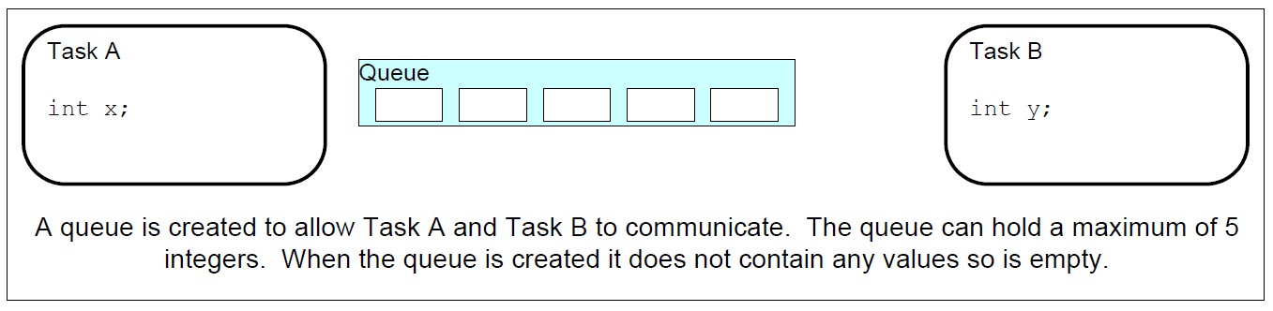
FreeRTOS Queues
Queues:
A queue can hold a finite number of fixed size data items
In most cases, used as thread safe FIFO (First In First Out) buffers with new data being sent to the back of the queue, and removed from the front
Can be used to send messages between tasks, and between interrupts and tasks

Slide 8
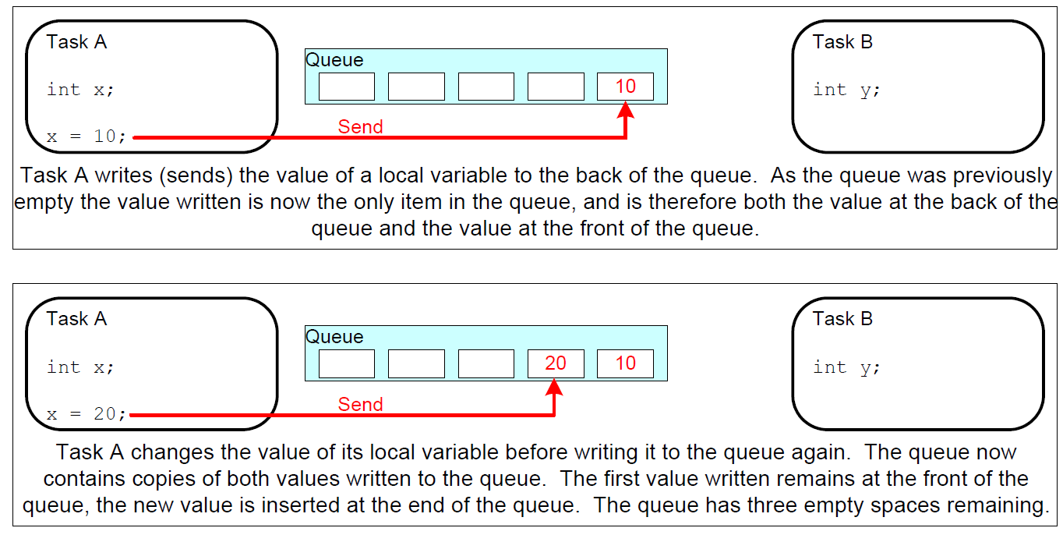
FreeRTOS Queues

Slide 9
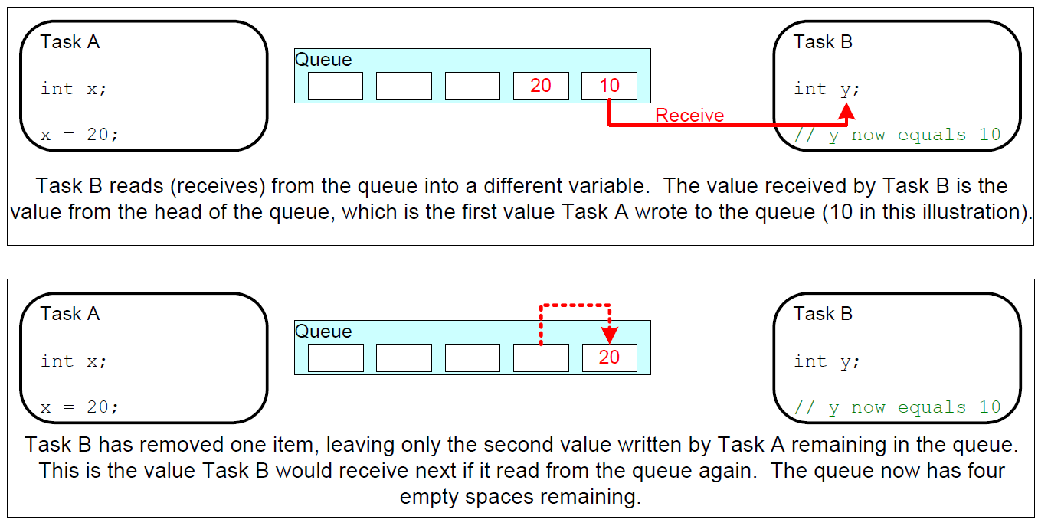
FreeRTOS Queues

Slide 10
FreeRTOS Queues
Queues are objects in their own right
May be read and written by different tasks, but do not belong to any task
# of items and item size determined at queue create time
Sending/receiving items are by copy not reference
What happen when more than one task write into or read from a queue?

Slide 11
FreeRTOS Queues
Queue functions
Create queues: xQueueCreate(), vQueueDelete()
Send/receive data to/from queues: xQueueSend(), xQueueSendToBack(), xQueueReceive(), xQueueReceiveFromISR()
Queue management: number of items in a queue, …
Blocking on a queue: effect of priority, …

Slide 12
Queue Creation
A queue must be explicitly created before it can be used
FreeRTOS allocates RAM from the heap when a queue is created
RAM holds both the queue data structure and the items that are contained in the queue
xQueueCreate():
Used to create a queue and returns an xQueueHandle to reference the queue it creates

Slide 13
Queue Creation
QueueHandle_t xQueueCreate(
UBaseType_t uxQueueLength,
UBaseType_t uxItemSize);
Creates a new queue instance
Allocates queue storage and returns a handle
uxQueueLength: maximum number of items that the queue can contain
uxItemSize: number of bytes that each item in the queue will require
Items are queued by copy, not by reference, so this is the number of bytes that will be copied for each posted item
Each item on the queue must be the same size

Slide 14
Send Data through Queues
BaseType_t xQueueSend(QueueHandle_t xQueue,
const void * pvItemToQueue,
TickType_t xTicksToWait);
Post an item on a queue
The item is queued by copy, not by reference
Must not be called from an interrupt service routine
xQueue: queue handle to which the item is to be posted
pvItemToQueue: pointer to item to be placed on queue
xTicksToWait: max. time (in ticks) that task should block waiting for space to become available, should it is full
If INCLUDE_vTaskSuspend is set to '1‘, then specifying the block time as portMAX_DELAY will block task indefinitely

Slide 15
Blocking on Queues
Queue APIs permit a block time to be specified
When read from an empty queue,
Task will be placed into the Blocked state
Until data is available on the queue or block time expires
When write to a full queue,
Task will be placed into the Blocked state
Until space is available in the queue, or block time expires
If more than one task block on same queue, then the task with the highest priority will be unblocked first
If the blocked tasks have equal priority, the task that has been waiting for data the longest will be unblocked
How about a queue with length 1?

Slide 16
Receive Data through Queues
BaseType_t xQueueReceive(
QueueHandle_t xQueue, void *pvBuffer,
TickType_t xTicksToWait);
Receive an item from a queue
The item is received by copy so a buffer of adequate size must be provided
Must not be used in an interrupt service routine
xQueue: queue handle from which to receive item
pvBuffer: pointer to the buffer into which the received item will be copied
xTicksToWait: max. amount of time the task should block waiting for an item, should the queue be empty

Slide 17
Example of Queues (1/2)
QueueHandle_t Global_Queue_Handle = 0; //Global Handler void setup() { Serial.begin(9600); // Create a queue of 3 int Global_Queue_Handle = xQueueCreate(3, sizeof(int)); // Create tasks with priority 1 // xTaskCreate(sender_task,(const portCHAR *)"sx", 128, NULL, 1, NULL); xTaskCreate(receiver_task,(const portCHAR *)"rx", 128, NULL, 1, NULL); vTaskStartScheduler(); }
Notes:
16
16

Slide 18
Example of Queues (2/2)
void sender_task(void *p){ int i=0; while(1){ Serial.println("sent value:"); Serial.println(i); if(!xQueueSend(Global_Queue_Handle, &i++, 1000)) Serial.println("Failed to send to queue"); vTaskDelay(3000/portTICK_PERIOD_MS); //delay 3 sec } } void receiver_task(void *p){ int rx_int = 0; while(1){ if(xQueueReceive(Global_Queue_Handle,&rx_int,1000)){ Serial.println("receive value:"); Serial.println(rx_int); } else Serial.println("Failed to receive from queue"); } }
Notes:
17
17

Slide 19
Using Queues within an ISR
BaseType_t xQueueSendFromISR(
QueueHandle_t xQueue,
const void *pvItemToQueue,
BaseType_t *pxHigherPriorityTaskWoken);
Post an item into the back of a queue
Safe to use from within an interrupt service routine
pxHigherPriorityTaskWoken: get set to pdTRUE if sending to the queue causes a task to unblock, and the unblocked task has a priority higher than the currently running task

Slide 20
Using Queues within an ISR
BaseType_t xQueueReceiveFromISR(
QueueHandle_t xQueue, void *pvBuffer,
BaseType_t *pxHigherPriorityTaskWoken);
Receive an item from a queue
Safe to use from within an interrupt service routine
pxHigherPriorityTaskWoken: A task may be blocked waiting for space to become available on the queue. If xQueueReceiveFromISR() causes such a task to unblock, *pxHigherPriorityTaskWoken will get set to pdTRUE, otherwise *pxHigherPriorityTaskWoken will remain unchanged

Slide 21
Other Functions for Queues
portBASE_TYPE xQueuePeek(
xQueueHandle xQueue,
const void * pvBuffer,
portTickType xTicksToWait);
Receive an item from the head of the queue without removing the item from the queue
unsigned portBASE_TYPE uxQueueMEssagesWaiting(
xQueueHandle xQueue);
Query the number of items currently in a queue

