Slide 1
CS4101 嵌入式系統概論 Low-Power Optimization
Prof. Chung-Ta King
Department of Computer Science
National Tsing Hua University, Taiwan
(Materials from MSP430 Microcontroller Basics, John H. Davies, Newnes, 2008)

Slide 2
Introduction
Why low power?
Portable and mobile devices are getting popular, but they have limited power sources, e.g., battery
Energy conservation for our planet
Power generates heat → slim formfactor, low carbon
Power optimization becomes a new dimension in system design, besides performance and cost
MSP430 provides many features for low-power operations, which will be discussed later

Slide 3
Outline
Introduction to low-power optimizations
Low-power design in MSP430

Slide 4

Energy and Power
Energy: ability to do work
Most important in battery-powered systems
Power: energy per unit time
Important even in wall-plug systems---power becomes heat
Power increases with…
Vcc
Clock speed
Temperature

Slide 5
Efforts for Low Power
Device/transistor level
Development of low power devices
Reducing power supply voltage
Reducing threshold voltage
Circuit level
Clock gating, frequency reduction, circuit turned off
Asynchronous circuits
System level
Compiler optimization for energy
OS-directed power management and resource scheduling
Application level
Notes:
4

Slide 6
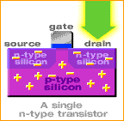
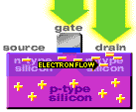
Power Consumption: Transistor Level
Switching consumes power → dynamic power
Switching slower, consume less power
Smaller sizes reduce power to operate
Leakage → static power

Slide 7
Power Consumption: Circuit Level
Power consumption of CMOS circuits (ignoring leakage):
Delay for CMOS circuits:
Decreasing V_{dd} reduces P quadratically, while the execution time of circuits is only linearly increased
Notes:
6

Slide 8
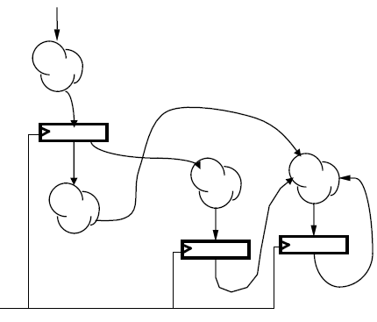
Power Consumption: Circuit Level
Clock gating for synchronous sequential logic:
Disable the clock so that flip-flops will hold their states forever and the whole circuit will not switch
→ no dynamic power consumed
Still need static power to hold the states
clock

Slide 9
System Level: Compiler
Energy-aware code scheduling
Energy-aware instruction selection
Operator strength reduction: e.g. replace * by + and <<
Standard optimizations with energy as a cost function
R2 = a[0]; for (i = 1; i < 10; i++) { R1 = a[i]; C = 2 * R1 + R2; R2 = R1; }
e.g.: register pipelining:
for (i = 1; i < 10; i++) C = 2 * a[i] + a[i-1];
Notes:
8

Slide 10
System Level: Compiler
First-order optimization:
high performance = low energy (some exceptions)
Eliminate pipeline stalls (e.g., software pipeline)
Use registers efficiently
Identify and eliminate cache conflicts
Optimize memory access patterns
Moderate loop unrolling eliminates some loop overhead instructions
Inlining procedures may help: reduces linkage, but may increase cache thrashing

Slide 11
System Level: OS
Idle base
After idle for a period, switch system to sleep mode
Power-aware memory management
e.g. OS can determine points during execution of an application where memory banks would remain idle, so they can be transitioned to low power modes
Power-aware disk buffer cache
Collect disk operations in a cache until the hard drive is running or has enough data

Slide 12
System Level: Cooperative I/O
Time
Idle
Idle
Idle
Idle
Idle
Standby
Idle
Time
Standby
Idle
Standby
Reduces power consumption by batching requests

Slide 13
Outline
Introduction to low-power optimizations
Low-power design in MSP430

Slide 14
General Strategies
Put the system in low-power modes and/or use low-power modules as much as possible
How?
Provide clocks of different frequencies → frequency scaling
Turn off clocks when no work to do → clock gating
Use interrupts to wake up the CPU, return to sleep when done (another reason to use interrupts)
Switch on peripherals only when needed
Use low-power integrated peripheral modules in place of software, e.g., move data between modules

Slide 15
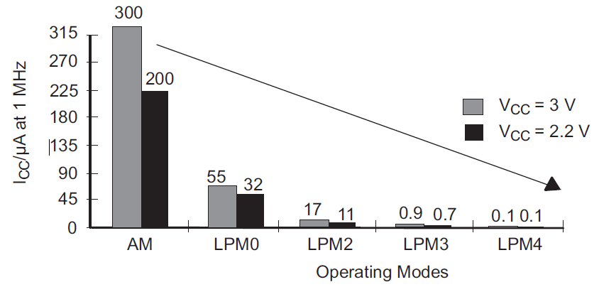
MSP430 Low-Power Modes
Mode | CPU and Clocks
Active | CPU active; all enabled clocks active
LPM0 | CPU, MCLK disabled; SMCLK, ACLK active
LPM1 | CPU, MCLK disabled; DCO disabled if not for SMCLK; ACLK active
LPM2 | CPU, MCLK, SMCLK, DCO disabled; ACLK active
LPM3 | CPU, MCLK, SMCLK, DCO disabled; ACLK active
LPM4 | CPU and all clocks disabled

Slide 16
MSP430 Low Power Modes
Active mode:
MSP430 starts up in this mode, which must be used when the CPU is required, i.e., to run code
An interrupt automatically switches MSP430 to active
Current can be reduced by running at the lowest supply voltage consistent with the frequency of MCLK, e.g. V_{CC} to 1.8V for f_{DCO} = 1MHz
LPM0:
CPU and MCLK are disabled
Used when CPU is not required but some I/O modules require a fast clock from SMCLK and DCO
Notes:
Low-power mode 2 or 3 is selected if bits CPUOff and SCG1 in the status register are set. Immediately after the bits are set, CPU, MCLK, and SMCLK operations halt and all internal bus activities stop until an interrupt request or reset occurs.
Peripherals that operate with the MCLK or SMCLK signal are inactive because the clock signals are inactive. Peripherals that operate with the ACLK signal are active or inactive according with the individual control registers and the module enable bits in the SFRs. All I/O port pins and the RAM/registers are unchanged. Wake up is possible by enabled interrupts coming from active peripherals or RST/NMI.

Slide 17
MSP430 Low Power Modes
LPM3:
Only ACLK remains active
Standard low-power mode when MSP430 must wake itself at regular intervals and needs a (slow) clock
Also required if MSP430 must maintain a real-time clock
LPM4:
CPU and all clocks are disabled
MSP430 can be wakened only by an external signal, e.g., RST/NMI, also called RAM retention mode

Slide 18
Controlling Low Power Modes
Through four bits in Status Register (SR) in CPU
SCG0 (System clock generator 0): when set, turns off DCO, if DCOCLK is not used for MCLK or SMCLK
SCG1 (System clock generator 1): when set, turns off the SMCLK
OSCOFF (Oscillator off): when set, turns off LFXT1 crystal oscillator, when LFXT1CLK is not use for MCLK or SMCLK
CPUOFF (CPU off): when set, turns off the CPU
All are clear in active mode

Slide 19
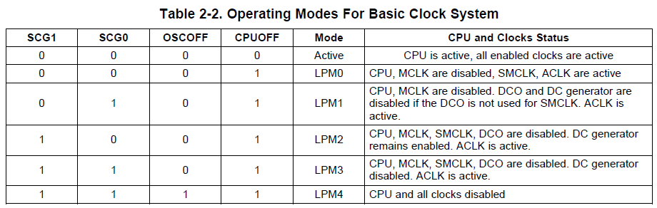
Controlling Low Power Modes
Status bits and low-power modes

Slide 20
Entering/Exiting Low-Power Modes
Interrupt wakes MSP430 from low-power modes:
Entering ISR:
PC and SR are stored on the stack
CPUOFF, SCG1, OSCOFF bits are automatically reset → entering active mode
MCLK must be started so CPU can handle interrupt
Options for returning from ISR:
Original SR is popped from the stack, restoring the previous operating mode
SR bits stored on stack can be modified within ISR to return to a different mode when RETI is executed

Slide 21

Sample Code 1 for Low Power
void main(void) { //Toggle P1.0 every 50000 cycles WDTCTL = WDTPW + WDTHOLD; // Stop WDT P1DIR |= 0x01; // P1.0 output TA0CCTL0 = CCIE; // CCR0 interrupt enabled TA0CCR0 = 50000-1; TA0CTL = TASSEL_2 + MC_1; // SMCLK, up mode _BIS_SR(LPM0_bits + GIE); // LPM0 w/ interrupt } #pragma vector=TIMERA0_VECTOR __interrupt void Timer0_A (void) { P1OUT ^= 0x01; // Toggle P1.0 }
Timer up
Use _BIC_SR(LPM0_EXIT) to exit LPM0

Slide 22
Sample Code 2 for Low Power
Multiple single conversion:
ADC repetitively perform single samples on A1 (pin P1.1) with reference to Vcc
If A1 > 0.5*Vcc, P1.0 set, else reset
Set ADC10SC to start sample and conversion
But ADC10SC is automatically cleared at end of conversion and thus needs to be reactivated in IRS
CPU goes to sleep while waiting for the ADC10 conversion and is waken up when ADC10 conversion is done

Slide 23
Sample Code 2 for Low Power
#include "msp430.h" void main(void) { WDTCTL = WDTPW + WDTHOLD; // Stop WDT // H&S time 16x, interrupt enabled ADC10CTL0 = ADC10SHT_2 + ADC10ON + ADC10IE; ADC10CTL1 = INCH_1; // A1 as input source ADC10AE0 |= 0x02; // Enable pin A1 for analog in P1DIR |= 0x01; // Set P1.0 to output for (;;) { ADC10CTL0 |= ENC + ADC10SC; // Start sampling __bis_SR_register(CPUOFF + GIE); // Sleep if (ADC10MEM < 0x1FF) // 0x1FF = 511 P1OUT &= ~0x01; // Clear P1.0 LED off else P1OUT |= 0x01; // Set P1.0 LED on } }
Sample done
Toggle LED outside of ISR
Notes:
22
Why not read ADC10MEM right after setting ADC10CTL0? While wait for interrupt?
Any one of the pins of Port 1 can be set to be an analog input. Thus up to 8 channels are available for separate ADC inputs.
Analog Enable control register ADC10AE0 will be use for enabling the corresponding input channels.
The settling time for the internal reference is < 30µs. A value of 5 cycles would be 40µs.
We should allow thirteen ADC10CLK cycles before we read the conversion result.
Thirteen cycles of the 5MHz ADC10CLK is 2.6µs. Even a single cycle of the DCO/8 would be longer than that. We will leave the LED on and use the same delay so that we can see it with our eyes.
When the conversion is complete, the encoder and reference need to be turned off.
Pulse-width modulation (PWM): The load is switched on and off periodically so that the average voltage has the desired value. The fraction of the time while the load is active is called the duty cycle D.
22

Slide 24
Sample Code 2 for Low Power
// ADC10 interrupt service routine #pragma vector=ADC10_VECTOR __interrupt void ADC10_ISR(void) { __bic_SR_register_on_exit(CPUOFF); // Clear CPUOFF bit from SR }
Wake up
Notes:
23
23

Slide 25
Sample Code 2’ for Low Power
void main(void) { WDTCTL = WDTPW + WDTHOLD; // Stop WDT // H&S time 16x, interrupt enabled ADC10CTL0 = ADC10SHT_2 + ADC10ON + ADC10IE; ADC10CTL1 = INCH_1; // A1 as input source ADC10AE0 |= 0x02; // Enable pin A1 for analog in P1DIR |= 0x01; // Set P1.0 to output __bis_SR_register(CPUOFF + GIE); // Sleep } #pragma vector=ADC10_VECTOR __interrupt void ADC10_ISR(void) { if (ADC10MEM < 0x1FF) // 0x1FF = 511 P1OUT &= ~0x01; // Clear P1.0 LED off else P1OUT |= 0x01; // Set P1.0 LED on ADC10CTL0 |= ENC + ADC10SC; // Start sampling }
Notes:
24
Why not read ADC10MEM right after setting ADC10CTL0? While wait for interrupt?
Any one of the pins of Port 1 can be set to be an analog input. Thus up to 8 channels are available for separate ADC inputs.
Analog Enable control register ADC10AE0 will be use for enabling the corresponding input channels.
The settling time for the internal reference is < 30µs. A value of 5 cycles would be 40µs.
We should allow thirteen ADC10CLK cycles before we read the conversion result.
Thirteen cycles of the 5MHz ADC10CLK is 2.6µs. Even a single cycle of the DCO/8 would be longer than that. We will leave the LED on and use the same delay so that we can see it with our eyes.
When the conversion is complete, the encoder and reference need to be turned off.
Pulse-width modulation (PWM): The load is switched on and off periodically so that the average voltage has the desired value. The fraction of the time while the load is active is called the duty cycle D.
24

Slide 26
Sample Code 3 for Low Power
Continuous sampling driven by Timer0_A3
ADC samples A1 16/second driven by Timer0_A3, and interrupts CPU after each sampling
CPU checks each sample and if A1 > 0.5Vcc, P1.0 is set, else reset
ADC samples A1 with reference to 1.5V
Timer0_A3 uses ACLK running at 32 KHz driven by an external crystal (2048 ACLK cycles thus give 1/16 second)
Timer0_A3 runs in up mode with CCR0 defining the sampling period (2048 cycles) and CCR1 triggering ADC10 to do conversion

Slide 27
Sample Code 3 for Low Power
#include "msp430.h" void main(void) { WDTCTL = WDTPW + WDTHOLD; // Stop WDT // TA1 trigger sample start ADC10CTL1 = SHS_1 + CONSEQ_2 + INCH_1; ADC10CTL0 = SREF_1 + ADC10SHT_2 + REFON + ADC10ON + ADC10IE; ADC10CTL0 |= ENC; // ADC10 Enable ADC10AE0 |= 0x02; // P1.1 ADC10 option select P1DIR |= 0x01; // Set P1.0 output TA0CCR0 = 2048-1; // Sampling period TA0CCTL1 = OUTMOD_3; // TACCR1 set/reset TA0CCR1 = 2046; // TACCR1 OUT1 on time TA0CTL = TASSEL_1 + MC_1; // ACLK, up mode // Enter LPM3 w/ interrupts __bis_SR_register(LPM3_bits + GIE); }
Timer up
Timer_A CCR1 out mode 3: The output (OUT1) is set when the timer counts to the TACCR1 value and is reset when the timer counts to the TACCR0 value.
Notes:
26
Pulse-width modulation (PWM): The load is switched on and off periodically so that the average voltage has the desired value. The fraction of the time while the load is active is called the duty cycle D.
26

Slide 28
Sample Code 3 for Low Power
// ADC10 interrupt service routine #pragma vector=ADC10_VECTOR __interrupt void ADC10_ISR(void){ if (ADC10MEM < 0x1FF) // ADC10MEM = A1 > 0.5V? P1OUT &= ~0x01; // Clear P1.0 LED off else P1OUT |= 0x01; // Set P1.0 LED on }
Notes:
27
27

Slide 29
Summary
Power and energy
Efforts for low power operations
Low-power modes of MSP430
Active, LPM0, LPM3
Controlling low power modes
Which saves more energy?
Use a higher frequency to run a program faster so as to sleep longer
Use a lower frequency to run a program to save power, but system may be active longer

