Slide 1
CS4101 Introduction to Embedded Systems
Lab 6: Serial Communication
Prof. Chung-Ta King
Department of Computer Science
National Tsing Hua University, Taiwan

Slide 2
Introduction
In this lab, we will learn
  To implement a software UART on MSP430 LaunchPad, which serves to summarize all that we have learned so far
  To communicate between MSP430 LaunchPad and PC through RS232 interface

Slide 3
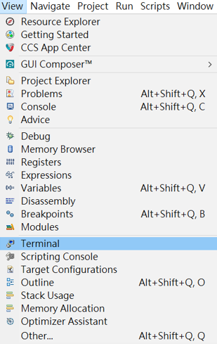
Setting PC for Serial Communication
In the Debug perspective of CCS IDE, click [View] -> [Terminal]

Slide 4
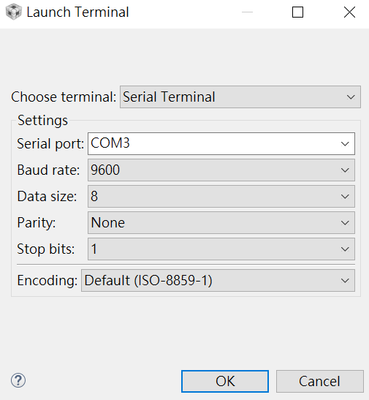
Setting PC for Serial Communication
A Terminal pane will appear on the screen.
Click the [Open a Terminal] button in the Terminal pane and make the selections (set the serial communication setting)

Slide 5
Lab 6
Basic 1: communicate with host computer (40%)
  LaunchPad: When the button is clicked once (i.e., pressed and released once), send the string “HELLO!” to the host computer via the software UART using 8-N-1 (8-bit data, no parity bit, 1 stop bit).
    On the host computer, “HELLO!” will be shown on CCS terminal.
    You must handle button event by interrupt.
  Host computer: Receive a string typed by the user and send it to LaunchPad after <enter> is pressed.
    On the LaunchPad, count the number of characters received and send that number and the received string back to the host computer to show on the CCS terminal.
  Hint: Include stdio.h to use sprint() for a string of a number.

Slide 6
Lab 6
Basic 2: device driver (60%)
  Write a function flash(char id, int on, int off) to flash the LEDs by interrupts using Timer1_A3 driven by ACLK sourced from VLO, where
    id = 0 for red LED; 1 for green LED
    on/off = time (in ms) for the LED to be on/off
    Let CPU enter LPM3 at the end of flash function.
  Write a function temp(int interval, int times) to measure the temperature using repeat-single-channel (see sample code) triggered by Timer0_A3, where
    interval: the interval (in ms) between measurements
    times: the number of times to measure
    Results are stored in a global integer array Temp[64]

Slide 7
Lab 6
Basic 2: (cont.)
  Part I (Normal state):
    Use flash() to flash the green LED at 0.5 Hz (0.5 sec on and 1.5 sec off) by interrupts (ACLK sourced from VLO).
    Use temp() to measure the temperature at 1 Hz continuously (Hint: must reuse Temp[])
    If average temperature of the last 2 seconds is higher than 737, go to Emergency state and stop measure the temperature.

Slide 8
Lab 6
Basic 2: (cont.)
  Part II (Emergency state):
    Flash the red LED with 0.2 sec on and 0.3 sec off and send the average temperature of the last 2 seconds to PC every two seconds using 8-N-2 (8-bit data, no parity bit, 2 stop bits).
      You must use 8-N-2 to get the full credit!
    Whenever PC receives the average temperature, it displays the string and waits for user’s input from its keyboard.
    When user enters a string, PC transmits the string to the LaunchPad using 8-N-2.
    If the string is “Ack!”, then the LaunchPad goes back to the Normal state. Otherwise, it ignores the string and keeps in Emergency state.

Slide 9
Sample Code for Repeat-Single-Channel
#include "msp430.h" void main(void) { WDTCTL = WDTPW + WDTHOLD; // Stop WDT // TA1 trigger sample start ADC10CTL1 = SHS_1 + CONSEQ_2 + INCH_10; ADC10CTL0 = SREF_1 + ADC10SHT_3 + REFON + ADC10ON + ADC10IE; ADC10CTL0 |= ENC; // ADC10 Enable ADC10AE0 |= 0x02; // P1.1 ADC10 option select P1DIR |= 0x01; // Set P1.0 output TA0CCR0 = 2048-1; // Sampling period TA0CCTL1 = OUTMOD_3; // TACCR1 set/reset TA0CCR1 = 2046; // TACCR1 OUT1 on time TA0CTL = TASSEL_1 + MC_1; // ACLK, up mode // Enter LPM3 w/ interrupts __bis_SR_register(LPM3_bits + GIE); }
Notes:
8
8

Slide 10
Sample Code for Repeat-Single-Channel
// ADC10 interrupt service routine #pragma vector=ADC10_VECTOR __interrupt void ADC10_ISR(void){ if (ADC10MEM < 0x1FF) // ADC10MEM = A1 > 0.5V? P1OUT &= ~0x01; // Clear P1.0 LED off else P1OUT |= 0x01; // Set P1.0 LED on }
Notes:
9
9

