Slide 1
SUPERVISED LEARNING
CLASSIFICATION

Slide 2
Problem -Statement
GIVEN –DESIGN MATRIX
PREDICT -OUTCOME
DEMOGRAPHICS
SOCIO-CULTURAL
OCCUPATION
FINANCIAL
RACE
COUNTRY OF ORIGIN
INCOME LEVELS
HICH INCOME (>$50K/annum)
LOW INCOME (< $ 50K /annum)
CLASSIFICATION PROBLEM

Slide 3
THE DATA SET
Total Variables : 15
Age Numeric
Workclass Categorical
Fnlwgt Numeric
Education Categorical
Education_num Numeric
Marital-Status Categorical
Occupation Categorical
Relationship Categorical
Race Categorical
Sex Categorical
C_gain Numeric
C-loss, Numeric
Hr-Week Numeric
Country Categorical
Income Categorical
6 Numeric Variables
9 Categorical Variables
IVs : 14
DV :1
Train :(32651,15 )
Test : (16281,15)

Slide 4
APPROACH
Pre-Modelling
Modelling
Post –Modelling

Slide 5
THE JOURNEY..1
Pre –modelling
MODELLING
Load / Eyeball the data set
Clean the data set
EDA
Feature Engineering
Class Imbalance
RE-SAMPLING
CLASSIFICATION MODELS
Linear
Non Linear
Ensemble
Voting Classifier
Hyper Parameter Optimization –Tuning

Slide 6
THE JOURNEY..2
POST MODELLING
MODEL SELECTION STRATEGY
Classification Evaluation metrics
Accuracy
Precision
Type 1 & Type 2 Errors
F1 score
AUC
Models chosen for deployment
Basis Domain /Business
Basis Data-set

Slide 7
Pre -modelling..DATA CLEANING
INITIAL DATASET
CLEANED DATASET
TOTAL FEATURES : 15
TOTAL OBSERVATIONS : (48842,15)
TOTAL FEATURES : 15
TOTAL OBSERVATION:
(45222,15)
Inclusive of Trained /Test Data
Junk Values : “? “
Class columns – “>=. , >=, <=. , <= cleaned to (>=)= 1 & (<=)=0

Slide 8
Pre modelling -EDA
Univariate
Bivariate
Multivariate
Pivot Tables /Cross –Tab Charts
Understanding the data structure
Key characteristics of Features
Data Insights

Slide 9
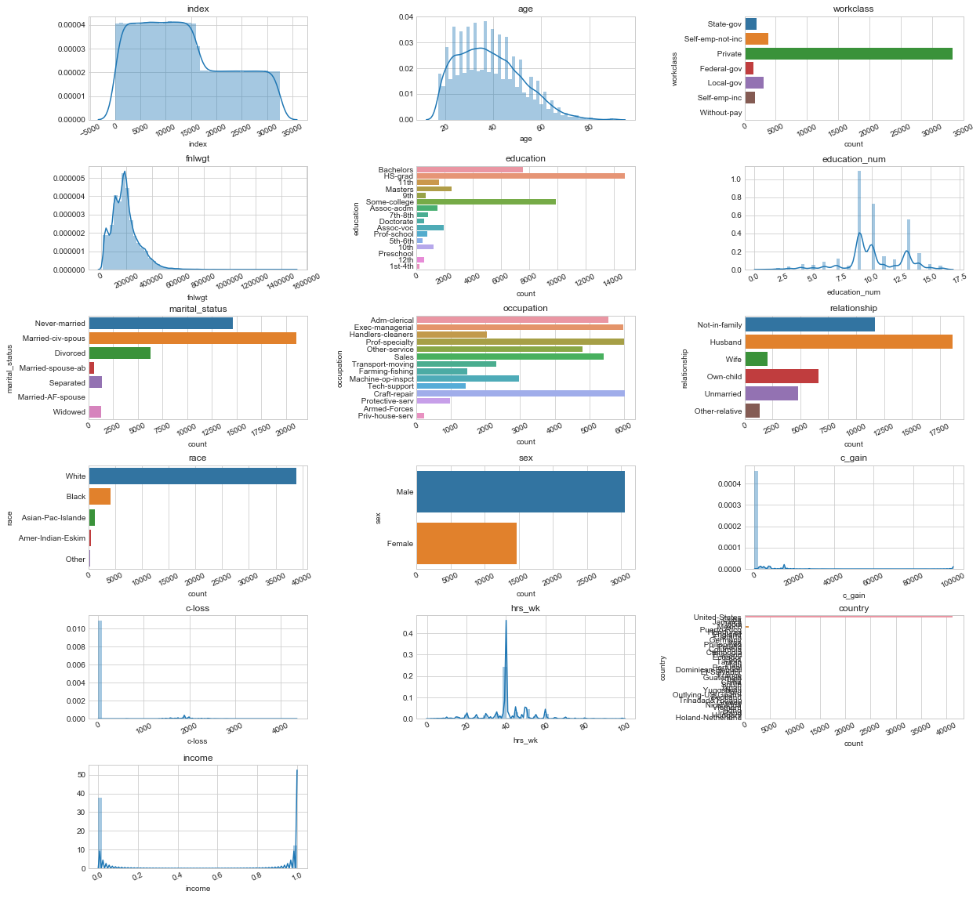
DATA SET CHARACTERISTICS
Age is right –skewed
College & Above with ~ 8 yrs spent on Education
Dominated by White population from USA
Male : Female @ 66:34
Married

Slide 10
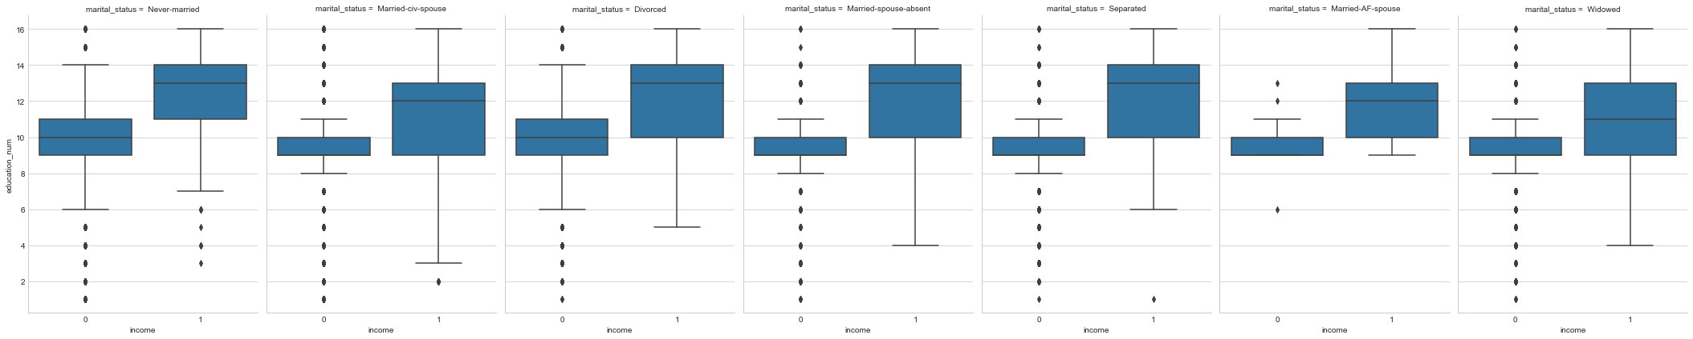
Higher Education years is associated with higher incomes across all social strata

Slide 11
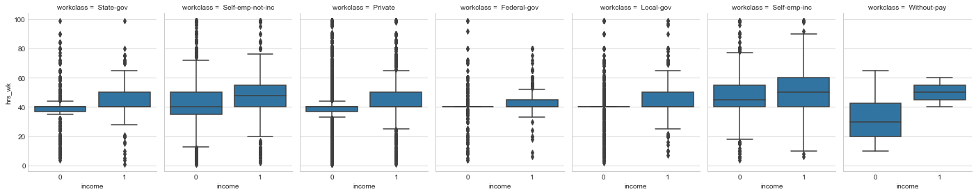
Higher Work-hrs is associated with higher incomes across all WORKCLASS CLASSIFICATIONS

Slide 12
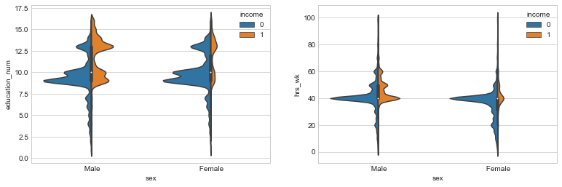
FOR MALES-EDUCATION & WORK-HRS PLAYS AN IMPORTANT ROLE TOWARDS EARNING HIGHER INCOME

Slide 13
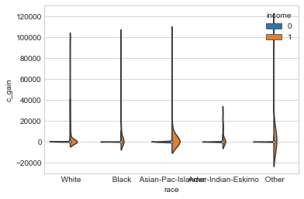
HIGHER INCOMES ASSOCIATED WITH WHITES & ASIAN-PAC

Slide 14
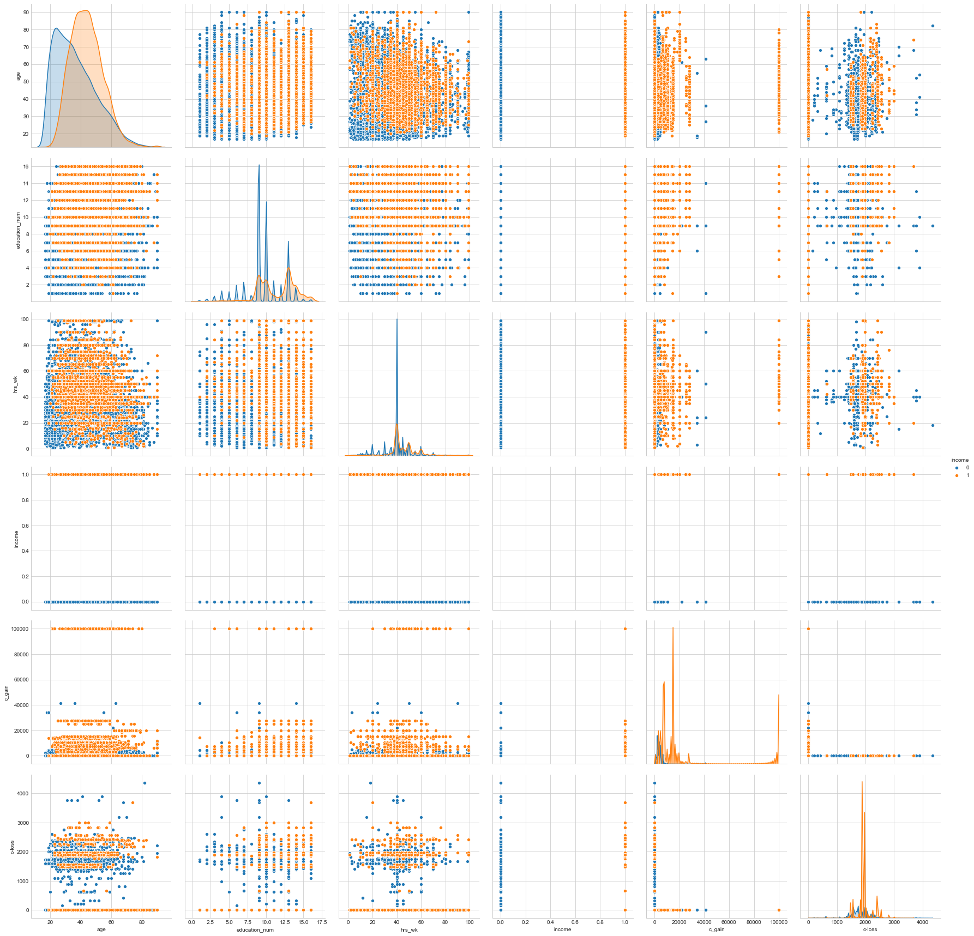
FEATURE INTERACTIONS
Corraborates with the univariate findings

Slide 15
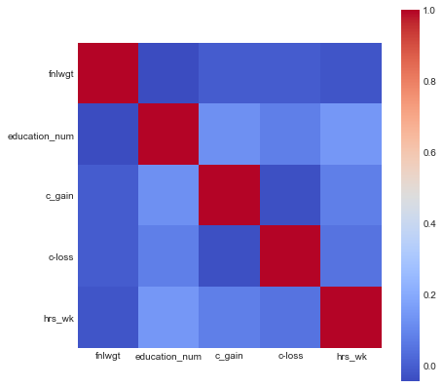
Numeric Features are not correlated
Chances of Multicollinearity is minimal
Independent Features

Slide 16
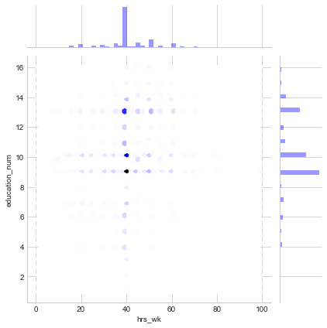
MAPPING EDUCATION _NUM VS HRS_WK

Slide 17
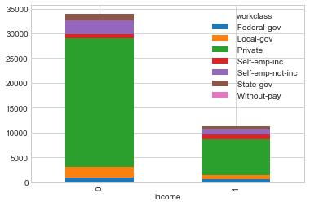
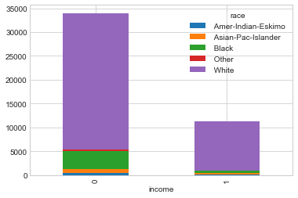
PRIVATE SECTOR / WHITE DOMINATES DATASET REPRESENTATION ACROSS CLASS LABELS
RACE
Workclass

Slide 18
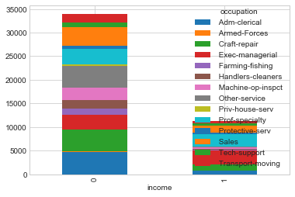
DATA SET REPRESENTED BY MULTIPLE OCCUPATIONS ACROSS LABELS

Slide 19
Higher work- hrs associated with Higher capital gains
workclass | Federal-gov | Local-gov | Private | Self-emp-inc | Self-emp-not-inc | State-gov | Without-pay
c_gain | 924.485064 | 766.129032 | 886.123127 | 5053.619077 | 1800.606955 | 750.135149 | 325.238095
workclass | Federal-gov | Local-gov | Private | Self-emp-inc | Self-emp-not-inc | State-gov | Without-pay
hrs_wk | 41.433144 | 40.865484 | 40.258925 | 48.578372 | 44.429136 | 39.121788 | 33.952381
Self Employed spends~ 7 hrs /day across a 1 week period
Govt & Private sectors employees spends ~ 8 hrs/day (5 day week )

Slide 20
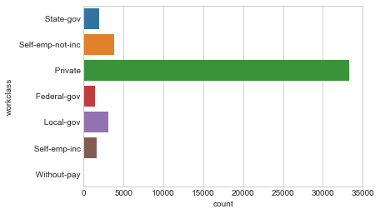
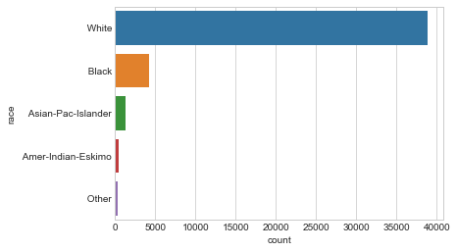
WORKCLASS & RACE IMBALANCE
Workclass
RACE

Slide 21
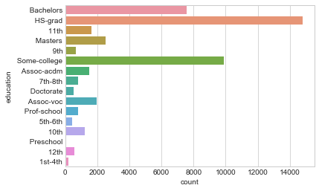
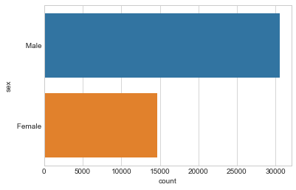
REBALANCING EDUCATION
GENDER
EDUCATION
Can be clubbed into a single subclass

Slide 22
TO SUMMARIZE
EDUCATION & AGE & WK-HRS ARE MOST IMPORTANT PREDICTORS FOR INCOME LABEL
AGE IS POSTIVE SKEWED
~ 40 HRS/WEEK EXCEPT SEPs (~ 49 hrs /week)
DATA –SET IS HIGHLY SKEWED BY REPRESENTION FROM
WHITE
PRIVATE SECTOR
USA

Slide 23
FEATURE ENGINEERING
FEATURE CREATION
TESTING SIGNIFICANCE OF NEW FEATURE –ANNOVA(F-stats)
FEATURE IMPORTANCE
FEATURE ELIMINATION
ADDRESSING CLASS IMBALANCE
DATA TRANSFORMATION

Slide 24
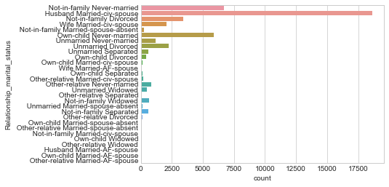
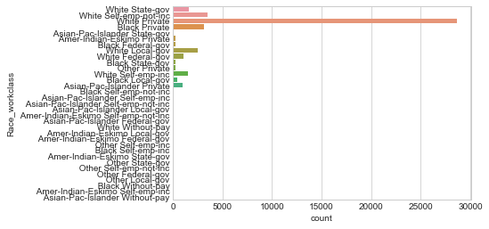
2 CATEGORICAL FEATURES CREATED
RELATIONSHIP+MARITAL STATUS
RACE + WORKCLASS

Slide 25
Feature creation –3 Numerical features created
Feature 3 : c_gain/hrs_wk
Feature 4: age/ hrs-week
Feature 5: age/education_num

Slide 26
ANNOVA
Statistical Test of significance –Using F stats
Ho=Mu_x1=Mu_x2=Mu_x3=……
Accept Ho when p-value >0.05 (significance limit)

Slide 27
Given high skews for numerical features –FEATURE BINNING REOMMENDED
df5.age.skew()=0.583
df5.hrs_wk.skew()=0.345
df5.c_gain.skew()=11.7
df5.feature3.skew()=18.47
df5.feature4.skew()22.14
df5.feature5.skew()=6.58
pd.cut function to bin the features in 10 quantiles

Slide 28
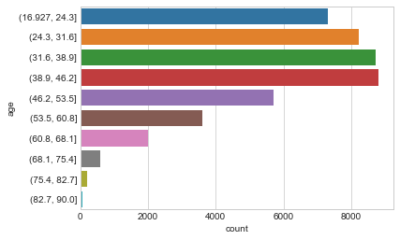
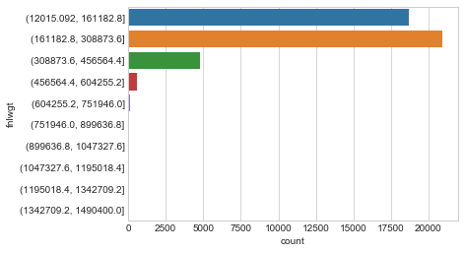
Binning Numerical features
age
fnlwgt

Slide 29
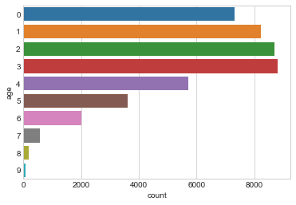
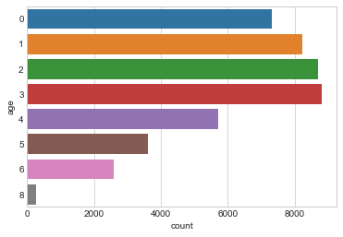
Re-balancing CATEGORICAL FEATURES
Pre –BALANCING -AGE
POST –BALANCING -AGE

Slide 30
DATA TRANSFORMATION
RE-SCALING
Normalizing
[ 0.31105265 2.9177173 -0.97928634 -0.34407409 0.97918814 0.94293603 -1.48262433 -0.25838652 0.38411021 0.69381348 -0.1209036 -0.21708494
-0.22621236 0.26299899 -0.36394164 0.87469094 -0.06817025 -0.05253139
-0.17520323]
[ 0.87227285 1.87399717 -0.97928634 -0.34407409 0.97918814 -0.3900051
-0.7375336 -0.88447855 0.38411021 0.69381348 -0.1209036 -0.21708494
-1.73569668 0.26299899 -0.79673813 0.69560246 -0.06817025 -0.052539
-0.17520323]]
[[0.05842062 0.09736771 0. 0.17526187 0.13631479 0.07789417
0. 0.01947354 0.07789417 0.01947354 0. 0.
0.05842062 0.73999457 0.09736771 0.60367978 0. 0.
0. ]
[0.07939884 0.07939884 0. 0.1786474 0.13894798 0.03969942
0.05954913 0. 0.07939884 0.01984971 0.
0. 0.01984971 0.75428902 0.01984971 0.59549133 0. 0.
0. ]]

Slide 31
DATA TRANSFORMATION
Principal Components

Slide 32
DATA TRANSFORMATION –In sum
Original
X
Scaled
Rescale_X
Normalized
Norm_X
PCA(3comp)
PCA_X
4 SETS OF DESIGN MATRIX [X] KEPT READY AND WILL BE PLACED BEFORE THE ALOGS TO CHECK THE ACCURACY OF PREDICTION

Slide 33
2 TECHNIQUES USED FOR FEATURE SELECTION
FEATURE SELECTION
RFE
Ensemble
Recursive Feature Elimination
Extra Tree Classifier

Slide 34
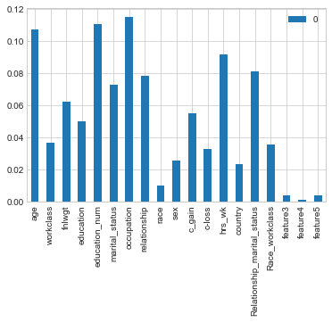
FEATURE SELECTION
Extra Tree Classifier
RFE
[False False False False True False False False False False True False
False False False False True False False] [ 8 13 14 15 1 3 17 2 10 7 1 5 9 16 4 11 1 6 12]
Age,Occupation,Education,hrs_wk are key features identified –Confirms our EDA findings

Slide 35
DATA SET SPLITS
Train/test/split
kfOLD RESAMPLING WITH CV=10
X_train,y_train,x_test,y_test=train_tet_split(X,y,test_split=0.3,random_state=1)
lr=LogisticRegression()
lr.fit(X_train.y_train)
lr.score(X_test,y_test) : 0.826
Kfold=Kfold(n_splits=10,random_state=7
lr=LogisticRegression()
results_cross_val_score=(lr,X_train,y_train,cv=10)
results.mean() : 0.8206
Given that small size is large (n=42555) therefore the bias is eliminated and Train/test/split is at par
with Kfold

Slide 36
Machine learning libraries-MODELS
from sklearn.linear_model import LogisticRegression
from sklearn.discriminant_analysis import LinearDiscriminantAnalysis
from sklearn.tree import DecisionTreeClassifier
from sklearn.naive_bayes import Gaussion NB
from sklearn.neigbors import KNeighborsClassifier
from sklearn.svm import SVC
from sklearn.ensemble import RandomForestClassifier, AdaBoostClassifier, GradientBoostingClassifier, VotingClassifier
from sklearn.model_selection import GradientSearchCV

Slide 37
MACHINE LEARNING MODELS..1
LINEAR MODELS
Model1 :Logistic Regression ()
Model2 :Logistic Regression (Hyperparameter Tuning)
Model3 :Logistic Regression (l1 penalty )
Model4 : LinearDiscriminatAnalysis()
NON LINEAR MODELS
Model5 : Decision Tree Classifier ()
Medel6 : Decision Tree Classifier(Hyperparameter Tuning)
Model 7 : Naïve Bayes
Model 8 : K Neigbors
Model 9 : Support Vector Classifier ()
Model 10: Support Vector Classifier(Hyperparameter Tuning)
Parametric
High Bias
Low Flexibility
Non -Parametric
High Variance
High Flexibility

Slide 38
MACHINE LEARNING MODELS 2
ENSEMBLE MODELS
Model11 :Random Forest ()
Model2 :Random Forest (Hyperparameter Tuning)
Model13 :Ada Boost Classifier()
Model14 : Ada Boost Classifier(Hypermater Tuning)
Model15 : Gradient Boosting Classifier ()
Model16 : Gradient Boosting Classifier(Hyperparameter Tuning)
VOTING ENSEMBLES : LINEAR + NON LINEAR
Model 17 : LR+LDA+DT+SVC
Boosts Accuracy by combining models of same type
Combines different types of models (Linear+Non Linear)

Slide 39
Hyper Parameter Tuning—LOGISTIC REGRESSION
Hyper Parameters
Best_Params_
C=1.0
Solver =“liblinear”
Penalty=l1
-C :[0.001,0.01,0.05,0.5,0.75,1.0]
Solver : [“newton-cg”,”lbfgs”,”liblinear]
Penalty : [l1,l2]
Score | LR Model | LR Model +GRID | LR +Penalty
Train | 0.821 | 0.823 | 0.821
Test | 0.822 | 0.824 | 0.823
Generalization Index | 100 | 100 | 100

Slide 40
Hyper Parameter Tuning—DECISION TREE
Hyper Parameters
Best_Params_
criterion =“gini”
Min_samples_split =10
Max_depth =6
Min_samples_leaf = 20
-criterion: :[“gini”,”entropy”]
min_samples_split :[10,20,30,40,50]
max_depth :[2,3,4]
Min_samples_leaf :[10,20,30,40]
Score | Decision Tree | Decision Tree +Grid
Train | 0.943 | 0.834
Test | 0.880 | 0.835
Generalization Index | 93 | 100
Overfitting

Slide 41
Hyper Parameter Tuning—SUPPORT VECTOR CLASSIFIER
Hyper Parameters
Best_Params_
Kernel=“linear”
C=10
Gamma=1e-4
kernel :[“linear”, ”rbf” ,”poly”]
C
gamma
Score | SVC | SVC+Grid
Train | 0.857 | 0.821
Test | 0.837 | 0.825
Generalization Index | 98 | 100

Slide 42
Hyper Parameter Tuning—Ada Boost Classifier
Hyper Parameters
Best_Params_
learning_rate=0.8
n_estimators=100
learning _rate
n_estimators
Score | AdaBoost Classidfier | AdaBoost Classidfier +Grid
Train | 0.845 | 0.846
Test | 0.843 | 0.845
Generalization Index | 100 | 100

Slide 43
Hyper Parameter Tuning—Gradient Boosting classifier
Hyper Parameters
Best_Params_
max_features =4
max_depth =5
n_estimators = 200
max_features :[3,4,5,7]
max_depth :[2,3,5,6]
n_estimators :[100,200,300,400,500]
Score | Gradient Boosting Classifier | Gradient Boosting Classifier+Grid
Train | 0.849 | 0.862
Test | 0.847 | 0.851
Generalization Index | 100 | 99

Slide 44
PREDICTION
PRECISION
ACCURACY

Slide 45
EVALUATING models basis PREDICTIVE METRICS
Accuracy : score
Classification report : precision, f1-score
Confusion Matrix : Type1 & Type 2 Errors
ROC curve : AUC(area under the curve)
Depending upon the Problem-statement and Domain Requirements
the appropriate metrics are given adequate importance

Slide 46
Summarizing the metrics
PREDICTION | Model | Name | Accuracy | f1 score
Linear | Model 1 | LR | 0.822 | 0.81
 | Model2 | LR+Grid | 0.8003 | 0.8
 | Model 3 | LR+Penalty(l1) | 0.8209 | 0.81
 | Model 4 | LDA | 0.8375 | 0.83
Non Linear | Model 5 | Decision Tree | 0.8005 | 0.8
 | Model 6 | Decision Tree +Grid | 0.83518 | 0.82
 | Model 7 | KNN | 0.8174 | 0.81
 | Model 8 | Naive-Bayes | 0.7875 | 0.76
 | Model 9 | SVM | 0.8375 | 0.83
 | Model 10 | SVM+Grid | 0.8245 | 0.81
Ensemble | Model 11 | Random Forest | 0.8243 | 0.82
 | Model 12 | Random Forest +Grid | 0.8379 | 0.83
 | Model 13 | Ada Boost | 0.8455 | 0.84
 | Model 14 | Ada Boost+Grid | 0.8474 | 0.84
 | Model 15 | Gradient Boosting | 0.8485 | 0.84
 | Model 16 | Gradient Boosting +Grid | 0.8514 | 0.85

Slide 47
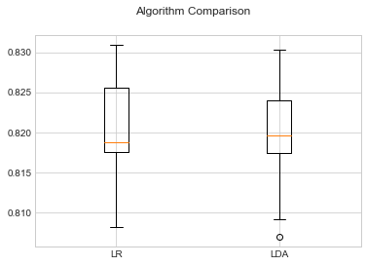
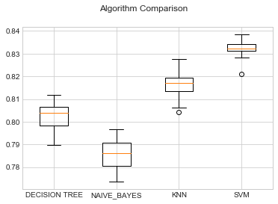
Mapping model accuracy …1
LINEAR MODELS
Non-Linear MODELS

Slide 48
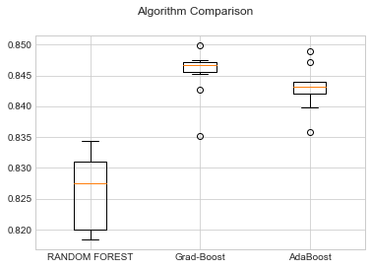
Mapping model accuracy ..2
Non Linear Model
EMSEMBLE

Slide 49
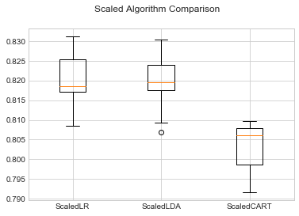
CAN WE INCREASE THE ACCURACY BY SCALING THE FEATURE MATRIX

Slide 50
MODEL SELECTION
Ideally deployment of 17 models recommended , however keeping in mind the cost and time we recommend 1 model each from each category
Linear Model –LDA
Non-Linear Model –SVC
Ensemble Model –Gradient Boosting

Slide 51
FINAL METRICS OF THE RECOMMENDED MODELS
Gradient Boosting :
Highest Accuracy
Highest Precision
LDA:
Lowest Type 1 Error

Slide 52
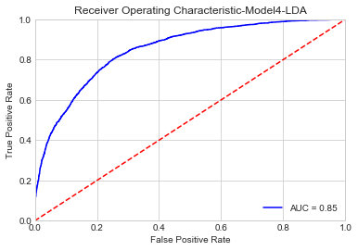
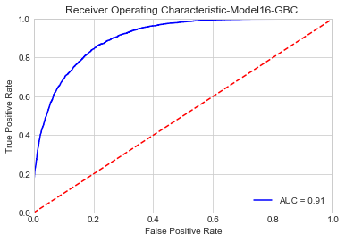
ROC –FINALIZED MODELS
LDA
Gradient Boosting

