Slide 1



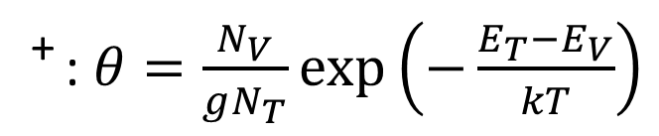




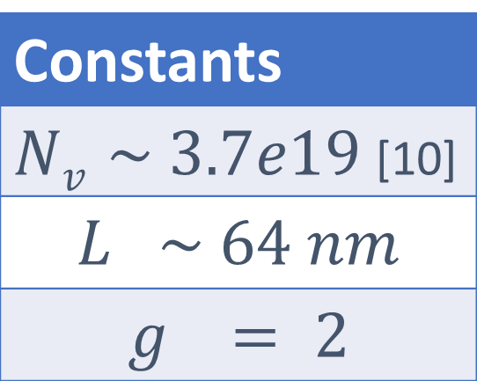
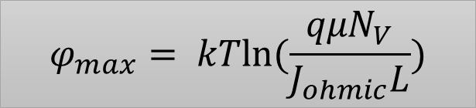
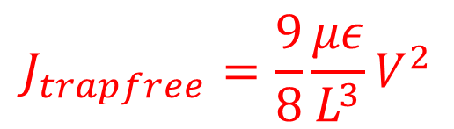
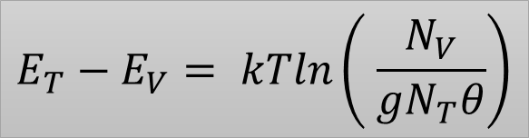


Materials Parameter Extraction using Analytical Models in PCMO based RRAM
I. Chakraborty, A. K. Singh, P. Kumbhare, N. Panwar, U. Ganguly
CEN, Department of Electrical Engineering, IIT Bombay, Mumbai 400076, India
MOTIVATION
FABRICATION AND I-V CHARACTERIZATION
BACKGROUND
Manganite based bipolar RRAM is an attractive prospect for non-stochastic switching, area-dependent current scaling, fast switching and long endurance, forming-less operation. [1,2]
Different mechanisms of switching have been proposed like interface resistance switching [3], SCLC [4] and Metal – Insulator Mott-Transition [5]. Exponential Distribution of traps have been proposed in similar devices(Ag/La_{0.7}Ca_{0.3}MnO₃/Pt)[6].
OBJECTIVE
We confirm SCLC as the transport mechanism
We extract materials parameters like spatial and energy distribution of traps by deriving simple analytical expressions from experimental I-V characteristics.
Process Flow
I-V Characterization
Si/SiO₂ substrate
Pt(57nm)/Ti(9nm) deposited on substrate
50nm layer of Pr_{0.7}Ca_{0.3}MnO (PCMO) deposited at room temperature(using PLD)
Annealed in N₂ at 650⁰C for 120 s
Tungsten probe-tips formed the top electrode
HRS resistance and Set Voltage(V_{set}) increase with increase in V_{reset}.
CURRENT TRANSPORT REGIMES AND MODELS
DERIVATION OF N_{T-OHMIC} [11]
CURRENT REGIMES
Regimes | Slope(α) | Equation[7]
1. Ohmic | ~1
2. Trap SCLC | ~2
3. Trap-filled Limit | >>2
4. Trap-free SCLC | ~2
BAND PROFILE
$$J_{ohmic}=\frac{q{μN}_{V}}{L}\exp\left(−\frac{φ_{max}}{kT}\right)V$$
Constants
$Nv \sim 3.7e19$[10]
$$L \sim 64 nm$$
$$g = 2$$
$$J_{trap}=θ+{×J}_{trapfree}$$
$$V_{TFL}=\frac{{qN}_{T}L^{2}}{2εg}$$
J ~V^{α}
$$J_{trapfree}=\frac{9}{8}\frac{με}{L^{3}}V^{2}$$
φ_{max} is assumed to be at the center of the device
⁺ : $θ=\frac{N_{V}}{gN_{T}}exp\left(−\frac{E_{T}−E_{V}}{kT}\right)$
PARAMETER EXTRACTION
METHODOLOGY
Assumptions: 1. Single energy trap level with uniform spatial distribution 2. Permittivity(ε) ~ 30-40 [8,9]
Step 1: Mobility estimate: $J_{trapfree}=\frac{9}{8}\frac{με}{L^{3}}V^{2}$ gives us $με product \sim 110 Fcm/Vs$ thus $μ\sim 3.6 cm^{2}/Vs$
Step 2: N_{T} estimate (method 1): $N_{T−Ohmic}=f\left(θ,E_{T}−E_{V},φ_{max}\right)$
N_{T} estimate (method 2): $N_{T−TFL}=\frac{{2εgV}_{TFL}}{qL^{2}}$
RESULTS
Using Poisson, $\frac{dE}{dx}=\frac{ρ(x)}{ε} \& E=−\frac{1}{q}\frac{dE_{V}}{dx}$
$$\frac{d^{2}E_{V}}{dx^{2}}=\frac{−qρ}{ε}=\frac{−q(θ+1)ρ_{t}}{ε}$$
Charge concentration:$ρ_{t}={qN}_{T}exp\left(−\frac{−φ+E_{T}−E_{V}}{KT}\right)$
$$\frac{d^{2}φ}{dx^{2}}=−\frac{q^{2}(θ+1)}{ε}N_{T}exp\left(−\frac{−φ+E_{T}−E_{V}}{KT}\right)$$
$$N_{T}={\left(\frac{π}{L}\right)}^{2}\frac{kTε}{2q^{2}\left(θ+1\right)}\exp\left(−\frac{−φ_{max}+E_{T}−E_{V}}{KT}\right)$$
Trap Depth(E_{T}-E_{V}) | Remains Constant(LRS) Negligibly rises(HRS) | With increasing V_{reset}
N_{T-Ohmic} and N_{T-TFL} increases linearly with increasing V_{reset}
Linear correlation between N_{T-Ohmic} and N_{T-TFL} (R²=0.9921)
$$θ=\frac{J_{trap}}{J_{trapfree}}$$
$$E_{T}−E_{V}= kTln\left( \frac{N_{V}}{gN_{T}θ}\right)$$
$$φ_{max}= kTln(\frac{qμN_{V}}{J_{ohmic}L})$$
Single trap level assumption validated
Trap densities at low and high bias are consistent
I-V ASYMMETRY & NON-UNIFORM N_{T}
Asymmetry in current levels observed between –ve and +ve polarity for both HRS and LRS.
$$Current Ratio=\frac{J_{negative}}{J_{positive}}$$
$$(in trap SCLC regime)$$
Various trap concentration profiles simulated
Trap profile of gentle asymmetry of 2-4× can produce the polarity dependent current asymmetry of 1.2×, of the same order as experimental
Fairly uniform trap distribution assumption validated.
CONCLUSIONS
REFERENCES
ACKNOWLEDGEMENTS
Developed analytical models based extraction of materials parameters for PCMO RRAM
Energy and spatial distribution of trap-density is extracted.
Results estimate an almost uniform (N_{T}~10¹⁷/cc) single trap-level(E_{T} –E_{V}~0.15eV)
Model provides consistent trap-density estimated from low-bias Ohmic regime as well as high-bias trap-filled limit.
S. Park et al, Phys. Status Solidi RRL 5
N. Panwar et al, MRS (Fall), 2013.
S. Jung et al, IEDM 2011
T. Harada et al, APPLIED PHYSICS LETTERS 92, 222113 (2008)
H. S. Lee et al, Nature Scientific Report, 2013.
D. S. Shang et al, PHYSICAL REVIEW B 73, 245427 (2006)
M. Lampert., Reports on Progress in Physics 27.1 (1964): 329.
N. Biškup et al, PHYSICAL REVIEW B 72, 024115 (2005)
S. Zhigao et al., Nature communications 3 (2012): 94
. Herpers et al, Adv. Mater. 2014.
J. G. Simmons, PHYSICAL REVIEW LETTERS, Volume 23, Number 6, 1969.
Funded by -
Department of Science and
Technology (DST),
Government of India

