Slide 1

LAPTOP PRICE PREDICTION USING
MACHINE LEARNING
Prepared By:
Joydeep Debnath(S6054)

Slide 2
OBJECTIVE OVERVIEW
The main objective of the project is to build a robust machine learning model that predicts the price of the laptops accurately
ACCURATE PRICING
MARKET POSITIONING
BRAND INFLUENCE
Develop a model that can accurately predict laptop prices based on various features, helping our clients stay competitive in the market.
Understand how different features contribute to pricing.
Assess the impact of brand reputation on pricing, providing insights into brand perception and market demand.

Slide 3



TOOLS USED
SYSTEM: Windows
INTEGRATED DEVELOPMENT ENVIRONMENT: Jupyter Notebook
LANGUAGE: Python

Slide 4

ABOUT THE DATASET
The dataset provided consisted of various types of laptop names, brands, their specification, features and price
Data Dictionary:
Company, Type Name, Inches, Screen Resolution, CPU, RAM, Memory, GPU, Operating System, Weight
The data contains 1303 rows and 13 columns

Slide 5
DATA DEFINITION
COLUMN | DESCRIPTION
Company | Name of the company/brand
Type Name | Type of Device/ Category
Inches | Size of the screen
Screen Resolution | The number of pixels a screen can display horizontally and vertically, and is represented as two numbers
CPU | Processor
RAM | Primary memory
Memory | Secondary storage/ Flash memory
GPU | Graphics
Op Sys | Operating System
Weight | Weight of the laptop in kg
Price | Price of the brand

Slide 6
DATA CLEANING
There were 2 unnecessary columns initially named ‘Unnamed 0.1’, ‘Unnamed 0’ and they were dropped
The data consisted of null values in each column which was 2% of the total dataset and hence was removed from the data
There were few special characters present in the columns like ‘Weight’, ‘Memory’, ‘Inches’ which was taken care by replacing with relevant values after a thorough research over the internet
Finally after all the data cleaning process we were left with 1273 rows and 11 columns

Slide 7
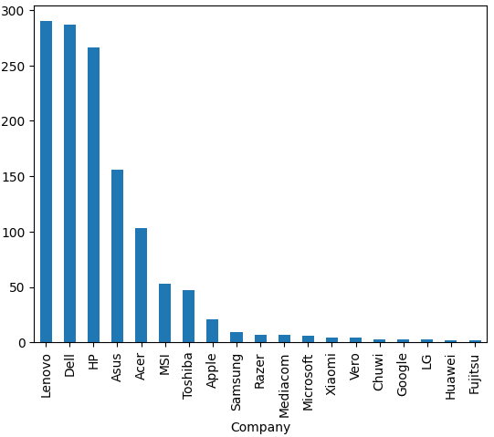
EDA & FEATURE ENGINEERING
About the Company
There are 19 brands available
Lenovo 290
Dell- 287
HP- 256
Asus-156
Acer-103

Slide 8
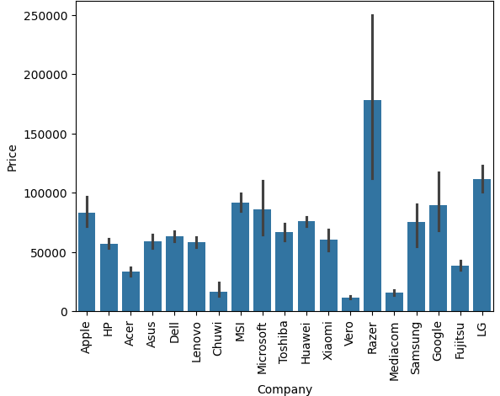
Price Variation
Razer brand is the most expensive brand as it comes under the gaming laptop category and it must have high specification
Common brands includes APPLE which is expensive
But DELL,LENOVO,HP,ASUS are budget friendly ranging around 50k

Slide 9
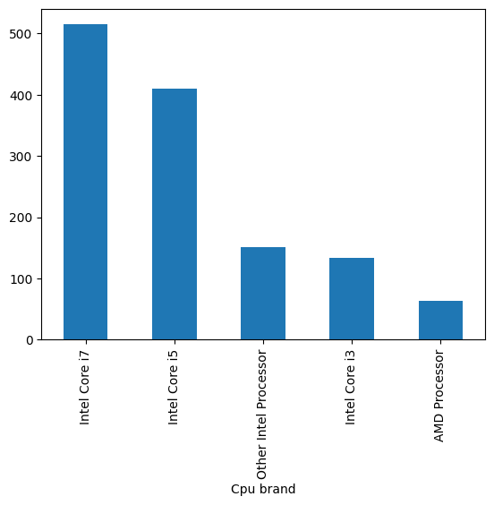
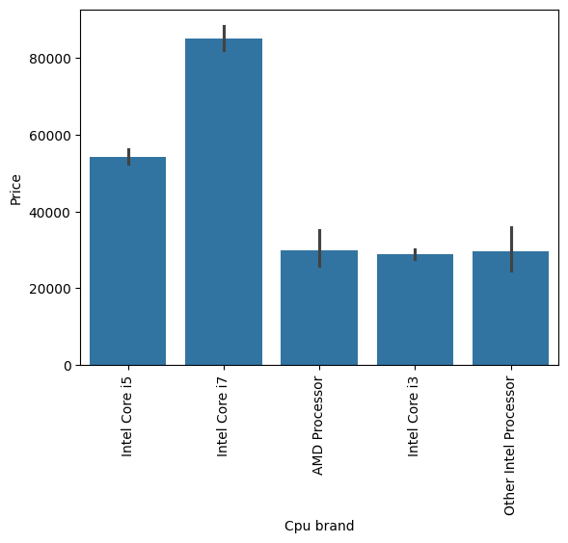
CPU vs Price
Core i7 processors are very popular in the market followed by core i5 processors
In terms of price also Core i7 processors laptops are expensive

Slide 10
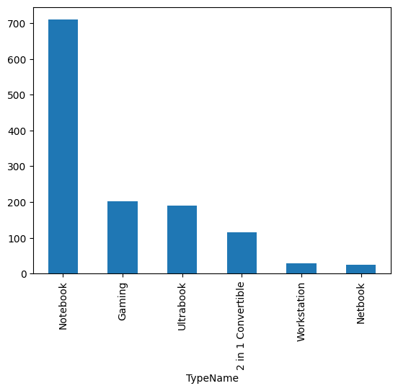
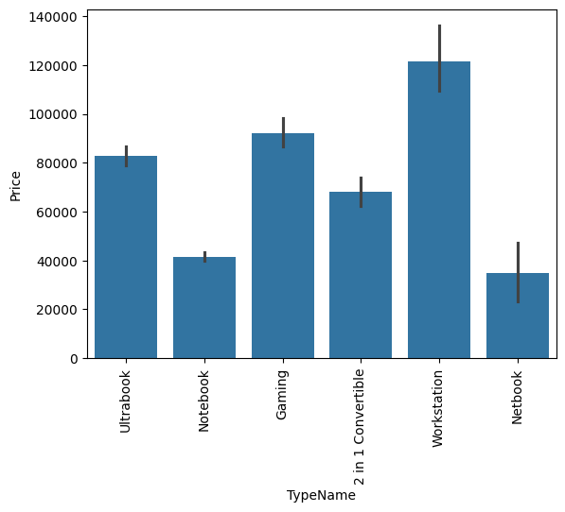
Type vs Price
Notebooks are very popular and also budget friendly (around 40000)
Workstations are expensive for obvious reasons but Gaming laptops are expensive followed by Ultrabooks due their high specifications

Slide 11
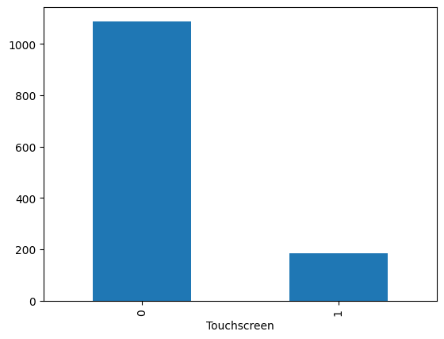
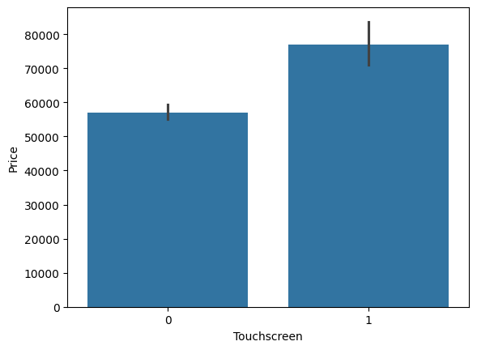
TOUCHSCREEN vs PRICE
Non touch screen laptops dominates the market while Touch screen laptops are less in variants
Price wise Non touch screen laptops are more budget friendly(avg 55000) than touch screens laptops(avg 75K)

Slide 12
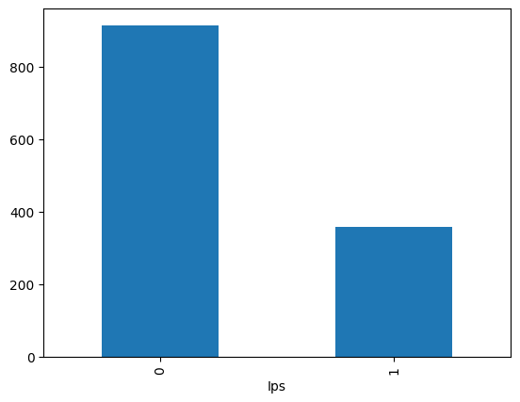
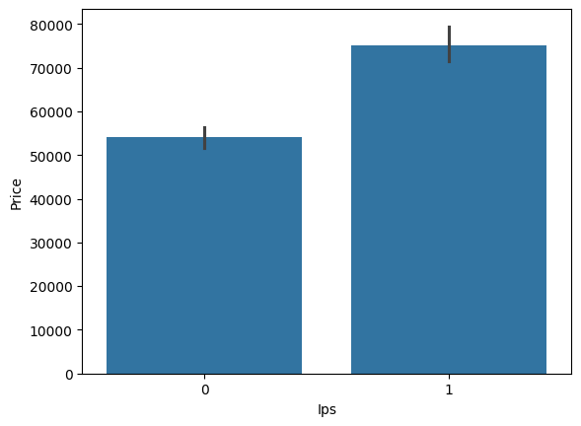
Display vs Price
In Plane switching display are new technology that are trending but non-IPS display are more in production and are also popular among the customers may be due to its lesser cost

Slide 13
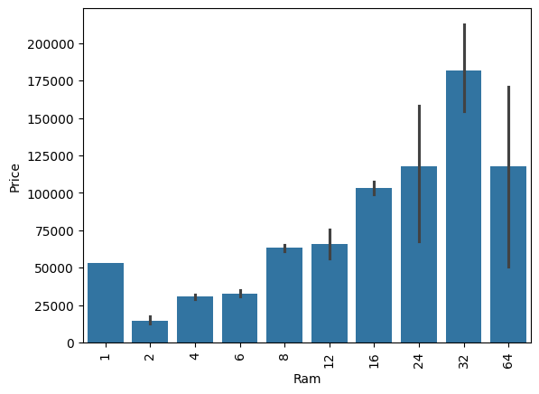
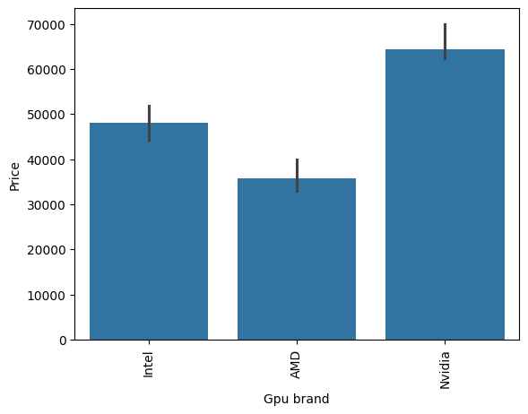
RAM vs GPU vs PRICE
Laptops with RAM 4,6,8,12GB are most budget friendly moreover RAM is highly correlated to Price
NVIDIA Gpu’s are expensive which comes with gaming laptop but AMD and INTEL Gpu’s are most common in budget laptops

Slide 14
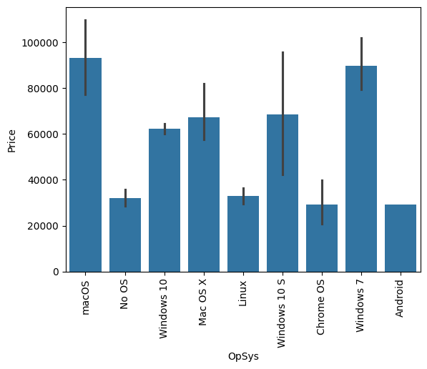
OS vs Price
Operating systems has also a good impact on the price
Mac OS makes the price high and as its an Apple product
Microsoft Win 10 and 10S comes with budget friendly laptops
In some cases Win 7 is still preferred in high end laptops
Android, Linux, No OS makes to the bottom of the chart as they impacts the price less

Slide 15

CONCLUSION
RAM and GPU are the most important feature which can tweak the price
Other features which has significant impact on the price are Category, Display Type, Screen Resolution, Memory
Brands like Lenovo, Dell, ASUS, Acer, HP has more variety to choose from and they target a large amount of population but Apple and other Gaming brands has a specific target audience with high valued systems.

Slide 16
MODEL SELECTION AND EVALUATION
MODEL NAME | R2 SCORE | MAE SCORE
LINEAR REGRESSOR | 0.7205642 | 0.2335782
RANDOM FORREST REGRESSOR | 0.8309754 | 0.1900568
GRADIENT BOOST REGRESSOR | 0.8309967 | 0.1879954
Among all the model and the evaluation Gradient Boosting Model predicts the price of the laptop with an accuracy of 83.10% with a minimum error of 0.188 that’s why its preferred over the others

Slide 17


