Slide 1
Financial Sentiment Analysis

Slide 2

Problem Overview:
Need to get sentiment analysis of financial statements and gauge its impact i.e. positive, negative or neutral on the business and government.
This project will build a model that can correctly predict if a given sentiment is positive , negative or neutral and due to this user can easily get an idea about sentiment and its easy to improve business.

Slide 3

Objectives:
Study about financial statements and its impact on business.
Find insights and areas for improvement for business.
Create a web app where user can put sentiment and model can predict sentiment is positive , negative or neutral.

Slide 4
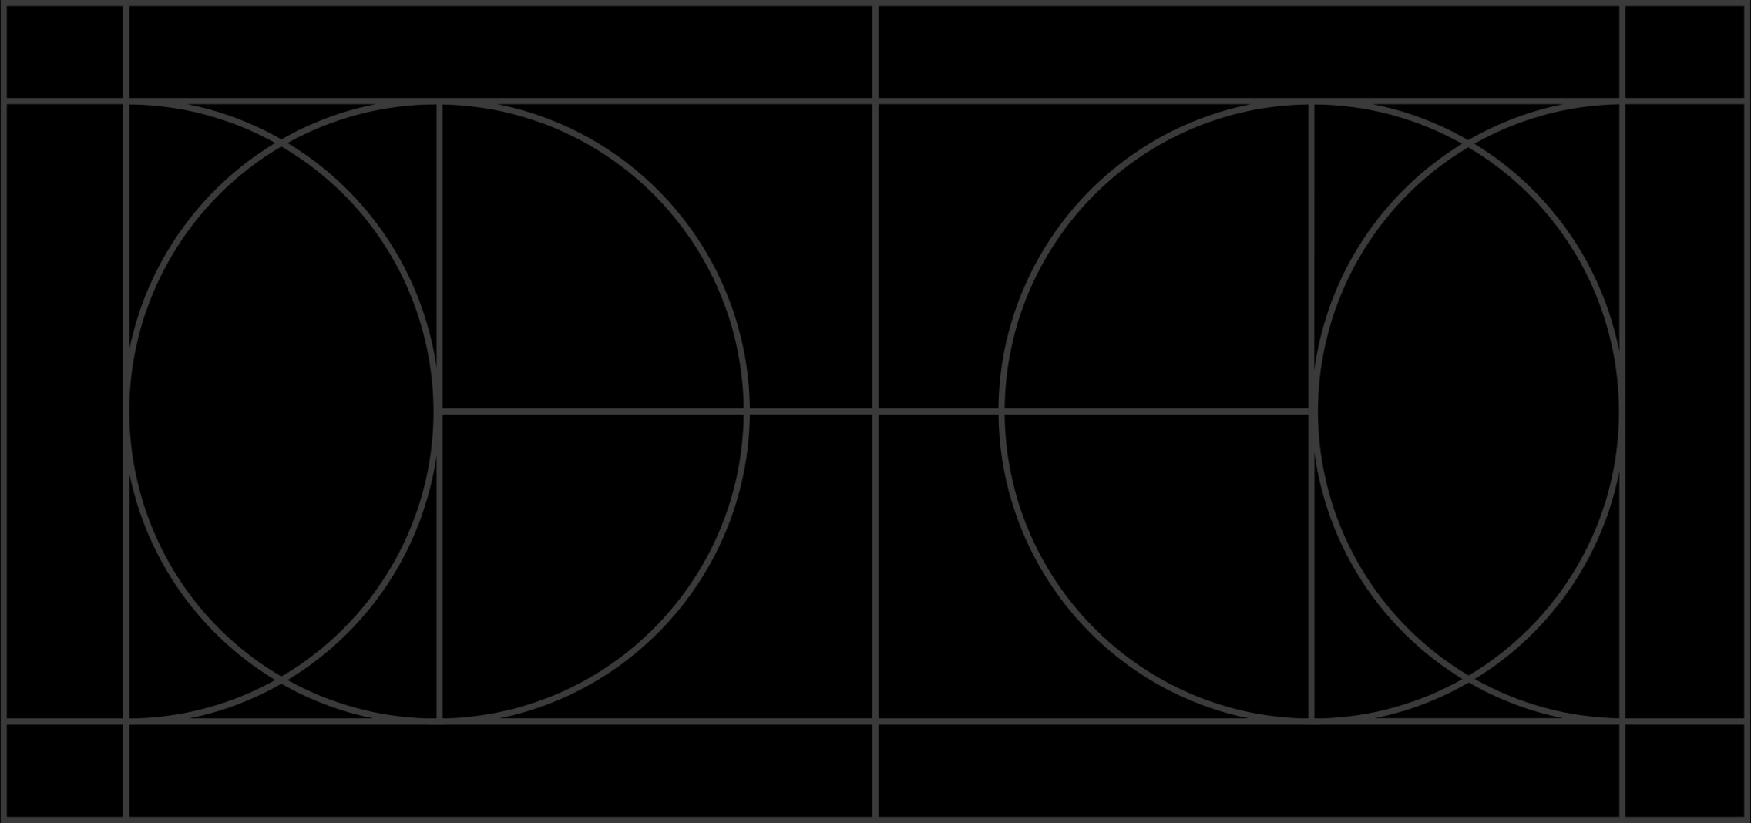
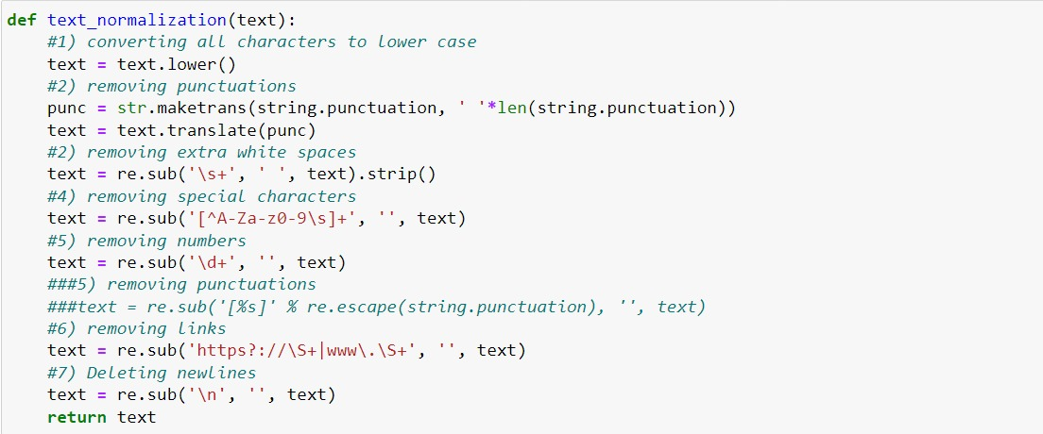
Exploratory Data Analysis: 1. Data Cleaning:
To begin with the process, first we commenced with cleaning text process. In this we have removed white spaces, punctuations, numerical data, changed text to lower case, removed special characters, removed numbers, we remove stopwords & newlines.

Slide 5
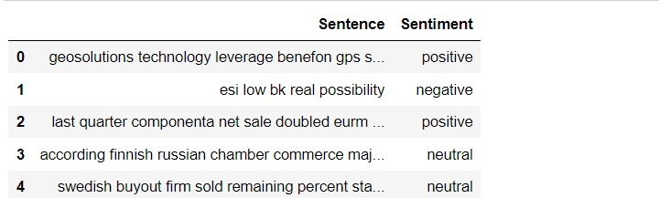
This is the text after cleaning process

Slide 6
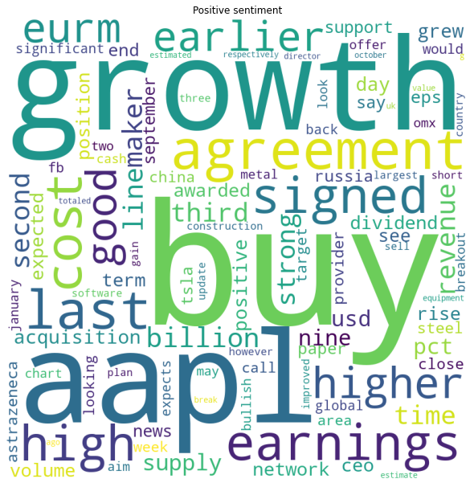
2. Wordcloud for Positive Sentiment :
It is a data visualization technique used for representing text data in which the size of each word indicates its frequency or importance.
This is for positive sentiment.

Slide 7
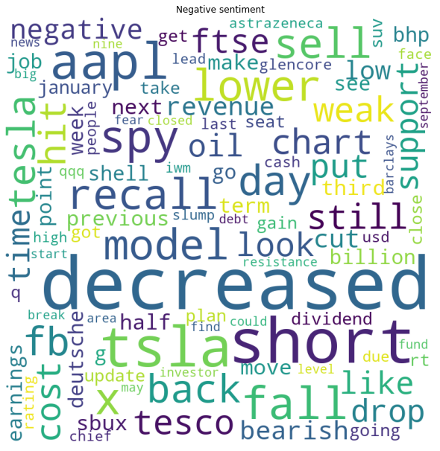
2. Wordcloud for Negative Sentiment :
It is a data visualization technique used for representing text data in which the size of each word indicates its frequency or importance.
This is for Negative sentiment.

Slide 8
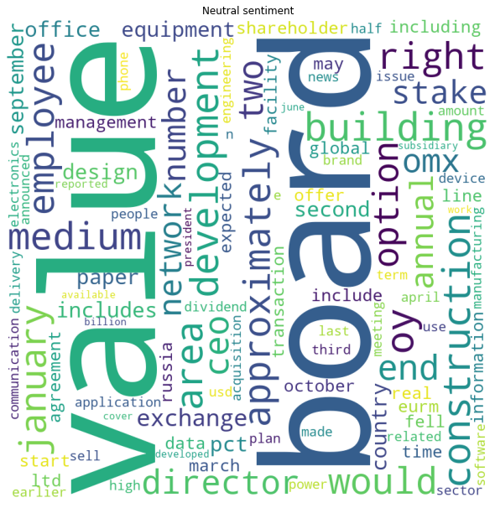
2. Wordcloud for Neutral Sentiment :
It is a data visualization technique used for representing text data in which the size of each word indicates its frequency or importance.
This is for Neutral sentiment.

Slide 9
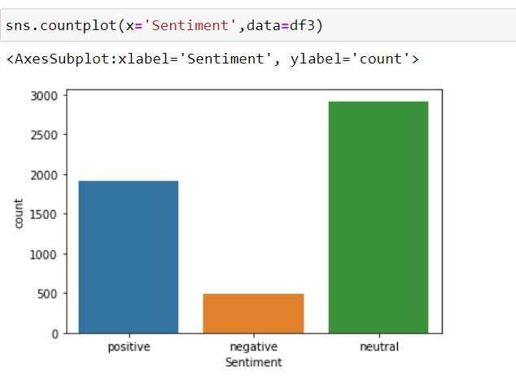
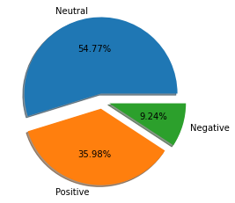
3. Sentiment Analysis:
Created function to compute positive, negative and neutral:
From the following countplot we can get to know that the majority of reviews are Neutral sentiments.

Slide 10

Analytical Approach:
Here we have applied the following Models: 1. Multinomial Naive Bayes 2. Adaboost 3. Random Forest 4. Xgboost

Slide 11
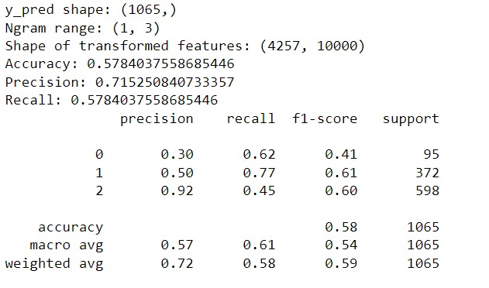
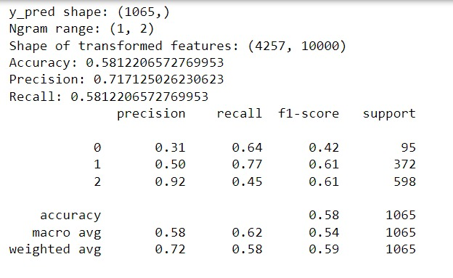
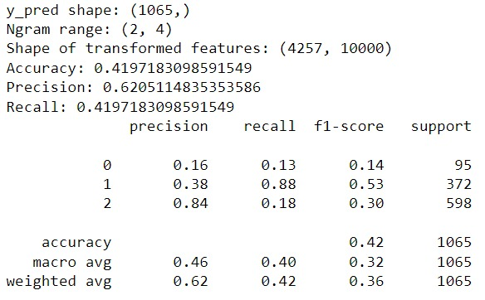
1 . Multinomial Naive Bayes :

Slide 12
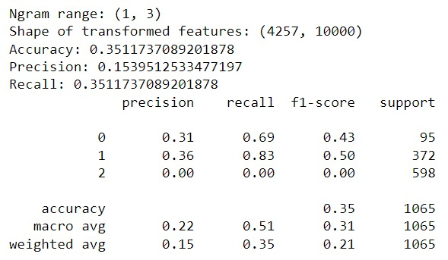
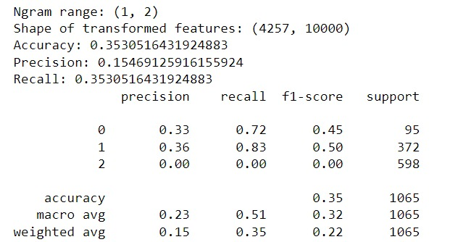
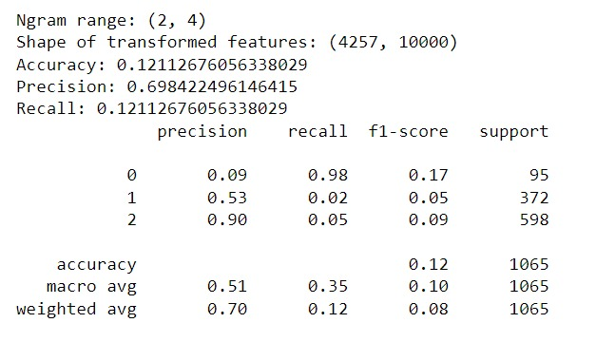
2. Ada Boost :

Slide 13
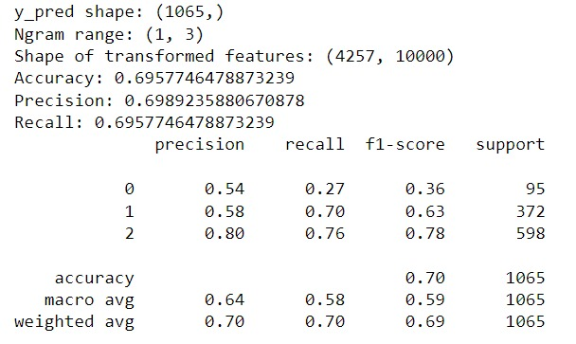
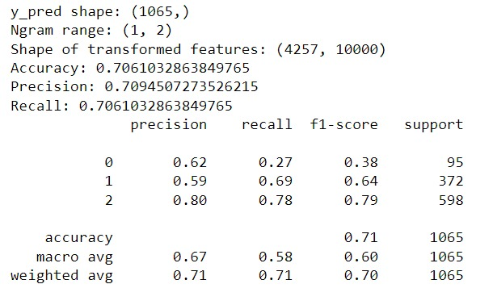
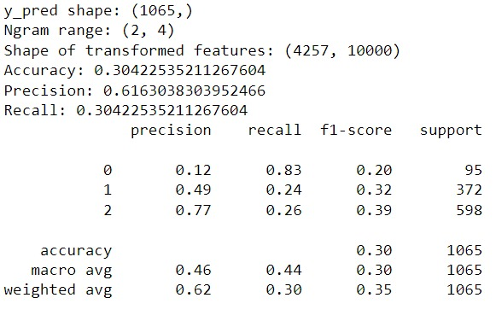
3. Random Forest :

Slide 14
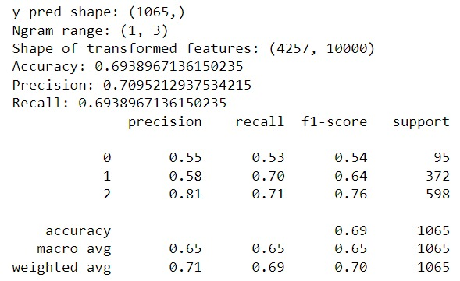
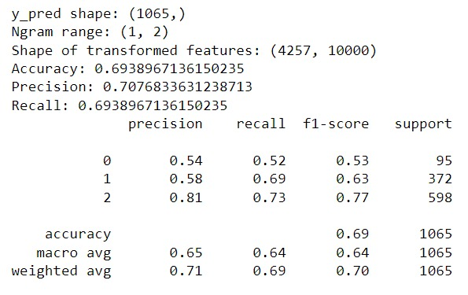
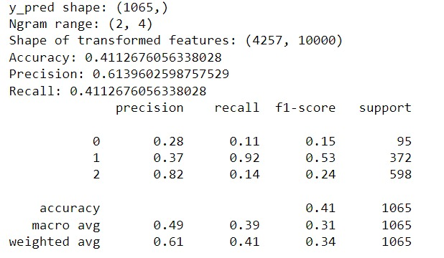
4. Xgboost :

Slide 15
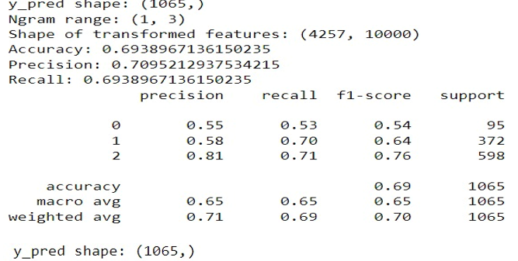
Model comparison:
So mam we had concluded to go with Tfidf feature extraction. Model of Xgboost.

Slide 16

Finalizing the Model:
After checking the accuracy of all models we decided to go with the XGboost model for the Deployment.
For the deployment we used Streamlit.
We built front end of our website using HTML and deployed it on our local machine.

Slide 17

Final Recommendations
The negative reviews suggests that there is some downfall or loss of the business
The positive review suggests that there is the profit, growth of the business.
The neutral review suggests that there is neither profit nor loss of business

