Slide 1

Forecasting of Stock’s Prices Using Machine learning Models

Slide 2
Business Problem:
A company’s performance gets immediately reflected in its stock prices. It is very important to factor in this element when planning to investing in that company for short or long term.
With modern data analysis techniques, we can make an educated forecast of a companies future stock prices in order to decide if it is going to be a good investment opportunities for investor or not.
Objective:
The objective of the analysis is to try various forecasting models on a historic data of the stock to predict if the given stock is a good option to invest in.

Slide 3
Project Architecture / Project Flow
Data Collect
Data Pre-processing
Data Input
Exploratory Data Analysis
Training Various Models
Predicting Results and Selecting Best Model
Analysis and Conclusion
Deployment

Slide 4
Exploratory Data Analysis (EDA) and
Feature Engineering

Slide 5
All Columns
All columns we have is Date, Open, High, Low, Close, Adj Close, Volume
Date: Date is on which day the stock values are. As we can see it is a weekly data only 5 days a week.
Open: it is the Opening price when stock’s are started.
High: it is the Highest price reached in the whole day.
Low: it is the Lowest price reached in the whole day.
Adj Close: price defined by the company of their stock for that day.
Volume: Number of Stocks remaining open for the company on the particular day.

Slide 6
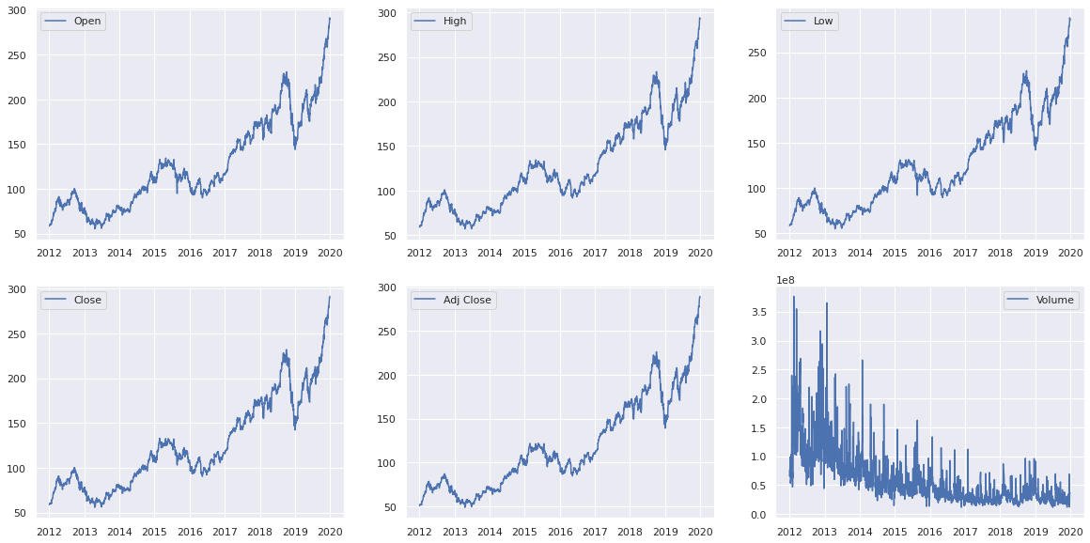
Plot of all columns with date
Observations: All plots Open, High, Low, Close, Adj Close are fallowing same trend and seasonality.
Volume is continually decreasing as dates passing.

Slide 7
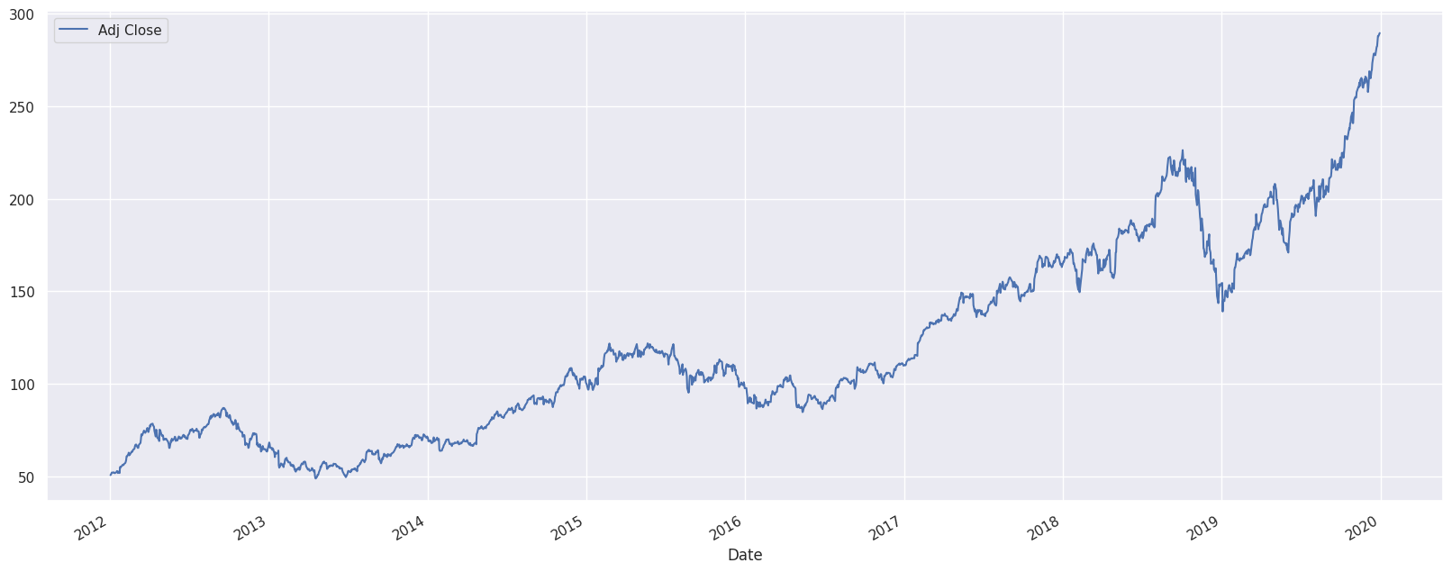
Observation of Value from plot
Observation: from this I can say that there is seasonality of 1 and half year.
Trend is incremental.
Seasonality is multiplicative

Slide 8
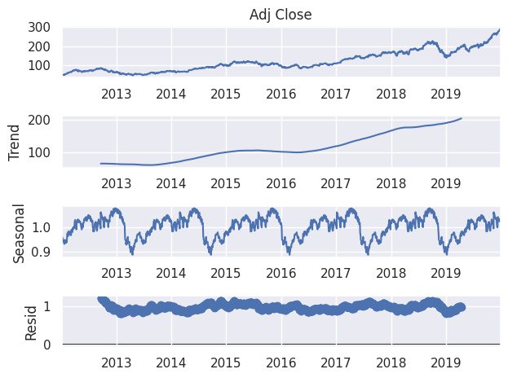
Seasonal Decompose
Observation: As we observe there is not trend in residuals.

Slide 9
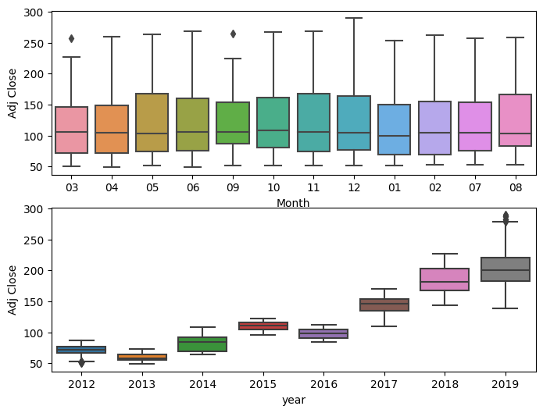
Monthly And Yearly Box Plot
Observation:
from Monthly graph I can say that among every month Adj Close has a median of 100.
Yearly the median is being increased

Slide 10
Out Comes from EDA
The results of Ad fuller test entire data is p value got 0.99734
From this I can say that the data is non stationary we have to make it stationary.
Seasonality is Multiplicative and Trend is positive.
Seasonal period is 1 ½ year.
It had Seasonality so I feel SARIMA will be the best model to predict.

Slide 11
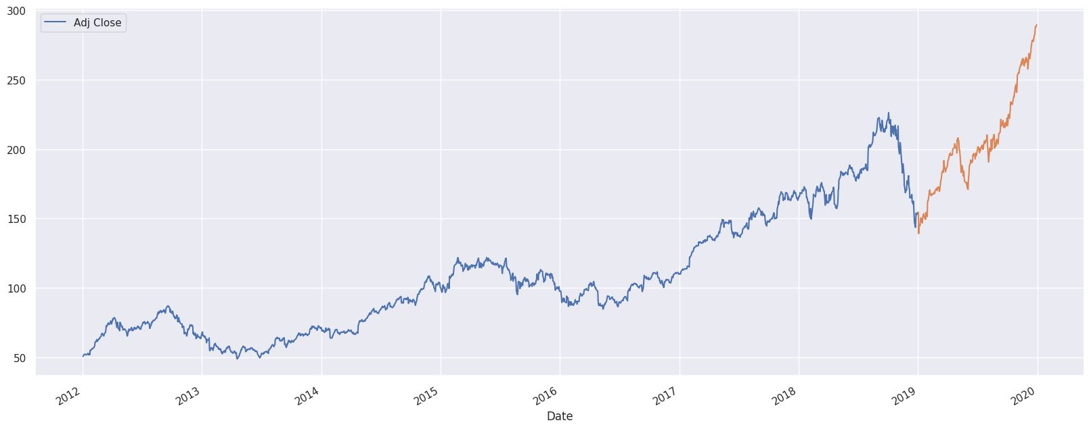
Splitting the data to Train and Test
We are splitting data into training and testing before 2019 and after 2019 and mark data this way.
Blue data is training data and orange part is the testing data.
Done ada fuller test for training data and got p value as 0.65 which explains data is not stationary.

Slide 12
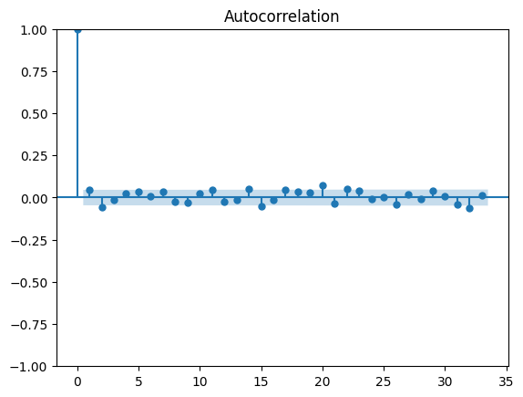
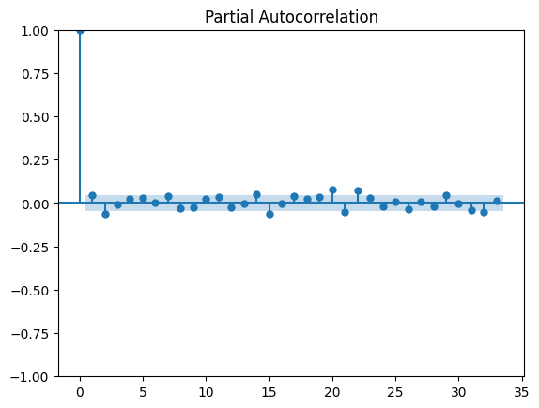
Making Data Stationary
Done first differential and done adafuller test and got result as
1.33 x e⁻¹⁰
Done pacf plot for diff 1
P=0
Q=0
D=1

Slide 13
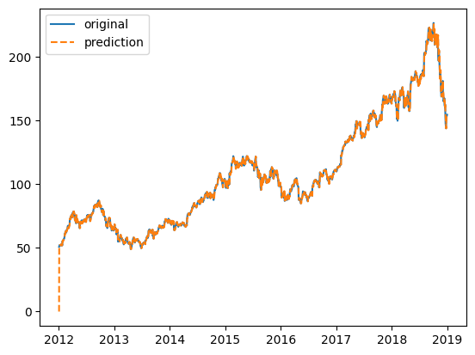
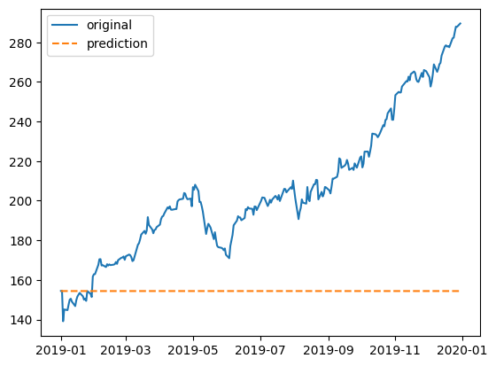
ARIMA model
Built model for (p,d,q)=(0,1,0)
Got AIC=7230 , BIC=7236
Training plot prediction.
Test plot prediction
Train RMSE=2.11
Test RMSE=61.61

Slide 14
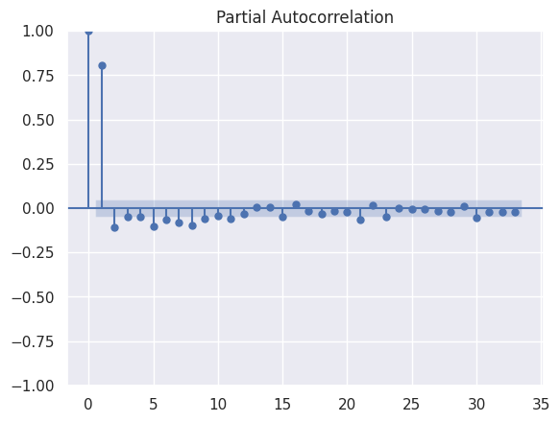
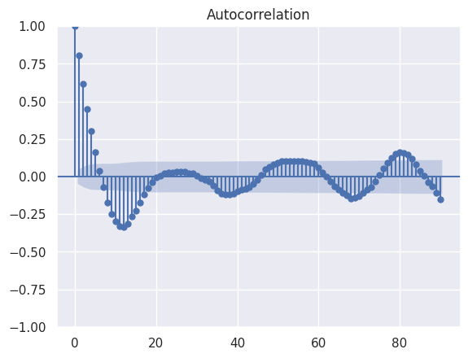
ARIMA by residuals
Built ARIMA model for residuals
Done Adfuller test 9.65 x e⁻²¹
PACF
ACF
P=1
Q=5
(p,d,q)=(1,0,5)

Slide 15
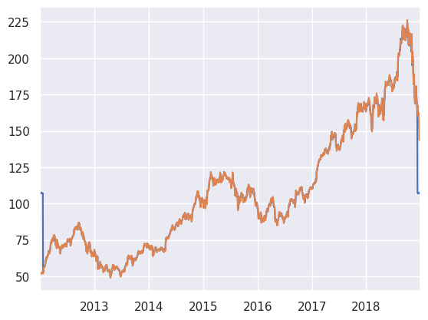
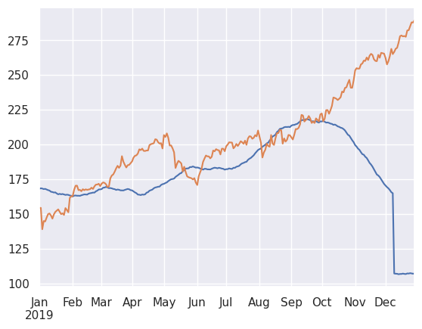
Got train results.
Got test results
Train RMSE=6.914
Test RMSE=51.049

Slide 16
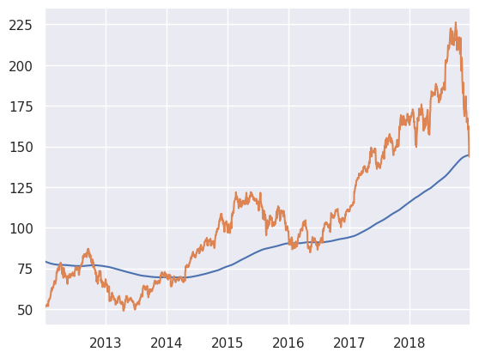
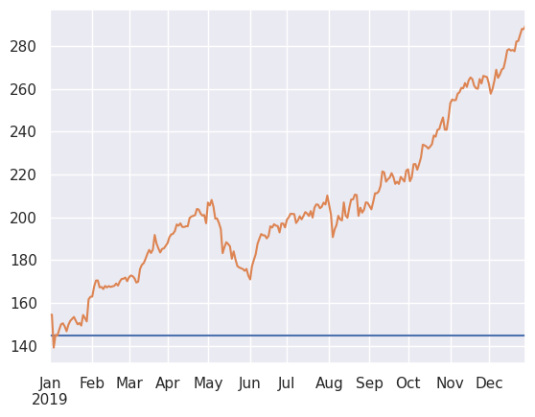
Simple Exponential Smoothing
AIC = 12416
BIC = 12427
SME train plot
SME test plot
RMSE=29.9
RMSE=69.69

Slide 17
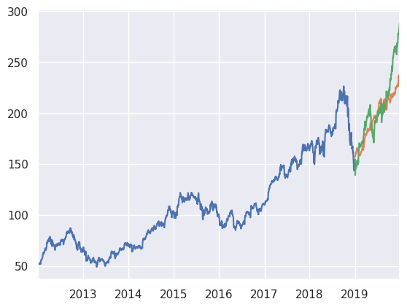
Exponential Moving Average
AIC=2237
BIC=4242
EMA train and test
Blue is the training data orange is predicted data green is testing data Train RMSE=1.51 Test RMSE=20.22

Slide 18
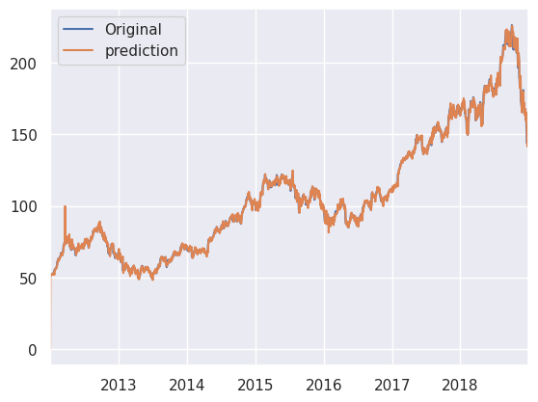
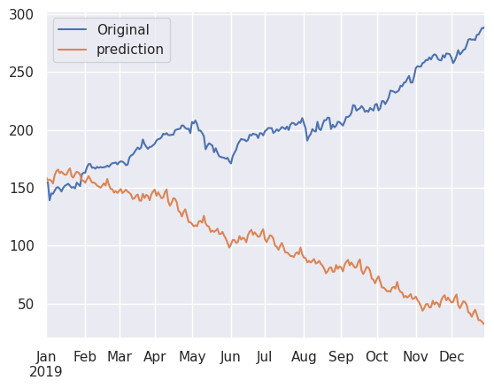
SARIMA model
For order=(1,1,1),Seasonal order=(1,1,0,57)
AIC=7652 BIC=7673
7652.032
SARIMA train original vs prediction
SARIMA test original vs prediction
Train RMSE=2.46
Test RMSE=125.014

Slide 19
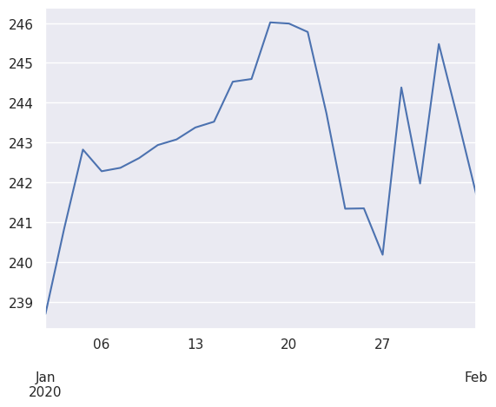
Forecasted Results for next 30Days
I considered EMA modal as the best modal as it got the better results than other modal so the prediction plot for next 30 days is

