Slide 1

JavaScript
Lecture 4. Object, Array, Context.

Slide 2

Lesson Plan
Object
Methods
This
Object destructing
Array
Array destructing
Context

Slide 3
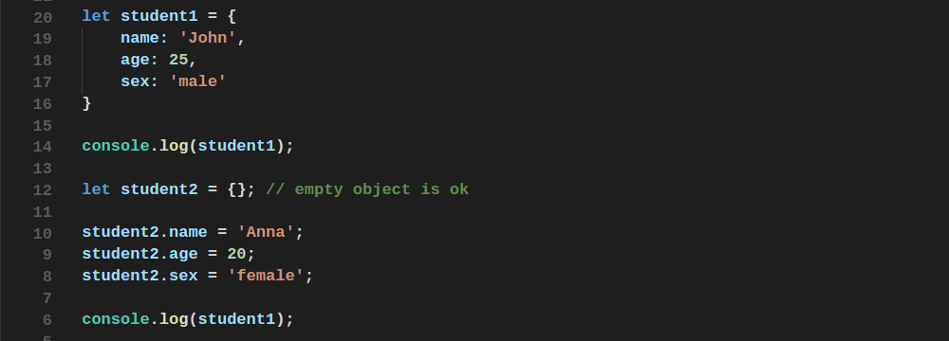
Object
Associative array - is an abstract data type composed of a collection of
(key, value) pairs, such that each possible key appears at most once
in the collection.

Slide 4
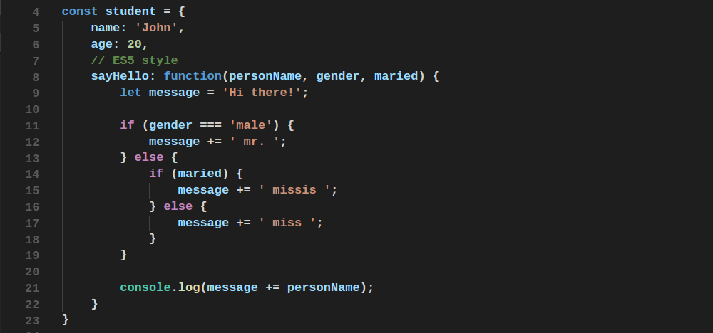
Object Methods

Slide 5
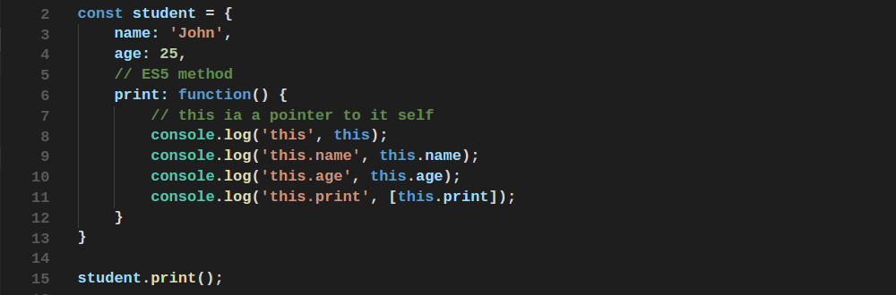

This
All functions have a local variable ‘this’ (context)
I

Slide 6
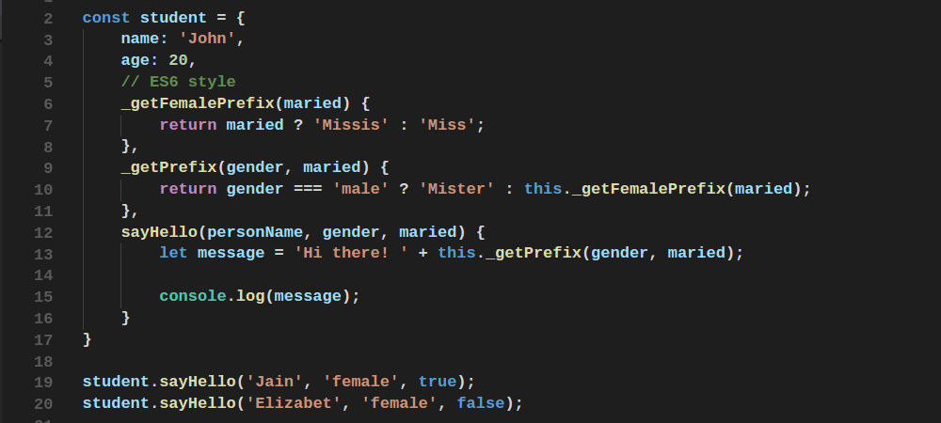
Methods in ES6
ES6 brought us concise notation of methods

Slide 7
Methods
Let’s see
arrow function method example

Slide 8
Property Accessors
Let’s see dictionary example
with brackets and dot notations.

Slide 9
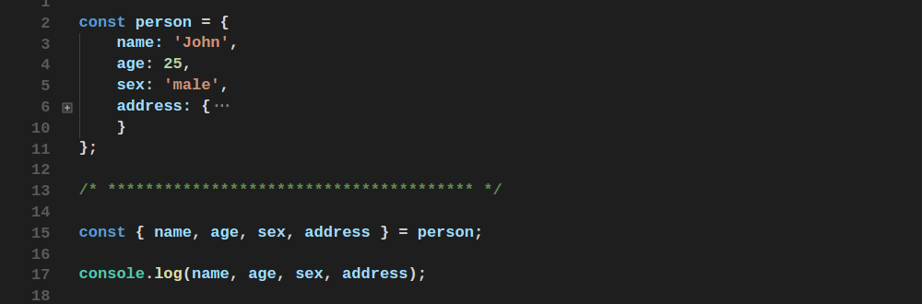
Object Destructuring

Slide 10
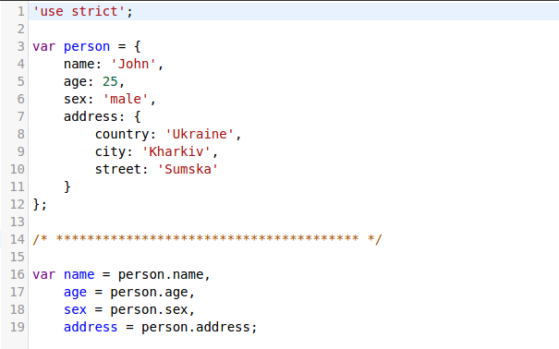
Object Destructuring

Slide 11
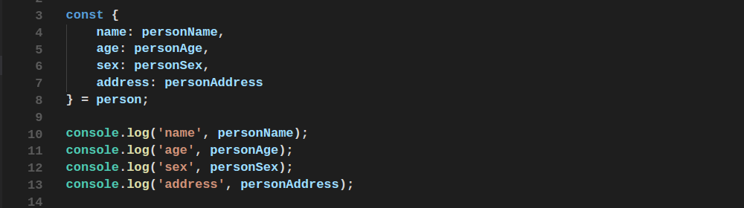
Object Destructuring
Variable renaming

Slide 12
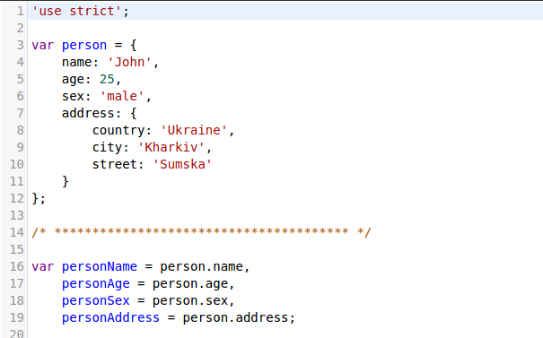
Object Destructuring

Slide 13
Reference and Value types
Let’s see example with object and function.

Slide 14
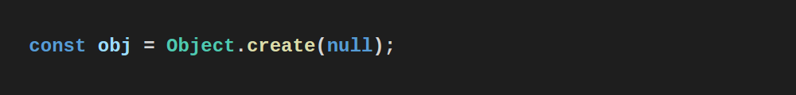
Object Static Methods
Let’s see some useful methods

Slide 15
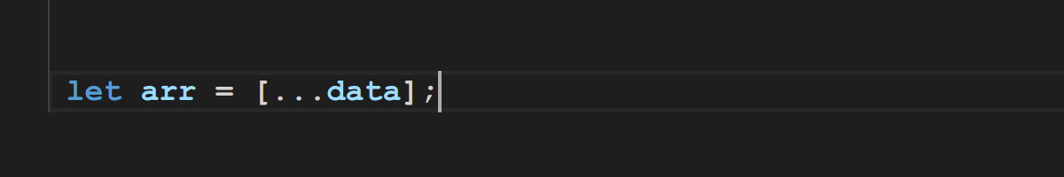
Array
Let’s see some useful methods

Slide 16
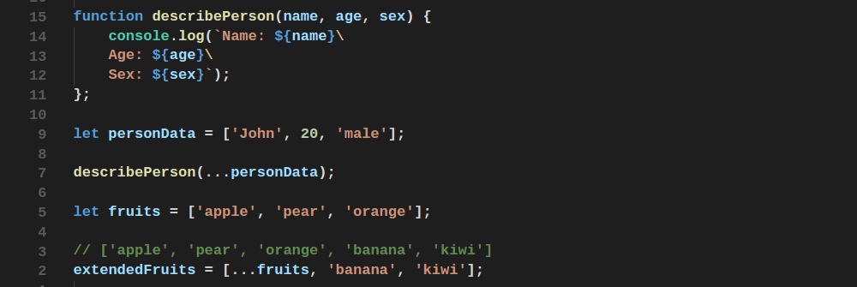
Array
Spread operator

Slide 17
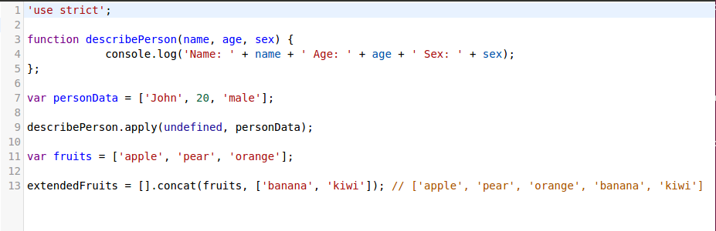
Array
Spread operator

Slide 18
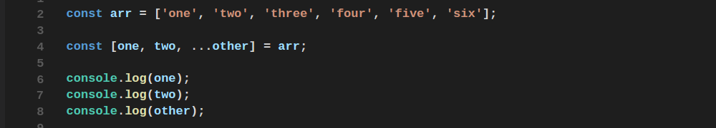
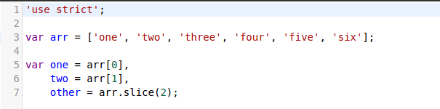
Array Destructuring

Slide 19
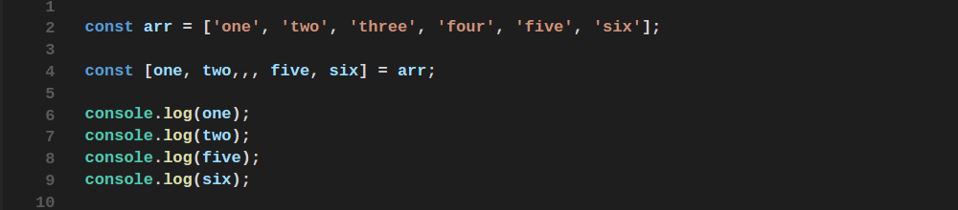
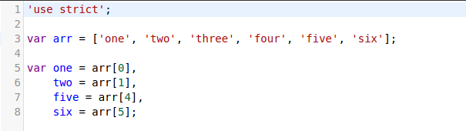
Array Destructuring

Slide 20

Garbage Collector
I

Slide 21
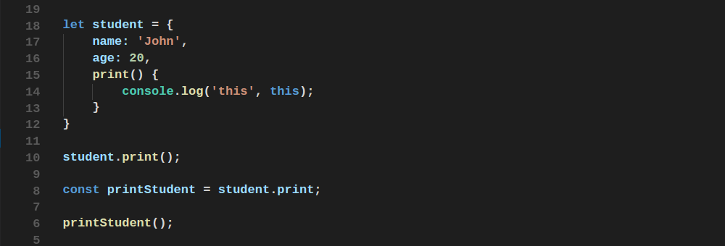
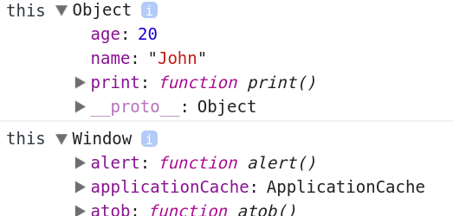
Context
What happened? How can we fix this?

Slide 22
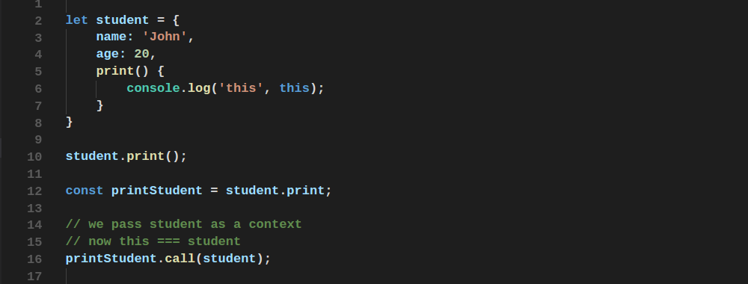
.call

Slide 23
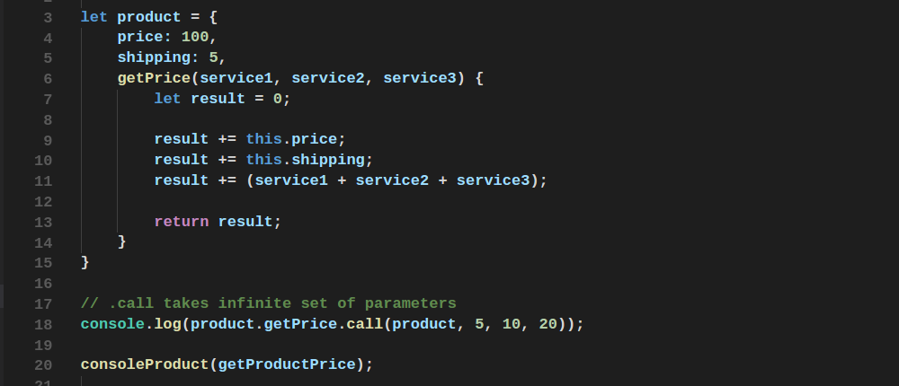
.call

Slide 24
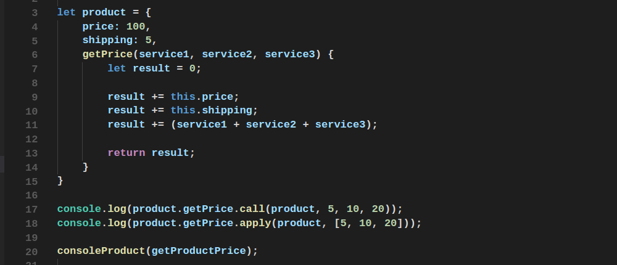
.apply
.call takes infinite set of parameters
.apply takes array with parameters as second parameter

Slide 25
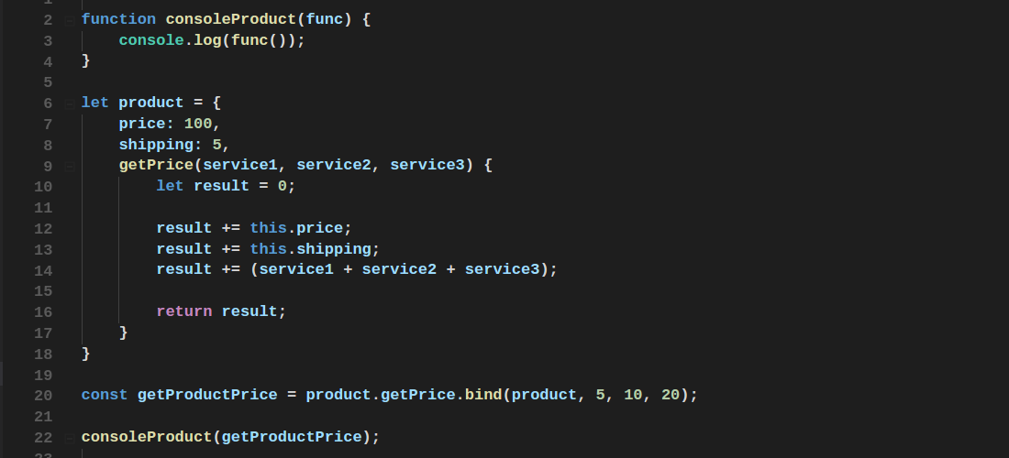
.bind

Slide 26
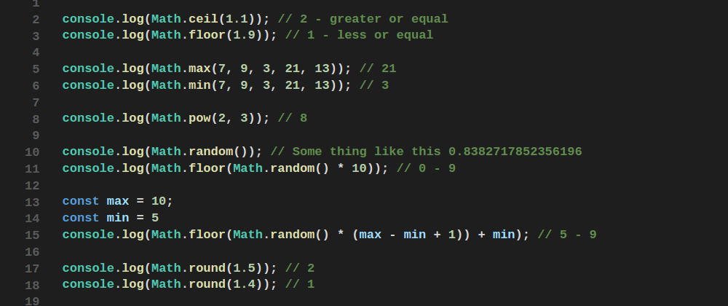
Math
Some useful methods

Slide 27
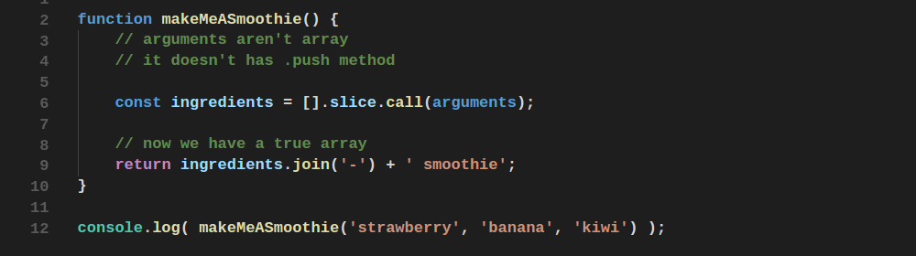
Methods Borrowing

Slide 28
Task 1
Please write a function that retrieve an array of digits and
returns the bigger one.

Slide 30
Task 2
Please write a function that retrieve number of string arguments and return joined string from that arguments.

Slide 31
Thanks for attention

