Slide 1
Docker and Kubernetes

Slide 2
Docker
Introduction to docker, images and containers

Slide 3
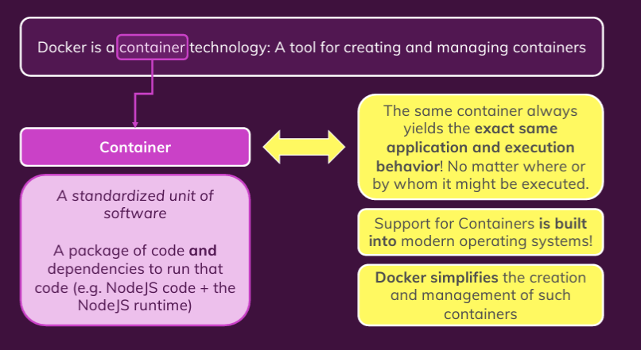
What is and Why Docker?

Slide 4
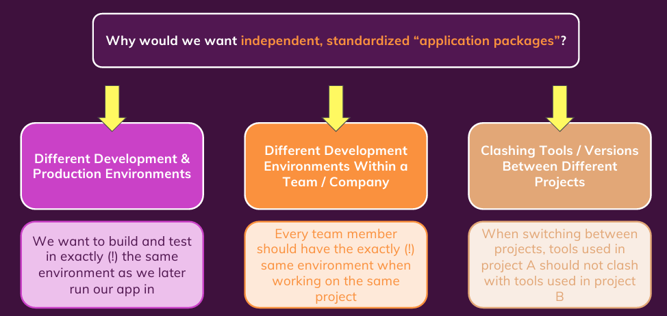
Why Containers?

Slide 5
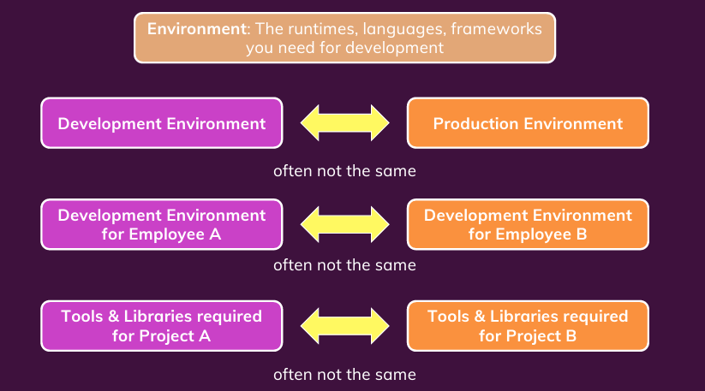
Problems Without Container

Slide 6
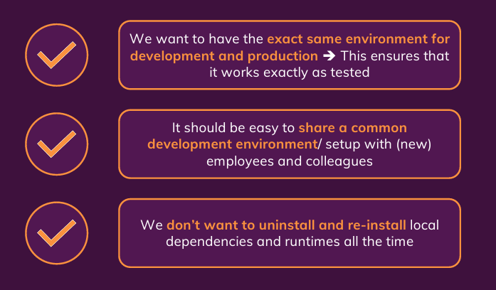
What you need as solution?

Slide 7
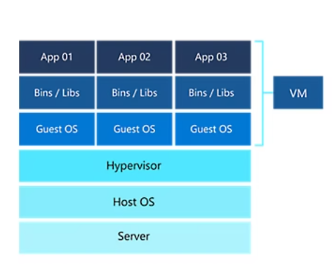
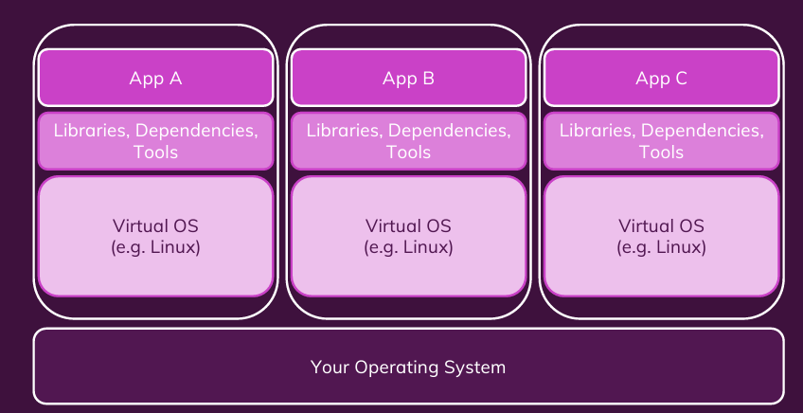
Virtual Machines

Slide 8
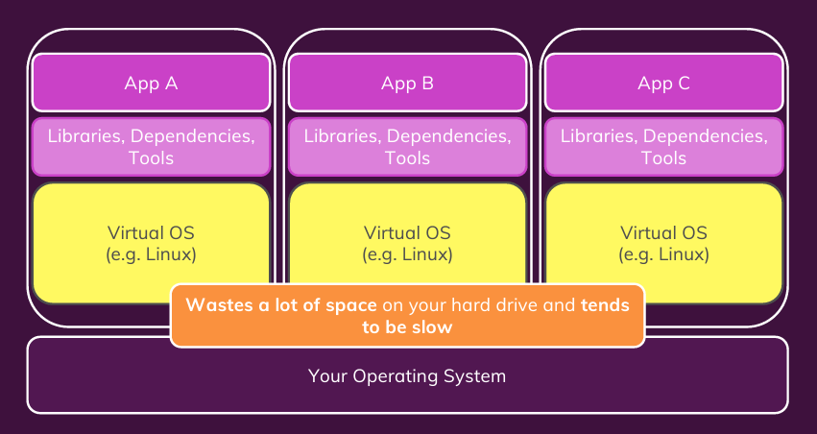
Disadvantages of VM

Slide 9
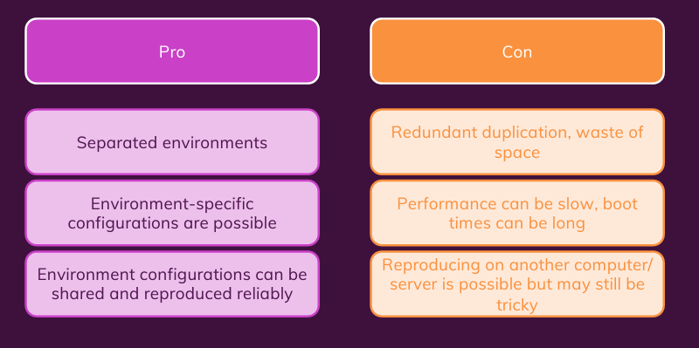
VM: Pros and Cons

Slide 10
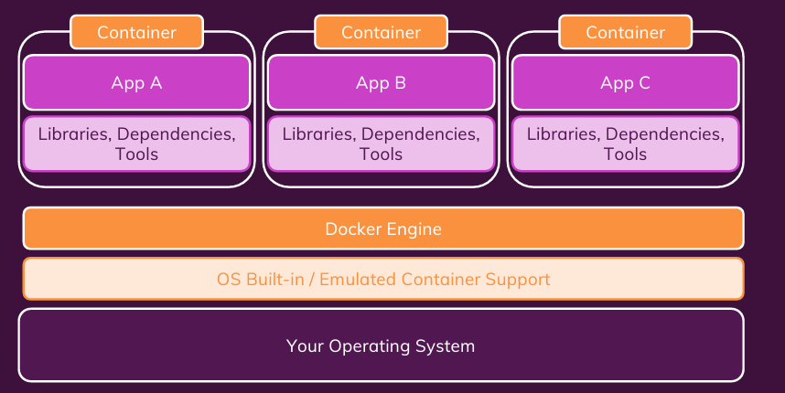
Docker Helps You Manage Containers

Slide 11
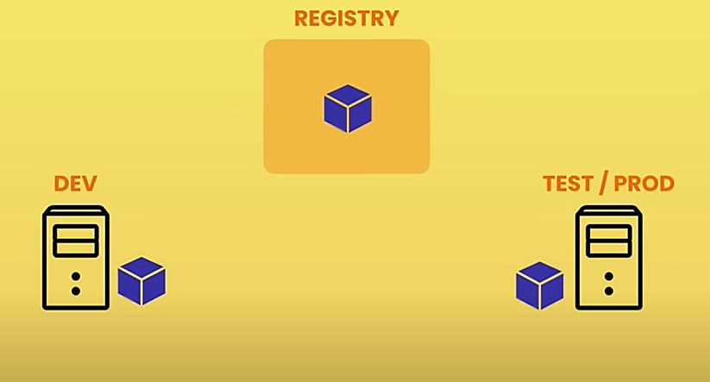
Build and Share Image

Slide 12
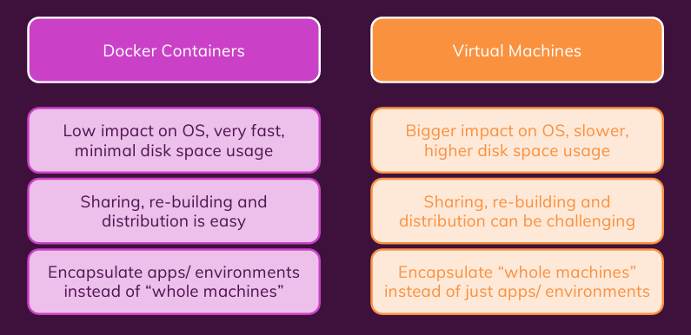
Docker Containers Vs VMs

Slide 13
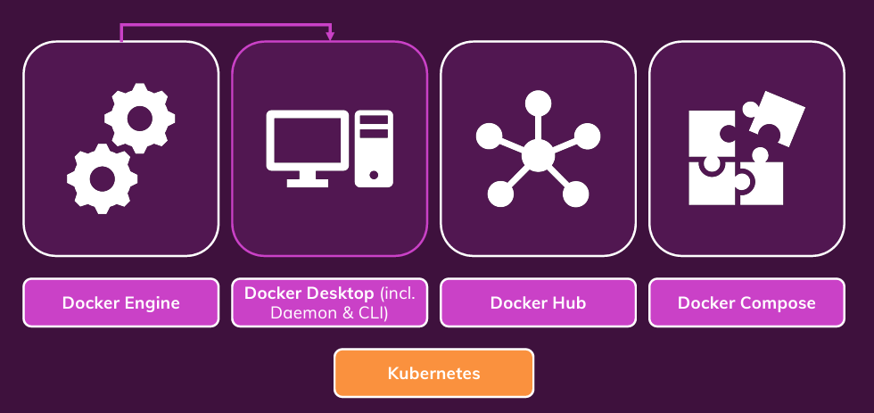
Docker Tools and Building Blocks

Slide 14
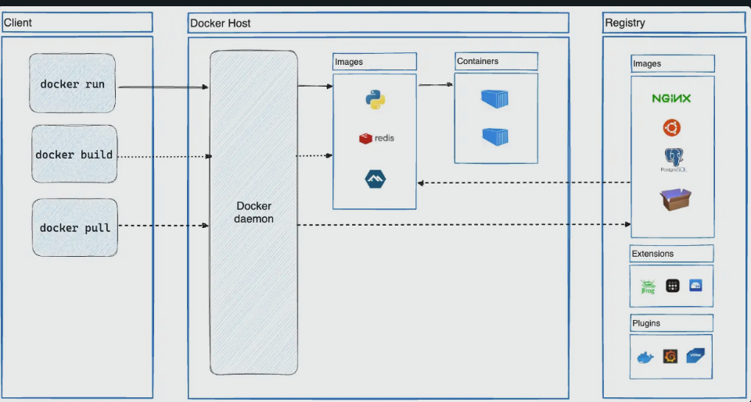
Docker Archtecture

Slide 15
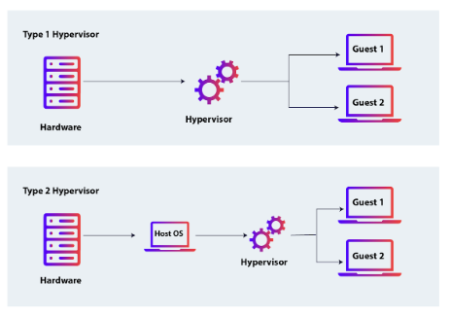
Types of Hypervisor

Slide 16
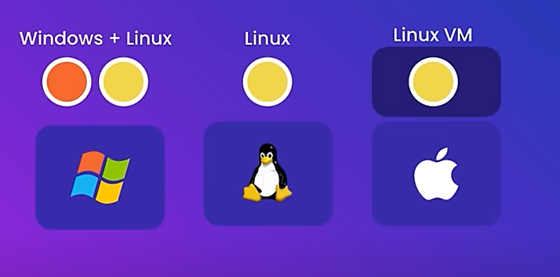
Docker on different O/S

Slide 17
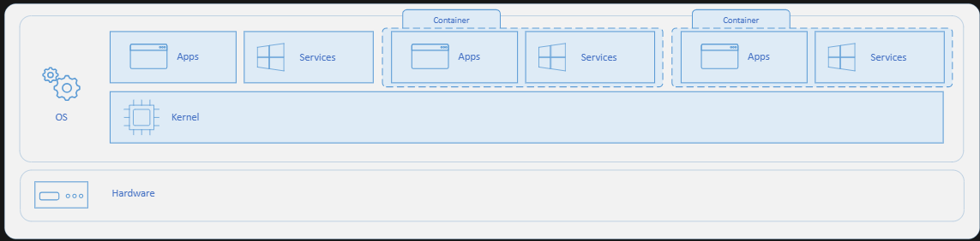
How containers work

Slide 18
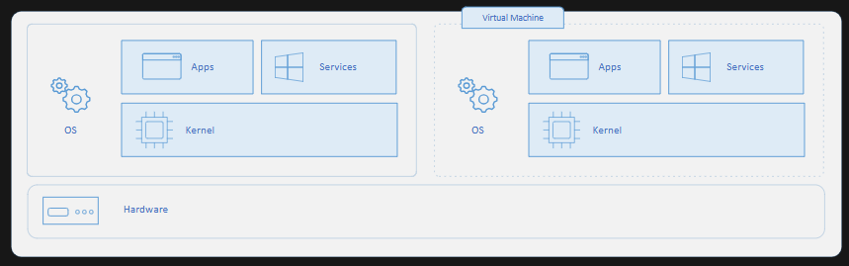
Containers vs. Virtual Machines

Slide 19
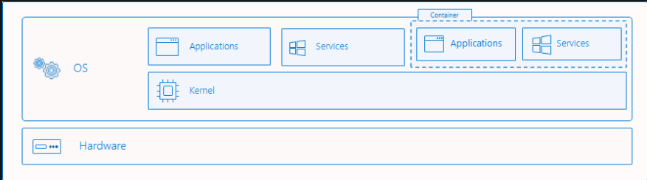
Process Isolation of Windows Containers

Slide 20
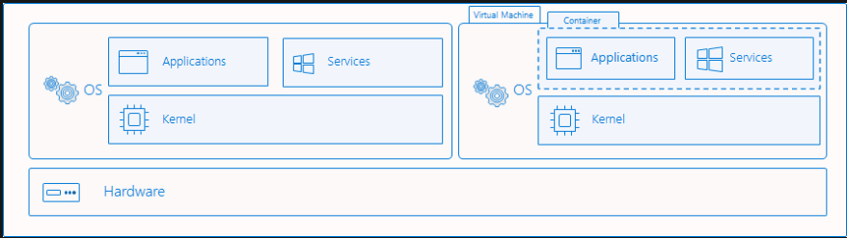
Hyper-V isolation

Slide 21
Docker Images and Containers
The Core Building Blocks

Slide 22
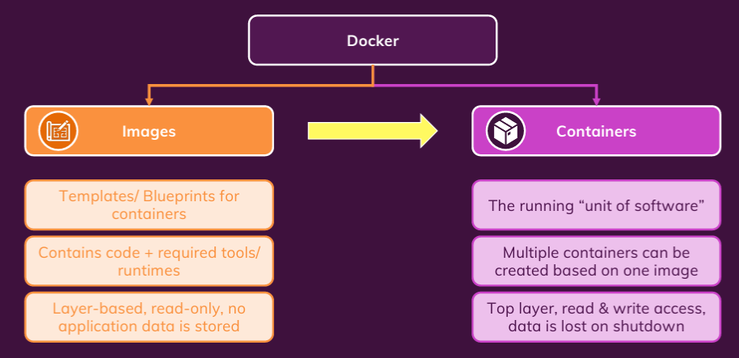
Images Vs Containers

Slide 23
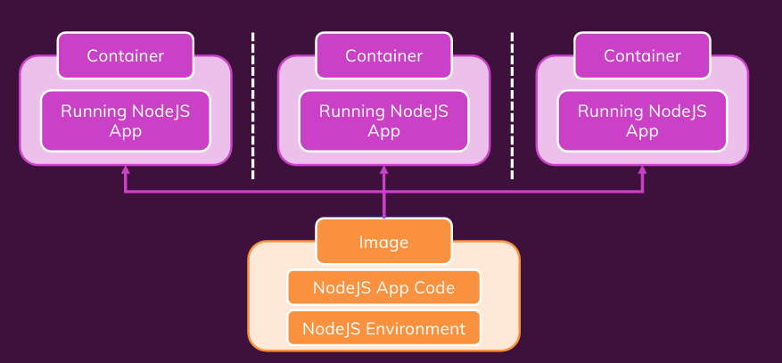
One Image, Multiple Containers

Slide 24
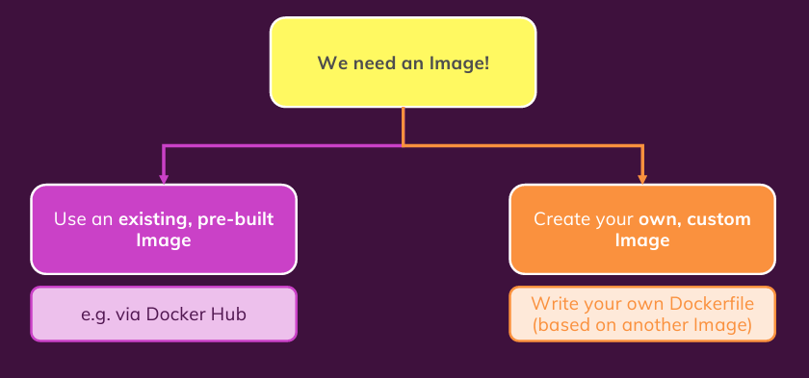
Finding/Creating Image

Slide 25
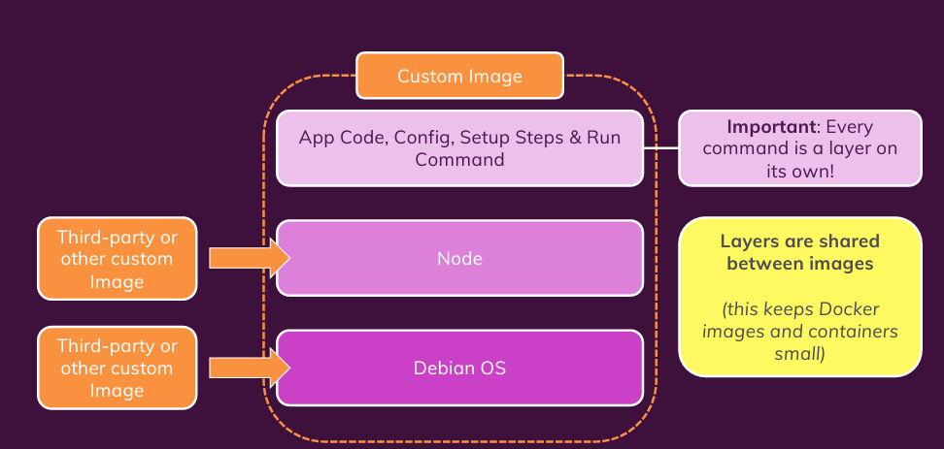
Image and Image Layers

Slide 26
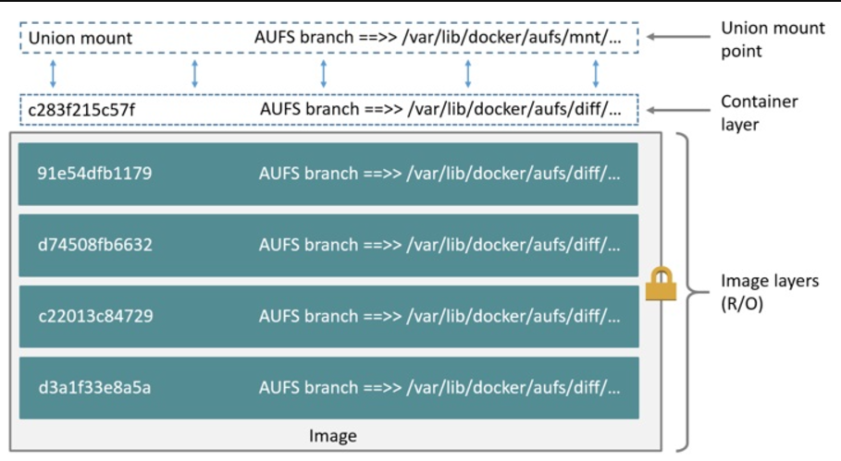
The OS Image layer (in container)

Slide 27
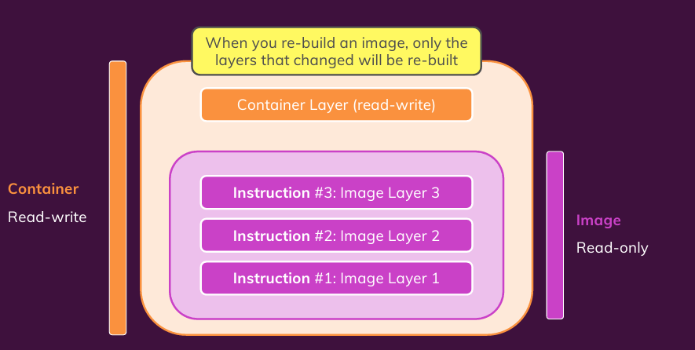
Container is Based on An Image

Slide 28
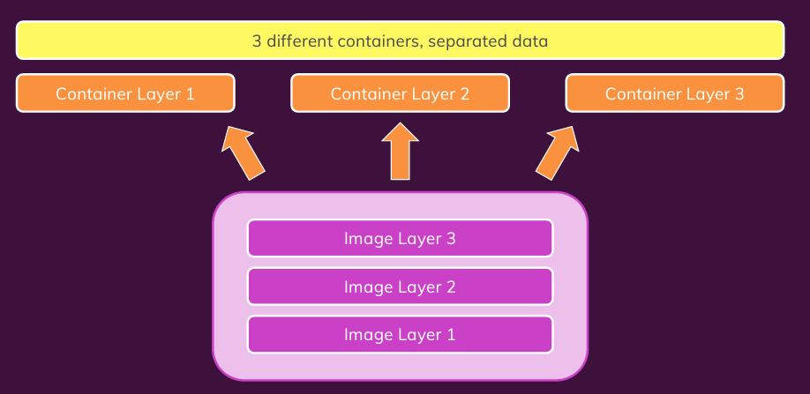
Multiple Containers Based on Same Image

Slide 29
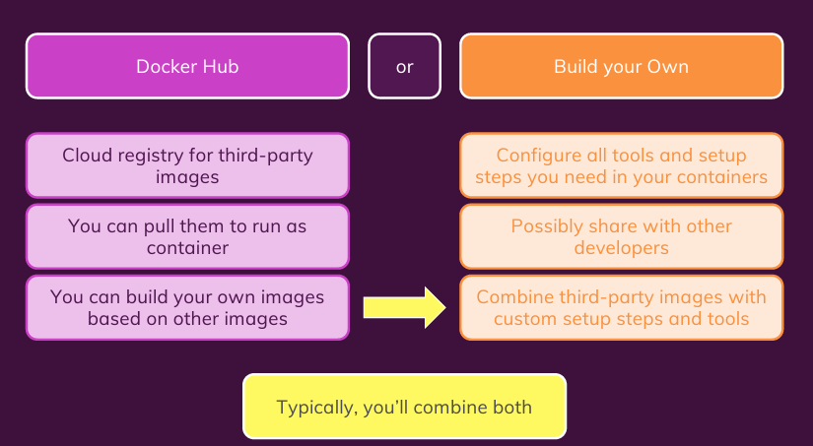
Where to Get Image

Slide 30
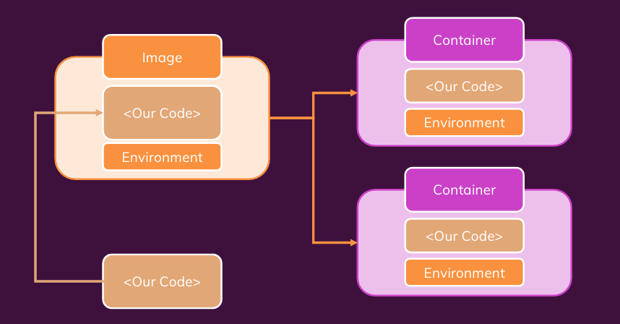
Summary

Slide 31
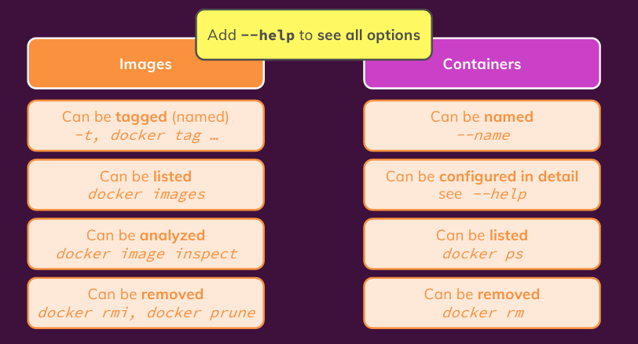
Managing Images and Containers

Slide 32
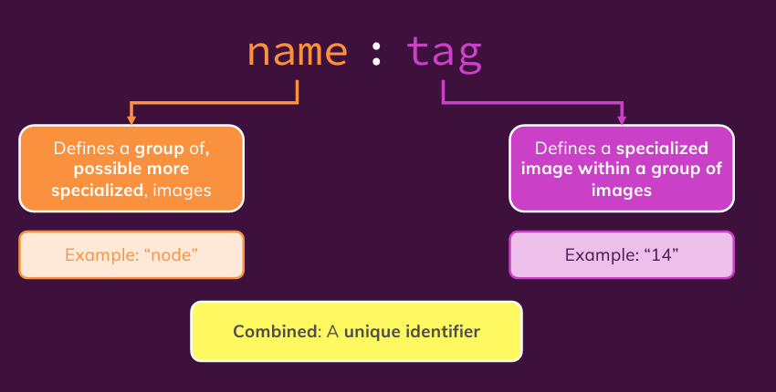
Image Tags

Slide 33
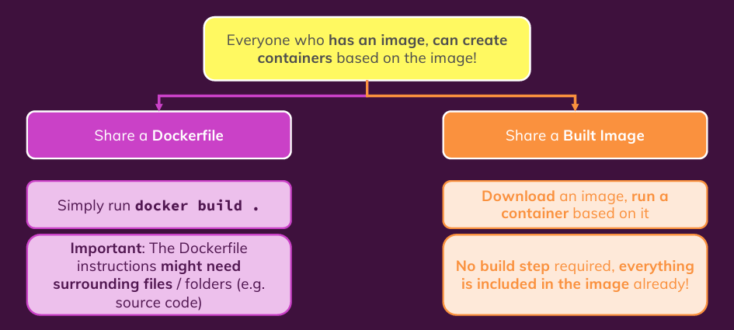
Sharing Image and Container

Slide 34
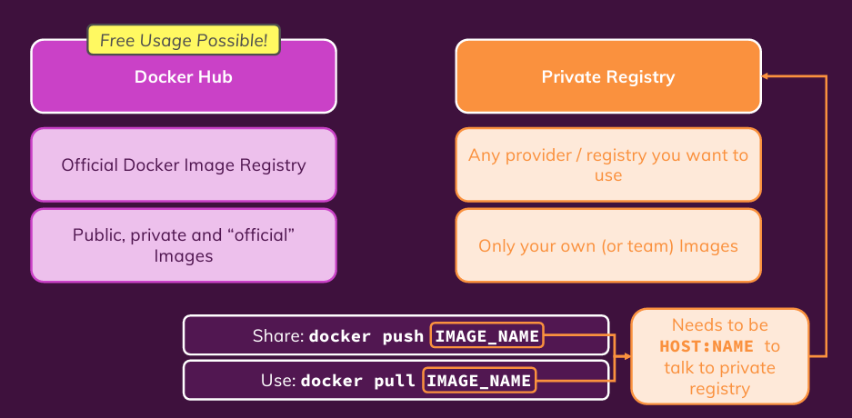
Sharing via Dicker Hub or Private Registry

Slide 35
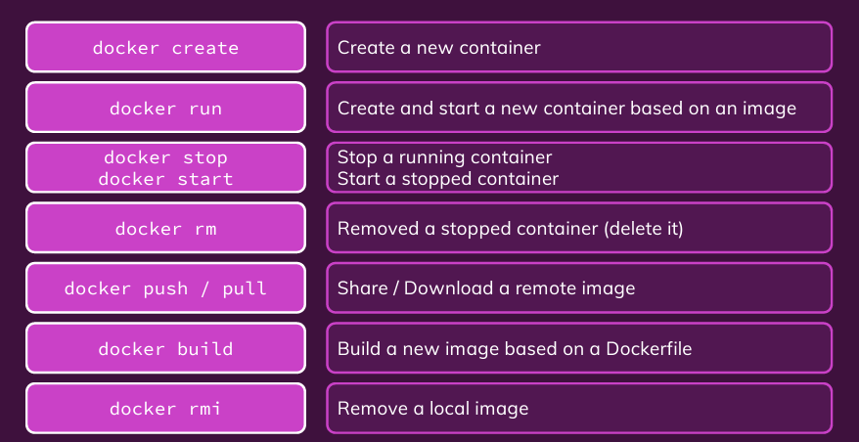
Key Commands

Slide 36
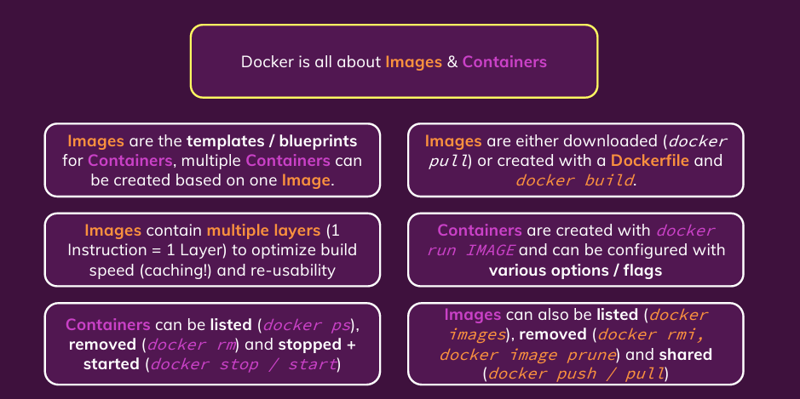
Summary

Slide 37
Data and Volumes
Managing data and working with volumes

Slide 38
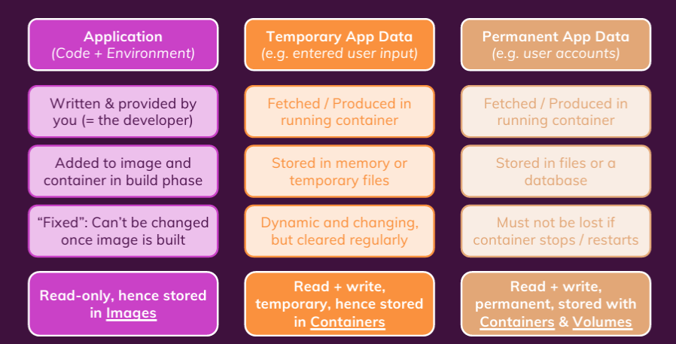
Data

Slide 39
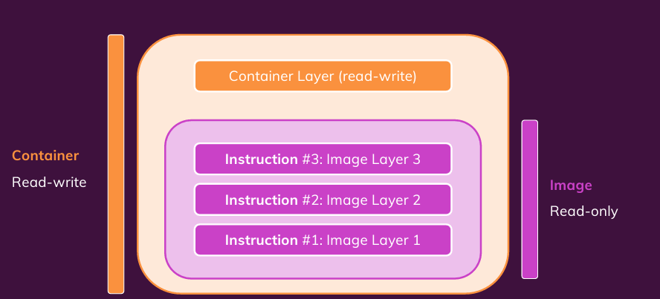
Container: Its Internal Storage

Slide 40
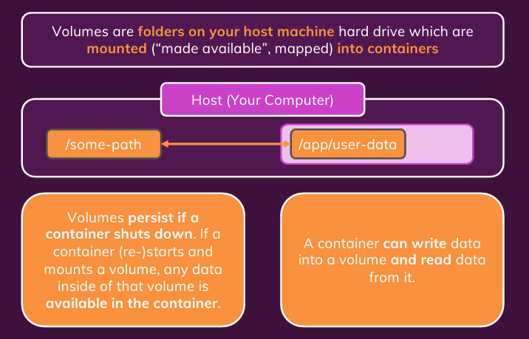
Understanding Volumes

Slide 41
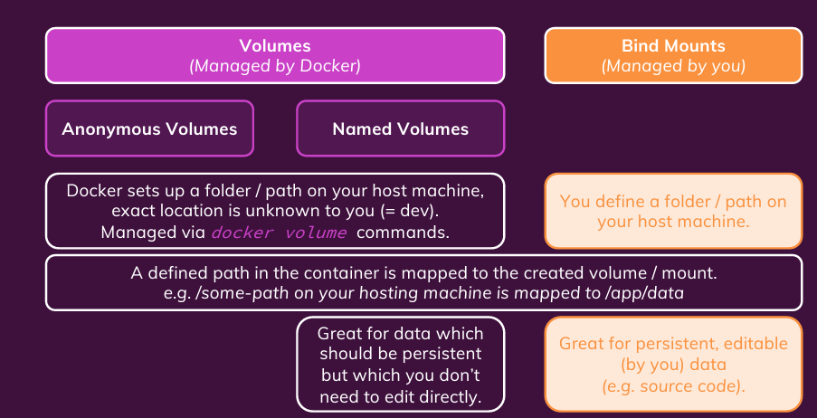
Types of External Data Storages

Slide 42
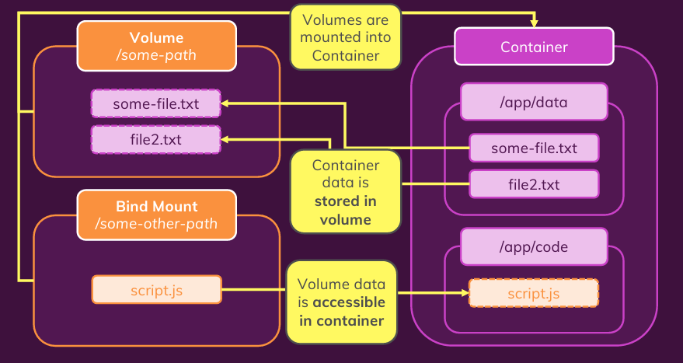
Understanding Volume/Container Interaction

Slide 43
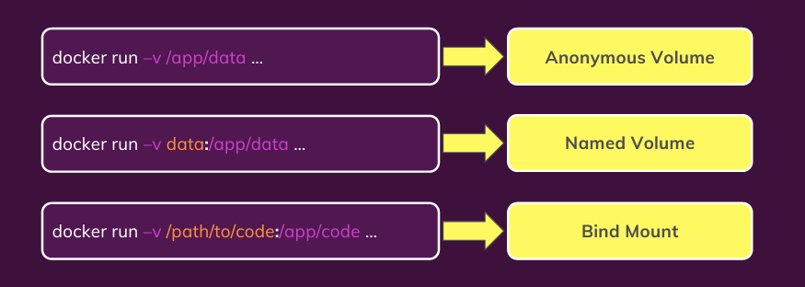
Volumes and Bind Mounts: Quick Look

Slide 44
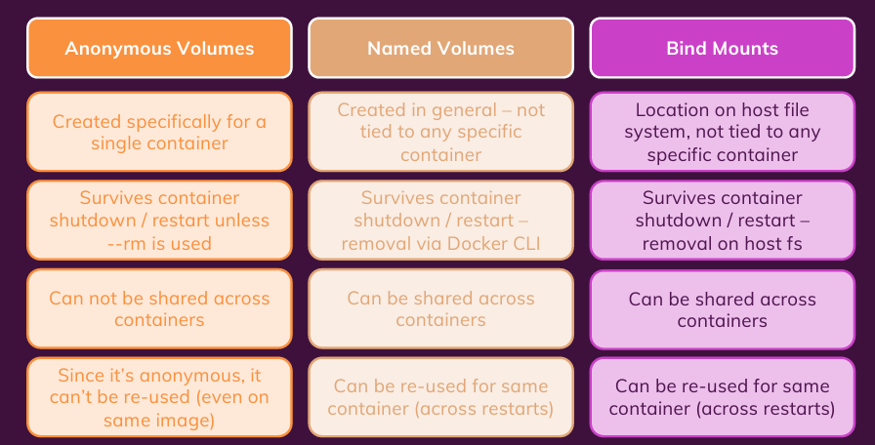
Volumes Comparison

Slide 45
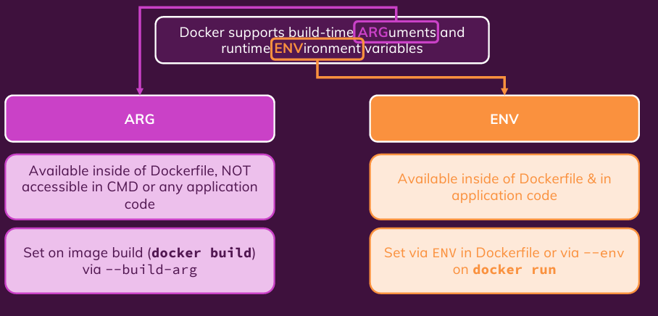
Arguments and Environment Variables

Slide 46
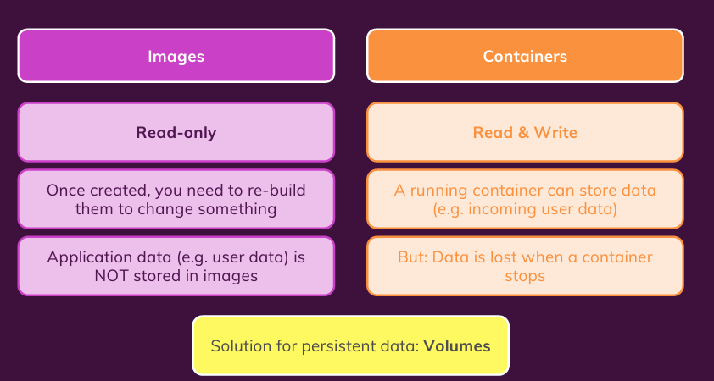
Read-only, Read-Write Volumes

Slide 47
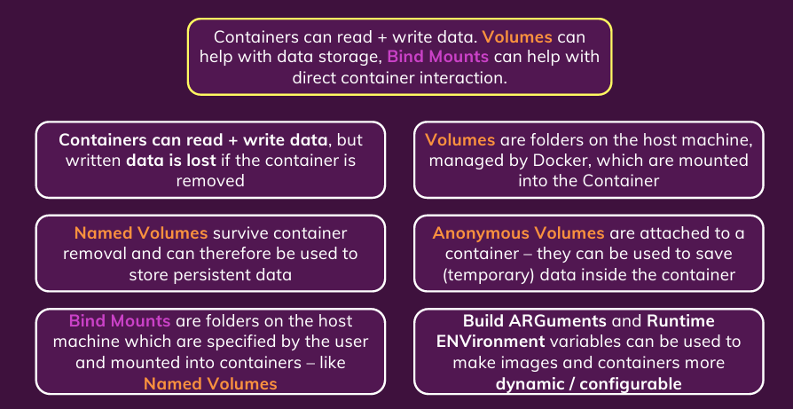
Summary

Slide 48
Networking in Docker
(Cross-) Container interaction/communication

Slide 49
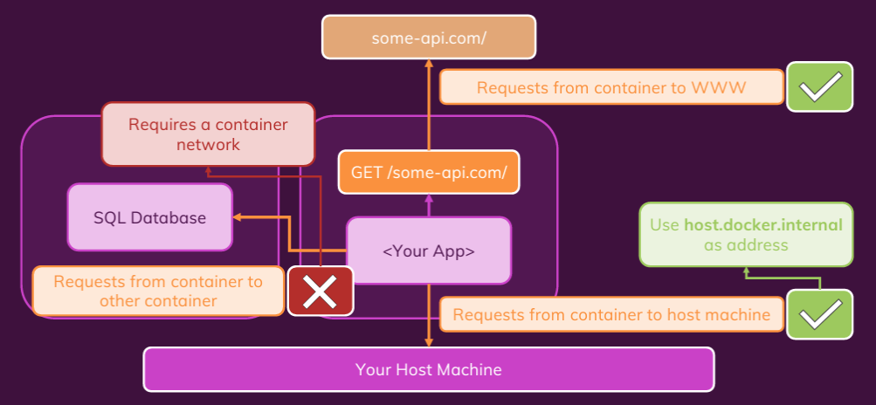
Containers and Network Requests

Slide 50
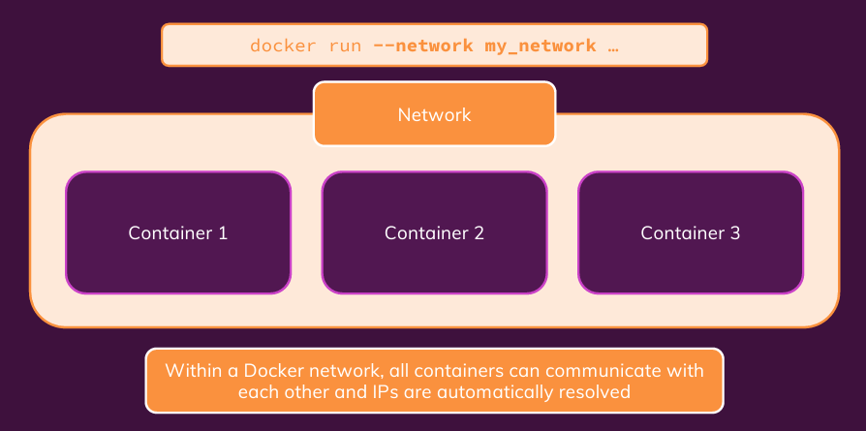
Creating Container Networks

Slide 51
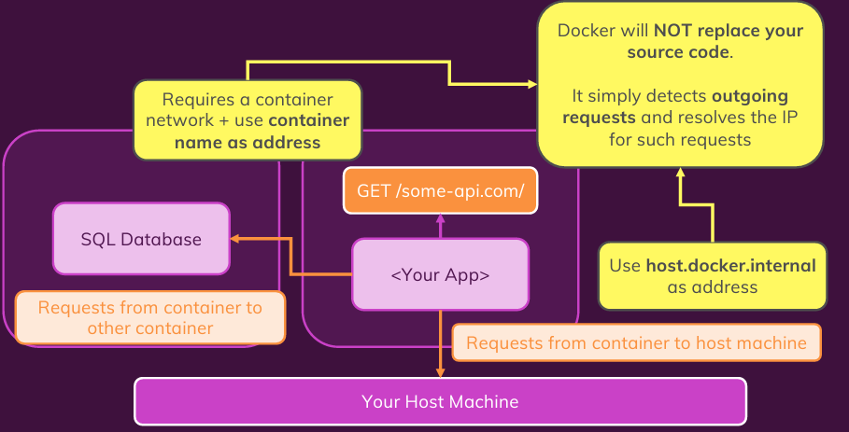
Understanding Docker Network IP Resolving

Slide 52
Multi-container Application with Docker
Multiple containers with different applications and services

Slide 53
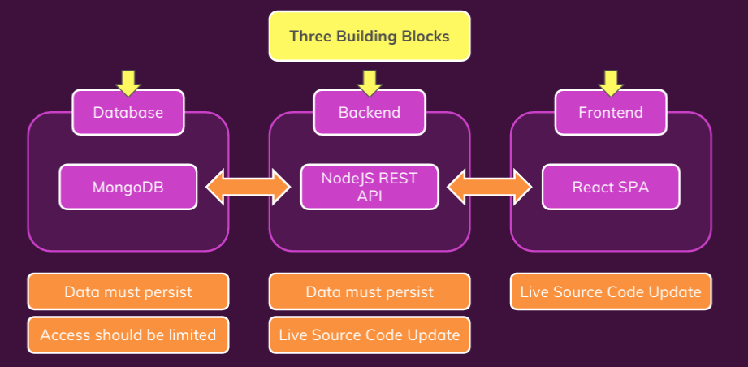
Demo

Slide 54
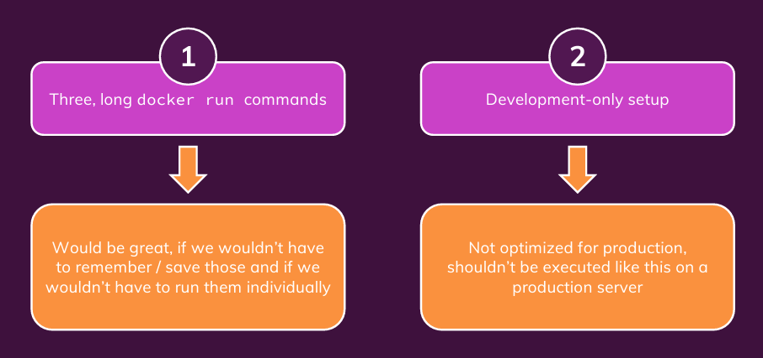
Issues

Slide 55
Docker Compose

Slide 56
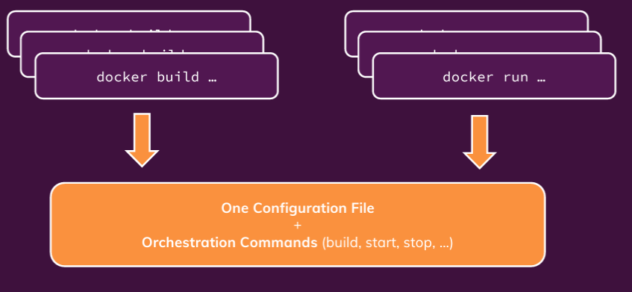
What is Docker Compose?

Slide 57

What Docker Compose Is Not?

Slide 58

Writing Docker Compose File

Slide 59
Kubernetes
Introduction to Kubernetes

Slide 60

Possible Problems with Docker

Slide 61

Solution (provided by AWS)

Slide 62

Problem with a Cloud Provider

Slide 63

Kubernetes to Your Rescue
Kubernetes is like Docker-Compose for multiple machines

Slide 64

Why Kubernetes?

Slide 65

Extensible, Yet Standardized Configuration

Slide 66

What Kubernetes is and is not

Slide 67

Kubernetes Architecture

Slide 68

How Worker Nodes Work

Slide 69

Core Kubernetes Concepts and Architecture
If some pods go down or for scaling up, some new pods need to be created. It tells the API server to pass instruction to worker nodes

Slide 70

Core Components of Kubernetes

Slide 71

Kubernetes ‘s and Developer’s Work

Slide 72
Using Kubernetes
Set-up and Deep Dive into Core Concepts

Slide 73

Kubectl

Slide 74

Kubernetes Objects

Slide 75

Pod Object

Slide 76

Deployment Object

Slide 77

Service Object

Slide 78

Behind the Scene

Slide 79

Imperative Vs. Declarative Usage

Slide 80

Resource Definition

Slide 81
Data and Volumes

Slide 82

Understanding “State”

Slide 83

Managing Volumes in Kubernetes

Slide 84

Kubernetes Volumes

Slide 85

K8s Volumes Vs Docker Volumes

Slide 86
emptyDir
For a Pod that defines an emptyDir volume, the volume is created when the Pod is assigned to a node
The emptyDir volume is initially empty.
All containers in the Pod can read and write the same files in the emptyDir volume, though that volume can be mounted at the same or different paths in each container.
When a Pod is removed from a node for any reason, the data in the emptyDir is deleted permanently.
Note: A container crashing does not remove a Pod from a node. The data in an emptyDir volume is safe across container crashes.

Slide 87

emptyDir Configuration:

Slide 88
hostPath Volume
A hostPath volume mounts a file or directory from the host node's filesystem into your Pod.
This is not something that most Pods will need, but it offers a powerful escape hatch for some applications.
Survives Pod crash even as the file system is in the host system
But it is for “One-pod” situation (like minikube). It can’t be shared across multiple nodes.

Slide 89
hostPath Volume Types
In addition to the required path property, you can optionally specify a type for a hostPath volume.
Value | Behavior
‌"" | Empty string (default) is for backward compatibility, which means that no checks will be performed before mounting the hostPath volume.
DirectoryOrCreate | If nothing exists at the given path, an empty directory will be created there as needed with permission set to 0755, having the same group and ownership with Kubelet.
Directory | A directory must exist at the given path
FileOrCreate | If nothing exists at the given path, an empty file will be created there as needed with permission set to 0644, having the same group and ownership with Kubelet.
File | A file must exist at the given path
Socket | A UNIX socket must exist at the given path
CharDevice | (Linux nodes only) A character device must exist at the given path
BlockDevice | (Linux nodes only) A block device must exist at the given path

Slide 90

hostPath Configuration

Slide 91

Persisted Volumes

Slide 92

From Volumes to Persistent Volumes

Slide 93

Persistent Volumes and Persistent Volume Claims

Slide 94

Normal Volumes Vs. Persistent Volumes

Slide 95
Kubernetes Networking

Slide 96

Our App

Slide 97

Our App

Slide 98

Our App

