Slide 1
Introduction

Slide 2
Lesson Objectives
After completing this lesson, you should be able to do the following:
Define the goals of the course
List the features of Oracle Database 19c
Discuss the theoretical and physical aspects of a relational database
Describe Oracle server’s implementation of relational database management system (RDBMS) and object relational database management system (ORDBMS)
Identify the development environments that can be used for this course
Describe the database and schema used in this course
Notes:
In this lesson, you gain an understanding of RDBMS. You are also introduced to Oracle SQL Developer and SQL*Plus as development environments used for executing SQL statements, and for formatting and reporting purposes.

Slide 3

Lesson Agenda
Course objectives, roadmap, and appendixes used in the course
Overview of Oracle Database 19c and related products
Overview of relational database management concepts and terminologies
Human Resource (HR) Schema and the tables used in the course
Introduction to SQL and its development environments
Oracle Database 19c SQL Documentation and Additional Resources

Slide 4
Course Objectives
After completing this course, you should be able to:
Identify the major components of Oracle Database and MySQL
Retrieve row and column data from tables with the SELECT statement
Create reports of sorted and restricted data
Employ SQL functions to generate and retrieve customized data
Run complex queries to retrieve data from multiple tables
Run data manipulation language (DML) statements to update data in a database
Run data definition language (DDL) statements to create and manage schema objects
Notes:
This course offers you an introduction to the Oracle Database technology. Completing this course will equip you with essential SQL skills. Some of the tasks you can do with these skills include querying single and multiple tables, inserting data in tables, creating tables, and querying metadata.

Slide 5


Icons Used in This Course
Indicates the output from Oracle Database
Indicates the output from MySQL
Notes:
The above icons have been used throughout the course to indicate the output results from Oracle Database and MySQL.
The respective icons have also been used in the title of the slides to indicate exclusive Oracle Database or MySQL only content.
Look out for these icons throughout the course!

Slide 6
Course Roadmap
Lesson 1: Introduction
Lesson 2: Retrieving Data using SQL SELECT
Unit 1: Retrieving, Restricting, and Sorting Data
Lesson 3: Restricting and Sorting Data
Unit 2: Joins, Subqueries, and Set Operators
Lesson 4: Using Single-Row Functions to Customize Output
Lesson 5: Using Conversion Functions and Conditional Expressions
Unit 3: DML and DDL
Notes:
In Unit 1, you will learn how to query data from tables, how to query selected records from tables, and also how to sort the data retrieved from the tables.

Slide 7
Course Roadmap
Lesson 1: Introduction
Lesson 6: Reporting Aggregated Data Using Group Functions
Unit 1: Retrieving, Restricting, and Sorting Data
Lesson 7: Displaying Data from Multiple Tables Using Joins
Unit 2: Joins, Subqueries, and Set Operators
Lesson 8: Using Subqueries to Solve Queries
Unit 3: DML and DDL
Lesson 9: Using Set Operators
Notes:
In Unit 2, you will learn about SQL statements to query and display data from multiple tables using Joins. You will also learn to use subqueries when the condition is unknown, use group functions to aggregate data, and use set operators.

Slide 8
Course Roadmap
Lesson 1: Introduction
Unit 1: Retrieving, Restricting, and Sorting Data
Unit 2: Joins, Subqueries, and Set Operators
Lesson 10: Managing Tables Using DML Statements
Unit 3: DML and DDL
Lesson 11: Introduction to Data Definition Language
Notes:
In Unit 3, you will learn how to create and manage database objects using DDL statements. You will also learn how to manage data in the tables using DML statements.

Slide 9
Course Roadmap
ç
Unit 4: Views, Sequences, Synonyms, and Indexes
Lesson 12: Introduction to Data Dictionary Views
Unit 5: Managing Database Objects and Subqueries
Lesson 13: Creating Sequences, Synonyms, and Indexes
Unit 6: User Access
Lesson 14: Creating Views
Unit 7: Advanced Queries
Notes:
In Unit 4, you get an introduction to data dictionary views. You learn how to create views on tables. You also learn about synonyms, sequences, and indexes, and how to create them.

Slide 10
Course Roadmap
ç
Unit 4: Views, Sequences, Synonyms, and Indexes
Lesson 15: Managing Schema Objects
Unit 5: Managing Database Objects and Subqueries
Lesson 16: Retrieving Data by Using Subqueries
Unit 6: User Access
Lesson 17: Manipulating Data by Using Subqueries
Unit 7: Advanced Queries
Notes:
In Unit 4, you get an introduction to data dictionary views. You learn how to create views on tables. You also learn about synonyms, sequences, and indexes, and how to create them.

Slide 11
Course Roadmap
ç
Unit 4: Views, Sequences, Synonyms, and Indexes
Unit 5: Managing Database Objects and Subqueries
Unit 6: User Access
Lesson 18: Controlling User Access
Unit 7: Advanced Queries
Notes:
In Unit 7, you will learn to use advanced SQL statements to manage data. You will also learn to manipulate data in different time zones.

Slide 12
Course Roadmap
ç
Unit 4: Views, Sequences, Synonyms, and Indexes
Unit 5: Managing Database Objects and Subqueries
Lesson 19: Manipulating Data Using Advanced Queries
Unit 6: User Access
Lesson 20: Managing Data in Different Time Zones
Unit 7: Advanced Queries
Notes:
In Unit 7, you will learn to use advanced SQL statements to manage data. You will also learn to manage data in different time zones.

Slide 13

Appendixes and Practices Used in the Course
Activity Guides for Oracle and MySQL
Appendix A: Table Descriptions
Appendix B: Using SQL Developer
Appendix C: Using SQL*Plus
Appendix D: Commonly Used SQL Commands
Appendix E: Generating Reports by Grouping Related Data
Appendix F: Hierarchical Retrieval
Appendix G: Writing Advanced Scripts
Appendix H: Oracle Database Architectural Components
Appendix I: Regular Expression Support
Practices and Solutions
Additional Practices and Solutions
Notes:
The course has one student guide which covers topics on both Oracle and MySQL.
There are separate activity guides for Oracle and MySQL. The students can choose to complete either of the activity guides depending on the environment he/she chooses.

Slide 14
Lesson Agenda
Course objectives, roadmap, and appendixes used in the course
Overview of Oracle Database 19c and related products
Overview of relational database management concepts and terminologies
Human Resource (HR) Schema and the tables used in the course
Introduction to SQL and its development environments
Oracle Database 19c SQL Documentation and Additional Resources

Slide 15







Oracle Database 19c: Focus Areas
Information
Management
Application
Development
Oracle Cloud
Infrastructure
Grids
Notes:
By using Oracle Database 19c, you can utilize the following features across focus areas:
With the Infrastructure Grid technology of Oracle, you can pool low-cost servers and storage to form systems that deliver the highest quality of service in terms of manageability, high availability, and performance. Oracle Database 19c also helps you to consolidate and extend the benefits of grid computing and manage changes in a controlled and cost-effective manner.
Oracle Database 19c enables Information Management by providing capabilities in content management, information integration, and information lifecycle management areas. You can manage content of advanced data types such as Extensible Markup Language (XML), text, spatial, multimedia, medical imaging, and semantic technologies using the features provided by Oracle.
With Oracle Database 19c, you can manage all the major Application Development environments such as PL/SQL, Java/JDBC, .NET, Windows, PHP, SQL Developer, and Application Express.
You can now plug into Oracle Cloud with Oracle Database 19c. This will help you to standardize, consolidate, and automate database services on the cloud.

Slide 16






Oracle Database 19c
High Availability
Manageability
Performance
Information
Integration
Security
Notes:
Imagine you have an organization that needs to support multiple terabytes of information for users who demand fast and secure access to business applications round the clock. The database systems must be reliable and must be able to recover quickly in the event of any kind of failure. Oracle Database 19c is designed to help organizations manage infrastructure grids easily and deliver high-quality service:
Manageability: By using some of the change assurance, management automation, and fault diagnostics features, the database administrators (DBAs) can increase their productivity, reduce costs, minimize errors, and maximize quality of service. Some of the useful features that promote better management are the Database Replay facility, the SQL Performance Analyzer, the Automatic SQL Tuning facility, and Real-Time Database Operations Monitoring.
Enterprise Manager Database Express 19c is a web-based tool for managing Oracle databases. It greatly simplifies database performance diagnostics by consolidating the relevant database performance screens into a view called Database Performance Hub. DBAs get a single, consolidated view of the current real-time and historical view of the database performance across multiple dimensions such as database load, monitored SQL and PL/SQL, and Active Session History (ASH) on a single page for the selected time period.
High availability: By using the high availability features, you can reduce the risk of down time and data loss. These features improve online operations and enable faster database upgrades.
Performance: By using capabilities such as SecureFiles, Result Caches, and so on, you can greatly improve the performance of your database. Oracle Database 19c enables organizations to manage large, scalable, transactional, and data warehousing systems that deliver fast data access using low-cost modular storage.
Security: Oracle Database 19c helps in protecting your information with unique secure configurations, data encryption and masking, and sophisticated auditing capabilities.

Slide 17
Notes:
Information integration: You can utilize Oracle Database 19c features to integrate data throughout the enterprise in a better way. You can also manage the changing data in your database by using Oracle Database 19c’s advanced information lifecycle management capabilities.

Slide 18
















MySQL: A Modern Database for the Digital Age
Digital Disruptors and Large Enterprises Rely on MySQL to Innovate
Notes:
The slide lists several digital disruptors and companies that have redefined customer expectations. They rely on MySQL, and so do large enterprises that drive digital transformation initiatives.
They choose MySQL because it is a modern database designed for web-based applications, which allows them to innovate quickly. But those are not the only reasons. As the world’s most popular open source database with over 20 years of existence, MySQL is a proven, battle-tested, and mature technology.

Slide 19





High Scalability with MySQL
Mobile Network Supporting Over 800 Million Subscribers
2 Billion Events/Day for Booking.com
IDs Processed for 1 Billion Citizens
They Scale with MySQL.
1.7 Billion Active Users
100 TB of User Data for PayPal
850 Million Candy Crush Game Plays/Day
Notes:
MySQL Cluster powers a mobile network in Asia that has a count of over 800 million subscribers.
A government, also in Asia, has processed over one billion IDs for its citizens.

Slide 20
MySQL-Supported Operating Systems
MySQL:
Provides control and flexibility for users
Supports multiple commodity platforms, including:
Windows (x86, x86_64)
Linux (x86, x86_64)
Oracle Solaris (SPARC_64, x86_64, x86)
Mac OS X (x86, x86_64)
Can be compiled to run on other platforms
Notes:
For a full list of supported operating systems, see the website at: http://www.mysql.com/support/supportedplatforms/database.html.

Slide 21



MySQL Enterprise Edition
Advanced Features
Management Tools
Support
Scalability
MySQL Enterprise Thread Pool
Group Replication
InnoDB Cluster
High Availability
MySQL Enterprise HA
Security
Network Access Control
MySQL Enterprise Authentication
MySQL Enterprise Audit
MySQL Enterprise Encryption/Transparent Data Encryption (TDE)
MySQL Enterprise Firewall
Monitoring
MySQL Enterprise Monitor
Backup
MySQL Enterprise Backup
Development
MySQL Connectors
Administration
MySQL Workbench
MySQL Utilities
Migration
Technical and Consultative Support
Oracle Premier Support for MySQL
Oracle Certifications
Oracle Certified MySQL Database Administrator
Oracle Certified MySQL Developer
Notes:
Scalability
MySQL Enterprise Thread Pool allows you to scale the performance of your application in the face of increasing user, query, and data loads.
The MySQL Group Replication feature is a multi-master, update-anywhere replication plug-in for MySQL.
InnoDB Cluster is an integrated, native, full stack high availability solution for MySQL.
MySQL Enterprise High Availability
MySQL Enterprise High Availability enables you to meet the availability requirements of even the most demanding, mission-critical applications. MySQL Group Replication provides native high availability with built-in group membership management, data consistency guarantees, conflict detection and handling, node failure detection, and database failover–related operations, all without the need for manual intervention or custom tooling.
MySQL Security
Network Access Control: Restrict connections to your MySQL instances.
MySQL Enterprise Authentication: Authenticate MySQL users against your existing directory services and security rules.
MySQL Enterprise Audit: Generate a complete audit trail to track MySQL access and usage.
MySQL Enterprise Encryption: Protect the sensitive data that is stored in MySQL databases, in backups, or during transfer.
MySQL Transparent Data Encryption (TDE): Protect data at rest and securely manage your encryption keys.
MySQL Enterprise Firewall: Ensure real-time protection against database-specific attacks.

Slide 22



Why MySQL Enterprise Edition?
In addition to all the features you love...
Get Immediate Help if/when Needed
Improve Performance & Scalability
Insure your deployment.
Get the best results.
Reduce TCO
Delight customers.
Mitigate Risks
Enhance Agility & Productivity

Slide 23

Oracle Premier Support for MySQL
Largest MySQL engineering and support organization
Backed by MySQL developers
World-class support in 29 languages
Hot fixes and maintenance releases
24 x 7 x 365
Unlimited incidents
Consultative support
Global scale and reach
Get immediate help for any MySQL issue, plus expert advice.
"The MySQL support service has been essential in helping us with troubleshooting and providing recommendations for the production cluster. Thanks."
– Carlos Morales (playfulplay.com)

Slide 24

MySQL and Oracle Integration
MySQL Integrates into the Oracle Environment
Oracle Linux
Oracle Solaris
Oracle OpenStack
Oracle Fusion Middleware
Oracle Enterprise Manager
Oracle Secure Backup
Oracle Clusterware
Oracle Audit Vault and Database Firewall
Notes:
In addition to Oracle Enterprise Manager, MySQL is now integrated with nearly all relevant Oracle products.
Oracle wants to make it very easy for existing Oracle customers to integrate and manage MySQL in their current environment.

Slide 25
Lesson Agenda
Course objectives, agenda, and appendixes used in the course
Overview of Oracle Database 19c and related products
Overview of relational database management concepts and terminologies
Human Resource (HR) Schema and the tables used in this course
Introduction to SQL and its development environments
Oracle Database 19c SQL Documentation and Additional Resources

Slide 26

Relational and Object Relational Database Management Systems
Relational model and object relational model
User-defined data types and objects
Fully compatible with relational database
Supports multimedia and large objects
High-quality database server features
Notes:
Consider a situation where you put all your stationery in a single drawer without organizing. When you want a pencil immediately, you tend to search the entire drawer, which consumes a lot of time. This can be compared to the normal file storage in your system. But if the amount of information is huge, this system becomes inefficient.
Now imagine that you organize your stationery such that all the pencils/pens go into the first drawer, notepads in the second, gluesticks in third, and so on. Now when you want to fetch a pencil immediately, you will know where to find it efficiently. This can be compared to the relational model of storage.
Oracle Database is a Relational Database Management System (RDBMS). An RDBMS that implements object-oriented features such as user-defined types, inheritance, and polymorphism is called an object relational database management system (ORDBMS). Oracle Database has extended the relational model to an object relational model, making it possible to store complex business models in a relational database.
Some of the advantages are:
Improved performance and functionality
Better sharing of runtime data structures
Larger buffer caches
Deferrable constraints
Features such as parallel execution of insert, update, and delete operations; partitioning; and parallel-aware query optimization provide benefits to data warehouse applications.
The Oracle model supports client/server and web-based applications that are distributed and multi-tiered.
For more information about the relational and object relational model, refer to Oracle Database Concepts for 19c Database.

Slide 27
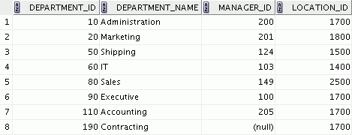
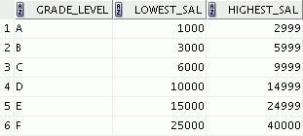




Data Storage on Different Media
Electronic spreadsheet
Filing cabinet
Database
Notes:
Every organization has some information needs. A library keeps a list of members, books, due dates, and fines. A company needs to save information about its employees, departments, and salaries. These pieces of information are called data.
Organizations can store data in various media and in different formats, such as a hard copy document in a filing cabinet, or data stored in electronic spreadsheets, or in databases.
A database is an organized collection of information.
To manage databases, you need a database management system (DBMS). A DBMS is a program that stores, retrieves, and modifies data in databases on request. There are four main types of databases: hierarchical, network, relational, and (most recently) object relational.

Slide 28

Relational Database Concept
Dr. E. F. Codd proposed the relational model for database systems in 1970.
It is the basis for RDBMS.
The relational model consists of the following:
Collection of objects or relations
Set of operators to act on the relations
Data integrity for accuracy and consistency
Notes:
The principles of the relational model were first outlined by Dr. E. F. Codd in a June 1970 paper titled A Relational Model of Data for Large Shared Data Banks. In this paper, Dr. Codd proposed the relational model for database systems.
The common models used at that time were hierarchical and network, or even simple flat-file data structures. Relational database management systems (RDBMS) soon became very popular, especially for their ease of use and flexibility in structure. In addition, a number of innovative vendors, such as Oracle, supplemented the RDBMS with a suite of powerful application development and user-interface products, thereby providing a total solution.
Components of the Relational Model
Collections of objects or relations that store the data
A set of operators that can act on the relations to produce other relations
Data integrity for accuracy and consistency

Slide 29



Definition of a Relational Database
A relational database is a collection of relations or two-dimensional tables controlled by the Oracle server.
Oracle server
Table name: EMPLOYEES
Table name: DEPARTMENTS
…
…
Notes:
Every organization has information that it must store and manage to meet its requirements.
For example, you might want to store information about all the employees in your company. In a relational database, you create several tables to store different pieces of information about your employees, such as an employee table, a department table, and a salary table.
A relational database uses relations or two-dimensional tables to store information.
But before storing any information in the database, you need to first design a model of how and what data will be stored in the tables. In the following slide, you will learn about different data models that help in visualizing the architecture.

Slide 30







Data Models
Model of system in client’s mind
Entity model of client’s model
Oracle
server
Table model of entity model
Tables on disk
Notes:
Models are the cornerstone of design. Engineers build a model of a car to work out any details before putting it into production. In the same manner, system designers develop models to explore ideas and improve the understanding of database design.
Purpose of Models
Models help you to communicate the concepts that are in people’s minds. They can be used to do the following:
Communicate
Categorize
Describe
Specify
Investigate
Evolve
Analyze
Imitate
The objective is to produce a model that fits a multitude of these uses, can be understood by an end user, and contains sufficient detail for a developer to build a database system. An Entity-Relationship model is one such data model.

Slide 31
Entity Relationship Model
Create an entity relationship diagram from business specifications or narratives:
Scenario:
“. . . Assign one or more employees to a department. . .”
“. . . Some departments do not yet have assigned employees. . .”
EMPLOYEE
#* number
* name
o job title
DEPARTMENT
#* number
* name
o location
assigned to
composed of
Notes:
Entity relationship model is widely used because in an effective system, data is divided into discrete categories or entities.
An entity relationship (ER) model is an illustration of the various entities in a business and the relationships among them. You can derive an ER model from business specifications or narratives and build it during the analysis phase of the system development life cycle. ER models separate the information required by a business from the activities performed within the business. Although businesses can change their activities, the type of information tends to remain constant. Therefore, the data structures also tend to be constant.
Benefits of ER Modeling
You can:
Document information for the organization in a clear, precise format
Provide a clear picture of the scope of the information requirement
Provide an easily understood pictorial map for database design
Offer an effective framework for integrating multiple applications
Key Components
Entity: An aspect of significance about which information must be known. For example, departments, employees, and orders are entities.
Attribute: Something that describes or qualifies an entity. For example, in the employee entity, the attributes would be the employee number, name, job title, hire date, department number, and so on. Each of the attributes is either required or optional. This state is called optionality.
Relationship: A named association between entities showing optionality and degree. For example, an employee assigned to a department is a relationship between the employee and department entities.

Slide 32
Entity Relationship Modeling Conventions
Entity
Attribute
Singular, unique name
Uppercase
Soft box
Synonym in parentheses
Singular name
Lowercase
Mandatory marked with ‘*’
Optional marked with ‘o’
EMPLOYEE
#* number
* name
o job title
DEPARTMENT
#* number
* name
o location
assigned to
composed of
Unique Identifier (UID)
Primary marked with “#”
Secondary marked with “(#)”
Notes:
Entities
To represent an entity in a model, use the following conventions:
Singular, unique entity name
Entity name in uppercase
Soft box
Optional synonym names in uppercase within parentheses: ( )
Attributes
To represent an attribute in a model, use the following conventions:
Singular name in lowercase
Asterisk (*) tag for mandatory attributes (that is, values that must be known)
Letter “o” tag for optional attributes (that is, values that may be known)

Slide 33
Notes:
Relationships
Each direction of the relationship contains:
A label: For example, taught by or assigned to
An optionality: Either must be or maybe
A degree: Either one and only one or one or more
Note: The term cardinality is a synonym for the term degree.
Each source entity {may be | must be} in relation {one and only one | one or more} with the destination entity.
Note: The convention is to read clockwise.
Unique Identifiers
A unique identifier (UID) is any combination of attributes or relationships, or both, that serves to distinguish occurrences of an entity. Each entity occurrence must be uniquely identifiable.
Tag each attribute that is part of the UID with a hash sign “#”.
Tag secondary UIDs with a hash sign in parentheses (#).
For example, employee ID is an unique identifier in EMPLOYEE entity since no two employees can have the same employee ID.

Slide 34
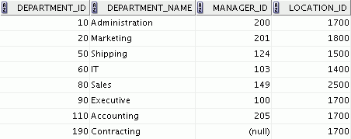
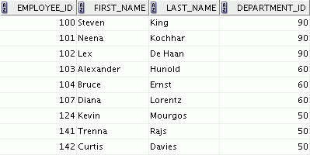
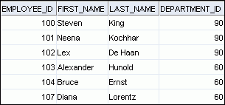
Relating Multiple Tables
Each row of data in a table can be uniquely identified by a primary key.
You can logically relate data from multiple tables using foreign keys.
Table name: DEPARTMENTS
Table name: EMPLOYEES
…
Primary key
Primary key
Foreign key
Notes:
Each table contains data that describes exactly one entity. For example, the EMPLOYEES table contains information about employees. Categories of data are listed across the top of each table, and individual records are listed below. Each table can have one primary key, which in effect names the row and ensures no duplicate rows exist.
Because data about different entities is stored in different tables, you may need to combine two or more tables to answer a particular question. For example, you may want to know the location of the department where an employee works.
In this scenario, you need information from the EMPLOYEES table (which contains data about employees) and the DEPARTMENTS table (which contains information about departments). With an RDBMS, you can relate the data in one table to the data in another table by using foreign keys. A foreign key is a column (or a set of columns) that refers to a primary key in the same table or another table.
You can use the ability to relate data in one table to the data in another table to organize information in separate, manageable units. Employee data can be kept logically distinct from the department data by storing them in separate tables.
Guidelines for Primary Keys and Foreign Keys
You cannot use duplicate values in a primary key.
Primary keys generally cannot be changed.
Foreign keys are based on data values and are purely logical (not physical) pointers.
A foreign key value must match an existing primary key value or unique key value; otherwise, it must be null.
A foreign key must reference either a primary key or a unique key column.

Slide 35
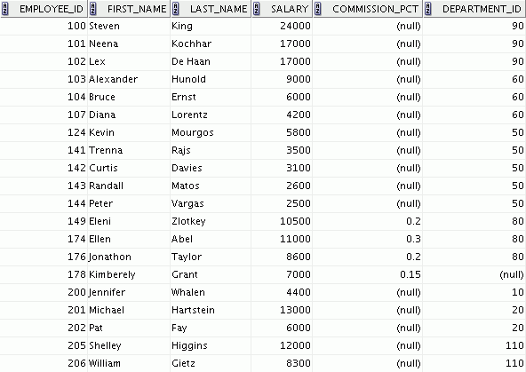
Relational Database Terminology
3
2
4
5
6
1
Notes:
A relational database can contain one or many tables. A table is the basic storage structure of an RDBMS. A table holds all the data necessary about something in the real world, such as employees, invoices, or customers.
The slide shows the contents of the EMPLOYEES table or relation. The numbers indicate the following:
1. A single row (or tuple) representing all the data required for a particular employee. Each row in a table should be identified by a primary key, which permits no duplicate rows. The order of rows is insignificant; specify the row order when the data is retrieved.
2. A column or attribute containing the employee number. The employee number identifies a unique employee in the EMPLOYEES table. In this example, the employee number column is designated as the primary key. A primary key must contain a value and the value must be unique.
A column that is not a key value. A column represents one kind of data in a table; in this example, the data is the salaries of all the employees. Column order is insignificant when storing data; specify the column order when the data is retrieved.
4. A column containing the department number, which is also a foreign key. A foreign key is a column that defines how tables relate to each other. A foreign key refers to a primary key or a unique key in the same table or in another table. In the example, DEPARTMENT_ID uniquely identifies a department in the DEPARTMENTS table.
5. A field can be found at the intersection of a row and a column. There can be only one value in it.
6. A field may have no value in it. This is called a null value. In the EMPLOYEES table, only those employees who have the role of sales representative have a value in the COMMISSION_PCT (commission) field.

Slide 36
Lesson Agenda
Course objectives, agenda, and appendixes used in the course
Overview of Oracle Database 19c and related products
Overview of relational database management concepts and terminologies
Human Resource (HR) Schema and the tables used in this course
Introduction to SQL and its development environments
Oracle Database 19c SQL Documentation and Additional Resources

Slide 37








Human Resources (HR) Application
HR Application
Basic Search:
Advanced Search:
First Name
Emp. ID
Last Name
Department
GO
Notes:
The slide shows an example of a sample HR application, which is generally used by the HR department in an organization. The HR application consists of details of all the employees in the organization whose information is stored in various tables such as EMPLOYEES, DEPARTMENTS, JOBS, LOCATIONS, etc. HR managers use this application to search for an employee’s details, to update employee records such as when an employee gets promoted, to add new employee records such as when an employee joins the organization, or to delete employee records of employees who have quit. In addition to these, HR managers can use this application to generate a variety of reports, such as the number of employees who have quit and the number of new hires, the average salaries in each department, the list of employees who received a bonus this year, etc.
In this course, we will discuss various scenarios based on the sample HR application. You will also see different examples in the lessons based on HR schema.
Note: Screens like the one shown in this slide are a mockup of an application that could be developed using a tool like APEX or in a programming language like Java or PHP. This course will not be concerned about developing those screens but rather about the database maintaining the data for the HR application. Oracle provides courses on application development in APEX, and MySQL provides training in the MySQL for Developers course on application development in Java, PHP, and Python.
For more information, visit https://education.oracle.com/home

Slide 38







Tables Used in This Course
DEPARTMENTS
department_id
department_name
manager_id
location_id
LOCATIONS
location_id
street_address
postal_code
city
state_province
country_id
JOB_HISTORY employee_id
start_date
end_date
job_id
department_id
EMPLOYEES
employee_id
first_name
last_name
email
phone_number
hire_date
job_id
salary
commission_pct
manager_id
department_id
COUNTRIES
country_id
country_name
region_id
JOBS job_id
job_title
min_salary
max_salary
REGIONS
region_id
region_name
JOB_GRADES
grade_level
lowest_sal
highest_sal
Notes:
This course uses data from the following tables:
Table Descriptions
The EMPLOYEES table contains information about all the employees, such as their first and last names, job IDs, salaries, hire dates, department IDs, and manager IDs. This table is a child of the DEPARTMENTS table.
The DEPARTMENTS table contains information such as the department ID, department name, manager ID, and location ID. This table is the primary key table to the EMPLOYEES table.
The LOCATIONS table contains department location information. It contains location ID, street address, city, state province, postal code, and country ID information. It is the primary key table to the DEPARTMENTS table and is a child of the COUNTRIES table.
The COUNTRIES table contains the country names, country IDs, and region IDs. It is a child of the REGIONS table. This table is the primary key table to the LOCATIONS table.
The REGIONS table contains region IDs and region names of the various countries. It is a primary key table to the COUNTRIES table.
The JOB_GRADES table identifies a salary range per job grade. The salary ranges do not overlap.
The JOB_HISTORY table stores job history of the employees.
The JOBS table contains job titles and salary ranges.

Slide 39
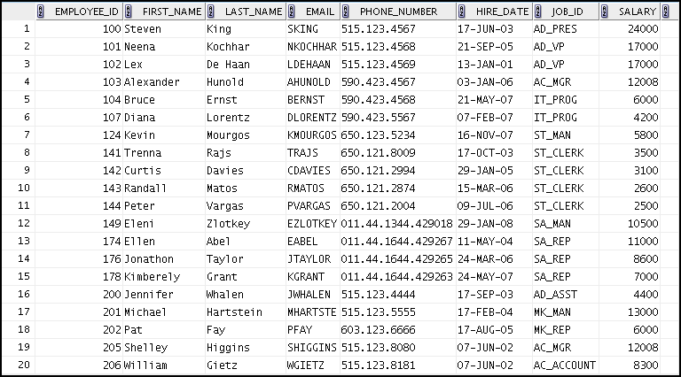
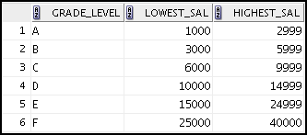
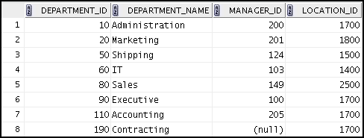
Tables Used in the Course
EMPLOYEES
JOB_GRADES
DEPARTMENTS
Notes:
The following main tables are used in this course:
EMPLOYEES table: Gives details of all the employees
DEPARTMENTS table: Gives details of all the departments
JOB_GRADES table: Gives details of salaries for various grades
Apart from these tables, you will also use the other tables listed in the previous slide such as the LOCATIONS and the JOB_HISTORY table.
Note: The structure and data for all the tables are provided in Appendix A.

Slide 40
Lesson Agenda
Course objectives, agenda, and appendixes used in the course
Overview of Oracle Database 19c and related products
Overview of relational database management concepts and terminologies
Human Resource (HR) Schema and the tables used in this course
Introduction to SQL and its development environments
Oracle Database 19c SQL Documentation and Additional Resources

Slide 41

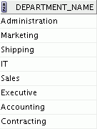
Using SQL to Query Your Database
Structured query language (SQL) is:
The ANSI standard language for operating relational databases
Efficient, easy to learn and use
Functionally complete (With SQL, you can define, retrieve, and manipulate data in tables.)
SELECT department_name
FROM departments;
Oracle Server
Notes:
In a relational database, you do not specify the access route to the tables, and you do not need to know how the data is arranged physically.
To access the database, you execute a structured query language (SQL) statement, which is the American National Standards Institute (ANSI) standard language for operating relational databases. SQL is also compliant to ISO Standard (SQL 2016). The Oracle Database complies with the ANSI and ISO standards for SQL (mandatory portion compliance is known as Core SQL which is at SQL:2016 for the 19c version of the Oracle database)
SQL is a set of statements with which all programs and users access data in an Oracle database. Application programs and Oracle tools often allow users access to the database without using SQL directly, but these applications, in turn, must use SQL when executing the user’s request. Oracle Application Express is one such example.
SQL provides statements for a variety of tasks, including:
Querying data
Inserting, updating, and deleting rows in a table
Creating, replacing, altering, and dropping objects
Controlling access to the database and its objects
Guaranteeing database consistency and integrity
SQL unifies all of the preceding tasks in one consistent language and enables you to work with data at a logical level.

Slide 42



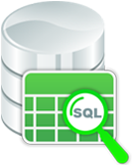
How SQL Works
SQL is standalone and powerful.
SQL processes groups of data.
SQL lets you work with data at a logical level.
Notes:
Using SQL benefits all types of users, including application programmers, database administrators, managers, and end users. The purpose of SQL is to provide an interface to a relational database such as Oracle Database. All SQL statements are instructions to the database. Some of the features of SQL are:
It processes sets of data as groups rather than as individual units.
It provides automatic navigation to the data.
It uses statements that are complex and powerful individually, and are therefore standalone.
SQL lets you work with data at the logical level. For example, to retrieve a set of rows from a table, you define a condition used to filter the rows. All rows satisfying the condition are retrieved in a single step and can be passed as a unit to the user, to another SQL statement, or to an application. You need not deal with the rows one by one, nor do you have to worry about how they are physically stored or retrieved.

Slide 43
SQL Statements Used in the Course
Data manipulation language (DML)
SELECT
INSERT
UPDATE
DELETE
MERGE
Data definition language (DDL)
CREATE
ALTER
DROP
RENAME
TRUNCATE
COMMENT
Data control language (DCL)
GRANT
REVOKE
Transaction control
COMMIT
ROLLBACK
SAVEPOINT
Notes:
SQL statements are used to access the database and maintain the data.
SQL statements supported by Oracle comply with industry standards. Oracle Corporation ensures future compliance with evolving standards by actively involving key personnel in SQL standards committees. The industry-accepted committees are ANSI and International Standards Organization (ISO). Both ANSI and ISO have accepted SQL as the standard language for relational databases.

Slide 44
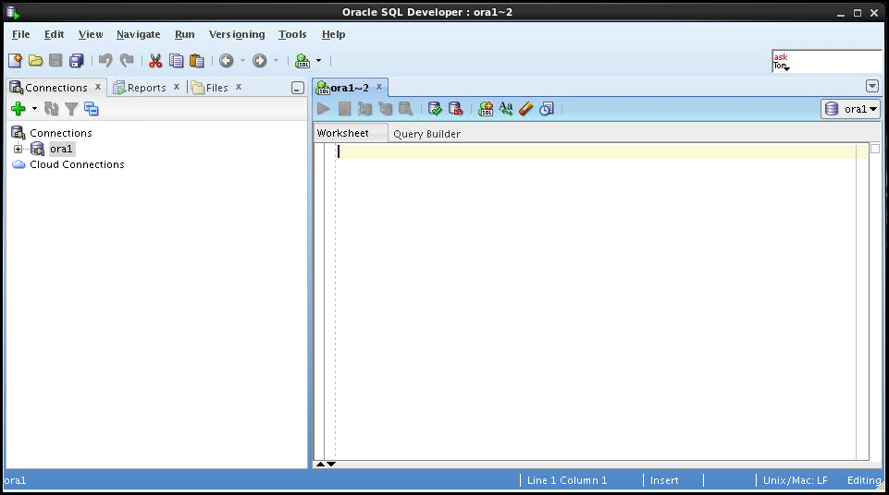
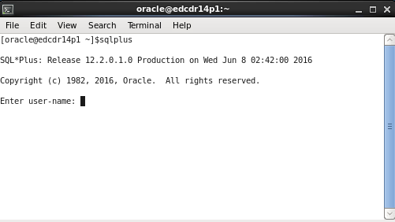
Development Environments for SQL in Oracle
There are two Oracle development environments for this course:
The primary tool is Oracle SQL Developer.
The SQL*Plus command-line interface can also be used.
SQL Developer
SQL*Plus
Notes:
There are various development environments for writing SQL statements. Oracle SQL Developer and Oracle SQL*Plus are the commonly used tools in Oracle.
Oracle SQL Developer
Oracle SQL Developer is a graphical interface for developing SQL. It provides features to view the database components and update values without writing any SQL query. In this course, Oracle SQL Developer is used to create and execute example SQL statements. You will use Oracle SQL Developer to perform the hands-on exercises.
Oracle SQL*Plus
If you like working with a command-line interface, you can use Oracle SQL*Plus, which is a command-line based environment. It can also be used to run all SQL commands covered in this course.
Notes
See Appendix B for information about using Oracle SQL Developer, including simple instructions on the installation process.
See Appendix C for information about using Oracle SQL*Plus.

Slide 45
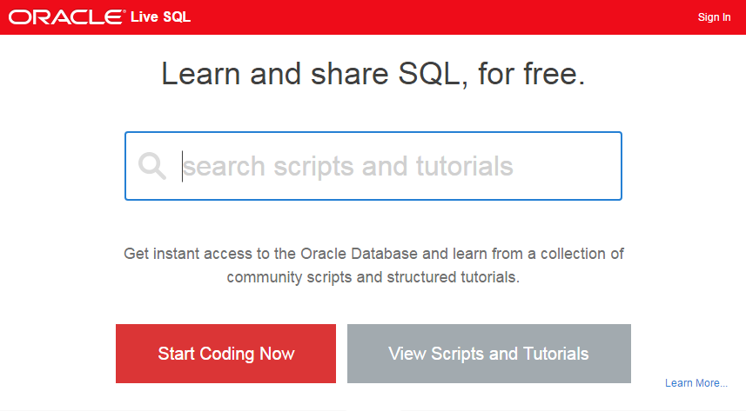

Introduction to Oracle Live SQL
Easy way to learn, access, test, and share SQL and PL/SQL scripts on Oracle Database
Sign up and use it free of cost.
Notes:
Oracle Live SQL is another environment where you can write and execute SQL statements.
You can now learn SQL without the need to install a database or download any tool. Oracle Live SQL exists to provide the Oracle database community with an easy online way to test and share SQL and PL/SQL application development concepts.
Let us look at some of the features of Oracle Live SQL:
Provides browser-based SQL worksheet access to an Oracle database schema
Has the ability to save and share SQL scripts
Provides a schema browser to view and extend database objects
Provides access to interactive educational tutorials
Provides customized data access examples for PL/SQL, Java, PHP, C
You can continue to learn SQL by using Live SQL yourself. All you need is your Oracle Technology Network (OTN) credentials and an interest in learning SQL.
Note: Oracle Live SQL cannot be used to execute the lab exercises without the initial schema setup.

Slide 46
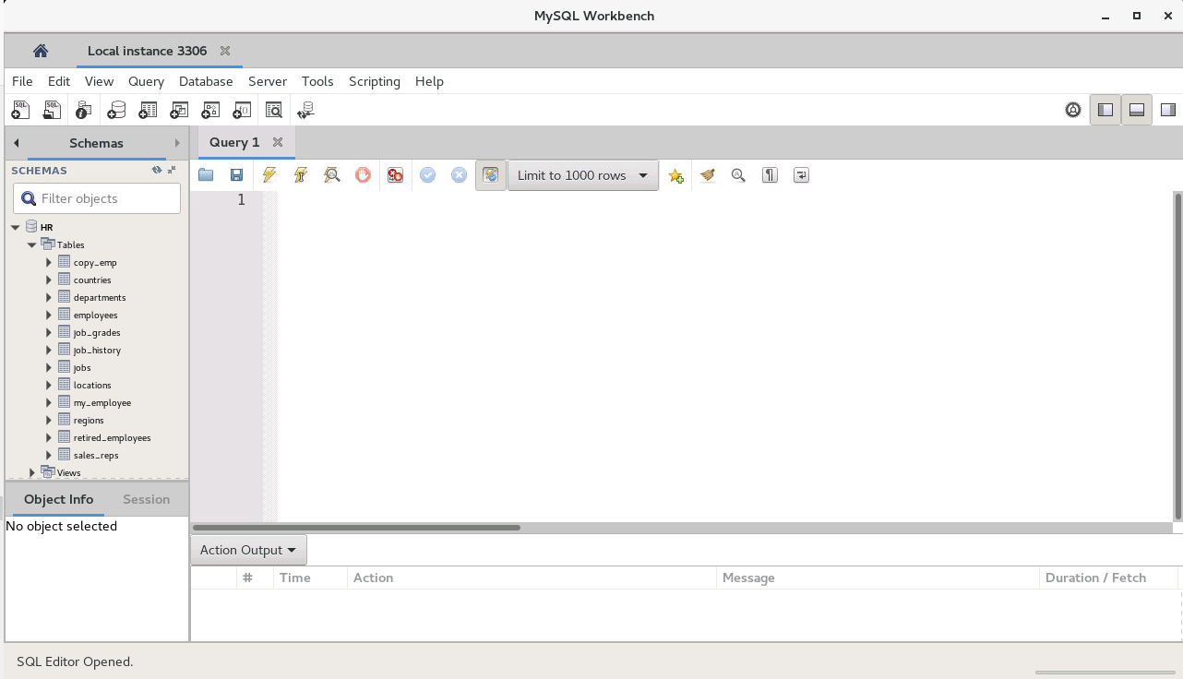
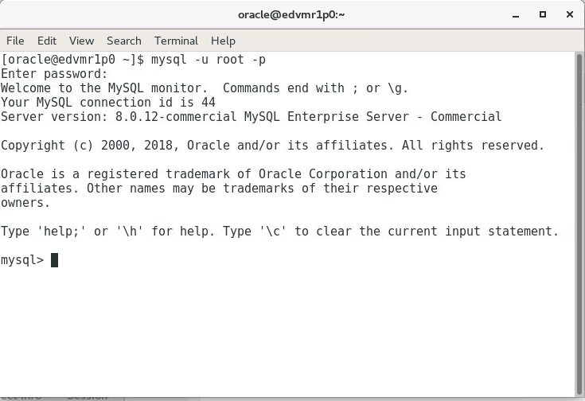
Development Environments for SQL in MySQL
There are two MySQL development environments available for this course:
For this course, the primary tool is MySQL Workbench.
mysql, the MySQL command-line tool can be used instead.
mysql Command-line Tool
MySQL Workbench
Notes:
There are various development environments for writing SQL statements. MySQL Workbench and the mysql command-line tool are commonly used for MySQL database development.
MySQL Workbench
This is a graphical interface for developing SQL. It provides features to view the database components and update values by navigating a graphical user interface in addition to entering SQL statements. In this course, MySQL Workbench is used to create and execute example SQL statements. You will use MySQL Workbench to perform the hands-on exercises.
mysql – the MySQL Command-Line Tool
If you like working with a command-line interface, you can use mysql, which is the command-line interpreter for the MySQL Database. It processes SQL statements and also MySQL-specific commands. It can also be used to run all SQL commands covered in this course.

Slide 47
Lesson Agenda
Course objectives, agenda, and appendixes used in the course
Overview of Oracle Database 19c and related products
Overview of relational database management concepts and terminologies
Human Resource (HR) Schema and the tables used in this course
Introduction to SQL and its development environments
Oracle Database 19c SQL Documentation and Additional Resources

Slide 48

Oracle Database Documentation
Oracle Database New Features Guide
Oracle Database Reference
Oracle Database SQL Language Reference
Oracle Database Concepts
Oracle Database SQL Developer User’s Guide
Notes:
Navigate to https://docs.oracle.com/en/database/database.html to access the Oracle Database 19c documentation library.

Slide 49

Additional Resources for Oracle
For additional information about Oracle Database 19c, refer to the following:
Oracle Learning Library:
http://www.oracle.com/goto/oll
Oracle Cloud:
cloud.oracle.com
The online SQL Developer Home Page, which is available at:
http://www.oracle.com/technology/products/database/sql_developer/index.html
The SQL Developer tutorial, which is available online at:
http://download.oracle.com/oll/tutorials/SQLDeveloper/index.htm

Slide 50
Oracle University: Oracle SQL Training
Database developers
Introductory
Introduction to SQL ILT/LVC/TOD
Intermediate
PL/SQL Fundamentals ILT/LVC/TOD
Advanced
SQL Tuning for Developers ILT/LVC/TOD
Notes:
Training Formats
Instructor-Led Training (ILT): Delivered in a classroom with the instructor and students present at the same location and time
Live Virtual Class (LVC): Delivered by using video and audio through a web-based delivery system (WebEx) in which geographically distributed instructor and students participate, interact, and collaborate in a virtual class environment
Training On Demand (TOD): On-demand training that takes traditional classroom training (complete with all classroom content, including lectures, white boarding, and practice videos) and makes it available in a video-based, online format so that you can start your customized training at your convenience
For full details about Oracle SQL training options, go to http://education.oracle.com.

Slide 51
Oracle SQL Certification
The Oracle Certification Program validates your expertise in the following areas:
Oracle Database SQL Certified Associate
Oracle Database PL/SQL Certified Associate
Oracle Database PL/SQL Certified Professional
Take the examination at a local Pearson VUE test center:
At a time suitable to you
In over 175 countries
Notes:
For full details of SQL and other Oracle Certification options, visit: http://education.oracle.com/certification.

Slide 52
MySQL Websites
http://www.mysql.com includes:
Product information
Services (Training, Certification, Consulting, and Support)
White papers, webinars, and other resources
MySQL Enterprise Edition downloads (trial versions)
http://dev.mysql.com includes:
Developer Zone (forums, articles, Planet MySQL, and more)
Documentation
Downloads
https://github.com/mysql
Source code for MySQL Server and other MySQL products
Notes:
Download MySQL Community Edition general availability (GA) and development releases from the http://dev.mysql.com website. This site also hosts the online documentation, which is an extremely valuable resource for both beginners and expert users of MySQL, and includes several example databases. Download trial versions of the MySQL Enterprise Edition software, view detailed product information, and find out more about Oracle MySQL services at http://www.mysql.com.

Slide 53
MySQL Community Resources
Mailing lists
Forums
Developer articles
MySQL Newsletter (published monthly)
Planet MySQL blogs
Social media channels
Facebook, Twitter, and Google+
Physical and virtual events, including:
Developer days
MySQL Tech Tours
Webinars
Bug tracking
GitHub repositories
Notes:
MySQL has a very large and active community. Engage with your peers, report bugs, share information, and discover what is happening in the world of MySQL by using the following resources:
Mailing lists (http://lists.mysql.com)
Forums (http://forums.mysql.com)
Developer articles (http://forums.mysql.com
MySQL Newsletter (http://www.mysql.com/news-and-events/newsletter/)
Planet MySQL blogs (http://planet.mysql.com)
Social media channels:
Facebook: http://facebook.com/mysql
Twitter: https://twitter.com/mysql_community and http://twitter.com/MySQL
Physical and virtual events (http://www.mysql.com/news-and-events)
Bug tracking (http://bugs.mysql.com)
GitHub repositories

Slide 54
Oracle University: MySQL Training
Database developers
Database administrators
Introductory
MySQL Fundamentals ILT/LVC/TOD
Intermediate
MySQL for Developers ILT/LVC/TOD
MySQL for Database Administrators ILT/LVC/TOD
Advanced
MySQL Performance Tuning ILT/LVC/TOD
MySQL Cluster ILT/LVC
Notes:
Training Formats
Instructor-Led Training (ILT): Delivered in a classroom with the instructor and students present at the same location and time
Live Virtual Class (LVC): Delivered by using video and audio through a web-based delivery system (WebEx) in which geographically distributed instructor and students participate, interact, and collaborate in a virtual class environment
Training On Demand (TOD): On-demand training that takes traditional classroom training (complete with all classroom content, including lectures, white boarding, and practice videos) and makes it available in a video-based, online format so that you can start your customized training at your convenience
For full details about MySQL training options, go to http://education.oracle.com/mysql.

Slide 55
MySQL Certification
The Oracle Certification Program validates your expertise in the following areas:
Oracle Certified Professional: MySQL 5.6 Database Administrator
Oracle Certified Professional: MySQL 5.6 Developer
Take the examination at a local Pearson VUE test center:
At a time suitable to you
In over 175 countries
Notes:
For full details of MySQL and other Oracle Certification options, visit: http://education.oracle.com/certification.

Slide 56
Summary
In this lesson, you should have learned about:
The goals of the course
The features of Oracle Database 19c
The theoretical and physical aspects of a relational database
Oracle server’s implementation of RDBMS and ORDBMS
The development environments that can be used for this course
The database and schema used in this course
Notes:
Relational database management systems are composed of objects or relations. They are managed by operations and governed by data integrity constraints.
Oracle Corporation produces products and services to meet your RDBMS needs. The main products are the following:
Oracle Database, which you use to store and manage information by using SQL
Oracle Fusion Middleware, which you use to develop, deploy, and manage modular business services that can be integrated and reused
Oracle Enterprise Manager Grid Control, which you use to manage and automate administrative tasks across sets of systems in a grid environment
SQL
The Oracle server supports ANSI-standard SQL and contains extensions. SQL is the language that is used to communicate with the server to access, manipulate, and control data.

Slide 57

Practice 1: Overview
This practice covers the following topics:
Starting Oracle SQL Developer
Creating a new database connection
Browsing the HR tables
Notes:
In this practice, you perform the following:
Start Oracle SQL Developer and create a new connection to the ora1 account.
Use Oracle SQL Developer to examine data objects in the ora1 account. The ora1 account contains the HR schema tables.
Note the following location for the lab files:
/home/oracle/labs/sql1_oracle/labs
If you are asked to save any lab files, save them in this location.
In any practice, there may be exercises that are prefaced with the phrases “If you have time” or “If you want an extra challenge.” Work on these exercises only if you have completed all other exercises within the allocated time and would like a further challenge to your skills.
Perform the practices slowly and precisely. You can experiment with saving and running command files. If you have any questions at any time, ask your instructor.
Note: All written practices use Oracle SQL Developer as the development environment. Although it is recommended that you use Oracle SQL Developer, you can also use SQL*Plus that is available in this course.

