Slide 1
Creating Procedures

Slide 2
Course Road Map
Lesson 11: Creating Procedures
Lesson 12: Creating Functions
Lesson 13: Debugging Subprograms
Unit 4: Working with Sub programs
Lesson 14: Creating Packages
Unit 5: Working with Triggers
Lesson 15: Working with Packages
Lesson 16: Using Oracle-Supplied Packages in Application Development
Unit 6: Working with PL/SQL Code
Lesson 17: Using Dynamic SQL
Notes:
In the fourth unit, we have seven lessons – Creating Stored Procedures, Creating Functions, Debugging Subprograms, Creating Packages, Working with Packages, Using Oracle Supplied Packages in Application Development, and Using Dynamic SQL. You will learn to write PL/SQL subprograms, packages, and use them in Application Development.

Slide 3
Objectives
After completing this lesson, you should be able to:
Identify the benefits of modularized and layered subprogram design
Create and call procedures
Use formal and actual parameters
Use positional, named, or mixed notation for passing parameters
Identify the available parameter-passing modes
Handle exceptions in procedures
Remove a procedure and display its information
Notes:
In this lesson, you learn to create, execute, and remove procedures with or without parameters. Procedures are the foundation of modular programming in PL/SQL. To make procedures more flexible, it is important that varying data is either calculated or passed into a procedure by using input parameters. Calculated results can be returned to the caller of a procedure by using OUT parameters.
To make your programs robust, you should manage exception conditions by using the exception-handling features of PL/SQL.

Slide 4

Lesson Agenda
Modularizing code with PL/SQL
Working with procedures:
Creating and calling procedures
Identifying the available parameter-passing modes
Using formal and actual parameters
Using positional, named, or mixed notation
Handling exceptions in procedures, removing a procedure, and displaying the procedure’s information

Slide 5


Modularized Program Design
Hey Alice, I need your help in updating the database with new organizational changes
Sure tell me your requirements
I need a program which can help me change the salary of the employee, change the job_id and promote the employee
Notes:
Here the HR manager comes up with a requirement for which Alice has to write a code. The HR manager wants to put the organizational changes in the database. The organizational changes are:
Salary Hike – Employees get a salary hike but practically every employee wouldn’t get a salary hike and even when they get the amount of hike might not be uniform.
Promotion – Employees got a promotion but practically every employee wouldn’t get a promotion.
However it is clear that these two functions on the database are independent of each other, because an employee who gets a hike may not get a promotion and vice versa may also be true.
Therefore it would be efficient if Alice implement them as independent modules. When implemented as two independent functions they can be used together also if there’s a requirement, a situation where an employee gets both salary hike and promotion.
PL/SQL provides for this kind of modular design where you write a subprogram to implement an independent functionality and when required you can merge the functionality of more than one modules together.

Slide 6
Modularizing Code with PL/SQL
PL/SQL is a block-structured language. The PL/SQL code block helps modularize code by using:
Anonymous blocks
Procedures and functions
Packages
Database triggers
Notes:
Modularization converts large blocks of code into smaller groups of code called modules. When you create modules, you should ensure that each module is representing a logically independent function of the application. The modules can be reused by the same program or shared with other programs. It is easier to maintain and debug code that comprises of smaller modules than it is to maintain code in a single large program. These modules are implemented as subprograms in PL/SQL.
You create a subprogram with a declarative section, executable section, and an exception section. A PL/SQL block can’t exist without an executable section, but it can exist without a declarative section and exception section. Apart from anonymous blocks, all other PL/SQL blocks mentioned in the slide can be compiled and stored in the database as independent objects. As you store them in the database, you can independently invoke them and use them in other PL/SQL blocks, thus reducing the effort of rewriting the same code.
When you reuse a tried and tested PL/SQL subprogram in your application, it brings in certain amount of assured performance into the application.
Note: Knowing how to develop anonymous blocks is a prerequisite for the rest of this course.

Slide 7









Benefits of Modularization
Easy maintenance
Improved data integrity
Subprograms: Stored procedures and functions
Improved data security
Improved performance
Notes:
Procedures and functions have many benefits due to modularizing of code:
Easy maintenance - When you make changes and recompile the code of the subprogram stored in the database, the changes would be in effect in all the following calls to the subprogram. A change in one place is sufficient, you need not make changes in every module which uses the subprogram.
Data integrity is maintained through subprograms. Each subprogram usually represents a logical function. A subprogram is executed completely or doesn’t execute at all which implies a logical function executes completely or it doesn’t execute at all, thus leaving your database in a consistent state.
Improved performance is assured when you reuse a tried and tested code. The compiled subprograms in the database therefore ensure better performance in your application.
Improved data security is assured because PL/SQL subprograms reside on the server, where the implementation isn’t exposed to the client. The internal details, the structure of the database are hidden from the end user. The client can use the functionality of the sub program but can’t modify the internal structure of the database.

Slide 8


What Are PL/SQL Subprograms?
A PL/SQL subprogram is a named PL/SQL block.
It enables modularization in the application.
A subprogram consists of a specification and a body.
Subprograms can be grouped into PL/SQL packages.
Notes:
You write a subprogram to implement a logical function of the application. For example, you can write a subprogram to reflect the promotion of an employee.
Syntactically a subprogram has the following components:
A subprogram consists of a specification (spec) and a body.
The specification is the name of the subprogram and the description of parameters if it is defined to accept any.
To define a subprogram, you must provide both the specifications and the body. You can either declare a subprogram first or define it later.
Subprogram Types: PL/SQL has three types of subprograms: procedures, functions, and triggers.
Procedures are used to perform an action on the database.
Functions are used to perform an operation and return a value.
Triggers are used to execute actions in response to some event in the database. Procedures and functions can be invoked in the PL/SQL block to perform an action whereas triggers are defined to respond to an event in the database.

Slide 9
Lesson Agenda
Modularizing code with PL/SQL
Working with procedures:
Creating and calling procedures
Identifying the available parameter-passing modes
Using formal and actual parameters
Using positional, named, or mixed notation
Handling exceptions in procedures, removing a procedure, and displaying the procedures’ information

Slide 10
Procedures
I understand your requirements.
I will come up with a solution
Thanks, Alice.
Alice concludes that she will create two different procedures raise_sal and promotion.
Notes:
Alice started the task of creating two procedures – raise_sal and promotion. Let us first understand how to write procedures and then discuss how can we use them to solve this problem.

Slide 11
What Are Procedures?
A type of subprogram that performs an action
Can be stored in the database as a schema object
Promote reusability and maintainability
Notes:
A procedure is a named PL/SQL block that can accept parameters (sometimes referred to as arguments). Generally, you use a procedure to perform an action. It has a header, a declaration section, an executable section, and an optional exception-handling section. A procedure is invoked by using the procedure name in the execution section of another PL/SQL block.
A procedure is compiled and stored in the database as a schema object.
Procedures promote reusability and maintainability. When validated, they can be used in any number of applications.

Slide 12








Creating Procedures: Overview
/
YES
Create/edit procedure
Compiler warnings/errors?
View compiler warnings/errors
NO
Execute procedure
Notes:
To develop a procedure by using a tool such as SQL Developer, perform the following steps:
1. Create the procedure using SQL Developer or SQL Plus.
2. Compile the procedure. The procedure is created in the database on compilation. The CREATE PROCEDURE statement creates and stores the source code and the compiled m-code in the database. The compilation process can be GUI based as in SQL Developer or as in case of command line interface such as SQL Plus ,you can compile the procedure like any other command.
3. If compilation errors exist, then the m-code is not generated and you must edit the source code to make corrections. You cannot invoke a procedure that contains compilation errors. You can view the compilation errors in Compiler log of the SQL Developer, SQL*Plus when you compile the code.
4. After successful compilation, execute the procedure to perform the desired action. You can run the procedure using SQL Developer GUI or use the EXECUTE command in SQL*Plus.

Slide 13
Creating Procedures
Use the CREATE clause to create a stand-alone procedure that is stored in the Oracle database.
Use the OR REPLACE option to overwrite an existing procedure.
CREATE [OR REPLACE] PROCEDURE procedure_name
[(parameter1 [mode] datatype1,
parameter2 [mode] datatype2, ...)]
IS|AS
[local_variable_declarations; ...]
BEGIN -- actions;
END [procedure_name];
PL/SQL block
Notes:
You can use the CREATE PROCEDURE SQL statement to create stand-alone procedures that are stored in an Oracle database. A procedure performs a specific action. You specify the name of the procedure, its parameters, its local variables, and the BEGIN-END block that contains its code and handles any exceptions.
Procedures start with BEGIN, optionally preceded by the declaration of local variables and end with either END or END procedure_name.
The REPLACE option indicates that if the procedure exists, it is dropped and replaced with the new version created by the statement. The REPLACE option doesn’t drop any of the privileges associated with the procedure.
Other Syntactic Elements
parameter1 represents the name of a parameter.
The mode option defines how a parameter is used: IN (default), OUT, or IN OUT.
datatype1 specifies the parameter data type, without any precision.

Slide 14
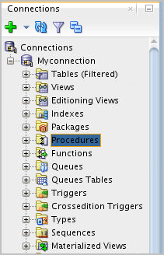
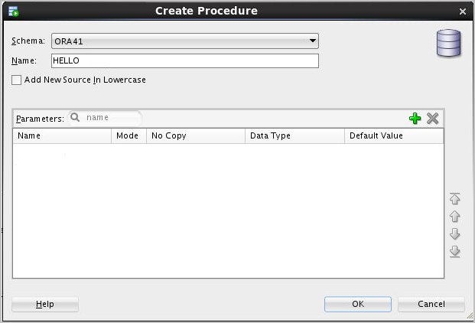
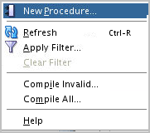
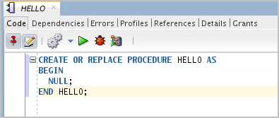
Creating Procedures Using SQL Developer
Notes:
To create a procedure by using SQL Developer, perform the following steps:
1. Right-click the Procedures in the Connections tab.
Select New Procedure from the shortcut menu. The Create PL/SQL Procedure dialog box is displayed.
Specify the information for the new procedure.
Click OK to create the subprogram and have it displayed in the Editor window, where you can enter the details.
Note: You can also write the code of the procedure in a SQL worksheet and execute it like any other SQL statement.
The components of the Create PL/SQL Procedure dialog box are as follows:
Schema: The database schema in which to create the PL/SQL subprogram
Name: The name of the subprogram that must be unique within a schema
Add New Source in Lowercase: If this option is selected, new text appears in lowercase regardless of the case in which you enter it. This option affects only the appearance of the code, because PL/SQL isn’t case-sensitive in its execution.
Parameters tab: To add a parameter, click the Add (+) icon. For each parameter in the procedure to be created, specify the parameter name, data type, mode, and optionally the default Value. Use the Remove (X) icon and the arrow icons to delete and to move a parameter up or down in the list, respectively.

Slide 15

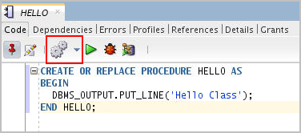
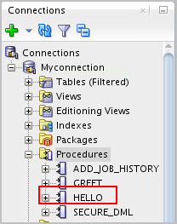

Compiling Procedures
Click to “Compile”.
If there are compiler errors
Notes:
You can compile procedures by clicking the compile button. It provides you with two options: Compile and Compile for Debug. You choose the appropriate one and run compilation.
If the compilation goes through successfully, you see the response ‘Procedure HELLO Compiled’ in the Messages tab and a Procedure object is created in Connections tab.
If there are compiler errors you see the response ‘Procedure HELLO Compiled’ Errors: check compiler log in the Messages tab. You can check the Compiler Log for description on errors.
You can fix the errors and recompile the code.

Slide 16
Calling Procedures
You can call procedures from:
Anonymous blocks
Another named PL/SQL block
Command prompt using EXECUTE
--invoking procedure from anonymous block
BEGIN
hello;
END;
/
--invoking procedure in another procedure
CREATE OR REPLACE PROCEDURE greet IS
BEGIN
hello;
END greet;
/
--invoking procedure with EXECUTE
EXECUTE greet;
Notes:
You can invoke procedures by using:
Anonymous blocks
Another procedure or PL/SQL subprogram
EXECUTE command with procedure name at the command prompt
Examples in the slide have been illustrated using all the three options.
The example in the slide shows you how to invoke a procedure hello from anonymous PL/SQL block. You can also see that the procedure hello is invoked from the procedure greet.
The third code box shows invoking the procedure from the command prompt using the EXECUTE command.

Slide 17
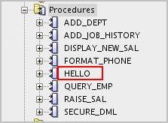
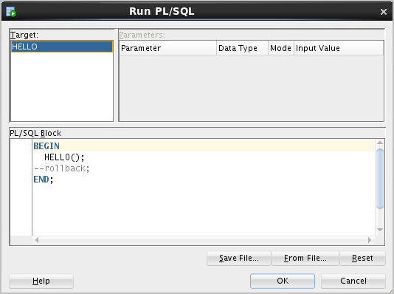
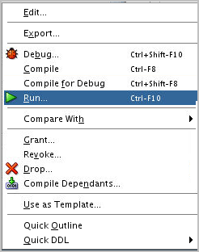
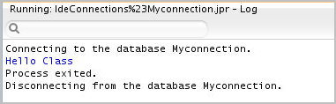
Calling Procedures Using SQL Developer
1
3
2
4
Notes:
In the slide example, the hello procedure is called to raise the current salary of employee 176 ($ 8,600) by 10 percent as follows:
1. Right-click the procedure name in the Procedures node, and then click Run. The Run PL/SQL dialog box is displayed.
2. You see that the procedure hello is enclosed in an anonymous PL/SQL block for execution.
3. Click OK. SQL Developer runs the procedure and displays "Hello Class".

Slide 18
Procedures
CREATE OR REPLACE PROCEDURE raise_sal AS
v_raise_percent NUMBER := 10;
BEGIN
UPDATE employees
SET
salary = salary *(1+1/v_raise_percent);
END salary_hike;
Alice created the procedure raise_sal, but she had questions for the HR manager before creating the promotion procedure
I have created this procedure where you can increment the salary of all the employees by 10%. You can change the percentage to some other value too
There is a problem here Alice!
Notes:
Alice here created a procedure raise_sal which would update the salary of all the employees by 10%, where you can the change the percentage of hike by initializing the variable with a different value. However things don’t work like this practically. The increment an employee gets depend on factors like employee’s performance, the job he/she hold and other factors and remember every employee may not get an increment.
Our HR manager expressed the same to Alice. Now Alice has to modify this procedure to accept input such as employee_id and raise percentage as input and perform the expected operation on the database.
We will further look into the concept of parameters. Parameters enable you to provide a different input each time you execute the procedure. Alice can use parameters to pass input to the increment procedure and perform the required operations.

Slide 19
What Are Parameters and Parameter Modes?
Means of communication between the calling environment and the Procedure
Each parameter is associated with a mode:
An IN parameter mode (the default) provides values for a subprogram to process.
An OUT parameter mode returns a value to the caller.
An IN OUT parameter mode supplies an input value, which may be returned (output) as a modified value.
Notes:
Parameters are used to transfer data values among the calling environment and the procedure (or subprogram). Parameters are declared in the subprogram header, after the name and before the declaration section for local variables.
Parameters are defined with one of the three parameter-passing modes: IN, OUT, or IN OUT.
An IN parameter passes a constant value from the calling environment into the procedure.
An OUT parameter passes a value from the procedure to the calling environment.
An IN OUT parameter passes a value from the calling environment to the procedure and a possibly different value from the procedure back to the calling environment using the same parameter.

Slide 20
Formal and Actual Parameters
Formal parameters are place holders for data in a subprogram specification.
Actual parameters are literal values, variables or expressions substituted in the parameter list while invoking the subprogram.
-- Procedure definition Formal_parameters
CREATE PROCEDURE raise_sal(p_id NUMBER) IS BEGIN
. . .
END raise_sal;
--Procedure calling, Actual parameters (arguments)
execute raise_sal(100)
Notes:
Formal parameters are declared in the parameter list of a subprogram specification. In the procedure definition of raise_sal, the variable p_id identifier represent the formal parameter.
The actual parameters can be literal values, variables, and expressions that are provided in the parameter list while calling a procedure. In the procedure call, the raise_sal procedure is invoked with a value of 100, which is the actual parameter.
Actual parameters:
Are associated with formal parameters during the subprogram call
Can also be expressions, as in the following example: raise_sal(v_emp_id, raise+100);
where v_emp_id and raise are variables with some initialized values
The formal and actual parameters should be of compatible data types. If necessary, before assigning the value, PL/SQL converts the data type of the actual parameter value to that of the formal parameter.

Slide 21
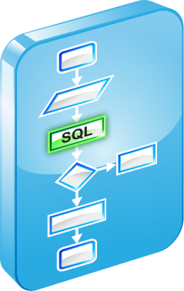

Procedural Parameter Modes
Parameter modes are specified in the formal parameter declaration, after the parameter name and before its data type.
The IN mode is the default if no mode is specified.
CREATE PROCEDURE proc_name(param_name [mode] datatype,...)
...
Modes
Calling environment
IN (default)
OUT
IN OUT
Procedure
Notes:
The parameter mode IN is the default passing mode—that is, if no mode is specified with a parameter declaration, the parameter is considered to be an IN parameter. The parameter modes OUT and IN OUT must be explicitly specified in their parameter declarations.
The datatype is specified without a size specification. It can be specified:
As an explicit data type
Using the %TYPE definition
Using the %ROWTYPE definition
Note: One or more formal parameters can be declared, each separated by a comma.

Slide 22
Comparing the Parameter Modes
IN | OUT | IN OUT
It is the default mode. | It must be specified. | It must be specified.
Value is passed into subprogram. | Value is returned to the calling environment. | Value is passed into sub-program; value is returned to calling environment.
Formal parameter acts as a constant. | It is uninitialized variable. | It is initialized variable.
Actual parameter can be a literal, expression, constant, or initialized variable. | It must be a variable. | It must be a variable.
It can be assigned a default value. | It cannot be assigned a default value. | It cannot be assigned a default value.
Notes:
The IN parameter mode is the default mode if no mode is specified in the declaration. The OUT and IN OUT parameter modes must be explicitly specified with the parameter declaration.
A formal parameter of IN mode cannot be assigned a value and cannot be modified in the body of the procedure. By default, the IN parameter is passed by reference. An IN parameter can be assigned a default value in the formal parameter declaration, in which case the caller need not provide a value for the parameter if the default applies.
An OUT or IN OUT parameter must be assigned a value before returning to the calling environment. The OUT and IN OUT parameters cannot be assigned default values.

Slide 23
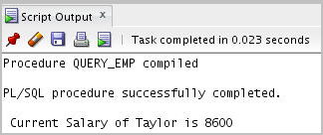
Using the IN Parameter Mode: Example
CREATE OR REPLACE PROCEDURE query_emp
(p_id IN employees.employee_id%TYPE) AS
v_name employees.last_name%TYPE;
v_salary employees.salary%TYPE;
BEGIN
SELECT last_name, salary INTO v_name,v_salary
FROM employees
WHERE employee_id = p_id;
DBMS_OUTPUT.PUT_LINE(' Current Salary of '||v_name || ' is '|| v_salary);
END query_emp;
EXECUTE query_emp(176)
Notes:
The slide shows an example for using IN mode of procedure parameters. IN mode implies input to the procedure.
In the example, the procedure accepts an employee ID as input parameter. This input parameter is used to retrieve data from the employees table inside the procedure and display the current value of the employee salary.
Here in the slide we invoke the procedure by using the EXECUTE command.
You can also invoke a procedure from another procedure by making a direct call inside an executable section of the calling block. Invoke the procedure with actual parameters in the PL/SQL block as shown below:
...
BEGIN
query_emp(176);
END;
Note: IN parameters are passed as read-only values from the calling environment into the procedure. Attempts to change the value of an IN parameter result in a compile-time error.

Slide 24
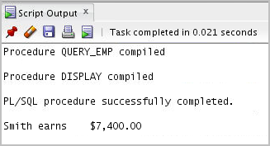
Using the OUT Parameter Mode: Example
CREATE OR REPLACE PROCEDURE query_emp
(p_id IN employees.employee_id%TYPE,
p_name OUT employees.last_name%TYPE,
p_salary OUT employees.salary%TYPE) IS
BEGIN
SELECT last_name, salary INTO p_name, p_salary
FROM employees
WHERE employee_id = p_id;
END query_emp;
CREATE OR REPLACE PROCEDURE display AS
v_emp_name employees.last_name%TYPE;
v_emp_sal employees.salary%TYPE;
BEGIN
query_emp(171, v_emp_name, v_emp_sal);
DBMS_OUTPUT.PUT_LINE(v_emp_name||' earns '|| to_char(v_emp_sal, '$999,999.00'));
END display;
EXECUTE display;
Notes:
The slide shows the usage of OUT parameters in a procedure.
The first piece of code is the definition of a procedure query_emp which has one parameter set to IN mode and two parameters set to OUT mode. The parameter set to IN mode is the value of the employee_id and the parameters set to OUT mode are the values of last_name and salary of the employee. We use this procedure in another procedure display defined in the second code box.
The query_emp procedure is invoked in the display procedure by passing only the input parameter. There are place holders for the output parameter, declared as variables in the display procedure. The output parameters of the query_emp procedure are retrieved into the display procedure and used in the output message.
Note: Make sure that the data type for the actual parameter variables used to retrieve values from the OUT parameters has a size sufficient to hold the data values being returned.

Slide 25
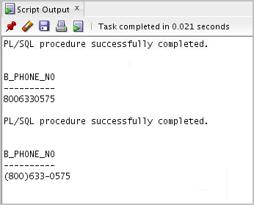
Using the IN OUT Parameter Mode: Example
Calling environment
p_phone_no (before the call)
p_phone_no (after the call)
'8006330575'
'(800) 633-0575'
CREATE OR REPLACE PROCEDURE format_phone
(p_phone_no IN OUT VARCHAR2) IS
BEGIN
p_phone_no := '(' || SUBSTR(p_phone_no,1,3) ||
') ' || SUBSTR(p_phone_no,4,3) ||
'-' || SUBSTR(p_phone_no,7);
END format_phone;
/
EXECUTE format_phone('8006330575');
Notes:
Using an IN OUT parameter, you can pass a value into a procedure that can be updated and returned as output. The actual parameter value supplied from the calling environment can return either the original unchanged value or a new value that is set within the procedure.
The slide example creates a procedure with an IN OUT parameter to accept a character string containing digits for a phone number. The procedure returns the phone number formatted with parentheses around the first three characters and a hyphen after the sixth digit; for example, the phone string 8006330575 is returned as (800) 633-0575.
The following code uses the b_phone_no host variable of SQL*Plus to provide the input value passed to the FORMAT_PHONE procedure. The procedure is executed and returns an updated string in the b_phone_no host variable. The output of the following code is displayed in the slide:
VARIABLE b_phone_no VARCHAR2(15)
EXECUTE :b_phone_no := '8006330575'
PRINT b_phone_no
EXECUTE format_phone (:b_phone_no)
PRINT b_phone_no

Slide 26
Passing Parameters to Procedures
When calling a subprogram, you can write the actual parameters using the following notations:
Positional: Lists the actual parameters in the same order as the formal parameters
Named: Lists the actual parameters in arbitrary order and uses the association operator (=>) to associate a named formal parameter with its actual parameter
Mixed: Lists some of the actual parameters as positional and some as named
Notes:
When calling a subprogram, you can write the actual parameters by using the following notations:
Positional: You list the actual parameter values in the same order in which the formal parameters are declared. This notation is compact, but if you specify the parameters (especially literals) in the wrong order, the procedure execution may give wrong results or it might result in an error.
Named: You list the actual values in an arbitrary order and use the association operator to associate each actual parameter with its formal parameter by name. The PL/SQL association operator is an “equal” sign followed by an “is greater than” sign, without spaces: =>. The order of the parameters is not significant. This notation is more verbose, but makes your code easier to read and maintain. You can sometimes avoid changing your code if the procedure’s parameter list changes, for example, if the parameters are reordered or a new optional parameter is added.
Mixed: You list the first parameter values by their position and the remainder by using the special syntax of the named method. You can use this notation to call procedures that have some required parameters, followed by some optional parameters.

Slide 27

Passing Actual Parameters: Creating the raise_sal Procedure
CREATE OR REPLACE PROCEDURE raise_sal
(p_id IN employees.employee_id%TYPE,
p_percent IN NUMBER) AS
BEGIN
UPDATE employees
SET salary = salary * (1 + p_percent/100)
WHERE employee_id = p_id;
END raise_sal;
Notes:
You can see in the slide that Alice has modified the raise_sal procedure to accept input parameters. The procedure accepts the employee_id and the percentage of salary raise that has to be given to the specific employee.
Based on the values of the input parameters an UPDATE command is executed in the executable section of the raise_sal procedure.

Slide 28
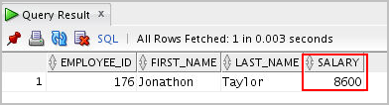

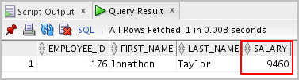
Passing Actual Parameters: Examples
-- Passing parameters using the positional notation.
SELECT * FROM EMPLOYEES WHERE employee_id = 176;
EXECUTE raise_sal ('176', 10)
SELECT * FROM EMPLOYEES WHERE employee_id = 176;
-- Passing parameters using the named notation.
EXECUTE raise_sal( p_percent =>10,p_id => 176)
Thanks Alice. This will help. Please find a solution to update the promotion data also in the database
Notes:
Passing actual parameters by position is shown in the first call to execute raise_sal in the first code example in the slide. The first actual parameter supplies the value 176 for the p_id formal parameter. The second actual parameter value of 10 is assigned by position to the p_percent formal parameter.
Passing parameters using the named notation is shown in the second code example in the slide. The p_percent actual parameter, which is declared as the second formal parameter, is referenced by name in the call, where it is associated with the actual value of 10. The p_id parameter is associated with the value 176. The order of the actual parameters is irrelevant if all parameter values are specified with the names.
Note: You must provide a value for each parameter unless the formal parameter is assigned a default value. We discuss specifying default values for formal parameters in the following slides.
Now the HR manager can either execute multiple EXECUTE commands for updating the salaries of different employees or ask Alice to write a PL/SQL block to for all the UPDATES by providing the employee ids and their corresponding salary raise percentage.

Slide 29
Using the DEFAULT Option for the Parameters
Defines default values for parameters
Provides flexibility by combining the positional and named parameter-passing syntax
CREATE OR REPLACE PROCEDURE raise_sal
(p_id IN employees.employee_id%TYPE,
p_percent IN NUMBER DEFAULT 10) AS
BEGIN
UPDATE employees
SET salary = salary * (1 + p_percent/100)
WHERE employee_id = p_id;
END raise_sal;
An enhancement !
EXECUTE raise_sal(176) or
EXECUTE raise_sal(176,10)
EXECUTE raise_sal (p_id => 176)
Notes:
This is an enhancement provided by Alice where the HR manager can apply a default value for raise percentage. Wherever there are exceptions to the default value the HR manager can explicitly enter the value while invoking the procedure.
You can assign a default value to an IN parameter through one of the following options:
Through an assignment operator (:=)
Through DEFAULT option, as shown for the p_percent parameter in the slide
When default values are assigned to formal parameters, you can call the procedure without supplying an actual parameter value for the parameter. Thus, you can pass different numbers of actual parameters to a subprogram, either by accepting or by overriding the default values as required.
Note: You cannot assign default values to the OUT and IN OUT parameters.
The second code box in the slide shows three ways of invoking the raise_sal procedure:
The first example assigns the default value for the p_percent parameter.
The second example illustrates assigning values to both the parameters
The last example uses the named notation to assign value to the parameter p_id

Slide 30
Lesson Agenda
Modularizing code with PL/SQL
Working with procedures:
Creating and calling procedures
Identifying the available parameter-passing modes
Using formal and actual parameters
Using positional, named, or mixed notation
Handling exceptions in procedures, removing a procedure, and displaying the procedure’s information

Slide 31
Handled Exceptions
Calling procedure
Called procedure
PROCEDURE
PROC1 ...
IS
...
BEGIN
...
PROC2(arg1);
...
EXCEPTION
...
END PROC1;
PROCEDURE
PROC2 ...
IS
...
BEGIN
...
EXCEPTION
...
END PROC2;
Exception raised
Exception handled
Control returns to calling procedure
Notes:
When you develop procedures that are called from other procedures, you should be aware of the effects that handled and unhandled exceptions have on the transaction and the calling procedure.
When an exception is raised in a called procedure, the control immediately goes to the exception section of that block. An exception is considered handled if the exception section provides a handler for the exception raised.
When an exception occurs and is handled, the following code flow takes place:
1. The exception is raised.
2. Control is transferred to the exception handler.
3. The block is terminated.
4. The calling program/block continues to execute unaffected.
If a transaction was started in the calling block, then the transaction is unaffected. A DML operation performed within the procedure before the exception is rolled back.
Note: You can explicitly end a transaction by executing a COMMIT or ROLLBACK operation in the exception section.

Slide 32


Handled Exceptions: Example
CREATE PROCEDURE add_department(
p_name VARCHAR2, p_mgr NUMBER, p_loc NUMBER) IS
BEGIN
INSERT INTO DEPARTMENTS (department_id,
department_name, manager_id, location_id)
VALUES (DEPARTMENTS_SEQ.NEXTVAL, p_name, p_mgr, p_loc);
DBMS_OUTPUT.PUT_LINE('Added Dept: '|| p_name);
EXCEPTION
WHEN OTHERS THEN
DBMS_OUTPUT.PUT_LINE('Err: adding dept: '|| p_name);
END;
CREATE PROCEDURE create_departments IS
BEGIN
add_department('Media', 100, 1800);
add_department('Editing', 99, 1800);
add_department('Advertising', 101, 1800);
END;
Notes:
The two procedures in the slide are the following:
The add_department procedure creates a new department record by allocating a new department number from an Oracle sequence, and sets the department_name, manager_id, and location_id column values using the p_name, p_mgr, and p_loc parameters, respectively.
The create_departments procedure creates more than one department by using calls to the add_department procedure.
The add_department procedure catches all raised exceptions in its own handler. When create_departments is executed, the following output is generated:
The Editing department with a manager_id of 99 is not inserted because a foreign key integrity constraint violation on manager_id ensures that no manager has an ID of 99. Because the exception was handled in the add_department procedure, the create_department procedure continues to execute. A query on the DEPARTMENTS table where the location_id is 1800 shows that Media and Advertising are added but the Editing record is not.

Slide 33
Exceptions Not Handled
Calling procedure
Called procedure
PROCEDURE
PROC1 ...
IS
...
BEGIN
...
PROC2(arg1);
...
EXCEPTION
...
END PROC1;
PROCEDURE
PROC2 ...
IS
...
BEGIN
...
EXCEPTION
...
END PROC2;
Exception raised
Exception not handled
Control returned to exception section of calling procedure
Notes:
As discussed earlier, when an exception is raised in a called procedure, control immediately goes to the exception section of that block. If the exception section does not provide a handler for the raised exception, then it is not handled. The following code flow occurs:
1. The exception is raised.
2. The block terminates because no exception handler exists; any DML operations performed within the procedure are rolled back.
3. The exception propagates to the exception section of the calling procedure—that is, control is returned to the exception section of the calling block, if one exists.
If an exception is not handled, then all the DML statements in the calling procedure and the called procedure are rolled back along with any changes to any host variables.

Slide 34
Exceptions Not Handled: Example
SET SERVEROUTPUT ON
CREATE PROCEDURE add_department_noex(
p_name VARCHAR2, p_mgr NUMBER, p_loc NUMBER) IS
BEGIN
INSERT INTO DEPARTMENTS (department_id,
department_name, manager_id, location_id)
VALUES (DEPARTMENTS_SEQ.NEXTVAL, p_name, p_mgr, p_loc);
DBMS_OUTPUT.PUT_LINE('Added Dept: '|| p_name);
END;
CREATE PROCEDURE create_departments_noex IS
BEGIN
add_department_noex('Media', 100, 1800);
add_department_noex('Editing', 99, 1800);
add_department_noex('Advertising', 101, 1800);
END;
/
EXECUTE create_departments_noex
Notes:
The code example in the slide shows add_department_noex, which does not have an exception section. In this case, the exception occurs when the Editing department is added. Because of the lack of exception handling in either of the subprograms, no new department records are added into the DEPARTMENTS table. Executing the create_departments_noex procedure produces a result that is similar to the following:
Although the results show that the Media department was added, its operation is rolled back because the exception was not handled in either of the subprograms invoked.

Slide 35
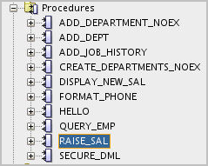
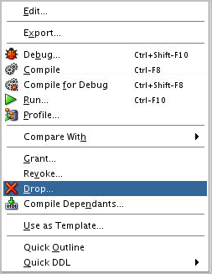
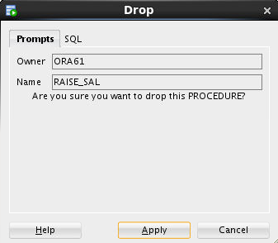
Removing Procedures: Using the DROP SQL Statement or SQL Developer
Using the DROP statement:
Using SQL Developer:
DROP PROCEDURE raise_sal;
1
2
3
Notes:
When a stored procedure is no longer required, you can use the DROP PROCEDURE SQL statement followed by the procedure’s name to remove it as follows:
DROP PROCEDURE procedure_name
You can also use SQL Developer to drop a stored procedure as follows:
1. Right-click the procedure name in the Procedures node, and then click Drop. The Drop dialog box is displayed.
2. Click Apply to drop the procedure.
Note
Whether successful or not, executing a data definition language (DDL) command such as DROP PROCEDURE commits any pending transactions that cannot be rolled back.
You might have to refresh the Procedures node before you can see the results of the drop operation. To refresh the Procedures node, right-click the procedure name in the Procedures node, and then click Refresh.

Slide 36
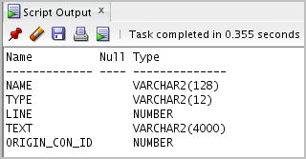
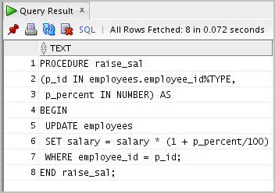
Viewing Procedure Information Using the Data Dictionary Views
DESCRIBE user_source
SELECT text
FROM user_source
WHERE name = 'RAISE_SAL' AND type = 'PROCEDURE'
ORDER BY line;
Notes:
The source code for PL/SQL subprograms is stored in the data dictionary tables. The source code is accessible to PL/SQL procedures that are successfully or unsuccessfully compiled. To view the PL/SQL source code stored in the data dictionary, execute a SELECT statement on the following tables:
The USER_SOURCE table to display PL/SQL code that you own
The ALL_SOURCE table to display PL/SQL code to which you have been granted the EXECUTE right by the owner of that subprogram code
The query example shows all the columns provided by the USER_SOURCE table:
The NAME column holds the name of the subprogram in uppercase text.
The TYPE column holds the subprogram type, such as PROCEDURE or FUNCTION.
The LINE column stores the line number for each source code line.
The TEXT column holds PL/SQL source code.
The ORIGIN_CON_ID holds the ID of the container where the data originates. The value of the container id can range from 0-n based on database configuration.
The ALL_SOURCE table provides an OWNER column in addition to the preceding columns.
Note: You cannot display the source code for Oracle PL/SQL built-in packages, or PL/SQL whose source code has been wrapped by using a WRAP utility. The WRAP utility converts the PL/SQL source code into a form that cannot be deciphered by humans.

Slide 37
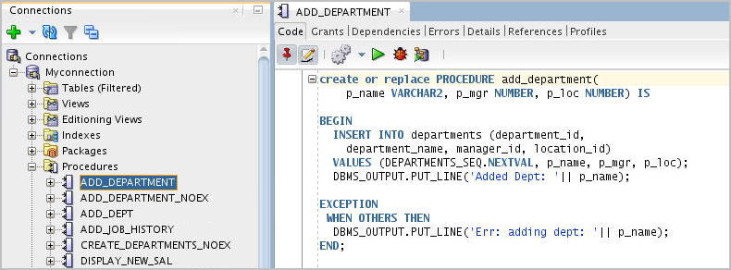
Viewing Procedures Information Using SQL Developer
Notes:
To view a procedure’s code in SQL Developer, perform the following steps:
1. Click the Procedures node in the Connections tab.
2. Click the procedure’s name.
3. The procedure's code is displayed in the Code tab as shown in the slide.

Slide 38
Quiz
Which of the following is an invalid procedure call for a procedure?
ADD(a IN NUMBER DEFAULT 10, b IN NUMBER DEFAULT 20, result OUT NUMBER)
ADD
ADD(ex)
ADD(10,20,ex)
ADD(b=>45,a=>35,ex)
Notes:
Answer: a
Options b and c and show procedure calls with the parameter specified through OUT mode but option a does have the parameter with the OUT mode as defined in the procedure specification.

Slide 39
Summary
In this lesson, you should have learned how to:
Identify the benefits of modularized and layered subprogram design
Create and call procedures
Use formal and actual parameters
Use positional, named, or mixed notation for passing parameters
Identify the available parameter-passing modes
Handle exceptions in procedures
Remove a procedure and display its information

Slide 40

Practice 11-1 Overview: Creating a New Database Connection
This practice covers the following topics:
Creating a new Database Connection to:
The user ora61 which will be named Myconnection
Notes:
Practice 11: Overview
In this practice, you create, compile, and invoke procedures that issue DML and query commands. You also learn how to handle exceptions in procedures.
If you encounter compilation errors when you execute procedures, you can use the Compiler-Log tab in SQL Developer.
Note: It is recommended to use SQL Developer for this practice.
Important
All practices in this course and the practice solutions assume that you create objects such as procedures, functions, and so on using the SQL Worksheet area in SQL Developer. When you create an object in the SQL Worksheet area, you need to refresh the object node in order for the new object to be displayed in the Navigator tree. To compile the newly created object, you can right-click the object name in the Navigator tree, and then select Compile from the shortcut menu. For example, after you enter the code to create a procedure in the SQL Worksheet area, click the Run Script icon (or press F5) to run the code. This creates and compiles the procedure.
Alternatively, you can create objects such as procedures using the PROCEDURES node in the Navigator tree, and then compile the procedure. Creating objects using the Navigator tree automatically displays the newly created object.

Slide 41
Practice 11-2 Overview: Creating, Compiling, and Calling Procedures
This practice covers the following topics:
Creating stored procedures to:
Insert new rows into a table using the supplied parameter values
Update data in a table for rows that match the supplied parameter values
Delete rows from a table that match the supplied parameter values
Query a table and retrieve data based on supplied parameter values
Handling exceptions in procedures
Compiling and invoking procedures
Notes:
Practice 11: Overview
In this practice, you create, compile, and invoke procedures that issue DML and query commands. You also learn how to handle exceptions in procedures.
If you encounter compilation errors when you execute procedures, you can use the Compiler-Log tab in SQL Developer.
Note: It is recommended to use SQL Developer for this practice.
Important
All practices in this course and the practice solutions assume that you create objects such as procedures, functions, and so on using the SQL Worksheet area in SQL Developer. When you create an object in the SQL Worksheet area, you need to refresh the object node in order for the new object to be displayed in the Navigator tree. To compile the newly created object, you can right-click the object name in the Navigator tree, and then select Compile from the shortcut menu. For example, after you enter the code to create a procedure in the SQL Worksheet area, click the Run Script icon (or press F5) to run the code. This creates and compiles the procedure.
Alternatively, you can create objects such as procedures using the PROCEDURES node in the Navigator tree, and then compile the procedure. Creating objects using the Navigator tree automatically displays the newly created object.

