Slide 1
Debugging Subprograms

Slide 2
Course Road Map
Lesson 11: Creating Procedures
Lesson 12: Creating Functions
Lesson 13: Debugging Subprograms
Unit 4: Working with Sub programs
Lesson 14: Creating Packages
Unit 5: Working with Triggers
Lesson 15: Working with Packages
Lesson 16: Using Oracle-Supplied Packages in Application Development
Unit 6: Working with PL/SQL Code
Lesson 17: Using Dynamic SQL
Notes:
In the fourth unit, we have seven lessons – Creating Stored Procedures, Creating Functions, Debugging Subprograms, Creating Packages, Working with Packages, Using Oracle Supplied Packages in Application Development, and Using Dynamic SQL. You will learn to write PL/SQL subprograms, packages, and use them in Application Development.

Slide 3
Objectives
After completing this lesson, you should be able to:
Describe the functionality of the SQL Developer debugger
Debug Subprograms
Use various features of SQL Developer debugger for debugging
Notes:
In this lesson, you learn how to create, invoke, and maintain functions.

Slide 4
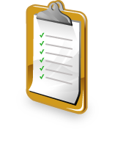
Lesson Agenda
Before debugging PL/SQL subprograms
Debugging a subprogram
Using the debugging Log Tab toolbar
Debugging a procedure

Slide 5


Before Debugging PL/SQL Subprograms
Before you start debugging PL/SQL Subprograms, you should have the following privileges:
DEBUG CONNECT SESSION privilege
DEBUG ANY PROCEDURE privilege
EXECUTE privilege on DBMS_DEBUG_JDWP
EXECUTE privilege on the object you want to debug
Notes:
Debugging is the process of locating and removing any defects in the program code. To debug a PL/SQL Subprogram you (user of the schema through which you have logged in) should have certain privileges mentioned in the slide.
You can look at the privileges for the current user by executing the following query :
select * from user_sys_privs;

Slide 6
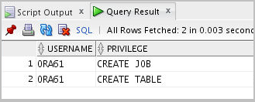
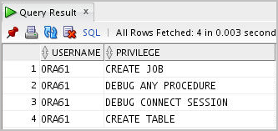
Before Debugging PL/SQL Subprograms
You can look at the privileges of the current user by executing the following statement:
SELECT * from user_sys_privs;
ORA61 does not have DEBUG CONNECT SESSION and DEBUG ANY PROCEDURE privileges. You can grant them by executing the following statements as a SYSDBA role user.
GRANT DEBUG ANY PROCEDURE TO ora61;
GRANT DEBUG CONNECT SESSION TO ora61;
-- Login as ora61
select * from user_sys_privs;
Notes:
The process of granting privileges is demonstrated in the slide. You query the existing privileges using the query in the first code box.
Note: To grant privileges to a user, you have to be a SYSDBA role user.
To grant the required privileges to ora61, log in as a SYSDBA role user and run the GRANT statements in the second code box.
To see the current set of privileges, log in as ora61 and then run the query:
select * from user_sys_privs;

Slide 7

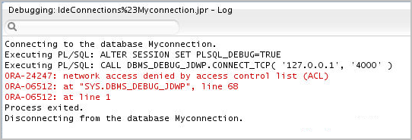
Before Debugging PL/SQL Subprograms
You might encounter the following error while running the SQL debugger in Oracle 19c.
The error implies that the current database session is trying to establish a connection with the debugger on the local host, but not able to do so.
Notes:
While debugging in Oracle 19c, in spite of having the DEBUG CONNECT SESSION privilege, you might encounter the error mentioned in the slide. This error occurs when the database session tries to connect to the debugger on the localhost. Your current database session should have the jdwp ACL privilege to successfully connect to the debugger.
SQL developer uses Java Debug Wire Protocol (JDWP)–based debugger to debug an Oracle 19c PL/SQL subprogram. Debugger generally resides on the local host. Your database session should connect to the debugger on the local host to start the debugging process. You must be granted the jdwp ACL privilege to connect to the debugger on the local host.

Slide 8
Before Debugging PL/SQL Subprograms
You have to execute the following PL/SQL block to grant the jdwp ACL privilege as a SYSDBA role user.
BEGIN
DBMS_NETWORK_ACL_ADMIN.APPEND_HOST_ACE
(
host => '127.0.0.1',
lower_port => null,
upper_port => null,
ace => xs$ace_type(privilege_list => xs$name_list('jdwp'),
principal_name => 'ora61',
principal_type => xs_acl.ptype_db)
);
END;

Slide 9
Lesson Agenda
Before debugging PL/SQL subprograms
Debugging a subprogram
Using the debugging Log Tab toolbar
Debugging a procedure

Slide 10
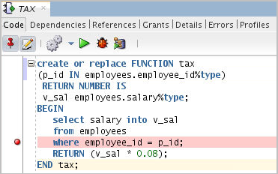
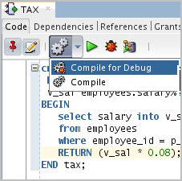
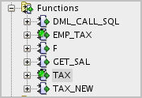

Debugging a Subprogram: Overview
Subprogram Compiled for Debug
1. Add Breakpoints
2. Compile for Debug
3. Debug
Notes:
The process of debugging starts by adding breakpoints. Breakpoint is added at a statement where the developer wants to inspect various parameters of the code or values of different variables in the code. Identify such statements in your code and add breakpoints.
When the debugging process reaches the breakpoint, you can use Data and Smart Data tabs in SQL Developer to inspect the state of various variables and data objects during the program execution.
After adding breakpoints, compile the code through the Compile for Debug option.

Slide 11
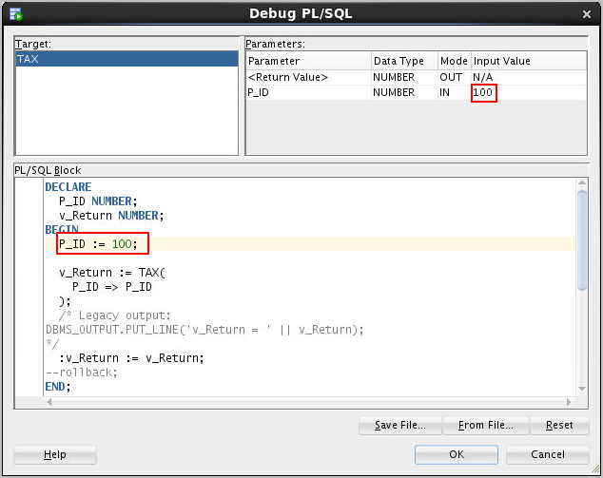
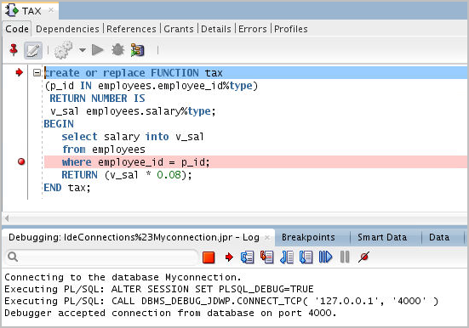
Debugging a Subprogram: Overview
Notes:
When you start debugging the subprogram, the debugger creates an anonymous PL/SQL block which invokes the function. The debugger also declares variables to accept the values returned by the function.
As you see in the slide the wizard has a PL/SQL block which invokes the function “tax” from an anonymous PL/SQL block.
You can modify the value of the input variables accepted by the function in this wizard. In the slide the value of the variable p_id is set to 100.
The debug process starts once you click OK in the wizard.

Slide 12
Lesson Agenda
Before debugging PL/SQL subprograms
Debugging a subprogram
Using the debugging Log Tab toolbar
Debugging a procedure

Slide 13
The Debugging – Log Tab Toolbar
3
1
2
4
Icon | Description
1. Terminate | Halts and exits the execution
2. Find Execution Point | Goes to the next execution point
3. Step Over | Bypasses the execution of statements of a subprogram invoked from the current subprogram and executes the statement after the subprogram call
4. Step Into | Executes a single program statement at a time. If the execution point is located on a call to a subprogram, it steps into the first statement in that subprogram.
Notes:
After the debugging process starts, the debug toolbar shown in the slide appears in the SQL developer.
The Debugging Log has all the informational messages and the following tabs:
1. Terminate: Halts and exits the execution. You cannot resume execution from this point; instead, to start running or debugging from the beginning of the subprogram, click the Run or Debug icon in the Source tab toolbar.
2. Find Execution Point: Goes to the execution point (the next line of source code to be executed by the debugger)
3. Step Over: When there is a subprogram call, Step Over skips entering the subprogram block. The next statement to be executed will be the statement following the subprogram call. So the debugger steps over debugging the subprogram body which is invoked from the subprogram currently being executed.
4. Step Into: Executes a single program statement at a time. If the execution point is located on a call to a subprogram, Step Into steps into that subprogram and places the execution point on the first statement of the invoked subprogram.
Note: The functionality of Step Over and Step Into would effectively be the same when there are no subprogram calls in the current subprogram.

Slide 14
The Debugging – Log Tab Toolbar
5
7
9
6
8
Icon | Description
5. Step Out | Leaves the current subprogram and goes to the next statement with a breakpoint
6. Step to End of Method | Goes to the last statement of the current subprogram
7. Resume | Continues execution
8. Pause | Halts execution but does not exit
9. Suspend all breakpoints | Turns off all the breakpoints in the current PL/SQL block
Notes:
5. Step Out: Leaves the current subprogram and goes to the next executable statement
6. Step to End of Method: Goes to the last statement of the current subprogram
7. Resume: Continues execution
8. Pause: Halts execution but does not exit, thus allowing you to resume execution
9. Suspend all breakpoints: Renders all the breakpoints defined in the subprogram ineffective

Slide 15
Tracking Data and Execution
1
2
3
4
Tab | Description
1. Breakpoints | It displays breakpoints, both system defined and user defined.
2. Smart Data | Displays information about variables. You can specify these preferences by right-clicking in the Smart Data window and selecting Preferences.
3. Data | You can see the data in all the variables.
4. Watches | You can monitor all the watches set while debugging.
Notes:
You can monitor how the data is changing while executing the subprogram through the tabs: Breakpoints, Data, Smart Data, and Watches.
Breakpoints: Breakpoints are defined by the developer while debugging. The execution of the subprogram stops at the breakpoint and allows the developer to inspect data or modify certain data if required. After performing the data inspection, developer can start the debugging process by clicking on Step Into or Step Over.
Smart Data: Smart Data tab displays information about the variables in the subprogram. SQL Developer allows to modify the data here enabling the developer to try all the possibilities.
Data: The Data tab has all the values of the variables used in the subprogram being debugged.
Watches: A watch enables you to monitor the changing values of variables as the subprogram executes. You can create a Watch expression in the Watches tab based on the values of variables used in the subprogram.

Slide 16
Lesson Agenda
Before debugging PL/SQL subprograms
Debugging a subprogram
Using the debugging Log Tab toolbar
Debugging a procedure

Slide 17
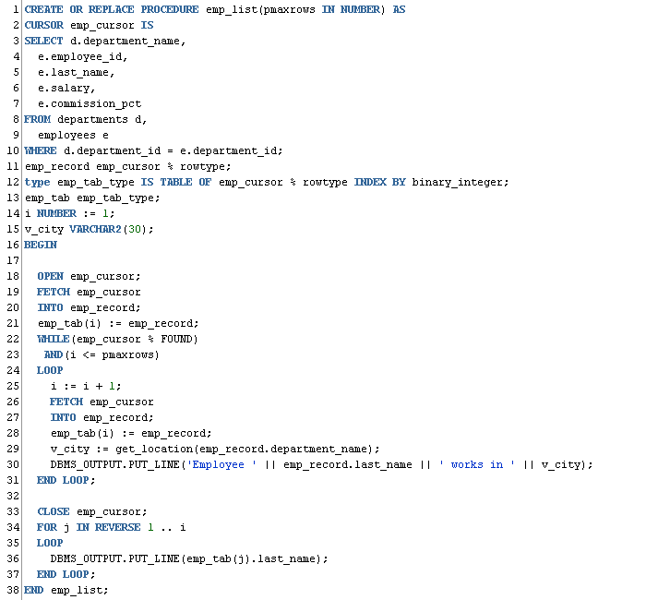
Debugging a Procedure Example: Creating a New emp_list Procedure
Notes:
Now let us look at the debugging process of the procedure emp_list. The procedures retrieves the employee details such as employee_id, last_name, salary, and commission_pct from the EMPLOYEES table along with the department name in which the employee works in the DEPARTMENT table. The procedure also has a function call to retrieve the location of the employee based on the department in which the employee works. All these details are retrieved into a record called emp_record, these records are later stored in a table emp_tab. And finally displayed in a for loop.
Let us see the process of debugging this procedure.
This procedure has a cursor, function call, and for loop. A developer would like to set a breakpoint at these statements because they are some likely locations of error in the subprogram.
Note: Make sure that you are displaying the procedure code in edit mode. To edit the procedure code, click the Edit icon on the procedure’s toolbar.

Slide 18
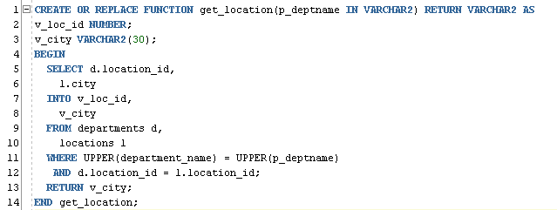
Debugging a Procedure Example: Creating a New get_location Function
Notes:
This function returns the city in which an employee works. It is called from the emp_list procedure.

Slide 19
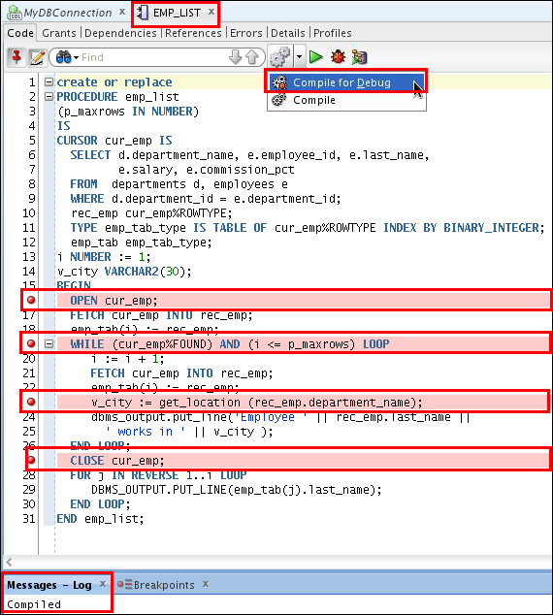
Setting Breakpoints and Compiling emp_list for Debug Mode
Notes:
The slide shows adding breakpoints for the cursor, function call, and the loop statement. You generally add a break point by clicking the appropriate line number.
Before debugging, it is essential to Compile for Debug. This will add additional overhead which enables debugging process.
The slide shows the emp_list procedure displayed in edit mode, and four breakpoints added to various locations in the code. To compile the procedure for debugging, right-click the code, and then select Compile for Debug from the shortcut menu. The Messages – Log tab displays the message that the procedure was compiled.

Slide 20
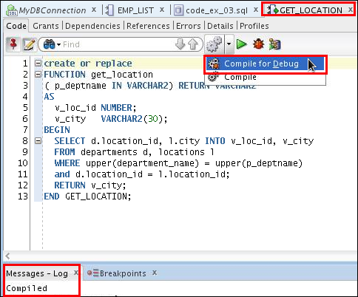
Compiling the get_location Function for Debug Mode
Notes:
You should also compile the user-defined functions invoked from the subprogram you intend to debug. Therefore, you should debug the get_location function also.
In the slide, the get_location function is displayed in edit mode. To compile the function for debugging, right-click the code, and then select Compile for Debug from the shortcut menu. The Messages – Log tab displays the message that the function was compiled.

Slide 21
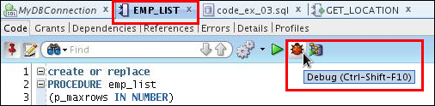
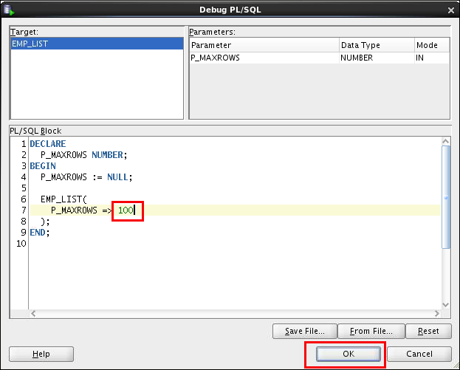
Debugging emp_list and Entering Values for the PMAXROWS Parameter
Enter the procedure’s parameter value using the anonymous block.
Notes:
The next step in the debugging process is to debug the procedure using any of the several available methods mentioned earlier, such as clicking the Debug icon on the procedure’s toolbar. When you start the debugging process an anonymous block is displayed, where you are prompted to enter the parameters for this procedure. emp_list has one parameter, PMAXROWS, which specifies the number of records to return. Replace the second PMAXROWS with a number such as 100, and then click OK.
After you start the debugging process, you can use Step Into or Step Over to debug the subprogram step by step.
Note: Use Step Over to avoid entering the called function subprogram from the currently executing subprogram.

Slide 22
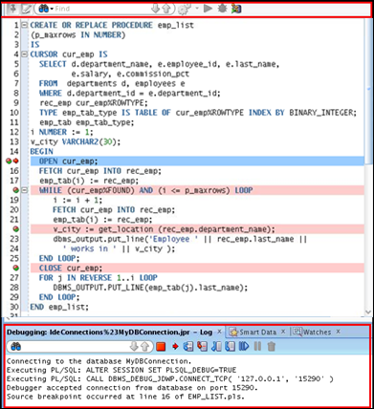
Debugging emp_list: Step Into (F7) the Code
Program control stops at first breakpoint.
1
Notes:
The slide demonstrates the debugging process. The slide shows that the program control is stopped at the first breakpoint in the code. The arrow next to the breakpoint indicated that this is the line of code that will be executed next. Note the various tabs at the bottom of the window.
At this breakpoint, you can inspect different values of the data and monitor the expression watches set by navigating through the Smart Data, Data, and Watches tabs.

Slide 23

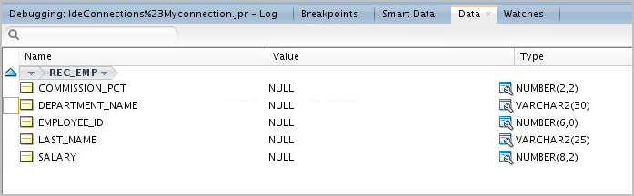

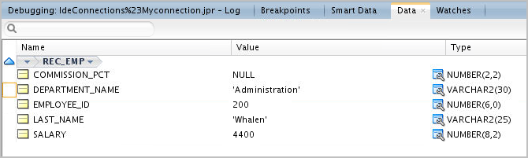
Viewing the Data
Notes:
While you are debugging your code, you can use the Data tab to display and modify the variables. You can also set watches to monitor a subset of the variables displayed in the Data tab. To display or hide the Data, Smart Data, and Watch tabs, select View > Debugger, and then select the tabs that you want to display or hide.

Slide 24
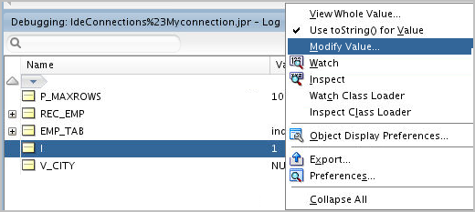
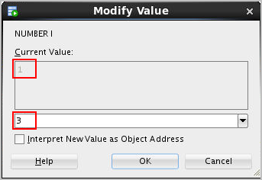
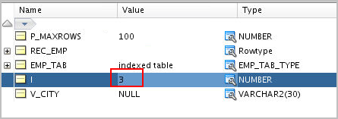
Modifying the Variables While Debugging the Code
1
2
3
Notes:
To modify the value of a variable in the Data tab, right-click the variable name, and then select Modify Value from the shortcut menu. The Modify Value window is displayed with the current value for the variable. You can enter a new value in the second text box, and then click OK.
You can see in the slide that the value of variable i is modified from 1 to 3.

Slide 25
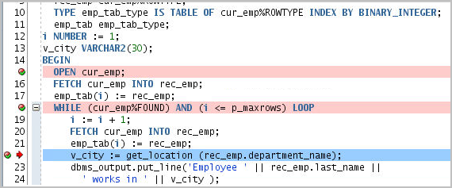
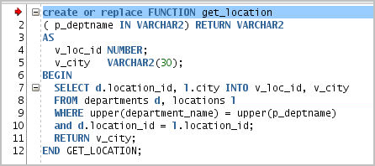
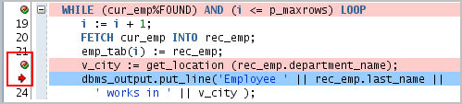
Debugging emp_list: Step Over Versus Step Into
Step Into
Step Over
Notes:
You can appreciate the difference between Step Into and Step Over process of debugger at code line number 21.
We have a function call get_location at line 21. At this point when you use Step Into, the debugging control shifts to the first line of the function definition of the get_location function. Instead of Step Into if you use Step Over, the debug control will remain in the current sub program. The control will be transferred to next statement (line 22) in the emp_list subprogram.

Slide 26
Debugging emp_list: Step Out of the Code (Shift + F7)
Step Out
Notes:
To look at how Step Out works, let us consider that currently we are debugging the first line of the get_location function. When we Step Out control here, debugging of the entire get_location function is skipped and the control moves to the statement after the function call in the emp_list procedure.

Slide 27
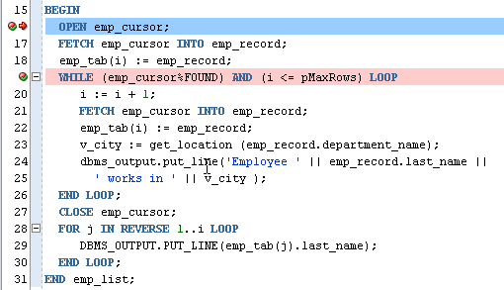
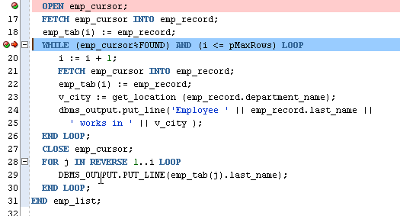
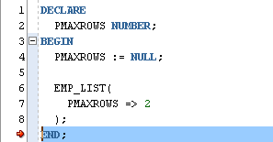
Debugging emp_list: Step to End of Method
Loops until i <> PMAXROWS
Notes:
Step to End of Method goes to the last statement in the current subprogram or to the next breakpoint if there are any in the current subprogram.
In the example in the slide, the Step to End of Method of debugging tool is used. Because there is a second breakpoint, selecting Step to End of Method transfers control to that breakpoint. Selecting Step to End of Method again goes through the iterations of the while loop first, and then transfers the program control to the next executable statement in the anonymous block.

Slide 28
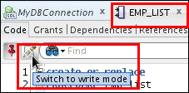
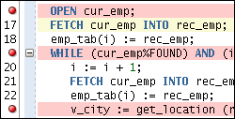
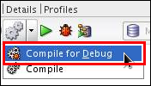
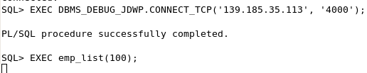
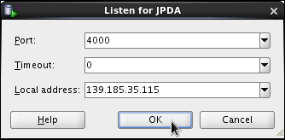
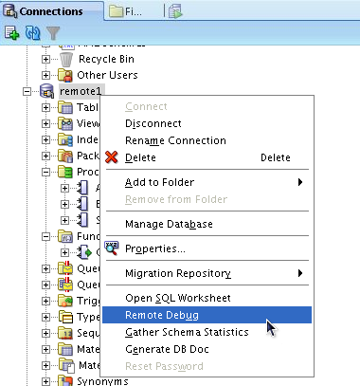
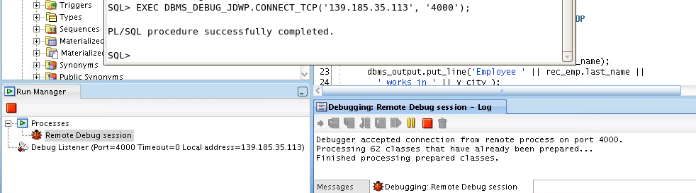
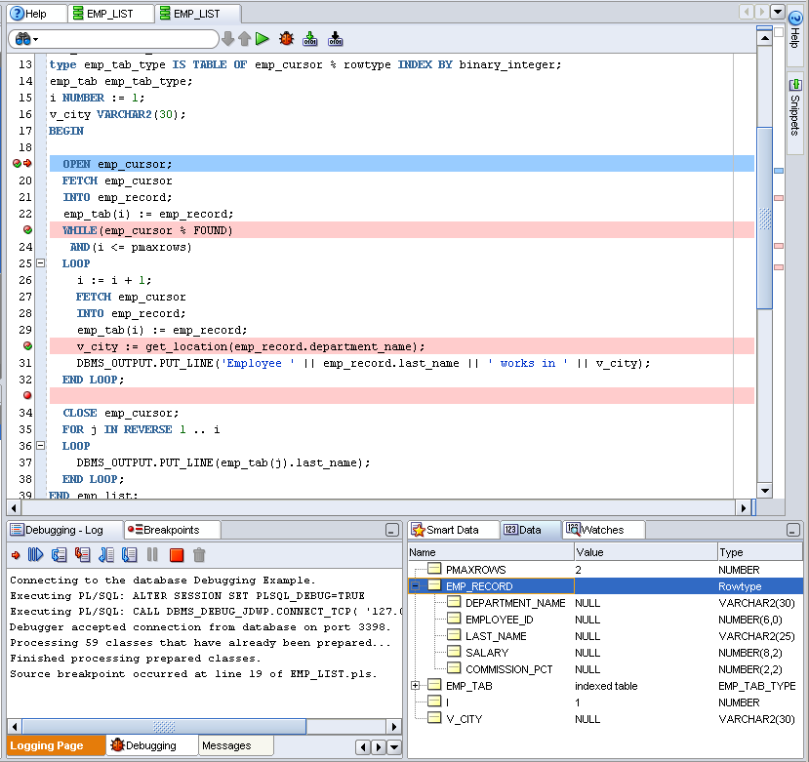
Debugging a Subprogram Remotely: Overview
1. Edit procedure.
2. Add breakpoints.
3. Compile for Debug.
6. Issue the debugger connection command and call procedure in another session such as SQL*Plus.
5. Enter local machine IP address and debugging port.
4. Select Remote Debug.
7. When the breakpoint is reached, control passes to SQL Developer.
8. Debug and monitor data using debugging tools.
Notes:
You can use remote debugging to connect to any PL/SQL code in a database and debug it, regardless of where the database is located as long as you have access to the database and have created a connection to it. Remote debugging is when something else, other than you as a developer, kicks off a procedure that you can then debug. Remote debugging and local debugging have many steps in common. To debug remotely, perform the following steps:
1. Edit the subprogram that you would like to debug.
2. Add the breakpoints in the subprogram.
3. Click the Compile for Debug icon in the toolbar.
4. Right-click the connection for the remote database, and select Remote Debug.
5. In the Debugger - Attach to JPDA dialog box, enter the local machine IP address and port number, such as 4000, and then click OK.
6. Issue the debugger connection command using a different session such as SQL*Plus, and then call the procedure in that session.
7. When a breakpoint is reached, control is passed back to the original SQL Developer session and the debugger toolbar is displayed.
8. Debug the subprogram and monitor the data using the debugging tools discussed earlier.

Slide 29
Summary
In this lesson, you should have learned how to:
Describe the basic functionality of the SQL Developer debugger
Run the debugging process
Use various features that can be used while debugging
Notes:
A function is a named PL/SQL block that must return a value. Generally, you create a function to compute and return a value, and you create a procedure to perform an action.
A function can be created or dropped.
A function is invoked as a part of an expression.

Slide 30

Practice 13 Overview: Introduction to the SQL Developer Debugger
This practice covers the following topics:
Creating a procedure and a function
Inserting breakpoints in the procedure
Compiling the procedure and function for debug mode
Debugging the procedure and stepping into the code
Displaying and modifying the subprograms’ variables
Notes:
You must use SQL Developer for this practice. This practice introduces you to the basic functionality of the SQL Developer debugger.

