Slide 1
Spring Security Architecture

Slide 2
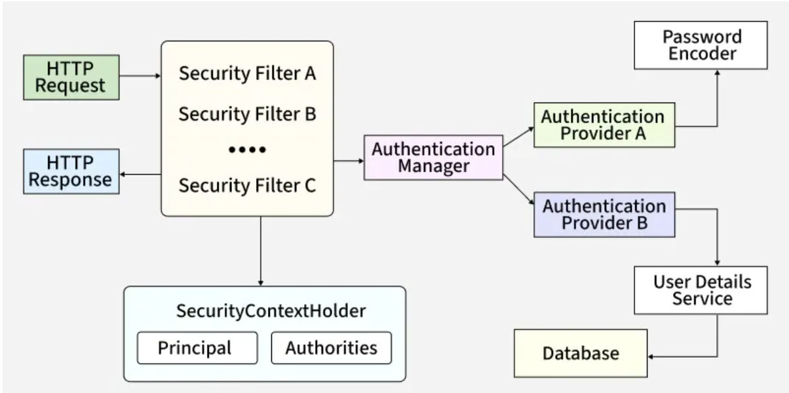
Core Components in Spring Security Architecture
The following diagram shows how an HTTP request is processed through the Spring Security filter chain to handle authentication and authorization before returning the response.

Slide 3
Security Filter Chain
Acts as the entry point for all incoming HTTP requests in Spring Security
Every request passes through a chain of filters such as UsernamePasswordAuthenticationFilter and BasicAuthenticationFilter
Handles authentication, authorization, CSRF protection, and session management
Ensures a modular and customizable security flow

Slide 4
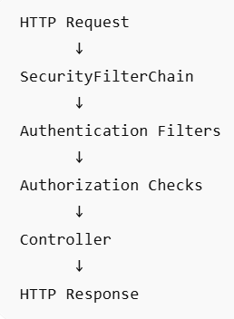
SecurityFilterChain Bean
Request Flow
SecurityFilterChain is a Spring Security bean that defines how incoming HTTP requests are secured.
It configures authentication, authorization, login mechanisms, session management, CSRF protection, and custom filters.
When Spring Boot detects a SecurityFilterChain bean, it uses that configuration instead of the default security auto-configuration

Slide 5
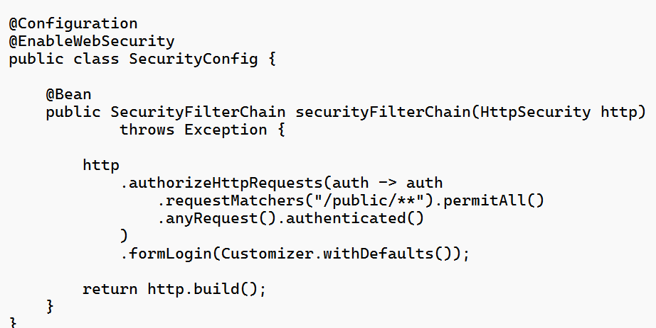
Basic Configuration
In Spring Security 6 / Spring Boot 3, the recommended way to configure security is by defining a SecurityFilterChain bean. This replaces the older WebSecurityConfigurerAdapter, which has been removed.
/public/** → accessible to everyone
All other URLs → require authentication
Enables default login page
Builds and registers the filter chain

Slide 6
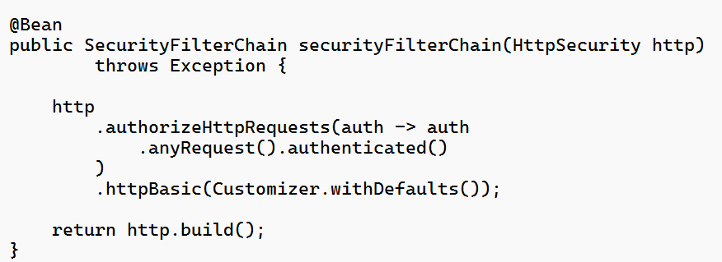
HTTP Basic Authentication [Useful for RESTful APIs]
HTTp request must include
Authorization: Basic base64(username:password)

Slide 7
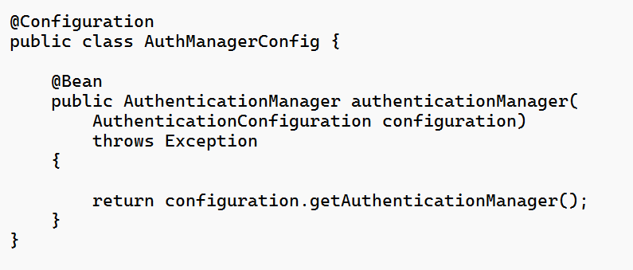
Authentication Manager
Core component responsible for handling user authentication
Delegates authentication requests to one or more AuthenticationProvider instances
Follows the Strategy design pattern, allowing multiple authentication mechanisms such as DB, LDAP, JWT, and OAuth2

Slide 8
Authentication Providers
Authentication Providers are the components responsible for validating user credentials
They process authentication requests coming from the AuthenticationManager
Different providers support different authentication mechanisms
Example:
DaoAuthenticationProvider -> Uses database authentication with UserDetailsService and PasswordEncoder
JwtAuthenticationProvider -> Validates JWT tokens

Slide 9
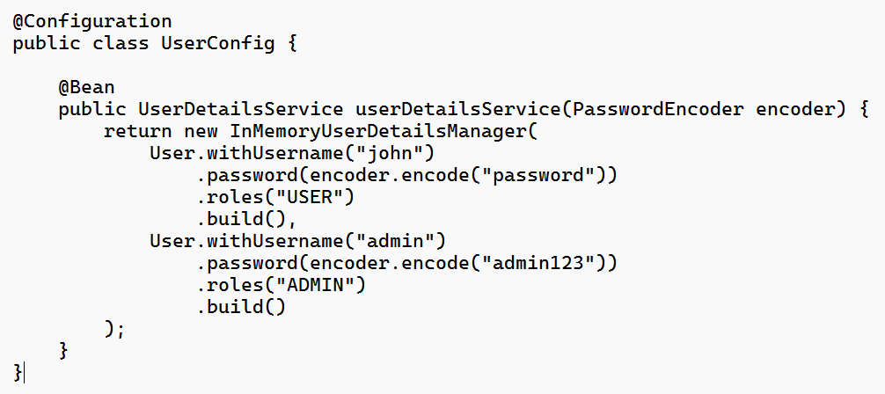
UserDetailsService
Loads user-specific data (username, password, roles) from a data source like a database.
Returns a UserDetails object.
Used primarily by providers like DaoAuthenticationProvider.

Slide 10
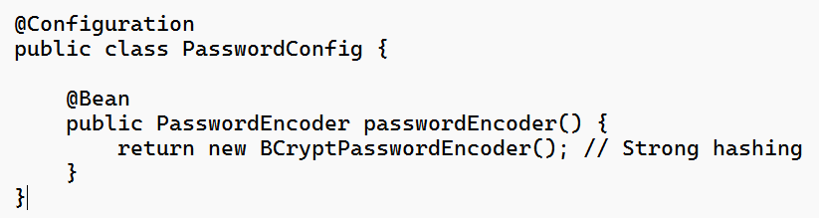
Password Encoder
Ensures secure password storage and validation.
Encodes raw passwords into secure hashes before saving/validation.

Slide 11
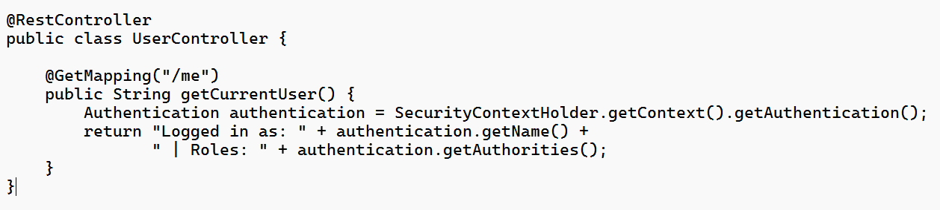
Security Context Holder
Stores the SecurityContext for the current request/thread. And holds the Authentication object, which contains:
Principal: Represents the logged-in user (username or user object).
Authorities: Roles/permissions granted to the user.

Slide 12
How Spring Security Works Internally
A client sends an HTTP request to the application.
The request passes through the Security Filter Chain where multiple security filters are applied.
The Authentication Manager receives the request and delegates authentication to the appropriate Authentication Provider.
The Authentication Provider validates credentials using UserDetailsService and PasswordEncoder (if required).
On successful authentication, user details are stored in SecurityContextHolder.
Authorization is performed using the stored principal and authorities to check access permissions.
If all checks pass, the request reaches the controller and an HTTP response is returned.

Slide 13
Spring Boot Security Auto-Configuration

Slide 14
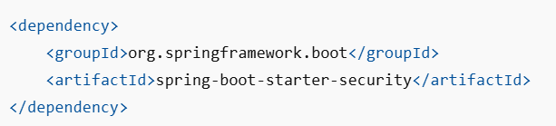
Introduction
Spring Boot Security Auto-Configuration automatically configures security for your application when the security dependency is present on the classpath.
For example, if you add the following code Spring Boot automatically applies a default security configuration without requiring any additional code

Slide 15
What gets added automatically?
Authentication
Creates an in-memory user:
Username: user
Password: randomly generated and printed in the startup logs
Authorization
Secures all endpoints.
Any request requires authentication.
Login Mechanism
Form-based login for browsers
HTTP Basic authentication for API clients

Slide 16
What gets added automatically?
Security Filter Chain
Registers Spring Security filters automatically
Authentication Event Publishing
Configures a DefaultAuthenticationEventPublisher

Slide 17
Auto-Configuration Classes
For Spring MVC applications, the main classes involved are:
SecurityAutoConfiguration
UserDetailsServiceAutoConfiguration
These classes create the default security setup when no custom security beans are provided.

Slide 18
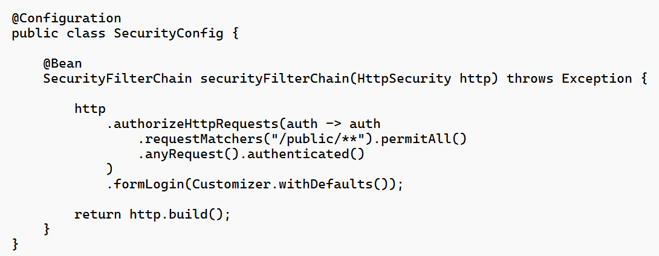
How to Override the Default Configuration
The recommended approach in modern Spring Security is to provide a SecurityFilterChain bean
Once a SecurityFilterChain bean is defined, Spring Boot's default web security configuration backs off

Slide 19
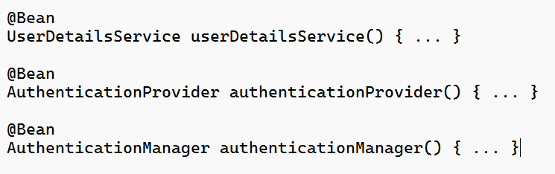
How to Disable the Default User
If you define any of these beans yourself Spring Boot stops creating the default in-memory user and generated password

Slide 20
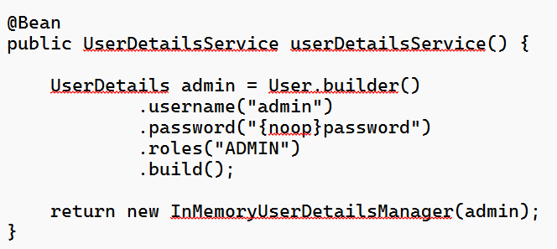
Example:
In the following code, the default generated user is no longer created

Slide 21
Summary
Spring Boot automatically
configures Spring Security, secures all endpoints,
creates a default in-memory user with a generated password,
enables form login/HTTP Basic authentication, and
registers the necessary security filter chain.
The configuration can be customized or replaced by defining beans such as SecurityFilterChain or UserDetailsService

