Slide 1
Introduction to Data Dictionary Views

Slide 2
Course Roadmap
ç
Unit 4: Views, Sequences, Synonyms, and Indexes
You are here!
Lesson 12: Introduction to Data Dictionary Views
Unit 5: Managing Database Objects and Subqueries
Lesson 13: Creating Sequences, Synonyms, and Indexes
Unit 6: User Access
Lesson 14: Creating Views
Unit 7: Advanced Queries
Notes:
In Unit 4, you get an introduction to data dictionary views. You learn how to create views on tables. You also learn about synonyms, sequences, and indexes, and how to create them.

Slide 3
Objectives
After completing this lesson, you should be able to:
Use data dictionary views to research data on your objects
Query various data dictionary views
Notes:
In this lesson, you are introduced to data dictionary views. You learn that dictionary views can be used to retrieve metadata and create reports about your schema objects.

Slide 4

Lesson Agenda
Introduction to data dictionary
Querying the dictionary views for the following:
Table information
Column information
Constraint information
Adding a comment to a table and querying the dictionary views for comment information
Notes:
This section gives a brief introduction to data dictionary.

Slide 5




Why Data Dictionary?
Hi, I am Brian. My team and I develop and maintain our company’s database.
Now, before updating the EMPLOYEES table I want to know who created the table? Or, before adding new values I need to know the constraints on DEPARTMENTS table!
That is easy!
Query the Data Dictionary.
Brian
Team Leader
Developers/Admin
Notes:
Brian and his team of developers are currently developing and maintaining his company’s database. So, at some point in time, Brian (Team Leader) wants to alter the EMPLOYEES table by dropping/adding a column. Before altering the table, he wants to check with the owner of the table and discuss the effects of the change. He also wants to add a new department into the DEPARTMENTS table. Before inserting new values into the table, he needs to know the various constraints on the table so that they are not violated.
How do you think Brian will keep track of this information?
The good news is that Brian need not maintain any other document or table to store such information. All he needs to do is learn to query the data dictionary. The data dictionary is a list of in-built tables and views, which come along with the database. You learn more about data dictionary in the following slides.

Slide 6

Data Dictionary
Oracle Server
Tables containing business data:
EMPLOYEES
DEPARTMENTS
LOCATIONS
JOB_HISTORY
...
Data dictionary views:
DICTIONARY
USER_OBJECTS
USER_TABLES
USER_TAB_COLUMNS
...
Notes:
User tables are tables created by you and contain business data, such as EMPLOYEES. Along with user tables, there is another collection of tables and views in the Oracle database known as the data dictionary. This collection is created and maintained by the Oracle Server and contains information about the database.
The data dictionary is structured in tables and views, just like other database data. The data dictionary is central to every Oracle database, and is an important tool for all users, from end users to application designers and database administrators.
You use SQL statements to access the data dictionary. Remember that the data dictionary is read-only and, therefore, you can issue queries only against its tables and views.
You can query the dictionary views that are based on the dictionary tables to find information such as:
Definitions of all schema objects in the database (tables, views, indexes, synonyms, sequences, procedures, functions, packages, triggers, and so on)
Default values for columns
Integrity constraint information
Names of Oracle users
Privileges and roles that each user has been granted
Other general database information

Slide 7
Data Dictionary Structure
Oracle Server
Consists of:
Base tables
User-accessible views
Notes:
Underlying base tables store information about the associated database. Only the Oracle Server should write to and read from these tables. You rarely access them directly.
There are several views that summarize and display the information stored in the base tables of the data dictionary. These views decode the base table data into useful information (such as user or table names) using joins and WHERE clauses to simplify the information. You are mostly given access to the views rather than the base tables.
The Oracle user SYS owns all base tables and user-accessible views of the data dictionary. No Oracle user should ever alter (UPDATE, DELETE, or INSERT) any rows or schema objects contained in the SYS schema; doing so can compromise data integrity.
You will learn more about views and how to create them in the lesson titled “Creating Views.”

Slide 8
Data Dictionary Structure
View naming convention is as follows:
View Prefix | Purpose
USER | User’s view (what is in your schema; what you own)
ALL | Expanded user’s view (what you can access)
DBA | Database administrator’s view (what is in everyone’s schemas)
V$ | Performance-related data
Notes:
The data dictionary consists of sets of views. In many cases, a set consists of three views containing similar information and distinguished from each other by their prefixes. For example, there is a view named USER_OBJECTS, another named ALL_OBJECTS, and a third named DBA_OBJECTS.
These three views contain similar information about objects in the database, except that the scope is different.
USER_OBJECTS contains information about objects that you own or you created. ALL_OBJECTS contains information about all objects to which you have access. DBA_OBJECTS contains information about all objects that are owned by all users.
For views that are prefixed with ALL or DBA, you will find an additional column in the view named OWNER to identify who owns the object.
There is also a set of views that is prefixed with v$. These views are dynamic in nature and hold information about performance. Dynamic performance tables are not true tables, and they should not be accessed by most users. However, database administrators can query and create views on the tables and grant access to those views to other users. This course does not go into details about these views.

Slide 9


How to Use Dictionary Views
Start with DICTIONARY. It contains the names and descriptions of the dictionary tables and views.
DESCRIBE DICTIONARY
SELECT *
FROM dictionary
WHERE table_name = 'USER_OBJECTS';
Notes:
To familiarize yourself with the dictionary views, you can use the dictionary view named DICTIONARY. It contains the name and short description of each dictionary view to which you have access.
You can write queries to search for information about a particular view name, or you can search the COMMENTS column for a word or phrase. In the example shown in the slide, the DICTIONARY view is described. It has two columns. The SELECT statement in the slide retrieves information about the dictionary view named USER_OBJECTS. The USER_OBJECTS view contains information about all the objects that you own.
You can write queries to search the COMMENTS column for a word or phrase. For example, the following query returns the names of all views that you are permitted to access in which the COMMENTS column contains the word columns:
SELECT table_name
FROM dictionary
WHERE LOWER(comments) LIKE '%columns%';
Note: The table names in the data dictionary are in uppercase.

Slide 10




USER_OBJECTS and ALL_OBJECTS Views
USER_OBJECTS:
Query USER_OBJECTS to see all the objects that you own.
Using USER_OBJECTS, you can obtain a listing of all object names and types in your schema, plus the following information:
Date created
Date of last modification
Status (valid or invalid)
ALL_OBJECTS:
Query ALL_OBJECTS to see all the objects to which you have access.
Owner
You
Objects owned by other users
Can access
Notes:
You can query the USER_OBJECTS view to see the names and types of all the objects in your schema. There are several columns in this view:
OBJECT_NAME: Name of the object
OBJECT_ID: Dictionary object number of the object
OBJECT_TYPE: Type of object (such as TABLE, VIEW, INDEX, SEQUENCE)
CREATED: Time stamp for the creation of the object
LAST_DDL_TIME: Time stamp for the last modification of the object resulting from a data definition language (DDL) command
STATUS: Status of the object (VALID, INVALID, or N/A)
GENERATED: Was the name of this object system generated? (Y|N)
Note: This is not a complete listing of the columns. For a complete listing, see “USER_OBJECTS” in Oracle® Database Reference 19c .
You can also query the ALL_OBJECTS view to see a listing of all objects to which you have access.

Slide 11
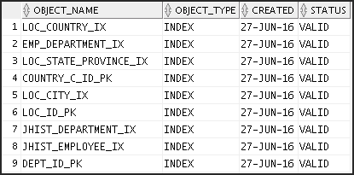
USER_OBJECTS View
SELECT object_name, object_type, created, status
FROM user_objects
ORDER BY object_type;
Owned by the user
…
Notes:
The example in the slide shows the name, type, date of creation, and status of all objects that are owned by this user.
The OBJECT_TYPE column holds the values of either TABLE, VIEW, SEQUENCE, INDEX, PROCEDURE, FUNCTION, PACKAGE, or TRIGGER.
The STATUS column holds a value of VALID, INVALID, or N/A. Although tables are always valid, the views, procedures, functions, packages, and triggers may be invalid.
The CAT View
For a simplified query and output, you can query the CAT view. This view contains only two columns:
TABLE_NAME
TABLE_TYPE
It provides the names of all your INDEX, TABLE, CLUSTER, VIEW, SYNONYM, SEQUENCE, or UNDEFINED objects.
Note: CAT is a synonym for USER_CATALOG—a view that lists tables, views, synonyms and sequences owned by the user.

Slide 12
Lesson Agenda
Introduction to data dictionary
Querying the dictionary views for the following:
Table information
Column information
Constraint information
Adding a comment to a table and querying the dictionary views for comment information
Notes:
This section discusses about querying the dictionary views for table information, column information, and constraint information.

Slide 13
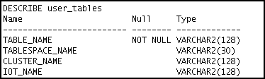
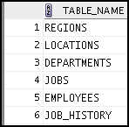
Table Information
USER_TABLES:
DESCRIBE user_tables
…
SELECT table_name
FROM user_tables;
…
Notes:
You can use the USER_TABLES view to obtain the names of all your tables. The USER_TABLES view contains information about your tables. In addition to providing the table name, it contains detailed information about the storage.
The TABS view is a synonym of the USER_TABLES view. You can query it to see a listing of tables that you own:
SELECT table_name
FROM tabs;
Note: For a complete listing of the columns in the USER_TABLES view, see “USER_TABLES” in Oracle® Database Reference 19c.
You can also query the ALL_TABLES view to see a listing of all tables to which you have access.

Slide 14
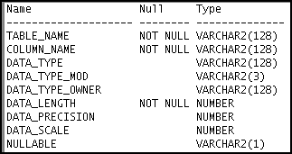
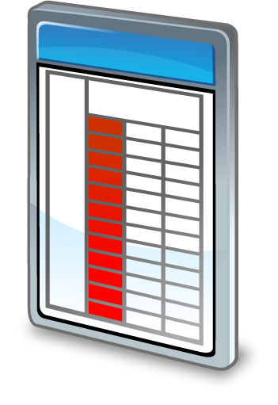
Column Information
USER_TAB_COLUMNS:
DESCRIBE user_tab_columns
…
Get information about a column.
Notes:
You can query the USER_TAB_COLUMNS view to find detailed information about the columns in your tables. Although the USER_TABLES view provides information about your table names and storage, you will find detailed column information in the USER_TAB_COLUMNS view.
This view contains information such as:
Column names
Column data types
Length of data types
Precision and scale for NUMBER columns
Whether nulls are allowed (Is there a NOT NULL constraint on the column?)
Default value
Note: For a complete listing and description of the columns in the USER_TAB_COLUMNS view, see “USER_TAB_COLUMNS” in the Oracle® Database Reference 19c.

Slide 15
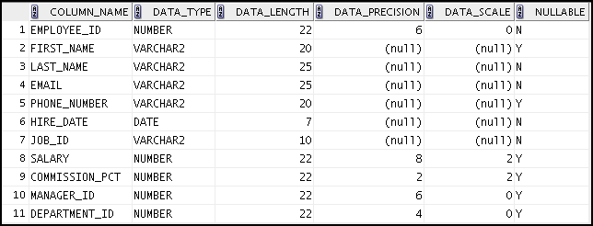
Column Information
SELECT column_name, data_type, data_length,
data_precision, data_scale, nullable
FROM user_tab_columns
WHERE table_name = 'EMPLOYEES';
Notes:
By querying the USER_TAB_COLUMNS table, you can find details about your columns, such as the names, data types, data type lengths, null constraints, and default value for a column.
The example shown displays the columns, data types, data lengths, and null constraints for the EMPLOYEES table. Note that this information is similar to the output from the DESCRIBE command.
To view information about columns set as unused, you use the USER_UNUSED_COL_TABS dictionary view.
Note: Names of the objects in data dictionary are in uppercase.

Slide 16
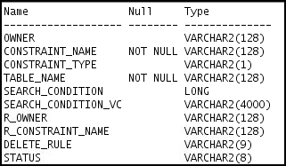

Constraint Information
USER_CONSTRAINTS describes the constraint definitions on your tables.
USER_CONS_COLUMNS describes columns that are owned by you and that are specified in constraints.
DESCRIBE user_constraints
…
Notes:
You can find out the names of your constraints, the type of constraint, the table name to which the constraint applies, the condition for check constraints, foreign key constraint information, deletion rule for foreign key constraints, the status, and many other types of information about your constraints.
Note: For a complete listing and description of the columns in the USER_CONSTRAINTS view, see “USER_CONSTRAINTS” in Oracle® Database Reference 19c.

Slide 17
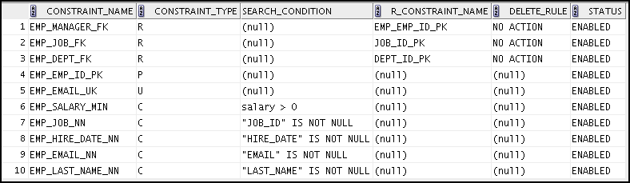
USER_CONSTRAINTS: Example
SELECT constraint_name, constraint_type,
search_condition, r_constraint_name,
delete_rule, status
FROM user_constraints
WHERE table_name = 'EMPLOYEES';
Notes:
In the example in the slide, the USER_CONSTRAINTS view is queried to find the names, types, check conditions, name of the unique constraint that the foreign key references, deletion rule for a foreign key, and status for constraints on the EMPLOYEES table.
The CONSTRAINT_TYPE can be:
C (check constraint on a table, or NOT NULL)
P (primary key)
U (unique key)
R (referential integrity)
V (with check option, on a view)
O (with read-only, on a view)
The DELETE_RULE can be:
CASCADE: If the parent record is deleted, the child records are deleted too.
SET NULL: If the parent record is deleted, change the respective child record to null.
NO ACTION: A parent record can be deleted only if no child records exist.
The STATUS can be:
ENABLED: Constraint is active.
DISABLED: Constraint is made inactive.

Slide 18
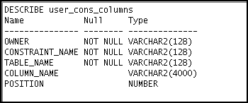
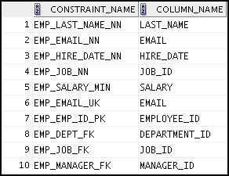
Querying USER_CONS_COLUMNS
DESCRIBE user_cons_columns
SELECT constraint_name, column_name
FROM user_cons_columns
WHERE table_name = 'EMPLOYEES';
…
Notes:
To find the names of the columns to which a constraint applies, query the USER_CONS_COLUMNS dictionary view. This view tells you the name of the owner of a constraint, the name of the constraint, the table that the constraint is on, the names of the columns with the constraint, and the original position of column or attribute in the definition of the object.
Note: A constraint may apply to more than one column.
You can also write a join between USER_CONSTRAINTS and USER_CONS_COLUMNS to create customized output from both tables.

Slide 19
Lesson Agenda
Introduction to data dictionary
Querying the dictionary views for the following:
Table information
Column information
Constraint information
Adding a comment to a table and querying the dictionary views for comment information
Notes:
In this section, you learn how to add a comment to a table and how to view the comment by using dictionary views.

Slide 20
Adding Comments to a Table
You can add comments to a table or column by using the COMMENT statement:
Comments can be viewed through the data dictionary views:
ALL_COL_COMMENTS
USER_COL_COMMENTS
ALL_TAB_COMMENTS
USER_TAB_COMMENTS
COMMENT ON TABLE employees
IS 'Employee Information';
COMMENT ON COLUMN employees.first_name
IS 'First name of the employee';
Notes:
You can add a comment of up to 4,000 bytes about a column, table, view, or snapshot by using the COMMENT statement. The comment is stored in the data dictionary and can be viewed in one of the following data dictionary views in the COMMENTS column:
ALL_COL_COMMENTS
USER_COL_COMMENTS
ALL_TAB_COMMENTS
USER_TAB_COMMENTS
Syntax
COMMENT ON {TABLE table | COLUMN table.column}
IS 'text';
In the syntax:
table Is the name of the table
column Is the name of the column in a table
text Is the text of the comment
You can drop a comment from the database by setting it to empty string (''):
COMMENT ON TABLE employees IS '';

Slide 21
Summary
In this lesson, you should have learned how to find information about your objects by using the following dictionary views:
DICTIONARY
USER_OBJECTS
USER_TABLES
USER_TAB_COLUMNS
USER_CONSTRAINTS
USER_CONS_COLUMNS
Notes:
In this lesson, you learned about some of the dictionary views that are available to you. You can use these dictionary views to find information about your tables, constraints, views, sequences, and synonyms.

Slide 22

Practice 12: Overview
This practice covers the following topics:
Querying the dictionary views for table and column information
Querying the dictionary views for constraint information
Adding a comment to a table and querying the dictionary views for comment information
Notes:
In this practice, you query the dictionary views to find information about objects in your schema.

