Slide 1
Retrieving Data Using the SQL SELECT Statement

Slide 2
Course Roadmap
Lesson 1: Introduction
Lesson 2: Retrieving Data using SQL SELECT
You are here!
Unit 1: Retrieving, Restricting and Sorting Data
Lesson 3: Restricting and Sorting Data
Unit 2: Joins, Subqueries, and Set Operators
Lesson 4: Using Single-Row Functions to Customize Output
Unit 3: DML and DDL
Lesson 5: Using Conversion Functions and Conditional Expressions
Notes:
In Unit 1, you will learn how to query the data from tables, how to query selected records from tables, and also how to sort the data retrieved from the tables.

Slide 3
Objectives
After completing this lesson, you should be able to do the following:
List the capabilities of SQL SELECT statements
Execute a basic SELECT statement
Notes:
To extract data from a database, you need to use the SQL SELECT statement. However, you may need to restrict the columns that are displayed. This lesson describes the SELECT statement that is needed to perform these actions. Further, you may want to create SELECT statements that can be used more than once.

Slide 4

Lesson Agenda
Capabilities of SQL SELECT statements
Arithmetic expressions and NULL values in the SELECT statement
Column aliases
Use of the concatenation operator, literal character strings, the alternative quote operator, and the DISTINCT keyword
DESCRIBE command

Slide 5




HR Application Scenario
HR Application
Employee Search:
Advanced Search:
I want a list of employees working in the Accounting department. How do I generate this report?
First Name
Location
Last Name
Department
Accounting
GO
Result Set
HR Application
Emp_ID | First Name | Last Name | Department
205 | Sheldon | Cooper | Accounting
109 | Racheal | Higgins | Accounting
123 | Parvathy | Patil | Accounting
Alex
…
Notes:
Alex, an HR manager in India, wants a report of all the employees in the Accounting department of the organization. This slide displays a mockup of the screens that the application might display in order to access the database. The HR application consists of a database of all the employees in the organization. So, how does Alex search based on the criteria in the HR application?
Alex finds it very efficient to use the HR application to generate reports. He logs in to the application, enters ‘Accounting’ in the Department field, and clicks Go.
The HR application fires a SQL SELECT statement to query the database for all employees in the Accounting department. Alex then sees the result on his application.
Basically, you can query the database for information by writing conditional and complex SQL statements. In this lesson, you will learn more about SQL SELECT statements. You will not learn about the application used to develop the interface screens like those shown in the mockup in this slide. Those are covered in Oracle courses on application development like APEX and in the MySQL for Developers course.

Slide 6

Writing SQL Statements
SQL statements are not case-sensitive.
SQL statements can be entered on one or more lines.
Keywords cannot be abbreviated or split across lines.
Clauses are usually placed on separate lines.
Indents are used to enhance readability.
Notes:
Writing SQL Statements
By using the following simple rules and guidelines, you can construct valid statements that are easy to read and edit:
SQL statements are not case-sensitive (unless indicated).
SQL statements can be entered on one or many lines.
Keywords cannot be split across lines or abbreviated.
Clauses are usually placed on separate lines for readability and ease of editing.
Indents should be used to make code more readable.
Keywords typically are entered in uppercase; all other words, such as table names and columns names, are entered in lowercase.

Slide 7

Basic SELECT Statement
SELECT identifies the columns to be displayed.
FROM identifies the table containing those columns.
SELECT *|{[DISTINCT] column [alias],...}
FROM table;
Selecting from a table
Notes:
Use the SELECT statement to retrieve data from one or more tables or views in the database.
In its simplest form, a SELECT statement must include the following:
A SELECT clause, which specifies the columns to be displayed
A FROM clause, which identifies the table containing the columns that are listed in the SELECT clause
In the syntax:
SELECT Is a list of one or more columns
* Selects all columns
DISTINCT Suppresses duplicates
column|expression Selects the named column or the expression
alias Gives different headings to the selected columns
FROM table Specifies the table containing the columns
Throughout this course, you will see that the words keyword, clause, and statement are used as follows:
A keyword refers to an individual SQL element—for example, SELECT and FROM are keywords.
A clause is a part of a SQL statement—for example, SELECT employee_id, last_name, and so on.
A statement is a combination of two or more clauses—for example, SELECT * FROM employees.

Slide 8

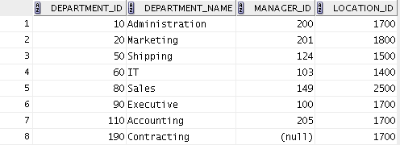

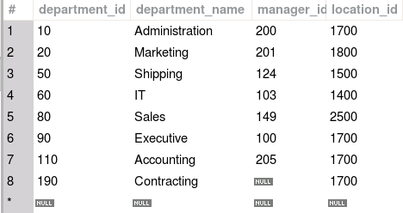
Selecting All Columns
Oracle SQL Developer:
MySQL Workbench:
SELECT *
FROM departments;
Notes:
You can display all columns of data in a table by following the SELECT keyword with an asterisk (*). In the example in the slide, the departments table contains four columns: department_id, department_name, manager_id, and location_id. The table contains eight rows, one for each department.
You can also display all columns in the table by listing them after the SELECT keyword. For example, the following SQL statement (like the example in the slide) displays all columns and all rows of the departments table:
SELECT department_id, department_name, manager_id, location_id
FROM departments;
The examples in the slide show the output from executing the displayed statement in both Oracle SQL Developer and MySQL Workbench. Before considering other SELECT statements, the next few topics explain how to execute statements and what the output looks like in SQL Developer and MySQL Workbench.
Note: In this course, for examples on slides when both Oracle and MySQL use the same syntax, the output of both Oracle SQL Developer and MySQL Workbench appear. Your output should appear like the output of the database you are using. For topics where the databases use a different syntax or have other significant differences, separate slides are provided. You can skip over slides that do not apply to the database you are using.

Slide 9
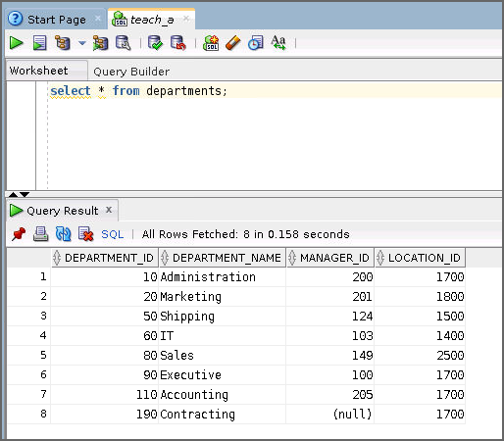
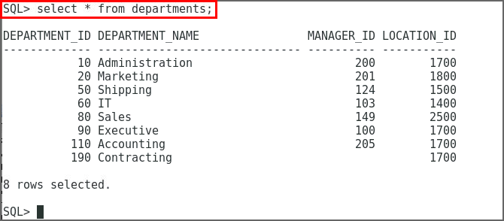
Executing SQL Statements with Oracle SQL Developer and SQL*Plus
SQL Developer
Execute statement
SQL * Plus
Run script
Notes:
In SQL Developer:
Click the Run Script icon or press [F5] to run the command or commands in the SQL Worksheet.
You can also click the Execute Statement icon or press [F9] to run a SQL statement in the SQL Worksheet.
The Execute Statement icon executes the statement at the cursor in the Enter SQL Statement box, while the Run Script icon executes all the statements in the Enter SQL Statement box.
The Execute Statement icon displays the output of the query on the Results tabbed page, whereas the Run Script icon emulates the SQL*Plus display and shows the output on the Script Output tabbed page.
In SQL*Plus:
In SQL*Plus, terminate the SQL statement with a semicolon, and then press [Enter] to run the command.

Slide 10

Column Heading Defaults in SQL Developer and SQL*Plus
SQL Developer:
Default heading alignment: Left-aligned
Default heading display: Uppercase
SQL*Plus:
Character and Date column headings are left-aligned.
Number column headings are right-aligned.
Default heading display: Uppercase
Notes:
In SQL Developer, column headings are displayed in uppercase and are left-aligned.
Run the following SQL statement and observe the column headings in the output:
SELECT last_name, hire_date, salary
FROM employees;
You can override the column heading display with an alias. Column aliases are covered later in this lesson.

Slide 11
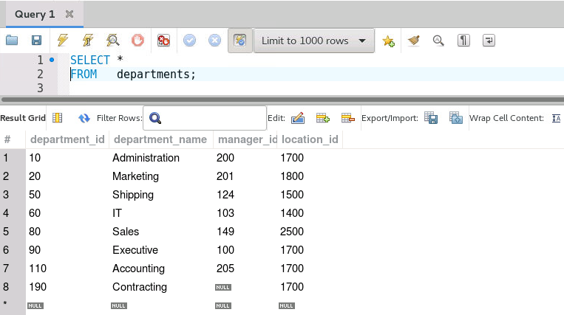
Executing SQL Statements in MySQL Workbench
Enter statements in the SQL Editor. To execute a single statement, place the cursor anywhere in the statement and click the Execute Current SQL Script button or press Ctrl+Enter. The results display in the Results Grid.
Execute Current SQL Script Button
SQL Editor
Results Grid
Notes:
You can enter multiple statements in the SQL Editor. You can select one statement or multiple statements in the SQL Editor and click the Execute SQL Script button (to the left of the Execute Current SQL Script button) or press Ctrl+Shift+Enter to execute the selected statement or statements, or execute all statements in the SQL Editor if nothing is selected.
By default, the headings of the results in the Result Grid are the column names, displayed left-aligned above the results. Run the following SQL statement and observe the column headings in the output:
SELECT last_name, hire_date, salary
FROM employees;
You can override the column heading display with an alias. Column aliases are covered later in this lesson.

Slide 12
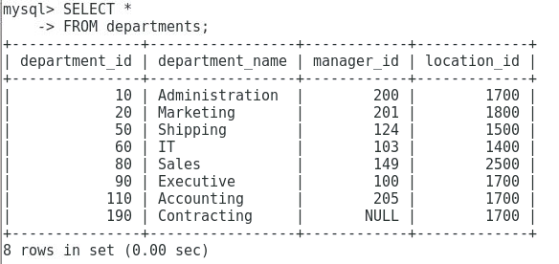
Executing SQL Statements in mysql Command-line Client
Enter statements in the mysql command-line client. Press Enter to continue a statement to another line. Terminate a statement with semicolon (;) and press Enter to execute the statement. Results display in a text table.
Notes:
The default prompt for mysql command line client is mysql>. When you press Enter before terminating the statement with a semicolon, the prompt becomes ->. The MySQL examples in this course use MySQL Workbench, but you can use the mysql command-line client if you prefer a command-line tool.
By default, the headings of the results are the column names, displayed left-aligned. Run the following SQL statement and observe the column headings in the output:
SELECT last_name, hire_date, salary
FROM employees;
You can override the column heading display with an alias. Column aliases are covered later in this lesson.

Slide 13
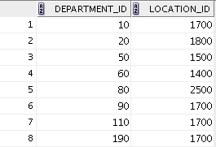
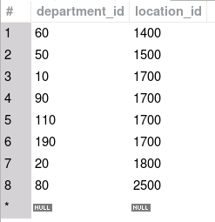
Selecting Specific Columns
Oracle SQL Developer:
MySQL Workbench:
SELECT department_id, location_id
FROM departments;
Notes:
You can use the SELECT statement to display specific columns of the table by specifying the column names, separated by commas. The example in the slide displays all the department numbers and location numbers from the departments table. The results from Oracle SQL Developer and MySQL Workbench are the same. The order of the results might differ unless you specify an order. You learn to specify an order for the results in the lesson titled Restricting and Sorting Data.
In the SELECT clause, specify the columns that you want, in the order in which you want them to appear in the output. For example, to display location before department number (from left to right), you use the following statement:
SELECT location_id, department_id
FROM departments;

Slide 14


Selecting from dual with Oracle Database
dual is a table automatically created by Oracle Database.
dual has one column called DUMMY, of data type VARCHAR(1), and contains one row with a value x.
SELECT *
FROM dual;
SELECT SYSDATE
FROM dual;
Notes:
When you install Oracle Database, a dual table is automatically created. This table is in the SYS user schema but is accessible by the name dual to all users. When you display the contents of the dual table, you will observe that it has one column, DUMMY, defined to be varchar(1), and contains one row with a value x.
Selecting from the dual table is useful for computing a constant expression with the SELECT statement. Because dual has only one row, the constant is returned only once. Alternatively, you can select a constant, pseudocolumn, or expression from any table, but the value will be returned as many times as there are rows in the table.
For example, if you want to compute the expression 12*4/5+5*8, use the following statement:
SELECT 12*4/5+5*8
FROM dual;

Slide 15

Selecting Constant Expressions in MySQL
MySQL accepts the FROM DUAL clause but ignores it. The following statements are equivalent:
SELECT SYSDATE();
SELECT SYSDATE()
FROM DUAL;
Notes:
Selecting from the dual table is useful for computing a constant expression with the SELECT statement. It returns the value only once. Alternatively, you can select a constant, pseudocolumn, or expression from any table, but the value will be returned as many times as there are rows in the table.
For example, if you want to compute the expression 12*4/5+5*8, use either of the following equivalent statements:
SELECT 12*4/5+5*8
FROM dual;
SELECT 12*4/5+5*8;
MySQL does not create a dual table. In MySQL, the statement SELECT * from dual; will generate an error message because the dual table does not exist.

Slide 16
Lesson Agenda
Capabilities of SQL SELECT statements
Arithmetic expressions and NULL values in the SELECT statement
Column aliases
Use of the concatenation operator, literal character strings, the alternative quote operator, and the DISTINCT keyword
DESCRIBE command

Slide 17

Arithmetic Expressions
You can create expressions with number and date data by using arithmetic operators.
Operator | Description
+ | Add
- | Subtract
* | Multiply
/ | Divide
Notes:
You may need to modify the way in which data is displayed, or you may want to perform calculations or look at what-if scenarios. All these are possible using arithmetic expressions. An arithmetic expression can contain column names, constant numeric values, and the arithmetic operators.
Arithmetic Operators
The slide lists the arithmetic operators that are available in SQL. You can use arithmetic operators in any clause of a SQL statement (except the FROM clause).
Remember that you can use only the addition and subtraction operators with the DATE and TIMESTAMP data types.

Slide 18
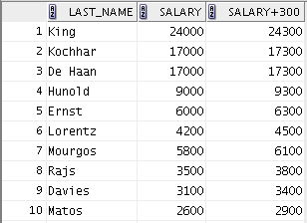
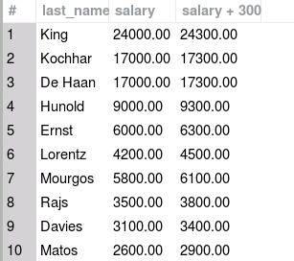

Using Arithmetic Operators
SELECT last_name, salary, salary + 300
FROM employees;
…
…
Notes:
The example in the slide uses the addition operator to calculate a salary increase of $300 for all employees. The slide also displays a SALARY+300 column in the output.
Note that the resultant calculated column, SALARY+300, is not a new column in the EMPLOYEES table; it is for display only. By default, the name of a new column comes from the calculation that generated it—in this case, salary+300.
Remember that the Oracle server ignores blank spaces before and after the arithmetic operator.
Rules of Precedence
Multiplication and division occur before addition and subtraction.
Operators of the same priority are evaluated from left to right.
Parentheses are used to override the default precedence or to clarify the statement.

Slide 19
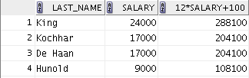
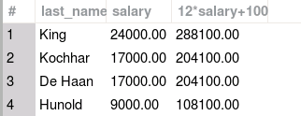
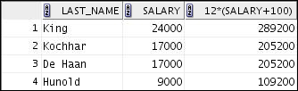
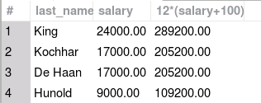
Operator Precedence
1
SELECT last_name, salary, 12*salary+100
FROM employees;
…
…
2
SELECT last_name, salary, 12*(salary+100)
FROM employees;
…
…
Notes:
The first example in the slide displays the last name, salary, and annual compensation of employees. It calculates the annual compensation by multiplying the monthly salary with 12, plus a one-time bonus of $100. Note that multiplication is performed before addition.
Note: Use parentheses to reinforce the standard order of precedence and to improve clarity. For example, the expression in the slide can be written as (12*salary)+100 with no change in the result.
Using Parentheses
You can override the rules of precedence by using parentheses to specify the desired order in which the operators are to be executed.
The second example in the slide displays the last name, salary, and annual compensation of employees. It calculates the annual compensation as follows: adding a monthly bonus of $100 to the monthly salary, and then multiplying that subtotal with 12. Because of the parentheses, addition takes priority over multiplication.

Slide 20



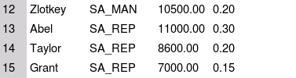



Defining a Null Value
Null is a value that is unavailable, unassigned, unknown, or inapplicable.
Null is not the same as zero or a blank space.
SELECT last_name, job_id, salary, commission_pct
FROM employees;
…
…
…
…
Notes:
If a row lacks a data value for a particular column, that value is said to be NULL or to contain a null.
You can select columns with NULL value in a SELECT query and NULL values can be part of an arithmetic expression. Any arithmetic expression using NULL values results into NULL.
Columns of any data type can contain nulls. However, some constraints (NOT NULL and PRIMARY KEY) prevent nulls from being used in the column.
In the slide example, notice that only a sales manager or sales representative can earn a commission in the COMMISSION_PCT column of the EMPLOYEES table. Other employees are not entitled to earn commissions. A null represents that fact.
You can see that by default, SQL Developer uses the literal, (null), to identify null values, and MySQL Workbench displays NULL as a graphic in white on Gray. The mysql command-line client displays the word NULL.

Slide 21





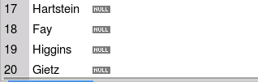
Null Values in Arithmetic Expressions
Arithmetic expressions containing a null value evaluate to null.
SELECT last_name, 12*salary*commission_pct
FROM employees;
…
…
…
…
Notes:
If any column value in an arithmetic expression is null, the result is null. For example, if you attempt to perform division by zero, you get an error. However, if you divide a number by null, the result is a null or unknown.
In the example in the slide, employee King does not get any commission. Because the commission_pct column in the arithmetic expression is null, the result is null.

Slide 22
Lesson Agenda
Capabilities of SQL SELECT statements
Arithmetic expressions and NULL values in the SELECT statement
Column aliases
Use of the concatenation operator, literal character strings, the alternative quote operator, and the DISTINCT keyword
DESCRIBE command

Slide 23

Defining a Column Alias
A column alias:
Renames a column heading
Is useful with calculations
Immediately follows the column name (there can also be the optional AS keyword between the column name and the alias)
Requires double quotation marks if it contains spaces or special characters. In Oracle, it requires double quotation marks if it is case-sensitive
Column Alias
Notes:
When displaying the result of a query, the results normally use the name of the selected column as the column heading. This heading might not be descriptive and, therefore, might be difficult to understand. You can change a column heading by using a column alias.
Specify the alias after the column in the SELECT list using blank space or the optional keyword AS as a separator between the column name and the alias.
In Oracle database, by default, alias headings appear in uppercase, so enclose a case-sensitive alias in double quotation marks (" "). In Oracle database, if the alias contains spaces or special characters (such as -, !, _), enclose the alias in double quotation marks (" ").
In MySQL, if the alias contains spaces or special characters, quote the alias by being enclosing it in backticks (` `), single quotation marks (' '), or double quotation marks (" "). In MySQL, alias headings are case-sensitive. That is, they appear in the case specified, even if they are not quoted with backticks (` `), single quotation marks (' '), or double quotation marks (" ").

Slide 24
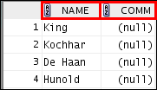
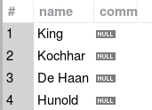
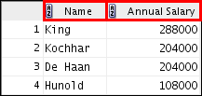
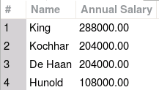
Using Column Aliases
SELECT last_name AS name, commission_pct comm
FROM employees;
…
…
SELECT last_name "Name" , salary*12 "Annual Salary"
FROM employees;
…
…
Notes:
The first example displays the names and the commission percentages of all the employees. Note that the optional AS keyword has been used before the column alias ‘name’. The result of the query is the same whether the AS keyword is used or not. Also, note that the SQL statement has the column aliases, name and comm, in lowercase, whereas the result of the query in Oracle displays the column headings in uppercase. As mentioned in the preceding slide, column headings appear in uppercase by default.
The second example displays the last names and annual salaries of all the employees. Because Annual Salary contains a space, it has been enclosed in double quotation marks. Note that the column heading in the output is exactly the same as the column alias.
Note: In MySQL the second example does not require the double quotation marks for ‘Name’. It would be equivalent as the following:
SELECT last_name Name, salary*12 "Annual Salary"
FROM employees;

Slide 25
Lesson Agenda
Capabilities of SQL SELECT statements
Arithmetic expressions and NULL values in the SELECT statement
Column aliases
Use of the concatenation operator, literal character strings, the alternative quote operator, and the DISTINCT keyword
DESCRIBE command

Slide 26
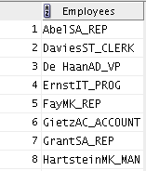
Concatenation Operator in Oracle
The concatenation operator:
Links columns or character strings to other columns
Is represented by two vertical bars (||)
Creates a resultant column that is a character expression
SELECT last_name||job_id AS "Employees"
FROM employees;
…
Notes:
You can link columns to other columns, arithmetic expressions, or constant values to create a character expression by using the concatenation operator (||). Columns on either side of the operator are combined to make a single output column.
In the example, LAST_NAME and JOB_ID are concatenated, and given the alias Employees. Note that the last name of the employee and the job code are combined to make a single output column.
The AS keyword before the alias name makes the SELECT clause easier to read.
Null Values with the Concatenation Operator
In Oracle databases, if you concatenate a null value with a character string, the result is a character string. LAST_NAME || NULL results in LAST_NAME.

Slide 27
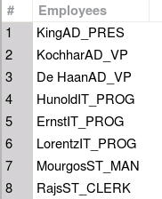
Concatenation Function in MySQL – CONCAT()
The CONCAT()function:
Links columns or character strings to other columns
Is a function that concatenates the values provided to it
Creates a resultant column that is a character expression
SELECT CONCAT(last_name, job_id) AS "Employees"
FROM employees;
…
Notes:
You can link columns to other columns, arithmetic expressions, or constant values to create a character expression by using CONCAT(). Columns names, separated by commas, are combined to make a single output column.
In the example, Last_name and Job_id are concatenated, and given the alias Employees. Note that the last name of the employee and the job code are combined to make a single output column, with no space between them.
The AS keyword before the alias name makes the SELECT clause easier to read.
Null Values with the Concatenation Operator
In MySQL, if you use the CONCAT() function to concatenate a null value with a character string, the result is NULL.
Instructor Note
In MySQL if you set sql_mode to PIPES_AS_CONCAT, you can use two vertical bars (pipes) as a concatenation operator, just as in Oracle. Setting the sql_mode system variable in MySQL is beyond the scope of this course. MySQL and Oracle treat concatenation with NULL differently. In Oracle, concatenation of a character string with NULL returns the character string, while in MySQL any concatenation with NULL returns NULL.

Slide 28

Literal Character Strings
A literal is a character, a number, or a date that is included in the SELECT statement.
Date and character literal values must be enclosed within single quotation marks.
Each character string is output once for each row returned.
Notes:
A literal is a character, a number, or a date that is included in the SELECT list. It is not a column name or a column alias. It is printed for each row returned. Literal strings of free-format text can be included in the query result and are treated the same as a column in the SELECT list.
The date and character literals must be enclosed within single quotation marks (''); number literals need not be enclosed in a similar manner.
MySQL accepts either single quotation marks (' ') or double quotation marks (" "), unless ANSI_QUOTES is enabled for the sql_mode system variable. Setting system variables is beyond the scope of this course, so examples of literal character strings in this course use single quotation marks.

Slide 29
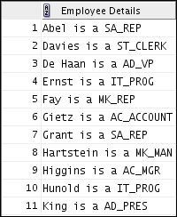
Using Literal Character Strings in Oracle
SELECT last_name ||' is a '||job_id
AS "Employee Details"
FROM employees;
…
Notes:
The example in the slide displays the last names and job codes of all employees. The column has the heading Employee Details. Note the spaces between the single quotation marks in the SELECT statement. The spaces improve the readability of the output.
In the following example, the last name and salary for each employee are concatenated with a literal, to give the returned rows more meaning:
SELECT last_name ||': 1 Month salary = '||salary Monthly
FROM employees;

Slide 30
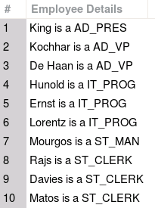
Using Literal Character Strings in MySQL
SELECT CONCAT(last_name,' is a ', job_id)
AS 'Employee Details'
FROM employees;
…
Notes:
The example in the slide displays the last names and job codes of all employees. The column has the heading Employee Details. Note the spaces between the single quotation marks in the SELECT statement. The spaces improve the readability of the output.
In the following example, the last name and salary for each employee are concatenated with a literal, to give the returned rows more meaning:
SELECT CONCAT(last_name, ': 1 Month salary = ', salary) AS Monthly
FROM employees;

Slide 31
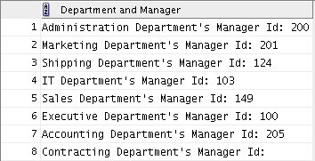
Alternative Quote (q) Operator in Oracle
Specify your own quotation mark delimiter.
Select any delimiter.
Increase readability and usability.
SELECT department_name || q'[ Department's Manager Id: ]'
|| manager_id
AS "Department and Manager"
FROM departments;
Notes:
Many SQL statements use character literals in expressions or conditions. If the literal itself contains a single quotation mark, you can use the quote (q) operator and select your own quotation mark delimiter.
You can choose any convenient delimiter, single-byte or multibyte, or any of the following character pairs: [ ], { }, ( ), or < >.
In the example shown, the string contains a single quotation mark, which is normally interpreted as a delimiter of a character string. By using the q operator, however, brackets [ ] are used as the quotation mark delimiters. The string between the brackets delimiters is interpreted as a literal character string.

Slide 32
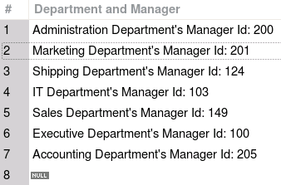
Including a Single Quotation Mark in a String with an Escape Sequence in MySQL
To indicate a quotation mark is to be included in a string, use the \' escape sequence.
SELECT CONCAT(department_name,
' Department\'s Manager Id: ', manager_id)
AS "Department and Manager"
FROM departments;
Notes:
Many SQL statements use character literals in expressions or conditions. If the literal itself contains a single quotation mark, you can use the (\) escape sequence to indicate that the quotation mark is part of the string.
In the example shown, the string contains a single quotation mark, which is normally interpreted as a delimiter of a character string. By using the \' escape sequence, however, the single quotation mark is included as part of the string. MySQL supports a number of other escape sequences.

Slide 33
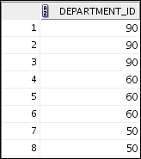
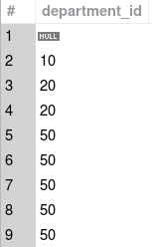
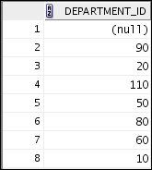
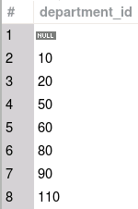
Duplicate Rows
The default display of queries is all rows, including duplicate rows.
1
2
SELECT department_id
FROM employees;
SELECT DISTINCT department_id
FROM employees;
…
…
Notes:
Unless you indicate otherwise, SQL displays the results of a query without eliminating the duplicate rows. The first example in the slide displays all the department numbers from the EMPLOYEES table. Note that the department numbers are repeated.
To eliminate duplicate rows in the result, include the DISTINCT keyword in the SELECT clause immediately after the SELECT keyword. In the second example in the slide, the EMPLOYEES table actually contains 20 rows, but there are only seven unique department numbers in the table.
You can specify multiple columns after the DISTINCT qualifier. The DISTINCT qualifier affects all the selected columns, and the result is every distinct combination of the columns.
SELECT DISTINCT department_id, job_id
FROM employees;

Slide 34
Lesson Agenda
Capabilities of SQL SELECT statements
Arithmetic expressions and NULL values in the SELECT statement
Column aliases
Use of the concatenation operator, literal character strings, the alternative quote operator, and the DISTINCT keyword
DESCRIBE command

Slide 35
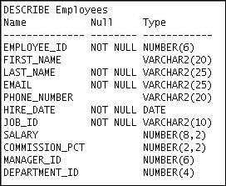
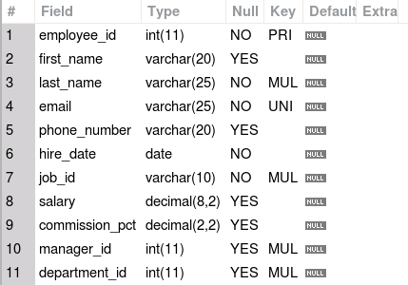
Displaying Table Structure by Using the DESCRIBE Command
Syntax:
Example:
DESCRIBE tablename
DESCRIBE employees
Notes:
In the syntax, tablename is the name of any existing table, view, or synonym that is accessible to the user.
The example in the slide displays information about the structure of the employees table using the DESCRIBE command.
In the resulting display, Null indicates that the values for this column may be unknown. NOT NULL in SQL Developer or NO in MySQL Workbench indicates that a column must contain data. Type displays the data type for a column.
Data types are explained in the lesson titled Introduction to Data Definition Language.

Slide 36
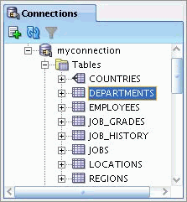
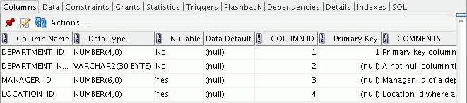
Displaying Table Structure by Using Oracle SQL Developer
Use the DESCRIBE command to display the structure of a table.
Alternatively, select the table in the Connections tree and use the Columns tab to view the table structure.
Notes:
You can display the structure of a table in Oracle SQL Developer by using the DESCRIBE command. The command displays the column names and the data types, and it shows you whether a column must contain data (that is, whether the column has a NOT NULL constraint).
In the syntax, table name is the name of any existing table, view, or synonym that is accessible to the user.
Using the SQL Developer GUI interface, you can select the table in the Connections tree and use the Columns tab to view the table structure.
Note: DESCRIBE is a SQL*Plus command supported by SQL Developer. It is abbreviated as DESC.

Slide 37
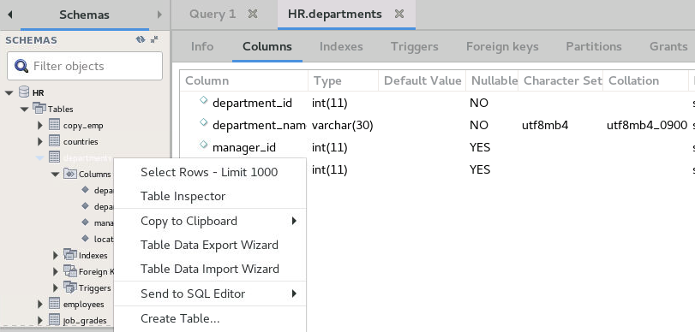
Displaying Table Structure by Using MySQL Workbench
Use the DESCRIBE command to display the structure of a table.
Alternatively, right-click the table in the Navigator and select Table Inspector from the menu. Select the Columns tab.
Notes:
You can display the structure of a table in MySQL Workbench by using the DESCRIBE command. The command displays the column names and the data types, and it shows you whether a column must contain data (that is, whether the Nullable column indicates NO).
Using the SQL Developer GUI interface, you can right-click the table in the Navigator and select Table Inspector from the menu. Then select the Columns tab.
Note: DESCRIBE is abbreviated as DESC.

Slide 38
Summary
In this lesson, you should have learned how to write a SELECT statement that:
Returns all rows and columns from a table
Returns specified columns from a table
Uses column aliases to display more descriptive column headings
Describes the structure of a table
Notes:
In this lesson, you should have learned how to retrieve data from a database table with the SELECT statement.
SELECT *|{[DISTINCT] column [alias],...}
FROM table;
In the syntax:
SELECT Is a list of one or more columns
* Selects all columns
DISTINCT Suppresses duplicates
column|expression Selects the named column or the expression
alias Gives different headings to the selected columns
FROM table Specifies the table containing the columns

Slide 39

Practice 2: Overview
This practice covers the following topics:
Selecting all data from different tables
Describing the structure of tables
Performing arithmetic calculations and specifying column names
Notes:
In this practice, you write simple SELECT queries. The queries cover most of the SELECT clauses and operations that you learned in this lesson.

