Slide 1
Restricting and Sorting Data

Slide 2
Course Roadmap
Lesson 1: Introduction
Lesson 2: Retrieving Data using SQL SELECT
Unit 1: Retrieving, Restricting and Sorting Data
Lesson 3: Restricting and Sorting Data
You are here!
Unit 2: Joins, Subqueries, and Set Operators
Lesson 4: Using Single-Row Functions to Customize Output
Unit 3: DML and DDL
Lesson 5: Using Conversion Functions and Conditional Expressions
Notes:
In Unit 1, you will learn how to query the data from tables, how to query selected records from tables, and also how to sort the data retrieved from the tables.

Slide 3
Objectives
After completing this lesson, you should be able to do the following:
Limit the rows that are retrieved by a query
Sort the rows that are retrieved by a query
Notes:
When retrieving data from a database, you may need to do the following:
Restrict the rows of data that are displayed
Specify the order in which the rows are displayed
This lesson explains the SQL statements that you use to perform the actions listed in the slide.

Slide 4

Lesson Agenda
Limiting rows with:
The WHERE clause
The comparison operators using =, <=, BETWEEN, IN, LIKE, and NULL conditions
Logical conditions using AND, OR, and NOT operators
Rules of precedence for operators in an expression
Sorting rows using the ORDER BY clause
SQL row limiting clause in a query
Substitution variables in Oracle
Assigning values to variables

Slide 5

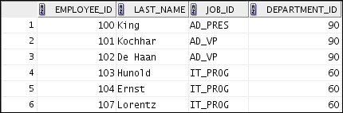

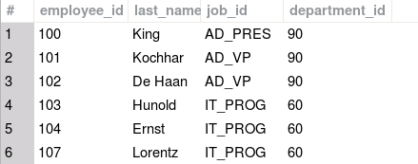


Limiting Rows by Using a Selection
SELECT employee_id, last_name, job_id, department_id
FROM employees;
…
…
What it you want to retrieve all employees in department 90, but not other departments?
Notes:
In the example in the slide, assume that you want to display all the employees in department 90. The rows with a value of 90 in the DEPARTMENT_ID column are the only ones that are returned. This method of restriction is the basis of the WHERE clause in SQL.

Slide 6

Limiting Rows That Are Selected
Restrict the rows that are returned by using the WHERE clause:
The WHERE clause follows the FROM clause.
SELECT *|{[DISTINCT] column [alias],...}
FROM table
[WHERE logical expression(s)];
Notes:
You can restrict the rows that are returned from the query by using the WHERE clause. A WHERE clause contains a condition that must be met and it directly follows the FROM clause. If the condition is true, the row meeting the condition is returned.
In the syntax:
WHERE Restricts the query to rows that meet a condition
logical expression Is composed of column names, constants, and a comparison operator. It specifies a combination of one or more expressions and Boolean operators, and returns a value of TRUE, FALSE, or KNOWN.
The WHERE clause can compare literals and values in columns, arithmetic expressions, or functions. It consists of three elements:
Column name
Comparison condition
Column name, constant, or list of values

Slide 7
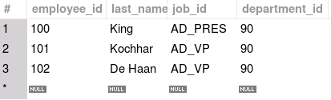
Using the WHERE Clause
SELECT employee_id, last_name, job_id, department_id
FROM employees
WHERE department_id = 90 ;
Notes:
In the example, the SELECT statement retrieves the employee ID, last name, job ID, and department number of all employees who are in department 90.
Note: You cannot use column alias in the WHERE clause.

Slide 8




Character Strings and Dates
Character strings and date values are enclosed within single quotation marks ('').
Character values are case-sensitive and date values are format-sensitive.
The default display format for date is DD-MON-RR in Oracle databases and YYYY-MM-DD in MySQL.
SELECT last_name, job_id, department_id
FROM employees
WHERE last_name = 'Whalen' ;
SELECT last_name
FROM employees
WHERE hire_date = '17-OCT-11' ;
SELECT last_name, hire_date
FROM employees
WHERE hire_date = '2011-10-17' ;
Notes:
You must enclose character strings and dates in the WHERE clause within single quotation marks (''). Number constants, however, need not be enclosed within single quotation marks.
Remember that all character searches are case-sensitive. In the following example, observe that no rows are returned because the EMPLOYEES table stores all the last names in mixed case:
SELECT last_name, job_id, department_id
FROM employees
WHERE last_name = 'WHALEN';
Oracle and MySQL databases store dates in an internal numeric format, representing the century, year, month, day, hours, minutes, and seconds. The default date display is in the DD-MON-RR format in Oracle and YYYY-MM-DD in MySQL.
Note: For details about the RR format and about changing the default date format, see the lesson titled “Using Single-Row Functions to Customize Output.” Also, you learn about the use of single-row functions such as UPPER and LOWER to override case sensitivity in the same lesson.

Slide 9
Comparison Operators
Operator | Meaning
= | Equal to
> | Greater than
>= | Greater than or equal to
< | Less than
<= | Less than or equal to
<> | Not equal to
BETWEEN ...AND... | Between two values (inclusive)
IN(set) | Match any of a list of values
LIKE | Match a character pattern
IS NULL | Is a null value
Notes:
You can use comparison operators in conditions that compare one expression with another value or expression. They are used in the WHERE clause in the following format:
Syntax
... WHERE expr operator value
Example
... WHERE hire_date = '01-JAN-05'
... WHERE salary >= 6000
... WHERE last_name = 'Smith'
Remember, an alias cannot be used in the WHERE clause.
Note: The symbols != and ^= can also represent the not equal to condition.

Slide 10


Using Comparison Operators
Let us look at some examples:
SELECT last_name, salary
FROM employees
WHERE salary <= 3000 ;
SELECT *
FROM employees
WHERE last_name = 'Abel';
Notes:
In the first example in the slide, the SELECT statement retrieves the last name and salary from the employees table for any employee whose salary is less than or equal to $3,000. Observe that there is an explicit value supplied to the WHERE clause. The explicit value of 3000 is compared to the salary value in the salary column of the employees table.
In the second example, the SELECT statement retrieves all rows where the last name is Abel. Because * is used in the SELECT statement, all fields from the employees table appear in the result set.

Slide 11
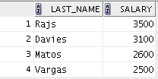
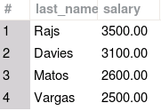
Range Conditions Using the BETWEEN Operator
You can use the BETWEEN operator to display rows based on a range of values:
SELECT last_name, salary
FROM employees
WHERE salary BETWEEN 2500 AND 3500 ;
Lower limit
Upper limit
Notes:
You can display rows based on a range of values using the BETWEEN operator. The range that you specify contains a lower limit and an upper limit.
The SELECT statement in the slide returns rows from the employees table for any employee whose salary is between $2,500 and $3,500.
Values that are specified with the BETWEEN operator are inclusive. Remember, you must specify the lower limit first.
You can also use the BETWEEN operator on character values:
SELECT last_name FROM employees
WHERE last_name BETWEEN 'King' AND 'Whalen';

Slide 12
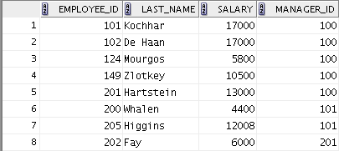
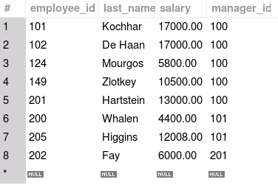
Using the IN Operator
Use the IN operator to test for values in a list:
SELECT employee_id, last_name, salary, manager_id
FROM employees
WHERE manager_id IN (100, 101, 201) ;
Notes:
You can use the IN operator to test for values among a specified set of values. The condition defined using the IN operator is also known as the membership condition.
The example in the slide displays employee IDs, last names, salaries, and manager’s employee IDs for all the employees whose manager’s employee ID is 100, 101, or 201.
Note: The set of values can be specified in any random order—for example, (201,100,101).
The IN operator can be used with any data type. The following example returns rows from the employees table, for any employee whose last name is included with the IN operator:
SELECT employee_id, manager_id, department_id
FROM employees
WHERE last_name IN ('Hartstein', 'Vargas');
If characters or dates are used in a list, they must be enclosed within single quotation marks ('').

Slide 13


Pattern Matching Using the LIKE Operator
You can use the LIKE operator to perform wildcard searches of valid string patterns.
The search conditions can contain either literal characters or numbers:
% denotes zero or more characters.
_ denotes one character.
SELECT first_name
FROM employees
WHERE first_name LIKE 'S%' ;
Notes:
You may not always know the exact value to search for. You can select rows that match a character pattern by using the LIKE operator. The character pattern–matching operation is referred to as a wildcard search. Two symbols can be used to construct the search string.
The SELECT statement in the slide returns the first name from the employees table for any employee whose first name begins with the letter “S.” Note the uppercase “S.” Consequently, names beginning with a lowercase “s” are not returned.
The LIKE operator can be used as a shortcut for some BETWEEN comparisons. In Oracle, the following example displays the last names and hire dates of all employees who joined between January 2015 and December 2015:
SELECT last_name, hire_date
FROM employees
WHERE hire_date LIKE '%15'
In MySQL, the following example displays the last names and hire dates of all employees who joined between January 2015 and December 2015:
SELECT last_name, hire_date
FROM employees
WHERE hire_date LIKE '2015%';

Slide 14

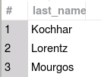
Combining Wildcard Symbols
You can combine the two wildcard symbols (%, _) with literal characters for pattern matching:
You can use the ESCAPE identifier to search for the actual % and _ symbols.
SELECT last_name
FROM employees
WHERE last_name LIKE '_o%' ;
Notes:
The % and _ symbols can be used in any combination with literal characters. The example in the slide displays the names of all employees whose last names have the letter “o” as the second character.
When you need to have an exact match for the actual % and _ characters, use the ESCAPE identifier. For example, in Oracle, to find the last name and job ID of all the employees whose job ID contains 'SA_', use the following statement:
SELECT last_name, job_id
FROM employees
WHERE job_id LIKE 'SA\_%' ESCAPE '\';
To do the same thing in MySQL, use the following statement:
SELECT last_name, job_id
FROM employees
WHERE job_id LIKE 'SA\_%';

Slide 15



Using NULL Conditions
You can use the IS NULL operator to test for NULL values in a column.
SELECT last_name, manager_id
FROM employees
WHERE manager_id IS NULL ;
Notes:
There are two types of NULL conditions:
IS NULL tests for NULL values.
IS NOT NULL tests for values that are not NULL.
A null value means that the value is unavailable, unassigned, unknown, or inapplicable. Therefore, you cannot test with =, because a null cannot be equal or unequal to any value. The example in the slide retrieves the last_name and manager_id of all employees who do not have a manager.
Here is another example: To display the last name, job ID, and commission for all employees who are not entitled to receive a commission, use the following SQL statement:
SELECT last_name, job_id, commission_pct
FROM employees
WHERE commission_pct IS NULL;

Slide 16
Defining Conditions Using Logical Operators
You can use the logical operators to filter the result set based on more than one condition or invert the result set.
Operator | Meaning
AND | Returns TRUE if both component conditions are true
OR | Returns TRUE if either component condition is true
NOT | Returns TRUE if the condition is false
Notes:
A logical condition combines the results of two or more component conditions to produce a single result based on those conditions, or it inverts the result of a single condition. A row is returned only if the overall result of the condition is true.
Three logical operators are available in SQL:
AND
OR
NOT
All the examples so far have specified only one condition in the WHERE clause. You can use several conditions in a single WHERE clause using the AND and OR operators.

Slide 17

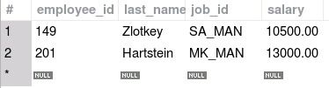
Using the AND Operator
AND requires both the component conditions to be true:
SELECT employee_id, last_name, job_id, salary
FROM employees
WHERE salary >= 10000
AND job_id LIKE '%MAN%' ;
Notes:
In the example, both the component conditions must be true for any record to be selected. Therefore, only those employees who have a job title that contains the string ‘MAN’ and earn $10,000 or more are selected.
All character searches are case-sensitive, that is, no rows are returned if ‘MAN’ is not uppercase. Further, character strings must be enclosed within quotation marks.
AND Truth Table
The following table shows the results of combining two expressions with AND:

Slide 18
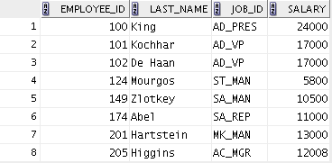
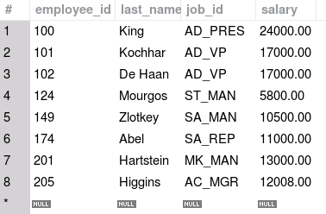
Using the OR Operator
OR requires either component condition to be true:
SELECT employee_id, last_name, job_id, salary
FROM employees
WHERE salary >= 10000
OR job_id LIKE '%MAN%' ;
Notes:
In the example, either component condition can be true for any record to be selected. Therefore, any employee who has a job ID that contains the string ‘MAN’ or earns $10,000 or both is selected.
OR Truth Table
The following table shows the results of combining two expressions with OR:

Slide 19
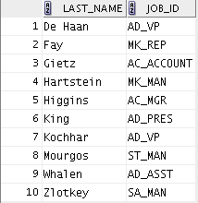
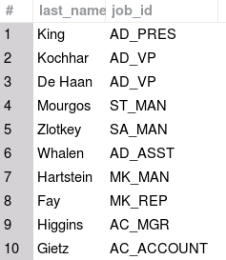
Using the NOT Operator
NOT is used to negate a condition:
SELECT last_name, job_id
FROM employees
WHERE job_id
NOT IN ('IT_PROG', 'ST_CLERK', 'SA_REP');
Notes:
The example in the slide displays the last name and job ID of all employees whose job ID is not IT_PROG, ST_CLERK, or SA_REP.
NOT Truth Table
The following table shows the result of applying the NOT operator to a condition:

Slide 20
Lesson Agenda
Limiting rows with:
The WHERE clause
The comparison operators using =, <=, BETWEEN, IN, LIKE, and NULL conditions
Logical conditions using AND, OR, and NOT operators
Rules of precedence for operators in an expression
Sorting rows using the ORDER BY clause
SQL row limiting clause in a query
Substitution variables in Oracle
Assigning values to variables

Slide 21
Rules of Precedence
Order | Operator
1 | Arithmetic operators
2 | Concatenation operator
3 | Comparison conditions
4 | IS [NOT] NULL, LIKE, [NOT] IN
5 | [NOT] BETWEEN
6 | Not equal to
7 | NOT logical operator
8 | AND logical operator
9 | OR logical operator
You can use parentheses to override rules of precedence.
Notes:
The rules of precedence determine the order in which expressions are evaluated and calculated. The table in the slide lists the default order of precedence. However, you can override the default order by using parentheses around the expressions that you want to calculate first.

Slide 22
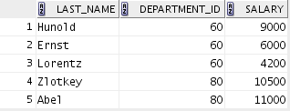
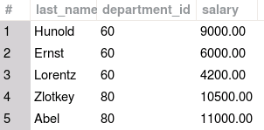


Rules of Precedence
1
SELECT last_name, department_id, salary
FROM employees
WHERE department_id = 60
OR department_id = 80
AND salary > 10000;
2
SELECT last_name, department_id, salary
FROM employees
WHERE (department_id = 60
OR department_id = 80)
AND salary > 10000;
Notes:
1. Precedence of the AND Operator: Example
In this example, there are two conditions:
The first condition is that the department ID is 80 and the salary is greater than $10,000.
The second condition is that the department ID is 60.
Therefore, the SELECT statement reads as follows:
“Select the row if an employee’s department ID is 80 and earns more than $10,000, or if the employee’s department ID is 60.”
2. Using Parentheses: Example
In this example, there are two conditions:
The first condition is that the department ID is 80 or 60.
The second condition is that the salary is greater than $10,000.
Therefore, the SELECT statement reads as follows:
“Select the row if an employee’s department ID is 80 or 60, and if the employee earns more than $10,000.”

Slide 23
Lesson Agenda
Limiting rows with:
The WHERE clause
The comparison operators using =, <=, BETWEEN, IN, LIKE, and NULL conditions
Logical conditions using AND, OR, and NOT operators
Rules of precedence for operators in an expression
Sorting rows using the ORDER BY clause
SQL row limiting clause in a query
Substitution variables in Oracle
Assigning values to variables

Slide 24
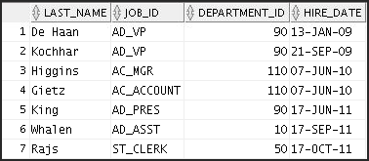
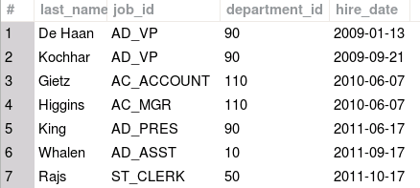
Using the ORDER BY Clause
You can sort the retrieved rows with the ORDER BY clause:
ASC: Ascending order, default
DESC: Descending order
SELECT last_name, job_id, department_id, hire_date
FROM employees
ORDER BY hire_date ;
…
…
Notes:
The order of rows that are returned in a query result is undefined. The ORDER BY clause can be used to sort the rows. You can specify an expression, an alias, or a column position as the sort condition. You can specify multiple expressions in the ORDER BY clause. Rows are first sorted based on their values for the first expression. Rows with the same value for the first expression are then sorted based on their values for the second expression, and so on.
Syntax
SELECT expr
FROM table
[WHERE condition(s)]
[ORDER BY {column, expr, numeric_position} [ASC|DESC]];
In the syntax:
ORDER BY Specifies the order in which the retrieved rows are displayed
ASC Orders the rows in ascending order (this is the default order)
DESC Orders the rows in descending order
If the ORDER BY clause is not used, the sort order is undefined, and the Oracle server may not fetch rows in the same order for the same query twice. Use the ORDER BY clause to display the rows in a specific order.

Slide 25
Sorting
Sorting in descending order:
Sorting by column alias:
1
SELECT last_name, job_id, department_id, hire_date
FROM employees
ORDER BY department_id DESC ;
2
SELECT employee_id, last_name, salary*12 annsal
FROM employees
ORDER BY annsal ;
Notes:
The default sort order is ascending. Let us look at the other characteristics:
Numeric values are displayed with the lowest values first (for example, 1 to 999).
Date values are displayed with the earliest value first (for example, 01-JAN-92 before 01-JAN-95 in Oracle and 1992-01-01 before 1995-01-01 in MySQL).
Character values are displayed in the alphabetical order (for example, “A” first and “Z” last).
In Oracle, null values are displayed last for ascending sequences and first for descending sequences. In MySQL, null values are displayed first for ascending sequences and last for descending sequences.
You can also sort by a column that is not in the SELECT list.
Examples
To reverse the order in which the rows are displayed, specify the DESC keyword after the column name in the ORDER BY clause. The example in the slide sorts the result by the department_id.
2. You can also use a column alias in the ORDER BY clause. The slide example sorts the data by annual salary.
Note: In Oracle, use the keywords NULLS FIRST or NULLS LAST to specify whether returned rows containing null values should appear first or last in the ordering sequence. Those options are not valid in MySQL.

Slide 26
Sorting
Sorting by using the column’s numeric position:
Sorting by multiple columns:
3
SELECT last_name, job_id, department_id, hire_date
FROM employees
ORDER BY 3;
4
SELECT last_name, department_id, salary
FROM employees
ORDER BY department_id, salary DESC;
Notes:
Examples
You can sort query results by specifying the numeric position of the column in the SELECT clause. The example in the slide sorts the result by the department_id as this column is at the third position in the SELECT clause.
4. You can sort query results by more than one column. You list the columns (or SELECT list column sequence numbers) in the ORDER BY clause, delimited by commas. The results are ordered by the first column, then the second, and so on for as many columns as the ORDER BY clause includes. If you want any results sorted in descending order, your ORDER BY clause must use the DESC keyword directly after the name or the number of the relevant column. The result of the query example shown in the slide is sorted by department_id in ascending order and also by salary in descending order.

Slide 27
Lesson Agenda
Limiting rows with:
The WHERE clause
The comparison operators using =, <=, BETWEEN, IN, LIKE, and NULL conditions
Logical conditions using AND, OR, and NOT operators
Rules of precedence for operators in an expression
Sorting rows using the ORDER BY clause
SQL row limiting clause in a query
Substitution variables in Oracle
Assigning values to variables

Slide 28

SQL Row Limiting Clause
You can use the row limiting clause to limit the rows that are returned by a query.
You can use this clause to implement Top-N reporting.
Table with 100 rows
Fetch first 3 rows only
Notes:
Limiting the number of rows returned by a query can be valuable for reporting, analysis, data browsing, and other tasks.
With the SQL SELECT syntax, you can limit the number of rows that are returned in the result set using the row limiting clause.
Queries that order data and then limit row output are widely used and are often referred to as Top-N queries. Top-N queries sort their result set and then return only the first n rows.
The SQL row limiting clause has certain limitations. These limitations are explained in the lesson titled Managing Tables Using DML Statements and Transactions.

Slide 29
Using SQL Row Limiting Clause in a Query in Oracle
You specify the row_limiting_clause in the SQL SELECT statement by placing it after the ORDER BY clause.
Syntax:
SELECT …
FROM …
[ WHERE … ]
[ ORDER BY … ]
[OFFSET offset { ROW | ROWS }]
[FETCH { FIRST | NEXT } [{ row_count | percent PERCENT }] { ROW | ROWS }
{ ONLY | WITH TIES }]
Notes:
You specify the row_limiting_clause in the SQL SELECT statement by placing it after the ORDER BY clause. Note that an ORDER BY clause is required if you want to sort the rows for consistency.
OFFSET: Use this clause to specify the number of rows to skip before row limiting begins. The value for offset must be a number. If you specify a negative number, offset is treated as 0. If you specify NULL or a number greater than or equal to the number of rows that are returned by the query, 0 rows are returned.
ROW | ROWS: Use these keywords interchangeably. They are provided for semantic clarity.
FETCH: Use this clause to specify the number of rows or percentage of rows to return.
FIRST | NEXT: Use these keywords interchangeably. They are provided for semantic clarity.
row_count | percent PERCENT: Use row_count to specify the number of rows to return. Use percent PERCENT to specify the percentage of the total number of selected rows to return. The value for percent must be a number.
ONLY | WITH TIES: Specify ONLY to return exactly the specified number of rows or percentage of rows. Specify WITH TIES to return additional rows with the same sort key as the last row fetched. You must specify the ORDER BY clause for additional rows to be returned.

Slide 30
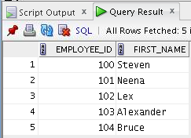
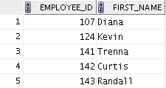
SQL Row Limiting Clause: Example in Oracle
SELECT employee_id, first_name
FROM employees
ORDER BY employee_id
FETCH FIRST 5 ROWS ONLY;
SELECT employee_id, first_name
FROM employees
ORDER BY employee_id
OFFSET 5 ROWS FETCH NEXT 5 ROWS ONLY;
Notes:
The first example in the slide returns the first five employees after sorting the rows in ascending order of the employee_id.
The second example in the slide returns the next set of five employees after sorting the rows in ascending order of the employee_id.
Note: If employee_id is assigned sequentially by the date when the employee joined the organization, these examples give us the top 5 employees and then employees 6-10, all in terms of seniority.

Slide 31
Using SQL Row Limiting Clause in a Query in MySQL
You specify the row limiting clause in the SQL SELECT statement by placing it after the ORDER BY clause.
Syntax:
SELECT …
FROM …
[ WHERE … ]
[ ORDER BY … ]
[LIMIT {[offset,] row_count | row_count OFFSET offset}]
Notes:
You specify the row limiting clause in the SQL SELECT statement by placing it after the ORDER BY clause. Note that an ORDER BY clause is required if you want consistent output. Without an ORDER BY clause, the first rows are not predictable. MySQL uses either of the following syntaxes in the row limiting clause.
Use the LIMIT keyword followed by a nonnegative numeric integer for the maximum number of rows, followed by the OFFSET keyword, followed by the offset of the first row to return. The offset of the initial row is 0. For example:
LIMIT 7 OFFSET 5 returns 7 rows starting at row 6, that is rows 6 - 12.
Use the LIMIT keyword, followed by either one or two nonnegative numeric arguments separated by a comma. With two arguments, the first argument specifies the offset of the first row to return, and the second specifies the maximum number of rows to return. The offset of the initial row is 0. For example:
LIMIT 5,7 returns 7 rows starting at row 6, that is, rows 6 - 12. Note that this is the same as LIMIT 7 OFFSET 5.
LIMIT 0,7 returns the first 7 rows, that is, rows 1 - 7
LIMIT 7 returns the first 7 rows, that is, rows 1 - 7

Slide 32
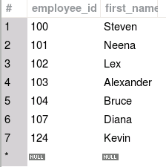
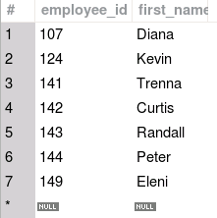
SQL Row Limiting Clause: Example in MySQL
SELECT employee_id, first_name
FROM employees
ORDER BY employee_id
LIMIT 7;
SELECT employee_id, first_name
FROM employees
ORDER BY employee_id
LIMIT 7 OFFSET 5;
Notes:
The first example in the slide returns the first seven employees after sorting the rows in ascending order of the employee_id.
The second example in the slide returns seven employees, starting with the sixth employee after sorting the rows in ascending order of the employee_id. For the second example, LIMIT 5,7 would be equivalent to LIMIT 7 OFFSET 5.
Note: If employee_id is assigned sequentially by the date when the employee joined the organization, these examples give us the top 7 employees and then employees 6-12, all in terms of seniority.

Slide 33
Lesson Agenda
Limiting rows with:
The WHERE clause
The comparison operators using =, <=, BETWEEN, IN, LIKE, and NULL conditions
Logical conditions using AND, OR, and NOT operators
Rules of precedence for operators in an expression
Sorting rows using the ORDER BY clause
SQL row limiting clause in a query
Substitution variables in Oracle
Assigning values to variables

Slide 34



Substitution Variables in Oracle
... salary = ? …
… department_id = ? …
... last_name = ? ...
I want to query
different values.
Notes:
So far, all the SQL statements were executed with predetermined columns, conditions, and their values. Suppose that you want a query that lists the employees with various jobs and not just those whose job_ID is SA_REP. You can edit the WHERE clause to provide a different value each time you run the command, but there is also an easier way in Oracle.
By using a substitution variable in place of the exact values in the WHERE clause, you can run the same query for different values.
You can create reports that prompt users to supply their own values to restrict the range of data returned, by using substitution variables. You can embed substitution variables in a command file or in a single SQL statement. A variable can be thought of as a container in which values are temporarily stored. When the statement is run, the stored value is substituted.

Slide 35

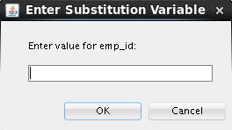
Substitution Variables in Oracle
Use substitution variables to:
Temporarily store values with single-ampersand (&) and double-ampersand (&&) substitution
Use substitution variables to supplement the following:
WHERE conditions
ORDER BY clauses
Column expressions
Table names
Entire SELECT statements
Notes:
You can use single-ampersand (&) substitution variables to temporarily store values.
You can also predefine variables by using the DEFINE command. DEFINE creates and assigns a value to a variable.
Restricted Ranges of Data: Examples
Reporting figures only for the current quarter or specified date range
Reporting on data relevant only to the user requesting the report
Displaying personnel only within a given department
Other Interactive Effects
Interactive effects are not restricted to direct user interaction with the WHERE clause. You can also use it for:
Obtaining input values from a file rather than from a person
Passing values from one SQL statement to another
Note: Both Oracle SQL Developer and SQL*Plus support substitution variables and the DEFINE/UNDEFINE commands.

Slide 36
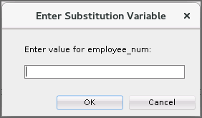

Using the Single-Ampersand Substitution Variable
Use a variable prefixed with an ampersand (&) to prompt the user for a value:
SELECT employee_id, last_name, salary, department_id
FROM employees
WHERE employee_id = &employee_num ;
Notes:
When running a report, users often want to restrict the data that is returned dynamically. SQL*Plus and SQL Developer provide this flexibility with user variables. Use an ampersand (&) to identify each variable in your SQL statement. However, you do not need to define the value of each variable.
The example in the slide creates a SQL Developer substitution variable for an employee number. When the statement is executed, SQL Developer prompts the user for an employee number and then displays the employee number, last name, salary, and department number for that employee.
With the single ampersand, the user is prompted every time the command is executed if the variable does not exist.

Slide 37
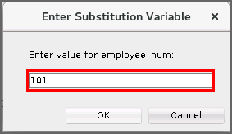
Using the Single-Ampersand Substitution Variable
Notes:
When SQL Developer detects that the SQL statement contains an ampersand, you are prompted to enter a value for the substitution variable that is named in the SQL statement.
After you enter a value and click the OK button, the results are displayed.
Note that if the substitution variable is referenced twice, even in the same command, then you are prompted twice. Different values can be entered at each prompt.

Slide 38
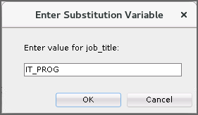



Character and Date Values with Substitution Variables
Use single quotation marks for date and character values:
SELECT last_name, department_id, salary*12
FROM employees
WHERE job_id = '&job_title' ;
Notes:
In a WHERE clause, you must enclose date and character values within single quotation marks. The same rule applies to the substitution variables.
Enclose the variable with single quotation marks within the SQL statement itself.
The slide shows a query to retrieve the employee names, department numbers, and annual salaries of all employees based on the job title value of the SQL Developer substitution variable.

Slide 39
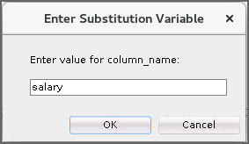
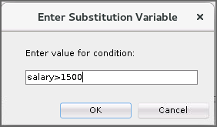
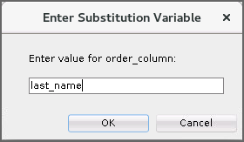
Specifying Column Names, Expressions, and Text
SELECT employee_id, last_name, job_id,&column_name
FROM employees
WHERE &condition
ORDER BY &order_column ;
Notes:
You can use the substitution variables not only in the WHERE clause of a SQL statement, but also as substitution for column names, expressions, or text.
Example
The example in the slide displays the employee number, last name, job title, and any other column that is specified by the user at run time, from the EMPLOYEES table. For each substitution variable in the SELECT statement, you are prompted to enter a value, and then click OK to proceed.
If you do not enter a value for the substitution variable, you get an error when you execute the preceding statement.
Note: A substitution variable can be used anywhere in the SELECT statement.

Slide 40
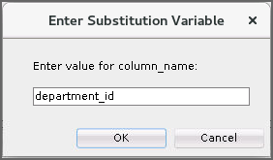

Using the Double-Ampersand Substitution Variable
Use double ampersand (&&) if you want to reuse the variable value without prompting the user each time:
SELECT employee_id, last_name, job_id, &&column_name
FROM employees
ORDER BY &column_name ;
…
Notes:
You can use the double-ampersand (&&) substitution variable if you want to reuse the variable value without prompting the user each time. The user sees the prompt for the value only once.
In the example in the slide, the user is asked to give the value for the variable column_name only once. The value that is supplied by the user (department_id) is used for both display and ordering of data. If you run the query again, you will not be prompted for the value of the variable.
SQL Developer stores the value that is supplied by using the DEFINE command; it uses it again whenever you reference the variable name. After a user variable is in place, you need to use the UNDEFINE command to delete it:
UNDEFINE column_name;

Slide 41
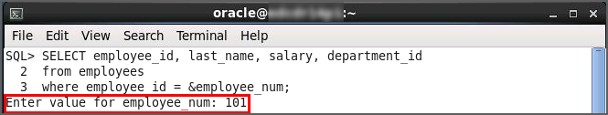
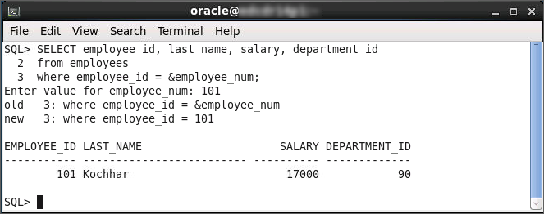
Using the Ampersand Substitution Variable in SQL*Plus
Notes:
The example in the slide creates a SQL*Plus substitution variable for an employee number. When the statement is executed, SQL*Plus prompts you for an employee number and then displays the employee number, last name, salary, and department number for that employee.

Slide 42
Lesson Agenda
Limiting rows with:
The WHERE clause
The comparison operators using =, <=, BETWEEN, IN, LIKE, and NULL conditions
Logical conditions using AND, OR, and NOT operators
Rules of precedence for operators in an expression
Sorting rows using the ORDER BY clause
SQL row limiting clause in a query
Substitution variables in Oracle
Assigning values to variables

Slide 43

Using the DEFINE Command in Oracle
Use the DEFINE command to create a variable and assign a value to it.
Use the UNDEFINE command to remove a variable.
DEFINE employee_num = 200
SELECT employee_id, last_name, salary, department_id
FROM employees
WHERE employee_id = &employee_num ;
UNDEFINE employee_num
Notes:
The example shown in the slide creates a substitution variable for an employee number by using the DEFINE command. At run time, this displays the employee number, name, salary, and department number for that employee.
Because the variable is created using the SQL Developer DEFINE command, the user is not prompted to enter a value for the employee number. Instead, the variable value is automatically substituted in the SELECT statement.
The EMPLOYEE_NUM substitution variable is present in the session until the user undefines it or exits the SQL Developer session.

Slide 44
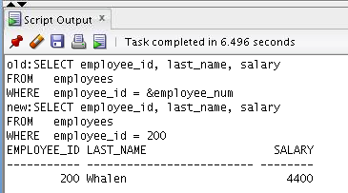
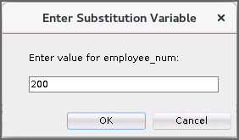
Using the VERIFY Command in Oracle
Use the VERIFY command to toggle the display of the substitution variable, both before and after SQL Developer replaces substitution variables with values:
SET VERIFY ON
SELECT employee_id, last_name, salary
FROM employees
WHERE employee_id = &employee_num;
Notes:
You can use the VERIFY command to confirm the changes in the SQL statement. Setting SET VERIFY ON forces SQL Developer to display the text of a command after it replaces substitution variables with values.
To see the VERIFY output, you should use the Run Script (F5) icon in the SQL Worksheet. SQL Developer displays the text of a command after it replaces substitution variables with values, on the Script Output tab as shown in the slide.
The example in the slide displays the new value of the EMPLOYEE_ID column in the SQL statement followed by the output.
SQL*Plus System Variables
SQL*Plus uses various system variables that control the working environment. One of the variables is VERIFY. To obtain a complete list of all the system variables, you can issue the SHOW ALL command on the SQL*Plus command prompt.

Slide 45

Using the SET Statement in MySQL
Use the SET statement to create a user-defined variable and assign a value to it.
User-defined variables are entered as @var_name.
SET @employee_num = 200;
SELECT employee_id, last_name, salary, department_id
FROM employees
WHERE employee_id = @employee_num ;
Notes:
The example shown in the slide creates a user-defined variable for an employee number by using the SET command. At run time, tthe variable value is automatically substituted in the SELECT statement, whic displays the employee number, name, salary, and department number for that employee.
The employee_num variable is specific to the session and remains assigned until the user assigns a different value or exits the session.

Slide 46
Summary
In this lesson, you should have learned how to:
Limit the rows that are retrieved by a query
Sort the rows that are retrieved by a query
Notes:
In this lesson, you should have learned about restricting and sorting rows that are returned by the SELECT statement. You should also have learned how to implement various operators and conditions.

Slide 47

Practice 3: Overview
This practice covers the following topics:
Selecting data and changing the order of the rows that are displayed
Restricting rows by using the WHERE clause
Sorting rows by using the ORDER BY clause
Using substitution variables to add flexibility to your SQL SELECT statements
Notes:
In this practice, you build more reports, including statements that use the WHERE clause and the ORDER BY clause. You make the SQL statements more reusable and generic by including the ampersand substitution.

