Slide 1
Using Conversion Functions and Conditional Expressions

Slide 2
Course Roadmap
Lesson 1: Introduction
Lesson 2: Retrieving Data using SQL SELECT
Unit 1: Retrieving, Restricting and Sorting Data
Lesson 3: Restricting and Sorting Data
Unit 2: Joins, Subqueries, and Set Operators
Lesson 4: Using Single-Row Functions to Customize Output
Unit 3: DML and DDL
Lesson 5: Using Conversion Functions and Conditional Expressions
You are here!
Notes:
In Unit 1, you will learn how to query the data from tables, how to query selected records from tables, and also how to sort the data retrieved from the tables.

Slide 3
Objectives
After completing this lesson, you should be able to do the following:
Describe the various types of conversion functions that are available in SQL
Use the TO_CHAR, TO_NUMBER, and TO_DATE conversion functions
Apply conditional expressions in a SELECT statement
Notes:
This lesson focuses on functions that convert data from one type to another (for example, conversion from character data to numeric data) and discusses the conditional expressions in SQL SELECT statements.

Slide 4

Lesson Agenda
Implicit and explicit data type conversion
TO_CHAR, TO_DATE, TO_NUMBER functions in Oracle
Using the CAST() function in MySQL
General functions:
NVL
NVL2
NULLIF
COALESCE
Conditional expressions:
CASE
Searched CASE
DECODE
JSON functions:
JSON_QUERY
JSON_TABLE
JSON_VALUE

Slide 5

Conversion Functions
Data type
conversion
Implicit data type
conversion
Explicit data type
conversion
Performed by the Oracle Server
Performed by the user
Notes:
In some situations, the database server is provided data of one type when it expects data of a different data type. This can happen when providing output, when making comparisons in a WHERE clause, or when using a function that expects a specific data type. When this happens, the database can automatically convert the data to the expected data type. This data type conversion can be done implicitly by the Oracle server or explicitly by the user.
Implicit data type conversions work according to the rules explained in the following slides.
Explicit data type conversions are performed by using the conversion functions. Conversion functions convert a value from one data type to another.
Note: Although implicit data type conversion is available, it is recommended that you do the explicit data type conversion to ensure the reliability of your SQL statements.

Slide 6

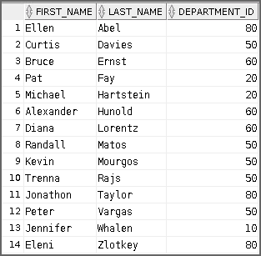

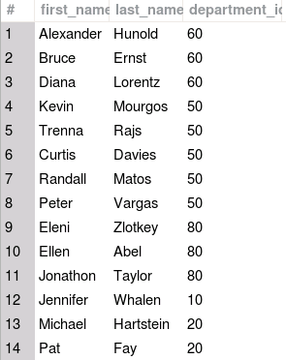




Implicit Data Type Conversion of Strings to Numbers
In expressions, the database can automatically convert strings to numbers. In this example, two strings are concatenated and then implicitly converted to a number for comparison with the numeric department ID in the WHERE clause.
SELECT first_name, last_name, department_id
FROM employees WHERE department_id < CONCAT('9', '0');
Notes:
The server can automatically perform data type conversion in an expression from VARCHAR2 (Oracle), VARCHAR (MySQL) or CHAR to a numeric or date data type.
For example, the expression hire_date > '01-JAN-90' (Oracle) or hire_date > '1990-01-01' (MySQL) results in the implicit conversion from the string to a date. Therefore, a character expression or value can be implicitly converted to a number or date data type in an expression.
Note: CHAR to numeric data type conversions succeed only if the character string provided represents a valid number.

Slide 7
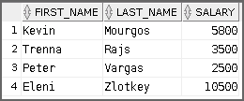
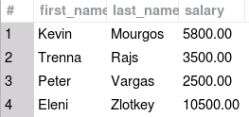
Implicit Data Type Conversion of Numbers to Strings
In expressions, the database can automatically convert numbers to strings. In this example, the salary column is converted to a string to determine if it contains a character.
SELECT first_name, last_name, salary
FROM employees
WHERE INSTR(salary, '5') > 0;
Notes:
The Oracle server can automatically perform data type conversion in an expression from NUMBER or DATE to VARCHAR2 or CHAR.
In general, the Oracle server uses the rule for expressions when a data type conversion is needed. For example, the expression job_id = 2 results in the implicit conversion of the number 2 to the string “2” because job_id is a VARCHAR(2) column.

Slide 8
Lesson Agenda
Implicit and explicit data type conversion
TO_CHAR, TO_DATE, TO_NUMBER functions in Oracle
Using the CAST()function in MySQL
General functions:
NVL
NVL2
NULLIF
COALESCE
Conditional expressions:
CASE
Searched CASE
DECODE
JSON functions:
JSON_QUERY
JSON_TABLE
JSON_VALUE

Slide 9


Using the TO_CHAR Function with Dates
Example:
TO_CHAR(date[,'format_model'])
SELECT employee_id, TO_CHAR(hire_date, 'MM/YY') Month_Hired
FROM employees
WHERE last_name = 'Higgins';
Notes:
You can convert a datetime data type to a value of VARCHAR2 data type using TO_CHAR in Oracle in the format specified by the format_model.
A format model is a character literal that describes the format of datetime stored in a character string. For example, the datetime format model for the string '11-Nov-2000' is 'DD-Mon-YYYY'. You can use the TO_CHAR function to convert a date from its default format to the one that you specify.
Here are some of the guidelines to follow while using TO_CHAR:
Enclose the format model within single quotation marks. The format model is case-sensitive.
Ensure that you separate the date value from the format model with a comma. The format model can include any valid date format element.
The names of days and months in the output are automatically padded with blanks.
Use the fill mode fm element to remove padded blanks or to suppress leading zeros.

Slide 10
Elements of the Date Format Model
Element | Result
YYYY | Full year in numbers
YEAR | Year spelled out (in English)
MM | Two-digit value for the month
MONTH | Full name of the month
MON | Three-letter abbreviation of the month
DY | Three-letter abbreviation of the day of the week
DAY | Full name of the day of the week
DD | Numeric day of the month
Notes:
You can refer to the complete list of date format model elements in the following page.

Slide 12
Elements of the Date Format Model
Time elements help you format the time portion of the date:
HH24:MI:SS AM
15:45:32 PM
Add character strings by enclosing them within double quotation marks:
DD "of" MONTH
12 of OCTOBER
Number suffixes help in spelling out numbers:
ddspth
fourteenth
Notes:
Use the formats that are listed in the following tables to display time information and literals, and to change numerals to spelled numbers:
Other Formats
Specifying Suffixes to Influence Number Display

Slide 13
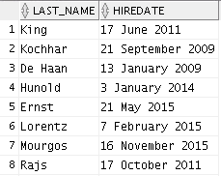
Using the TO_CHAR Function with Dates
SELECT last_name,
TO_CHAR(hire_date, 'fmDD Month YYYY')
AS HIREDATE
FROM employees;
…
Notes:
The SQL statement in the slide displays the last names and hire dates for all the employees. Observe that the hire date appears as 17 June 2011.
Example
Modify the example in the slide to display the dates in a format that appears as “Seventeenth of June 2011 12:00:00 AM.”
SELECT last_name,
TO_CHAR(hire_date,
'fmDdspth "of" Month YYYY fmHH:MI:SS AM')
HIREDATE
FROM employees;
Notice that the month follows the format model specified; in other words, the first letter is capitalized and the rest are in lowercase.

Slide 14
Using the TO_CHAR Function with Numbers
These are some of the format elements that you can use with the TO_CHAR function to display a number value as a character:
TO_CHAR(number[, 'format_model'])
Element | Result
9 | Represents a number
0 | Forces a zero to be displayed
$ | Places a floating dollar sign
L | Uses the floating local currency symbol
. | Prints a decimal point
, | Prints a comma as a thousands indicator
Notes:
When working with number values, such as character strings, you should convert the numbers to the character data type using the TO_CHAR function. This function translates a value of NUMBER data type to VARCHAR2 data type.
This technique is especially useful with concatenation.

Slide 15
Notes:
Number Format Elements
If you are converting a number to the character data type, you can use the following format elements:

Slide 16


Using the TO_CHAR Function with Numbers
Let us look at an example:
SELECT TO_CHAR(salary, '$99,999.00') SALARY
FROM employees
WHERE last_name = 'Ernst';
2
7
4
Notes:
Good to know:
The Oracle server displays a string of number signs (#) in place of a whole number whose digits exceed the number of digits provided in the format model.
The Oracle server rounds the stored decimal value to the number of decimal places provided in the format model.

Slide 17
Using the TO_NUMBER and TO_DATE Functions
Convert a character string to a number format using the TO_NUMBER function:
TO_NUMBER(char[, 'format_model'])
Convert a character string to a date format using the TO_DATE function:
TO_DATE(char[, 'format_model'])
Notes:
You may want to convert a character string to either a number or a date. To accomplish this task, use the TO_NUMBER or TO_DATE functions. The format model that you select is based on the previously demonstrated format elements.
The fx modifier in these functions specifies the exact match for the character argument and date format model of a TO_DATE function:
Punctuation and quoted text in the character argument must exactly match (except for case) the corresponding parts of the format model.
The character argument cannot have extra blanks. Without fx, the Oracle server ignores extra blanks.
Numeric data in the character argument must have the same number of digits as the corresponding element in the format model. Without fx, the numbers in the character argument can omit leading zeros.

Slide 18
Notes:
Example
Display the name and hire date for all employees who started on May 24, 2015. There are two spaces after the month May and before the number 24 in the following example. Because the fx modifier is used, an exact match is required and the spaces after the word May are not recognized:
SELECT last_name, hire_date
FROM employees
WHERE hire_date = TO_DATE('May 24, 2015', 'fxMonth DD, YYYY');
The resulting error output looks like this:
To see the output, correct the query by deleting the extra space between ‘May’ and ‘24’.
SELECT last_name, hire_date
FROM employees
WHERE hire_date = TO_DATE('May 24, 2015', 'fxMonth DD, YYYY');

Slide 19

Using TO_CHAR and TO_DATE Functions with the RR Date Format
To find employees hired before 2010, use the RR date format, which produces the correct result if the command is run now or before the year 2049:
SELECT last_name, TO_CHAR(hire_date, 'DD-Mon-YYYY')
FROM employees
WHERE hire_date < TO_DATE('01 Jan, 10','DD Mon,RR');
Notes:
To find employees who were hired before 2010, the RR format can be used. Because the current year is greater than 1999, the RR format interprets the year portion of the date from 2000 to 2049.
Alternatively, the following command also results in the same rows being selected because the YY format interprets the year portion of the date in the current century (2010).
SELECT last_name, TO_CHAR(hire_date, 'DD-Mon-yyyy')
FROM employees
WHERE hire_date < '01-Jan-10';
Notice that the same rows are retrieved from the preceding query.
The general tip is to use the YYYY format instead of RR format to avoid confusion.

Slide 20
Lesson Agenda
Implicit and explicit data type conversion
TO_CHAR, TO_DATE, TO_NUMBER functions in Oracle
Using the CAST() function
General functions:
NVL
NVL2
NULLIF
COALESCE
Conditional expressions:
CASE
Searched CASE
DECODE
JSON functions:
JSON_QUERY
JSON_TABLE
JSON_VALUE

Slide 21
Using the CAST() function in Oracle
CAST lets you convert one data type to another.
CAST(input_value as destination_type)
Examples:
1
SELECT first_name, last_name, department_id
FROM employees
WHERE department_id < CAST(CONCAT('9', '0') AS DECIMAL(2,0));
2
SELECT first_name, last_name, salary
FROM employees
WHERE INSTR(CAST(salary AS VARCHAR2(30)), '5') > 0;
Notes:
CAST lets you convert built-in data types of one type into another built-in data type. You can convert a string to a number or a date, a number to a string, etc.
In the first example, two strings are concatenated and then explicitly converted to a DECIMAL numeric data type using the CAST() function to compare to the numeric department ID. The query displays the first name, last name, department ID of those employees whose department ID is less than 90.
In the second example, the salary column is explicitly converted to a string using the CAST() function to determine if it contains a character. The query display the first name, last name and salary of employees whose salary contains the digit ‘5’.
For more information on the CAST() function, refer to the Oracle Database 18c SQL Language Reference guide.

Slide 22

Explicit Data Type Conversion of Strings to Numbers in MySQL
You can use the CAST() function to explicitly convert strings to numbers. In this example, two strings are concatenated and then explicitly converted to a DECIMAL numeric data type to compare to the numeric department ID.
SELECT first_name, last_name, department_id FROM employees
WHERE department_id < CAST(CONCAT('9', '0') AS DECIMAL(2,0));
Notes:
The CAST() function explicitly converts from a character to a decimal number value. (INTEGER data type is not accepted).

Slide 23
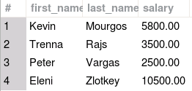
Explicit Data Type Conversion of Numbers to Strings in MySQL
You can use the CAST() function to explicitly convert strings to numbers. In this example, the salary column is explicitly converted to a string to determine if it contains a character.
SELECT first_name, last_name, salary
FROM employees
WHERE INSTR(CAST(salary AS CHAR), '5');

Slide 24
Lesson Agenda
Implicit and explicit data type conversion
TO_CHAR, TO_DATE, TO_NUMBER functions in Oracle
Using the CAST() function in MySQL
General functions:
NVL
NVL2
NULLIF
COALESCE
Conditional expressions:
CASE
Searched CASE
DECODE
JSON functions:
JSON_QUERY
JSON_TABLE
JSON_VALUE

Slide 25

General Functions
The following functions pertain to using nulls and can be used with any data type:
A
NVL (expr1, expr2)
NVL2 (expr1, expr2, expr3)
1
COALESCE (expr1, expr2,
..., exprn)
NULLIF (expr1, expr2)
A
1
IFNULL (expr1, expr2)
In MySQL
Notes:
These functions work with any data type and pertain to the use of null values in the expression list.
Note: For more information about the hundreds of functions available, see the “Functions” section in Oracle Database SQL Language Reference for 19c database.

Slide 26

NVL Function (Oracle) and IFNULL() Function (MySQL)
Converts a null value to an actual value:
Data types that can be used are date, character, and number.
Data types for both expressions must match.
Examples:
Oracle | MySQL
NVL(commission_pct,0) | IFNULL(commission_pct,0)
NVL(hire_date,'01-JAN-97') | IFNULL(hire_date, '1997-01-01')
NVL(job_id,'No Job Yet') | IFNULL(job_id,'No Job Yet')
NVL (expr1, expr2)
IFNULL(expr1, expr2)
Notes:
To convert a null value to an actual value, use the NVL function or IFNULL function.
Syntax
NVL (expr1, expr2)
IFNULL (expr1, expr2)
In the syntax:
expr1 is the source value or expression that may contain a null
expr2 is the target value for converting the null
You can use the NVL function with any data type, but the return value is always the same as the data type of expr1.
NVL Conversions for Various Data Types

Slide 27
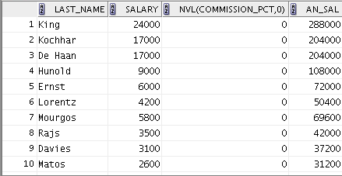
Using the NVL Function in Oracle
SELECT last_name, salary, NVL(commission_pct, 0),
(salary*12) + (salary*12*NVL(commission_pct, 0)) AN_SAL
FROM employees;
1
2
…
1
2
Notes:
To calculate the annual compensation of all employees, you need to multiply the monthly salary by 12 and then add the commission percentage to the result:
SELECT last_name, salary, commission_pct,
(salary*12) + (salary*12*commission_pct) AN_SAL
FROM employees;
Notice that the annual compensation is calculated for only those employees who earn a commission. If any column value in an expression is null, the result is null. To calculate values for all employees, you must convert the null value to a number before applying the arithmetic operator. In the example in the slide, the NVL function is used to convert null values to zero.

Slide 28
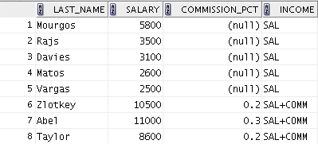
Using the NVL2 Function in Oracle
NVL2 (expr1, expr2, expr3)
SELECT last_name, salary, commission_pct,
NVL2(commission_pct,
'SAL+COMM', 'SAL') income
FROM employees WHERE department_id IN (50, 80);
1
2
1
2
Notes:
The NVL2 function examines the first expression. If the first expression is not null, the NVL2 function returns the second expression. If the first expression is null, the third expression is returned.
Syntax
NVL2(expr1, expr2, expr3)
In the syntax:
expr1 is the source value or expression that may contain a null
expr2 is the value that is returned if expr1 is not null
expr3 is the value that is returned if expr1 is null
In the example shown in the slide, the COMMISSION_PCT column is examined. If a value is detected, the text literal value of SAL+COMM is returned. If the COMMISSION_PCT column contains a null value, the text literal value of SAL is returned.
Note: The argument expr1 can be of any data type, but expr2 and expr3 should be of the same data type.

Slide 29



Using the IFNULL Function in MySQL
SELECT last_name, salary, IFNULL(commission_pct, 0),
(salary*12) + (salary*12*IFNULL(commission_pct, 0)) AN_SAL
FROM employees;
1
2
…
…
1
2
Notes:
To calculate the annual compensation of all employees, you need to multiply the monthly salary by 12 and then add the commission percentage to the result:
SELECT last_name, salary, commission_pct,
(salary*12) + (salary*12*commission_pct) AN_SAL
FROM employees;
Notice that the annual compensation is calculated for only those employees who earn a commission. If any column value in an expression is null, the result is null. To calculate values for all employees, you must convert the null value to a number before applying the arithmetic operator. In the example in the slide, the NVL function is used to convert null values to zero.

Slide 30
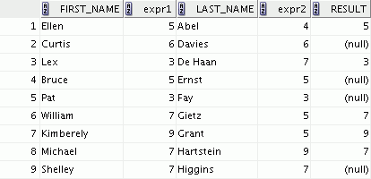
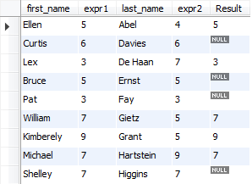
Using the NULLIF Function
NULLIF (expr1, expr2)
SELECT first_name, LENGTH(first_name) AS expr1,
last_name, LENGTH(last_name) AS expr2,
NULLIF(LENGTH(first_name), LENGTH(last_name)) AS Result
FROM employees;
1
2
3
…
…
1
2
3
1
2
3
Notes:
The NULLIF function compares two expressions.
Syntax
NULLIF (expr1, expr2)
In the syntax:
NULLIF compares expr1 and expr2. If they are equal, the function returns null. If they are not, the function returns expr1. However, you cannot specify the literal NULL for expr1.
In the example shown in the slide, the length of the first name in the EMPLOYEES table is compared with the length of the last name in the EMPLOYEES table. When the lengths of the names are equal, a null value is displayed. When the lengths of the names are not equal, the length of the first name is displayed.

Slide 31
Using the COALESCE Function
The advantage of the COALESCE function over the NVL or IFNULL functions is that the COALESCE function can take multiple alternative values.
If the first expression is not null, the COALESCE function returns that expression; otherwise, it does a COALESCE of the remaining expressions.
COALESCE (expr1, expr2, ..., exprn)
Notes:
The COALESCE function returns the first non-null expression in the list.
Syntax
COALESCE (expr1, expr2, ... exprn)
In the syntax:
expr1 is the value returned if this expression is not null
expr2 is the value returned if the first expression is null and this expression is not null
exprn is the value returned if the preceding expressions are null
Note that all expressions must be of the same data type.

Slide 32
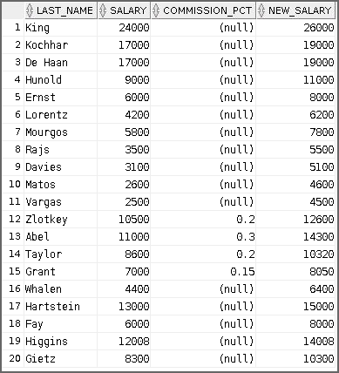
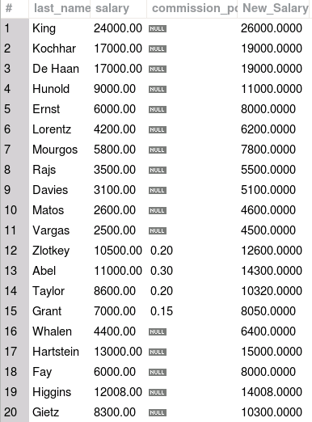
Using the COALESCE Function
SELECT last_name, salary, commission_pct,
COALESCE((salary+(commission_pct*salary)), salary+2000)
AS New_Salary
FROM employees;
Notes:
In the example shown in the slide, for the employees who do not get any commission, your organization wants to give a salary increment of $2,000 and, for employees who get commission, the query should compute the new salary that is equal to the existing salary added to the commission amount.
Note: Examine the output. For employees who do not get any commission, the New Salary column shows the salary incremented by $2,000 and for employees who get commission, the New Salary column shows the computed commission amount added to the salary.

Slide 33
Lesson Agenda
Implicit and explicit data type conversion
TO_CHAR, TO_DATE, TO_NUMBER functions in Oracle
Using the CAST() function in MySQL
General functions:
NVL
NVL2
NULLIF
COALESCE
Conditional expressions:
CASE
Searched CASE
DECODE
JSON functions:
JSON_QUERY
JSON_TABLE
JSON_VALUE

Slide 34
Conditional Expressions
Help provide the use of IF-THEN-ELSE logic within a SQL statement
You can use the following methods:
CASE expression
Searched CASE expression
DECODE function
Notes:
The two methods that are used to implement conditional processing (IF-THEN-ELSE logic) in a SQL statement are the CASE expression and the DECODE function.
Note: The CASE expression complies with the ANSI SQL. The DECODE function is specific to Oracle syntax.

Slide 35
CASE Expression
Facilitates conditional inquiries by doing the work of an IF-THEN-ELSE statement:
CASE expr WHEN comparison_expr1 THEN return_expr1
[WHEN comparison_expr2 THEN return_expr2
WHEN comparison_exprn THEN return_exprn
ELSE else_expr]
END
Notes:
CASE expressions allow you to use the IF-THEN-ELSE logic in SQL statements without having to invoke procedures.
In a simple CASE expression, the Oracle server searches for the first WHEN ... THEN pair for which expr is equal to comparison_expr and returns return_expr. If none of the WHEN ... THEN pairs meet this condition, and if an ELSE clause exists, the Oracle server returns else_expr. Otherwise, the Oracle server returns a null. You cannot specify the literal NULL for all the return_exprs and the else_expr.
The expressions expr and comparison_expr must be of the same data type, which can be CHAR, VARCHAR2, NCHAR, NVARCHAR2, NUMBER, BINARY_FLOAT, or BINARY_DOUBLE or must all have a numeric data type. All of the return values (return_expr) must be of the same data type.

Slide 36


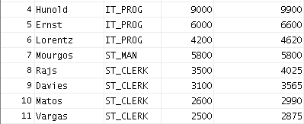
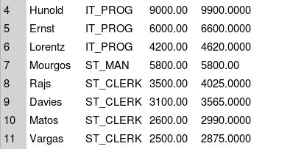


Using the CASE Expression
SELECT last_name, job_id, salary,
CASE job_id WHEN 'IT_PROG' THEN 1.10*salary
WHEN 'ST_CLERK' THEN 1.15*salary
WHEN 'SA_REP' THEN 1.20*salary
ELSE salary END AS REVISED_SALARY
FROM employees;
…
…
…
…
Notes:
In the SQL statement in the slide, the value of JOB_ID is decoded.
If JOB_ID is IT_PROG, the salary increase is 10%.
If JOB_ID is ST_CLERK, the salary increase is 15%.
If JOB_ID is SA_REP, the salary increase is 20%.
For all other job roles, there is no increase in salary.
The same statement can be written with the DECODE function.

Slide 37
Searched CASE Expression
CASE
WHEN condition1 THEN use_expression1
WHEN condition2 THEN use_expression2
WHEN condition3 THEN use_expression3
ELSE default_use_expression
END
SELECT last_name,salary,
(CASE WHEN salary<5000 THEN 'Low'
WHEN salary<10000 THEN 'Medium'
WHEN salary<20000 THEN 'Good'
ELSE 'Excellent'
END) AS qualified_salary
FROM employees;
Notes:
In a searched CASE expression, the search occurs from left to right until an occurrence of the listed condition is found, and then it returns the return expression. If no condition is found to be true, and if an ELSE clause exists, the return expression in the ELSE clause is returned; otherwise, a NULL is returned. The searched CASE expression evaluates the conditions independently under each of the WHEN options.
The difference between the CASE expression and the searched CASE expression is that in a searched CASE expression, you specify a condition or predicate instead of a comparison_expression after the WHEN keyword.
For both simple and searched CASE expressions, all of the return_exprs must either have the same data type CHAR, VARCHAR2, NCHAR, NVARCHAR2, NUMBER, BINARY_FLOAT, or BINARY_DOUBLE or must all have a numeric data type.
The code in the slide is an example of the searched CASE expression.

Slide 38

DECODE Function in Oracle
Facilitates conditional inquiries by doing the work of a CASE expression or an IF-THEN-ELSE statement:
DECODE(col|expression, search1, result1
[, search2, result2,...,]
[, default])
Notes:
The DECODE function decodes an expression in a way similar to the IF-THEN-ELSE logic that is used in various languages. The DECODE function decodes expression after comparing it to each search value. If the expression is the same as search, result is returned.
If the default value is omitted, a null value is returned where a search value does not match any of the result values.

Slide 39
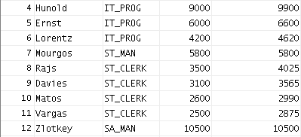

Using the DECODE Function
SELECT last_name, job_id, salary,
DECODE(job_id, 'IT_PROG', 1.10*salary,
'ST_CLERK', 1.15*salary,
'SA_REP', 1.20*salary,
salary)
REVISED_SALARY
FROM employees;
…
…
Notes:
In the SQL statement in the slide, the value of JOB_ID is tested.
If JOB_ID is IT_PROG, the salary increase is 10%.
If JOB_ID is ST_CLERK, the salary increase is 15%.
If JOB_ID is SA_REP, the salary increase is 20%.
For all other job roles, there is no increase in salary.
The same statement can be expressed in pseudocode as an IF-THEN-ELSE statement:
IF job_id = 'IT_PROG' THEN salary = salary*1.10
IF job_id = 'ST_CLERK' THEN salary = salary*1.15
IF job_id = 'SA_REP' THEN salary = salary*1.20
ELSE salary = salary

Slide 40
Using the DECODE Function
Display the applicable tax rate for each employee in department 80:
SELECT last_name, salary,
DECODE (TRUNC(salary/2000, 0),
0, 0.00,
1, 0.09,
2, 0.20,
3, 0.30,
4, 0.40,
5, 0.42,
6, 0.44,
0.45) TAX_RATE
FROM employees
WHERE department_id = 80;
Notes:
This slide shows another example using the DECODE function. In this example, you determine the tax rate for each employee in department 80 based on the monthly salary. The tax rates are as follows:
Monthly Salary Range Tax Rate
$0.00–1,999.99 00%
$2,000.00–3,999.99 09%
$4,000.00–5,999.99 20%
$6,000.00–7,999.99 30%
$8,000.00–9,999.99 40%
$10,000.00–11,999.99 42%
$12,200.00–13,999.99 44%
$14,000.00 or greater 45%

Slide 41
Lesson Agenda
Implicit and explicit data type conversion
TO_CHAR, TO_DATE, TO_NUMBER functions in Oracle
Using the CAST() function in MySQL
General functions:
NVL
NVL2
NULLIF
COALESCE
Conditional expressions:
CASE
Searched CASE
DECODE
JSON functions:
JSON_QUERY
JSON_TABLE
JSON_VALUE

Slide 42
JSON_QUERY Function
The SQL/JSON function JSON_QUERY finds one or more specified JSON values in JSON data and returns the values in a character string.
SELECT JSON_QUERY('{a:100, b:200, c:300}', '$') AS value
FROM DUAL;
VALUE
--------------------------------------------------------------------------------
{"a":100,"b":200,"c":300}
Notes:
The following query returns the context item or the specified string of JSON data. The path expression matches a single JSON object, which does not require an array wrapper. Note that the JSON data is converted to strict JSON syntax in the returned value—that is, the object property names are enclosed in double quotation marks.
Note: See Appendix C in Oracle Database Globalization Support Guide for the collation derivation rules, which define the collation assigned to the character value returned by JSON_QUERY.

Slide 43
JSON_TABLE Function
The SQL/JSON function JSON_TABLE creates a relational view of JSON data.
SELECT JSON_QUERY('{a:100, b:200, c:300}', '$') AS value
FROM DUAL;
VALUE
--------------------------------------------------------------------------------
{"a":100,"b":200,"c":300}
Notes:
It maps the result of a JSON data evaluation into relational rows and columns. You can query the result returned by the function as a virtual relational table using SQL. The main purpose of JSON_TABLE is to create a row of relational data for each object inside a JSON array and output JSON values from within that object as individual SQL column values.
You must specify JSON_TABLE only in the FROM clause of a SELECT statement. The function first applies a path expression, called a SQL/JSON row path expression, to the supplied JSON data. The JSON value that matches the row path expression is called a row source in that it generates a row of relational data. The COLUMNS clause evaluates the row source, finds specific JSON values within the row source, and returns those JSON values as SQL values in individual columns of a row of relational data.
Note: See Appendix C in Oracle Database Globalization Support Guide for the collation derivation rules, which define the collation assigned to each character data type column in the table generated by JSON_TABLE.

Slide 44
JSON_VALUE Function
The SQL/JSON function JSON_QUERY finds one or more specified JSON values in JSON data and returns the values in a character string.
SELECT JSON_VALUE('{a:100}', '$.a') AS value
FROM DUAL;
VALUE
-----
100
Notes:
The example query listed returns the value of the member with a property name. Because the RETURNING clause is not specified, the value is returned as a VARCHAR2(4000) data type.
Note: See Appendix C in Oracle Database Globalization Support Guide for the collation derivation rules, which define the collation assigned to the value returned by this function when it is a character value.

Slide 45
Summary
In this lesson, you should have learned how to:
Alter date formats for display using functions
Convert column data types using functions
Use NVL functions
Use IF-THEN-ELSE logic and other conditional expressions in a SELECT statement
Notes:
Remember the following:
Conversion functions can convert character, date, and numeric values: TO_CHAR, TO_DATE, TO_NUMBER
There are several functions that pertain to nulls, including NVL, NVL2, NULLIF, and COALESCE.
The IF-THEN-ELSE logic can be applied within a SQL statement by using the CASE expression, searched CASE, or the DECODE function.

Slide 46

Practice 5: Overview
This practice covers the following topics:
Creating queries that use TO_CHAR, TO_DATE, and other DATE functions
Creating queries that use conditional expressions such as CASE, searched CASE, and DECODE
Notes:
This practice provides a variety of exercises using the TO_CHAR and TO_DATE functions, and conditional expressions such as CASE, searched CASE, and DECODE.
Remember that for nested functions, the results are evaluated from the innermost function to the outermost function.

