Slide 1
Using Set Operators

Slide 2
Course Roadmap
Lesson 1: Introduction
Lesson 6: Reporting Aggregated Data Using Group Functions
Unit 1: Retrieving, Restricting, and Sorting Data
Lesson 7: Displaying Data from Multiple Tables Using Joins
Unit 2: Joins, Subqueries, and Set Operators
Lesson 8: Using Subqueries to Solve Queries
Unit 3: DML and DDL
Lesson 9: Using Set Operators
You are here!
Notes:
In Unit 2, you will learn to use:
SQL statements to query and display data from multiple tables using Joins
Subqueries when the condition is unknown
Group functions to aggregate data
Set operators

Slide 3
Objectives
After completing this lesson, you should be able to do the following:
Describe set operators
Use a set operator to combine multiple queries into a single query
Control the order of rows returned
Notes:
In this lesson, you learn how to write queries by using set operators.

Slide 4

Lesson Agenda
Set operators: Types and guidelines
Tables used in this lesson
UNION and UNION ALL operator
INTERSECT operator
MINUS operator
Matching SELECT statements
Using the ORDER BY clause in set operations

Slide 5
Set Operators
A
B
A
B
UNION/UNION ALL
A
B
INTERSECT
A
B
MINUS
Notes:
Set operators combine the results of two or more component queries into one result. Queries containing set operators are called compound queries.
All set operators have equal precedence. If a SQL statement contains multiple set operators, the Oracle server evaluates them from left (top) to right (bottom), if no parentheses explicitly specify another order. You should use parentheses to specify the order of evaluation explicitly in queries that use the INTERSECT operator with other set operators.

Slide 6


Set Operator Rules
The expressions in the SELECT lists must match in number.
The data type of each column in the subsequent query must match the data type of its corresponding column in the first query.
Parentheses can be used to alter the sequence of execution.
The ORDER BY clause can appear only at the very end of the statement.
Notes:
The expressions in the SELECT lists of the queries must match in number and data type. When you use the UNION, UNION ALL, INTERSECT, and MINUS operators, ensure that the SELECT lists have the same number and data type of columns. The data type sometimes may not be exactly the same. In such cases, the column in the second query must be in the same data type group (such as numeric or character) as the corresponding column in the first query.
You can use the set operators in subqueries.
You should use parentheses to specify the order of evaluation in queries that use the INTERSECT operator with other set operators. According to SQL standards, the INTERSECT operator has greater precedence than the other set operators.

Slide 7


Oracle Server and Set Operators
Duplicate rows are automatically eliminated except in UNION ALL.
Column names from the first query appear in the result.
The output is sorted in ascending order by default, except in UNION ALL.
Notes:
The SELECT lists of a compound query must match the corresponding expressions in number and data type. If component queries select character data, the data type of the return values is determined as follows:
If both queries select values of CHAR data type, of equal length, the returned values have the CHAR data type of that length. If the queries select values of CHAR with different lengths, the returned value is VARCHAR2 with the length of the larger CHAR value.
If either or both of the queries select values of VARCHAR2 data type, the returned values have the VARCHAR2 data type.
If component queries select numeric data, the data type of the return values is determined by numeric precedence.
If all queries select values of the NUMBER type, the returned values have the NUMBER data type.
In queries using set operators, the Oracle server does not perform implicit conversion across data type groups. Therefore, if the corresponding expressions of component queries resolve to both character data and numeric data, the Oracle server returns an error.

Slide 8
Lesson Agenda
Set operators: Types and guidelines
Tables used in this lesson
UNION and UNION ALL operator
INTERSECT operator
MINUS operator
Matching SELECT statements
Using the ORDER BY clause in set operations

Slide 9


Tables Used in This Lesson
The tables used in this lesson are:
employees: Provides details about all current employees
retired_employees: Provides details about all past employees
Notes:
Two tables are used in this lesson: employees and retired_employees.
You are already familiar with the employees table that stores employee details, such as a unique identification number, email address, job identification (such as ST_CLERK, SA_REP, and so on), salary, manager, and so on.
retired_employees stores the details of the employees who have left the company.
The structure of and data from the employees and retired_employees tables are shown on the following pages.

Slide 10
Notes:
DESCRIBE employees

Slide 11
Notes:
SELECT employee_id, last_name, job_id, hire_date, department_id
FROM employees;
DESCRIBE retired_employees

Slide 12
Notes:
SELECT * FROM retired_employees;

Slide 13
Lesson Agenda
Set operators: Types and guidelines
Tables used in this lesson
UNION and UNION ALL operator
INTERSECT operator
MINUS operator
Matching SELECT statements
Using the ORDER BY clause in set operations

Slide 14
UNION Operator
Duplicates are removed
Returns all rows from A & B
A
B
The UNION operator returns rows from both queries after eliminating duplications.
Notes:
The UNION operator returns all rows that are selected by either query. Use the UNION operator to return all rows from multiple tables and eliminate any duplicate rows.
Guidelines
The number of columns being selected must be the same.
The data types of the columns being selected must be in the same data type group (such as numeric or character).
The names of the columns need not be identical.
UNION operates over all of the columns being selected.
NULL values are not ignored during duplicate checking.
By default, the output is sorted in ascending order of the columns of the SELECT clause.

Slide 15
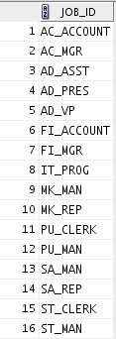

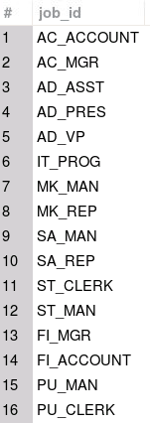

Using the UNION Operator
Display the job details of all the current and retired employees. Display each job only once.
SELECT job_id
FROM employees
UNION
SELECT job_id
FROM retired_employees;
Notes:
The UNION operator eliminates any duplicate records. If records that occur in both the EMPLOYEES and the RETIRED_EMPLOYEES tables are identical, the records are displayed only once.

Slide 16
UNION ALL Operator
Duplicates are not removed
Returns all rows from A & B
A
B
The UNION ALL operator returns rows from both queries, including all duplications.
Notes:
Use the UNION ALL operator to return all rows from multiple queries.
Guidelines
The guidelines for UNION and UNION ALL are the same, with the following two exceptions that pertain to UNION ALL: Unlike UNION, duplicate rows are not eliminated and the output is not sorted by default.

Slide 17
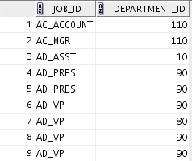
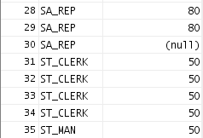
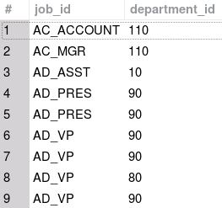
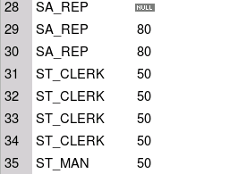
Using the UNION ALL Operator
Display the jobs and departments of all current and previous employees.
SELECT job_id, department_id
FROM employees
UNION ALL
SELECT job_id, department_id
FROM retired_employees
ORDER BY job_id;
…
…
Notes:
In the example in the slide, 35 rows are selected. The combination of the two tables totals to 35 rows. The UNION ALL operator does not eliminate duplicate rows. UNION returns all distinct rows selected by either query. UNION ALL returns all rows selected by either query, including all duplicates.
Consider the query in the slide, now written with the UNION clause:
SELECT job_id,department_id FROM employees UNION SELECT job_id,department_id FROM retired_employees ORDER BY job_id;
The preceding query returns 19 rows. This is because it eliminates all the duplicate rows.

Slide 18
Lesson Agenda
Set operators: Types and guidelines
Tables used in this lesson
UNION and UNION ALL operator
INTERSECT operator
MINUS operator
Matching SELECT statements
Using ORDER BY clause in set operations

Slide 19
INTERSECT Operator
Returns all rows common to A & B
A
B
The INTERSECT operator returns rows that are common to both queries.
Notes:
Use the INTERSECT operator to return all rows that are common to multiple queries.
Guidelines
The number of columns and the data types of the columns being selected by the SELECT statements in the queries must be identical in all the SELECT statements used in the query. The names of the columns, however, need not be identical.
Reversing the order of the intersected tables does not alter the result.
INTERSECT does not ignore NULL values.

Slide 20

Using the INTERSECT Operator
Display the common manager IDs and department IDs of current and previous employees.
SELECT manager_id,department_id
FROM employees
INTERSECT
SELECT manager_id,department_id
FROM retired_employees;
Notes:
In the example in this slide, the query returns only those records that have the same values in the selected columns in both tables.

Slide 21
Lesson Agenda
Set operators: Types and guidelines
Tables used in this lesson
UNION and UNION ALL operator
INTERSECT operator
MINUS operator
Matching SELECT statements
Using the ORDER BY clause in set operations

Slide 22
MINUS Operator
A
B
Returns all rows from A
Removes all rows from B
The MINUS operator returns all the distinct rows selected by the first query, but not present in the second query result set.
Notes:
Use the MINUS operator to return all distinct rows selected by the first query, but not present in the second query result set (the first SELECT statement MINUS the second SELECT statement).
Note: The number of columns must be the same and the data types of the columns being selected by the SELECT statements in the queries must belong to the same data type group in all the SELECT statements used in the query. The names of the columns, however, need not be identical.

Slide 23

Using the MINUS Operator
Display the manager IDs and Job IDs of employees whose managers have never managed retired employees in the Sales department.
SELECT manager_id, job_id
FROM employees
WHERE department_id = 80
MINUS
SELECT manager_id, job_id
FROM retired_employees
WHERE department_id = 80;
Notes:
In the example in the slide, the manager IDs and job IDs in the RETIRED_EMLOYEES table are subtracted from those in the EMPLOYEES table. The results set displays the employees remaining after the subtraction; they are represented by rows that exist in the EMPLOYEES table, but do not exist in the RETIRED_EMPLOYEES table. These are the records of the employees who work in the sales department and are being managed by managers who have not managed any of the retired employees.

Slide 24
Lesson Agenda
Set operators: Types and guidelines
Tables used in this lesson
UNION and UNION ALL operator
INTERSECT operator
MINUS operator
Matching SELECT statements
Using ORDER BY clause in set operations

Slide 25
Matching SELECT Statements in Oracle
You must match the data type (using the TO_CHAR function or any other conversion functions) when columns do not exist in one or the other table.
SELECT location_id, department_name "Department",
TO_CHAR(NULL) "Warehouse location"
FROM departments
UNION
SELECT location_id, TO_CHAR(NULL) "Department",
state_province
FROM locations;
Notes:
Because the expressions in the SELECT lists of the queries must match in number, you can use the dummy columns and the data type conversion functions to comply with this rule.
To match the column list explicitly, you can insert NULL columns at the missing positions so as to match the count and data type of selected columns in each SELECT statement.
In the slide, the name Warehouse location is given as the dummy column heading. The TO_CHAR function is used in the first query to match the VARCHAR2 data type of the state_province column that is retrieved by the second query. Similarly, the TO_CHAR function in the second query is used to match the VARCHAR2 data type of the department_name column that is retrieved by the first query.

Slide 26
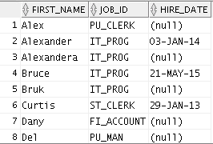
Matching the SELECT Statement: Example in Oracle
Using the UNION operator, display the employee name, job ID, and hire date of all employees.
SELECT FIRST_NAME, JOB_ID, hire_date "HIRE_DATE"
FROM employees
UNION
SELECT FIRST_NAME, JOB_ID, TO_DATE(NULL)"HIRE_DATE"
FROM retired_employees;
…
Notes:
The EMPLOYEES and RETIRED_EMPLOYEES tables have several columns in common (for example, EMPLOYEE_ID, JOB_ID, and DEPARTMENT_ID). However, what if you want the query to display FIRST_NAME, JOB_ID, and HIRE_DATE using the UNION operator, knowing that HIRE_DATE exists only in the EMPLOYEES table?
The code example in the slide matches the FIRST_NAME and JOB_ID columns in the EMPLOYEES and RETIRED_EMPLOYEES tables. NULL is added to the RETIRED_EMPLOYEES SELECT statement to match the HIRE_DATE column in the EMPLOYEES SELECT statement.
In the results shown in the slide, each row in the output that corresponds to a record from the RETIRED_EMPLOYEES table contains a NULL in the HIRE_DATE column.

Slide 27
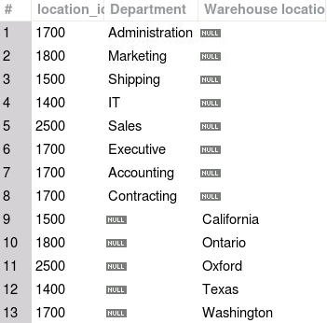
Matching SELECT Statements in MySQL
You must match the data type (using the CAST function) when columns do not exist in one or the other table.
SELECT location_id, department_name 'Department',
CAST(NULL AS CHAR) 'Warehouse location'
FROM departments
UNION
SELECT location_id, CAST(NULL AS CHAR),
state_province
FROM locations;
Notes:
Because the expressions in the SELECT lists of the queries must match in number, you can use the dummy columns and the data type conversion functions to comply with this rule.
To match the column list explicitly, you can insert NULL columns at the missing positions so as to match the count and data type of selected columns in each SELECT statement.
In the slide, the name Warehouse location is given as the dummy column heading. The CAST function is used in the first query to match the VARCHAR data type of the state_province column that is retrieved by the second query. Similarly, the CAST function in the second query is used to match the VARCHAR data type of the department_name column that is retrieved by the first query.

Slide 28
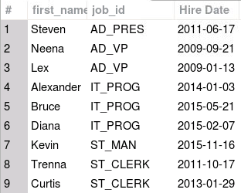
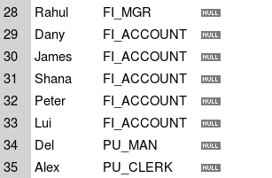
Matching the SELECT Statement: Example in MySQL
Using the UNION operator, display the employee name, job ID, and hire date of all employees.
SELECT first_name, job_id, hire_date 'Hire Date'
FROM employees
UNION
SELECT first_name, job_id, CAST(NULL AS DATE)
FROM retired_employees;
…
Notes:
The employees and retired_employees tables have several columns in common (for example, employee_id, job_id, and department_id). However, what if you want the query to display first_name, job_id, and hire_date using the UNION operator, knowing that hire_date exists only in the employees table?
The code example in the slide matches the first_name and job_id columns in the employees and retired_employees tables. NULL is added to the retired_employees SELECT statement to match the hire_date column in the employees SELECT statement.
In the results shown in the slide, each row in the output that corresponds to a record from the retired_employees table contains a NULL in the hire_date column.

Slide 29
Lesson Agenda
Set operators: Types and guidelines
Tables used in this lesson
UNION and UNION ALL operator
INTERSECT operator
MINUS operator
Matching SELECT statements
Using the ORDER BY clause in set operations

Slide 30

Using the ORDER BY Clause in Set Operations in Oracle
The ORDER BY clause can appear only once at the end of the compound query.
Component queries cannot have individual ORDER BY clauses.
The ORDER BY clause recognizes only the columns of the first SELECT query.
By default, the first column of the first SELECT query is used to sort the output in ascending order.
Notes:
You can use the ORDER BY clause only once in a compound query. Place the ORDER BY clause at the end of the query. The ORDER BY clause accepts the column name or an alias. By default, the output is sorted in ascending order in the first column of the first SELECT query.
Note: The ORDER BY clause does not recognize the column names of the second SELECT query. To avoid confusion over column names, it is a common practice to ORDER BY column positions.
For example, in the following statement, the output will be shown in ascending order of job_id.
SELECT employee_id, job_id, salary
FROM employees
UNION
SELECT employee_id, job_id, 0
FROM retired_employees
ORDER BY 2;
If you omit ORDER BY, by default, the output will be sorted in ascending order of employee_id. You cannot use the columns from the second query to sort the output.

Slide 31
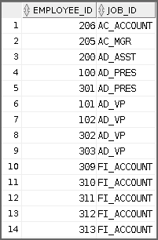
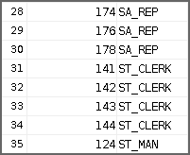
Using the ORDER BY Clause in Set Operations in Oracle: Example
Display the employee ID and job ID of all current and retired employees, sorted by job ID.
SELECT employee_id, job_id
FROM employees
UNION
SELECT employee_id, job_id
FROM retired_employees
ORDER BY 2;
…
Notes:
In the example shown on the slide, the output is sorted in the ascending order of job_id.
Note: The ORDER BY clause does not recognize the column names of the second SELECT query. To avoid confusion over column names, it is a common practice to ORDER BY column positions.
If you omit ORDER BY, by default, the output will be sorted in ascending order of employee_id. You cannot use the columns from the second query to sort the output.

Slide 32
Using the ORDER BY Clause with UNION in MySQL
To use an ORDER BY clause to sort the entire UNION result, place the ORDER BY clause only once at the end of the compound query.
The ORDER BY clause uses the columns of the first SELECT query.
If a column to be sorted is aliased, the ORDER BY clause must use the alias rather than the column name.
Notes:
You can use the ORDER BY clause to sort the entire result set in a compound query. Place the ORDER BY clause at the end of the query. In the ORDER BY clause, you can refer to a column alias or column name from the first SELECT statement. If the sort column is aliased, you must use the alias rather than the column name. You can use the column position in the ORDER BY clause, but this use is deprecated.
Note: You can use an ORDER BY clause in each SELECT statement, but it has no effect on the sort order of the result set, but rather is used by the LIMIT clause. To apply an ORDER BY clause to an individual SELECT statement, enclose the statement in parentheses, with the ORDER BY and LIMIT clauses inside the parentheses. For example, the following query selects and combines the first 10 employees from each table and sorts the results by Job ID.
(SELECT employee_id, job_id
FROM employees ORDER BY employee_id LIMIT 10)
UNION
(SELECT employee_id, job_id
FROM retired_employees ORDER BY employee_id LIMIT 10)
ORDER BY job_id;

Slide 33
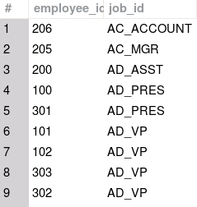
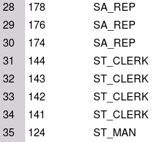
Using the ORDER BY Clause with UNION: Example in MySQL
Display the employee ID and job ID of all current and retired employees, sorted by job ID.
SELECT employee_id, job_id
FROM employees
UNION
SELECT employee_id, job_id
FROM retired_employees
ORDER BY job_id;
…
Notes:
In the example shown on the slide, the output is sorted in the ascending order of job_id.

Slide 34
Summary
In this lesson, you should have learned how to use:
UNION to return all distinct rows
UNION ALL to return all rows, including duplicates
INTERSECT to return all rows that are shared by both queries
MINUS to return all distinct rows that are selected by the first query, but not by the second
ORDER BY only at the very end of the statement
Notes:
The UNION operator returns all the distinct rows selected by each query in the compound query. Use the UNION operator to return all rows from multiple tables and eliminate any duplicate rows.
Use the UNION ALL operator to return all rows from multiple queries. Unlike the case with the UNION operator, duplicate rows are not eliminated and the output is not sorted by default.
Use the INTERSECT operator to return all rows that are common to multiple queries.
Use the MINUS operator to return rows returned by the first query that are not present in the second query.
Remember to use the ORDER BY clause only at the very end of the compound statement.
Make sure that the corresponding expressions in the SELECT lists match in number and data type.

Slide 35

Practice 9: Overview
In this practice, you create reports by using:
The UNION operator
The INTERSECT operator
The MINUS operator
Notes:
In this practice, you write queries using set operators.

