Slide 1
Introduction to Data Definition Language in MySQL

Slide 2
Course Roadmap
Lesson 1: Introduction
Unit 1: Retrieving, Restricting and Sorting Data
Unit 2: Joins, Subqueries, and Set Operators
Lesson 10: Managing Tables Using DML Statements
Lesson 11: Introduction to Data Definition Language
You are here!
Unit 3: DML and DDL
Notes:
In Unit 3, you learn how to create and manage database objects using data definition language (DDL) statements. You will also learn how to manage data in the tables using data manipulation language (DML) statements.

Slide 3
Objectives
After completing this lesson, you should be able to do the following:
Create a database
Add tables to a database
List the data types that are available for columns
Use the SHOW CREATE TABLE statement
Describe and set column and table options
Create indexes, keys, and constraints
Notes:
In this lesson, you are introduced to the data definition language (DDL) statements. You learn the basics of creating simple tables, altering them, and removing them. The data types available in DDL are shown and schema concepts are introduced. Constraints are discussed in this lesson. Exception messages that are generated from violating constraints during DML operations are shown and explained.

Slide 4




HR Application Scenario
HR Application
HR Application
HR Application
job_ID | Min_Salary | Max_Salary
AD_PRES | 20080 | 40000
SA_MAN | 10000 | 20080
IT_PROG | 4000 | 10000
Action:
Add Column
The JOBS table looks fine except it does not contain a column for JOB_TITLE. What should I do now?
Name:
Job Title
Datatype:
varchar2(25)
…
Default:
EDIT
SUBMIT
Bob
DBA
job_ID | Min_ Salary | Max_Salary | Job_Title
AD_PRES | 20080 | 40000 | NULL
SA_MAN | 10000 | 20080 | NULL
IT_PROG | 4000 | 10000 | NULL
Runs
DDL
Notes:
Consider a scenario where Bob, an HR manager is creating tables to store all the employee information in the database. While creating the JOBS table to store all the job information, he forgets to create a column for the job title. So what should Bob do now?
Should he drop the table and create JOBS table again? No!
Bob can alter the table and add a new column (JOB_TITLE) to the existing JOBS table. The statements that allow you to modify the structure of database objects are called data definition language (DDL) statements. Usually, the permission to execute DDL statements is given only to the admin.
Bob submits the request to alter the JOBS table structure along with the details. The DBA receives the request and constructs an appropriate SQL statement to alter the JOBS table.
A new column called Job_Title is added to the JOBS table. The value for Job_Title remains NULL until Bob goes to the application and updates the values for all the records.
In this lesson, you learn more about DDL statements.

Slide 5

Lesson Agenda
Database objects
Naming rules
CREATE TABLE statement
Data types
Indexes, keys, and constraints
Column options
Creating a table using a subquery
ALTER TABLE statement
DROP TABLE statement

Slide 6
Creating a Database: Syntax
General syntax for creating a database: Or:
The IF NOT EXISTS option prevents getting an error if the database already exists.
CREATE DATABASE [IF NOT EXISTS] database_name;
CREATE SCHEMA [IF NOT EXISTS] database_name;
Notes:
The terms database and schema are synonymous in MySQL. In this course, you have been working with one database or schema, the HR database, with tables for employees and jobs. You might also have an inventory database with tables for items, their locations, manufacturers, costs, and so on.
The statement to create the HR database is the following:
CREATE DATABASE IF NOT EXISTS HR;

Slide 7



MySQL Naming Conventions
Database names, table names, and column names:
Can contain A–Z, a–z, 0–9, _, and $
Cannot have more than 64 characters
Cannot contain reserved words or special characters, such as /, \, ., # or spaces unless you enclose the name with backticks
For example, the following causes an error:
Correct the error by enclosing the name in backticks:
Case sensitivity of database and table names depends on the host operating system.
CREATE DATABASE my database;
CREATE DATABASE `my database`;
Notes:
Databases and tables in MySQL are created by using directories and files in the host file system. Because of this, if the host operating system is case-sensitive in its treatment of directory and file names, so is MySQL. Windows file names are not case-sensitive, so a server running on Windows does not treat database and table names as case-sensitive. MySQL servers running on UNIX usually treat database and table names as case-sensitive because UNIX file names are case-sensitive.
Table names can be reserved words or contain special characters if the name is quoted in backticks (``).

Slide 8
Lesson Agenda
Database objects
Naming rules
CREATE TABLE statement
Data types
Indexes, keys, and constraints
Column options
Creating a table using a subquery
ALTER TABLE statement
DROP TABLE statement

Slide 9

CREATE TABLE Statement
General syntax for creating a table:
Example:
CREATE TABLE [database.]table
(column_name datatype [, ...]);
CREATE TABLE employees1
(employee_id INTEGER,
first_name VARCHAR(20),
last_name VARCHAR(25),
email VARCHAR(25),
phone_number VARCHAR(20),
hire_date DATE,
job_id VARCHAR(10),
salary DECIMAL(8,2),
commission_pct DECIMAL(2,2),
manager_id INTEGER,
department_id INTEGER);
Notes:
You create tables to store data by executing the SQL CREATE TABLE statement. This statement is one of the DDL statements that are used to create, modify, or remove database structures. These statements record information in the data dictionary. The data dictionary is an important set of read-only tables that provide database information.
To create a table, a user must have the CREATE TABLE privilege. The example in this slide creates a table similar to the employees table It creates a table with columns and their datatypes specified. This lesson describes numerous other options that can be used when creating tables. The table in this slide uses the data types in the employee table. MySQL supports many other data types.

Slide 10
Lesson Agenda
Database objects
Naming rules
CREATE TABLE statement
Data types
Indexes, keys, and constraints
Column options
Creating a table using a subquery
ALTER TABLE statement
DROP TABLE statement

Slide 11
Data Types: Overview
Numeric data types
Integer, decimal, and floating point data
Date and time data types
Calendar dates, with or without time data and time intervals
String data types
Character strings and BLOBs
Spatial data types
Data representing geographic features
JavaScript Object Notation (JSON)
Structured text data stored in JSON documents
Notes:
MySQL supports a wide variety of data types. In this course, you have worked with examples of numeric, date, and character data. This lesson describes some other of the commonly used MySQL data types. Spatial data and JSON documents are beyond the scope of this course. Data types are covered in more depth in the MySQL Essentials course.

Slide 12
Numeric Data Types
Integer
Positive or negative whole numbers
Syntax: INT[(M)] [UNSIGNED] [ZEROFILL]
Fixed Point
Used for exact-value numbers: integer, fractional, or both
Syntax: DECIMAL[(M[, D])] [UNSIGNED] [ZEROFILL]
Floating Point
Used for approximate-value numbers: integer, fractional, or both
Syntax: FLOAT[(M, D)] [UNSIGNED] [ZEROFILL]
Notes:
In the syntax, M represents an optional value for the maximum number of digits available, and, for DECIMAL and FLOAT, D represents the number of digits following the decimal point. INTEGER is a synonym for INT. For INT, if M is omitted, a default number of digits is provided.
NUMERIC and DEC are synonyms for DECIMAL. For DECIMAL data type, if D is omitted, the default is 0 decimal places, and if M is omitted, the default is 10 significant digits. The decimal point and (for negative numbers) the minus (-) sign are not counted in M.
Floating point numbers are used to represent very large or very small numbers (close to zero) using a small amount of space. For example 6.022169E+23 represents 602216900000000000000000, while 6.022169E-23 represents .00000000000000006022169 as a value. If M and D are omitted, FLOAT values are stored to the limits permitted by the hardware.
MySQL supports a number of other integer, fixed point, and floating point data types for efficiency of storage or calculations. Other data types are covered in the course on MySQL Essentials.

Slide 13
Date and Time Data Types
DATE
YYYY-MM-DD as in 2018-01-04
TIME
HH:MM:SS as in 12:59:02
DATETIME
YYYY-MM-DD HH:MM:SS as in 2018-01-04 12:59:02
Notes:
Here, YYYY, MM, DD, HH, MM, and SS stand for year, month, day of month, hour, minute, and second, respectively.
You have used the DATE data type previously in this course.
The TIME data type can express time of day or elapsed time.
The DATETIME data type is a combination of date and time.
The TIME and DATETIME data types can include fractional seconds up to 6 decimal places.
Other date and time data types and the use of fractional seconds are covered in the course on MySQL Essentials.

Slide 14
String Data Types
Fixed length character strings: CHAR(M)
Stored as fixed length M, right-padded with spaces
Variable length character strings: VARCHAR(M)
Stored up to length M, not right-padded with spaces
Extremely long character strings: TEXT
Variable length character strings, stored as a separately allocated object
Binary large objects: BLOB
Variable length binary data, stored as a separately allocated object
Notes:
The CHAR data type is efficient for storage when the character string column always has the same number of characters, such as for a 2 character state or region abbreviation or a 3 character country abbreviation. The VARCHAR data type is common for character strings that are variable in length, such as names of people or places. For CHAR, length can be up to 255, while for VARCHAR, length can be up to 65,535, but cannot cause the size of the row, including all columns, to exceed 65,535 bytes. For extremely long character strings, the TEXT type can hold a variable amount of data. A BLOB (binary large object) is binary data stored as a single value in a database.
The course on MySQL Essentials provides more coverage of the TEXT and BLOB data types, along with BINARY, VARBINARY, ENUM, and SET data types.

Slide 15
Lesson Agenda
Database objects
Naming rules
CREATE TABLE statement
Data types
Indexes, keys, and constraints
Column options
Creating a table using a subquery
ALTER TABLE statement
DROP TABLE statement

Slide 16
Indexes, Keys, and Constraints
Index: A column or columns of table data designated to be used as pointers to table rows to speed up data retrieval
Key: Normally a synonym for index in MySQL
Constraint: A restriction placed on one or more column values of a table to enforce integrity rules
The following MySQL indexes (keys) include designated combinations of constraints:
Primary Keys
Unique Keys
Foreign Keys
Notes:
A constraint is a condition that data must meet when being added to or removed from a table. For example, a unique constraint requires all values in an index to be distinct. If you try to add a new row with a value in the index that matches a value in an existing row, an error occurs. Primary keys, unique keys, and foreign keys are indexes that have specific combinations of constraints. The sections in this lesson titled "Primary Keys", "Unique Key Constraints", and "Foreign Key Constraints" describe the constraints specific to these indexes and how you can include these types of indexes in a table.

Slide 17
Table Indexes
An index is a collection of pointers to records in a table.
An index helps to:
Locate rows quickly
Avoid full table scans
Improve query performance
Unnecessary indexes are wasteful.
They take up space in the database.
They are updated whenever data is updated.
Name_idx
Name
Cohen
Gibb
Jones
Mars
Smith
Walsh
Students
ID | Name | Grade
101 | Jones | C
102 | Smith | C-
103 | Gibb | B+
104 | Walsh | A
105 | Cohen | A-
106 | Mars | D
Notes:
By default, when MySQL attempts to locate a record, it scans the entire table until a match is found (full table scan). This can really slow down large queries.
An index helps MySQL find specific column values quickly. The index entries act as pointers to the rows that match these criteria so they can be accessed without a full table scan.
You can assign indexes when you create a table, or at any time afterwards. You can create indexes on single columns or multiple columns (composite indexes). For example, you can use the phone number for an individual in a phone book as a single column index, or you can use the last name and first name to create a composite index.
You can index any table column, but do not overdo it. Indexes take up space. Too many indexes can slow performance because indexes are updated whenever you add or delete rows or modify data in indexed columns. Avoid indexing fields that change regularly. Selecting columns for indexing is covered in the MySQL Database Administrators course.
Note: A B-tree is a type of data structure used by DBMSs to store indexes. The data is kept sorted at all times, which makes for fast lookup of exact matches or comparisons of values.

Slide 18
Primary Keys
A primary key has the following constraints:
Uniquely identifies a single row in the table
Null values not allowed
Only one primary key allowed per table
CREATE TABLE employees2
(employee_id INTEGER,
first_name VARCHAR(20),
last_name VARCHAR(25),
email VARCHAR(25),
phone_number VARCHAR(20),
hire_date DATE,
job_id VARCHAR(10),
salary DECIMAL(8,2),
commission_pct DECIMAL(2,2),
manager_id INTEGER,
department_id INTEGER,
PRIMARY KEY (employee_id));
Notes:
The primary key is the identifying key for the table. Each row in the table must have a unique value for the primary key and it cannot be NULL. The primary key can be a composite key, which is covered elsewhere in this lesson. The InnoDB engine stores tables sorted by the primary key.
The example in this slide uses the PRIMARY KEY clause at the end of the statement. Another option is to use the PRIMARY KEY attribute in the column definition for ID, as shown in this example:
CREATE TABLE employees2
(employee_id INTEGER PRIMARY KEY,
first_name VARCHAR(20),
last_name VARCHAR(25),
email VARCHAR(25),
phone_number VARCHAR(20),
hire_date DATE,
job_id VARCHAR(10),
salary DECIMAL(8,2),
commission_pct DECIMAL(2,2),
manager_id INTEGER,
department_id INTEGER);

Slide 19
Unique Key Constraints
Unique keys have the following constraints:
The value must be unique for that column within the table.
Null values are allowed for unique keys.
Multiple unique keys are allowed per table.
CREATE TABLE employees3
(employee_id INTEGER,
first_name VARCHAR(20),
last_name VARCHAR(25),
email VARCHAR(25),
phone_number VARCHAR(20),
hire_date DATE,
job_id VARCHAR(10),
salary DECIMAL(8,2),
commission_pct DECIMAL(2,2),
manager_id INTEGER,
department_id INTEGER,
PRIMARY KEY (employee_id),
UNIQUE KEY (email));
Notes:
The unique key constraint requires that all values in the column are different. Primary keys are unique keys that have the additional constraint that null values are not allowed and only one primary key is allowed per table. You can specify unique keys that do not have the additional constraints of primary keys. In the example in this slide, each employee's email must be unique. The example in this slide uses UNIQUE KEY clauses at the end of the statement. Another option is to use UNIQUE KEY attributes in the column definitions, as shown in this example:
CREATE TABLE employees3
(employee_id INTEGER PRIMARY KEY,
first_name VARCHAR(20),
last_name VARCHAR(25),
email VARCHAR(25) UNIQUE KEY,
phone_number VARCHAR(20),
hire_date DATE,
job_id VARCHAR(10),
salary DECIMAL(8,2),
commission_pct DECIMAL(2,2),
manager_id INTEGER,
department_id INTEGER);

Slide 20
Foreign Key Constraints
Foreign keys maintain referential integrity by enforcing a link between the data in two tables:
The foreign key in the child table references the primary key in the parent table.
The foreign key constraint prevents actions that would destroy the links between the child and parent tables. For example:
When inserting or updating a row in a child table, the value for the foreign key column being inserted or updated must already exist as the primary key for a row in the parent table. Otherwise the insert or update is rejected.
When deleting or updating a row in the parent table, the foreign key constraint determines what happens to any rows in the child table with a foreign key matching the column being deleted or updated.
Notes:
When you add a record to a table with a foreign key constraint, MySQL checks whether the value being added for the foreign key column has a matching value in the column referenced in the parent table and rejects the operation if no match is found. When you delete or update a record in a parent table, MySQL checks whether the value in the primary key column has any matching values in the foreign key column of the child table. Depending on how the foreign key is defined, the operation might be rejected, or the row might be deleted, updated, or set to a specified value. The actions are described in the section of this lesson titled "FOREIGN KEY Constraint: Referential Actions."

Slide 21
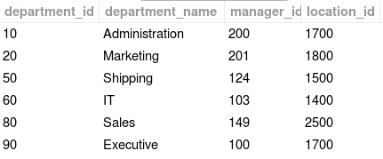
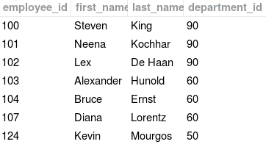
Foreign Key Constraint: Example Tables
departments table (partial)
Primary key
employees table (partial)
Foreign key
Notes:
The foreign key (or referential integrity) constraint designates a column or a combination of columns as a foreign key, and establishes a relationship with a primary key or a unique key in the same table or a different table.
In the example in the slide, department_id has been defined as the foreign key in the employees table (child table); it references the department_id column of the departments table (the parent table). If you try to insert a row into the employees table or change the department_id of a row in the employees table, the value provided for department_id must already be a primary key in the departments table. If you try to delete a row from the departments table or try to change the value for a department_id in the departments table it will first check whether there is a row in the employees table with that foreign key and take the action defined for the foreign key, described later in this lesson.
Guidelines
A foreign key value must match an existing value in the parent table or be NULL.
Foreign keys are based on data values and are purely logical, rather than physical, pointers.
The primary key and foreign key might have the same column name (as in this example), but that is not required and often not appropriate.

Slide 22
FOREIGN KEY Constraint: Example Statement
CREATE TABLE employees4
(employee_id INTEGER,
first_name VARCHAR(20),
last_name VARCHAR(25),
email VARCHAR(25),
phone_number VARCHAR(20),
hire_date DATE,
job_id VARCHAR(10),
salary DECIMAL(8,2),
commission_pct DECIMAL(2,2),
manager_id INTEGER,
department_id INTEGER,
PRIMARY KEY (employee_id),
UNIQUE KEY (email),
CONSTRAINT emp4_dept_fk
FOREIGN KEY (department_id)
REFERENCES departments (department_id));
Notes:
The example in the slide defines a FOREIGN KEY constraint on the department_id column of the employees table. This makes department_id in the employees4 child table a foreign key that must match a value for the primary key department_id in the departments table. The name of the constraint is emp4_dept_fk. The name must be unique for all tables in the database. If you do not provide a name for the foreign key constraint, MySQL will generate a name. The CONSTRAINT keyword is optional. If CONSTRAINT is omitted, the foreign key name must be omitted.

Slide 23
FOREIGN KEY Constraint: Referential Actions
To control what happens to rows in a child table when a DELETE or UPDATE operation affects a key value in a parent table that has matching rows in the child table, you can include one or both of these optional subclauses at the end of the FOREIGN KEY clause:
The referential_action can be one of the following:
RESTRICT or NO ACTION: This rejects the DELETE or UPDATE operation on the parent table. It is the default action if ON DELETE or ON UPDATE is omitted.
CASCADE: This deletes or updates the row in the parent table and automatically deletes or updates the matching rows in the child table.
SET NULL: This deletes or updates the row in the parent table and sets the foreign key column or columns in the child table to NULL.
[ON DELETE referential_action]
[ON UPDATE referential_action]
Notes:
If ON DELETE or ON UPDATE are not included at the end of a FOREIGN KEY clause, the default is to reject a deletion or update on the parent table. This is the same as specifying RESTRICT or NO ACTION. Specifying ON DELETE CASCADE in the example with the department_id foreign key would mean that, if you delete a department from the departments table, all employees with that same department_id would be deleted. Specifying ON UPDATE CASCADE in the example would mean that, if you change the department_id in the department table, all employees with that department_id would be assigned the newly updated department_id. If you specify ON DELETE SET NULL or ON UPDATE SET NULL, be sure the column in the child table is not defined as NOT NULL.

Slide 24
Secondary Indexes
A secondary index does not have any constraints and is used to speed up access to data. For example:
CREATE TABLE employees5
(employee_id INTEGER,
first_name VARCHAR(20),
last_name VARCHAR(25),
email VARCHAR(25),
phone_number VARCHAR(20),
hire_date DATE,
job_id VARCHAR(10),
salary DECIMAL(8,2),
commission_pct DECIMAL(2,2),
manager_id INTEGER,
department_id INTEGER,
PRIMARY KEY (employee_id),
UNIQUE KEY (email),
INDEX emp5_name_ix (last_name),
CONSTRAINT emp5_dept_fk
FOREIGN KEY (department_id)
REFERENCES departments (department_id));
Notes:
A secondary index (or key) does not have to be unique or have any referential constraints. The index provides faster access to data. For example, if you know that many searches will be done on employees' last names, you can create an index for the last_name column. Last names do not have to be unique. Any kind of index, including primary key, unique key, foreign key, or secondary index can be a composite key combining multiple columns to form the key value. For primary and unique keys, the individual parts of the composite key do not have to be unique, but the value of the combined columns must be unique.

Slide 25
Lesson Agenda
Database objects
Naming rules
CREATE TABLE statement
Data types
Indexes, keys, and constraints
Column options
Creating a table using a subquery
ALTER TABLE statement
DROP TABLE statement

Slide 26
Column Options
You can add options to the CREATE TABLE statement’s column definitions, including NULL, NOT NULL, DEFAULT, or AUTO_INCREMENT.
Example:
CREATE TABLE employees6
(employee_id INTEGER AUTO_INCREMENT,
first_name VARCHAR(20),
last_name VARCHAR(25) NOT NULL,
email VARCHAR(25) NOT NULL,
phone_number VARCHAR(20),
hire_date DATE NOT NULL,
job_id VARCHAR(10) NOT NULL,
salary DECIMAL(8,2),
commission_pct DECIMAL(2,2),
manager_id INTEGER DEFAULT 1,
department_id INTEGER DEFAULT 10,
PRIMARY KEY (employee_id),
UNIQUE KEY (email),
INDEX emp6_name_ix (last_name),
CONSTRAINT emp6_dept_fk
FOREIGN KEY (department_id)
REFERENCES departments (department_id));
Notes:
The example in this slide creates a table similar to the employees table. You can include NULL as an option or omit it because it is the default and means that the column can accept NULL as a value. Specifying NOT NULL indicates that the column must have a value and cannot be set to NULL. The DEFAULT option specifies the default value to use when a row is inserted. To use the default value, if specifying the list of column names in the INSERT statement, omit the column name for the column to be set to its default and don't provide a value for it in the VALUES clause. Alternatively, you can use the DEFAULT keyword in the VALUES clause to set the column to its default value.
The AUTO_INCREMENT attribute can be set on an indexed column and sets the value for the column to the next higher value. When inserting a new value, either omit the value from the list of column names and VALUES clause or specify the value as NULL, and it will be assigned the next higher value.
The following statement would set the employee_id to the next higher integer value, set manager_id and department_id to their default values of 1 and 10, respectively, and set any columns not listed to NULL.
INSERT INTO employees6 (last_name, email, hire_date, job_id)
VALUES ('jones', 'jones', '2010-01-01', 'AC_MGR');

Slide 27
Lesson Agenda
Database objects
Naming rules
CREATE TABLE statement
Data types
Indexes, keys, and constraints
Column options
Creating a table using a subquery
ALTER TABLE statement
DROP TABLE statement

Slide 28

Creating a Table Using a Subquery
Create a table and insert rows by combining the CREATE TABLE statement and the AS subquery option.
Match the number of specified columns to the number of subquery columns.
Define columns with column names and default values.
CREATE TABLE table
[(column, column...)]
AS subquery;
Notes:
A second method for creating a table is to apply the AS subquery clause, which both creates the table and inserts rows returned from the subquery.
In the syntax:
table: the name of the table
column: the name of the column, default value, and integrity constraint
subquery: the SELECT statement that defines the set of rows to be inserted into the new table
Guidelines
The table is created with the specified column names, and the rows retrieved by the SELECT statement are inserted into the table.
The column definition can contain only the column name and default value.
If column specifications are given, the number of columns must equal the number of columns in the subquery SELECT list.
If no column specifications are given, the column names of the table are the same as the column names in the subquery.
The column data type definitions and the NOT NULL constraint are passed to the new table. Note that only the explicit NOT NULL constraint will be inherited. The PRIMARY KEY column will not pass the NOT NULL feature to the new column. Any other constraint rules are not passed to the new table. However, you can add constraints in the column definition.

Slide 29
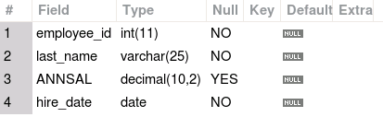
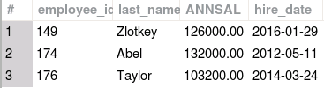
Creating a Table Using a Subquery: Example
CREATE TABLE dept80
AS
SELECT employee_id, last_name,
salary*12 ANNSAL,
hire_date
FROM employees
WHERE department_id = 80;
DESCRIBE dept80;
SELECT * FROM dept80;
Notes:
The example in the slide creates a table named dept80, which contains details of all the employees working in department 80. Notice that the data for the dept80 table comes from the employees table. You can verify the existence of a database table and check the column definitions by using the DESCRIBE statement. The employee_id column is not set as the primary key, but the NOT NULL attributes are maintained. You can provide a column alias when using an expression in the subquery. In the example, the expression salary*12 is given the alias ANNSAL.

Slide 30
Lesson Agenda
Database objects
Naming rules
CREATE TABLE statement
Data types
Indexes, keys, and constraints
Column options
Creating a table using a subquery
ALTER TABLE statement
DROP TABLE statement

Slide 31

ALTER TABLE Statement
Use the ALTER TABLE statement to:
Add a new column
Modify an existing column definition
Define a default value for the new column
Drop a column
Rename a column
Add an index or constraint
Notes:
After you create a table, you may need to change the table structure for any of the following reasons:
You omitted a column.
Your column definition or its name needs to be changed.
You need to remove columns.
You want to put the table into read-only mode
You can do this by using the ALTER TABLE statement.

Slide 32
ALTER TABLE Statement: Add, Modify, or Drop Columns
Use the ALTER TABLE statement to add, modify, or drop columns:
ALTER TABLE table
ADD [COLUMN] column datatype [column_options]
[FIRST | AFTER column_name];
ALTER TABLE table
MODIFY [COLUMN] column datatype [column_options]
[FIRST | AFTER column_name];
ALTER TABLE table
DROP [COLUMN] column;
Notes:
You can add columns to a table, modify columns, and drop columns from a table by using the ALTER TABLE statement.

Slide 33
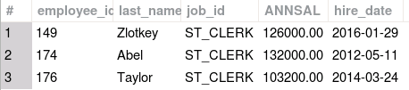

Adding a Column
You use the ADD clause to add columns:
The new job_id column is added after the last_name column, with the values set to ST_CLERK:
ALTER TABLE dept80
ADD job_id VARCHAR(10) NOT NULL DEFAULT 'ST_CLERK'
AFTER last_name;
SELECT * FROM dept80;
Notes:
The example in the slide adds a column named job_id to the dept80 table.. Because this table already contains data, in order to set the NOT NULL option, you need to provide a default value, and all the rows are provided with that default value in that column. If the table is empty, you can specify the NOT NULL option without providing a default value. If you do not specify the NOT NULL or DEFAULT options, the values of the new column are set to NULL. In the example, the job_id column is inserted after the last_name column If you specify FIRST rather than AFTER, the column is added before the employee_id column. If you do not specify either FIRST or AFTER, by default, the column is added at the end.

Slide 34
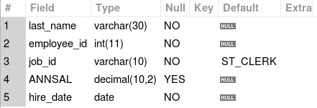
Modifying a Column
You can change a column’s data type, size, column options or position.
ALTER TABLE dept80
MODIFY last_name VARCHAR(30) NOT NULL FIRST;
DESCRIBE dept80;
The size of the last_name column is modified and it is moved to the first column.
The full column definition must be included. If NOT NULL had been omitted, the column would have been changed from NOT NULL to accepting NULL values.
If a default value is provided, it affects only subsequent insertions to the table
Notes:
You can modify a column definition by using the ALTER TABLE statement with the MODIFY clause. Column modification can include changes to a column’s data type, size, or column options like DEFAULT and NOT NULL. You can also change the position of the column with FIRST or AFTER. The column remains in its previous position if you omit FIRST or AFTER.

Slide 35
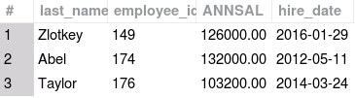

Dropping a Column
Use the DROP COLUMN clause to drop columns that you no longer need from the table:
ALTER TABLE dept80
DROP COLUMN job_id;
SELECT * FROM dept80;
Notes:
You can drop a column from a table by using the ALTER TABLE statement with the DROP COLUMN clause. If a table includes only one column, the column cannot be dropped. A MySQL extension to standard SQL permits a single ALTER TABLE statement to contain multiple ADD, MODIFY, or DROP clauses, separated by commas. For example, the following statement drops multiple columns:
ALTER TABLE dept80
DROP COLUMN ANNSAL,
DROP COLUMN hire_date;

Slide 36
ALTER TABLE Statement: Add an Index or Constraint
Normally, you create indexes and constraints by using the CREATE TABLE statement when you create the table. Use the ALTER TABLE statement to add an index or constraint:
ALTER TABLE table
ADD PRIMARY KEY (column_name);
ALTER TABLE table
ADD [UNIQUE] INDEX (column_name);
ALTER TABLE table
ADD CONSTRAINT key_name
FOREIGN KEY (child_column_name)
REFERENCES parent_table (parent_column_name);
Notes:
By using an ALTER TABLE statement, you can add a primary key (only if the table does not yet have a primary key, a UNIQUE index, a secondary index, or a foreign key. If you are adding a primary key or unique index to a table that contains data, the statement is rejected if the values are not unique. If you add a foreign key to a table that already contains data, if the values in the foreign key column in the child table do not have corresponding values in the primary key of the parent table, the statement is rejected.

Slide 37
ALTER TABLE to Add a Constraint or Index: Example
The following example adds the constraint of manager_id being a foreign key in the employees5 table that references the employee_id in the same table.
ALTER TABLE employees6
ADD CONSTRAINT emp6_manager_fk
FOREIGN KEY (manager_id)
REFERENCES employees6 (employee_id);
Notes:
The statement in this slide creates a foreign key for the manager_id column in the employees5 table that references the employee_id in the same table. Any manager_id must be the employee_id of some employee in the table.

Slide 38
Creating Indexes by Using the CREATE INDEX Statement
With the CREATE INDEX statement, you can add a unique key or a secondary index with no constraints to a table.
Syntax:
CREATE [UNIQUE] INDEX index_name
ON table_name (column_name);
Example:
CREATE INDEX emp6_job_ix ON employees6 (job_id);
Notes:
The example in this slide creates a secondary index for job_id in the employees6 table. If you find that many queries use job_id as a search criteria, you might find it useful to add this index to speed up searches. Note that job_id in the employees6 table cannot be a unique key because many people might have the same job_id. This statement is a shorter version of the following ALTER TABLE statement:
ALTER TABLE employees6
ADD INDEX emp6_job_ix (job_id);

Slide 39
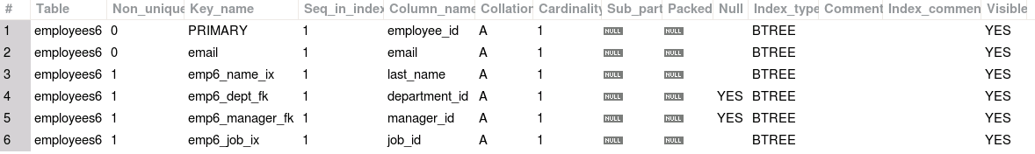
Viewing Index Definitions by Using the SHOW INDEX Statement
General syntax for viewing index definitions:
SHOW INDEX FROM table_name [FROM database_name]
Example:
SHOW INDEX FROM employees6;
Notes:
If the database containing the table has been set as the default, you can omit the database name from the statement. In the output, the Non_unique column displays a 1 if the index does not have the unique constraint and 0 if it is unique. The output displays the name of the index as well as the columns being indexed. The primary key always has the name PRIMARY. The Null column indicates if the column can be set to NULL.

Slide 40
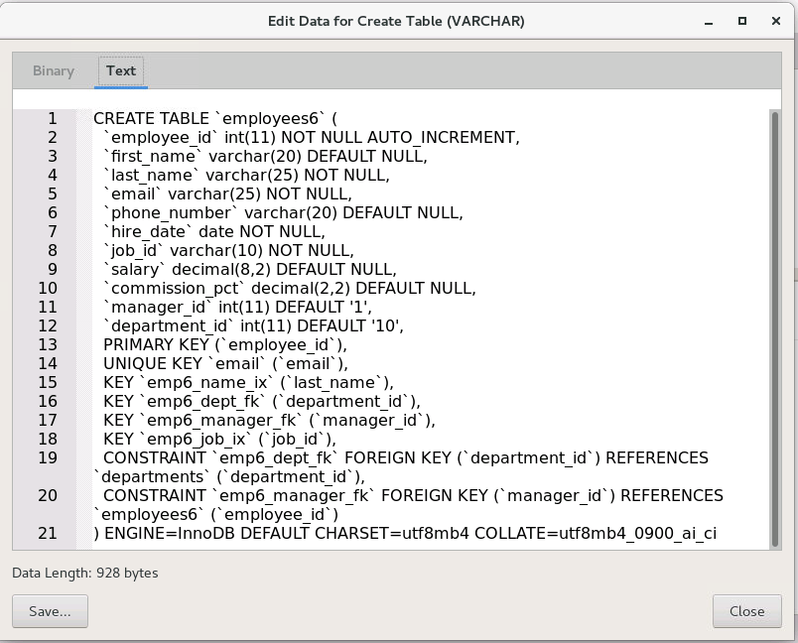
Showing How a Table Was Created with the SHOW CREATE TABLE Statement
View the statement that can be used to create the table. For example:
SHOW CREATE TABLE employees6;
Notes:
The SHOW CREATE TABLE statement produces a statement that can create a table with the same properties as the table specified. This helps you to understand the structure of a table. You can use it to create a new table with the same structure. It does not show the exact statement that was used to create the table. It includes any modifications to the table from ALTER statements and might include more information, for example, about default values than were specified in any CREATE TABLE or ALTER TABLE statements. For example, the output shows default values of NULL for some columns even though that was not specified in any statement. The CREATE TABLE statement also includes some table options at the end even though those were not specified when creating the table.
Note: The results of the statement in MySQL Workbench might be too long to read in the Result Grid. Right-click the output and select Open Value in Viewer. Select the Text tab. You can save the generated CREATE TABLE statement to a file. When you are finished, click the Close button.

Slide 41
Lesson Agenda
Database objects
Naming rules
CREATE TABLE statement
Data types
Indexes, keys, and constraints
Column options
Creating a table using a subquery
ALTER TABLE statement
DROP TABLE statement

Slide 42


Dropping a Table
DROP TABLE removes the table definition and all its data entirely.
Syntax:
DROP TABLE [IF EXISTS] table_name [, table_name] ...;
The optional IF EXISTS clause prevents an error from occurring if the table does not exist. If it is omitted, dropping a table that does not exist generates an error.
Example:
DROP TABLE IF EXISTS dept80;
Notes:
You can drop multiple tables in one statement. For example:
DROP TABLE IF EXISTS
employees1, employees2, employees3, employees4, employees5;

Slide 43
Summary
In this lesson, you should have learned how to use the CREATE TABLE, ALTER TABLE, and DROP TABLE statement to create a table, modify a table and columns, and include constraints.
Categorize the main database objects
Review the table structure
List the data types that are available for columns
Create a simple table
Explain how constraints are created at the time of table creation
Notes:
In this lesson, you should have learned the following:
CREATE TABLE
Use the CREATE TABLE statement to create a table and include constraints.
Create a table based on another table by using a subquery.
DROP TABLE
Remove rows and a table structure.
When executed, this statement cannot be rolled back.

Slide 44

Practice 11b: Overview
This practice covers the following topics:
Creating new tables
Creating a new table by using the CREATE TABLE AS syntax
Verifying that tables exist
Altering tables
Adding columns
Dropping columns
Dropping tables
Notes:
You create new tables by using the CREATE TABLE statement and confirm that the new table was added to the database.

