Slide 1
Creating Functions

Slide 2
Course Road Map
Lesson 11: Creating Procedures
Lesson 12: Creating Functions
Unit 4: Working with Sub programs
Lesson 13: Debugging Subprograms
Lesson 14: Creating Packages
Unit 5: Working with Triggers
Lesson 15: Working with Packages
Unit 6: Working with PL/SQL Code
Lesson 16: Using Oracle-Supplied Packages in Application Development
Lesson 17: Using Dynamic SQL
Notes:
In the fourth unit, we have seven lessons – Creating Stored Procedures, Creating Functions, Debugging Subprograms, Creating Packages, Working with Packages, Using Oracle Supplied Packages in Application Development, and Using Dynamic SQL. You will learn to write PL/SQL subprograms, packages, and use them in Application Development.

Slide 3
Objectives
After completing this lesson, you should be able to:
Differentiate between a procedure and a function
Describe the uses of functions
Create stored functions
Invoke a function
Remove a function
Explain the basic functionality of the SQL Developer debugger
Notes:
In this lesson, you learn how to create, invoke, and maintain functions.

Slide 4

Lesson Agenda
Creating and invoking functions
Functions in SQL expressions
Passing parameters to functions
Removing stored functions

Slide 5
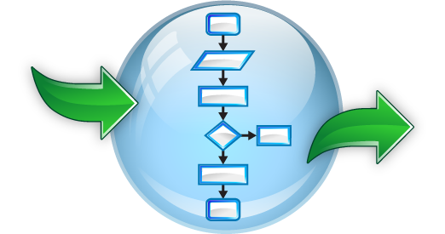
Functions
Named PL/SQL block like procedure
Accepts input as parameters
Processes the input and returns a value
Stored as a database object
Enables modularization in the application
Can be invoked as part of an expression
Notes:
You know about procedures: they are named PL/SQL blocks stored on the database. Functions are similar to procedures in most of its features except for the fact that they return a single value.
Functions are named PL/SQL blocks that are used to implement modularization in the application. You should define functions to represent a logical functionality of the application. Procedures do the same job except for the fact that functions return a value to the calling environment. In case of procedures, you can see the output of the procedure by accessing the OUT parameters of the procedure and procedures may or may not have an output, but functions will always return a value.
Each function has a RETURN statement in its PL/SQL block. There can be more than one return statements in a PL/SQL block; however, a function will execute only one of these return statements based on the function logic.

Slide 6
Creating Functions syntax
The PL/SQL block must have at least one RETURN statement.
CREATE [OR REPLACE] FUNCTION function_name [(parameter1 [mode1] datatype1, . . .)]
RETURN datatype IS|AS
[local_variable_declarations;
. . .]
BEGIN -- actions;
RETURN expression;
END [function_name];
Notes:
Syntax for Creating Functions
A function is a PL/SQL block that returns a value. A RETURN statement must be provided to return a value with a data type that is consistent with the function declaration.
You create new functions with the CREATE FUNCTION statement, which may declare a list of parameters, must return one value, and must define the actions to be performed by the standard PL/SQL block.
The type of value returned from the function can be a scalar data type or a composite data type.
You should consider the following points about the CREATE FUNCTION statement:
The REPLACE option indicates that if the function exists, it is dropped and replaced with the new version that is created by the statement.
The RETURN data type must not include a size specification.
The PL/SQL block starts with a BEGIN after the declaration of any local variables and ends with an END, optionally followed by the function_name.
There must be at least one RETURN expression statement.
You can’t reference host or bind variables in the PL/SQL block of a stored function.

Slide 7
Notes:
The function syntax shown in the slide is good enough to create a usable function; however, a function declaration may have following additional options to improve performance in an operational application. These options are not required to implement the basic functionality of a function.

Slide 8


Tax Calculation
I could update the database with the promotions and salary raise. Thanks Alice. Now I need your help in calculating the tax applicable for each employee.
Sure, tell me the formula for calculation.
I will mail you the formula. It’s a bit complicated. The code you write should help me in arriving at a value based on input. It should be good to use in mathematical formulas. I may have to calculate taxes in many places.
Got it
Notes:
The HR manager in this scenario wants to calculate the tax applicable for an employee. He wants to use this in some mathematical expression. For instance to calculate the payable salary for an employee, the tax per month must be deducted from the salary value in the EMPLOYEES table for that employee.
net salary = salary – tax applicable
The HR manager requires a program construct that can substitute the value of tax applicable in the mathematical expression.
Functions are useful in such scenarios. You can write a function for tax and pass the employee_id as the input parameter. The function should pick up the value of the salary from the database, calculate the applicable tax, and return the value of the tax into the mathematical expression. The expression would in turn calculate the net salary.

Slide 9
The Difference Between Procedures and Functions
Procedures | Functions
Execute as a PL/SQL statement | Invoke as part of an expression
Do not contain RETURN clause in the header | Must contain a RETURN clause in the header
Can pass values (if any) using output parameters | Must return a single value
Can contain a RETURN statement without a value | Must contain at least one RETURN statement
Cannot invoke from SQL expressions | Can be invoked from a SQL expression
Notes:
You create a procedure to store a series of actions for later execution. A procedure can contain zero or more parameters that can be transferred to and from the calling environment, but a procedure doesn’t have to return a value. A procedure can call a function to assist with its actions.
Note: A procedure containing a single OUT parameter would be better rewritten as a function returning the value.
You create a function when you want to compute a value that must be returned to the calling environment. A function can contain zero or more parameters that are transferred from the calling environment. Functions typically return only a single value, and the value is returned through a RETURN statement. Functions used in SQL statements should not use OUT or IN OUT mode parameters. Although a function using output parameters can be used in a PL/SQL procedure or block, it can’t be used in SQL statements.

Slide 10





Creating Functions: Overview
/
YES
Create/edit procedure
Compiler warnings/errors?
View compiler warnings/errors
NO
Execute procedure
Notes:
To develop a function by using a tool such as SQL Developer, perform the following steps:
You can create the function using SQL Developer or SQL Plus.
Compile the function. The function is created in the database on compilation. The CREATE FUNCTION statement creates and stores the source code and the compiled m-code in the database. The compilation process can be GUI based as in SQL Developer or as in the case of command-line interface such as SQL Plus ,you can compile the function like any other command.
If compilation errors exist, then the m-code isn’t generated and you must edit the source code to make corrections. You can’t invoke a function that contains compilation errors. You can view the compilation errors in the Compiler Log of SQL Developer, SQL*Plus when you compile the code.
After successful compilation, execute the procedure to perform the desired action. You can run the procedure using SQL Developer GUI or use the EXECUTE command in SQL*Plus.

Slide 11
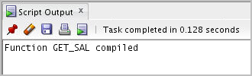
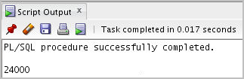
Invoking a Stored Function: Example
CREATE OR REPLACE FUNCTION get_sal
(p_id employees.employee_id%TYPE) RETURN NUMBER IS
v_sal employees.salary%TYPE := 0;
BEGIN
SELECT salary
INTO v_sal
FROM employees
WHERE employee_id = p_id;
RETURN v_sal;
END get_sal;
/
-- Invoke the function as an expression or as
-- a parameter value.
EXECUTE dbms_output.put_line(get_sal(100))
Notes:
In this slide, you create a get_sal function to retrieve the value of the salary of an employee. The code in the first code box creates the function. When the function is successfully compiled, you see the response ‘Function GET_SAL compiled’ as shown in the slide.
The function has one input parameter and returns a NUMBER value. It accepts the employee_id and retrieves the salary of the employee with the given employee_id.
The get_sal function follows a common programming practice of using a single RETURN statement that returns a value assigned to a local variable. If your function has an exception section, then it may also contain a RETURN statement.
You can incorporate a function call as part of a PL/SQL expression because the function will return a value to the calling environment. You can incorporate multiple function calls in a single PL/SQL expression resulting in a simpler and maintainable code.
The second code box uses the SQL*Plus EXECUTE command to call the DBMS_OUTPUT.PUT_LINE procedure whose argument is the return value from the function get_sal. In this case, get_sal is invoked first to calculate the salary of the employee with ID 100. The salary value returned is supplied as the value of the DBMS_OUTPUT.PUT_LINE parameter, which displays the result (if you have executed a SET SERVEROUTPUT ON).
Note: A function must always return a value. The example doesn’t return a value if a row is not found for a given id. Ideally, create an exception handler to return a value as well.

Slide 12
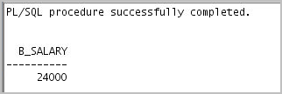

Using Different Methods for Executing Functions
-- As a PL/SQL expression, get the results using host variables
VARIABLE b_salary NUMBER
EXECUTE :b_salary := get_sal(100)
-- As a PL/SQL expression, get the results using a local
-- variable SET SERVEROUTPUT ON
DECLARE
sal employees.salary%type;
BEGIN
sal := get_sal(100);
DBMS_OUTPUT.PUT_LINE('The salary is: '|| sal);
END;
/
Notes:
Functions can be invoked in the following ways:
As part of PL/SQL expressions: You can use host or local variables to hold the returned value from a function. The first example in the slide uses a host variable and the second example uses a local variable in an anonymous block.
Note: The benefits and restrictions that apply to functions when used in a SQL statement are discussed in the following slides.

Slide 13
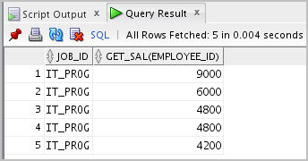
Using Different Methods for Executing Functions
-- Use as a parameter to another subprogram
EXECUTE dbms_output.put_line(get_sal(100))
-- Use in a SQL statement (subject to restrictions)
SELECT job_id, get_sal(employee_id)
FROM employees
WHERE department_id = 60;
Notes:
As a parameter to another subprogram: The first example in the slide demonstrates this usage. The get_sal function with all its arguments is nested in the parameter required by the DBMS_OUTPUT.PUT_LINE procedure. This comes from the concept of nesting functions as discussed in the course titled Oracle Database: SQL Fundamentals I.
As an expression in a SQL statement: The second example in the slide shows how a function can be used as a single-row function in a SQL statement.

Slide 14
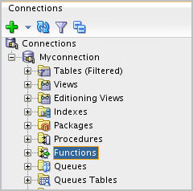
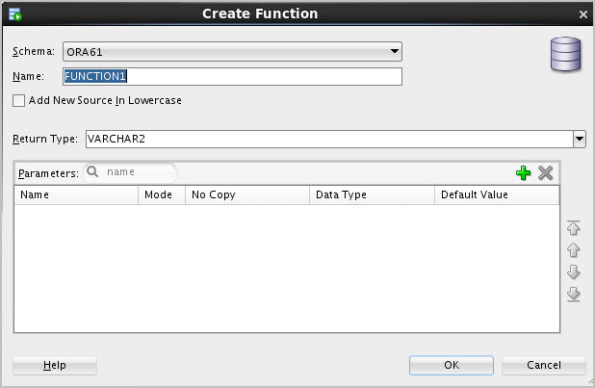
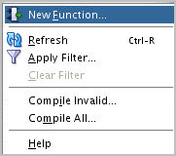
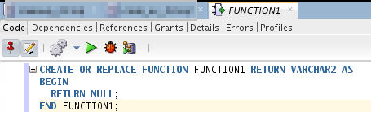
Creating and Compiling Functions Using SQL Developer
1
2
3
Change function name
4
Compile
Write function code
Notes:
You can create a new function in SQL Developer by using the following steps:
1. Right-click the Functions node.
2. Select New Function from the shortcut menu. The Create PL/SQL Function dialog box is displayed.
3. Select the schema, function name, and the parameters list (using the + icon), and then click OK. The code editor for the function is displayed.
4. Enter the function’s code.
5. To compile the function, click the Compile icon.
Note
To create a new function in SQL Developer, you can also enter the code in the SQL Worksheet, and then click the Run Script icon.
For additional information about creating functions in SQL Developer, access the appropriate online Help topic titled “Create PL/SQL Subprogram Function or Procedure.”

Slide 15
Lesson Agenda
Creating and invoking functions
Functions in SQL expressions
Passing parameters to functions
Removing stored functions

Slide 16
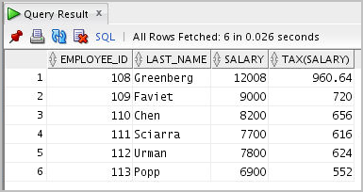
Using a Function in a SQL Expression: Example
CREATE OR REPLACE FUNCTION tax(p_id IN employees.employee_id%type)
RETURN NUMBER IS
v_sal employees.salary%type;
BEGIN
select salary into v_sal
from employees
where employee_id = p_id;
RETURN (v_sal * 0.08);
END tax;
/
SELECT employee_id, last_name, salary, tax(employee_id)
FROM employees
WHERE department_id = 100;
Notes:
The example in the slide shows how to create a tax function to calculate income tax. The function accepts an employee_id as input parameter and calculates the tax applicable for that employee based on the salary of that employee.
To execute the code shown in the slide example in SQL Developer, enter the code in the SQL Worksheet, and then click the Run Script icon. The tax function is invoked as an expression in the SELECT clause along with the employee ID, last name, and salary for employees in a department with ID 100. The return result from the tax function is displayed with the regular output from the query.

Slide 17
Calling User-Defined Functions in SQL Statements
User-defined functions act like built-in single-row functions and can be used in:
The SELECT list or clause of a query
Conditional expressions of the WHERE and HAVING clauses
The ORDER BY and GROUP BY clauses of a query
The VALUES clause of the INSERT statement
The SET clause of the UPDATE statement
Notes:
A PL/SQL user-defined function can be called from any SQL expression where a built-in single-row function can be called as shown in the following example:
SELECT employee_id, tax(employee_id) FROM employees
WHERE tax(employee_id) > (SELECT MAX(tax(employee_id))
FROM employees
WHERE department_id = 30)
ORDER BY tax(employee_id) DESC;
Note: You can use SQL functions with CONNECT BY and START WITH clauses in hierarchical SQL queries.

Slide 18
Restrictions When Calling Functions from SQL Expressions
User-defined functions that are callable from SQL expressions must:
Be stored in the database
Accept only IN parameters with valid SQL data types and PL/SQL-specific data types
Return valid SQL data types and PL/SQL-specific data types
When calling functions in SQL statements:
Be the owner of the function
Have the EXECUTE privilege
Enable the PARALLEL_ENABLE option in function specification
Notes:
The user-defined PL/SQL functions that are callable from SQL expressions must meet the following requirements:
The function must be stored in the database.
The function parameters must be IN and of valid SQL data types and PL/SQL-specific data types.
The functions must return data types that are valid SQL data types and PL/SQL-specific data types such as BOOLEAN, RECORD, or TABLE.
The following restrictions apply when calling a function in a SQL statement:
Parameters must use positional notation or named notation.
You must own or have the EXECUTE privilege on the function.
You may need to enable the PARALLEL_ENABLE option in the function specification to allow a parallel execution of the SQL statement using the function. Each parallel session using the function will have private copies of the function’s local variables.
Other restrictions on a user-defined function include the following:
You cannot invoke the function from the CHECK constraint clause of a CREATE TABLE or ALTER TABLE statement.
You cannot use a function to define the default value of a column.

Slide 19


Side Effects of Function Execution
A subprogram may have side effects when it performs one of the following operations:
Updates its own OUT or IN OUT parameter
Modifies a global variable
Modifies a public variable in a package
Updates a database table
Modifies the database
Notes:
A function executes with or without input parameters and returns a value. A function is expected to return one value of scalar data type or composite data type. However, developers can also use OUT or IN OUT parameters, which also reflect the output of the function. Functions can update global variables, perform update and other DML operations on the database.
If the function definition has any of the operations mentioned in the slide, then those updates and modifications are side effects of the function execution besides the value returned.
These side effects might sometimes produce undesirable effects in the database. Execution of such functions may result in inconsistent data in the database or an error. Therefore, it is essential to follow some guidelines while writing code for functions.

Slide 20
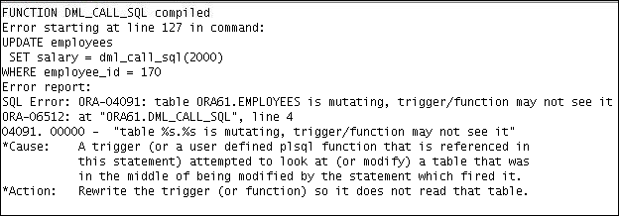
Controlling Side Effects
CREATE OR REPLACE FUNCTION dml_call_sql(p_sal NUMBER)
RETURN NUMBER IS
BEGIN
INSERT INTO employees(employee_id, last_name, email, hire_date, job_id, salary)
VALUES(1, 'Frost', 'jfrost@company.com',
SYSDATE, 'SA_MAN', p_sal);
RETURN (p_sal + 100);
END;
UPDATE employees
SET salary = dml_call_sql(2000)
WHERE employee_id = 170;
Notes:
The code example in the slide demonstrates that, when a function is called from an UPDATE or DELETE statement, the function cannot query or modify database tables modified by that statement. The dml_sql_call function is invoked in the UPDATE statement on the EMPLOYEES table and the function definition has an INSERT statement on the EMPLOYEES table.
You can see that dml_call_sql function in the slide contains an INSERT statement that inserts a new record into the EMPLOYEES table and returns the input salary value incremented by 100. This function is invoked in the UPDATE statement that modifies the salary of employee 170 to the amount returned from the function. The UPDATE statement fails with an error indicating that the table is mutating.
Therefore, a function invoked in an UPDATE statement on a table, which in turn has DML statements for the same table, would lead to an error.

Slide 21
Guidelines to Control Side Effects
Functions called from:
A SELECT statement cannot contain DML statements
An UPDATE or DELETE statement on a table T cannot query or contain DML on the same table T
SQL statements cannot end transactions (that is, cannot execute COMMIT or ROLLBACK operations)
Note: Calls to subprograms that break these restrictions are not allowed in the function.
Notes:
The slide discusses the guidelines to be followed to avoid undesirable side effects of a function execution.
Additional restrictions apply when a function is called in expressions of SQL statements:
When a function is called from a SELECT statement or a parallel UPDATE or DELETE statement, the function cannot modify database tables.
When a function is called from an UPDATE or DELETE statement, the function cannot query or modify database tables modified by that statement.
When a function is called from a SELECT, INSERT, UPDATE, or DELETE statement, the function cannot execute directly or indirectly through another subprogram or SQL transaction control statements such as:
A COMMIT or ROLLBACK statement
A session control statement (such as SET ROLE)
A system control statement (such as ALTER SYSTEM)
Any DDL statements (such as CREATE) because they are followed by an automatic commit

Slide 22
Lesson Agenda
Creating and Invoking functions
Functions in SQL expressions
Passing parameters to functions
Removing stored functions

Slide 23
Passing Parameters to Functions
Functions accept :
Named parameters
Positional parameters
Mixed parameters
Let us see a variant of the tax function. This new function would accept the employee_id and nontaxable allowances as input parameters and calculate the tax applicable for the employee. The nontaxable allowances per month has to be deducted from the salary and tax has to be calculated on the remaining amount.
Notes:
PL/SQL allows arguments in a subroutine call to be specified using positional, named, or mixed notation.

Slide 24
Named and Mixed Notation from SQL: Example
CREATE OR REPLACE FUNCTION tax_new(p_id IN employees.employee_id%type,
p_allowances NUMBER default 500)
RETURN NUMBER IS
v_sal employees.salary%type;
BEGIN
select salary into v_sal
from employees
where employee_id = p_id;
v_sal := v_sal-p_allowances;
RETURN (v_sal * 0.08);
END tax_new;
EXECUTE DBMS_OUTPUT.PUT_LINE(tax_new(100));
EXECUTE DBMS_OUTPUT.PUT_LINE(tax_new(100,1500));
EXECUTE DBMS_OUTPUT.PUT_LINE(tax_new(p_allowances =>1500, p_id=>100));
EXECUTE DBMS_OUTPUT.PUT_LINE(tax_new(p_id=>100));
Notes:
The slide shows a tax calculation function which accepts two parameters as input. The input parameters p_id and p_allowances represent the employee_id and allowances payable to the employee, respectively.
The second code box shows various valid function calls for the function tax_new.
The first function call tax_new(100) uses positional parameter, where the first parameter is the employee_id. The p_allowances parameter is substituted with the default value of 500.
The second function call also uses positional parameters where the first value represents the employee_id and the second value represents the allowances for the employee.
The third function call uses named parameters where the values of the parameters are mentioned along with the names.
The fourth function call has the parameter employee_id with the named notation and the parameter p_allowances is provided through the default value.

Slide 25
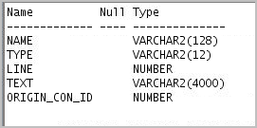
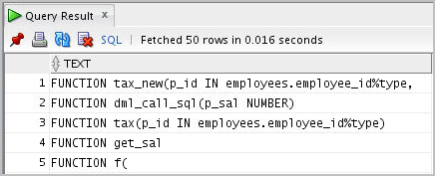
Viewing Functions Using Data Dictionary Views
DESCRIBE USER_SOURCE
SELECT text
FROM user_source
WHERE type = 'FUNCTION'
ORDER BY line;
. . .
Notes:
The source code for PL/SQL subprograms is stored in the data dictionary tables. The source code is accessible to PL/SQL procedures that are successfully or unsuccessfully compiled. To view the PL/SQL source code stored in the data dictionary, execute a SELECT statement on the following tables:
The USER_SOURCE table to display PL/SQL code that you own
The ALL_SOURCE table to display PL/SQL code to which you have been granted the EXECUTE right by the owner of that subprogram code
The query example shows all the columns provided by the USER_SOURCE table:
The NAME column holds the name of the subprogram in uppercase text.
The TYPE column holds the subprogram type, such as PROCEDURE or FUNCTION.
The LINE column stores the line number for each source code line.
The TEXT column holds PL/SQL source code.
The ORIGIN_CON_ID holds the ID of the container where the data originates. The value of the container ID can range from 0-n based on database configuration.
The ALL_SOURCE table provides an OWNER column in addition to the preceding columns.
You can also use the USER_OBJECTS data dictionary view to display a list of your function names.

Slide 26
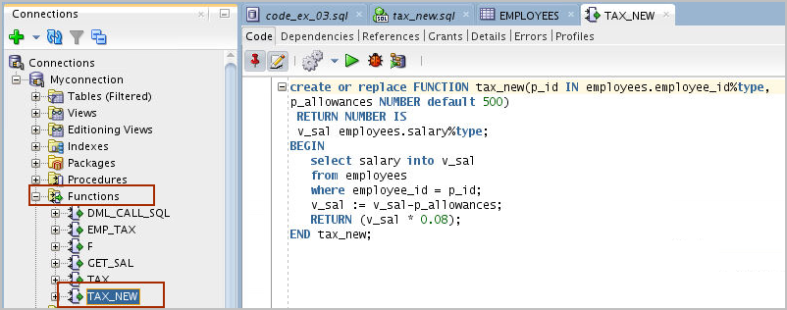
Viewing Functions Information Using SQL Developer
1
2
Notes:
To view a function’s code in SQL Developer, perform the following steps:
1. Click the Functions node in the Connections tab.
2. Click the function’s name.
3. The function's code is displayed in the Code tab as shown in the slide.

Slide 27
Lesson Agenda
Creating and Invoking functions
Functions in SQL expressions
Passing parameters to functions
Removing stored functions

Slide 28
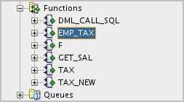
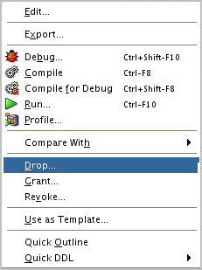
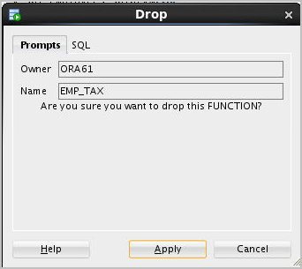
Removing Functions: Using the DROP SQL Statement or SQL Developer
Using the DROP statement:
Using SQL Developer:
DROP FUNCTION function_name;
1
2
3
Notes:
Using the DROP statement
When a stored function is no longer required, you can use a SQL statement in SQL*Plus to drop it. To remove a stored function by using SQL*Plus, execute the DROP FUNCTION SQL command.
Using CREATE OR REPLACE Versus DROP and CREATE
The REPLACE clause in the CREATE OR REPLACE syntax is equivalent to dropping a function and re-creating it. When you use the CREATE OR REPLACE syntax, the privileges granted on this object to other users remain the same. When you DROP a function and then re-create it, all the privileges granted on this function are automatically revoked.
Using SQL Developer
To drop a function in SQL Developer, right-click the function name in the Functions node, and then select Drop. The Drop dialog box is displayed. To drop the function, click Apply.

Slide 29
Quiz
Which of the following statements are true about a PL/SQL stored function?
Can be invoked as part of an expression
Must contain a RETURN clause in the header
Must return a single value
Must contain at least one RETURN statement
Does not contain a RETURN clause in the header
Notes:
Answer: a, b, c, d

Slide 30
Summary
In this lesson, you should have learned how to:
Differentiate between a procedure and a function
Describe the uses of functions
Create stored functions
Invoke a function
Remove a function
Explain the basic functionality of the SQL Developer debugger
Notes:
A function is a named PL/SQL block that must return a value. Generally, you create a function to compute and return a value, and you create a procedure to perform an action.
A function can be created or dropped.
A function is invoked as a part of an expression.

Slide 31

Practice 12: Overview
This practice covers the following topics:
Creating stored functions:
To query a database table and return specific values
To be used in a SQL statement
To insert a new row, with specified parameter values, into a database table
Using default parameter values
Invoking a stored function from a SQL statement
Invoking a stored function from a stored procedure
Notes:
It is recommended to use SQL Developer for this practice.

