Slide 1
Creating Packages

Slide 2
Course Road Map
Lesson 11: Creating Procedures
Lesson 12: Creating Functions
Unit 4: Working with Sub programs
Lesson 13: Debugging Subprograms
Lesson 14: Creating Packages
Unit 5: Working with Triggers
Lesson 15: Working with Packages
Unit 6: Working with PL/SQL Code
Lesson 16: Using Oracle-Supplied Packages in Application Development
Lesson 17: Using Dynamic SQL
Notes:
In the fourth unit, we have seven lessons – Creating Stored Procedures, Creating Functions, Debugging Subprograms, Creating Packages, Working with Packages, Using Oracle Supplied Packages in Application Development, and Using Dynamic SQL. You will learn to write PL/SQL subprograms, packages, and use them in Application Development.

Slide 3
Objectives
After completing this lesson, you should be able to:
Describe packages and list their components
Create a package to group together related variables, cursors, constants, exceptions, procedures, and functions
Designate a package construct as either public or private
Invoke a package construct
Describe the use of a bodiless package
Notes:
In this lesson, you learn what a package is and what its components are. You also learn how to create and use packages.

Slide 4

Lesson Agenda
Identifying the benefits and the components of packages
Working with packages:
Creating the package specification and body
Invoking the package subprograms
Displaying the package information
Removing a package

Slide 5
DBMS_OUTPUT.PUT_LINE
What is DBMS_OUTPUT?
DBMS_OUTPUT is an Oracle-supplied package.
What is PUT_LINE?
A procedure in the DBMS_OUTPUT package that enables displaying messages to output buffer.
DBMS_OUTPUT also have other procedures such as PUT_LINE.
Notes:
You’ve been using DBMS_OUTPUT.PUT_LINE in your code in functions and procedures.
What does DBMS_OUTPUT. PUT_LINE mean?
Oracle supplies many PL/SQL packages with the database to extend its functionality. You can use these packages when creating your applications. DBMS_OUTPUT is one such Oracle-supplied package and PUT_LINE is a procedure in that package. By using this procedure, you avoid writing code for displaying information onto the output buffer. Oracle provides several such packages which can be used in applications by developers.
Apart from the PUT_LINE procedure there are other procedures also defined in the DBMS_OUTPUT package. All the procedures in the DBMS_OUTPUT package are collectively used to display messages or read data from the end user or perform some other related functionality. Developers can use these procedures in their applications.
Oracle allows developers create their own packages with various procedures in it.
From the design perspective, you create a package to create a group of related procedures, functions and other program units. For instance, DBMS_OUTPUT has procedures that deal with displaying output. In your application, you can group multiple procedures performing a logical function into a package.

Slide 6
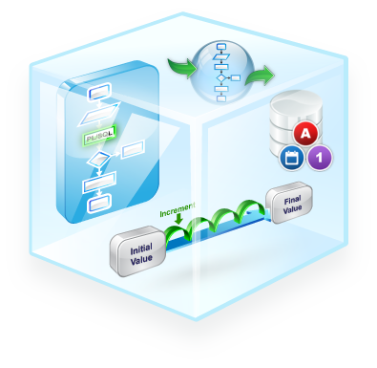
What Is a Package?
A package is a schema object that groups logically related PL/SQL types, variables, sequences, and subprograms.
A package is compiled and stored in the database, where many applications can share its contents.
Notes:
A package is a schema object that groups all logically related objects in an application. For instance, the DBMS_OUTPUT package, which is an Oracle Supplied Package, has all the procedures and functions related to handling output in PL/SQL.
A package may contain various members such as variables, constants, cursors, exceptions, sequences, and so on.

Slide 7







Advantages of Packages
Easier application design
Easy maintenance
Better performance
Modularity
Information hiding
Notes:
The following are the advantages of packages:
Modularity: Packages enable modularity by allowing the developer to logically group various variables, sequences, procedures in the application. You encapsulate logically related programming structures in a named module.
Easier maintenance: The specification and body of the package are independently maintained. You can modify the body of the package without modifying the specification of the package. This flexibility enables better maintenance of the application.
Easier application design: When designing an application, all you need is the interface information in the package specifications. You can code and compile specifications without their bodies. Next, you can compile stand-alone subprograms that reference the packages. You need not fully define the package bodies until you are ready to complete the application.
Information hiding: Packages let you share your interface information in the package specification, and hide the implementation details in the package body. This enables you to change the implementation details without affecting the application interface.
Better performance: The first time you invoke a package subprogram, Oracle database loads the entire package into memory. Subsequent invocations of other subprograms don’t result in additional I/O.

Slide 8
How Do You Create PL/SQL Packages?
Packages usually have two parts:
A specification (spec)
A body
The specification is the interface to the package.
The body has the implementation.
Notes:
If you are a developer creating a HR package, then the package may have a sequence for generating employee_id (which has a requirement of being unique in the company) for a new employee, a variable which provides the head count of employees in the company, a procedure to calculate the tax applicable to an employee and so on.
A package usually consists of two parts stored separately in the database:
A specification
A body
Package specification is declarative, where you declare the types, variables, constants, exceptions, declared cursors, and subprograms that can be referenced from outside the package. A package specification is an application program interface (API): it has all the information that client programs need to invoke its subprograms. The package specification is about what is in the package for the client.
The package body is about implementation of the declarations in the package specification. You can also define local subprograms in the package body which aren’t declared in the package specification. These local subprograms are hidden from client programs.

Slide 9


Components of a PL/SQL Package
variable
Public
Procedure A declaration;
Package
specification
variable initialized
Procedure B definition
…
Package
body
Procedure A definition
BEGIN
…
END;
Private
variable
Notes:
You create a package in two parts:
The package specification is the interface to your applications. It declares the public types, variables, constants, exceptions, cursors, and subprograms available for use. The package specification may also include PRAGMAs, which are directives to the compiler.
The package body defines its own subprograms and must fully implement subprograms declared in the specification part. The package body may also define PL/SQL constructs, such as types, variables, constants, exceptions, and cursors.
When you populate the package with variables, procedures, and other components, you can define whether the component can be accessed by the client or other external components by specifying them to be public or private.
When certain package member is declared as public, then those package members can be accessed by entities outside the package. All the members declared in package specification are public.
When certain package members are declared as private, then those package members can only be accessed by other package members. Private package members can’t be accessed by components external to the package.
In the slide, you can see that the package specification has two members, a variable and procedure A. However in the package body, you see that there is definition of procedure A and procedure B. Procedure A is public and, therefore, can be accessed by external components, whereas procedure B is private and, therefore, can only be accessed by procedure A or other components within the package.

Slide 10
Application Program Interface
Package
Public Components
Private Components
API
A developer can access the functionality of a package through the Application Program Interface (API) of the package.
Notes:
The Application Programming Interface(API) comprises of all the public components of the application.
Public components are declared in the package specification. The specification defines a public application programming interface (API) for users of package functionality. These public components can be referenced from any Oracle server environment that is external to the package.
Private components are placed in the package body and can be referenced only by other constructs within the same package body. Private components can reference the public components of a package.
Note: If a package specification doesn’t contain subprogram declarations, there is no requirement for a package body.
A client can access the package functionality by invoking procedures or functions in the package. The implementation of the package procedures and functions is hidden from the client.

Slide 11
Lesson Agenda
Identifying the benefits and the components of packages
Working with packages:
Creating the package specification and body
Invoking the package subprograms
Displaying the package information
Removing a package

Slide 12
Creating the Package Specification: Using the CREATE PACKAGE Statement
CREATE [OR REPLACE] PACKAGE package_name IS|AS
public type and variable declarations
subprogram specifications
END [package_name];
Notes:
To create packages, you declare all public constructs within the package specification.
Specify the OR REPLACE option if overwriting an existing package specification.
Initialize a variable with a constant value or formula within the declaration, if required; otherwise, the variable is initialized implicitly to NULL.
The following are definitions of items in the package syntax:
package_name specifies a name for the package that must be unique among objects within the owning schema. Including the package name after the END keyword is optional.
public type and variable declarations declares public variables, constants, cursors, exceptions, user-defined types, and subtypes.
subprogram specification specifies the public procedure or function declarations.
The package specification should contain procedure and function headings terminated by a semicolon, without the IS (or AS) keyword and its PL/SQL block. The implementation of a procedure or function that is declared in a package specification is done in the package body.
The Oracle database stores the specification and body of a package separately. This enables you to change the implementation of a program construct in the package body without invalidating other schema objects that call or reference the program construct.
All the constructs declared in a package specification are visible to users who are granted privileges on the package.

Slide 13
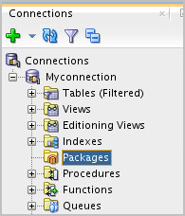
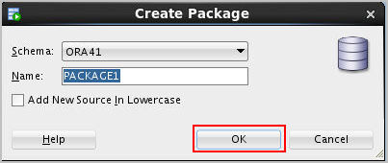
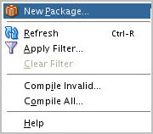
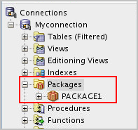
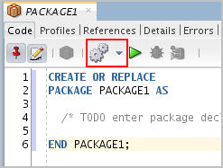

Creating Package Specification: Using SQL Developer
1
Right-click Packages in the Connections tab and select New Package.
2
Provide the package name in the wizard.
4
On successful compilation, package specification is created in the Connections tab and you can also see Compiled message in the Messages tab.
3
Add declarations to the specification and compile it.
Notes:
You can use SQL Developer to create the package specification as follows:
Right-click the Packages node in the Connections navigation tree and select New Package from the shortcut menu.
In the Create PL/SQL Package window, select the schema name, enter the name for the new package, and then click OK. A tab for the new package is displayed along with the shell for the new package.
Add code for the declarations in the package specification for the new package. Compile or save the new package. If there are errors in the package specification, the Messages – Log tab will display Compiled (with errors). You’ve to rectify the errors and recompile the package specification.
If there are no errors in the specification, then the Messages – Log tab will display Compiled as shown in the slide. The newly created package is displayed under the Packages node in the Connections navigation tree.

Slide 14
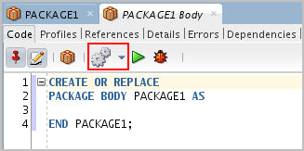
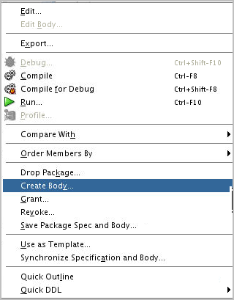
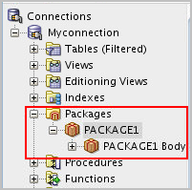
Creating the Package Body: Using SQL Developer
Right-click the Package created and select Create Body.
2
Add procedure and function definitions to the package and compile it.
1
On successful compilation, package body is created in the Connections tab and you can also see Compiled message in the Messages tab.
3
Notes:
You can use SQL Developer to create the package body by performing the following steps:
1. Right-click the package name for which you are creating a body in the Packages node in the Connections navigation tree. Select Create Body from the shortcut menu. A tab for the new package body is displayed along with the shell for the new package body.
2. Enter the code for the new package body. Compile or save the package body.
3. The Messages – Log tab displays whether compilation was successful or not.
4. The newly created package body is displayed under the Packages node in the Connections navigation tree. tree.

Slide 15
Example of a Package Specification: comm_pkg
-- The package spec with a public variable and a
-- public procedure that are accessible from
-- outside the package.
CREATE OR REPLACE PACKAGE comm_pkg IS
v_std_comm NUMBER := 0.10; --initialized to 0.10
PROCEDURE reset_comm(p_new_comm NUMBER);
END comm_pkg;
/
v_std_comm is a public global variable initialized to 0.10.
reset_comm is a public procedure used to reset the standard commission based on some business rules. It is implemented in the package body.
Notes:
The example in the slide creates a package called comm_pkg used to manage business processing rules for commission calculations.
The v_std_comm public (global) variable is declared to hold a maximum allowable percentage commission for the user session, and it is initialized to 0.10 (that is, 10%).
The reset_comm public procedure is declared to accept a new commission percentage that updates the standard commission percentage if the commission validation rules are accepted. The validation rules for resetting the commission aren’t made public and don’t appear in the package specification. The validation rules are managed by using a private function in the package body.

Slide 16
Creating the Package Body
CREATE [OR REPLACE] PACKAGE BODY package_name IS|AS
private type and variable declarations
subprogram bodies
[BEGIN initialization statements]
END [package_name];
The OR REPLACE option drops and re-creates the package body.
Identifiers defined in the package body are private and not visible outside the package body.
All private constructs must be declared before they are referenced.
Public constructs are visible to the package body.
Notes:
Create a package body to define and implement all public subprograms and supporting private constructs. While creating a package body, perform the following steps:
Specify the OR REPLACE option to overwrite an existing package body.
Define the subprograms in an appropriate order. The basic principle is that you must declare a variable or subprogram before it can be referenced by other components in the same package body. It is common to see all private variables and subprograms defined first and the public subprograms defined last in the package body.
Complete the implementation for all procedures or functions declared in the package specification within the package body.
The following are definitions of items in the package body syntax:
package_name specifies a name for the package that must be the same as its package specification. Using the package name after the END keyword is optional.
private type and variable declarations declares private variables, constants, cursors, exceptions, user-defined types, and subtypes.
subprogram specification specifies the full implementation of any private and/or public procedures or functions.
[BEGIN initialization statements] is an optional block of initialization code that executes when the package is first referenced.

Slide 17
Example of a Package Body: comm_pkg
CREATE OR REPLACE PACKAGE BODY comm_pkg IS
FUNCTION validate(p_comm NUMBER) RETURN BOOLEAN IS
v_max_comm employees.commission_pct%type;
BEGIN
SELECT MAX(commission_pct) INTO v_max_comm
FROM employees;
RETURN (p_comm BETWEEN 0.0 AND v_max_comm);
END validate;
PROCEDURE reset_comm(p_new_comm NUMBER) IS
BEGIN
IF validate(p_new_comm) THEN
v_std_comm := p_new_comm; -- reset public var
ELSE RAISE_APPLICATION_ERROR(
-20210, 'Bad Commission');
END IF;
END reset_comm;
END comm_pkg;
Notes:
The slide shows the complete package body for comm_pkg, with a private function validate to check for a valid commission. The validation requires that the commission be positive and less than the highest commission among existing employees. The reset_comm procedure invokes the private validation function before changing the standard commission in v_std_comm. In the example, note the following:
The v_std_comm variable referenced in the reset_comm procedure is a public variable. Variables declared in the package specification, such as v_std_comm, can be directly referenced without qualification.
The reset_comm procedure implements the public definition in the specification.
In the comm_pkg body, the validate function is private and is directly referenced from the reset_comm procedure without qualification.
Note: The validate function appears before the reset_comm procedure because the reset_comm procedure references the validate function. It’s possible to create forward declarations for subprograms in the package body if their order of appearance needs to be changed. If a package specification declares only types, constants, variables, and exceptions without any subprogram specifications, then the package body is unnecessary. However, the body can be used to initialize items declared in the package specification.

Slide 18
Invoking the Package Subprograms: Examples
-- Invoke a function within the same packages:
CREATE OR REPLACE PACKAGE BODY comm_pkg IS ...
PROCEDURE reset_comm(p_new_comm NUMBER) IS
BEGIN
IF validate(p_new_comm) THEN
...
END IF;
END reset_comm;
END comm_pkg;
-- Invoke a package procedure from SQL*Plus:
EXECUTE comm_pkg.reset_comm(0.15)
-- Invoke a package procedure in a different schema:
EXECUTE scott.comm_pkg.reset_comm(0.15)
Notes:
After the package is stored in the database, you can invoke public or private subprograms within the same package, or public subprograms if external to the package. Fully qualify the subprogram with its package name when invoked externally from the package. Use the package_name.subprogram syntax.
Fully qualifying a subprogram when invoked within the same package is optional.
Example 1: Invokes the validate function from the reset_comm procedure within the same package. The package name prefix is not required; it is optional.
Example 2: Calls the reset_comm procedure from SQL*Plus (an environment external to the package) to reset the prevailing commission to 0.15 for the user session
Example 3: Calls the reset_comm procedure that is owned by a schema user called SCOTT. Using SQL*Plus, the qualified package procedure is prefixed with the schema name. This can be simplified by using a synonym that references the schema.package_name.
Assume that a database link named NY has been created for a remote database in which the reset_comm package procedure is created. To invoke the remote procedure, use:
EXECUTE comm_pkg.reset_comm(0.15)

Slide 19
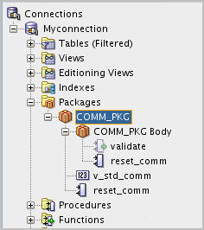
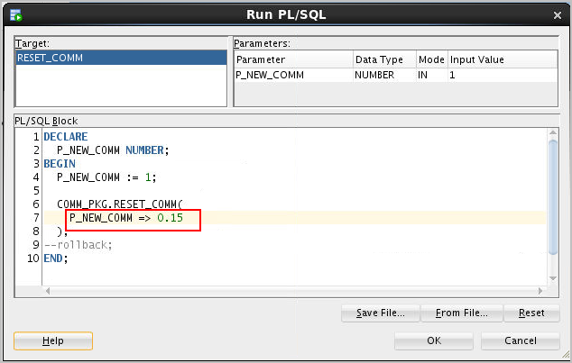
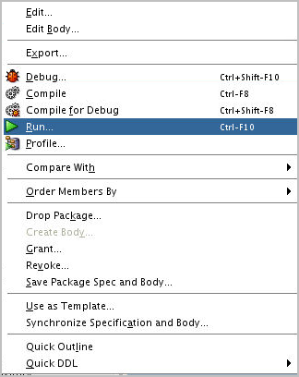
Invoking Package Subprograms: Using SQL Developer
1
2
Notes:
You can use SQL Developer to invoke a package's subprogram by performing the following steps:
1. Right-click the package's name in the Packages node in the Navigation tree and Select Run from the floating menu. The Run PL/SQL window is displayed. You can use the Run PL/SQL window to specify parameter values for running a PL/SQL function or procedure. (If you specify a package, select a function or procedure in the package.) Specify the following:
a. Target: Select the name of the function or procedure to run.
b. Parameters: This section lists each parameter for the specified target. The mode of each parameter can be IN (the value is passed in), OUT (the value is returned), or IN/OUT (the value is passed in, and the result of the function or procedure's action is stored in the parameter).
2. In the PL/SQL Block section, change the formal IN and IN/OUT parameter specifications in this block to actual values that you want to use for running the function or procedure. For example, to specify 0.15 as the value for an input parameter named P_NEW_COMM, change P_NEW_COMM => P_NEW_COMM to P_NEW_COMM => 0.15.
3. Click OK. SQL Developer runs the function or procedure.

Slide 20
Creating and Using Bodiless Packages
CREATE OR REPLACE PACKAGE global_consts IS
c_mile_2_kilo CONSTANT NUMBER := 1.6093;
c_kilo_2_mile CONSTANT NUMBER := 0.6214;
c_yard_2_meter CONSTANT NUMBER := 0.9144;
c_meter_2_yard CONSTANT NUMBER := 1.0936;
END global_consts;
SET SERVEROUTPUT ON
BEGIN
DBMS_OUTPUT.PUT_LINE('20 miles = ' ||
20 * global_consts.c_mile_2_kilo || ' km');
END;
SET SERVEROUTPUT ON
CREATE FUNCTION mtr2yrd(p_m NUMBER) RETURN NUMBER IS
BEGIN
RETURN (p_m * global_consts.c_meter_2_yard);
END mtr2yrd;
/
EXECUTE DBMS_OUTPUT.PUT_LINE(mtr2yrd(1))
Notes:
The variables and constants declared within stand-alone subprograms exist only for the duration that the subprogram executes. To provide data that would exist throughout the user session, create a package specification containing public (global) variables and constant declarations. In this case, a package body isn’t required, such packages are known as a bodiless packages. As discussed earlier in this lesson, if a specification declares only types, constants, variables, and exceptions, then the package body is unnecessary.
Examples:
The first code box in the slide creates a bodiless package specification with several constants to be used for conversion rates. A package body isn’t required to support this package specification. It is assumed that the SET SERVEROUTPUT ON statement was issued before executing the code examples in the slide.
The second code box references the c_mile_2_kilo constant in the global_consts package by prefixing the package name to the identifier of the constant.
The third example creates a stand-alone function c_mtr2yrd to convert meters to yards, and uses the constant conversion rate c_meter_2_yard declared in the global_consts package. The function is invoked in a DBMS_OUTPUT.PUT_LINE parameter.
Rule to be followed: When referencing a variable, cursor, constant, or exception from outside the package, you must qualify it with the name of the package.

Slide 21
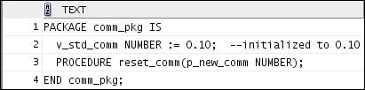
Viewing Packages by Using the Data Dictionary
-- View the package specification.
SELECT text
FROM user_source
WHERE name = 'COMM_PKG' AND type = 'PACKAGE'
ORDER BY LINE;
-- View the package body.
SELECT text
FROM user_source
WHERE name = 'COMM_PKG' AND type = 'PACKAGE BODY'
ORDER BY LINE;
Notes:
The source code for PL/SQL packages is also stored in the USER_SOURCE and ALL_SOURCE data dictionary views. The USER_SOURCE table is used to display PL/SQL code that you own. The ALL_SOURCE table is used to display PL/SQL code to which you’ve been granted the EXECUTE right by the owner of that subprogram code and provides an OWNER column in addition to the preceding columns.
When querying the package, use a condition in which the TYPE column is:
Equal to 'PACKAGE' to display the source code for the package specification
Equal to 'PACKAGE BODY' to display the source code for the package body
You can also view the package specification and body in SQL Developer using the package name in the Packages node.
Note: You can’t display the source code for Oracle PL/SQL built-in packages, or PL/SQL whose source code has been wrapped by using a WRAP utility or obfuscation. Obfuscating and wrapping PL/SQL source code is covered in the lesson titled “Working with Packages.” Clicking the Execute Statement icon (or pressing F9) instead of the Run Script icon in the SQL Worksheet toolbar, sometimes displays a better formatted output in the Results tab as shown in the slide examples.

Slide 22
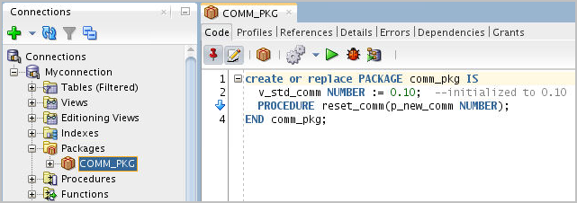
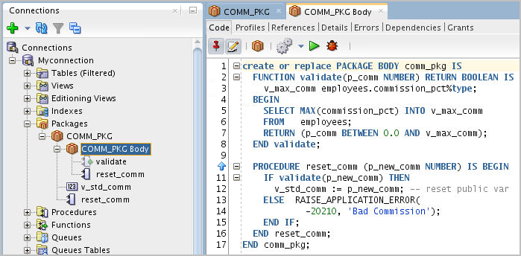
Viewing Packages by Using SQL Developer
1
To view the package spec, click the package name.
2
To view the package body, click the package body.
Notes:
To view a package's spec in SQL Developer, perform the following steps:
1. Click the Packages node in the Connections tab.
2. Click the package's name.
3. The package's spec code is displayed in the Code tab as shown in the slide.
To view a package's body in SQL Developer, perform the following steps:
1. Click the Packages node in the Connections tab.
2. Click the package’s body.
3. The package’s body code is displayed in the Code tab as shown in the slide.

Slide 23
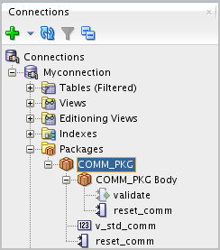
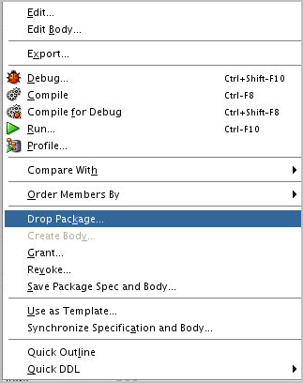
Removing Packages
Drop the package specification and body.
DROP PACKAGE package_name;
Notes:
When a package is no longer required, you can use a SQL statement in SQL Developer to remove it. A package has two parts; therefore, you can remove the whole package, or you can remove only the package body and retain the package specification.
The slide shows removing both the package specification and package body. Through the command-line interface you can remove a package by executing DROP PACKAGE package_name.
In SQL Developer, you can drop a package by right-clicking the package name and selecting Drop Package from the menu.

Slide 24
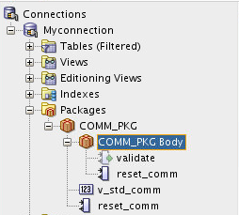
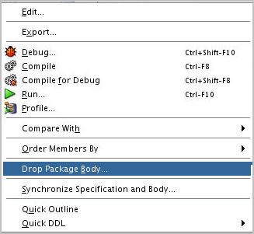
Removing Package Bodies
Drop only the package body.
DROP PACKAGE BODY package_name;
Notes:
The slide demonstrates how you can drop only the package body, instead of dropping the entire package.
You can drop the package body by executing the DROP PACKAGE BODY package_name command.
In SQL Developer, you drop package body by right-clicking the package body and selecting Drop Package Body from the menu.

Slide 25
Guidelines for Writing Packages
Develop packages for general use.
Define the package specification before the body.
The package specification should contain only those constructs that you want to be public.
Place items in the declaration part of the package body when you must maintain them throughout a session or across transactions.
The package specification should contain as few constructs as possible.
Notes:
Keep your packages as generic as possible, so that they can be reused in future applications. Also, avoid writing packages that duplicate features provided by the Oracle server.
Package specifications reflect the design of your application, so define them before defining the package bodies. The package specification should contain only those constructs that must be visible to the users of the package. Thus, other developers can’t misuse the package by basing code on irrelevant details.
Place items in the declaration part of the package body when you must maintain them throughout a session or across transactions. For example, declare a variable called NUMBER_EMPLOYED as a private variable if each call to a procedure that uses the variable needs to be maintained. When declared as a global variable in the package specification, the value of that global variable is initialized in a session the first time a construct from the package is invoked.

Slide 26
Quiz
The package specification is the interface to your applications. It declares the public types, variables, constants, exceptions, cursors, and subprograms available for use. The package specification may also include PRAGMAs, which are directives to the compiler.
True
False
Notes:
Answer: a

Slide 27
Summary
In this lesson, you should have learned how to:
Describe packages and list their components
Create a package to group related variables, cursors, constants, exceptions, procedures, and functions
Designate a package construct as either public or private
Invoke a package construct
Describe the use of a bodiless package
Notes:
You group related procedures and functions in a package. Packages improve organization, management, security, and performance.
A package consists of a package specification and a package body. You can change a package body without affecting its package specification.
Packages enable you to hide source code from users. When you invoke a package for the first time, the entire package is loaded into memory. This reduces the disk access for subsequent calls.

Slide 28

Practice 14 Overview: Creating and Using Packages
This practice covers the following topics:
Creating packages
Invoking package program units
Notes:
In this practice, you create package specifications and package bodies. You then invoke the constructs in the packages by using sample data.
Note: If you are using SQL Developer, your compile-time errors are displayed in the Message Log tab. If you are using SQL*Plus to create your stored code, use SHOW ERRORS to view compile errors.

