Slide 1
Tuning the PL/SQL Compiler

Slide 2
Course Road Map
Lesson 20: Design Considerations for the PL/SQL Code
Unit 4: Working with Subprograms
Lesson 21: Tuning the PL/SQL Compiler
Unit 5: Working with Triggers
Lesson 22: Managing Dependencies
Unit 6: Working with the PL/SQL Code
Notes:
In Unit 6, you will learn the design aspects of the PL/SQL code. You will also learn how to use PL/SQL compiler and how to manage dependencies among different objects in the database application.

Slide 3
Objectives
After completing this lesson, you should be able to:
Use the PL/SQL compiler initialization parameters
Use the PL/SQL compile-time warnings

Slide 4

Lesson Agenda
Using PL/SQL initialization parameters
Using the PL/SQL compile-time warnings:
Using the PLSQL_WARNING initialization parameter
Using the DBMS_WARNING package subprograms

Slide 5

Optimizing PL/SQL Compiler Performance
The PL/SQL compiler implicitly rearranges the code for better performance.
The compiler behavior is defined by its initialization parameters.
You can use initialization parameters to tune the performance of the compiler according to the application requirement.

Slide 6
Initialization Parameters for PL/SQL Compilation
Compilation Parameter | Description
PLSCOPE_SETTINGS | Controls the compile-time collection, cross-reference, and storage of the PL/SQL source text identifier data
PLSQL_CCFLAGS | Lets you control conditional compilation of each PL/SQL unit independently
PLSQL_CODE_TYPE | Specifies the compilation mode for PL/SQL units - INTERPRETED (the default) or NATIVE
PLSQL_OPTIMIZE_LEVEL | Specifies the optimization level at which to compile PL/SQL units
PLSQL_WARNINGS | Enables or disables the reporting of warning messages by the PL/SQL compiler, and specifies which warning messages to show as errors
NLS_LENGTH_SEMANTICS | Lets you create CHAR and VARCHAR2 columns by using either byte-length or character-length semantics
Notes:
PLSCOPE_SETTINGS determines whether the compiler should collect data about the identifiers in the PL/SQL program unit and provide it to the static data dictionary views. The collected data includes information about identifier types, usages, and location of each usage in the source code.
The PLSCOPE_SETTINGS parameter can assume either ‘IDENTIFIERS:ALL’ or ‘IDENTIFIERS:NONE’.
PLSQL_CCFLAGS lets you control the conditional compilation of each program unit. Conditional compilation lets you customize the functionality of a PL/SQL application without removing the source text. For example:
Using new features with the latest database release and disabling them when running the application in an older database release.
Activate debugging or tracing statements in the development environment and hide them when running the application at a production site.
The PLSQL_CODE_TYPE parameter can have either INTERPRETED or NATIVE as its value. It determines the mode of compilation.
The PL/SQL statements in a PL/SQL unit are compiled into an intermediate form, system code, which is stored in the catalog and interpreted at run time. This is the default behavior when the PLSQL_CODE_TYPE parameter is set to INTERPRETED value.
When the PLSQL_CODE_TYPE value is set to NATIVE, the PL/SQL statements in a PL/SQL unit are compiled into native code and stored in the catalog. The native code need not be interpreted at run time, so it runs faster.

Slide 7
Notes:
The PLSQL_OPTIMIZE_LEVEL parameter can have a value in the 0-3 range. A higher value of the parameter implies a greater level of optimization.
The PLSQL_WARNINGS parameter configures the response of the application to various PL/SQL warnings in the application.
The NLS_LENGTH_SEMANTICS parameter determines whether the compiler should use byte-length or character-length semantics for the VARCHAR2 and CHAR variables in the PL/SQL program unit.
The values at the time of compilation of PLSQL_CCFLAGS,PLSQL_CODE_TYPE, PLSQL_OPTIMIZE_LEVEL, PLSQL_WARNINGS, and NLS_LENGTH_SEMANTICS initialization parameters are stored with the unit's metadata. You can view information about the settings of these parameters with the ALL_PLSQL_OBJECT_SETTINGS view.

Slide 8
Using the Initialization Parameters for PL/SQL Compilation
PLSQL_CODE_TYPE: Specifies the compilation mode for PL/SQL library units
PLSQL_OPTIMIZE_LEVEL: Specifies the optimization level to be used to compile PL/SQL library units
19c: to compile PL/SQL units for debugging, specify PLSQL_OPTIMIZE_LEVEL=1
PLSQL_CODE_TYPE = { INTERPRETED | NATIVE }
PLSQL_OPTIMIZE_LEVEL = { 0 | 1 | 2 | 3}
Notes:
PLSQL_CODE_TYPE determines the compilation mode for the PL/SQL program unit. When the value of this parameter is changed, it has no effect on PL/SQL library units that have already been compiled. The value of this parameter is stored persistently with each library unit. If a PL/SQL library unit is compiled natively, all subsequent automatic recompilations of that library unit will use native compilation.
PLSQL_OPTIMIZE_LEVEL defines the extent of optimization applicable to the compilation of the program unit.
PLSQL_OPTIMIZE_LEVEL, when set to 0: the compiler would not reorder the code for better performance.
PLSQL_OPTIMIZE_LEVEL, when set to 1: applies a wide range of optimizations to PL/SQL programs, including the elimination of unnecessary computations and exceptions, but generally does not move the source code out of its original source order
PLSQL_OPTIMIZE_LEVEL, when set to 2: applies a wide range of modern optimization techniques beyond those of level 1, including changes that may move the source code relatively far from its original location.
PLSQL_OPTIMIZE_LEVEL, when set to 3: applies a wide range of optimization techniques beyond those of level 2, automatically including techniques not specifically requested
New for 19c: to compile PL/SQL units for debugging, specify PLSQL_OPTIMIZE_LEVEL=1

Slide 9
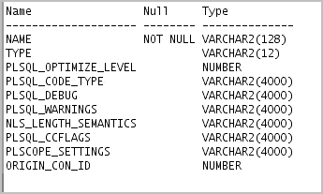
Displaying the PL/SQL Initialization Parameters
Use the USER|ALL|DBA_PLSQL_OBJECT_SETTINGS data dictionary views to display the settings for a PL/SQL object:
DESCRIBE USER_PLSQL_OBJECT_SETTINGS;
Notes:
The columns of the USER_PLSQL_OBJECTS_SETTINGS data dictionary view are:
Owner: The owner of the object. This column is not displayed in the USER_PLSQL_OBJECTS_SETTINGS view.
Name: The name of the object
Type: The available choices are PROCEDURE, FUNCTION, PACKAGE, PACKAGE BODY, TRIGGER, TYPE, TYPE BODY, or any other user-defined objects.
PLSQL_OPTIMIZE_LEVEL: The optimization level that was used to compile the object
PLSQL_CODE_TYPE: The compilation mode for the object
PLSQL_DEBUG: Specifies whether or not the object was compiled for debugging (deprecated in version 12.1)
PLSQL_WARNINGS: The compiler warning settings used to compile the object
NLS_LENGTH_SEMANTICS: The NLS length semantics used to compile the object
PLSQL_CCFLAGS: The conditional compilation flag used to compile the object
PLSCOPE_SETTINGS: Controls the compile-time collection, cross reference, and storage of PL/SQL source code identifier data
ORIGIN_CON_ID: The identifier of the container where the data originates. This value is 0 for non-container databases.

Slide 10
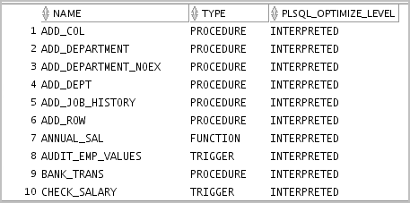
Displaying and Setting PL/SQL Initialization Parameters
SELECT name, type, plsql_code_type,
plsql_optimize_level
FROM user_plsql_object_settings;
Set the compiler initialization parameter’s value by using the ALTER SYSTEM or ALTER SESSION statements.
The parameters’ values are accessed when the CREATE OR REPLACE statement is executed.
Notes:
You can set the value of the compilation parameter through ALTER SESSION as follows:
ALTER SESSION SET PLSQL_OPTIMIZE_LEVEL=1;

Slide 11

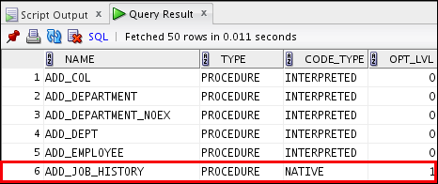
Changing PL/SQL Initialization Parameters: Example
ALTER SESSION SET PLSQL_OPTIMIZE_LEVEL = 1;
ALTER SESSION SET PLSQL_CODE_TYPE = 'NATIVE';
-- code displayed in the notes page
CREATE OR REPLACE PROCEDURE add_job_history
. . .
@code_11_09_sa.sql
. . .
Notes:
To change a compiled PL/SQL object from the interpreted code type to the native code type, you must first set the PLSQL_CODE_TYPE parameter to NATIVE (optionally set the other parameters) and then recompile the program.
To enforce native compilation to all PL/SQL code, you must recompile each one. Scripts (in the rdmbs/admin directory) are provided for you to achieve conversion to full native compilation (dbmsupgnv.sql) or full interpreted compilation (dbmsupgin.sql). The add_job_history procedure is created as follows:
CREATE OR REPLACE PROCEDURE add_job_history ( p_emp_id job_history.employee_id%type , p_start_date job_history.start_date%type , p_end_date job_history.end_date%type , p_job_id job_history.job_id%type , p_department_id job_history.department_id%type ) IS BEGIN INSERT INTO job_history (employee_id, start_date, end_date, job_id, department_id) VALUES(p_emp_id, p_start_date, p_end_date, p_job_id, p_department_id); END add_job_history;
/

Slide 12
Lesson Agenda
Using PL/SQL initialization parameters
Using the PL/SQL compile-time warnings:
Using the PLSQL_WARNING initialization parameter
Using the DBMS_WARNING package subprograms

Slide 13

PL/SQL Compile-Time Warnings
Messages from compiler that help in improving code maintainability
Developers can use them to reduce the chances of bugs creeping in to the application.
A PL/SQL unit flagged with warnings may execute successfully, but might exhibit unexpected behavior or inefficient performance.
All PL/SQL warning messages use the prefix PLW.
Notes:
To make your programs more robust and avoid problems at run time, you can turn on checking for certain warning conditions. These conditions are not serious enough to produce an error and keep you from compiling a subprogram. They may point out something in the subprogram that produces an undefined result or might create a performance problem.
With the PL/SQL compiler-warning feature, compiling a PL/SQL program could have the following two possible outcomes:
Success with compilation warnings
Failure with compilation errors and compilation warnings
Note that the compiler may issue warning messages even on a successful compile. A compilation error must be corrected to be able to use the stored procedure, whereas a warning is for informational purposes.
Examples of warning messages
SP2-0804: Procedure created with compilation warnings
PLW-07203: Parameter “IO_TBL” may benefit from use of the NOCOPY compiler hint.

Slide 14
Benefits of Compiler Warnings
Make programs more robust and avoid problems at run time
Identify potential performance problems
Identify factors that produce undefined results
Notes:
Using compiler warnings can help you to:
Make your programs more robust and avoid problems at run time
Identify potential performance problems
Identify factors that produce undefined results
All PL/SQL warning messages use the prefix PLW.

Slide 15
Categories of PL/SQL Compile-Time Warning Messages
SEVERE
PERFORMANCE
INFORMATIONAL
Condition might cause unexpected action or wrong results.
Condition might cause performance problems.
Condition does not affect performance or correctness, but you might want to change it for better maintainability.
Notes:
PL/SQL warning messages are divided into categories, so that you can suppress or display groups of similar warnings during compilation. The categories are:
SEVERE: Messages for conditions that may cause unexpected behavior or wrong results, such as aliasing problems with parameters
PERFORMANCE: Messages for conditions that may cause performance problems, such as passing a VARCHAR2 value to a NUMBER column in an INSERT statement
INFORMATIONAL: Messages for conditions that do not have an effect on performance or correctness, but that you may want to change to make the code more maintainable, such as unreachable code that can never be executed

Slide 16
Enabling Warning Messages
You can enable displaying warning messages by using one of the following methods:
The PLSQL_WARNINGS initialization parameter
The DBMS_WARNING package
Notes:
You can enable the display of compiler warning messages by using one of the following methods:
The PLSQL_WARNINGS Initialization Parameter
The PLSQL_WARNINGS parameter enables or disables warning messages being reported by the PL/SQL compiler and specifies which warning messages to show as errors. The settings for the PLSQL_WARNINGS parameter are stored along with each compiled subprogram. You can use the PLSQL_WARNINGS initialization parameter to do the following:
Enable or disable the reporting of all warnings, warnings of a selected category, or specific warning messages.
Treat all warnings, a selected category of warning, or specific warning messages as errors.
Following is the syntax to do so:
PLSQL_WARNINGS = '<DISABLE | ENABLE | ERROR>:<ALL | INFORMATIONAL | PERFORMANCE | SEVERE>' PLSQL_WARNINGS = 'DISABLE:<warning#>'ENABLE:<warning#>', 'ERROR:<warning#>'
You can disable or enable certain category of warnings. You can also configure the compiler to report certain category of warnings as errors.
Through the PLSQL_WARNINGS parameter you can enable, disable, or report specific warnings as errors.
The DBMS_WARNING Package
The DBMS_WARNING package provides a way to manipulate the behavior of PL/SQL warning messages, in particular by reading and changing the setting of the PLSQL_WARNINGS initialization parameter, to control what kinds of warnings are suppressed, displayed, or treated as errors. This package provides the interface to query, modify, and delete current system or session settings.

Slide 17

Setting Compiler Warning Levels: Using PLSQL_WARNINGS, Examples
ALTER SESSION
SET plsql_warnings = 'enable:severe', 'enable:performance', 'disable:informational';
ALTER SESSION
SET plsql_warnings = 'enable:severe';
ALTER SESSION SET PLSQL_WARNINGS='ENABLE:SEVERE',
'DISABLE:PERFORMANCE' , 'ERROR:05003';
Notes:
You can use the ALTER SESSION or ALTER SYSTEM command to change the PLSQL_WARNINGS initialization parameter. The graphic in the slide shows the various examples of enabling and disabling compiler warnings.
Example 1
In this example, you are enabling SEVERE and PERFORMANCE warnings and disabling INFORMATIONAL warnings.
Example 2
In the second example, you are enabling only SEVERE warnings.
Example 3
You can treat particular messages as errors, instead of warnings. In this example, if you know that the warning message PLW-05003 represents a serious problem in your code; ERROR:05003 in the PLSQL_WARNINGS setting makes that condition trigger an error message (PLS_05003) instead of a warning message. An error message causes the compilation to fail. In this example, you are also disabling PERFORMANCE warnings.

Slide 18
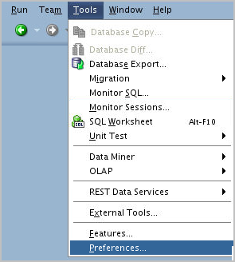
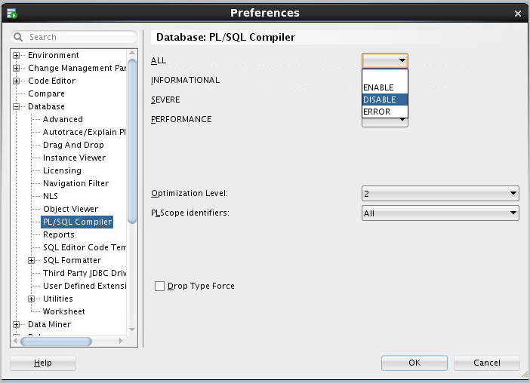
Enabling Compiler Warnings: Using PLSQL_WARNINGS in SQL Developer
Notes:
The PL/SQL Compiler pane specifies options for compilation of PL/SQL subprograms.
Setting and Viewing the PL/SQL Compile-Time Warning Messages Categories in SQL Developer
You can control the display of informational, severe, and performance-related messages. The ALL type overrides any individual specifications for the other types of messages. For each type of message, you can specify any of the following:
No entry (blank): Use any value specified for ALL; and if no value is specified, use the Oracle default.
Enable: Enable the display of all messages of this category.
Disable: Disable the display of all messages of this category.
Error: Enable the display of only error messages of this category.

Slide 19
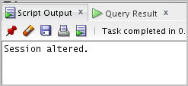
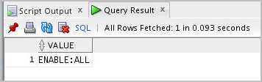
Viewing the Current Setting of PLSQL_WARNINGS
You can examine the current setting for the PLSQL_WARNINGS parameter by issuing a SELECT statement on the V$PARAMETER view.
ALTER SESSION SET plsql_warnings = 'enable:severe', 'enable:performance','enable:informational';
/
SELECT value FROM v$parameter WHERE name='plsql_warnings';
/
Notes:
Alternatively, you can use the DBMS_WARNING.GET_WARNING_SETTING_STRING package and procedure to retrieve the current settings for the PLSQL_WARNINGS parameter:
DECLARE s VARCHAR2(1000); BEGIN s := dbms_warning.get_warning_setting_string(); dbms_output.put_line (s); END; /

Slide 20
Viewing Compiler Warnings
You can view compiler warnings through:
SQL*Plus with SHOW ERRORS command
Data Dictionary views
Notes:
You can use SQL*Plus to see any warnings raised as a result of the compilation of a PL/SQL block. SQL*Plus indicates that a compilation warning has occurred. The “SP2-08xx: <object> created with compilation warnings.” message is displayed for objects compiled .You must enable the compiler warnings before compiling the program. You can display the compiler warning messages by using any of the following methods:
Using the SQL*Plus SHOW ERRORS Command
This command displays any compiler errors including the new compiler warnings and informational messages. This command is invoked immediately after a CREATE [PROGEDURE|FUNCTION|PACKAGE] command is used. The SHOW ERRORS command displays warnings and compiler errors. New compiler warnings and informational messages are “interleaved” with compiler errors when SHOW ERRORS is invoked.
Using Data Dictionary Views
You can select from the USER_|ALL_|DBA_ERRORS data dictionary views to display PL/SQL compiler warnings. The ATTRIBUTES column of these views has a new attribute called WARNING and the warning message displays in the TEXT column.

Slide 21
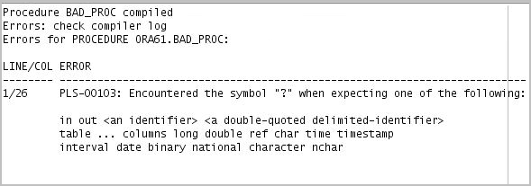
SQL*Plus Warning Messages: Example
CREATE OR REPLACE PROCEDURE bad_proc(p_out …) IS
BEGIN
. . .;
END;
/
SP2-0804: Procedure created with compilation warnings.
Notes:
Use the SHOW ERRORS command in SQL*Plus to display the compilation errors of a stored procedure. When you specify this option with no arguments, SQL*Plus displays the compilation errors for the most recently created or altered stored procedure. If SQL*Plus displays a compilation warnings message after you create or alter a stored procedure, you can use SHOW ERRORS commands to obtain more information.
With the introduction of support for PL/SQL warnings, the range of feedback messages is expanded to include a third message as follows:
SP2-08xx: <object> created with compilation warnings.
This enables you to differentiate between the occurrence of a compilation warning and a compilation error. You must correct an error if you want to use the stored procedure, whereas a warning is for informational purposes only.
The SP2 prefix is included with the warning message because this provides you with the ability to look up the corresponding message number in the SQL*Plus User’s Guide and Reference to determine the cause and action for the particular message.
Note: You can also view the compiler errors and warnings by using the USER_|ALL_|DBA_ERRORS data dictionary views.

Slide 22
Defining PLSQL_WARNINGS for Program Units
The settings for the PLSQL_WARNINGS parameter are stored along with each compiled subprogram.
If you recompile the subprogram using one of the following statements, the current settings for that session are used:
CREATE OR REPLACE
ALTER ... COMPILE
If you recompile the subprogram using the ALTER ... COMPILE statement with the REUSE SETTINGS clause, the original setting stored with the program is used.
Notes:
As already stated, the PLSQL_WARNINGS parameter can be set at the session level or at the system level.
The settings for the PLSQL_WARNINGS parameter are stored along with each compiled subprogram. If you recompile the subprogram with a CREATE OR REPLACE statement, the current settings for that session are used. If you recompile the subprogram with an ALTER...COMPILE statement, then the current session setting is used unless you specify the REUSE SETTINGS clause in the statement, which uses the original setting that is stored with the subprogram.

Slide 23
Lesson Agenda
Using the PL/SQL initialization parameters
Using the PL/SQL compile-time warnings:
Using the PLSQL_WARNING initialization parameter
Using the DBMS_WARNING package subprograms

Slide 24
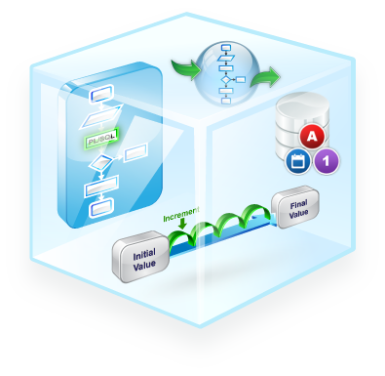

Using the DBMS_WARNINGS Package
You can use the DBMS_WARNINGS package to:
Manipulate the behavior of PL/SQL warning messages
Change the definition of PLSQL_WARNINGS parameter
Query, modify, and delete current system or session settings
Notes:
Use the DBMS_WARNING package to programmatically manipulate the behavior of PL/SQL warning settings for the current system or session. The DBMS_WARNING package provides a way to manipulate the behavior of PL/SQL warning messages, in particular by reading and changing the setting of the PLSQL_WARNINGS initialization parameter, to control the types of warnings suppressed, displayed, or treated as errors. This package provides the interface to query, modify, and delete current system or session settings.
The DBMS_WARNING package is valuable if you are writing a development environment that compiles PL/SQL subprograms. By using the package interface routines, you can control PL/SQL warning messages programmatically to suit your requirements.

Slide 25
Using the DBMS_WARNING Package Subprograms
Scenario | Subprograms to Use
Set warnings | ADD_WARNING_SETTING_CAT (procedure) ADD_WARNING_SETTING_NUM (procedure)
Query warnings | GET_WARNING_SETTING_CAT (function) GET_WARNING_SETTING_NUM (function) GET_WARNING_SETTING_STRING (function)
Replace warnings | SET_WARNING_SETTING_STRING (procedure)
Get the warnings’ categories names | GET_CATEGORY (function)
Notes:
The following is a list of the DBMS_WARNING subprograms:
ADD_WARNING_SETTING_CAT: Modifies the current session or system warning settings of the warning_category previously supplied
ADD_WARNING_SETTING_NUM: Modifies the current session or system warning settings of the warning_number previously supplied
GET_CATEGORY: Returns the category name, given the message number
GET_WARNING_SETTING_CAT: Returns the specific warning category in the session
GET_WARNING_SETTING_NUM: Returns the specific warning number in the session
GET_WARNING_SETTING_STRING: Returns the entire warning string for the current session
SET_WARNING_SETTING_STRING: Replaces previous settings with the new value
Note: For additional information about the preceding subprograms, refer to Oracle Database PL/SQL Packages and Types Reference or Oracle Database PL/SQL Packages and Types Reference (as applicable to the version you are using).

Slide 26
The DBMS_WARNING Procedures: Syntax, Parameters, and Allowed Values
EXECUTE DBMS_WARNING.ADD_WARNING_SETTING_CAT (-
warning_category IN VARCHAR2,
warning_value IN VARCHAR2,
scope IN VARCAHR2);
EXECUTE DBMS_WARNING.ADD_WARNING_SETTING_NUM (-
warning_number IN NUMBER,
warning_value IN VARCHAR2,
scope IN VARCAHR2);
EXECUTE DBMS_WARNING.SET_WARNING_SETTING_STRING (-
warning_value IN VARCHAR2,
scope IN VARCHAR2);
Notes:
The warning_category is the name of the category. The allowed values are:
ALL
INFORMATIONAL
SEVERE
PERFORMANCE.
The warning_value is the value for the category. The allowed values are:
ENABLE
DISABLE
ERROR
The warning_number is the warning message number. The allowed values are all valid warning numbers.
The scope specifies whether the changes are being performed in the session context or the system context. The allowed values are SESSION or SYSTEM. Using SYSTEM requires the ALTER SYSTEM privilege.

Slide 27
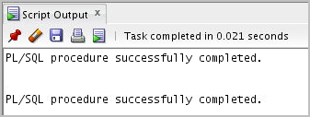
The DBMS_WARNING Procedures: Example
-- Establish the following warning setting string in the
-- current session:
-- ENABLE:INFORMATIONAL,
-- DISABLE:PERFORMANCE,
-- ENABLE:SEVERE
EXECUTE DBMS_WARNING.SET_WARNING_SETTING_STRING(-
'ENABLE:ALL', 'SESSION');
EXECUTE DBMS_WARNING.ADD_WARNING_SETTING_CAT(-
'PERFORMANCE','DISABLE', 'SESSION');
Notes:
By using the SET_WARNING_SETTING_STRING procedure, you can set one warning setting. If you have multiple warning settings, you should perform the following steps:
1. Call SET_WARNING_SETTING_STRING to set the initial warning setting string.
2. Call ADD_WARNING_SETTING_CAT (or ADD_WARNING_SETTING_NUM) repeatedly to add more settings to the initial string.
The example in the slide establishes the following warning setting string in the current session:
ENABLE:INFORMATIONAL,DISABLE:PERFORMANCE,ENABLE:SEVERE

Slide 28
The DBMS_WARNING Functions: Syntax, Parameters, and Allowed Values
DBMS_WARNING.GET_WARNING_SETTING_CAT (-
warning_category IN VARCHAR2) RETURN warning_value;
DBMS_WARNING.GET_WARNING_SETTING_NUM (-
warning_number IN NUMBER) RETURN warning_value;
DBMS_WARNING.GET_WARNING_SETTING_STRING
RETURN pls_integer;
DBMS_WARNING.GET_CATEGORY (-
warning_number IN pls_integer) RETURN VARCHAR2;
Notes:
The warning_category is the name of the category. The allowed values are:
ALL
INFORMATIONAL
SEVERE
PERFORMANCE
The warning_number is the warning message number. The allowed values are all valid warning numbers.
The scope specifies whether the changes are being performed in the session context or the system context. The allowed values are SESSION or SYSTEM. Using SYSTEM requires the ALTER SYSTEM privilege.
Note: Use the GET_WARNING_SETTING_STRING function when you do not have the SELECT privilege on the v$parameter or v$parameter2 fixed tables, or if you want to parse the warning string yourself, and then modify and set the new value by using SET_WARNING_SETTING_STRING.

Slide 29


The DBMS_WARNING Functions: Example
-- Determine the current session warning settings
SET SERVEROUTPUT ON
EXECUTE DBMS_OUTPUT.PUT_LINE( -
DBMS_WARNING.GET_WARNING_SETTING_STRING);
-- Determine the category for warning message number
-- PLW-07203
SET SERVEROUTPUT ON
EXECUTE DBMS_OUTPUT.PUT_LINE( -
DBMS_WARNING.GET_CATEGORY(7203));
Notes:
Note: The message numbers must be specified as positive integers because the data type for the GET_CATEGORY parameter is PLS_INTEGER (allowing positive integer values).

Slide 30
Using DBMS_WARNING: Example
CREATE OR REPLACE PROCEDURE compile_code(p_pkg_name VARCHAR2) IS
v_warn_value VARCHAR2(200);
v_compile_stmt VARCHAR2(200) :=
'ALTER PACKAGE '|| p_pkg_name ||' COMPILE';
BEGIN
v_warn_value := DBMS_WARNING.GET_WARNING_SETTING_STRING;
DBMS_OUTPUT.PUT_LINE('Current warning settings: '||
v_warn_value);
DBMS_WARNING.ADD_WARNING_SETTING_CAT(
'PERFORMANCE', 'DISABLE', 'SESSION');
DBMS_OUTPUT.PUT_LINE('Modified warning settings: '||
DBMS_WARNING.GET_WARNING_SETTING_STRING);
EXECUTE IMMEDIATE v_compile_stmt;
DBMS_WARNING.SET_WARNING_SETTING_STRING(v_warn_value,
'SESSION');
DBMS_OUTPUT.PUT_LINE('Restored warning settings: '||
DBMS_WARNING.GET_WARNING_SETTING_STRING);
END;
/
Notes:
In the example in the slide, the compile_code procedure is designed to compile a named PL/SQL package. The code suppresses the PERFORMANCE category warnings. The calling environment’s warning settings must be restored after the compilation is performed. The code does not know what the calling environment warning settings are; it uses the GET_WARNING_SETTING_STRING function to save the current setting. This value is used to restore the calling environment setting using the DBMS_WARNING.SET_WARNING_SETTING_STRING procedure in the last line of the example code. Before compiling the package using Native Dynamic SQL, the compile_code procedure alters the current session warning level by disabling warnings for the PERFORMANCE category. The code also prints the original, modified, and the restored warning settings.

Slide 31


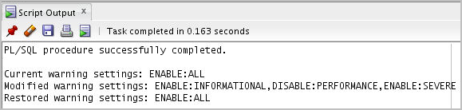
Using DBMS_WARNING: Example
EXECUTE DBMS_WARNING.SET_WARNING_SETTING_STRING(-
'ENABLE:ALL', 'SESSION');
@/home/oracle/labs/plpu/code_ex/code_ex_scripts/code_12_33_s.sql
EXECUTE compile_code('EMP_PKG');
Notes:
The example in the slide tests the example provided in the previous slide. First, enable all compiler warnings. Next, run the script on the previous page. Finally, call the compile_code procedure and pass it an existing package name, MY_PKG, as a parameter.

Slide 32
Quiz
The categories of PL/SQL compile-time warning messages are:
SEVERE
PERFORMANCE
INFORMATIONAL
All
CRITICAL
Notes:
Answer: a, b, c, d
PL/SQL warning messages are divided into categories, so that you can suppress or display groups of similar warnings during compilation. The categories are:
SEVERE: Messages for conditions that may cause unexpected behavior or wrong results, such as aliasing problems with parameters
PERFORMANCE: Messages for conditions that may cause performance problems, such as passing a VARCHAR2 value to a NUMBER column in an INSERT statement
INFORMATIONAL: Messages for conditions that do not have an effect on performance or correctness, but that you may want to change to make the code more maintainable, such as unreachable code that can never be executed
ALL: Displays all categories

Slide 33
Summary
In this lesson, you should have learned how to:
Use the PL/SQL compiler initialization parameters
Use the PL/SQL compile-time warnings

Slide 34

Practice 21 Overview: Tuning PL/SQL Compiler
This practice covers the following topics:
Displaying the compiler initialization parameters
Enabling native compilation for your session and compiling a procedure
Disabling the compiler warnings, and then restoring the original session-warning settings
Identifying the categories for some compiler-warning message numbers
Notes:
In this practice, you display the compiler initialization parameters. You then enable native compilation for your session and compile a procedure. You then suppress all compiler warnings categories and then restore the original session-warning settings. Finally, you identify the categories for some compiler-warning message numbers.

