Slide 1
Object Oriented Programming

Slide 2
Objectives
After this module you will be able to learn
Aggregation and Specialization
Abstract class
Interfaces
Cohesion and coupling
Object-oriented metrices
Static data types and methods
Advantages of Objects

Slide 3
Different Types of Relationship
By analyzing the five point requirement given previously, we can easily visualize four relationships
Inheritance
Aggregation
Association
Composition

Slide 4
Requirement 1: The IS A relationship
Requirement 1: Manager is an employee of XYZ limited corporation
Solution: Inheritance
Explanation:
If you look at the requirement, it’s a parent child relationship or inheritance relationship.
The sentence above specifies that Manager is a type of employee, in other words we will have two classes: parent class Employee, and a child class Manager which will inherit from the Employee class.
Notes:
We have discussed about inheritance in previous module. So, let’s have a look at it again.

Slide 5
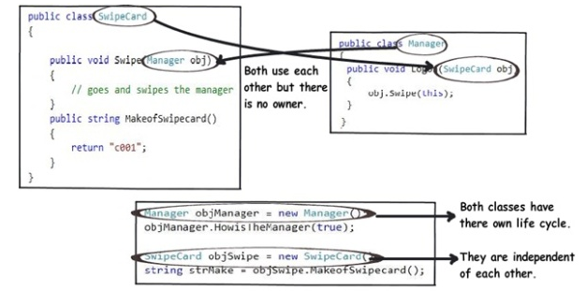
Requirement 2: The Using relationship: Association
Requirement 2: Manager uses a swipe card to enter XYZ premises
Solution: Association
Explanation:
In this requirement, the manager object and the swipe card object use each other but they have their own object life time.
In other words, they can exist without each other.
The most important point in this relationship is that there is no single owner.
Notes:
The above diagram shows how the SwipeCard class uses the Manager class and the Manager class uses theSwipeCard class. You can also see how we can create objects of the Manager class and SwipeCard class independently and they can have their own object life time.
This relationship is called the “Association” relationship.

Slide 6
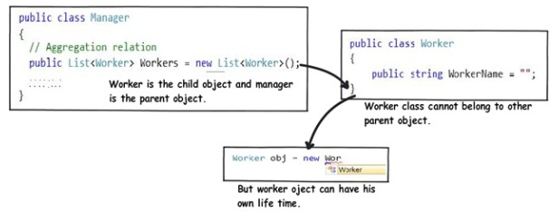
Requirement 3: The Using relationship with Parent: Aggregation
Requirement 3: Manager has workers who work under him
Solution: Aggregation
Explanation:
Requirement denotes the same type of relationship like association but with a difference that one of them is an owner.
So as per the requirement, the Manager object will own Worker objects.
Notes:
The child Worker objects can not belong to any other object. For instance, a Worker object cannot belong to aSwipeCard object.
But… the Worker object can have its own life time which is completely disconnected from the Manager object. Looking from a different perspective, it means that if the Manager object is deleted, the Worker object does not die.
This relationship is termed as an “Aggregation” relationship.

Slide 7
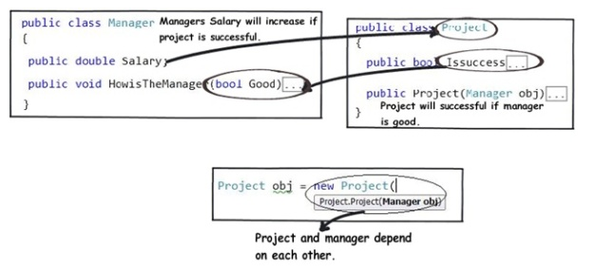
Requirements 4 and 5: The Death relationship: Composition
Requirement 4: Manager has the responsibility of ensuring that the project is successful.
Requirement 5: Manager's salary will be judged based on project success.
Conclusion:
Manager and the project objects are dependent on each other.
The lifetimes of both the objects are the same. In other words, the project will not be successful if the manager is not good, and the manager will not get good increments if the project has issues.
Notes:
You can also see that when the project object is created, it needs the manager object.
This relationship is termed as the composition relationship. In this relationship, both objects are heavily dependent on each other. In other words, if one goes for garbage collection the other also has to be garbage collected, or putting from a different perspective, the lifetime of the objects are the same. That’s why I have put in the heading “Death” relationship.

Slide 8
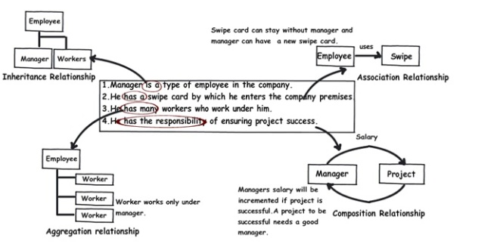
Putting Things Together

Slide 9
What is Abstract class and method?
When you want to create classes that will act as base class, but do not want to create object of that class, then you can make the class as an abstract class
An abstract class is the one, which has at least one abstract member
And, an abstract member is the one which does not have any code or implementation logic
Why?
Some classes exist solely to be derived from
It makes no sense to create instances of these classes
These classes are abstract classes

Slide 10
Important Points to Remember About Abstract
Abstract methods have to be implemented in the child class. Otherwise, child class will also become abstract class
Abstract class objects can’t be created
Abstract class variable can hold reference of child class objects (Upcasting)
Abstract class is basically used as a template for other classes. All members, that you want to implement differently in different child classes, should be declared as abstract members in an abstract base class

Slide 11
Interface
Interface is a pure abstract class. That means, all the members of an interface are pure abstract.
It does not contain any member with implementation
interfaces are for realization relationship.
A Realization is a relationship between two elements, in which one element (the client) realizes the behavior that the other element (the supplier) specifies.
Objects of interface can’t be created.

Slide 12
Cohesion and coupling
Object-oriented cohesion and coupling always reduces to classical cohesion
The only feature unique to the object-oriented paradigm is inheritance
Cohesion has nothing to do with inheritance
Two objects with the same functionality have the same cohesion
It does not matter if this functionality is inherited or not
Similarly, so-called object-oriented coupling always reduces to classical coupling

Slide 13
Object-Oriented Metrics (contd)
Two types of so-called object-oriented metric
Not related to inheritance
Reduces to a classical metric
Inheritance-related
May reduce to a classical metric
No problem
Classical metrics work just fine
But don’t mislead others by calling them object-oriented

Slide 14
Static Member
Static data describes information for all objects of a class
For example, suppose all accounts share the same interest rate. Storing the interest rate in every account would be a bad idea.
Make it a static data
Withdraw( )
Withdraw( )
Deposit( )
Deposit( )
balance 12.56
balance 99.12
û
û
interest 7%
interest 7%

Slide 15
Using Static Methods
Static methods can only access static data
A static method is called on the class, not the object
The account class
An account object
û
Withdraw( )
InterestRate( )
Deposit( )
✓
û
balance 99.12
interest 7%
owner "Fred"
Classes contain static data and
static methods
Objects contain object data and
object methods

Slide 16
Comparison Between Static and Non-static data
Static Member | Non-Static Member
1. Static data and static method are not accessed through instances, rather through class name | 1. Non-static data and method are accessed through instances, not using class name
2. Only single copy of static data member will be present and every instance will share that static data | 2. Non-static data is different for different instances and it is not shared amongst different instances. It is particular to the instance
3. Static method can only access static data | 3. Non-static method can access static as well as non-static data

Slide 17
Advantages of Objects
Same as advantages of abstract data types
Information hiding
Data abstraction
Procedural abstraction
Inheritance provides further data abstraction
Easier and less error-prone product development
Easier maintenance
Objects are more reusable than modules with functional cohesion

