Slide 1
RabbitMQ
The most widely deployed open source message broker

Slide 2
Module-1: Introduction to RabbitMQ
What is RabbitMQ, What are the components and How to use RabbitMQ

Slide 3
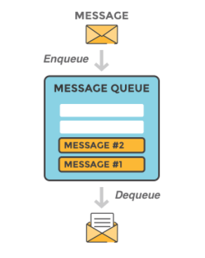
What is RabbitMQ
RabbitMQ is a message-queueing software also known as a message broker or queue manager.
it is software where queues are defined, to which applications connect in order to transfer a message or messages.

Slide 4
Message
A message can include any kind of information.
information about a process or task that should start on another application (which could even be on another server)
it could be just a simple text message
The queue-manager software stores the messages until a receiving application connects and takes a message off the queue.
The receiving application then processes the message.

Slide 5
Message Broker
A message broker acts as a middleman for various services
They can be used to reduce loads and delivery times of web application servers by delegating tasks that would normally take up a lot of time or resources to a third party that has no other job.

Slide 6
Example:
Consider a web application that allows users to upload information to a website.
The site will handle this information, generate a PDF, and email it back to the user.
Handling the information, generating the PDF, and sending the email will take several seconds.
That is one of the reasons why a message queue will be used to perform the task.
When the user has entered user information into the web interface, the web application will create a "PDF processing" message that includes all of the important information the user needs into a message and place it onto a queue defined in RabbitMQ.

Slide 7
The Basic Infrastructure of RabbitMQ
Producer:
They are client applications that create messages
Broker:
Producers deliver the messages to the broker which is nothing but a message queue
Consumer:
Other applications, who connect to the queue and subscribe to the messages to be processed

Slide 8

The Basic Infrastructure of RabbitMQ
Software may act as a producer, or consumer, or both a consumer and a producer of messages
Messages placed onto the queue are stored until the consumer retrieves them.

Slide 9
When and why should you use RabbitMQ?
Message queueing allows web servers to respond to requests quickly instead of being forced to perform resource-heavy procedures on the spot that may delay response time
Message queueing is also good when you want to distribute a message to multiple consumers or to balance loads between workers.
The consumer takes a message off the queue and starts processing.
At the same time, the producer is queueing up new messages.
The consumer can be on a totally different server than the producer or they can be located on the same server.
The request can be created in one programming language and handled in another programming language.
In short, the two applications will only communicate through the messages they are sending to each other, which means the sender and receiver have low coupling.

Slide 10
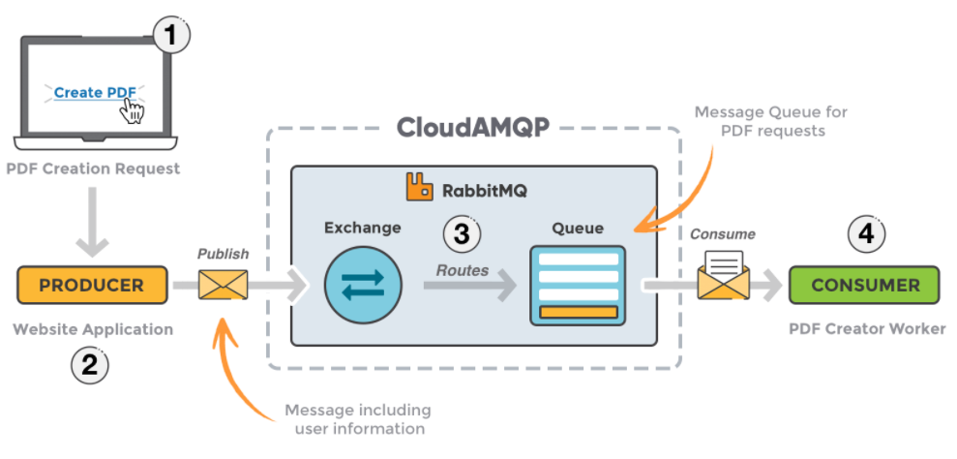
The Working of Example Application

Slide 11
The Working of Example Application
The user sends a PDF creation request to the web application.
The web application (the producer) sends a message to RabbitMQ that includes data from the request such as name and email.
An exchange accepts the messages from the producer and routes them to correct message queues for PDF creation.
The PDF processing worker (the consumer) receives the task message and starts processing the PDF.
Currently there is one producer (the website application) and one consumer (the PDF processing application).
If the PDF processing application crashes, or if many PDF requests are coming at the same time, messages would continue to stack up in the queue until the consumer starts again.
It would then process all the messages, one by one.

Slide 12
Exchanges
Messages are not published directly to a queue; instead, the producer sends messages to an exchange.
An exchange is responsible for routing the messages to different queues with the help of bindings and routing keys.
A binding is a link between a queue and an exchange.

Slide 13
Message Flow in RabbitMQ
The producer publishes a message to an exchange. When creating an exchange, the type must be specified.
The exchange receives the message and is now responsible for routing the message.
The exchange takes different message attributes into account, such as the routing key, depending on the exchange type.
Bindings must be created from the exchange to queues.
The exchange routes the message into the queues depending on message attributes.
The messages stay in the queue until they are handled by a consumer
The consumer handles the message.

Slide 14
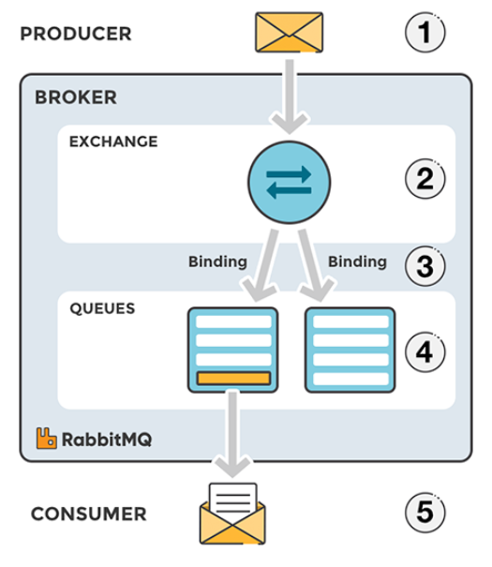
Message Flow in RabbitMQ

Slide 15
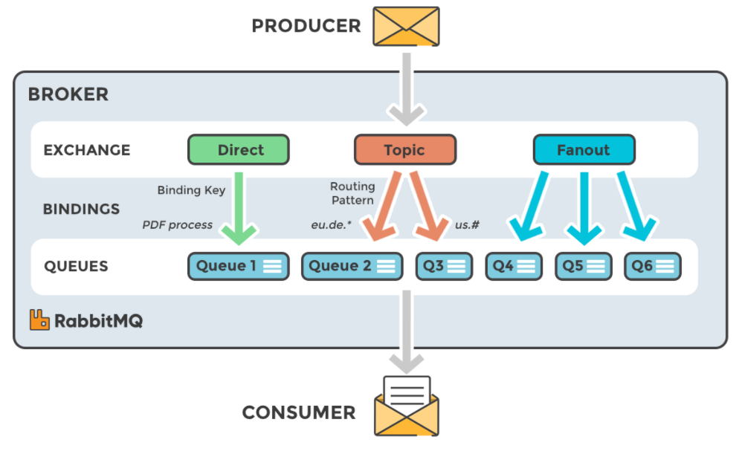
TYPES OF EXCHANGES

Slide 16
TYPES OF EXCHANGES
Direct: The message is routed to the queues whose binding key exactly matches the routing key of the message.
For example: if the queue is bound to the exchange with the binding key pdfprocess, a message published to the exchange with a routing key pdfprocess is routed to that queue.
Fanout: A fanout exchange routes messages to all of the queues bound to it.
Topic: The topic exchange does a wildcard match between the routing key and the routing pattern specified in the binding.
Headers: Headers exchanges use the message header attributes for routing.

Slide 17
RabbitMQ Client
RabbitMQ uses a protocol called AMQP by default.
To be able to communicate with RabbitMQ you need a library that understands the same protocol as RabbitMQ.
Download the client library for the programming language that you intend to use for your applications.
A client library is an application programming interface (API) for use in writing client applications.
A client library has several methods to communicate with RabbitMQ.
The methods should be used when you connect to the RabbitMQ broker (using the given parameters, hostname, port number, etc.), for example, or when you declare a queue or an exchange.
There is a choice of libraries for almost every programming language.

Slide 18
Steps to Follow When Setting Up a Connection and Publishing a Message/Consuming a Message
Set up/create a connection object:
The username, password, connection URL, port, etc., need to be specified.
A TCP connection will be set up between the application and RabbitMQ when the start method is called.
Create a channel in the TCP connection:
The connection interface can be used to open a channel through which to send and receive messages
Declare/create a queue:
Declaring a queue will cause it to be created if it does not already exist.
All queues need to be declared before they can be used.

Slide 19
Steps to Follow When Setting Up a Connection and Publishing a Message/Consuming a Message
Set up exchanges and bind a queue to an exchange in subscriber/consumer:
All exchanges must be declared before they can be used.
An exchange accepts messages from a producer application and routes them to message queues.
For messages to be routed to queues, queues must be bound to an exchange.
In publisher:
Publish a message to an exchange
In subscriber/consumer:
Consume a message from a queue.
Close the channel and the connection

Slide 20
Key Takeaways
Producer:
Application that sends the messages.
Consumer:
Application that receives the messages.
Queue:
Buffer that stores messages.
Message:
Information that is sent from the producer to a consumer through RabbitMQ.

Slide 21
Key Takeaways
Connection:
A TCP connection between your application and the RabbitMQ broker.
Channel:
A virtual connection inside a connection.
When publishing or consuming messages from a queue - it's all done over a channel.
Exchange:
Receives messages from producers and pushes them to queues depending on rules defined by the exchange type.
To receive messages, a queue needs to be bound to at least one exchange.

Slide 22
Key Takeaways
Binding:
A binding is a link between a queue and an exchange.
Routing key:
A key that the exchange looks at to decide how to route the message to queues.
Think of the routing key like an address for the message.
AMQP:
Advanced Message Queuing Protocol
This protocol is used by RabbitMQ for messaging.

Slide 23
Key Takeaways
Users:
It is possible to connect to RabbitMQ with a given username and password.
Every user can be assigned permissions such as rights to read, write and configure privileges within the instance.
Users can also be assigned permissions for specific virtual hosts.
Vhost, virtual host:
Provides a way to segregate applications using the same RabbitMQ instance.
Different users can have different permissions to different vhost and queues and exchanges can be created, so they only exist in one vhost.

Slide 24
Module-2: Introduction to The RabbitMQ Management Interface

