Slide 1
Microservices using .NET Core

Slide 2

Old Days of Computer
Pass instruction to the computer and it will deliver the result by…Hmm…may be by tomorrow or at the earliest within few hours…go grab a cup of coffee

Slide 3
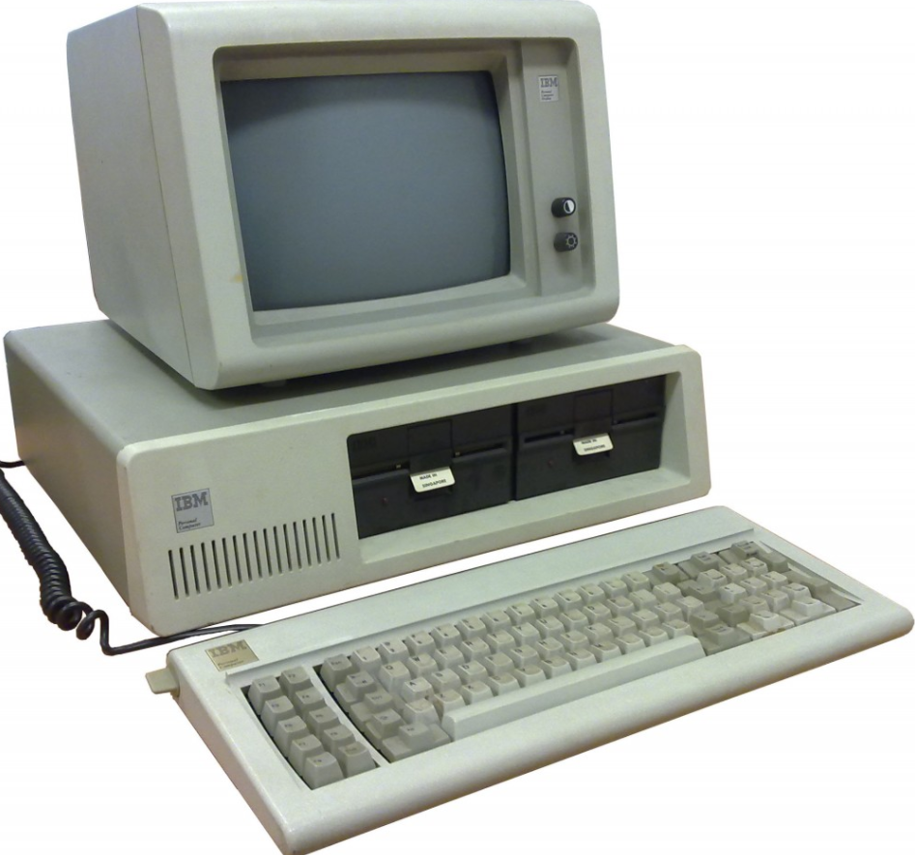
80’s Desktop machine and application
All the applications used to reside in the system itself
Entire application will be installed here

Slide 4
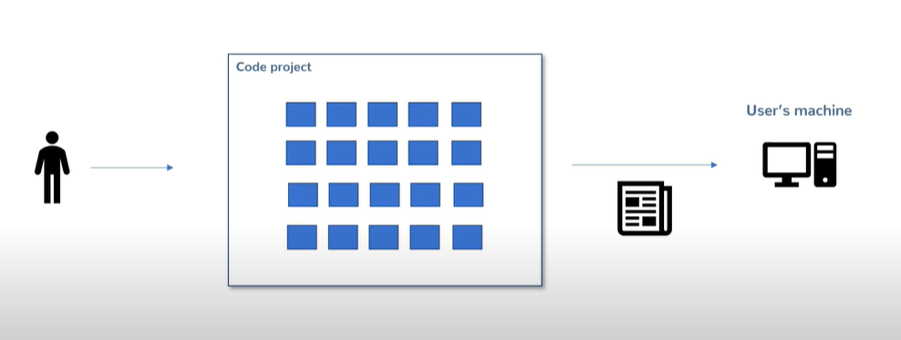
Traditional application development
Start with small codebase but over time it will grow large and complex
Best practices were created for such a large projects

Slide 5
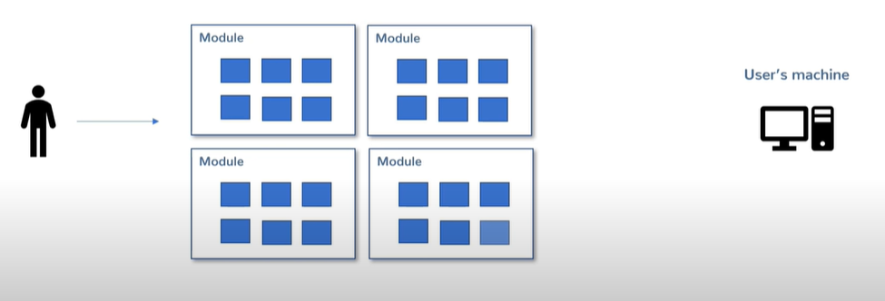
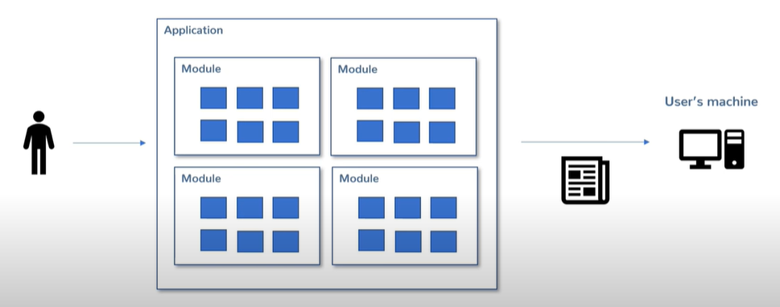
Modular application
But at the end you create a large deployable code from those modular codes
You start writing modular application
So the conclusion is though as much as modularity you introduce in your application, still you end up with large deployable code which is NOT modular
Anyway it was okay with desktop based application

Slide 6
Then two developments happened in the world of application development

Slide 7

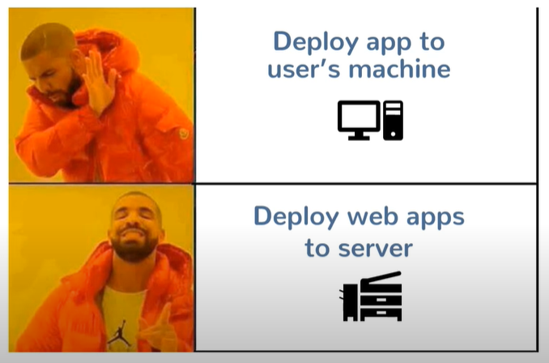
Development-1: Then came along web application development

Slide 8
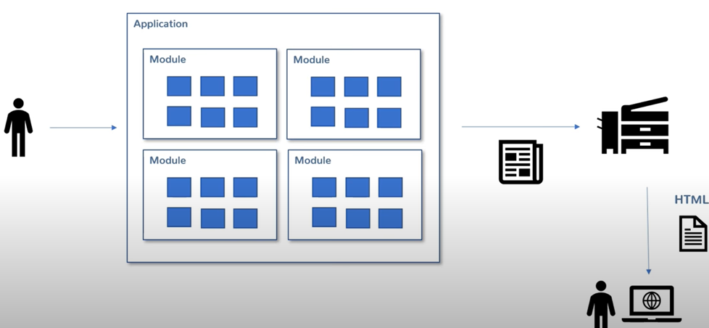
But Modular Approach Didn’t change
Conclusion: Now instead of deploying/installing that large deployable code into a individual machine, that gets deployed into a server machine and client accesses the same, but from client machine…nothing much changed

Slide 9
Development-2: Web applications started to become more complex, bigger, but faster too…
Search Engines
Ride sharing apps
File storage apps
Large e-commerce apps

Slide 10
Monolithic Application
So, actually you ended up creating monolithic (mono = single and lithic = stone) application
Doesn’t matter whether you created desktop or web-based and whether you followed modular approach or not, since you ended up with large deployable code

Slide 11
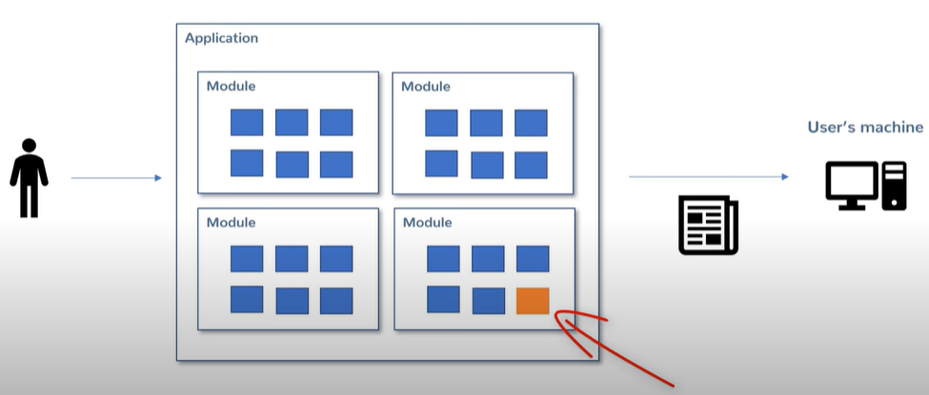
Disadvantages:
Bigger the deployable code, more challenging the deployment is
Making change in a small module is not the problem
But the problem is that you have to re-deploy the entire application once again, not only that you have to test the whole code again, though you have automated tests and many other things to do that

Slide 12
Disadvantages:
Scalability
Think about a large e-commerce site
During peak hour (such as sale/offer etc.) traffic increases
After that traffic becomes normal again

Slide 13
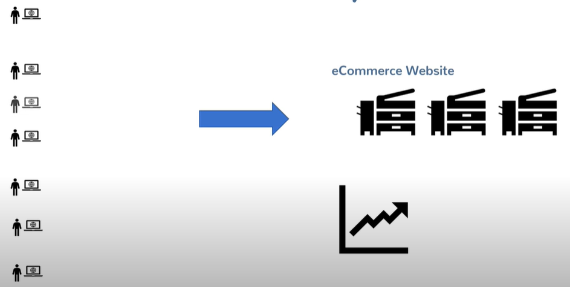
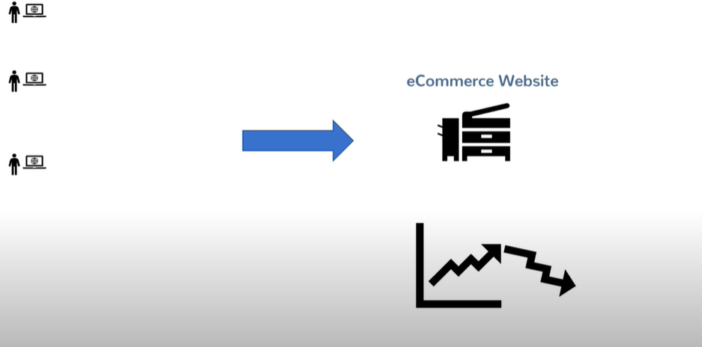
Traffic flow towards e-commerce site
During peak traffic you scale up the application by copying the same and hosting it into multiple server instances or use elastic servers
After peak hour traffic becomes normal and you scale the application down

Slide 14
Disadvantages:
Scalability
Think about a large e-commerce site
During peak hour (such as sale/offer etc.) traffic increases
After that traffic becomes normal again
Conclusion: It is difficult to scale up the entire large application though many of the modules were not necessary to scale up, since may be the customers did not use other modules, such as personal recommendations, profile etc. and may be just catalog and order and payment modules were used apart from cart module

Slide 15
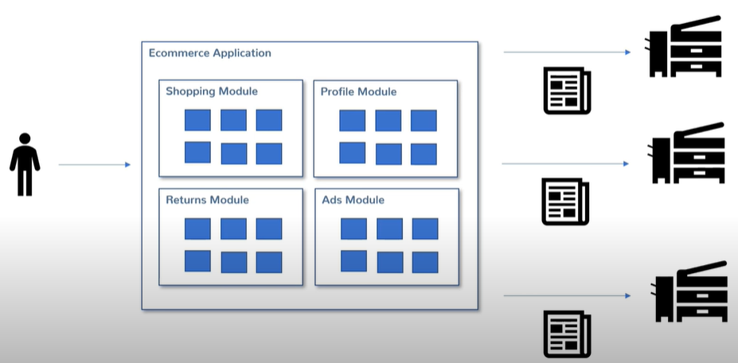
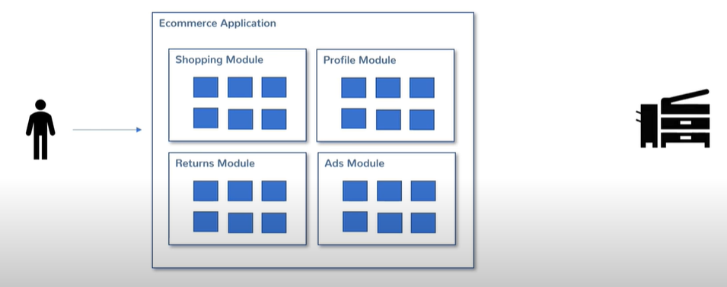
Scaling the entire application

Slide 16
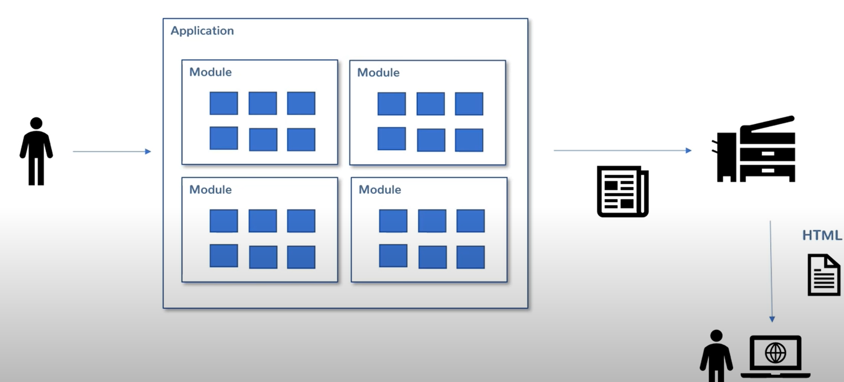
2 Problems…and a new thought
User does not care whether 1 or 10 applications running behind the scene
User does not care whether the application is running in the one or 10 different machines
Can’t help with desktop based applications, but web applications and modularity is an interesting breeding ground for a new thought

Slide 17
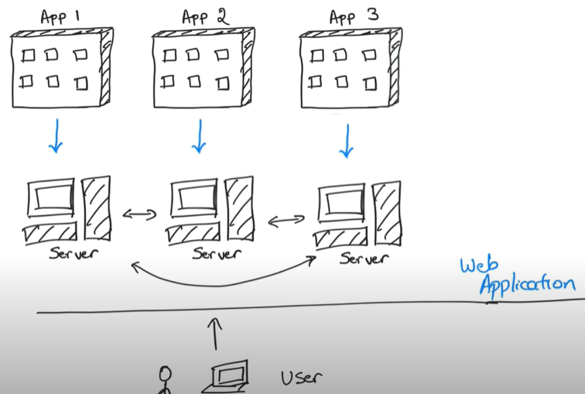
Why don’t we split the application itself?

Slide 18
Conclusion:
Let the application be divided into smaller pieces and deployed into different servers and let them talk to each other
Represent the applications as one application in front of the user

Slide 19
Microservices
You can maintain the separation of concern, that you followed during development mode, during deployment also
Microservice 1
Microservice 2
Each is a separate application, deployed separately
REST APIs
Microservice 3
Entire application

Slide 20
Advantages
Deployment flexibility: Every team can create a microservice and deploy in a server
Technology flexibility: Does not matter which language was used to create the microservice, as they all talk to each other using REST APIs.
Scaling: They all can be scaled separately

Slide 21
Disadvantages
Number of applications: Earlier people were dealing with one application, now with more than one
Deployment/architectural complexity: Separation of logic via microservices should be done in such a way that, if one microservice changes, others shold not be affected. If that happens, then separation of logic through microservice was not done properly and those effected microservices should be merged together
Service Discovery: How do one microservice know about another microservice? Which URL to use to make API calls? What is those APIs change over a period of time?
Etc.

Slide 22
Suggestion:
Don’t choose microservice architecture unnecessarily
Monolithic approach is not bad either, its just that the microservice is a different architecture
If you have no issues with scaling your application, because may be that’s an internal (just for the organization) application, which doesn’t face the problems like large e-commerce applications like Amazon does, then there is no need to convert your application to or create your application using microservice architecture

Slide 23
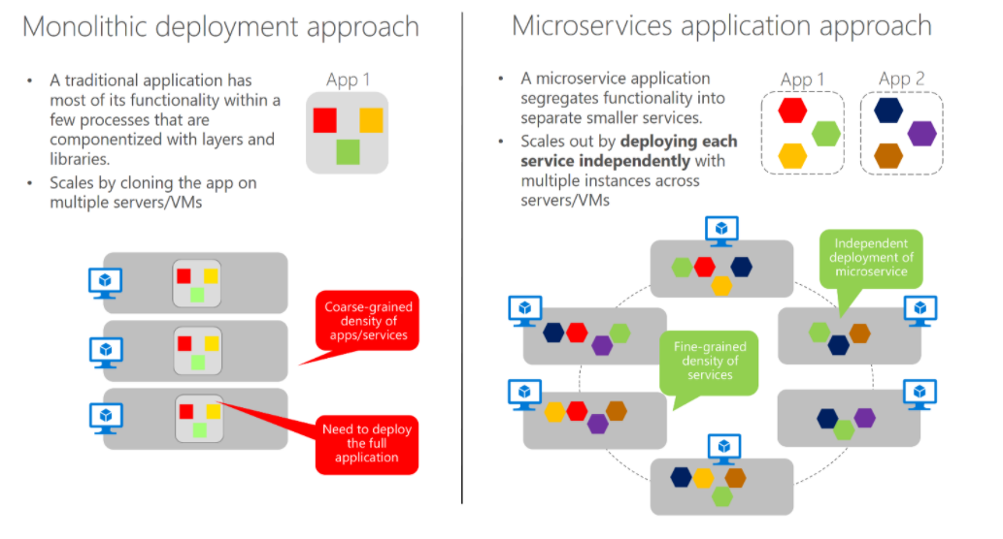

Slide 24
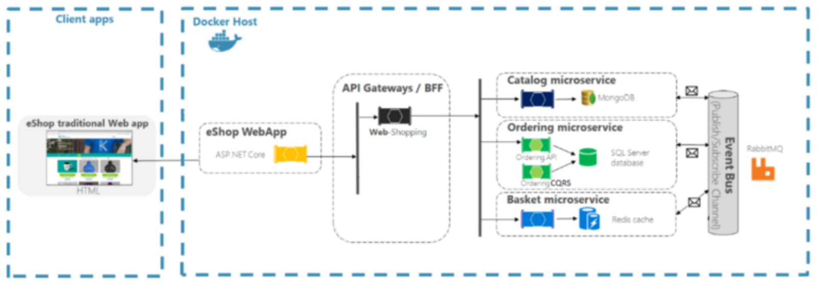
Microservices Environment Architecture

