Slide 1
Loan Approval: Explanation of Important Metrices
Joyita Sadhukhan

Slide 2
CONTENTS
Introduction
Data Dictionary
Important Numeric Metrices
Significant Categorical Metrices
Conclusion

Slide 3
INTRODUCTION
Loan Approval and Denied process, now a days is very popular in the financial industry. Most of the companies are still taking wrong decisions while approving loans due to lack of analysis of their customers data.
Sometimes data anomalies also create confusion to management people. Fraud detection is now a days very crucial part in financial industry. To resolve the issue we will try to create a automate database process for our financial client ActionLab.

Slide 4
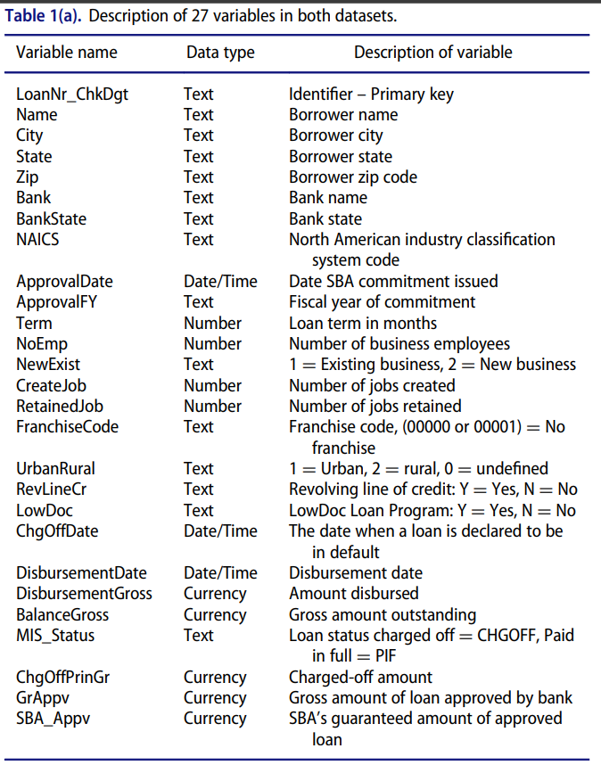
Data dictionary
To understand our data properly we need a data dictionary where a small introduction for all metrices will be there. Image is given :
In the picture you can see 3 things regarding all metrices.
Column name
Data type for the particular column
Description for that Column.
This is the easiest way to understand what is the meaning of all Metrices and which we need to choose for the future analysis.

Slide 5
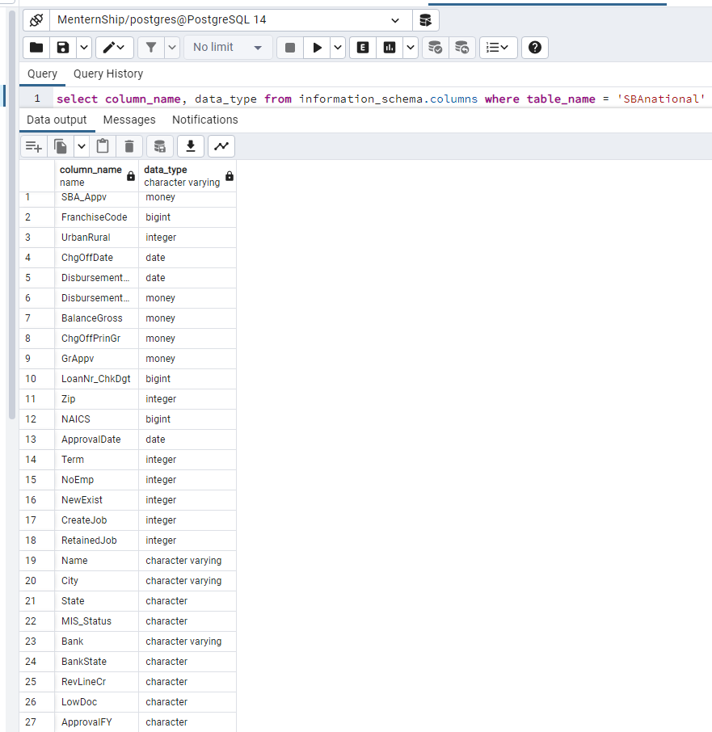
Data type
We imported the given .csv data in our PostgreSQL and while importing we needed to assign data type for each column.
We checked the data type for each metrices in the data base by running the given query as shown in the picture and we can conclude some points here:
Total 27 columns are present.
Data Type | Count
Integer | 7
Character | 6
Money | 5
Character Varying | 3
Date | 3
Bigint | 3

Slide 6
Analysis for Numeric columns
Term
NoEmp
DisbursementGross
BalanceGross
ChgOffPrinGr
AppvGr

Slide 7
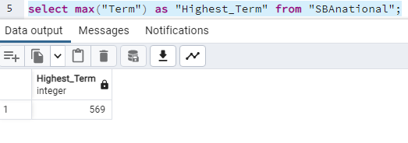
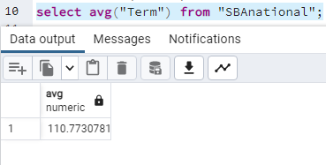
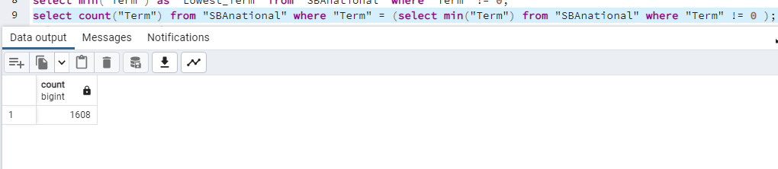
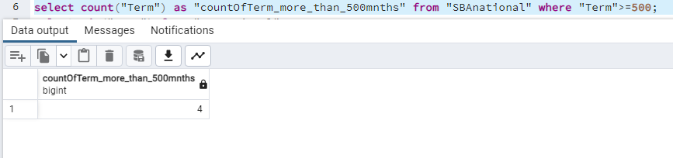
1. term*
Term is denoting the time period for paying back the amount of loan customer has taken.
We can understand by comparing this variable with amount of loan taken. Let’s say if Loan amount is more than 50 Lakhs and Term is 12 months then it is impossible for a client to payback the loan until and unless they are having an outstanding income background.
We have made some analysis on this Term with DDL and DML commands and find out some info which are given below: 1. Maximum Term is 569 months which can be an outlier. 2. There are almost 4 customers who are having Terms more than 500 months. 3. Lowest non-zero Term is 1 and 1608 customers are having this Term. 4. Average Term is 110.77 approximately.
Notes:
*Important Factor 1

Slide 8
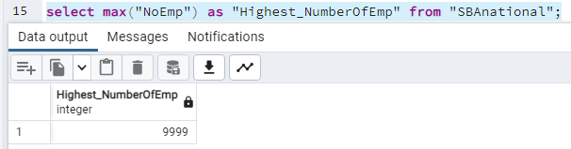
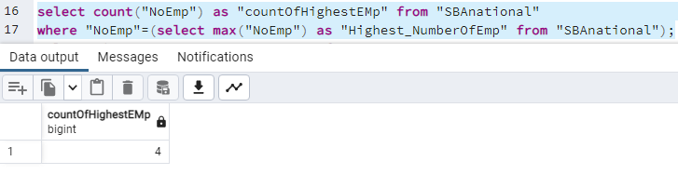
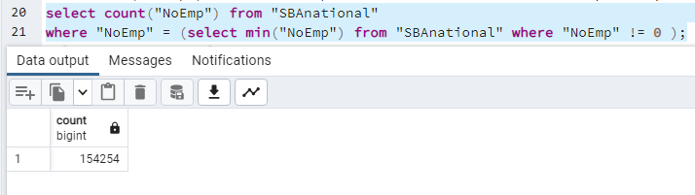
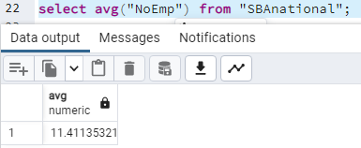
2. No emp
As per data dictionary this variable is describing the number of employees in a business.
It will not give you any specific clarity regarding the business profit but you can at least find a statistic regarding stability of a company.
We can see highest number of employees are 9999 and lowest is 1 which might be self business.
Almost 4 businesses are there where highest amount of employees are working.
Most of the population are having minimum employees 1 and number is pretty high which is 154254. This can be a Data anomaly as well
Average employees are approximately 11.

Slide 9
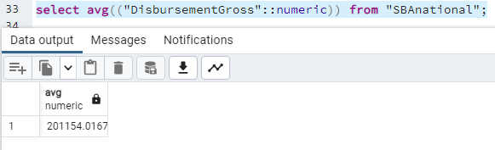
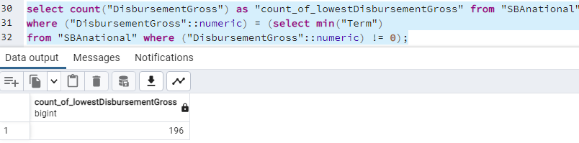
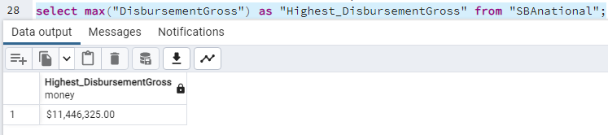
3. Disbursement gross amount*
This is an important risk factor for loan approval decision. Disbursement gross amount will simply indicates how much loan a customer applied for.
Generally it depends on the business plan and expanding plan. If a business is having plan for higher expanding and thinking to buy some assets which is future worthy then we can say that more the disbursement amount more the business will be successful and will be non-defaulters.
In this data set highest disbursement gross amount is $11,446,325 which is taken by only 1 business which can be identified as outlier.
Lowest disbursement amount is $1.00 and 196 rows are having this, which can be a data anomaly or impurity.
Average disbursement gross amount is $2,01,154 for this data set.
Notes:
*Important Factor 2

Slide 10
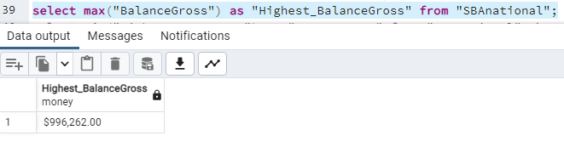
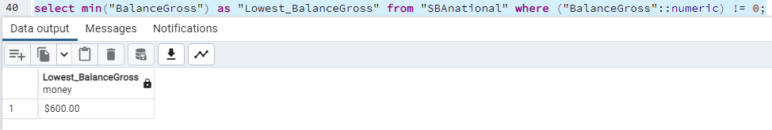
4. balance gross amount
As per data dictionary the meaning of this column is gross amount outstanding or total amount of debt for a company. Let’s say a company has taken loan 40K from bank A and 30K from a family person so total debt is 70K.
This is also an important column if a business is having high amount of total debt then we can conclude that it is hard to repay the loan amount for that company. Because already a lot of debt is there for them to pay.
In this data set highest amount of balance gross is $996,262 which is having only for 1 business and we can consider it as outlier.
Lowest balance gross is $600 and only 1 business is having this in the data set.
Average amount of balance gross is $2,01,154.

Slide 11
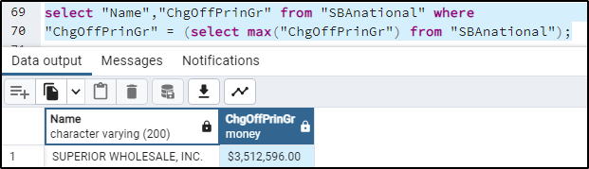
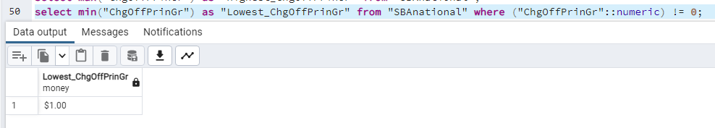
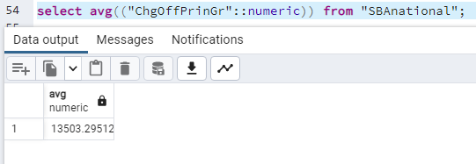
5. ChgOFFPRINGR*
Charged off amount is simply the loss amount after lending loan to a person. When the person failed to pay back the complete amount then the creditor charged off for that amount.
In simple term, let’s say business A lend 1 Lakh amount to a person and the person pay back 70k and left out amount is unable to pay by the person hence the company is charged of 30k in that case company will first sent a letter and then might take a legal step.
In this case if amount of charged-off for a company is high then we can say that company failed to pay the amount of loan previously to the creditor and it plays a vital role here.
Max charged off amount is $3,512,596 by Superior Wholesale, INC.
Minimum charged off amount is $1.00 which might be a data anomaly and average is $13,503
Notes:
*Important Factor 3

Slide 12
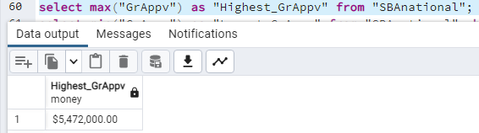
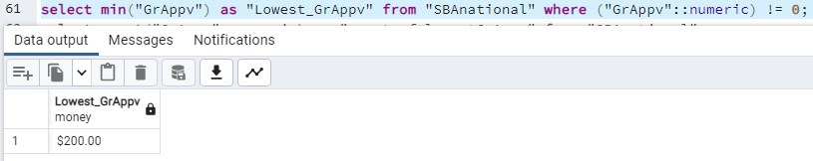
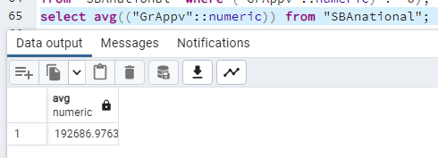
6. Grappv
This column means gross amount of loan approved by the bank for a company.
This also describe the liquidity amount. We can say that more the gross amount more chanced to be a non-defaulters.
Highest amount of GrAppv is $5,472,000 which is too high and high possibility to be an outlier.
Lowest amount is $200 and almost 2 companies are holding this.
Average amount of GrAppv is $1,92,686.

Slide 13
Analysis for categorical columns
NewExist
UrbanRural
LowDoc
MIS_Status
NAICS
State

Slide 14
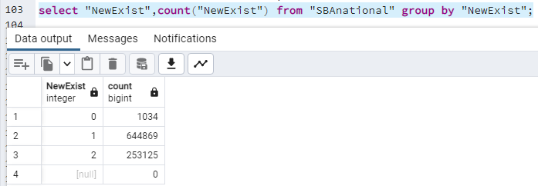
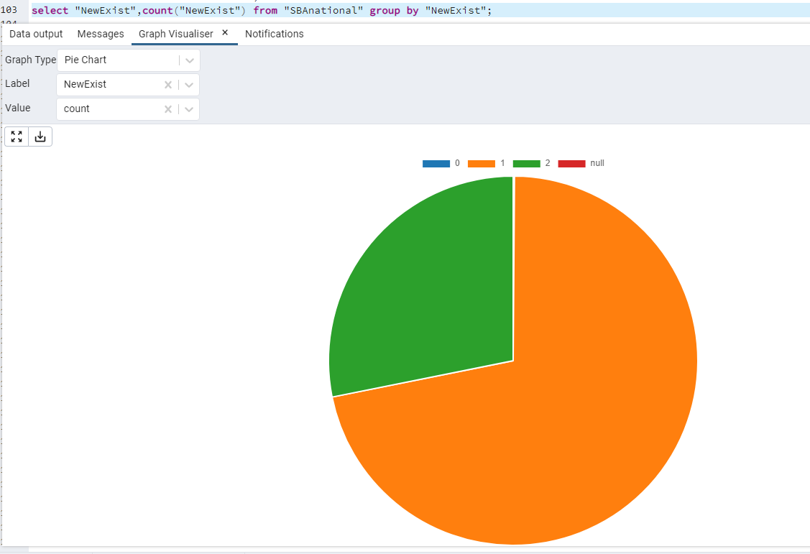
1. New exist*
This column described which business is already established and which are newly created.
It has an impact for loan approval. Existing companies are already having some history which is helpful for a company to analyse and understand if the company can pay the loan or not.
Here, 1=existing business and 2=new business
Almost 6,44,869 businesses are already existing and 2,53,123 businesses are new.
And 1034 values are unidentified or missing.
Notes:
*Important Factor 4

Slide 15
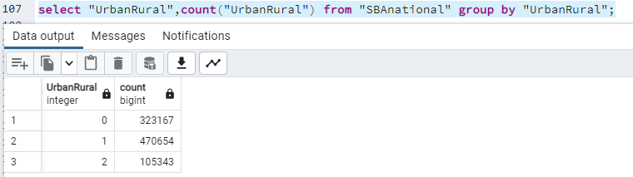
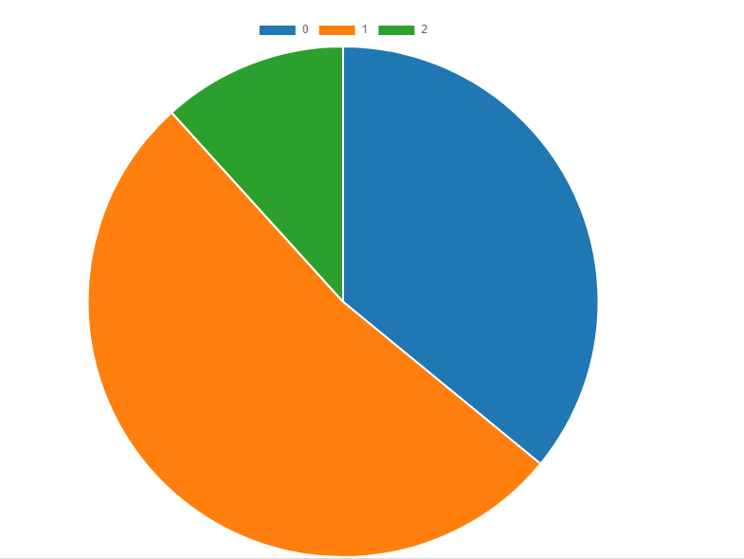
2. Urban rural
This describe us which companies are from urban area and which are from rural area.
It can give us a clarity of the success for their business. Let’s say, a business which is established in urban area is having more facilities than a business which is in rural area. It can also give us a picture for loan amount.
1 = Urban, 2 = Rural and 0 = Unidentified
Almost 4,70,654 businesses are from urban area and 1,05,343 businesses are from rural area.
3,23,167 numbers of values are undefined or missing.

Slide 16
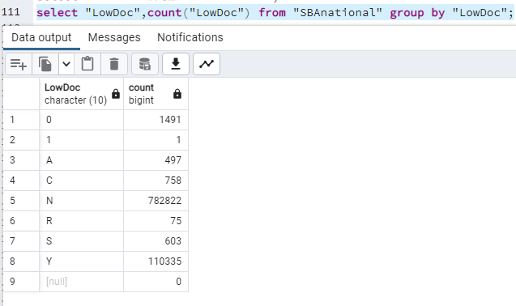
3. Low doc*
This column describe the low doc loan program or in simple term urgent loans with less documentation.
But this is a good example of data anomaly column.
Y = yes and N = no
But here we can see multiple entries other than Y and N which is a clear example of data anomaly or impurity.
Characters | Count
0 | 1491
1 | 1
A | 497
C | 758
N | 782822
R | 75
S | 603
Y | 110335
Notes:
*Important Factor 5

Slide 17
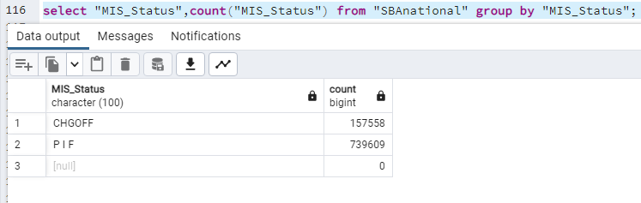
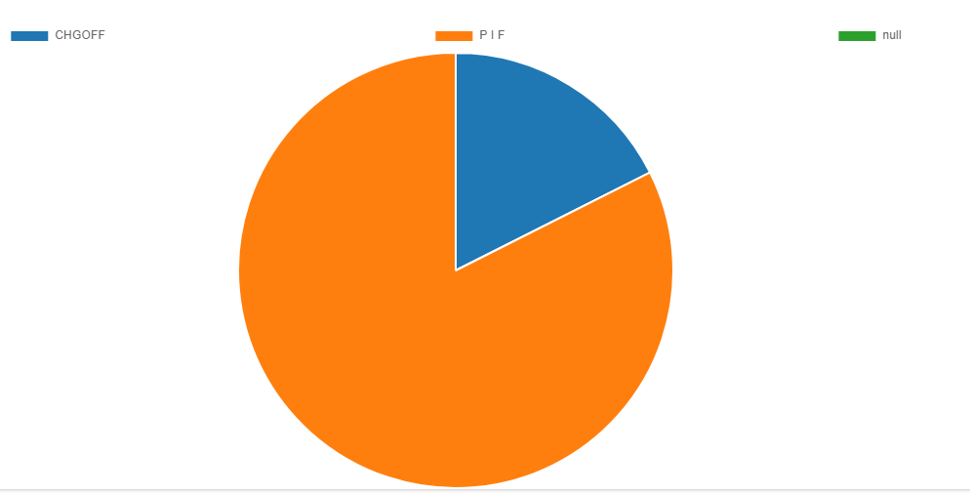
4. MIS_STATUS**
This column is most important in the whole data set. It decides whether a client is payment defaulters or non-defaulters.
Here 2 values are there. CHGOFF = payment defaulters and PIF = payment non-defaulters.
This column also gives us an insight about data imbalance which is a real problem in Real World Industry
As per this data 1,57,558 clients are payment defaulters and 7,39,609 clients are payment non-defaulters.
From the previous number only we can say the data is highly imbalance as majority are non-defaulters. In this case we need to focus more on statistical data of each metrices.
Notes:
**Important Factor 6

Slide 18
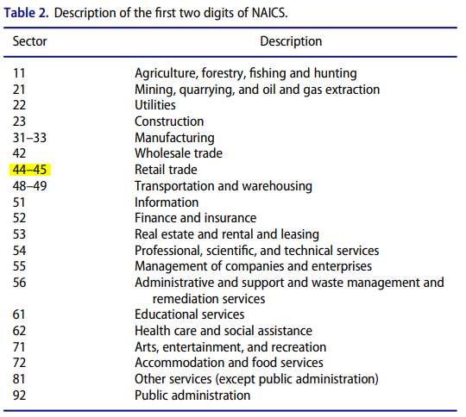
5. NAICS
This column describe the service type with a code. NAICS basically a number system which is allocated for defining the type of a business.
In this column there are multiple numeric values and the first 2 digits of that code describe us the service type for a business.
The chart given by North American Council is given in the right side.
We have done a huge analysis in this column. Maximum population from code 23 which is belong to business type construction.
Lowest population belongs from code 61 and 92 which are belongs to educational service and public administration.
In next slide the counts are given for this.

Slide 19
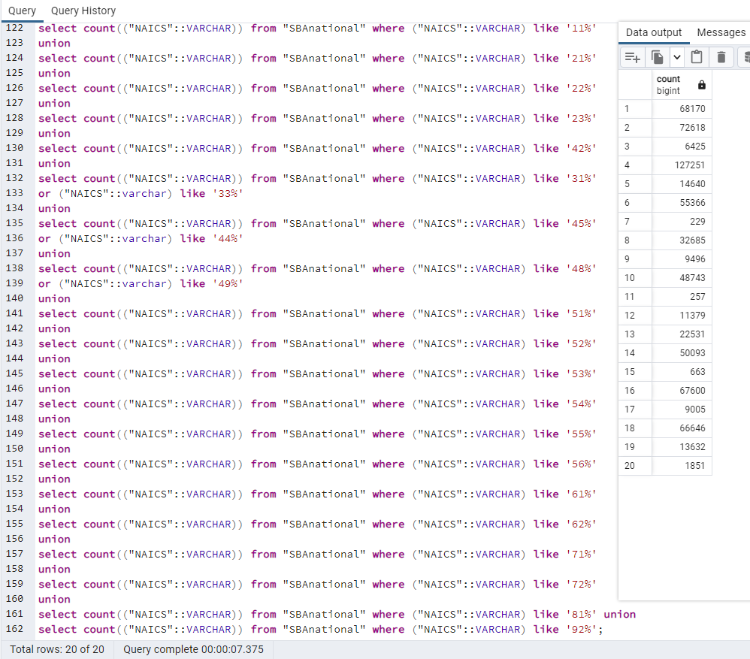
Counts for each NAICS:
Row Number | Code | Count
1 | 11 | 68170
2 | 21 | 72618
3 | 22 | 6425
4 | 23 | 127251
5 | 31-33 | 14640
6 | 42 | 55366
7 | 44-45 | 229
8 | 48-49 | 32685
9 | 51 | 9496
10 | 52 | 48743
11 | 53 | 257
12 | 54 | 11379
13 | 55 | 22531
14 | 56 | 50093
15 | 61 | 663
16 | 62 | 67600
17 | 71 | 9005
18 | 72 | 66646
19 | 81 | 13632
20 | 92 | 1851

Slide 20
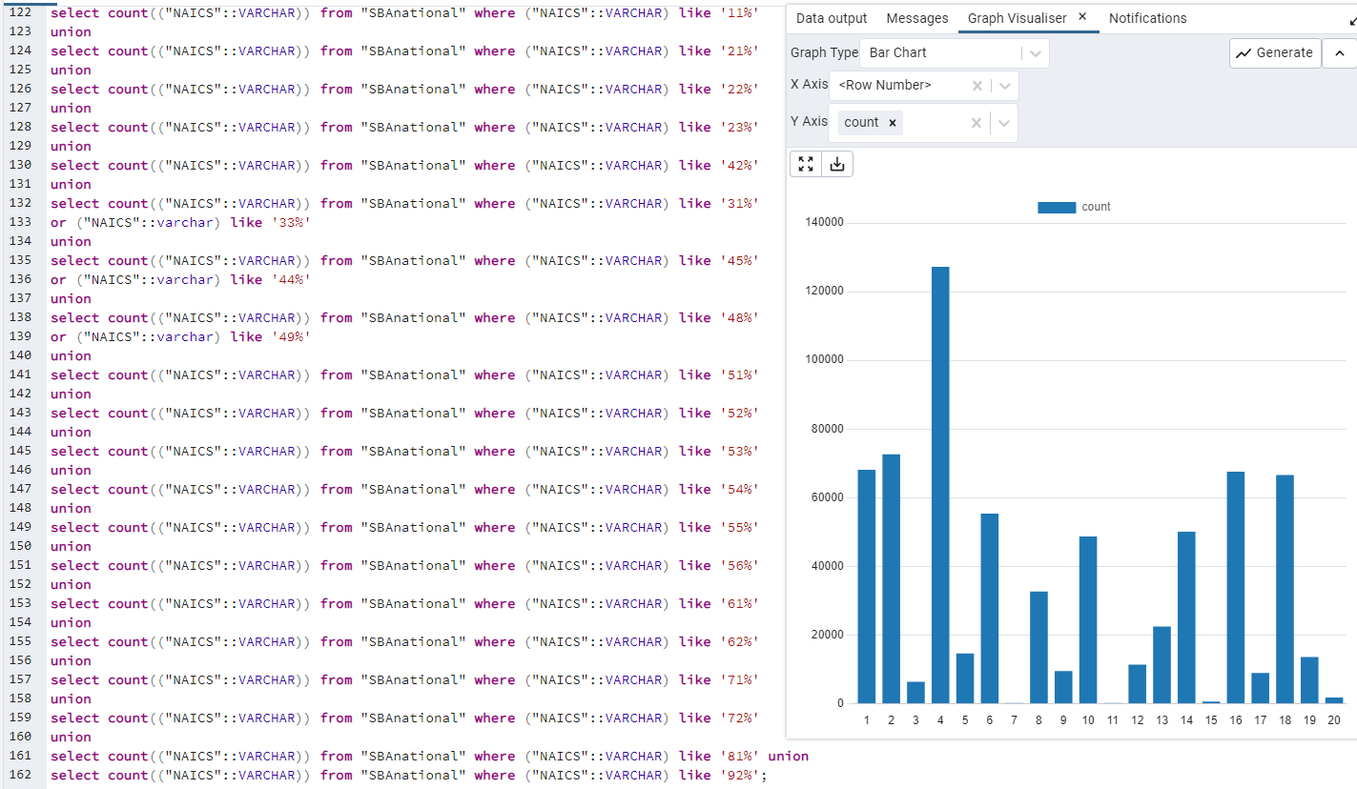
Graphs for Naics:

Slide 21
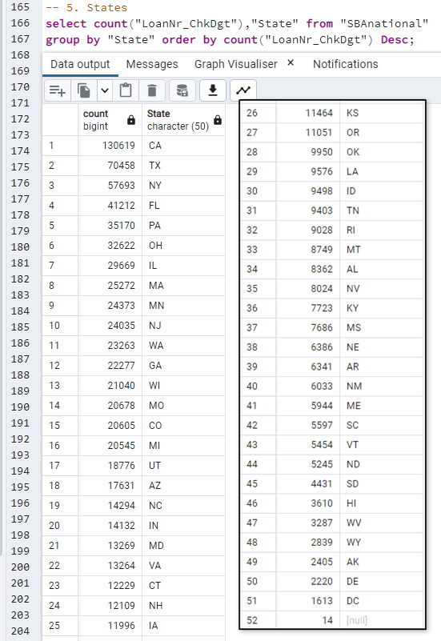
6.State
State is not important as per loan approval and rejection purpose but we can check the count of each state and check population of loan takers from each state .
Here 52 different states are there and highest loan taken from state CA and lowest is from state DC.
And only 14 values are null or missing while collecting data.

Slide 22
Almost observed 12 metrices among 27 and 6 are very important from these 12 in order to taking decision for loan approval.
Term
Disbursement Gross Amount
Charged-off Amount
New / Exist businesses
Low Document Loan
MIS_Status**

Slide 23
THANK YOU
Joyita Sadhukhan

