Slide 1
RIVORA AI
AI-Powered Community Flood Risk & Preparedness Assistant
An explainable environmental intelligence prototype for community-level flood and waterlogging risk interpretation.
PRIMARY SDG 11 • SUSTAINABLE CITIES & COMMUNITIES
SECONDARY: SDG 13 • SDG 6
Joyeeta Das | B.Tech CSE | Institute of Engineering & Management (IEM), Kolkata
IBM SkillsBuild + AICTE AI & Sustainability Virtual Internship
RIVORA AI • AI-assisted environmental risk & preparedness prototype
1

Slide 2
01 • PROBLEM
The Sustainability Problem
Flooding and waterlogging create practical risks for everyday community life.
WHAT COMMUNITIES EXPERIENCE
THE INFORMATION GAP
• Roads can become difficult to use after heavy rainfall, and moderate rain can also cause local water accumulation.
• Water may enter homes and shops located beside affected roads.
• Villagers can face serious travel disruption during flooding.
• Agricultural fields may remain submerged after prolonged rainfall.
• Riverbank erosion can threaten agricultural land and houses.
• Environmental factors such as rainfall, drainage, terrain and previous flooding contain useful risk signals.
• Ordinary users may find these factors difficult to interpret.
• RIVORA converts structured inputs into an understandable relative risk assessment.
• The system also provides practical preparedness guidance.
• It is a decision-support prototype—not an official warning system.
RIVORA AI • AI-assisted environmental risk & preparedness prototype
2

Slide 3
02 • USERS & SDGS
Who RIVORA Supports & SDG Alignment
Designed around community resilience rather than technology for its own sake.
TARGET USERS
SDG ALIGNMENT
• Community residents
• Farmers and rural communities
• Students and community volunteers
• NGOs and community-awareness programs
• Future application: local administration and disaster-management stakeholders
• SDG 11 — Sustainable Cities & Communities: primary focus on resilience and safer communities.
• SDG 13 — Climate Action: supports climate-risk awareness and preparedness.
• SDG 6 — Clean Water & Sanitation: connects flooding/waterlogging with water-related community risks.
HOW MIGHT WE?
How might we use AI to interpret environmental risk factors and provide understandable flood-risk and preparedness guidance so that communities can become more resilient to flooding and waterlogging?
RIVORA AI • AI-assisted environmental risk & preparedness prototype
3

Slide 4
03 • SOLUTION
RIVORA AI — The Proposed Solution
A layered AI-assisted decision-support workflow.
INPUTS
AI ROLES
OUTPUTS
• Rainfall intensity and duration
• Terrain / elevation context
• Drainage condition
• Previous flooding
• Existing water accumulation
• Location/general-area context
• Risk classification
• Explainable reasoning
• Knowledge retrieval / RAG
• Decision support
• Conversational preparedness guidance
• Uncertainty handling
• LOW / MODERATE / HIGH / VERY HIGH
• Main contributing factors
• Reasoning and uncertainty
• Practical preparedness actions
• Safety disclaimer
• Insufficient-data response when evidence is inadequate
RIVORA AI • AI-assisted environmental risk & preparedness prototype
4

Slide 5
04 • ARCHITECTURE
System Workflow
The prototype separates environmental inputs, risk interpretation, grounded knowledge and user guidance.
1
2
3
4
5
6
Environmental & community inputs
→
RIVORA risk engine
→
Explainable risk interpretation
→
Knowledge / evidence layer
→
Preparedness decision support
→
User-facing response
RESPONSIBLE DESIGN PRINCIPLE
• RIVORA does not invent measurements or official warnings; when information is insufficient, it explicitly says so and asks for additional data.
RIVORA AI • AI-assisted environmental risk & preparedness prototype
5

Slide 6
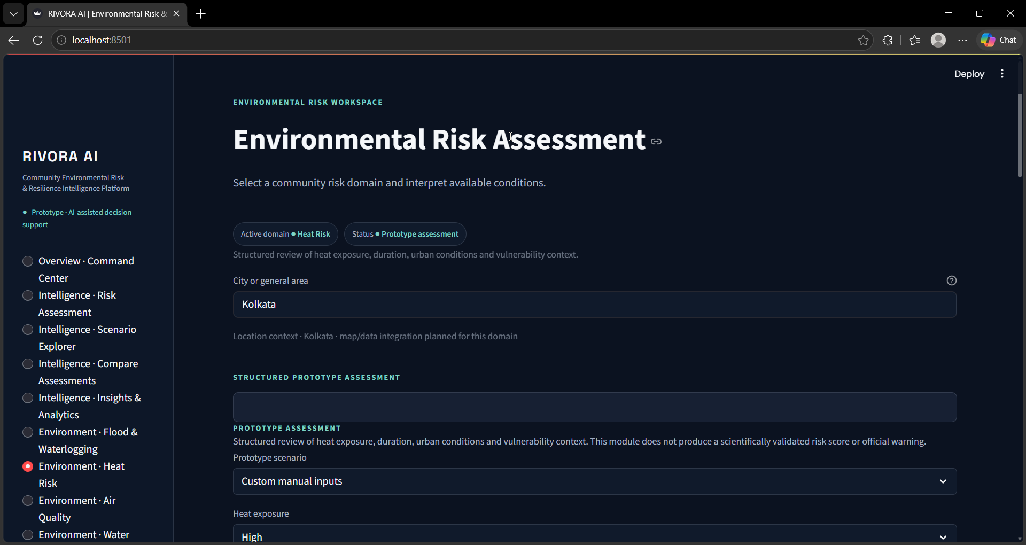
05 • PROTOTYPE
Flood & Waterlogging Risk Assessment
Example of the core environmental-risk interaction in the working prototype.
WHAT IT DEMONSTRATES
• Location/general-area context
• Recent rainfall reference
• Community conditions
• Relative risk classification
• Clear prototype boundary
Prototype screen: rainfall reference + community/environmental conditions + risk result
RIVORA AI • AI-assisted environmental risk & preparedness prototype
6

Slide 7
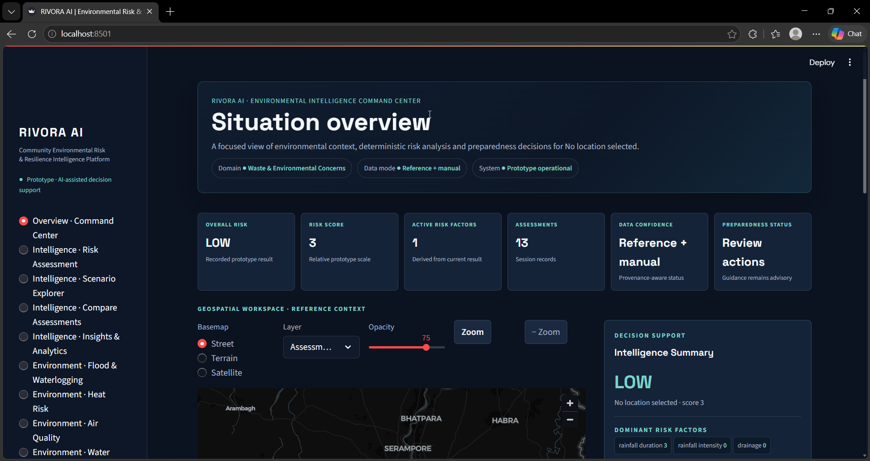
06 • PROTOTYPE
Environmental Intelligence Command Center
A centralized view of recorded risk context and decision support.
KEY ELEMENTS
• Overall risk
• Risk score
• Active risk factors
• Assessment count
• Data-confidence state
• Geospatial reference workspace
• Intelligence summary
• Assessment history
Situation Overview / Command Center
RIVORA AI • AI-assisted environmental risk & preparedness prototype
7

Slide 8
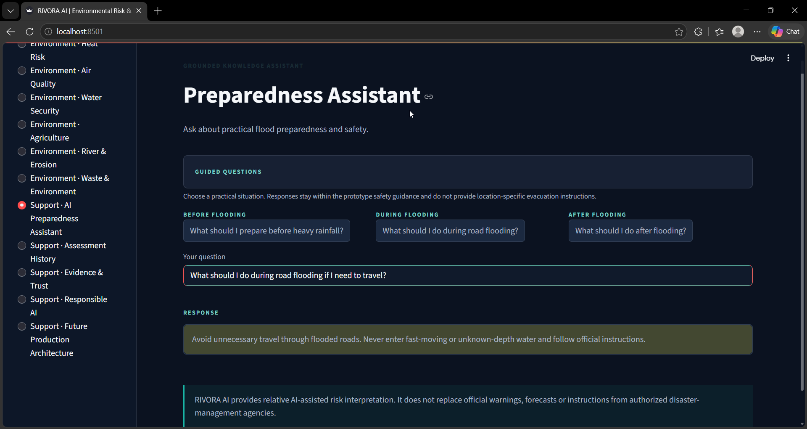
07 • AI ASSISTANT
AI Preparedness Assistant
Grounded, practical guidance for real-world flood situations.
EXAMPLE USE
• Before: prepare for heavy rainfall and waterlogging.
• During: respond safely to flooded roads.
• After: check hazards before returning.
• Guidance stays within the prototype's safety scope.
• Official government/disaster-management instructions remain authoritative.
Guided Before / During / After Flooding questions
RIVORA AI • AI-assisted environmental risk & preparedness prototype
8

Slide 9
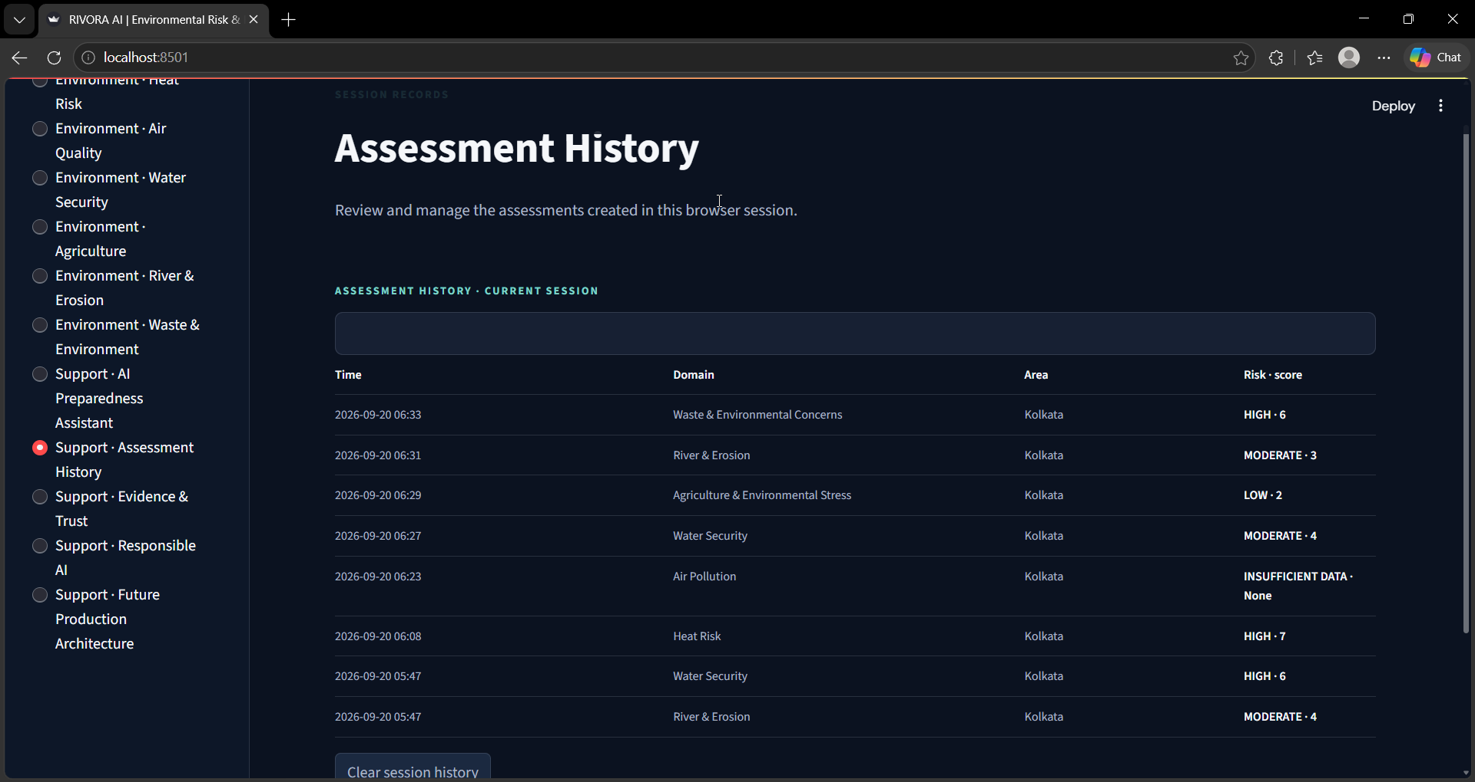
08 • AUDITABILITY
Assessment History & Analytics
The prototype records assessment activity for traceability and review.
WHY IT MATTERS
• Creates an auditable session record.
• Supports comparison of user-created assessments.
• Shows domain, location, risk level and timestamps.
• Helps evaluate consistency during prototype testing.
• Recorded assessments are not claimed as measured environmental change.
Recorded assessment history and analytics
RIVORA AI • AI-assisted environmental risk & preparedness prototype
9

Slide 10
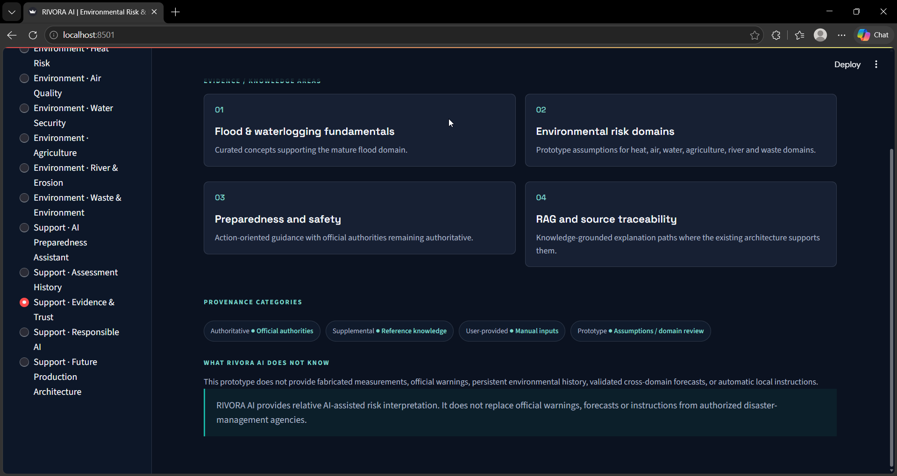
09 • TRUST
Evidence, Trust & Knowledge Layer
RIVORA separates evidence provenance from AI-generated interpretation.
KNOWLEDGE APPROACH
• Authoritative guidance
• Supplemental references
• User-provided context
• Prototype/reference information
• Grounded retrieval for preparedness responses
• No invented official warnings
Evidence & Trust / knowledge provenance
RIVORA AI • AI-assisted environmental risk & preparedness prototype
10

Slide 11
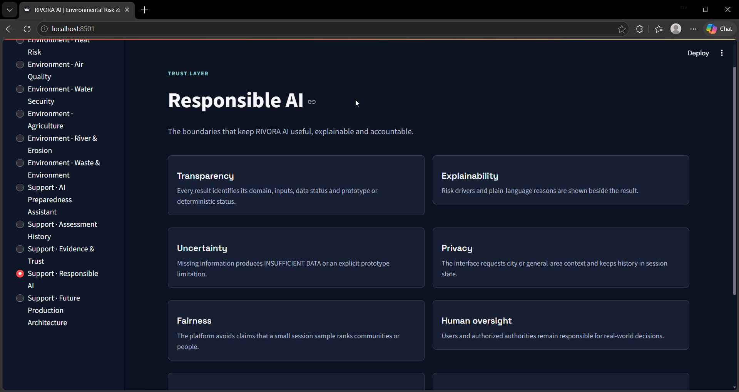
10 • RESPONSIBLE AI
Responsible AI & Safety
Safety is part of the product design, not an afterthought.
GUARDRAILS
• Transparency & explainability
• Explicit uncertainty
• Privacy / no unnecessary personal data
• Fairness across different community contexts
• Human oversight
• Safety boundaries
• Hallucination prevention
• No claim of official warning authority
Responsible AI safeguards in the prototype
RIVORA AI • AI-assisted environmental risk & preparedness prototype
11

Slide 12
11 • TESTING
Prototype Testing & Validation Plan
Testing focuses on logical consistency and safe handling of uncertainty.
TEST SCENARIOS
WHAT IS NOT CLAIMED
• Light rain + elevated terrain + good drainage → Low
• Heavy rain + good drainage + elevated terrain → Moderate
• Heavy/prolonged rain + poor drainage + low terrain + previous flooding → High
• Very heavy/prolonged rain + multiple severe factors → Very High
• Unknown critical inputs → Insufficient Data
• Mixed or ambiguous inputs → cautious interpretation rather than fabricated certainty
• No fabricated accuracy percentage.
• No official flood-warning authority.
• No exact flood depth or evacuation route prediction.
• No claim that prototype scores represent measured environmental conditions.
• Future validation should use historical events, authoritative datasets and domain experts.
RIVORA AI • AI-assisted environmental risk & preparedness prototype
12

Slide 13
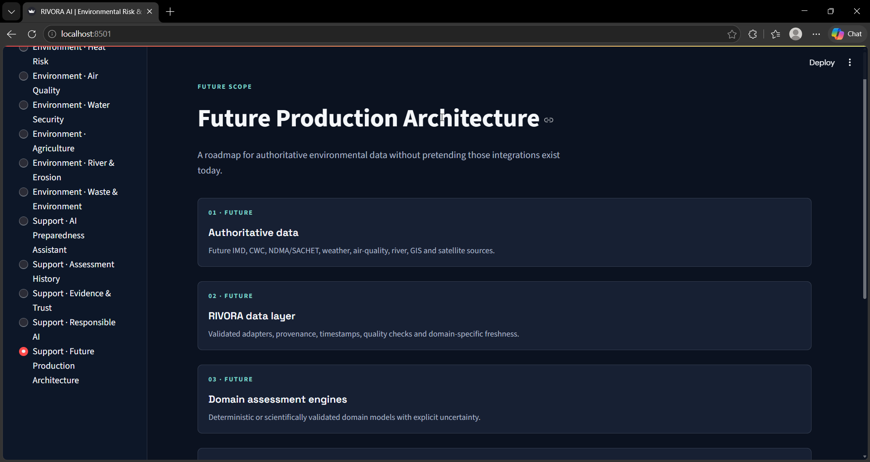
12 • FUTURE
Impact & Future Production Architecture
From a prototype decision-support layer toward a validated environmental intelligence system.
EXPECTED IMPACT PATH
• Environmental information
• → understandable risk interpretation
• → clearer preparedness decisions
• → earlier practical precautions
• → reduced exposure / potential losses
• → more resilient communities
Future Production Architecture
RIVORA AI • AI-assisted environmental risk & preparedness prototype
13

Slide 14
THANK YOU
RIVORA AI
AI-Powered Community Flood Risk & Preparedness Assistant
AI-ASSISTED DECISION SUPPORT • RESPONSIBLE AI • COMMUNITY RESILIENCE
Joyeeta Das | Institute of Engineering & Management (IEM), Kolkata
Prototype submission • IBM SkillsBuild + AICTE AI & Sustainability Virtual Internship
RIVORA AI • AI-assisted environmental risk & preparedness prototype
14

