Slide 1
EEE
Overview of Electrical Engineering
Lecture 1:
Introduction to Electromagnetic Fields;
Maxwell’s Equations; Electromagnetic Fields in Materials; Phasor Concepts;
Electrostatics: Coulomb’s Law, Electric Field, Discrete and Continuous Charge Distributions; Electrostatic Potential

Slide 2
Lecture 1 Objectives
To provide an overview of classical electromagnetics, Maxwell’s equations, electromagnetic fields in materials, and phasor concepts.
To begin our study of electrostatics with Coulomb’s law; definition of electric field; computation of electric field from discrete and continuous charge distributions; and scalar electric potential.

Slide 3
Introduction to Electromagnetic Fields
Electromagnetics is the study of the effect of charges at rest and charges in motion.
Some special cases of electromagnetics:
  Electrostatics: charges at rest
  Magnetostatics: charges in steady motion (DC)
  Electromagnetic waves: waves excited by charges in time-varying motion

Slide 4
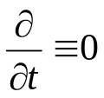

Introduction to Electromagnetic Fields
Fundamental laws of classical electromagnetics
Maxwell’s
equations
Special cases
Electro-statics
Magneto-statics
Electro-magnetic waves
Geometric Optics
Statics:
Transmission
Line
Theory
Input from other disciplines
Circuit
Theory
Kirchoff’s Laws

Slide 5
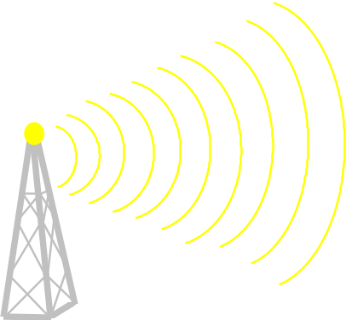

Introduction to Electromagnetic Fields
transmitter and receiver
are connected by a “field.”

Slide 6
Introduction to Electromagnetic Fields
High-speed, high-density digital circuits:
2
3
1
4
consider an interconnect between points “1” and “2”

Slide 7
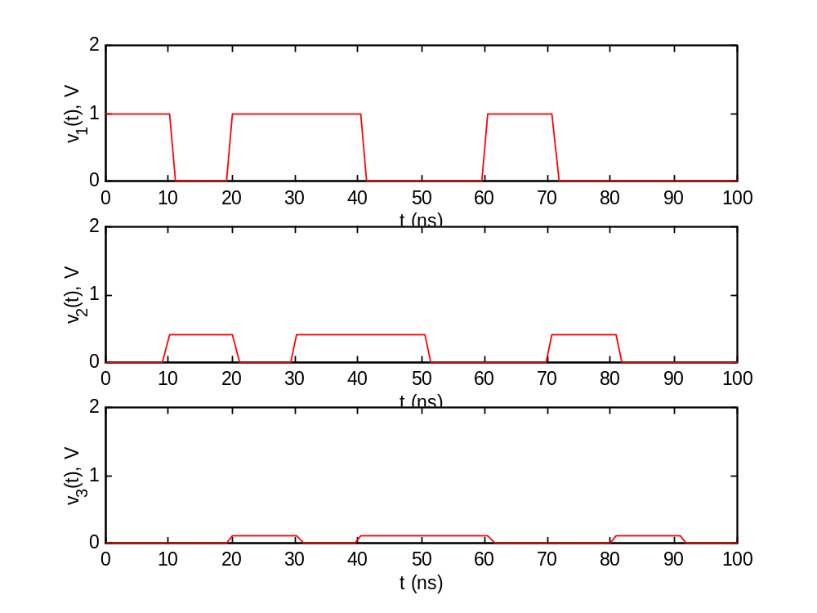
Introduction to Electromagnetic Fields
    Propagation delay
    Electromagnetic coupling
    Substrate modes

Slide 8
Introduction to Electromagnetic Fields
When an event in one place has an effect on something at a different location, we talk about the events as being connected by a “field”.
A field is a spatial distribution of a quantity; in general, it can be either scalar or vector in nature.

Slide 9
Introduction to Electromagnetic Fields
Electric and magnetic fields:
  Are vector fields with three spatial components.
  Vary as a function of position in 3D space as well as time.
  Are governed by partial differential equations derived from Maxwell’s equations.

Slide 10
Introduction to Electromagnetic Fields
A scalar is a quantity having only an amplitude (and possibly phase).
A vector is a quantity having direction in addition to amplitude (and possibly phase).
Examples: voltage, current, charge, energy, temperature
Examples: velocity, acceleration, force

Slide 11




Introduction to Electromagnetic Fields
Fundamental vector field quantities in electromagnetics:
  Electric field intensity
  Electric flux density (electric displacement)
  Magnetic field intensity
  Magnetic flux density
units = volts per meter (V/m = kg m/A/s³)
units = coulombs per square meter (C/m² = A s /m²)
units = amps per meter (A/m)
units = teslas = webers per square meter (T = Wb/ m² = kg/A/s³)

Slide 12
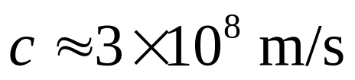
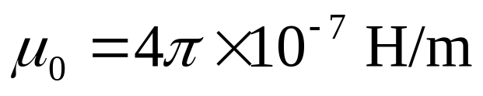
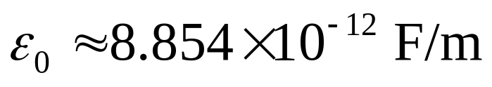
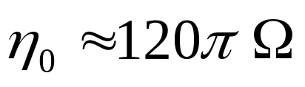
Introduction to Electromagnetic Fields
Universal constants in electromagnetics:
  Velocity of an electromagnetic wave (e.g., light) in free space (perfect vacuum)
  Permeability of free space
  Permittivity of free space:
  Intrinsic impedance of free space:

Slide 13
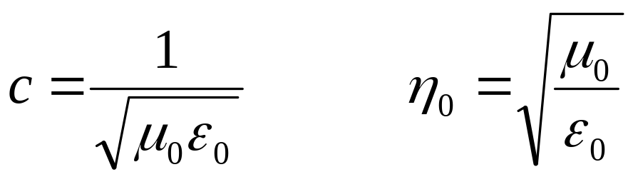
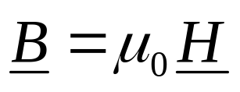
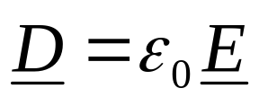
Introduction to Electromagnetic Fields
Relationships involving the universal constants:
In free space:

Slide 14
Introduction to Electromagnetic Fields
sources
J_{i}, K_{i}
Obtained
by assumption
from solution to IE
Solution to
Maxwell’s equations
fields
E, H
Observable quantities

Slide 15
Maxwell’s Equations
Maxwell’s equations in integral form are the fundamental postulates of classical electromagnetics - all classical electromagnetic phenomena are explained by these equations.
Electromagnetic phenomena include electrostatics, magnetostatics, electromagnetostatics and electromagnetic wave propagation.
The differential equations and boundary conditions that we use to formulate and solve EM problems are all derived from Maxwell’s equations in integral form.

Slide 16
Maxwell’s Equations
Various equivalence principles consistent with Maxwell’s equations allow us to replace more complicated electric current and charge distributions with equivalent magnetic sources.
These equivalent magnetic sources can be treated by a generalization of Maxwell’s equations.

Slide 17
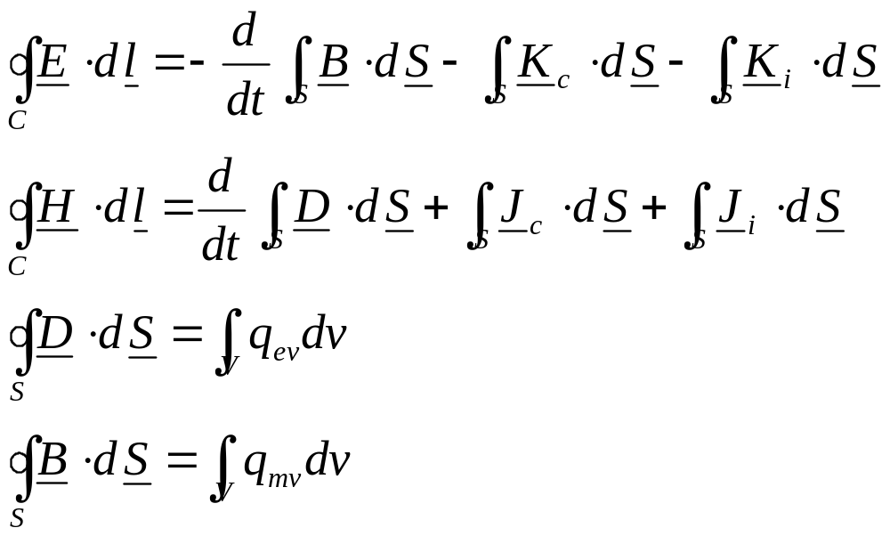
Maxwell’s Equations in Integral Form (Generalized to Include Equivalent Magnetic Sources)
Adding the fictitious magnetic source terms is equivalent to living in a universe where magnetic monopoles (charges) exist.

Slide 18
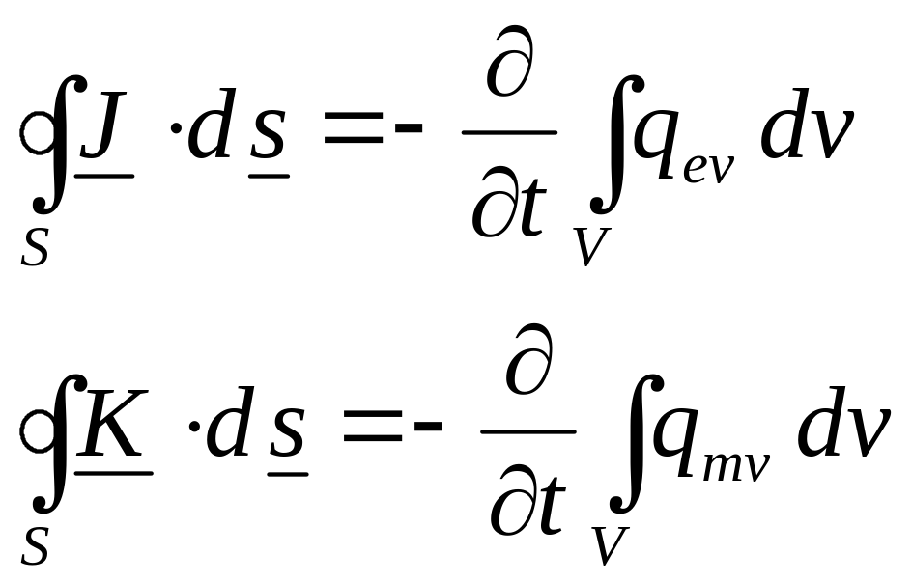
Continuity Equation in Integral Form (Generalized to Include Equivalent Magnetic Sources)
The continuity equations are implicit in Maxwell’s equations.

Slide 19
Contour, Surface and Volume Conventions
open surface S bounded by
closed contour C
dS in direction given by
RH rule
S
C
dS
S
volume V bounded by
closed surface S
dS in direction outward
from V
V
dS

Slide 20
Electric Current and Charge Densities
J_{c} = (electric) conduction current density (A/m²)
J_{i} = (electric) impressed current density (A/m²)
q_{ev} = (electric) charge density (C/m³)

Slide 21
Magnetic Current and Charge Densities
K_{c} = magnetic conduction current density (V/m²)
K_{i} = magnetic impressed current density (V/m²)
q_{mv} = magnetic charge density (Wb/m³)

Slide 22
Maxwell’s Equations - Sources and Responses
Sources of EM field:
  K_{i}, J_{i}, q_{ev}, q_{mv}
Responses to EM field:
  E, H, D, B, J_{c}, K_{c}

Slide 23
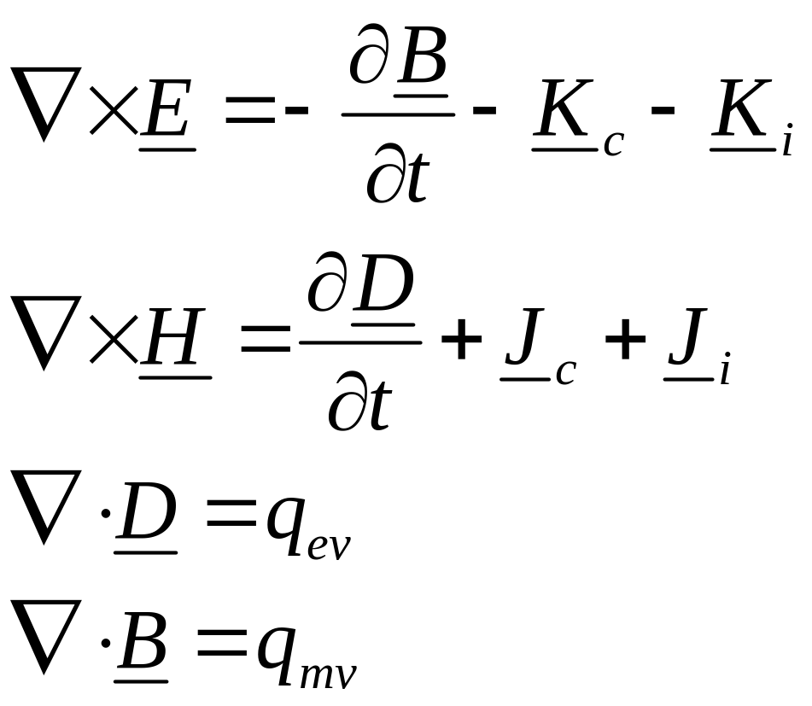
Maxwell’s Equations in Differential Form (Generalized to Include Equivalent Magnetic Sources)

Slide 24
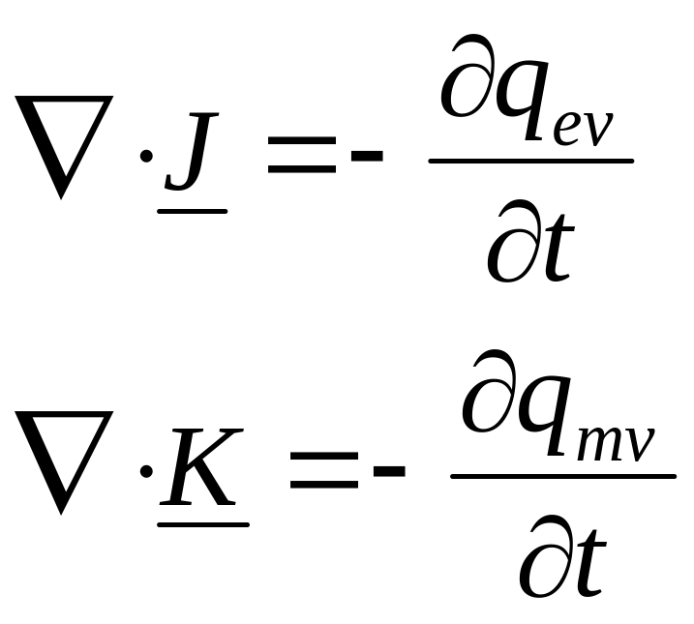
Continuity Equation in Differential Form (Generalized to Include Equivalent Magnetic Sources)
The continuity equations are implicit in Maxwell’s equations.

Slide 25
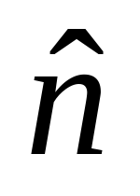
Electromagnetic Boundary Conditions
Region 1
Region 2

Slide 26
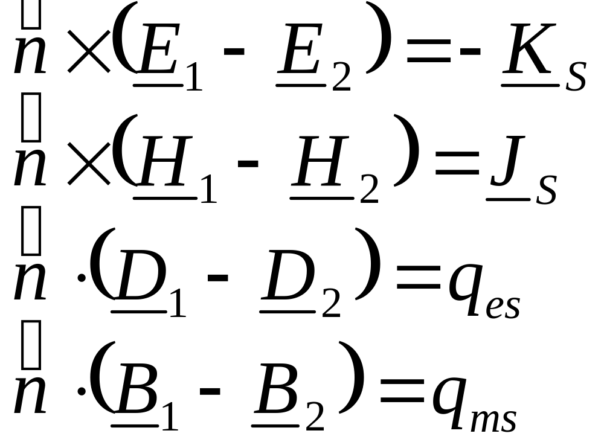
Electromagnetic Boundary Conditions

Slide 27
Surface Current and Charge Densities
Can be either sources of or responses to EM field.
Units:
  K_{s} - V/m
  J_{s} - A/m
  q_{es} - C/m²
  q_{ms} - W/m²

Slide 28
Electromagnetic Fields in Materials
In time-varying electromagnetics, we consider E and H to be the “primary” responses, and attempt to write the “secondary” responses D, B, J_{c}, and K_{c} in terms of E and H.
The relationships between the “primary” and “secondary” responses depends on the medium in which the field exists.
The relationships between the “primary” and “secondary” responses are called constitutive relationships.

Slide 29
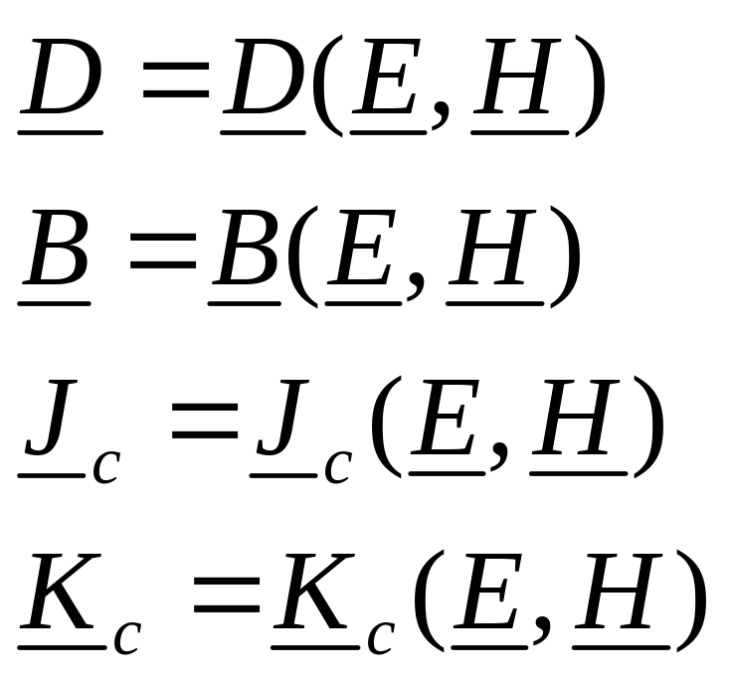
Electromagnetic Fields in Materials
Most general constitutive relationships:

Slide 30
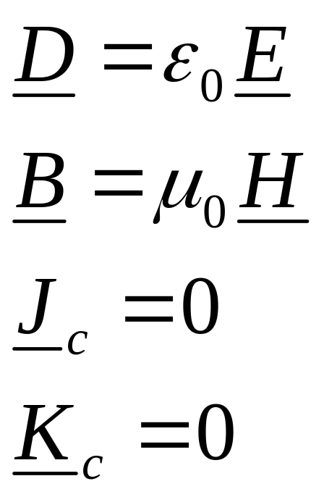
Electromagnetic Fields in Materials
In free space, we have:

Slide 31
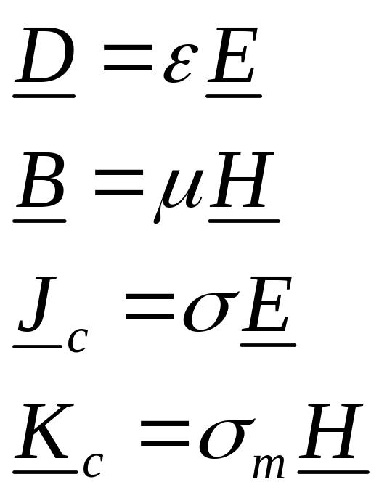
Electromagnetic Fields in Materials
In a simple medium, we have:
linear (independent of field strength)
isotropic (independent of position within the medium)
homogeneous (independent of direction)
time-invariant (independent of time)
non-dispersive (independent of frequency)

Slide 32
Electromagnetic Fields in Materials
ε = permittivity = ε_{r}ε₀ (F/m)
μ = permeability = μ_{r}μ₀ (H/m)
σ = electric conductivity = ε_{r}ε₀ (S/m)
σ_{m} = magnetic conductivity = ε_{r}ε₀ (Ω/m)

Slide 33
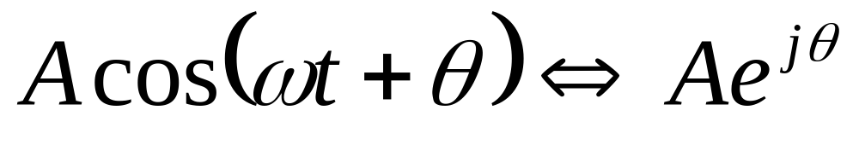
Phasor Representation of a Time-Harmonic Field
A phasor is a complex number representing the amplitude and phase of a sinusoid of known frequency.
phasor
frequency domain
time domain

Slide 34
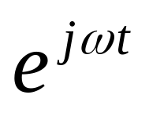
Phasor Representation of a Time-Harmonic Field
Phasors are an extremely important concept in the study of classical electromagnetics, circuit theory, and communications systems.
Maxwell’s equations in simple media, circuits comprising linear devices, and many components of communications systems can all be represented as linear time-invariant (LTI) systems. (Formal definition of these later in the course …)
The eigenfunctions of any LTI system are the complex exponentials of the form:

Slide 35

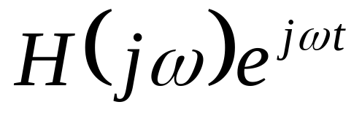
Phasor Representation of a Time-Harmonic Field
If the input to an LTI system is a sinusoid of frequency ω, then the output is also a sinusoid of frequency ω (with different amplitude and phase).
A complex constant (for fixed ω); as a function of ω gives the frequency response of the LTI system.

Slide 36
Phasor Representation of a Time-Harmonic Field
The amplitude and phase of a sinusoidal function can also depend on position, and the sinusoid can also be a vector function:

Slide 37
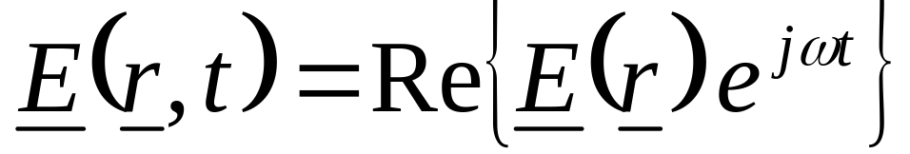
Phasor Representation of a Time-Harmonic Field
Given the phasor (frequency-domain) representation of a time-harmonic vector field, the time-domain representation of the vector field is obtained using the recipe:

Slide 38
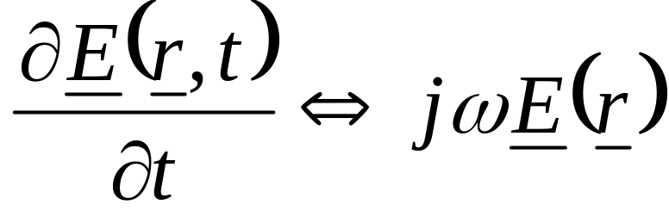
Phasor Representation of a Time-Harmonic Field
Phasors can be used provided all of the media in the problem are linear ⇒ no frequency conversion.
When phasors are used, integro-differential operators in time become algebraic operations in frequency, e.g.:

Slide 39
Time-Harmonic Maxwell’s Equations
If the sources are time-harmonic (sinusoidal), and all media are linear, then the electromagnetic fields are sinusoids of the same frequency as the sources.
In this case, we can simplify matters by using Maxwell’s equations in the frequency-domain.
Maxwell’s equations in the frequency-domain are relationships between the phasor representations of the fields.

Slide 40
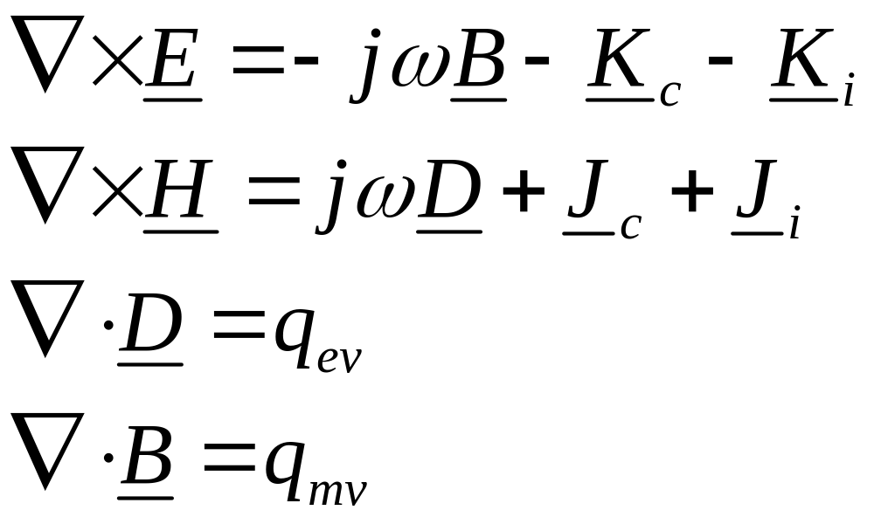
Maxwell’s Equations in Differential Form for Time-Harmonic Fields

Slide 41
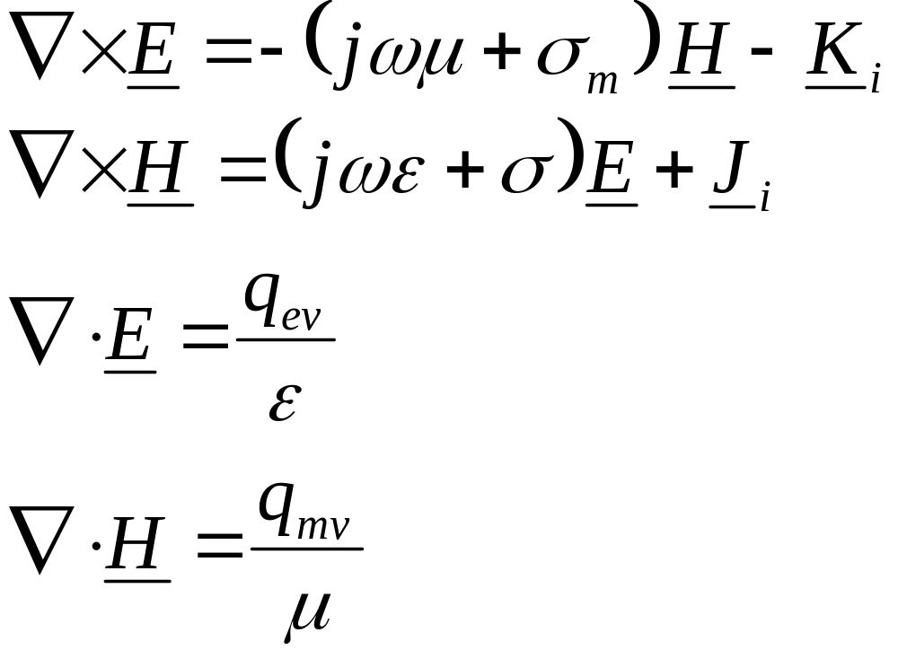
Maxwell’s Equations in Differential Form for Time-Harmonic Fields in Simple Medium

Slide 42
Electrostatics as a Special Case of Electromagnetics
Fundamental laws of classical electromagnetics
Maxwell’s
equations
Special cases
Electro-statics
Magneto-statics
Electro-magnetic waves
Geometric Optics
Statics:
Transmission
Line
Theory
Input from other disciplines
Circuit
Theory
Kirchoff’s Laws

Slide 43
Electrostatics
Electrostatics is the branch of electromagnetics dealing with the effects of electric charges at rest.
The fundamental law of electrostatics is Coulomb’s law.

Slide 44
Electric Charge
Electrical phenomena caused by friction are part of our everyday lives, and can be understood in terms of electrical charge.
The effects of electrical charge can be observed in the attraction/repulsion of various objects when “charged.”
Charge comes in two varieties called “positive” and “negative.”

Slide 45
Electric Charge
Objects carrying a net positive charge attract those carrying a net negative charge and repel those carrying a net positive charge.
Objects carrying a net negative charge attract those carrying a net positive charge and repel those carrying a net negative charge.
On an atomic scale, electrons are negatively charged and nuclei are positively charged.

Slide 46
Electric Charge
Electric charge is inherently quantized such that the charge on any object is an integer multiple of the smallest unit of charge which is the magnitude of the electron charge e = 1.602 × 10⁻¹⁹ C.
On the macroscopic level, we can assume that charge is “continuous.”

Slide 47
Coulomb’s Law
Coulomb’s law is the “law of action” between charged bodies.
Coulomb’s law gives the electric force between two point charges in an otherwise empty universe.
A point charge is a charge that occupies a region of space which is negligibly small compared to the distance between the point charge and any other object.

Slide 48
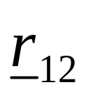
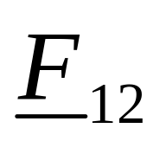
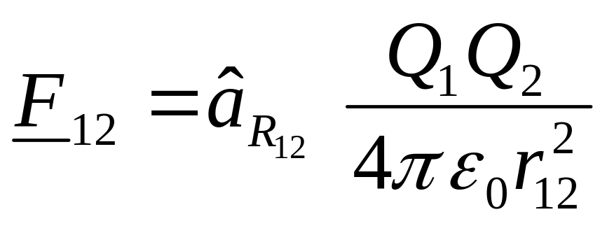
Coulomb’s Law
Q₁
Q₂
Unit vector in
direction of R₁₂
Force due to Q₁
acting on Q₂

Slide 49
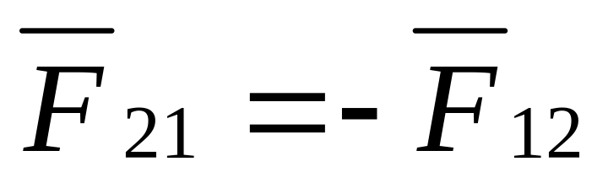
Coulomb’s Law
The force on Q₁ due to Q₂ is equal in magnitude but opposite in direction to the force on Q₂ due to Q₁.

Slide 50

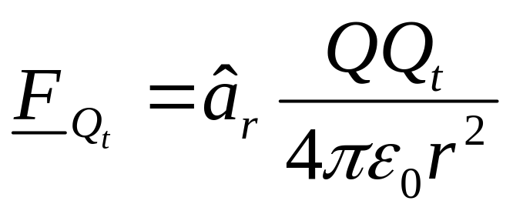
Electric Field
Consider a point charge Q placed at the origin of a coordinate system in an otherwise empty universe.
A test charge Q_{t} brought near Q experiences a force:
Q_{t}
Q

Slide 51
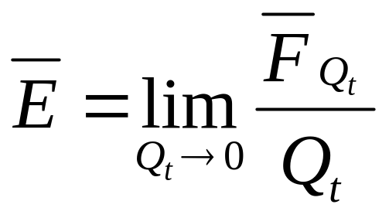
Electric Field
The existence of the force on Q_{t} can be attributed to an electric field produced by Q.
The electric field produced by Q at a point in space can be defined as the force per unit charge acting on a test charge Q_{t} placed at that point.

Slide 52
Electric Field
The electric field describes the effect of a stationary charge on other charges and is an abstract “action-at-a-distance” concept, very similar to the concept of a gravity field.
The basic units of electric field are newtons per coulomb.
In practice, we usually use volts per meter.

Slide 53
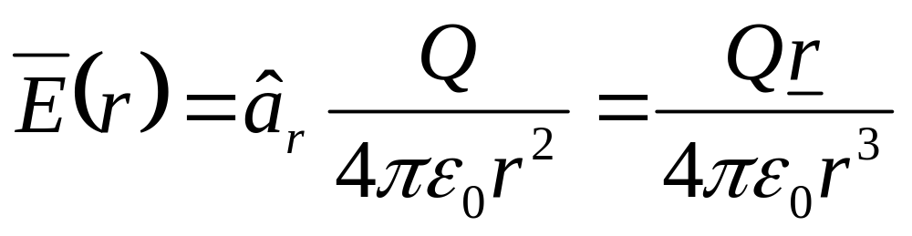
Electric Field
For a point charge at the origin, the electric field at any point is given by

Slide 54

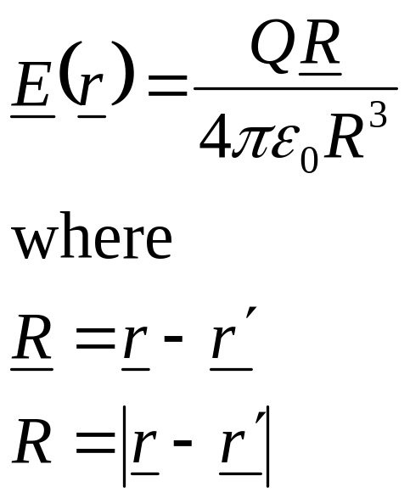
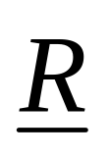
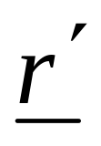
Electric Field
For a point charge located at a point P’ described by a position vector
the electric field at P is given by
P
Q
O

Slide 55
Electric Field
In electromagnetics, it is very popular to describe the source in terms of primed coordinates, and the observation point in terms of unprimed coordinates.
As we shall see, for continuous source distributions we shall need to integrate over the source coordinates.

Slide 56
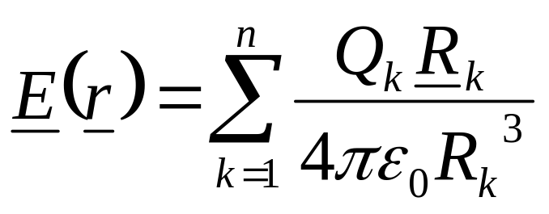
Electric Field
Using the principal of superposition, the electric field at a point arising from multiple point charges may be evaluated as

Slide 57
Continuous Distributions of Charge
Charge can occur as
  point charges (C)
  volume charges (C/m³)
  surface charges (C/m²)
  line charges (C/m)
⇐ most general

Slide 58

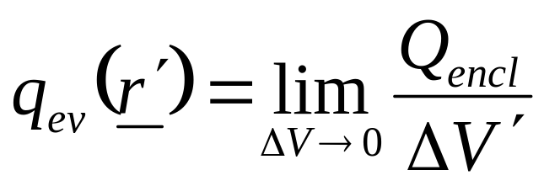
Continuous Distributions of Charge
Volume charge density
Q_{encl}
ΔV’

Slide 59


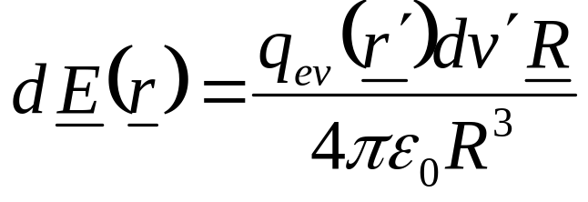
Continuous Distributions of Charge
Electric field due to volume charge density
dV’
P
Q_{encl}
V’

Slide 60
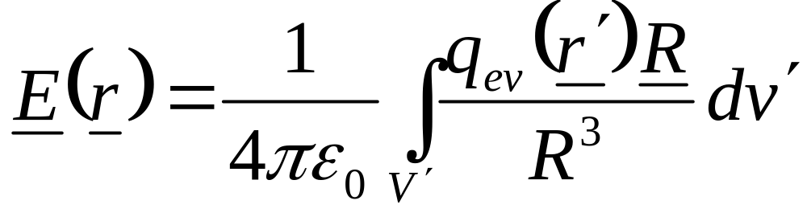
Electric Field Due to Volume Charge Density

Slide 61
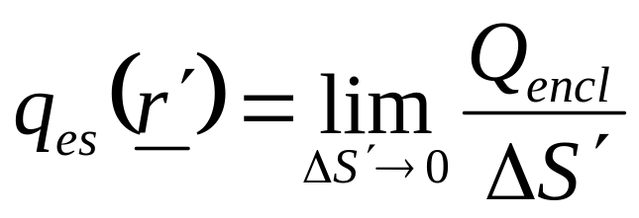
Continuous Distributions of Charge
Surface charge density
Q_{encl}
ΔS’

Slide 62

Continuous Distributions of Charge
Electric field due to surface charge density
dS’
P
Q_{encl}
S’

Slide 63

Electric Field Due to Surface Charge Density

Slide 64

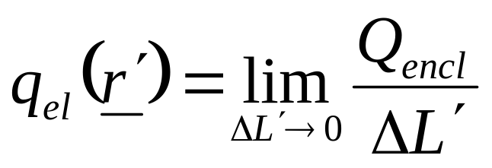
Continuous Distributions of Charge
Line charge density
ΔL’
Q_{encl}

Slide 65
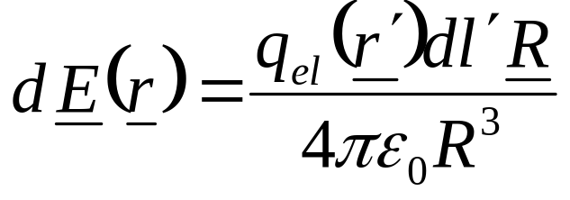
Continuous Distributions of Charge
Electric field due to line charge density
ΔL’
Q_{encl}
P

Slide 66
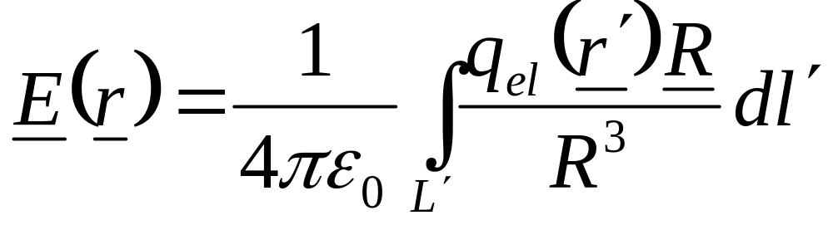
Electric Field Due to Line Charge Density

Slide 67
Electrostatic Potential
An electric field is a force field.
If a body being acted on by a force is moved from one point to another, then work is done.
The concept of scalar electric potential provides a measure of the work done in moving charged bodies in an electrostatic field.

Slide 68


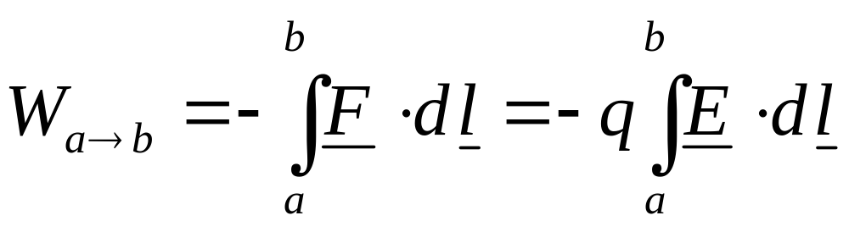
Electrostatic Potential
The work done in moving a test charge from one point to another in a region of electric field:
b
a
q

Slide 69
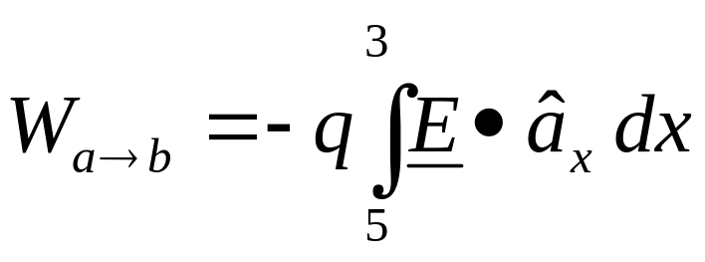
Electrostatic Potential
In evaluating line integrals, it is customary to take the dl in the direction of increasing coordinate value so that the manner in which the path of integration is traversed is unambiguously determined by the limits of integration.
b
a
x
3
5

Slide 70
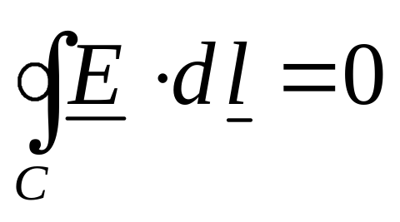
Electrostatic Potential
The electrostatic field is conservative:
  The value of the line integral depends only on the end points and is independent of the path taken.
  The value of the line integral around any closed path is zero.
C

Slide 71
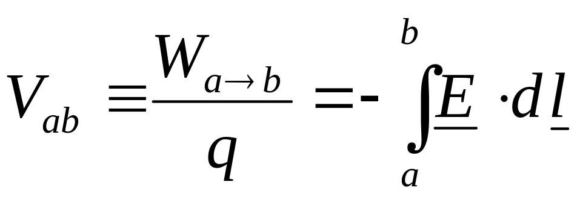
Electrostatic Potential
The work done per unit charge in moving a test charge from point a to point b is the electrostatic potential difference between the two points:
electrostatic potential difference
Units are volts.

Slide 72
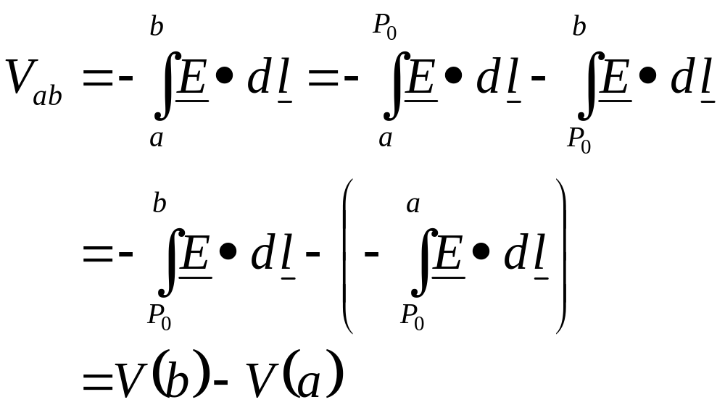
Electrostatic Potential
Since the electrostatic field is conservative we can write

Slide 73
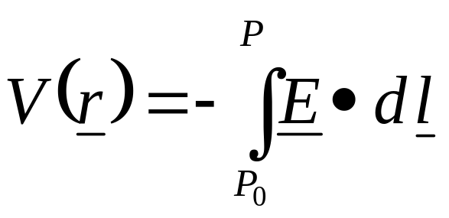
Electrostatic Potential
Thus the electrostatic potential V is a scalar field that is defined at every point in space.
In particular the value of the electrostatic potential at any point P is given by
reference point

Slide 74

Electrostatic Potential
The reference point (P₀) is where the potential is zero (analogous to ground in a circuit).
Often the reference is taken to be at infinity so that the potential of a point in space is defined as

Slide 75

Electrostatic Potential and Electric Field
The work done in moving a point charge from point a to point b can be written as

Slide 76

Electrostatic Potential and Electric Field
Along a short path of length Δl we have

Slide 77


Electrostatic Potential and Electric Field
Along an incremental path of length dl we have
Recall from the definition of directional derivative:

Slide 78

Electrostatic Potential and Electric Field
Thus:
the “del” or “nabla” operator

