Slide 1
BASIC CIVIL & MECHANICAL ENGINEERING
INTRODUCTORY CLASS

Slide 2
WHY BASIC CIVIL & MECHANICAL ENGINEERING?
ABOUT BASIC CIVIL ENGINEERING
SYLLABUS
TEACHER
STUDENTS
SYSTEM
CULTURE OF VOLUNTARY COMPLIANCE
COURSE WEBSITE
PATTIYAL

Slide 3
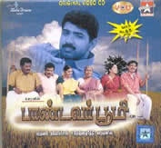

WHY BCM?
WANNA OWN?

Slide 4
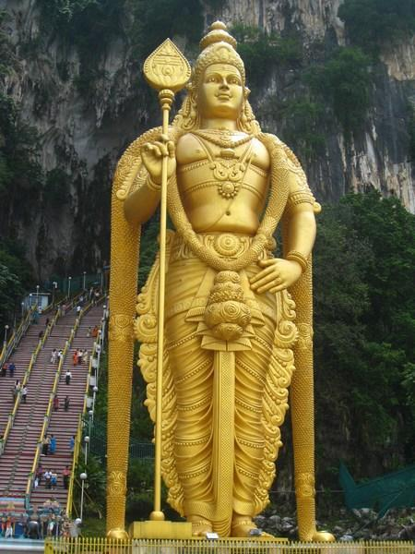
WHY FEAR WHEN I AM NEAR?
LORD MURUGA

Slide 5
BASIC CIVIL ENGINEERING
What is Engineering?
What is Civil?
What is Civil Engineering?
BASICA?!

Slide 6

AS IT IS
UNIT I - SURVEYING AND CIVIL ENGINEERING MATERIALS 15
Surveying: Objects – types – classification – principles – measurements of distances – angles – leveling – determination of areas – illustrative examples.
Civil Engineering Materials: Bricks – stones – sand – cement – concrete – steel sections.
UNIT II BUILDING COMPONENTS AND STRUCTURES 15
Foundations: Types, Bearing capacity – Requirement of good foundations.
Superstructure: Brick masonry – stone masonry – beams – columns – lintels – roofing – flooring – plastering – Mechanics – Internal and external forces – stress – strain – elasticity – Types of Bridges and Dams – Basics of Interior Design and Landscaping.
TOTAL : 30 PERIODS
SYLLABUS

Slide 7
COMMENTS
Lifted from GE2152 of Anna University
Marginally Different from Anna University Coimbatore Syllabus
Doesn’t Cover the Subject Entirely
Knowledge minimum 50% in terms of depth
Normally 8 Part A questions and 3 Part B questions
Theoretically 52 out of 116
As Easy to learn compared to Mechanical
Not as Presentable as Mechanical
No Previous Experience with the Subject
Observations Sub Consciously
SYLLABUS

Slide 8
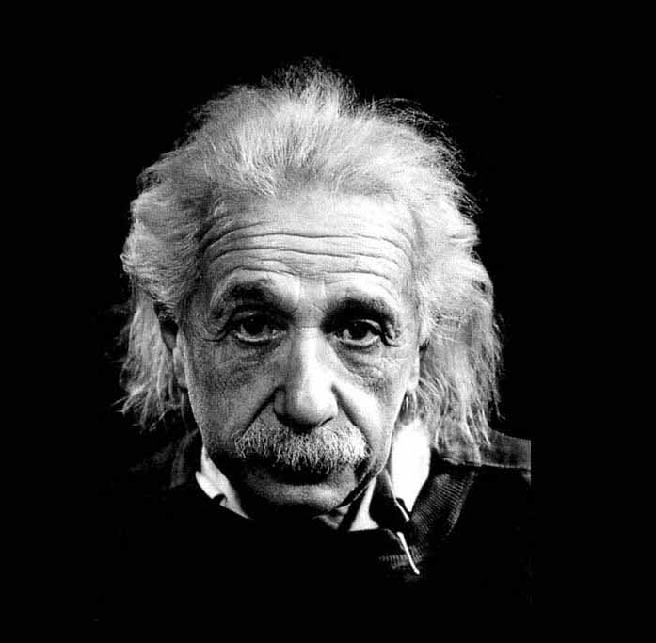
SIMPLY SPEAKING
“Lets make things simple, but no simpler”
COURSE PLAN
READY RECKONER
SYLLABUS

Slide 9
ENNA KODUMA SIR ITHU?
“The mediocre teacher tells.
The good teacher explains.
The superior teacher demonstrates.
The great teacher inspires.”
Spell
Favourite Music Director
Colleges
TEACHER

Slide 10
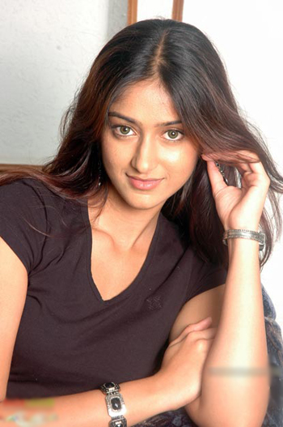
WHAT SAY?
“When Rathnavel Sir takes class, it is difficult to follow because he is so charming that I cannot take my eyes of him. How I can listen to him, when I am so enchanted by his personality?”
TEACHER

Slide 11
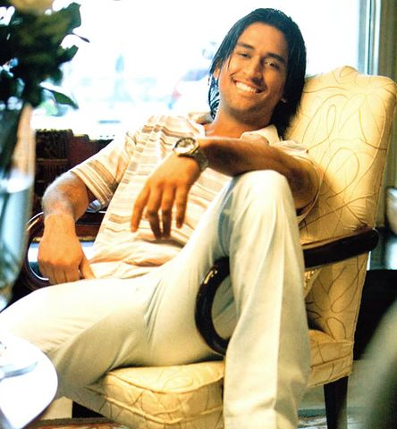
WHAT SAY
“I learnt how to manage my team from the great Pon.Rathnavel Sir only. I always call to him when I have problems dealing with my team mates. If he handles any theory/practical course for a class, that class is gifted and blessed”
TEACHER

Slide 12
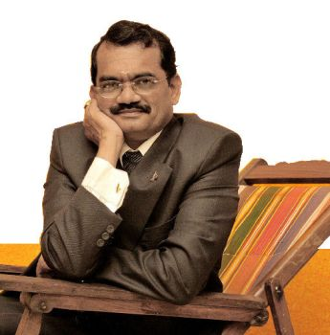
WHAT SAY
“Even in our very acclaimed project, if I had any fundamental doubts in Civil and Mechanical Engineering, I would immediately call Rathnavel. He will easily clarify my doubts. He is the best person to handle the subject BASIC CIVIL ENGINEERING”
TEACHER

Slide 13

WHAT SAY
“He is our official trainer. He is the person our young engineers look upon for doubts in Civil Engineering. His class is interesting, innovative and of course highly informative.”
TEACHER

Slide 14
PROs & CONs
ADVANTAGES
Easy to Understand
Easy to Remember
No Tension in the Class
DISADVANTAGES
* No Revision
* No Tests
* Unable to Complete Syllabus in Time
Courtesy
Ms.Ranjini, Ms.Surraya, Mr.Sajjad Khan, Mr.Prakash
Mr.Chandru, Ms.Dhanya, Mr.Gokul, Ms.Ramya
TEACHER

Slide 15
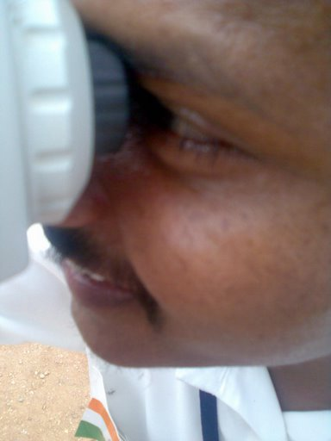
NOT WE, BUT YOU
“ EN MANAVAN NALLAVAN,
EM MANAVARGAL KETTAVARGAL”
STUDENT

Slide 16
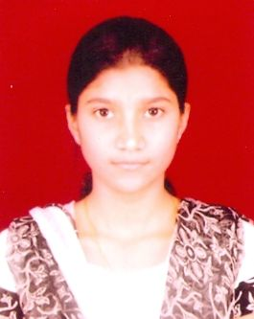
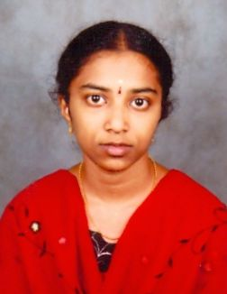
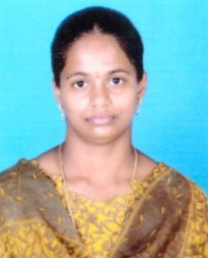
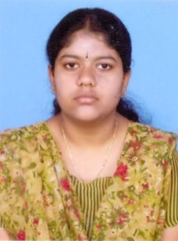
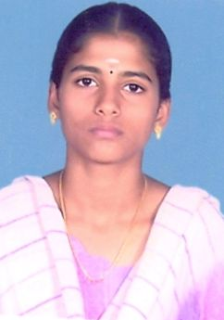
CO-OPERATION & CAPTAINS
STUDENT

Slide 17
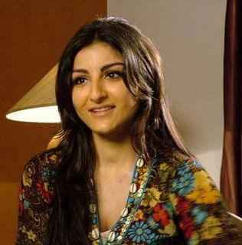
AT - ATTITUDE
“Your Attitude determines your Altitude”
TWO Cs OF INDIA
STUDENT

