Slide 1
Introduction to Wireless Communication

Slide 2
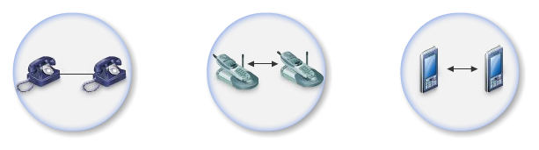
History of wireless communication
Guglielmo Marconi invented the wireless telegraph in 1896
  Communication by encoding alphanumeric characters in analog signal
  Sent telegraphic signals across the Atlantic Ocean
1914 – first voice communication over radio waves
Communications satellites launched in 1960s
Advances in wireless technology
  Radio, television, mobile telephone, communication satellites
More recently
  Satellite communications, wireless networking, cellular technology

Slide 3
Basics of Wireless Communication

Slide 4
What is Wireless Communication ?
Transmitting voice and data using electromagnetic waves in open space (atmosphere)
Electromagnetic waves
    Travel at speed of light (c = 3x10⁸ m/s)
    Has a frequency (f) and wavelength (λ)
        c = f x λ
    Higher frequency means higher energy photons
    The higher the energy photon the more penetrating is the radiation

Slide 5
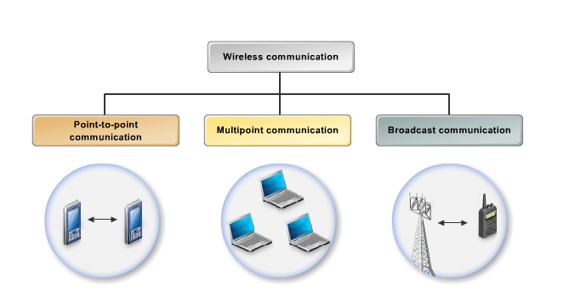
Types of wireless communication
celullar
wireless computer network
radio service

Slide 6
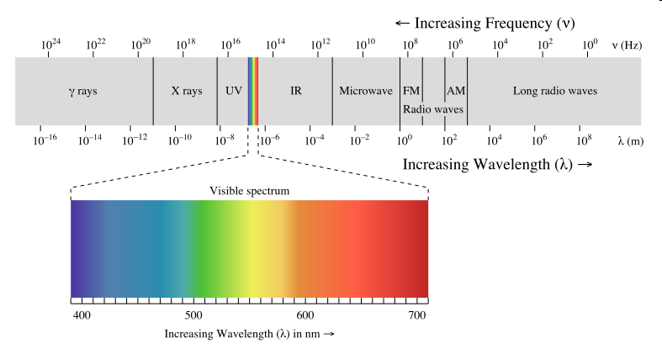
Electromagnetic radiation spectrum

Slide 7
Wavelength of Some Technologies
GSM Phones:
  frequency ~= 900 Mhz
  wavelength ~= 33cm
PCS Phones
  frequency ~= 1.8 Ghz
  wavelength ~= 17.5 cm
Bluetooth:
  frequency ~= 2.4Gz
  wavelength ~= 12.5cm

Slide 8
Types of electromagnetic carriers
when the distance between the sender and receiver is short (e.g. TV box and a remote control) infrared waves are used
for long range distances between sender and receiver (e.g. TV broadcasting and cellular service) both microwaves and radio waves are used
  radio waves are ideal when large areas need to be coverd and obstacles exist in the transmission path
  microwaves are good when large areas need to be coverd and no obstacles exist in the transmission path

Slide 9
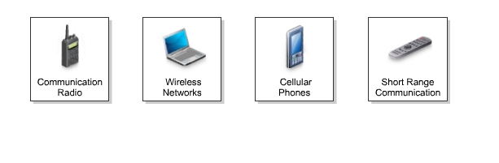
Wireless applications (services)

Slide 10
Advantages and disadvantages of wireless communication
advantages:
  mobility
  a wireless communication network is a solution in areas where cables are impossible to install (e.g. hazardous areas, long distances etc.)
  easier to maintain
disadvantages:
  has security vulnerabilities
  high costs for setting the infrastructure
  unlike wired comm., wireless comm. is influenced by physical obstructions, climatic conditions, interference from other wireless devices

Slide 11
Frequency Carries/Channels
The information from sender to receiver is carrier over a well defined frequency band.
This is called a channel
Each channel has a fixed frequency bandwidth (in KHz) and Capacity (bit-rate)
Different frequency bands (channels) can be used to transmit information in parallel and independently.

Slide 12
Example
Assume a spectrum of 90KHz is allocated over a base frequency b for communication between stations A and B
Assume each channel occupies 30KHz.
There are 3 channels
Each channel is simplex (Transmission occurs in one way)
For full duplex communication:
  Use two different channels (front and reverse channels)
  Use time division in a channel
Station A
Channel 1 (b - b+30)
Station B
Channel 2 (b+30 - b+60)
Channel 3 (b+60 - b+90)

Slide 13
Basics of Radio Communication

Slide 14
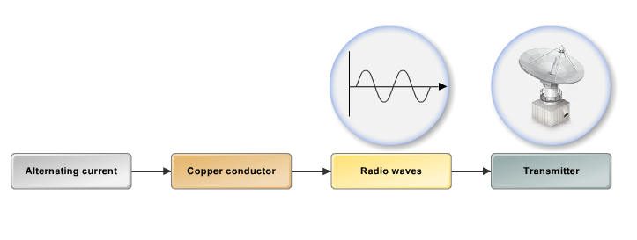
Radio waves generation
when a high-frequency alternating current (AC) passes through a copper conductor it generates radio waves which are propagated into the air using an antena
radio waves have frequencies between:
  3 Hz – 300 KHz - low frequency
  300 KHz – 30 MHz – high frequency
  30 MHz – 300 MHz – very high frequency
  300 MHz – 300 GHz – ultra high frequency

Slide 15
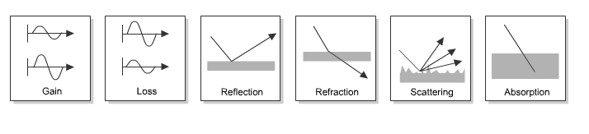
Radio propagation

Slide 16
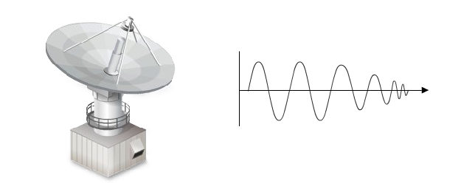
Radio propagation (2)
radio waves are generated by an antenna and they propagate in all directions as a straight line
radio waves travel at a velocity of 186.000 miles per second
radio waves become weaker as they travel a long distance

Slide 17
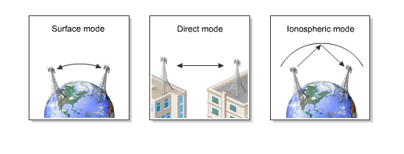
Radio propagation (3)
there are 3 modes of propagation:
  surface mode – for low frequency waves
  direct mode – for high frequency waves
  ionospheric mode – long distance high frequency waves

Slide 18
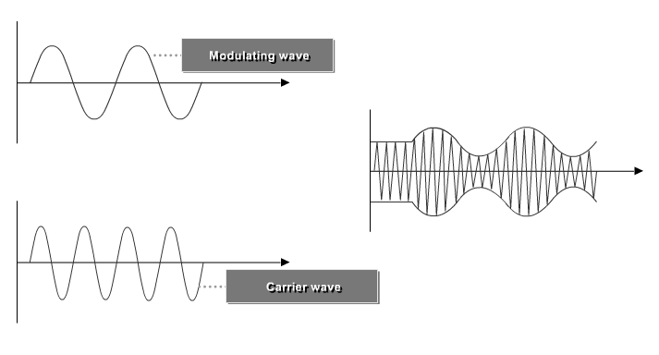
Modulation
modulation = adding information (e.g. voice) to a carrier electromagnetic (radio) signal

Slide 19
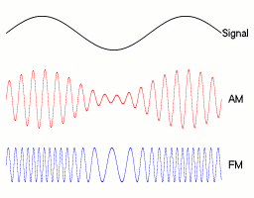
Frequency Modulation (FM).
Amplitude Modulation (AM)

Slide 20
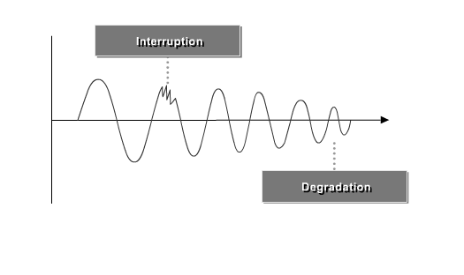
Radio frequency interference

Slide 21
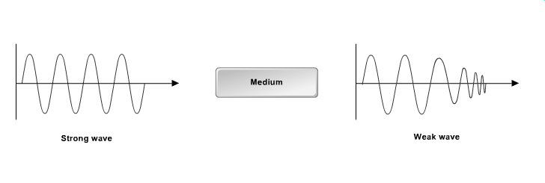
Radio signal attenuation (path loss)

