Slide 1
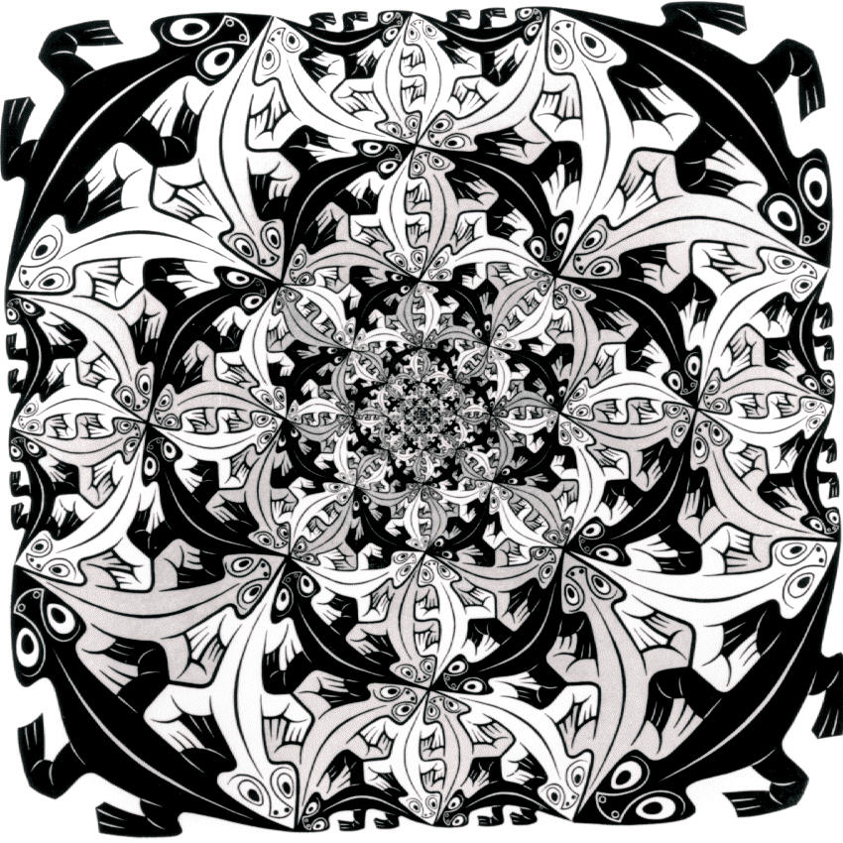
Introduction to
Computer Graphics
CS 445 / 645
Lecture 5
Transformations
M.C. Escher – Smaller and Smaller (1956)

Slide 2
Modeling Transformations
Specify transformations for objects
  Allows definitions of objects in own coordinate systems
  Allows use of object definition multiple times in a scene
    Remember how OpenGL provides a transformation stack because they are so frequently reused
Chapter 5 from Hearn and Baker
H&B Figure 109

Slide 3
Overview
2D Transformations
  Basic 2D transformations
  Matrix representation
  Matrix composition
3D Transformations
  Basic 3D transformations
  Same as 2D

Slide 4
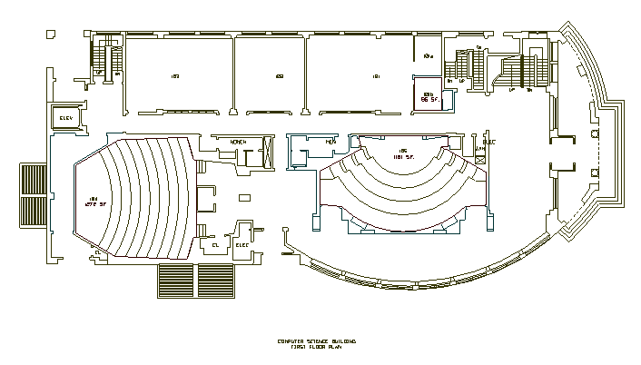
2D Modeling Transformations
Modeling
Coordinates
Scale
Translate
y
x
Scale
Rotate
Translate
World Coordinates

Slide 5
2D Modeling Transformations
Modeling
Coordinates
y
x
Let’s look
at this in
detail…
World Coordinates

Slide 6
2D Modeling Transformations
Modeling
Coordinates
y
x
Initial location
at (0, 0) with
x- and y-axes
aligned

Slide 7
2D Modeling Transformations
Modeling
Coordinates
y
x
Scale .3, .3
Rotate -90
Translate 5, 3

Slide 8
2D Modeling Transformations
Modeling
Coordinates
y
x
Scale .3, .3
Rotate -90
Translate 5, 3

Slide 9
2D Modeling Transformations
Modeling
Coordinates
y
x
Scale .3, .3
Rotate -90
Translate 5, 3
World Coordinates

Slide 10
Scaling
Scaling a coordinate means multiplying each of its components by a scalar
Uniform scaling means this scalar is the same for all components:
× 2

Slide 11
Scaling
Non-uniform scaling: different scalars per component:
How can we represent this in matrix form?
X × 2,
Y × 0.5

Slide 12
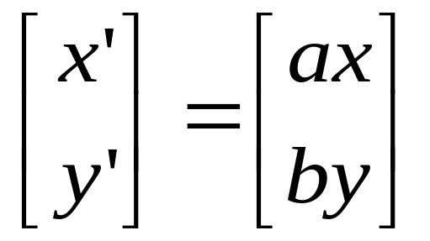
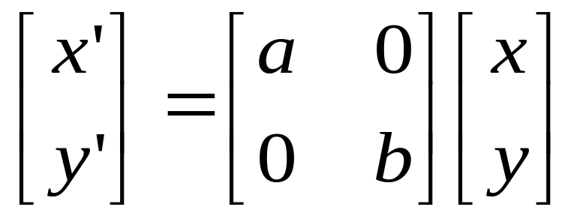
Scaling
Scaling operation:
Or, in matrix form:
scaling matrix

Slide 13
2-D Rotation
(x’, y’)
(x, y)
x’ = x cos(θ) - y sin(θ)
y’ = x sin(θ) + y cos(θ)
θ

Slide 14
2-D Rotation
x = r cos (φ)
y = r sin (φ)
x’ = r cos (φ + θ)
y’ = r sin (φ + θ)
Trig Identity…
x’ = r cos(φ) cos(θ) – r sin(φ) sin(θ)
y’ = r sin(φ) sin(θ) + r cos(φ) cos(θ)
Substitute…
x’ = x cos(θ) - y sin(θ)
y’ = x sin(θ) + y cos(θ)
(x’, y’)
(x, y)
θ
φ

Slide 15
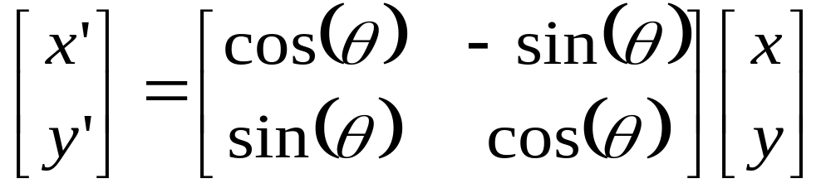
2-D Rotation
This is easy to capture in matrix form:
Even though sin(θ) and cos(θ) are nonlinear functions of θ,
  x’ is a linear combination of x and y
  y’ is a linear combination of x and y

Slide 16
Basic 2D Transformations
Translation:
  x’ = x + t_{x}
  y’ = y + t_{y}
Scale:
  x’ = x * s_{x}
  y’ = y * s_{y}
Shear:
  x’ = x + h_{x}*y
  y’ = y + h_{y}*x
Rotation:
  x’ = x*cosΘ - y*sinΘ
  y’ = x*sinΘ + y*cosΘ
Transformations
can be combined
(with simple algebra)

Slide 17
Basic 2D Transformations
Translation:
  x’ = x + t_{x}
  y’ = y + t_{y}
Scale:
  x’ = x * s_{x}
  y’ = y * s_{y}
Shear:
  x’ = x + h_{x}*y
  y’ = y + h_{y}*x
Rotation:
  x’ = x*cosΘ - y*sinΘ
  y’ = x*sinΘ + y*cosΘ

Slide 18
Basic 2D Transformations
Translation:
  x’ = x + t_{x}
  y’ = y + t_{y}
Scale:
  x’ = x * s_{x}
  y’ = y * s_{y}
Shear:
  x’ = x + h_{x}*y
  y’ = y + h_{y}*x
Rotation:
  x’ = x*cosΘ - y*sinΘ
  y’ = x*sinΘ + y*cosΘ
(x,y)
(x’,y’)
x’ = x*s_{x}
y’ = y*s_{y}

Slide 19
Basic 2D Transformations
Translation:
  x’ = x + t_{x}
  y’ = y + t_{y}
Scale:
  x’ = x * s_{x}
  y’ = y * s_{y}
Shear:
  x’ = x + h_{x}*y
  y’ = y + h_{y}*x
Rotation:
  x’ = x*cosΘ - y*sinΘ
  y’ = x*sinΘ + y*cosΘ
(x’,y’)
x’ = (x*s_{x})*cosΘ - (y*s_{y})*sinΘ
y’ = (x*s_{x})*sinΘ + (y*s_{y})*cosΘ

Slide 20
Basic 2D Transformations
Translation:
  x’ = x + t_{x}
  y’ = y + t_{y}
Scale:
  x’ = x * s_{x}
  y’ = y * s_{y}
Shear:
  x’ = x + h_{x}*y
  y’ = y + h_{y}*x
Rotation:
  x’ = x*cosΘ - y*sinΘ
  y’ = x*sinΘ + y*cosΘ
(x’,y’)
x’ = ((x*s_{x})*cosΘ - (y*s_{y})*sinΘ) + t_{x}
y’ = ((x*s_{x})*sinΘ + (y*s_{y})*cosΘ) + t_{y}

Slide 21
Basic 2D Transformations
Translation:
  x’ = x + t_{x}
  y’ = y + t_{y}
Scale:
  x’ = x * s_{x}
  y’ = y * s_{y}
Shear:
  x’ = x + h_{x}*y
  y’ = y + h_{y}*x
Rotation:
  x’ = x*cosΘ - y*sinΘ
  y’ = x*sinΘ + y*cosΘ
x’ = ((x*s_{x})*cosΘ - (y*s_{y})*sinΘ) + t_{x}
y’ = ((x*s_{x})*sinΘ + (y*s_{y})*cosΘ) + t_{y}

Slide 22
Overview
2D Transformations
  Basic 2D transformations
  Matrix representation
  Matrix composition
3D Transformations
  Basic 3D transformations
  Same as 2D

Slide 23
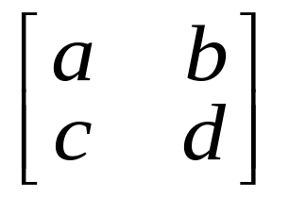
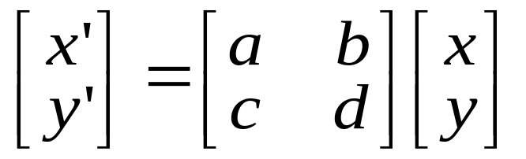
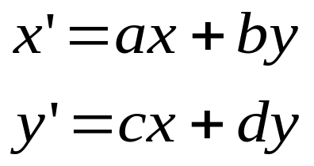
Matrix Representation
Represent 2D transformation by a matrix
Multiply matrix by column vector
⇔ apply transformation to point

Slide 24
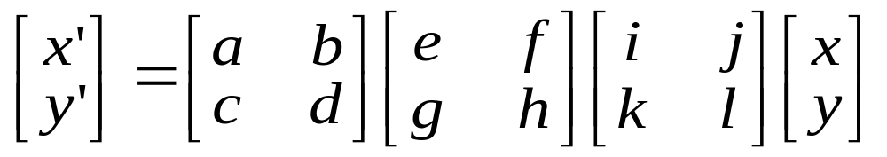
Matrix Representation
Transformations combined by multiplication
  Matrices are a convenient and efficient way
  to represent a sequence of transformations!

Slide 25
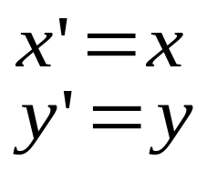
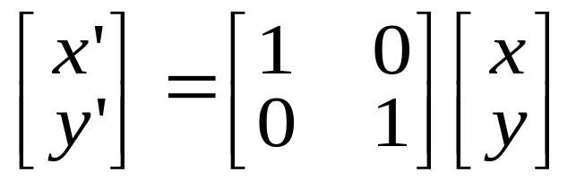
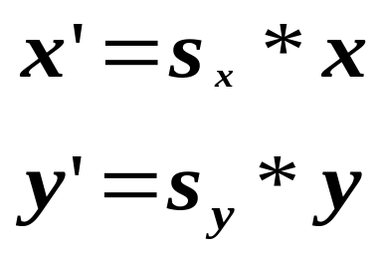
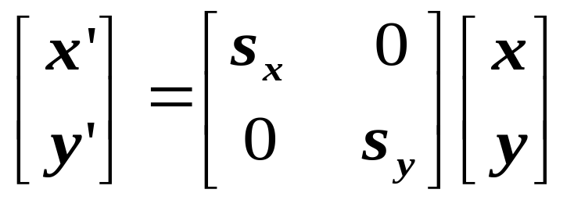
2x2 Matrices
What types of transformations can be
represented with a 2x2 matrix?
2D Identity?
2D Scale around (0,0)?

Slide 26
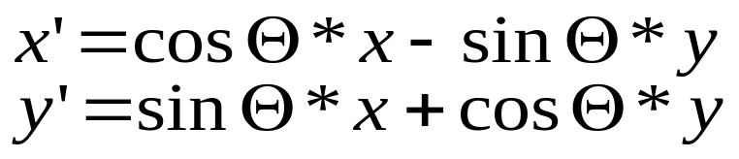
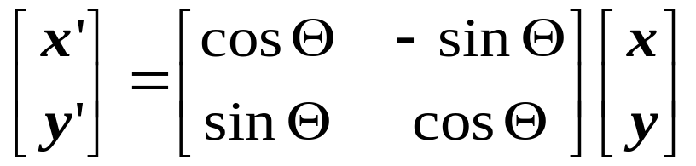
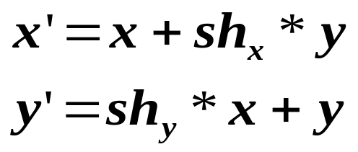
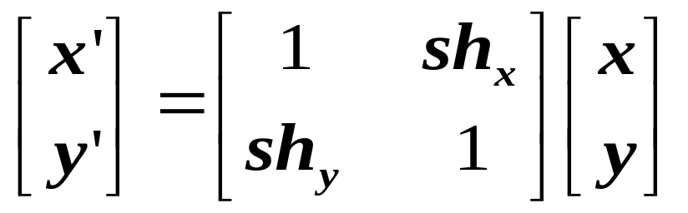
2x2 Matrices
What types of transformations can be
represented with a 2x2 matrix?
2D Rotate around (0,0)?
2D Shear?

Slide 27
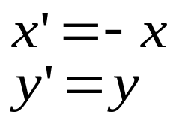
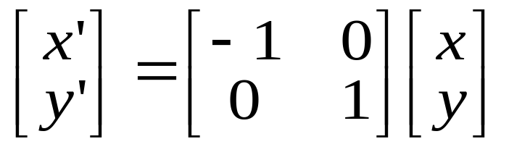
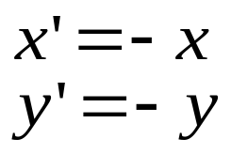
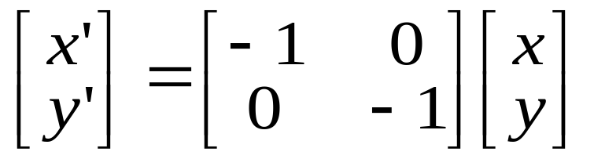
2x2 Matrices
What types of transformations can be
represented with a 2x2 matrix?
2D Mirror about Y axis?
2D Mirror over (0,0)?

Slide 28
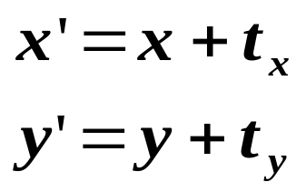
2x2 Matrices
What types of transformations can be
represented with a 2x2 matrix?
2D Translation?
NO!
Only linear 2D transformations
can be represented with a 2x2 matrix

Slide 29
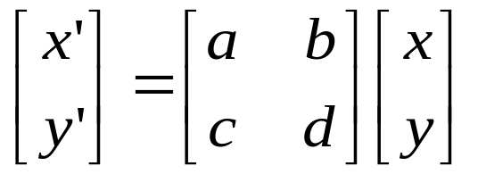
Linear Transformations
Linear transformations are combinations of …
  Scale,
  Rotation,
  Shear, and
  Mirror
Properties of linear transformations:
  Satisfies:
  Origin maps to origin
  Lines map to lines
  Parallel lines remain parallel
  Ratios are preserved
  Closed under composition

Slide 30
Homogeneous Coordinates
Q: How can we represent translation as a 3x3 matrix?

