Slide 1
Weekly update 04/17/26
Ruixuan Tang

Slide 2
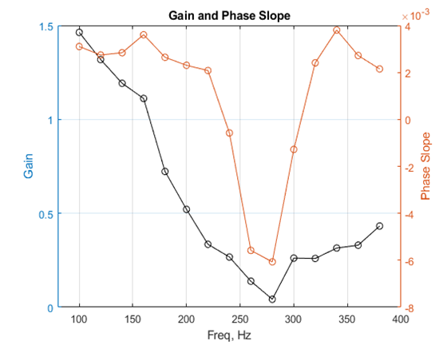
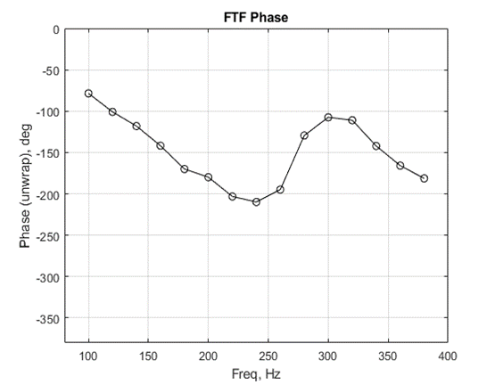
Observation
 | $$φ$$ | $$P,atm$$ | $$U_{in},m/s$$ | $$T_{u},K$$ | $$X_{CH_{4}}$$ | FTF Gain Behavior | FTF Phase Behavior
Test 3 | 0.6 | 4 | 30 | 523.15 | 1 | Local minimum | Non-Monotonic
Gain and Phase Slope
Phase

Slide 3
Current Findings
A single-delay model cannot consistently explain the observed excess gain, local minimum, and phase-kink behavior.
Under the perfectly premixed, velocity-perturbation framework, the observed excess gain suggests that the time-delay distribution cannot be entirely positive.
The most possible interpretation is that the flame response contains at least one positive and one negative delayed contribution, or equivalently, at least two pathway contributions whose superposition produces constructive and destructive interference in this flame.

Slide 4
Updated Hypothesis
H1: The observed global FTF behavior arises from the superposition of multiple pathway contributions with different time delays. Depending on frequency, these pathway contributions may interfere constructively or destructively, giving rise to the measured gain and phase features.
H2: The axial and tangential velocity pathways are hypothesized to contribute measurably to the global heat release response, with distinguishable temporal signatures, including different characteristic delays and different effective roles in shaping the global FTF.
H3: Two dominant pathways can be represented, at least at the level of a reduced-order (DTD) model, by its estimated time delay distribution and corresponding FTF contribution. The observed excess gain, local minimum, and phase-kink behavior would then result from the frequency-dependent interference among these pathway-specific contributions.
Notes:
Candidate pathways from previous papers includes axial velocity response tangential velocity / swirl number related response and Turbulent flame speed response.

Slide 5
Two Pathways Assumption
In the paper¹, the axial velocity and swirl effect were assumed two dominant pathways in the swirler premixed flame.
They computed the two pathways with different time delay distributions
Based on this, two pathways are assumed
Pathway A: axial velocity induced flame response
Pathway B: azimuthal velocity / swirl induced flame response
Working hypothesis:
The gain local minimum and phase kink arise from the relative phase and delay variation between the two pathways
The kink region may correspond to a transition from constructive to destructive interaction.

Slide 6
Current Progress
To apply this assumption, several questions are required to answer
What proxy quantity is applied to represent the pathway B?
Is the pathway B strong enough at the inlet to perturb the flame response?
If so, how is the pathway B effect on the flame response compare to the pathway A

Slide 7
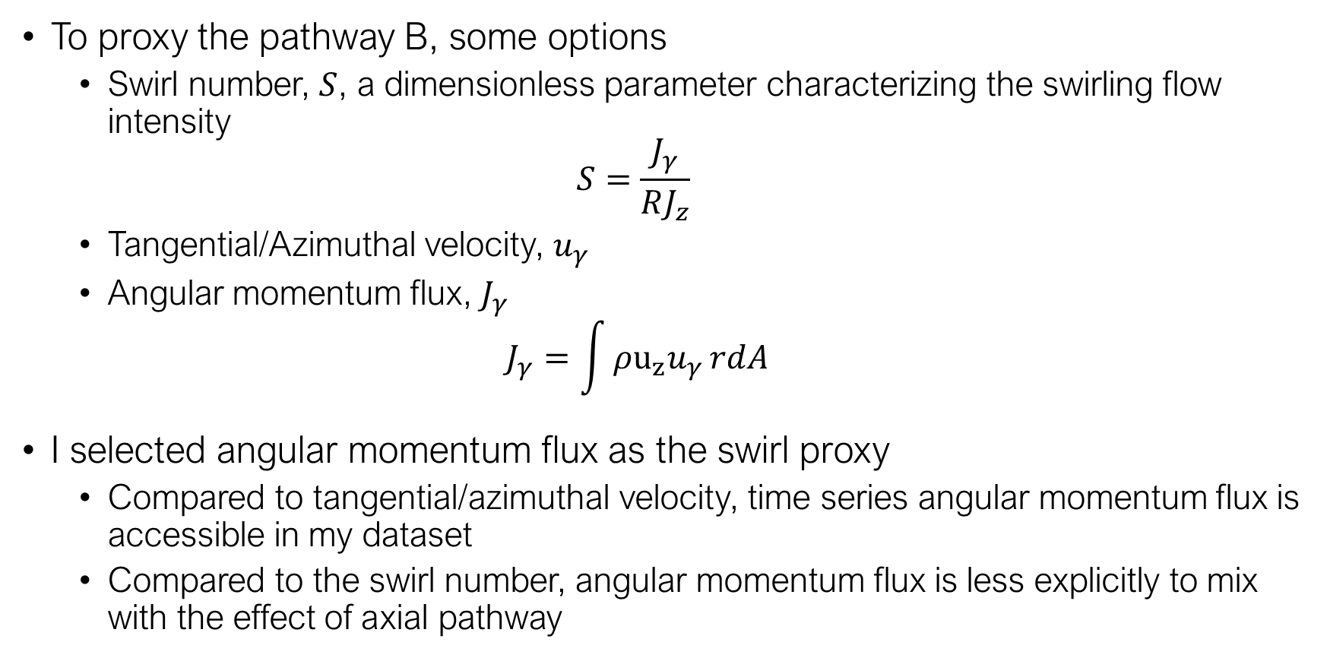
Current Data and Proxy
To proxy the pathway B, some options
Swirl number, $S$, a dimensionless parameter characterizing the swirling flow intensity
$$S=\frac{J_{γ}}{RJ_{z}}$$
Tangential/Azimuthal velocity, $u_{γ}$
Angular momentum flux, $J_{γ}$
$$J_{γ}=\int{ρu_{z}u_{γ}}rdA$$
I selected angular momentum flux as the swirl proxy
Compared to tangential/azimuthal velocity, time series angular momentum flux is accessible in my dataset
Compared to the swirl number, angular momentum flux is less explicitly to mix with the effect of axial pathway

Slide 8
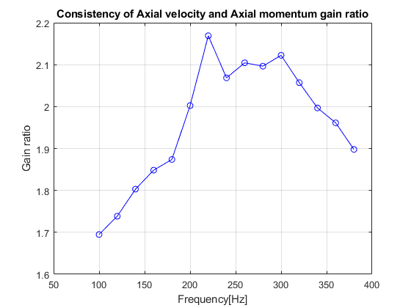
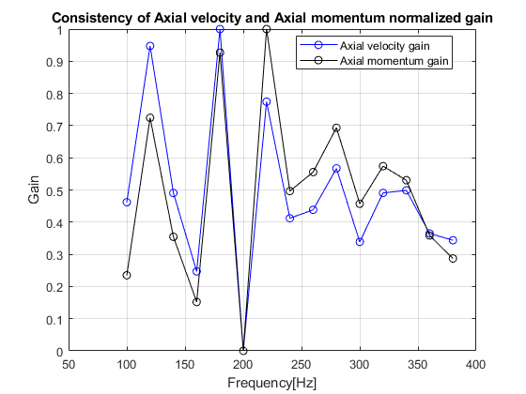
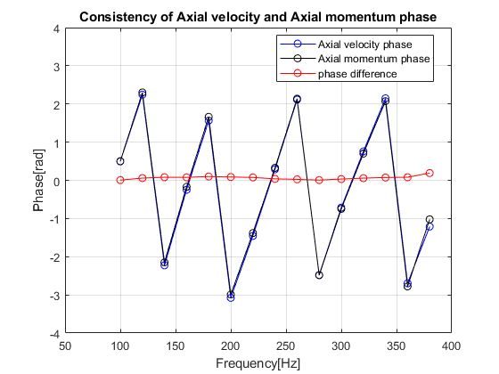
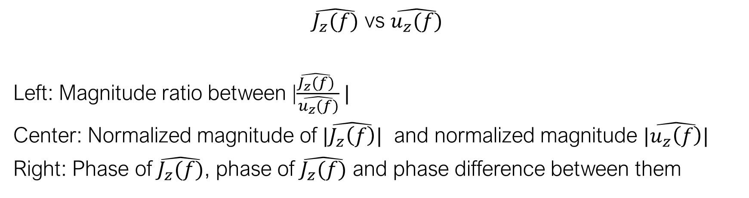
The Consistency of Axial-induced Pathway
$\hat{J_{z}(f)}$ vs $\hat{u_{z}(f)}$
Left: Magnitude ratio between |$\frac{\hat{J_{z}(f)} }{\hat{u_{z}(f)}}|$
Center: Normalized magnitude of $|\hat{J_{z}\left(f\right)}|$ and normalized magnitude $|\hat{u_{z}\left(f\right)}|$
Right: Phase of $\hat{J_{z}(f)}$, phase of $\hat{J_{z}(f)}$ and phase difference between them
Notes:
Test Axial velocity and axial momentum belongs to the same axial induced pathway

Slide 9
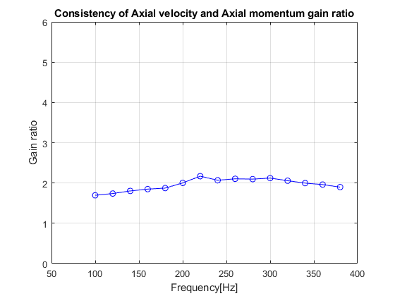
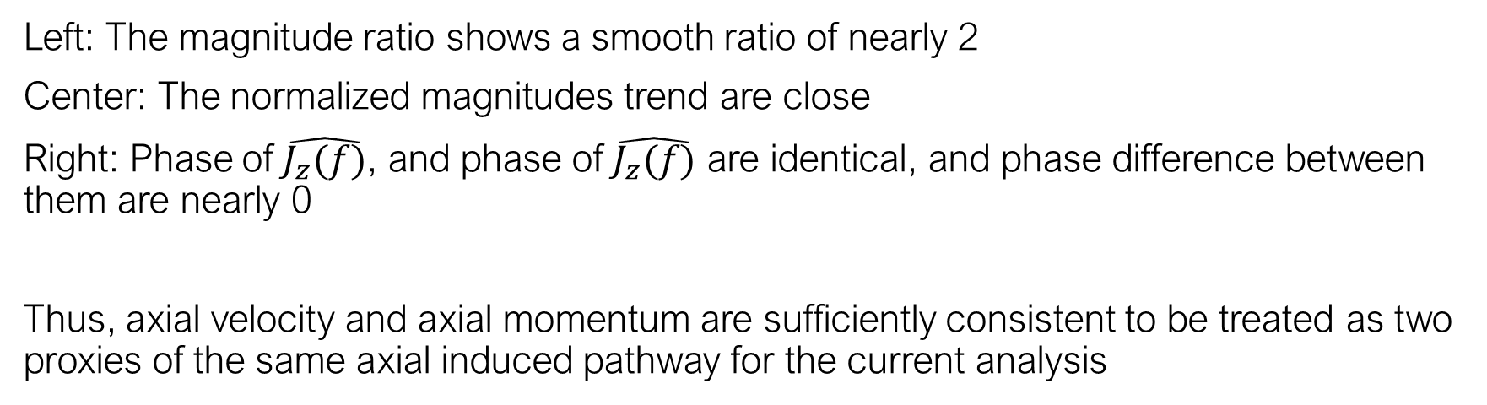
The Consistency of Axial-induced Pathway
Left: The magnitude ratio shows a smooth ratio of nearly 2
Center: The normalized magnitudes trend are close
Right: Phase of $\hat{J_{z}(f)}$, and phase of $\hat{J_{z}(f)}$ are identical, and phase difference between them are nearly 0
Thus, axial velocity and axial momentum are sufficiently consistent to be treated as two proxies of the same axial induced pathway for the current analysis
Notes:
Test Axial velocity and axial momentum belongs to the same axial induced pathway

Slide 10
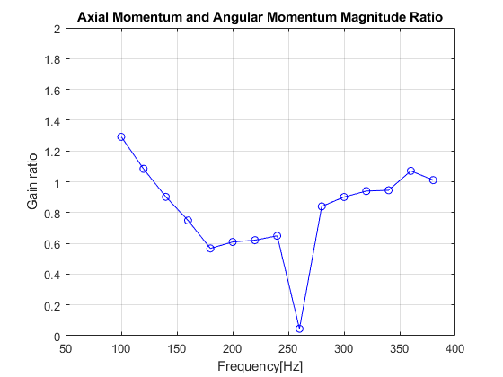

Swirl related measurability
The second step is to test if the swirl related proxy is measurable and worthy to carry forward.
Compare the magnitude ratio of |$\frac{\hat{J_{γ}(f)} }{\hat{J_{z}(f)}}|$
The magnitude ratio is about 1, which means the swirl related proxy is comparable to the axial related proxy at the same input surface.
The swirl related proxy is measurable.

Slide 11
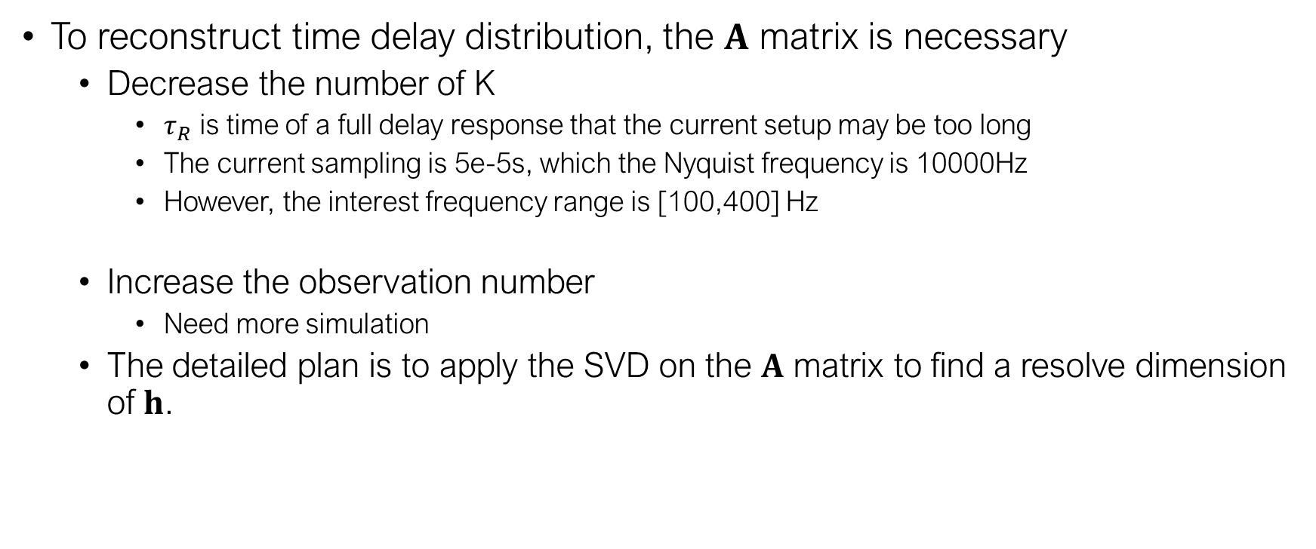
Plan
To reconstruct time delay distribution, the $A$ matrix is necessary
Decrease the number of K
$τ_{R}$ is time of a full delay response that the current setup may be too long
The current sampling is 5e-5s, which the Nyquist frequency is 10000Hz
However, the interest frequency range is [100,400] Hz
Increase the observation number
Need more simulation
The detailed plan is to apply the SVD on the $A$ matrix to find a resolve dimension of $h$.

