Slide 1
Name:V.Janakiraman Reg.no:422521205015 Dept:Information Technology
Final Project

Slide 2
PROJECT TITLE
IMAGE GENERATION USING GAN

Slide 3


AGENDA
Introduction to Image Generation with GANs:
An overview of Generative Adversarial Networks (GANs) and their role in creating realistic images.
Understanding GANs:
Explaining the architecture of GANs, comprising the Generator and Discriminator networks, and how they work together to produce high-quality images.
Training Process:
Detailing the process of training GANs, including data preprocessing, hyperparameter tuning, and convergence monitoring
3/21/2024 Annual Review

Slide 4

PROBLEM STATEMENT
Create photorealistic images using advanced Generative Adversarial Networks (GANs).
Tackle the challenge of generating diverse and high-resolution images with fine details.
Overcome limitations of traditional image generation techniques with innovative deep learning approaches. Explore applications in art, entertainment, and digital content creation.
Push the boundaries of image synthesis for impactful visual storytelling

Slide 5

PROJECT OVERVIEW
Develop an image generation system leveraging Generative Adversarial Networks (GANs) for realistic and diverse image synthesis.
Utilize deep learning techniques to train GAN models on large datasets to learn intricate image features and textures.
Address complexities in training GANs, such as mode collapse and training instability, to ensure reliable and high-quality image generation.

Slide 6
WHO ARE THE END USERS?
Artists and Designers
Researchers
Content Creators
Developers

Slide 7

YOUR SOLUTION AND ITS VALUE PROPOSITION
High-Quality Image Generation: Our solution employs Generative Adversarial Networks (GANs) to produce realistic and diverse images across multiple domains, ensuring superior visual fidelity.
Customizability and Control: Users can fine-tune parameters and conditions to generate images tailored to their specific requirements, offering unparalleled flexibility and control over the creative process.
Scalability and Efficiency: Leveraging state-of-the-art techniques and optimized algorithms, our solution achieves efficient image generation at scale, facilitating rapid experimentation and production.
Cost-Effectiveness: By generating synthetic images, our solution reduces the reliance on expensive and time-consuming manual image acquisition and production methods, resulting in significant cost savings.

Slide 8

THE WOW IN YOUR SOLUTION
Authenticity: We pledge to produce images that are visually indistinguishable from real ones, ensuring authenticity in every generated output.
Innovation: We commit to leveraging cutting-edge GAN techniques and advancements in deep learning to push the boundaries of image generation.
Customization: We promise to provide users with customizable controls and parameters, empowering them to tailor the generated images to their specific needs and preferences.
3/21/2024 Annual Review
8

Slide 9
MODELLING
Teams cam add wireframes
Discriminator Model: Sequential setup with convolutional and dense layers.
Activation Function: LeakyReLU used for non-linearity.
Optimizer: Adam optimizer employed for compiling the model.
Generator Model: Utilizes dense layers and Conv2DTranspose layers for upscaling input.
Final Layer Activation: Tanh function ensures output values range from -1 to 1.
9

Slide 10
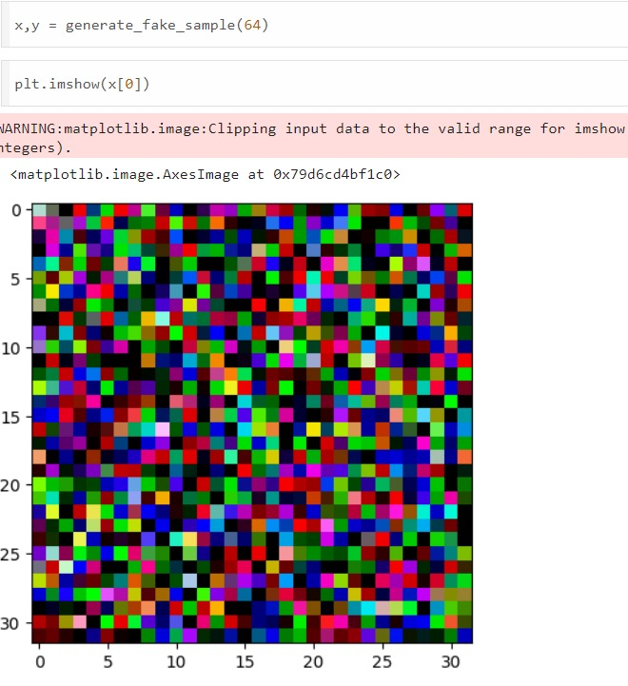
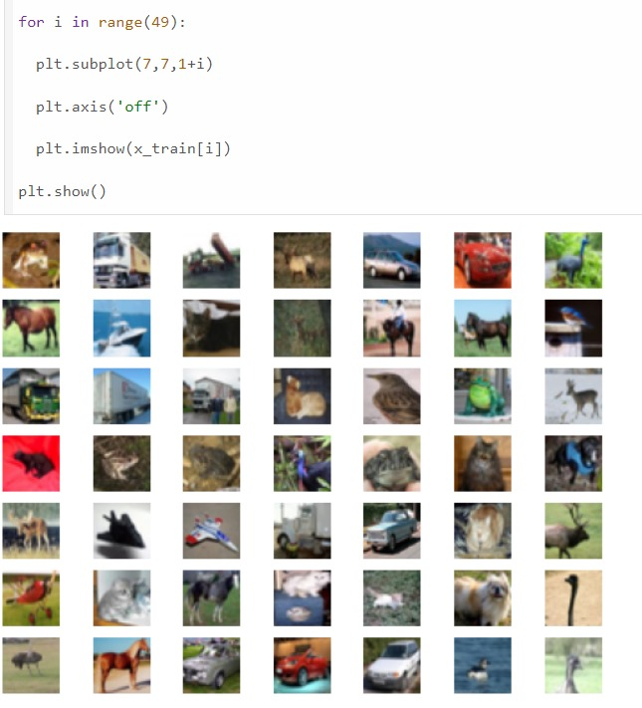
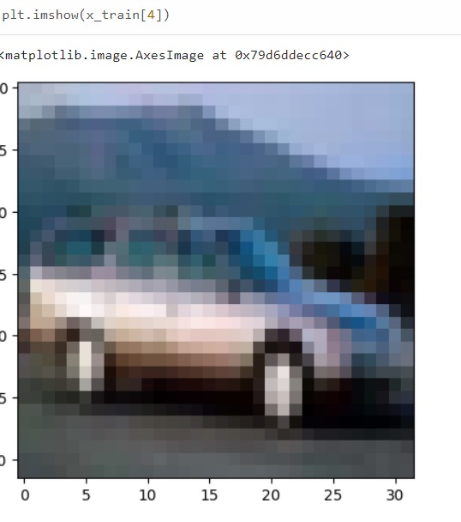
RESULTS
Github: https://github.com/joyfulljanakiraman/naan-madhalvan-project.git
10

