Slide 1



HOME
ABOUT
BLOG
TESTIMONIALS
PRODUCTS
CONTACT
PRIVACY & TERMS
JOYFUL ROSE DELIGHTS
JOYFUL MOMENTS,ROSY FLAVORS
BREAK DOWN THE BIG PICTURE INTO SMALLER MANAGEABLE MILESTONES

Slide 2

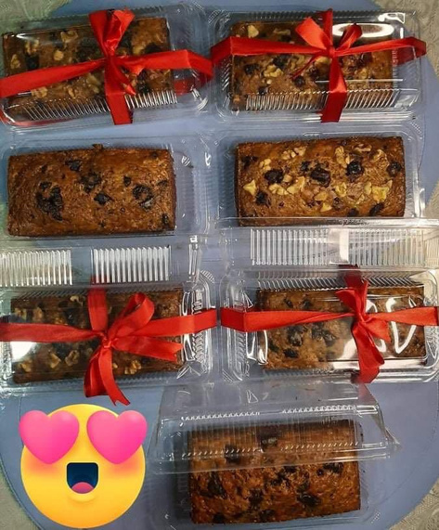
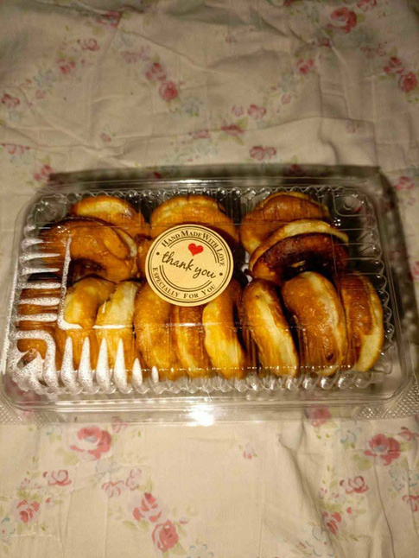
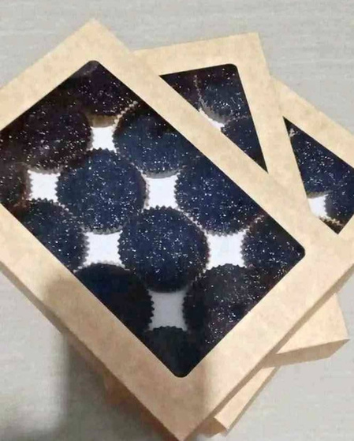

BEST SELLER
Banana loaf
Plain Mini Donut
Chocomoist cupcake

Slide 3

ABOUT US
Joyful Rose Delights is a local bakery business that provides high-quality, freshly baked goods designed to bring happiness and joy to customers. With a focus on fresh ingredients, creativity, and excellent customer service, the business aims to create memorable experiences and grow its loyal customer base both locally and online
MISSION
"At Joyful Rose Delights, our mission is to spread joy and happiness through our freshly baked goods. We believe that every bite can bring a smile, and our goal is to share this happiness with as many people as possible by crafting treats that are not only delicious but also made with love and care."
VISION
"To become a household name in our community and beyond, known for creating delightful baked goods that bring people together."

Slide 4
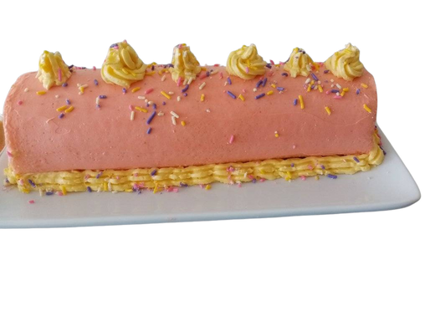
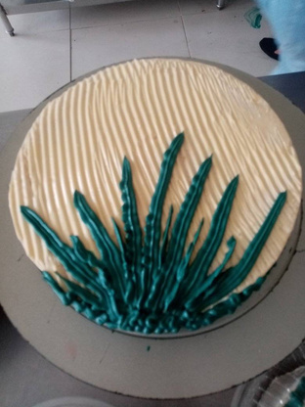
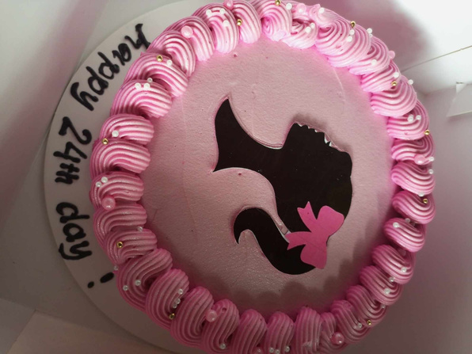
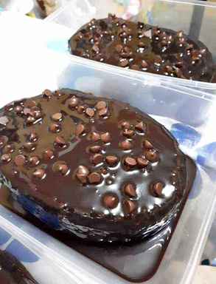
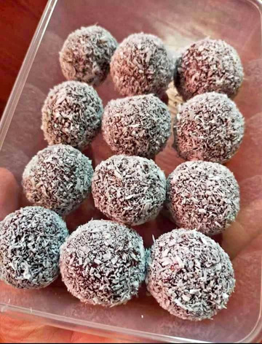
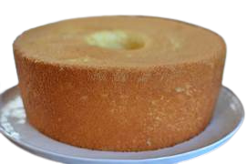
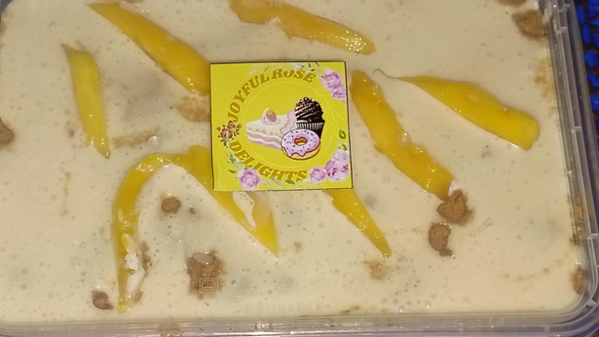

OUR PRODUCTS
swiss rolls
customized cakes
chocomoist cake
chiffon cake
mango float
munchkins bal
TASTE NOW

Slide 5
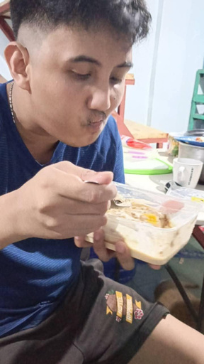
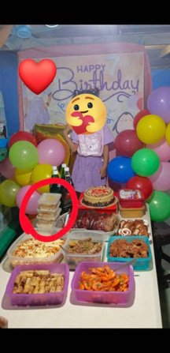
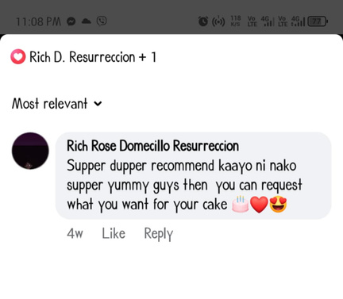
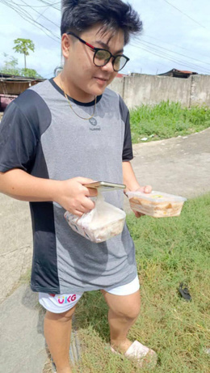
TESTIMONIALS

Slide 6




CONTACT US
JOYFULROSE DELIGHTS
We’re happy to help you!
Full Name :
E-Mail :
Phone Number :
Phone
+639473540144
Message :
Website
www.joyfulrosedelights.com
E-Mail
joyalamaidajoy@gmail.com
Address
Send Messages
Purok 3 Sunflower Pag-utlan Tayud Consolacion Cebu

Slide 7
PRIVACY &TERMS
PRIVACY POLICY
Effective Date: January 02,2025
At Joyful Rose Delights, we value your privacy and are committed to protecting your personal information. This Privacy Policy explains what information we collect, how we use it, and your rights regarding your data.
1. Information We Collect
Your name, email address, and phone number (when you contact us or place an order)
Delivery address (for local orders)
Payment details processed securely 50 % online (Gcash, Maya ,bank)& 50% will collected during pcikup/delivery.
2. How We Use Your Information
To fulfill and deliver your orders
To respond to inquiries and provide customer support
To improve our website and offerings
For marketing emails (only with your permission)
3. How We Protect Your Data
We use secure systems to store and manage data. We do not sell or share your personal information with third parties, except for trusted services used to process payments and deliveries.
4. Your Rights
You may request:
To access or correct your personal data
To unsubscribe from emails
To delete your information(joyalmedam@gmail.com)
5. Cookies
We may use cookies to improve your browsing experience. You can choose to disable cookies through your browser settings.
6. Contact
For any privacy concerns, email us at: joyalmedam@gmail.com/+639473540144

Slide 8
PRIVACY &TERMS
TERMS & CONDITIONS
Effective Date : January 2,2025
By using our website and services, you agree to the following terms and conditions.
1. Orders
Orders must be placed at least 2 days in advance.
Custom orders require full details and confirmation from our team.
Prices may vary based on customization.
2. Payments
Payments must be made in half before order processing.
We accept gcash, Maya and debit cards
3. Cancellations & Refunds
Cancellations must be made at least [e.g., 24 hours] before delivery/pickup.
Custom orders may not be eligible for full refunds.
If we cancel due to unforeseen circumstances, a full refund will be issued.
4. Deliveries
We deliver within Consolacion - Cebi City
Customers must provide accurate delivery details.
We are not liable for delivery delays due to incorrect information or external factors.
5. Intellectual Property
All content on this site (images, logos, designs) belongs to Joyful Rose Delights and may not be reused without permission.
6. Changes to Terms
We reserve the right to update these terms. Changes will be posted on this page with the updated date.

