Slide 1


Azure ML Studio
Hands on Lab - Workshop
@JoyjeetM
https://www.linkedin.com/in/joyjeetm/

Slide 2
Your go to Team!
Name | Email
Megan Smith | megan.smith@microsoft.com | SQL Server, SQL Data Warehouse
Joyjeet Majumdar | joyjeetm@microsof t.com | Advance Analytics, AI
Geoff Fawcett | Geoff.Fawcett@microsoft.com | Power BI
Amit Budhu | Amitraj.Budhu@microsoft.com | Apps, Infrastructure, DevOps
Tom Ford | TomFo@microsoft.com | All Data and AI needs for Business
Tom Roe | Tom.Roe@microsoft.com | All Apps & Infra needs for Business
Brian Hewitt | Brian.Hewitt@microsoft.com | Any Microsoft help you need

Slide 3
Azure Machine Learning Service Data -> Predictive model -> Operational web API in minutes
Data
Clients
API
ML STUDIO
Model is now a web service that is callable
Blobs and Tables
Hadoop (HDInsight)
Relational DB (Azure SQL DB)
Integrated development environment for Machine Learning
Monetize the API through our marketplace
Notes:
With the cloud, you can bring in data sources with the ease of a drop down or drop your on-premises data set into the built in storage space. Users can then model in our development environment – Machine Learning Studio – where we’re offering R, Python and SQLite as first class citizens in addition to our world-class Microsoft algorithms.
The second issue – and often the primary one – is putting finished work into production in a way others can use. We’ve heard from many data scientists that they model in R on a Linux stack but then have to hand over their work to developers who need to translate that into another language to actually make it work. This time consuming and unnecessary process has been eliminated with our system, as the model is with a click transformed into a web service end-point that can run over any data, anywhere and connect to any solution or client.
Next, not only can this model be put into production for your company, it can be made available for the world on our Machine Learning Marketplace. Microsoft hosts your solution and markets it for you, while you have the freedom to brand and monetize as you see fit. We also offer a number of Microsoft solutions here.

Slide 4
What is Machine Learning ?
Using known data, develop a model to predict unknown data.
Known Data: Big enough archive, previous observations, past data
Unknown Data: Missing, Unseen, not existing, future data
Model: Known data + Algorithms (ML algorithms)
Notes:
Basic definition:
Machine learning develops algorithms for making predictions (statistical sense) from data *
Learning models from available training data, to make good predictions on unseen test data
Highlight the keywords: Known Data, Model, Unknown Data and the Prediction (statistically…)

Slide 5
EXAMPLE

Slide 6




Known data
Model
Unknown data
…
…
…
…
…
1990
50°F
30°F
68°F
95°F
48°F
29°F
70°F
98°F
2000
Weather forecast sample
2010
49°F
27°F
67°F
96°F
2020
?
?
?
?
Using known data, develop a model to predict unknown data.
Notes:
Weather forecast sample:
- You have previous weather data
- You build your ML model based on existing data
- Based on the model you developed, make good predictions about future

Slide 7



Model (Regression)
90°F
1990
50°F
30°F
68°F
95°F
Predict 2020 Summer
2000
48°F
29°F
70°F
98°F
2010
49°F
27°F
67°F
96°F
-26°F
Using known data, develop a model to predict unknown data.
Notes:
Using appropriate algorithms with the existing data, we generate a mathematical model, formulation or define a pattern to predict future, unknown values
Highlight the keywords: Known Data, Model, Unknown Data and the Prediction (statistically…)

Slide 8


Machine Learning Algorithms
ML Algorithm defines how your model will react
Which Algorithm to use? Depends on:
Data Quality
Data Size
What you want to predict
Time constraint
Computation power
Memory limits
Notes:
Cheat Sheet:
https://docs.microsoft.com/en-us/azure/machine-learning/studio/algorithm-choice
https://docs.microsoft.com/en-us/azure/machine-learning/studio/algorithm-cheat-sheet

Slide 9
Machine Learning Algorithms
Two major category of algorithms
Supervised
Unsupervised
Most commonly used machine learning algorithms are supervised (requires labels)
Supervised learning examples
This customer will like coffee
This network traffic indicates a denial of service attack
Unsupervised learning examples
These customers are similar
This network traffic is unusual
Notes:
How to choose algorithms for Microsoft Azure Machine Learning
https://azure.microsoft.com/en-us/documentation/articles/machine-learning-algorithm-choice/

Slide 10
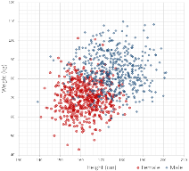
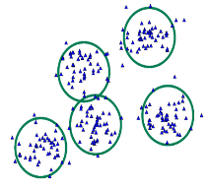
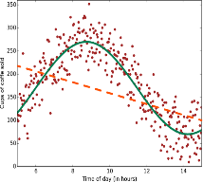
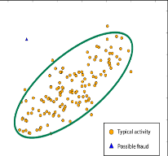
Common Classes of Algorithms (Supervised|Unsupervised)
Classification
Clustering
Regression
Anomaly Detection
Notes:
More samples on: https://azure.microsoft.com/en-us/documentation/articles/machine-learning-algorithm-choice/
Mention about Classification, Regression etc.

Slide 11
Why you need to know these algorithms?
If you want to answer a YES|NO question, it is classification
If you want to predict a numerical value, it is regression
If you want to group data into similar observations, it is clustering
If you want to recommend an item, it is recommender system
If you want to find anomalies in a group, it is anomaly detection
and many other ML algorithms for specific problem

Slide 12
Classification
Scenarios:
Which customer are more likely to buy, stay, leave (churn analysis)
Which transactions|actions are fraudulent
Which quotes are more likely to become orders
Recognition of patterns: speech, speaker, image, movement, etc.
Algorithms: Boosted Decision Tree, Decision Forest, Decision Jungle, Logistic Regression, SVM, ANN, etc.
Classification

Slide 13
Clustering
Scenarios:
Customer segmentation: divide a customer base into groups of individuals that are similar in specific ways relevant to marketing, such as age, gender, interests, spending habits, etc.
Market segmentation
Quantization of all sorts, such as, data compression, color reduction, etc.
Pattern recognition
Algorithms: K-means
Clustering

Slide 14
Regression
Scenarios:
Stock prices prediction
Sales forecasts
Premiums on insurance based on different factors
Quality control: number of complaints over time based on product specs, utilization, etc.
Workforce prediction
Workload prediction
Algorithms: Bayesian Linear, Linear Regression, Ordinal Regression, ANN, Boosted Decision Tree, Decision Forest
Regression

Slide 15
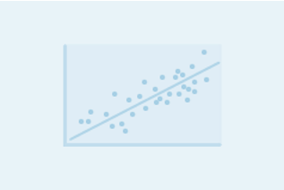
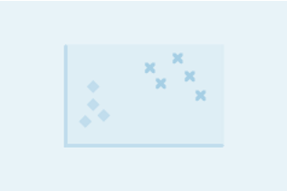
Regression versus Classification
Does your customer want to predict|estimate a number (regression) or apply a label|categorize (classification)?
Regression problems
Estimate household power consumption
Estimate customer’s income
Classification problems
Power station will|will not meet demand
Customer will respond to advertising

Slide 16
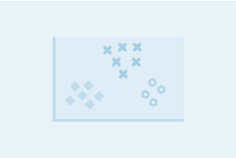
Binary versus Multiclass Classification
Does your customer want a yes|no answer?
Binary examples
click prediction
yes|no
over|under
win|loss
Multiclass examples
kind of tree
kind of network attack
type of heart disease

Slide 17
Learning resources
https://aischool.microsoft.com/en-us/learning-paths
https://azure.microsoft.com/en-us/solutions/architecture/?tag=artificial-intelligence
https://azure.microsoft.com/en-us/overview/ai-platform/
https://gallery.azure.ai/
https://www.edx.org/microsoft-professional-program-artificial-intelligence
https://www.edx.org/microsoft-professional-program-data-science

Slide 18
Your go to Team!
Name | Email
Megan Smith | megan.smith@microsoft.com | SQL Server, SQL Data Warehouse
Joyjeet Majumdar | joyjeetm@microsof t.com | Advance Analytics, AI
Geoff Fawcett | Geoff.Fawcett@microsoft.com | Power BI
Amit Budhu | Amitraj.Budhu@microsoft.com | Apps, Infrastructure, DevOps
Tom Ford | TomFo@microsoft.com | All Data and AI needs for Business
Tom Roe | Tom.Roe@microsoft.com | All Apps & Infra needs for Business
Brian Hewitt | Brian.Hewitt@microsoft.com | Any Microsoft help you need

Slide 19
References
What is ML Studio
https://docs.microsoft.com/en-us/azure/machine-learning/studio/what-is-ml-studio
Cheat Sheet:
https://docs.microsoft.com/en-us/azure/machine-learning/studio/algorithm-choice
https://docs.microsoft.com/en-us/azure/machine-learning/studio/algorithm-cheat-sheet
Notes:
https://docs.microsoft.com/en-us/azure/machine-learning/studio/what-is-ml-studio

