Slide 1
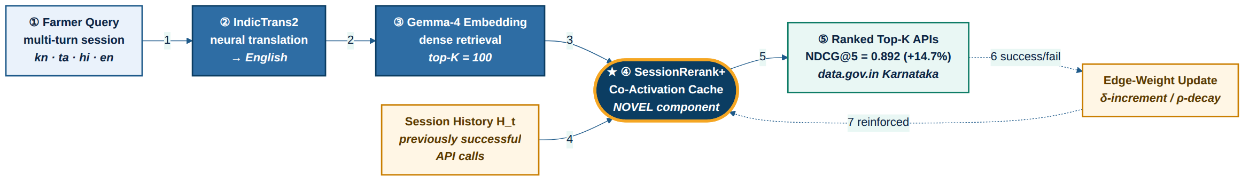
SessionRerank+ : System Architecture
Session-aware co-activation reranking for agentic tool retrieval
Flow key: 1 translate query 2 embed 3 retrieve top-100 4 fetch session history 5 rerank & rank 6-7 online feedback loop (success/fail → edge update → reinforced cache)

