Slide 1
B E K O O R 6
Team#3
Kim Ju Hyoung
Kim Young Kyoung
Shen Lu Jian
Kou Yanran

Slide 2

#1
project management
#2
system overview
#3
architecture design
#4
summary
1

Slide 3
Project Management
How we work together to finish the project

Slide 4


How we co-work?
utilize github to manage tasks and schedules
utilize ZenHub to visualize each member’s work
utilize github to manage document generated in each phase
3

Slide 5
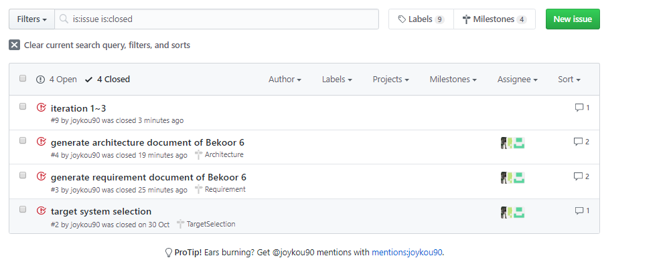
How we co-work?
4

Slide 6
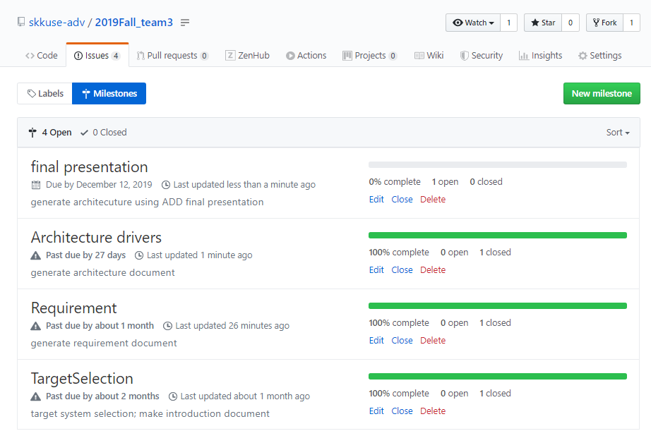
How we co-work?
5

Slide 7
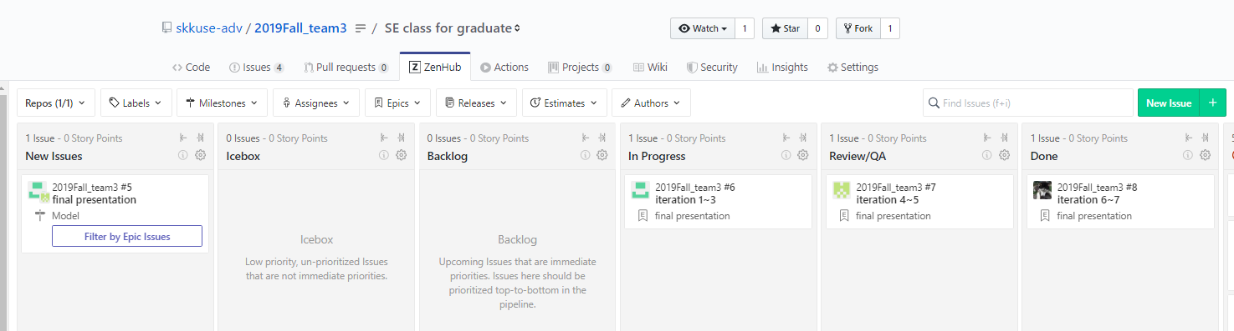
How we co-work?
6

Slide 8
system overview
introduction of Bekoor 6
7

Slide 9
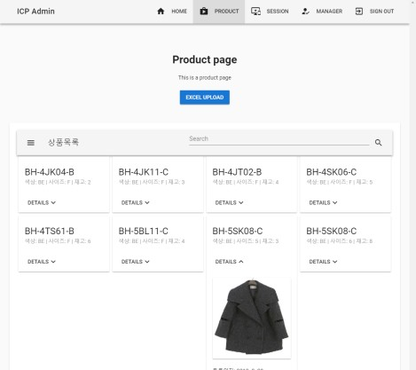


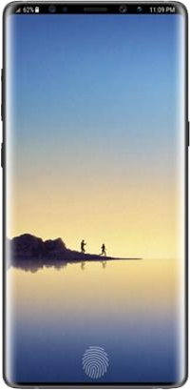

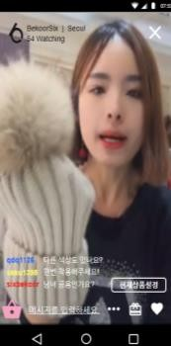
system overview
Management Page
BroadCasting Server (AWS EC2
& Wowza)
Admin
App Server
(Firebase cloud)
Mobile App
(Manager & Customer)
Manager
DB
8
Customer

Slide 10
About
Architecture Design
Architecture design using ADD

Slide 11
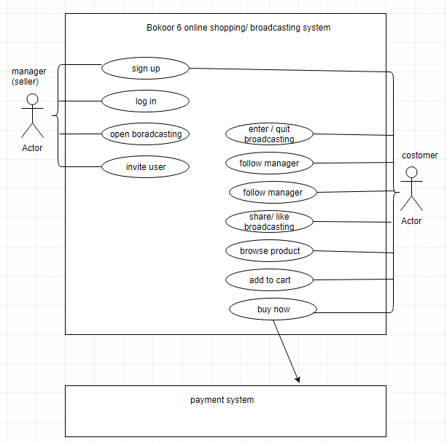
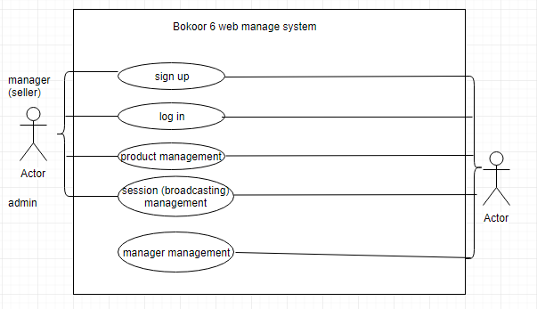
architecture design
10

Slide 12
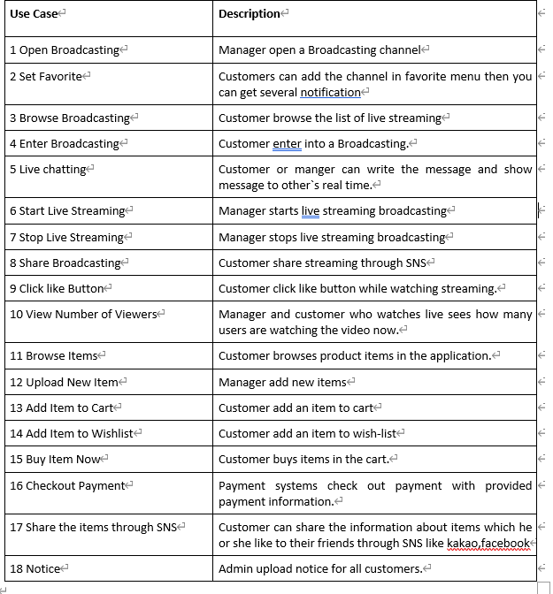
review input use case
11

Slide 13
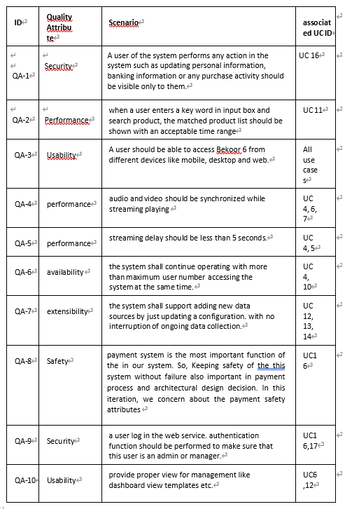
review input quality attribute
12

Slide 14
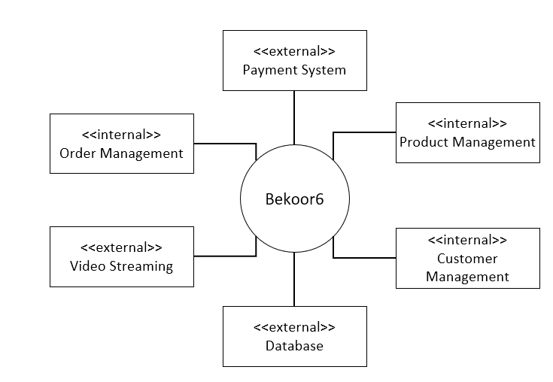
over-all analysis
a greenfield system
iteration 1~2: generate over all architecture of the whole system
iteration 3~5: focus on usability and performance
iteration 6: focus on multi device
iteration 7: focus on web management system
13

Slide 15
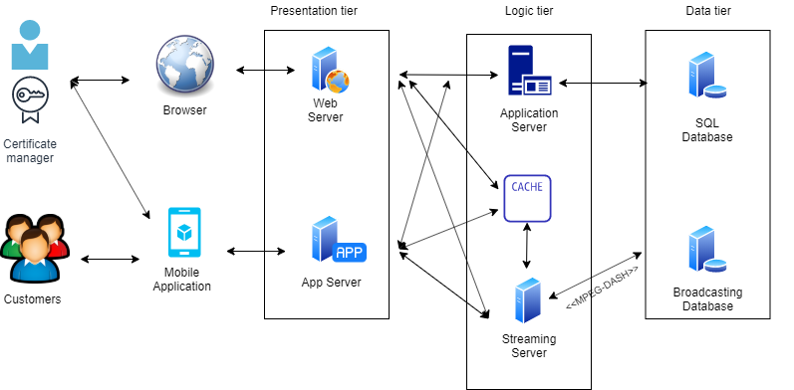
sketch view of iteration 1~6
14

Slide 16
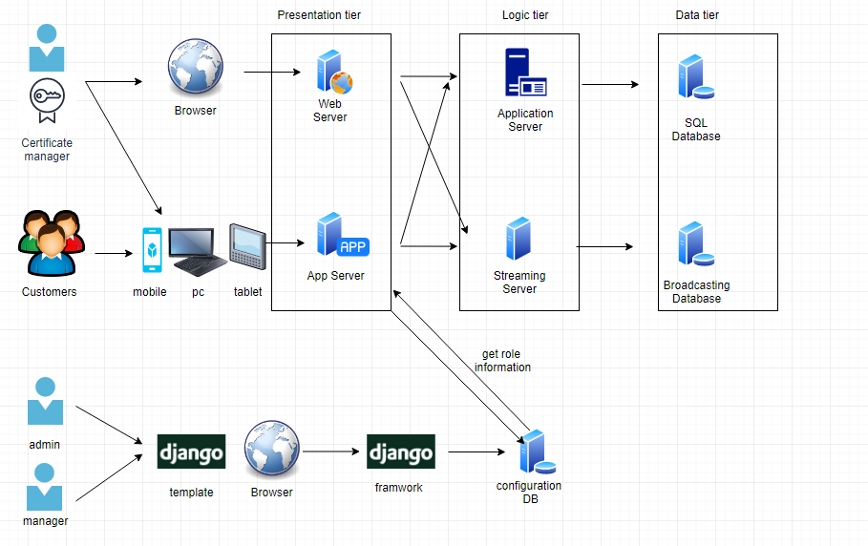
overall architecture
15

Slide 17
Summary
improvement suggestions of the system
16

Slide 18

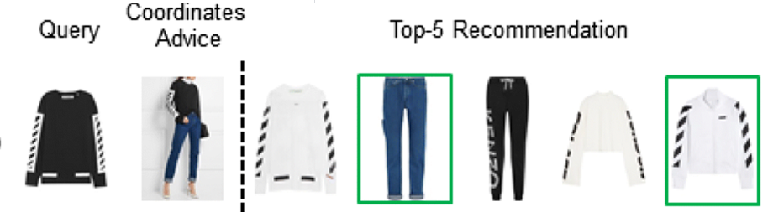
suggestions for functionalites
Clothes recommendation
If customer buy a clothes, App can recommend the other combinations clothes harmony with bought items.
Then it could increase the profit.
This is the basic function nowadays.
If customer buy sweater, then recommend pants or jacket to wear together.
17

Slide 19
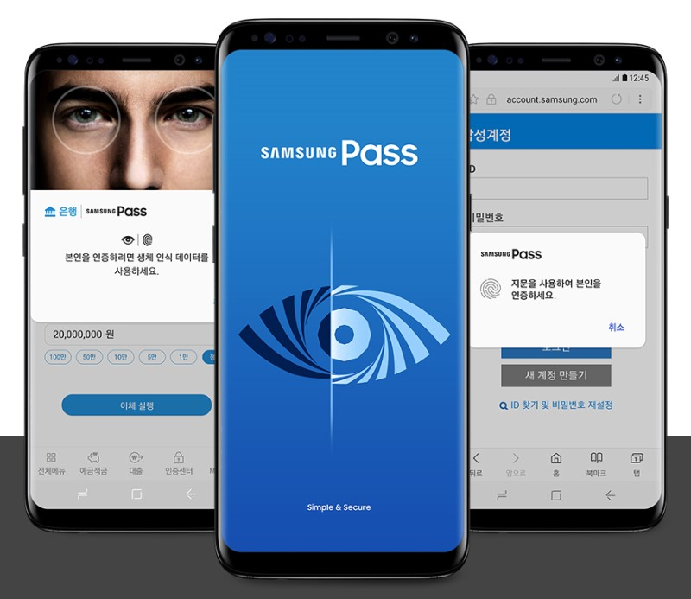
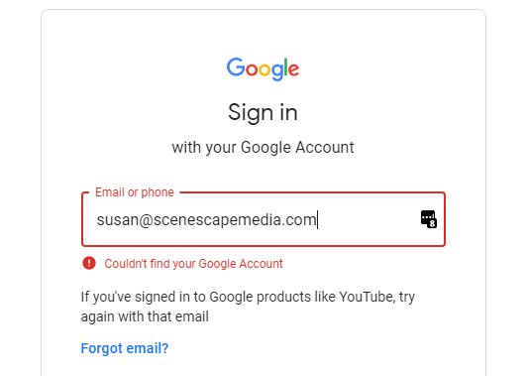
suggestions for techniques
biometrics authentication
It increase the user convenient
Samsung pass remember the user account information
So customer don`t need to remember their account
information. So It decrease the finding account issue.
18

Slide 20
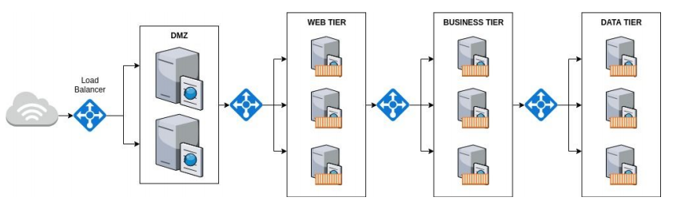
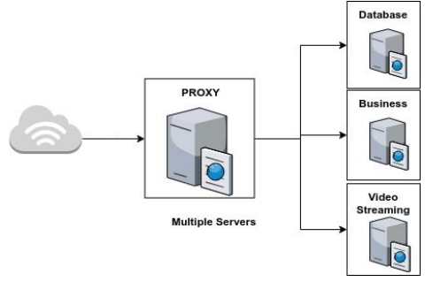
suggestions for techniques
using load balancer to balance requests sent to servers
using proxy server to improve performance
and to address firewall issues
19

Slide 21
Thank You
F O R W A T C H I N G A N D L I S T E N I N G

