Slide 1
layer 2
Spanning Tree Protocol

Slide 2
introduction
Spanning Tree Protocol (STP) was developed to prevent the broadcast storms caused by switching loops. STP was originally defined in IEEE 802.1D.
Switches running STP will build a map or topology of the entire switching network. STP will identify if there are any loops, and then disable or block as many ports as necessary to eliminate all loops in the topology.
A blocked port can be reactivated if another port goes down. This allows STP to maintain redundancy and fault-tolerance.

Slide 3
Building the STP topology is a multistep convergence process:
• A Root Bridge is elected
• Root ports are identified
• Designated ports are identified
• Ports are placed in a blocking state as required, to eliminate loops

Slide 4
Electing an STP Root Bridge
The first step in the STP convergence process is electing a Root Bridge, which is the central reference point for the STP topology. As a best practice, the Root Bridge should be the most centralized switch in the STP topology.
A Root Bridge is elected based on its Bridge ID, comprised of two components in the original 802.1D standard:
16-bit Bridge priority
48-bit MAC address The default priority is 32,768, and the lowest priority wins. If there is a tie in priority, the lowest MAC address is used as the tie-breaker.

Slide 5
Switches exchange BPDU’s to perform the election process, and the lowest Bridge ID determines the Root Bridge:
Switch B, Switch C, and Switch E have the default priority of 32,768.
Switch A and Switch D are tied with a lower priority of 100.
Switch A has the lowest MAC address, and will be elected the Root Bridge.
By default, a switch will always believe it is the Root Bridge, until it receives a BPDU from a switch with a lower Bridge ID. This is referred to as a superior BPDU. The election process is continuous – if a new switch with the lowest Bridge ID is added to the topology, it will be elected as the Root Bridge.

Slide 6
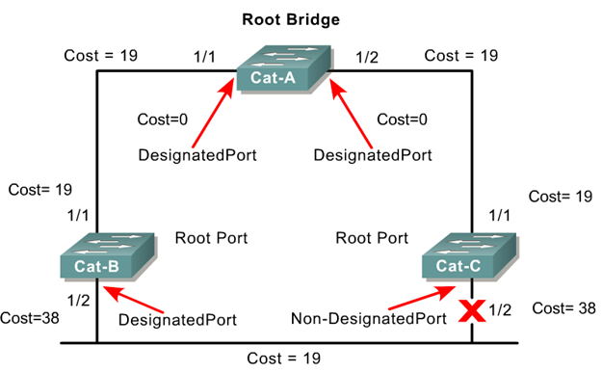
Two Key Concepts: BID and Path Cost
STP executes an algorithm called Spanning Tree Algorithm (STA).
STA chooses a reference point, called a root bridge, and then determines the available paths to that reference point.
If more than two paths exists, STA picks the best path and blocks the rest
STP calculations make extensive use of two key concepts in creating a loop-free topology:
Bridge ID
Path Cost

Slide 7
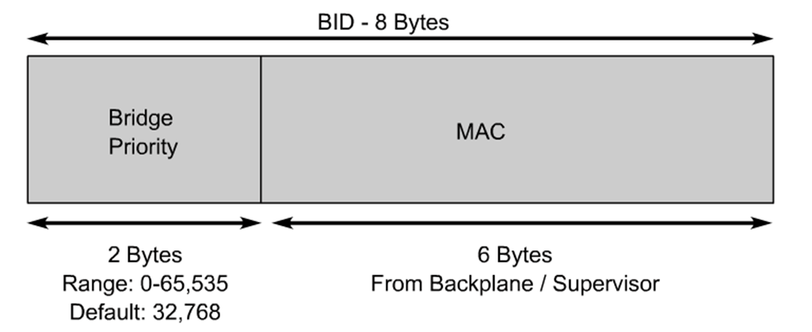
Bridge ID (BID)
Bridge ID (BID) is used to identify each bridge/switch.
The BID is used in determining the center of the network, in respect to STP, known as the root bridge.
Consists of two components:
A 2-byte Bridge Priority: Cisco switch defaults to 32,768 or 0x8000.
A 6-byte MAC address

Slide 8
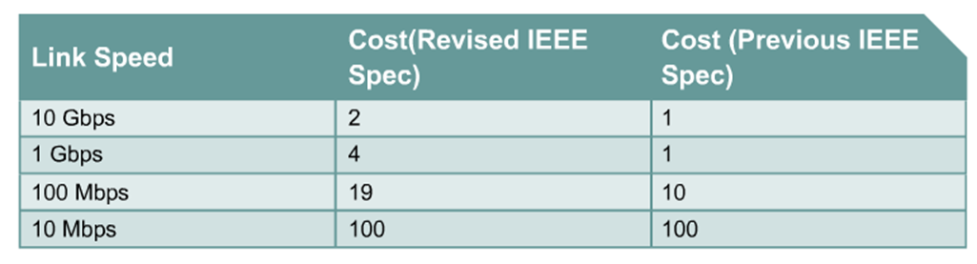
Path Cost
Bridges use the concept of cost to evaluate how close they are to other bridges.
This will be used in the STP development of a loop-free topology .
Originally, 802.1d defined cost as 1000/bandwidth of the link in Mbps.
Cost of 10Mbps link = 100 or 1000/10
Cost of 100Mbps link = 10 or 1000/100
Cost of 1Gbps link = 1 or 1000/1000
Running out of room for faster switches including 10 Gbps Ethernet.

Slide 9
Three Steps of Initial STP Convergence
STP Convergence
Step 1 Identifying Root Ports
Step 2 Identifying Designated Ports
Step 3 Port ID

Slide 10
Identifying Root Ports
The second step in the STP convergence process is to identify root ports. The root port of each switch has the lowest root path cost to get to the Root Bridge.
Each switch can only have one root port. The Root Bridge cannot have a root port, as the purpose of a root port is to point to the Root Bridge.
Path cost is a cumulative cost to the Root Bridge, based on the bandwidth of the links. The higher the bandwidth, the lower the path cost

Slide 11
Identifying Designated Ports
The third step in the STP convergence process is to identify designated ports. A single designated port is identified for each network segment. This port is responsible for forwarding BPDUs and frames to that segment.
If two ports are eligible to become the designated port, then there is a loop. One of the ports will be placed in a blocking state to eliminate the loop.
Similar to a root port, the designated port is determined by the lowest cumulative path cost leading the Root Bridge. A designated port will never be placed in a blocking state, unless there is a change to the switching topology and a more preferred designated port is elected.

Slide 12
CONSIDER THE FOLLOWING EXAMPLE :
Ports on the Root Bridge are never placed in a blocking state. Thus, the two ports off of Switch A will automatically become designated ports.
Remember, every network segment must have one designated port, regardless if a root port already exists on that segment.
Thus, the network segments between Switch B and Switch D, and between Switch C and Switch E, both require a designated port. The ports on Switch D and Switch E have already been identified as root ports, thus the ports on Switch B and C will become the designated ports.

Slide 13
Port ID
When electing root and designated ports, it is possible to have a tie in both path cost and Bridge ID.
Port ID is used as the final tiebreaker, and consists of two components:
4-bit port priority
12-bit port number, derived from the physical port number
By default, the port priority of an interface is 128, and a lower priority is preferred. If there is a tie in priority, the lowest port number is preferred.
The sender port ID determines the tie break, and not the local port ID. In the above example, SwitchB must decide whether gi2/23 or gi2/24 becomes the root port. SwitchB will observe BPDU’s from SwitchA, which will contain the port ID’s for gi2/10 and gi2/11.
If priorities are equal, the sender Port ID from gi2/10 is preferred, due to the lower port number. Thus, gi2/23 on SwitchB will become the root port.

Slide 14
CONSIDER THE FOLLOWING EXAMPLE :
The bandwidth of both links is equal, thus both ports on SwitchB have an equal path cost to the Root Bridge. Which port will become the root port then? Normally, the lowest Bridge ID is used as the tiebreaker, but that is not possible in this circumstance.

Slide 15
The end
That’s all folks

