Slide 1


Bank of Baroda Hackathon - 2022
Technology Partner
Your Team Name : TeamSpiderMan
Your team bio : Innovative thinking and optimised solution for business challenges.
Date : 17-Sept-2022

Slide 2
Importance of cheque transaction
One of the important means of efficient funds movement through the organized sector of an economy is the process of clearing of cheques.
01
Volume of Cheque Truncation System data was reported at 59.372 Unit mn in Jun 2022.
02
It is a negotiable instrument that can be endorsed in favor of a third party. They can be easily traced if lost.
03
Positive Pay system augments customer safety in cheque payments and reduce instances of fraud occurring due to tampering.
04

Slide 3

Pain Points
Clearing a cheque takes 2-3 days in bank
Recent publication of Reserve Bank of India, emphasizing on mechanized cheque processing based on MICR technology.
Stay compliant to the regulatory rules and the changes in them, over time from different governing bodies.
Few point of contacts for processing of the cheque due to manual intervention.

Slide 4
Pre-Requisite
There are multiple out of box products are available in the market, that can be cheaper to implement, but the Banking data is highly sensitive and should be traded carefully. The system also need access to the core customer data access, slightest carelessness can cause huge data breach.
Microsoft been known as the most secure cloud service provider with all possible security and provacy certificates, should be the choice for such a modernization solution.
The pre-requisite for starting with the solution is to create a Azure cloud account and configure all the organization privacy and security policies on the account.
Mocked up data repository should be prepared to train the data model and test it.

Slide 5
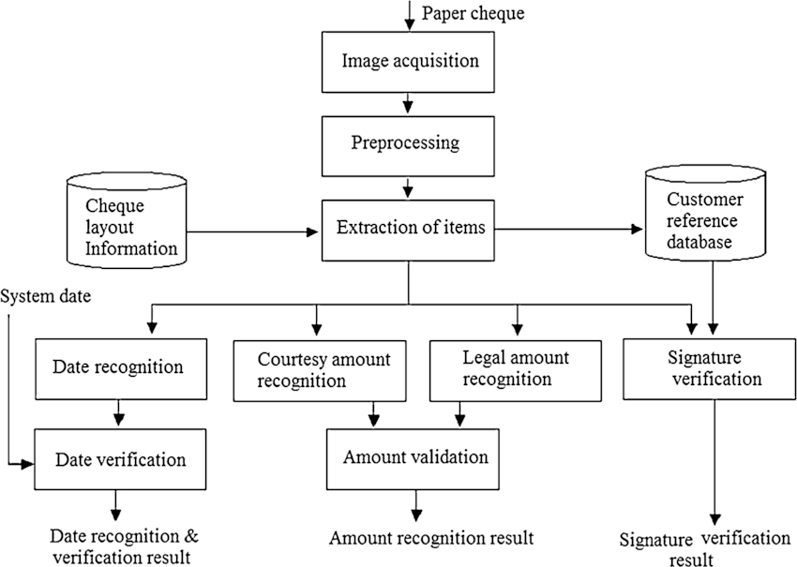






Our Understanding

Slide 6












Solution Architecture Diagram
Virtual Network 1
Image of the signature is matched with the stored signature of the customer using Deep learning
Virtual Network 2
Authorized (Authenticated by Active directory policy), user scans the cheque and uploads the file to the storage on cloud
File is processed using the Vision Service of the Azure to capture the handwritten information in the image of the cheque.
Azure functions to do date verification and amount validation
Handwritten data fields are stored in the cosmos DB for further consumption
Data from each of the cheque processed is stored and made available to the consumers via API endpoints
Event Hub to control triggering of different microservices.
Data lineage , monitoring and governance

Slide 7
Azure tools or resources
Azure computer vision
Azure Blob storage
Azure Cosmos DB
Azure Virtual Network
Azure API Management
Azure Purview
Azure Active Directory
Azure Event Hub
Databricks
Azure Function

Slide 8

Key Differentiators
Microservice based architecture
Makes the solution flexible and reusable. The components created for the solution can be reused for other purpose also adding new functionality becomes easy and maintainability cost is reduced.
Event Driven Design
This makes the solution most cost optimized, as the services are triggered and executed only when there is a need, down sizing the unnecessary running of services on cloud.
Scalability
Making use of the Azure fully managed cloud services, makes the solution scalable to any extent. Also the Microservice architecture gives the solution the add benefit of extensibility.
Serverless cloud implementation
The solution is cloud based making use of the fully managed services, which reduces the cost of maintainability of the infrastructure.
API endpoints
Making API endpoints available of the service, not only makes it secure, it also makes it easy for other systems to integrate and consume data.

Slide 9
Implementation Roadmap
05
Phase 4
MVP
Phase 3
04
03
Phase 2
1-2 Weeks UAT
1-2 Weeks SIT
02
Phase 1
3-4 Weeks (Creation of the functions and canonical data model for API endpoints, also training of model and testing accuracy).
01
Phase 0
1-2 Weeks (Identity and Access Management policies and PaaS configuration).

Slide 10
Summary
Why Consider our solution
We are a team of innovative thinkers,
I am a Senior Solution Architect with experience in the deployment of similar solutions in multiple enterprises and Abhishek Ojha is a very efficient senior developer skilled in multiple cloud environments and programming languages.
The solution provided above is the Holistic overview of how to address the problem statement, not only from core aspects but also on the security of the data. Regulatory and data privacy compliance are of utmost importance when it comes to personal data of the customer. The approach also need to have data governance in place to limit the data consumers to have limited and encrypted/masked data access.

Slide 11
GitHub Repository Link & supporting diagrams, screenshots, if any
How far it can go?

Slide 12
Thank You
Joy Maitra
Abhishek Ojha

